Slide 1

UPI ARM Sprint Demo
DEMO 1
gwest@redhat.com
Oct 11, 2019

Slide 2
Overview
Consists of:
Main arm template: azdeploy.json
sub templates:
master.json - for bootstrap and masters
node.json – for workers
Setup Script: setup_azarm.sh
Deploy Script: deploy_azarm.sh

Slide 3
What it does:
Deploys a UPI Azure OCP 4.x (4.1 at the moment)
3 Masters
N Workers – parameter – 3 for test
Availability Group for Masters
Availability Group for Nodes
Public Load Balancer for API
Public Load Balancer for Apps
Internal Load Balancer for Internal API

Slide 4
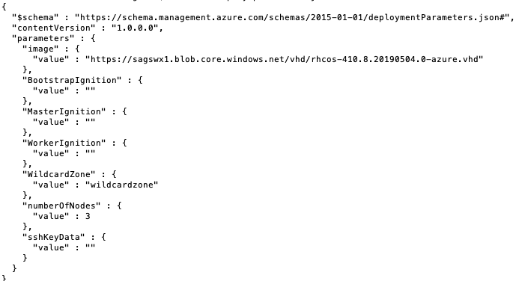
ARM Parameters

Slide 5
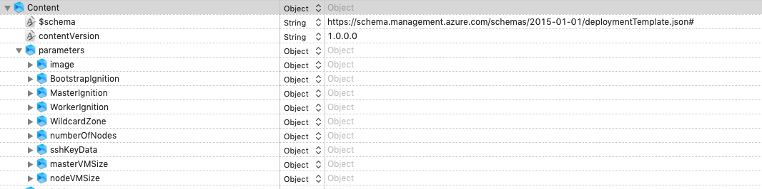
Azuredeploy.json

Slide 6
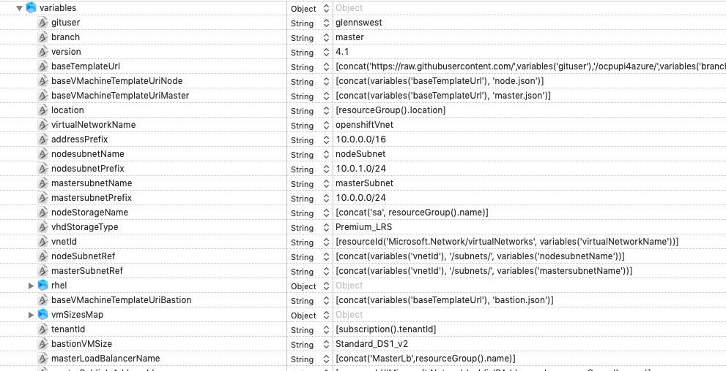
Variables

Slide 7
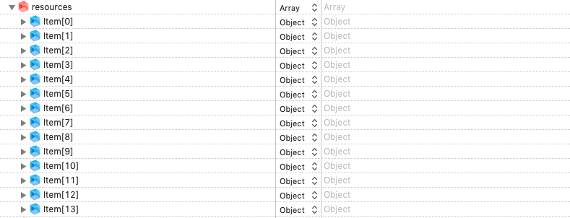
Resources

Slide 8
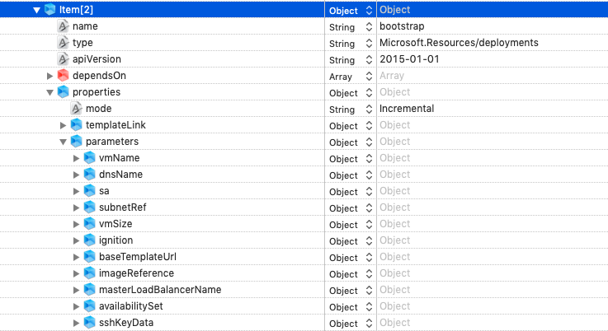
Bootstrap VM

Slide 9
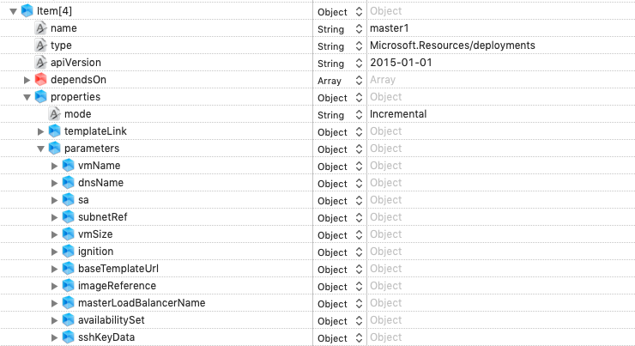
Master1

Slide 10
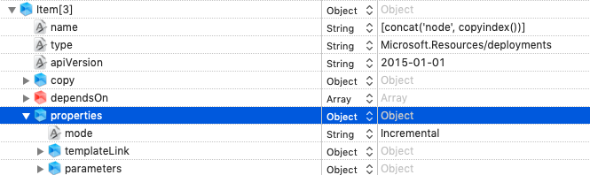
Workers

Slide 11
Steps By Step
How to run:
Clone repo
setup_azarm.sh
Setup your external dns
deploy_azarm.sh

Slide 12
Setup-azarm.sh
What it does:
Run the installer for ignition files
Create resource group
Copy RHCOS image into resource group
Copy bootstrap ignition file into resource group (To big for direct usage)
Build a indirect ignition file to point to bootstrap
Copy and encode ignitions into runit.deploy.json

Slide 13
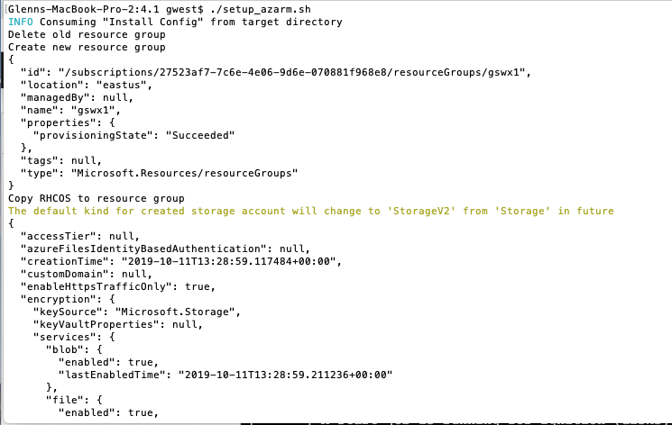

Slide 14
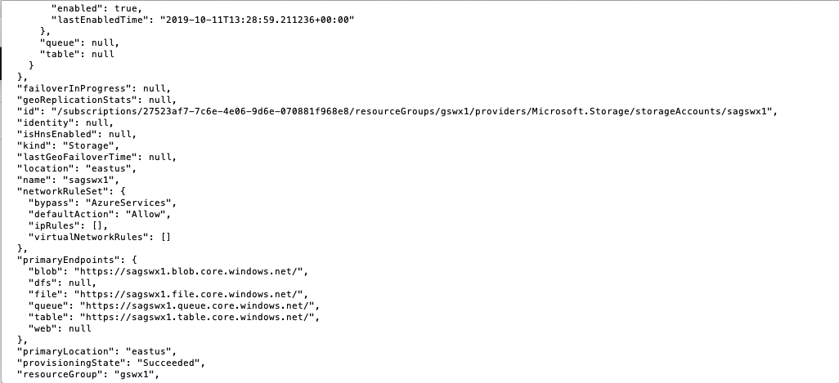

Slide 15
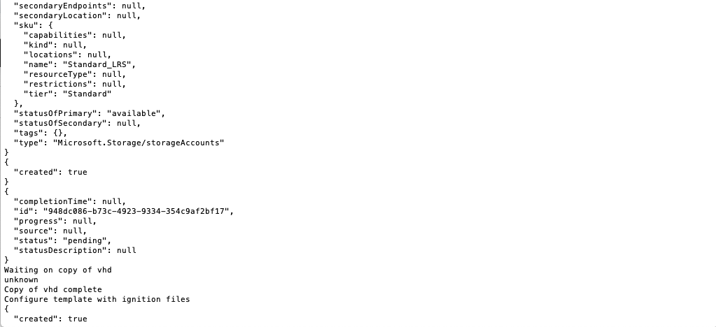

Slide 16
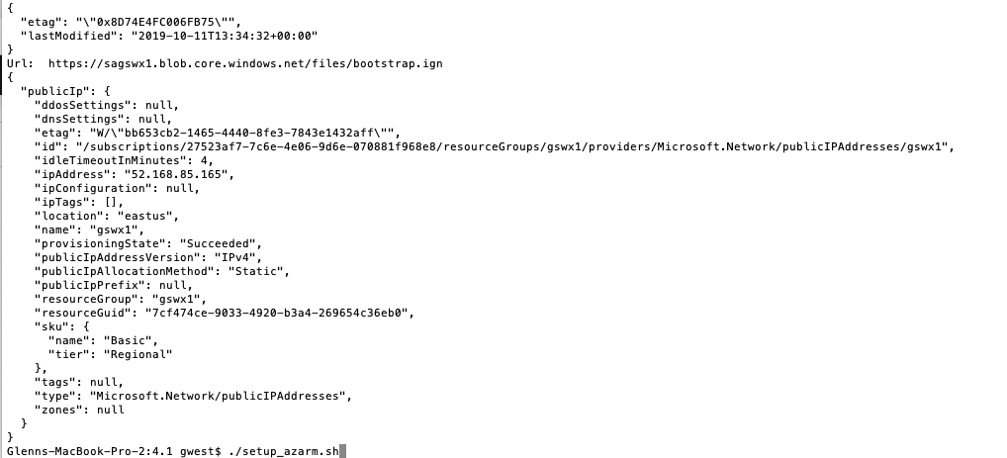

Slide 17
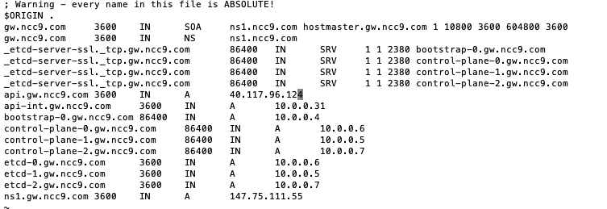
DNS Setup

Slide 18
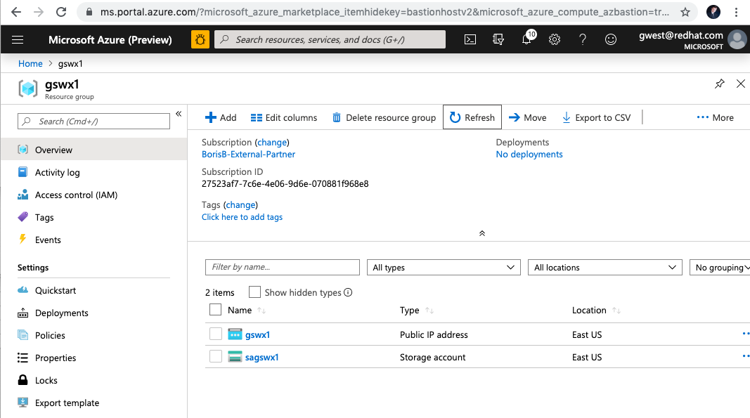
Resource Group – At This Point

Slide 19
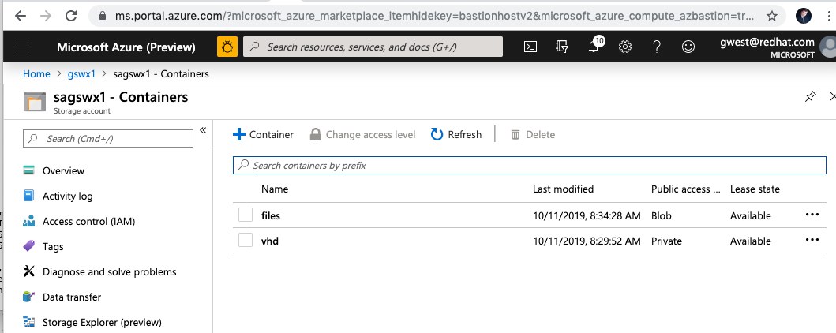
Storage Account

Slide 20
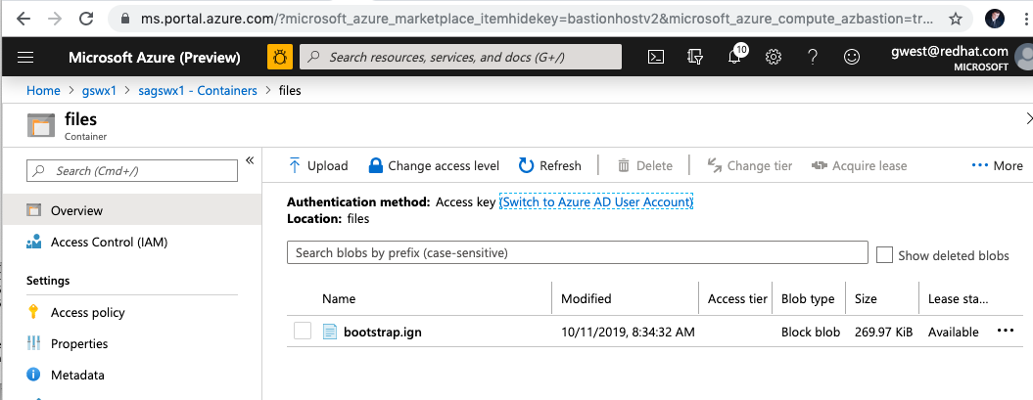
Bootstrap Ignition

Slide 21
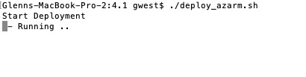
Start Deploy

Slide 22
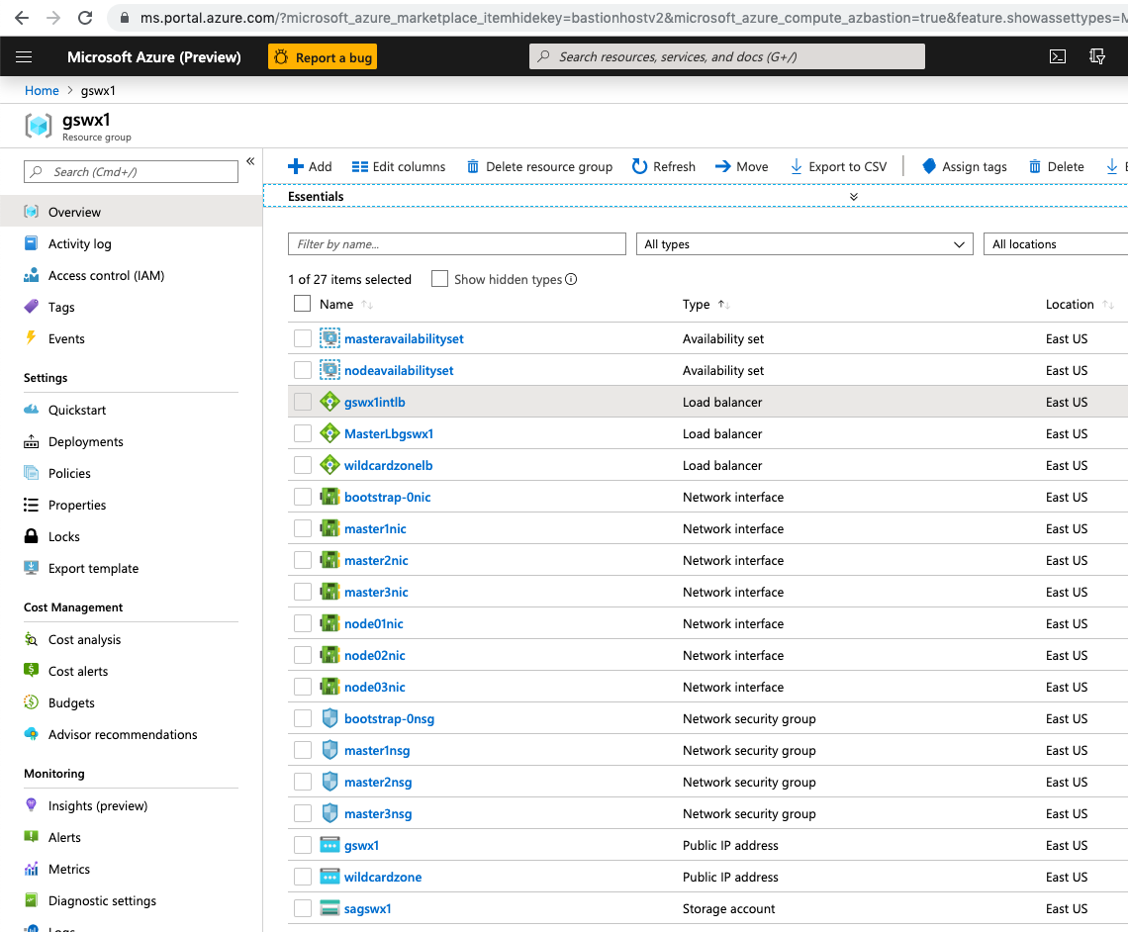

Slide 23
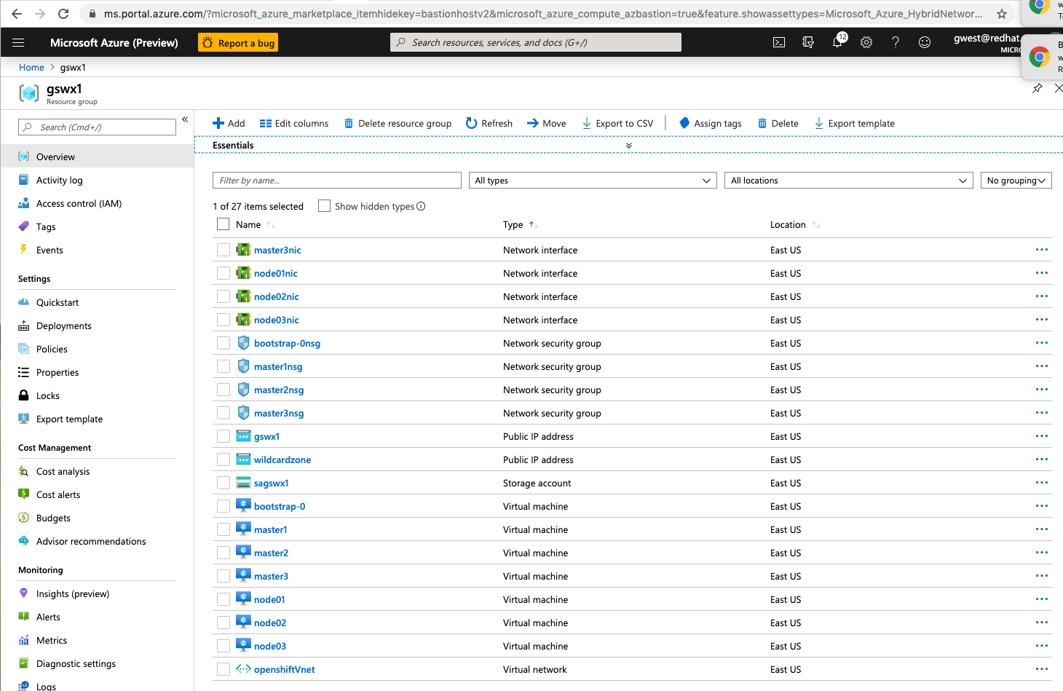

Slide 24
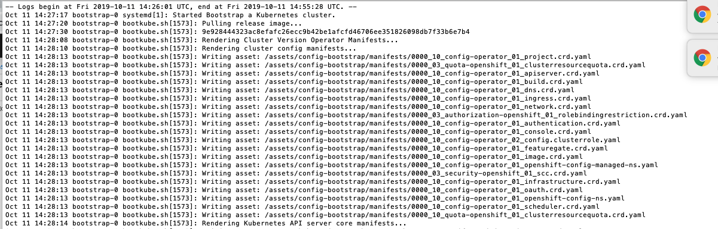

Slide 25
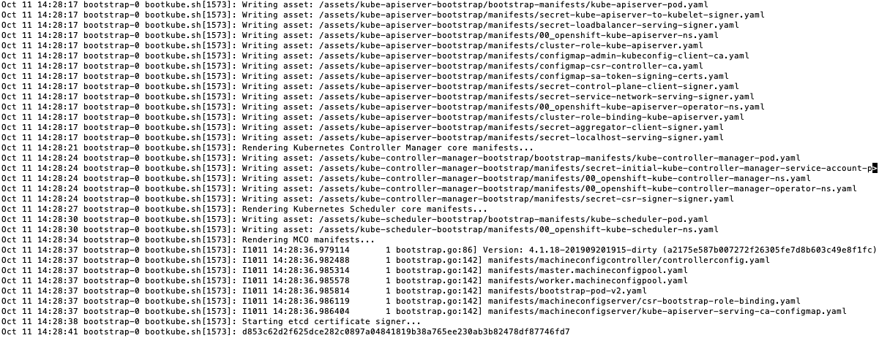

Slide 26
Current Status
Working:
Scripts do proper preparation
Igniition Files are getting passed and used
ARM Template deploys the intended resources
Bootstrap node is booting, and running bootstrap
Not Done/Not Working:
Need to add a bastion(rhel) for ease of debug
Internal LB Not routing/not found by masters
Masters not booting due to above
Need to fix up the apps loadbalacer/ip

Slide 27
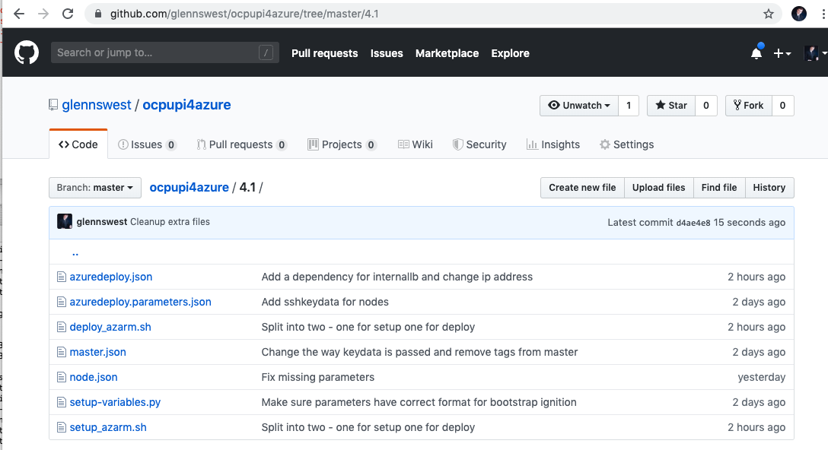
Where’s it at:
https://github.com/glennswest/ocpupi4azure/tree/master/4.1

