Slide 1

UPI ARM Sprint Demo
DEMO 2
gwest@redhat.com
Oct 11, 2019

Slide 2
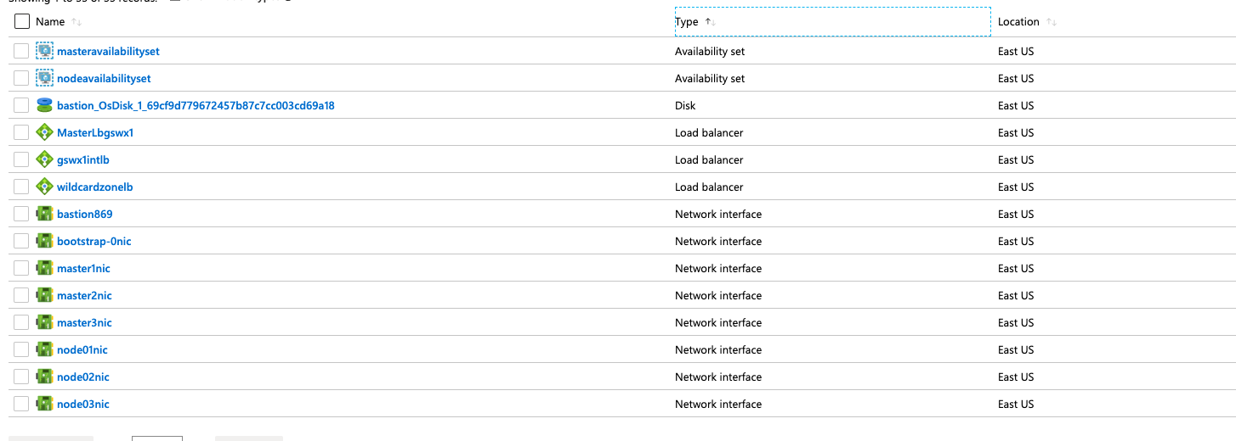
Internal Load Balancer – Created

Slide 3
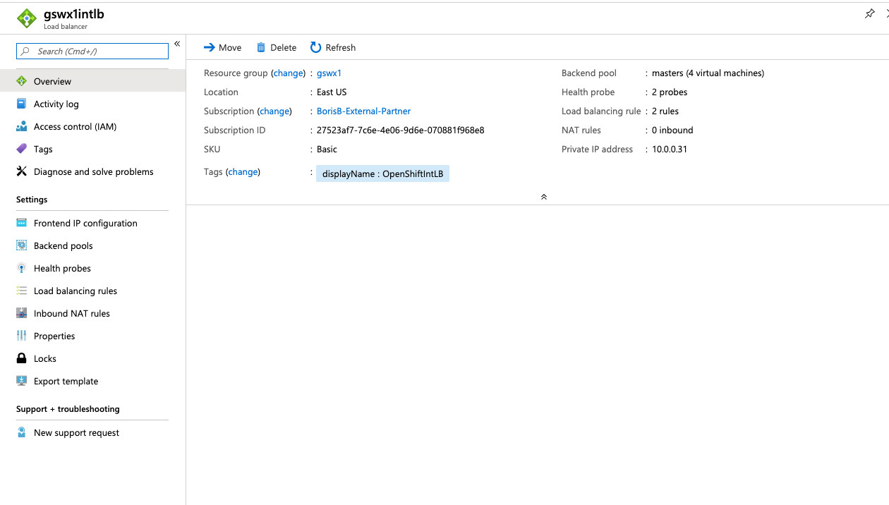
Internal Load Balancer - Working

Slide 4
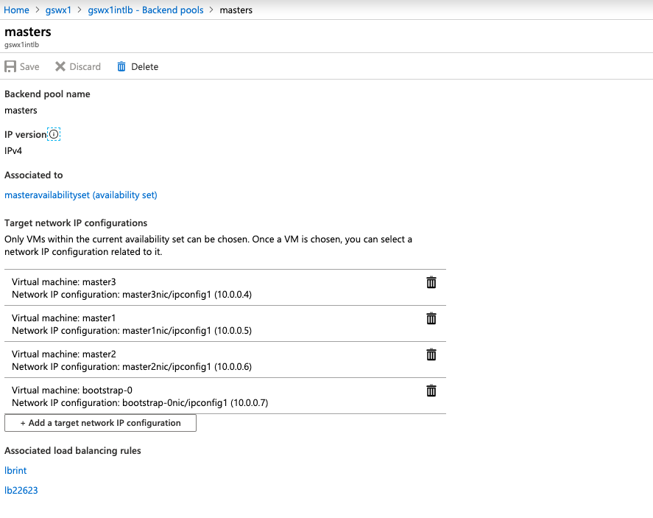
Internal Load Balancer – Backend Pool

Slide 5
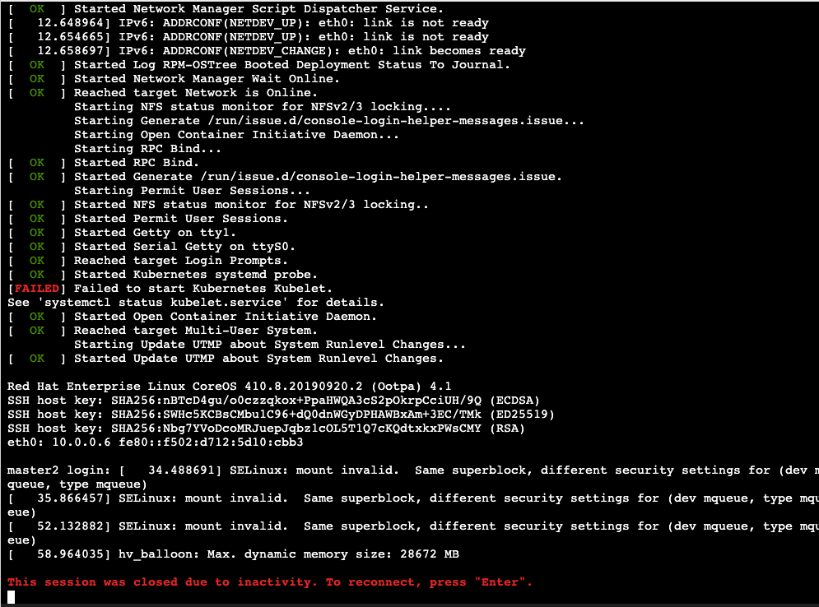
Kubelet Issue – 4.1 Flake?

Slide 6
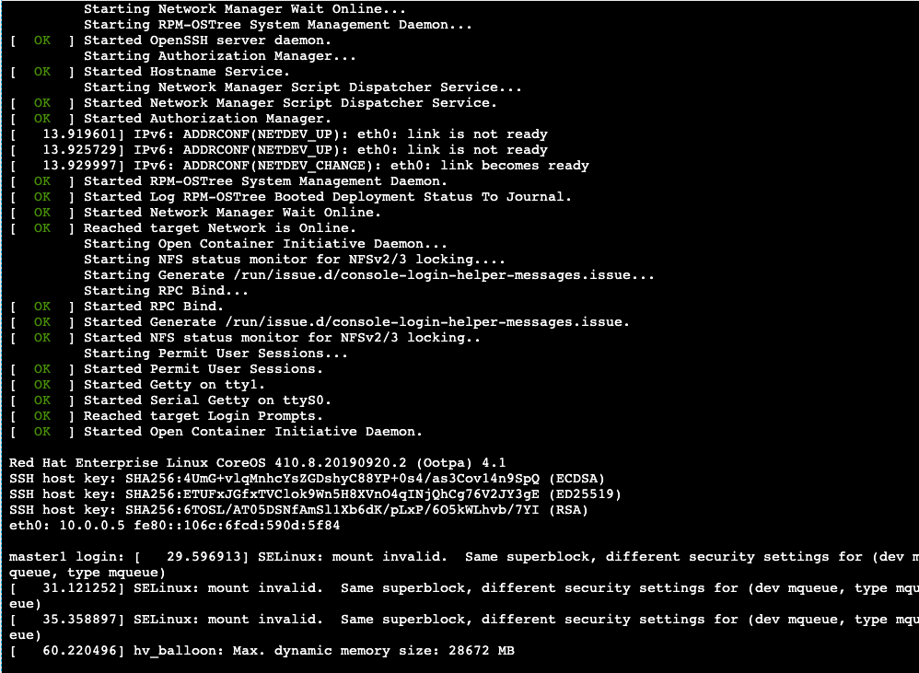
Other masters seem ok

Slide 7
Current Status
Working:
Internal Load Balancer is Fixed and Working
Not Done/Not Working:
Flake on one of the masters – kubelet not starting Internal LB Not routing/not found by masters
Need to fix up the apps loadbalacer/ip

Slide 8
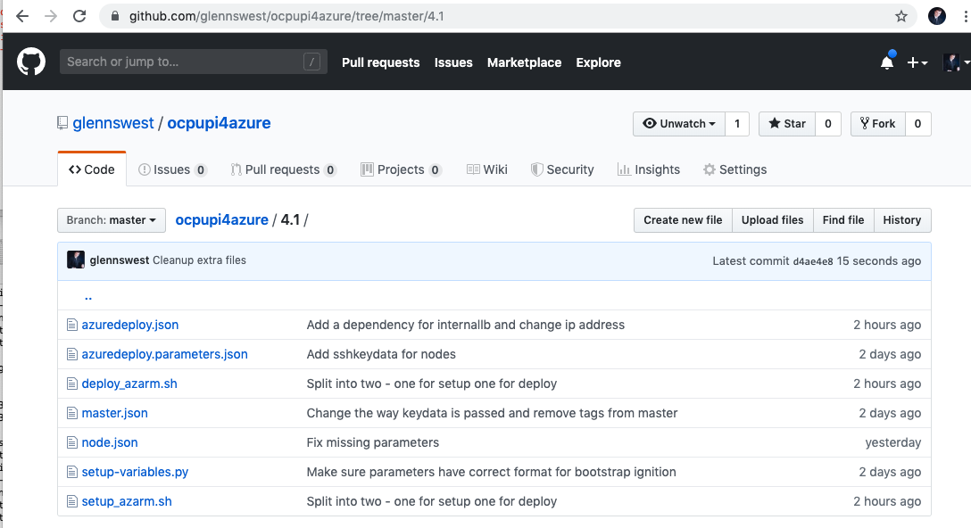
Where’s it at:
https://github.com/glennswest/ocpupi4azure/tree/master/4.1

