Slide 1

AZURE OpenShift UPI(User Provisioned Infrastructure) ARM Template Overview
gwest@redhat.com
Oct 18, 2019

Slide 2
Overview
Consists of:
Main arm template: azdeploy.json
sub templates:
master.json - for bootstrap and masters
node.json – for workers
Setup Script: setup_azarm.sh
Deploy Script: deploy_azarm.sh

Slide 3
What it does:
Deploys a UPI Azure OCP 4.x (4.2 at the moment)
3 Masters
N Workers – parameter – 3 for test
Availability Group for Masters
Availability Group for Nodes
Public Load Balancer for API
Public Load Balancer for Apps
Internal Load Balancer for Internal API
Uploads the vhd RHCOS image into resource group
Uploads bootstrap ignition into resource group
Creates a ignition pointer to bootstrap ignition

Slide 4
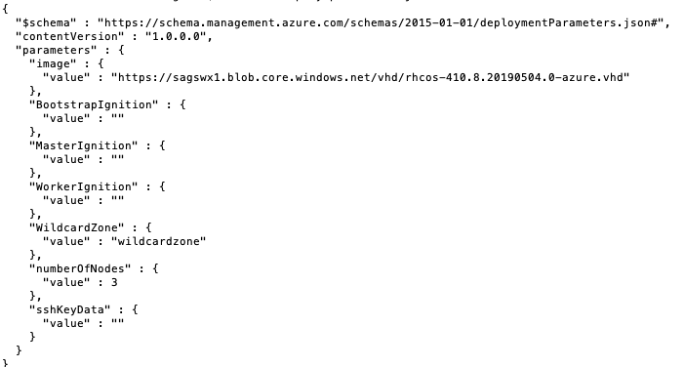
ARM Parameters

Slide 5
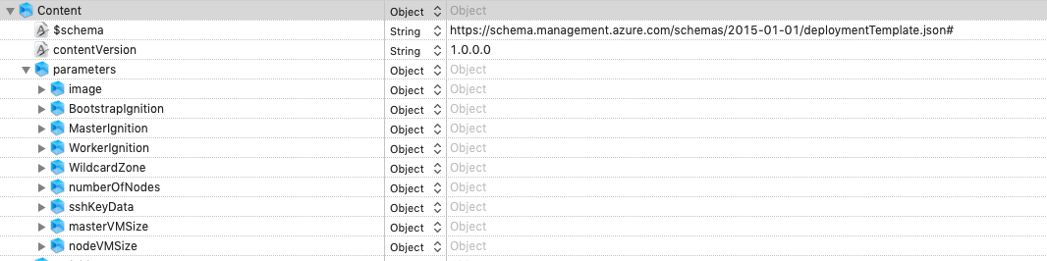
Azuredeploy.json

Slide 6
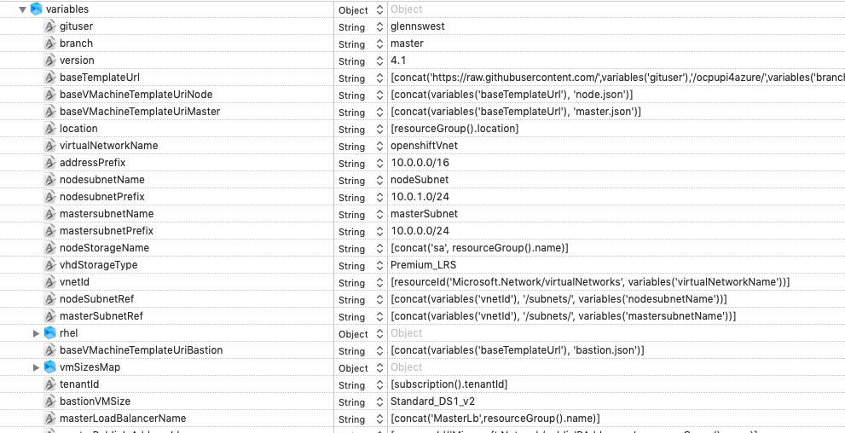
Variables

Slide 7
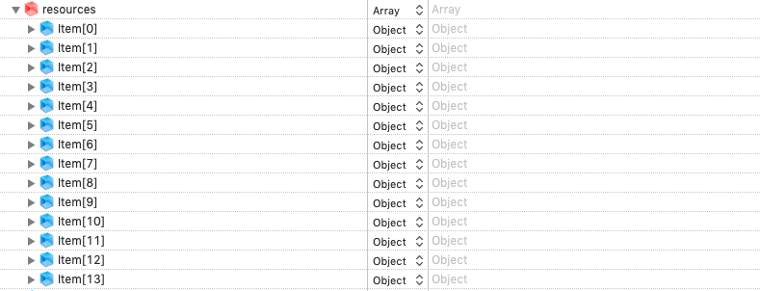
Resources

Slide 8
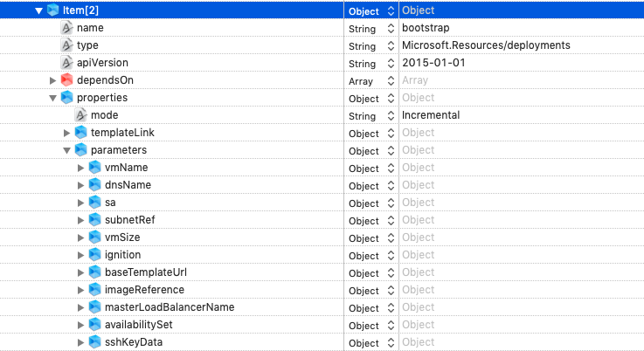
Bootstrap VM

Slide 9
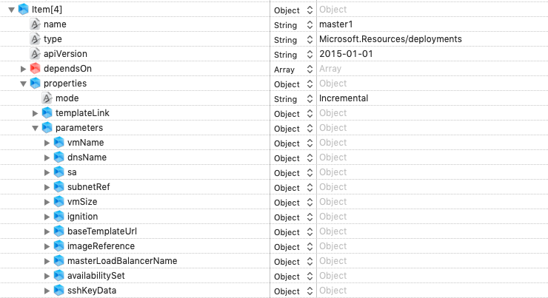
Master1

Slide 10
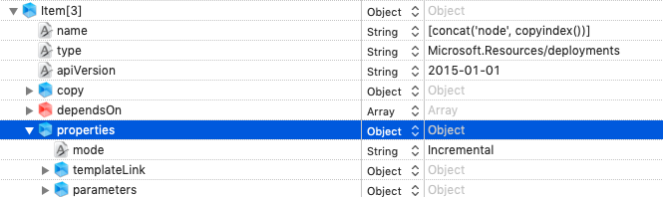
Workers

Slide 11
Steps By Step
How to run:
Clone repo
setup_azarm.sh
Setup your external dns
deploy_azarm.sh

Slide 12
Setup-azarm.sh
What it does:
Run the installer for ignition files
Create resource group
Copy RHCOS image into resource group
Copy bootstrap ignition file into resource group (To big for direct usage)
Build a indirect ignition file to point to bootstrap
Copy and encode ignitions into runit.deploy.json

Slide 13
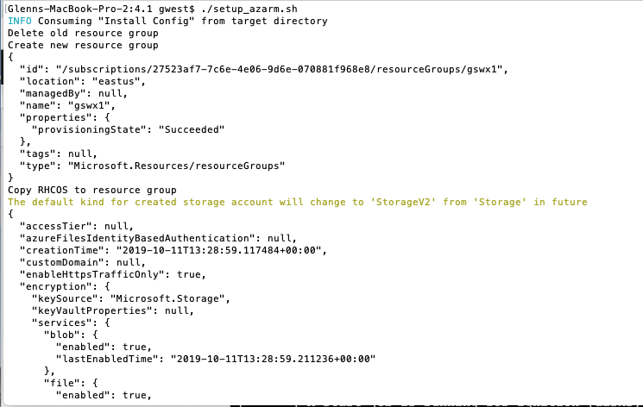

Slide 14
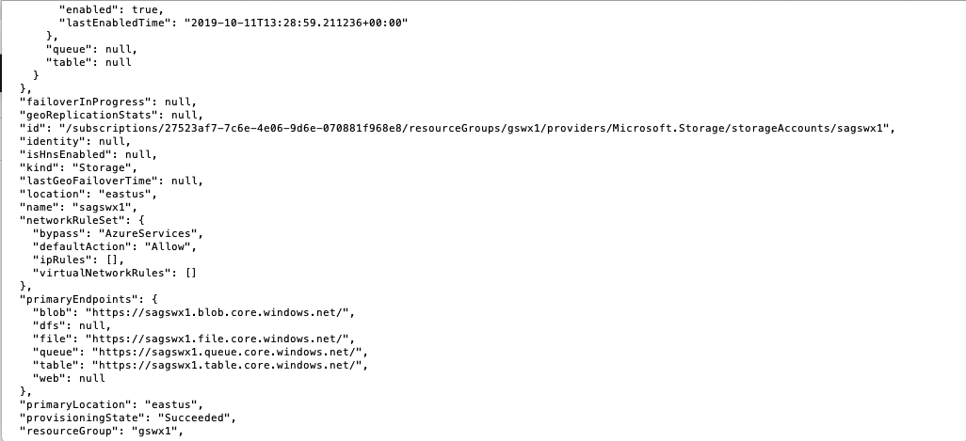

Slide 15
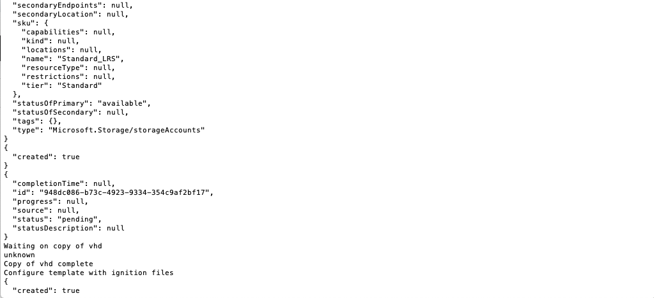

Slide 16
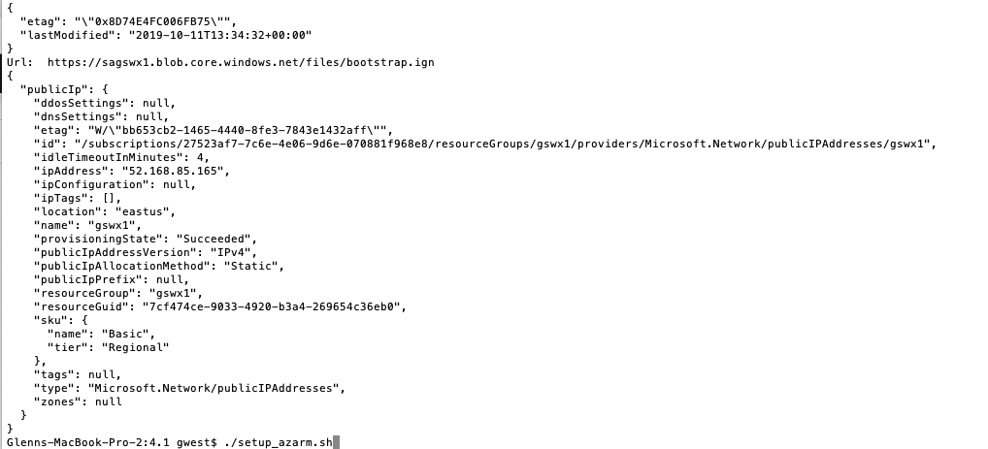

Slide 17
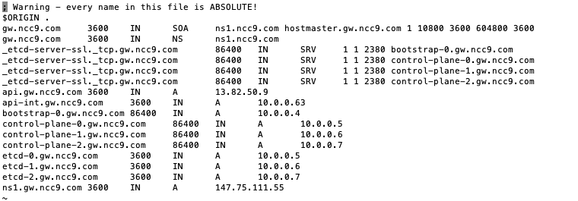
DNS Setup

Slide 18
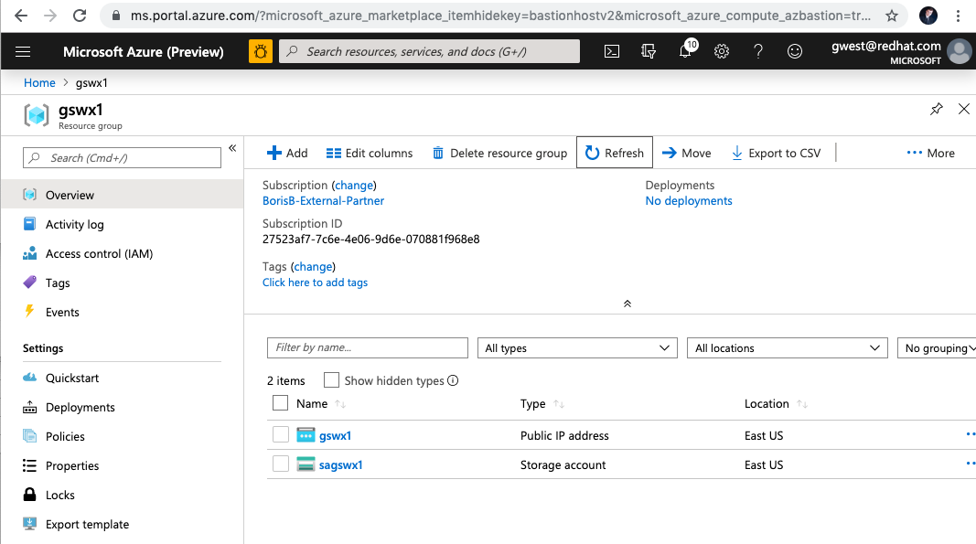
Resource Group – At This Point

Slide 19
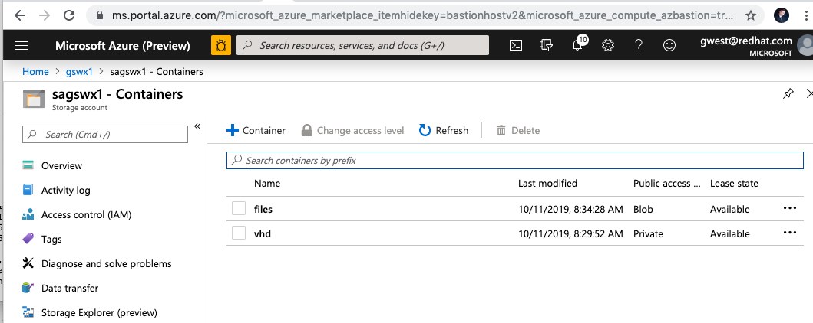
Storage Account

Slide 20
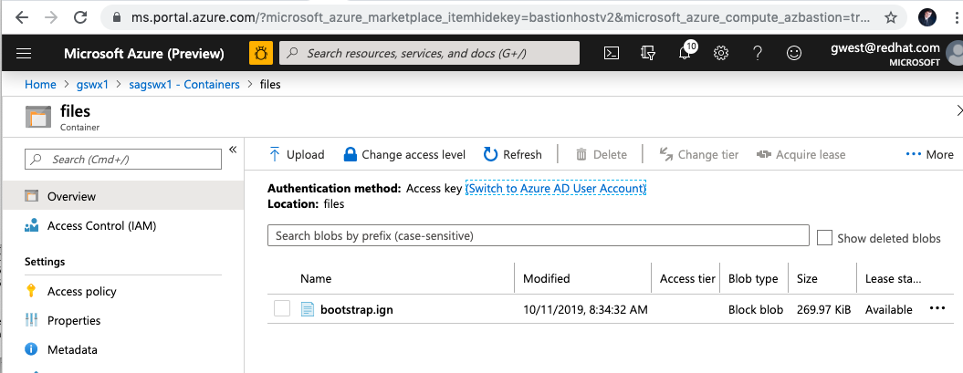
Bootstrap Ignition

Slide 21
deploy-azarm.sh
What it does:
Starts the deployment using the arm template
Creates and setups all resources (vms,load balancers, etc)
Wait for bootstrap complete
Delete the bootstrap ignition file
Wait for installation complete

Slide 22
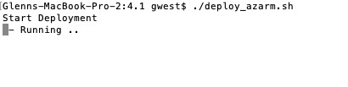
Start Deploy

Slide 23
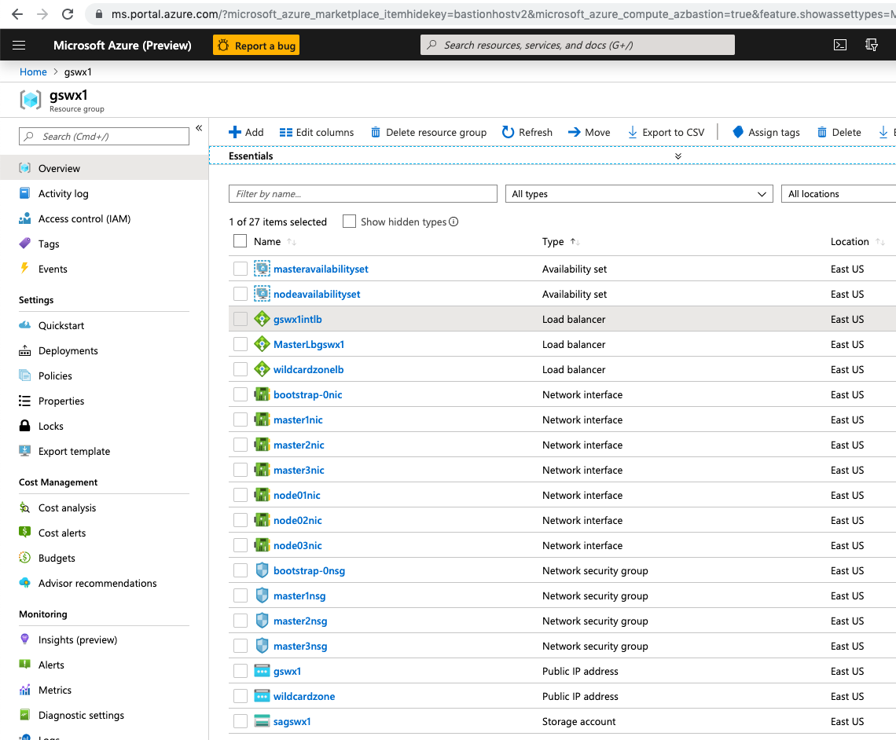

Slide 24
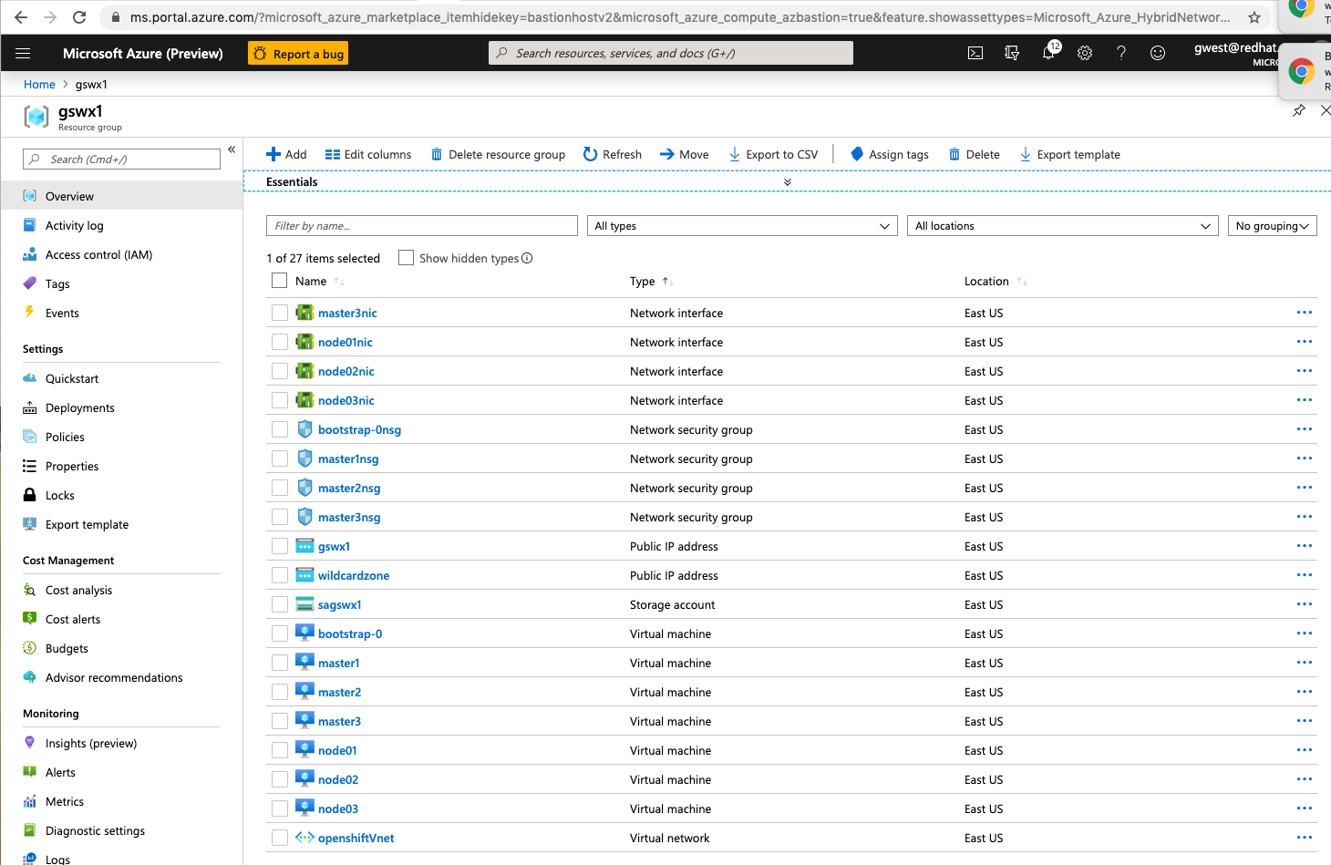

Slide 25
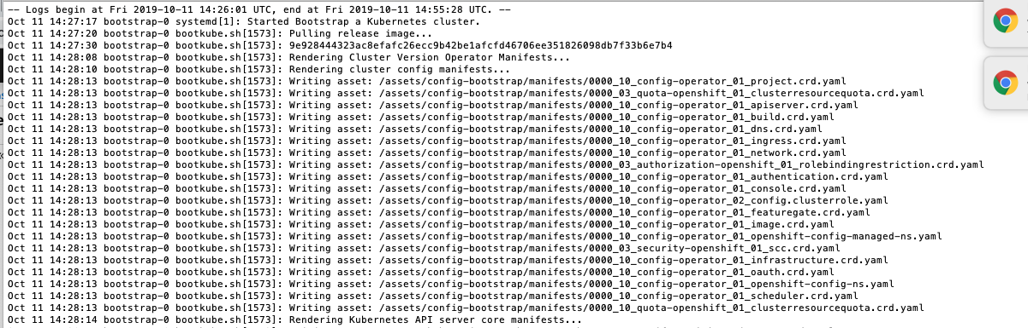

Slide 26
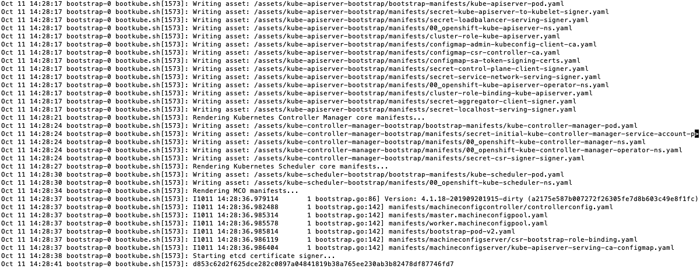

Slide 27
Change Versions
Installer – Pull down the installer that you want to use to the directory for azocpupi as the scripts all use ./openshift-install
Two file modifications are needed
Image for RHCOS

Slide 28
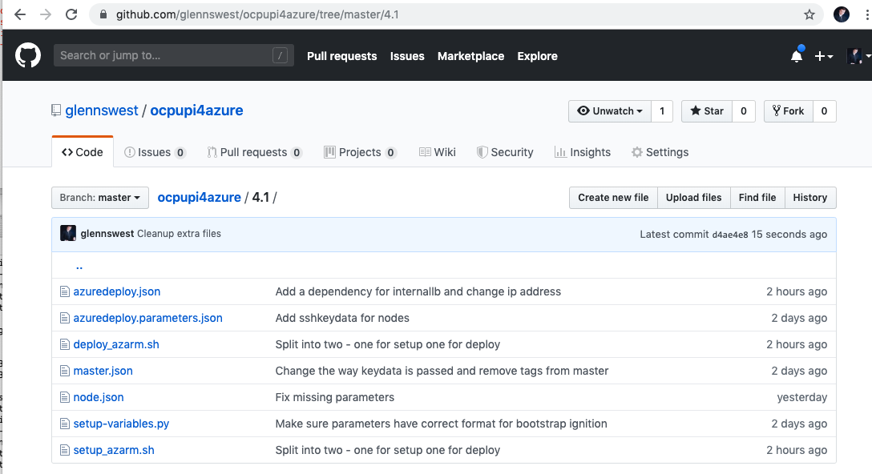
Where’s it at:
https://github.com/glennswest/ocpupi4azure/tree/master/4.1

