Slide 1

UPI ARM Sprint Demo
DEMO 3
gwest@redhat.com
Oct 11, 2019

Slide 2
WIP
Delete the Bootstrap Ignition after successful bootstrap
Fix wildcard app load balacer - size 2
Add azure cloud provider - size 3 – In Progresss – Pending Blocker
Dns local or automation - size 2
Work to support ci of azure arm upi - need help from someone who does ci
Cleanup of scripts

Slide 3
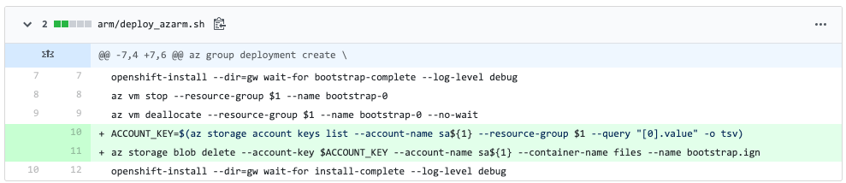
Cleanup bootstrap.ign after ignition

Slide 4
Minor Enhancements
Updated readme.md to point to overview
Change default region to Central US

Slide 5
Current Status
Testings Pending
Azure Cloud Provider
App Load Balancer/Portal
New Cards
4.3 – Test Bare Metal – In progress
Introduction/Overview Presentation
Include How To various subjects
Changing Internal IP’s
Changing Versions
Adding More Workers

Slide 6
Resolved Issues
Resolved Issues
SSH Not Working to masters – ssh key had extraneous character
Masters Not Booting – DNS Address Issue Fixed
Blockers
Azure Quota – Requested yesterday – Still not resolved

Slide 7
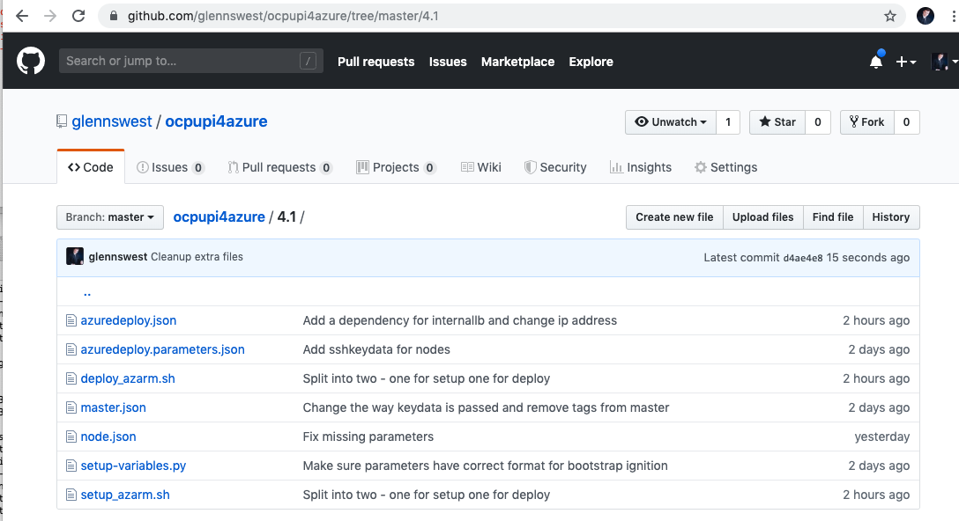
Where’s it at:
https://github.com/glennswest/ocpupi4azure/tree/master/4.1

