Slide 1

UPI ARM Sprint Demo
DEMO 3
gwest@redhat.com
Oct 11, 2019

Slide 2
WIP
Delete the Bootstrap Ignition after successful bootstrap
Fix wildcard app load balacer - size 2
Add azure cloud provider - size 3 – In Progresss – Pending Blocker
Dns local or automation - size 2
Work to support ci of azure arm upi - need help from someone who does ci
Cleanup of scripts

Slide 3
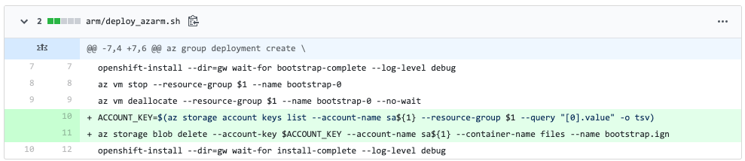
Cleanup bootstrap.ign after ignition

Slide 4
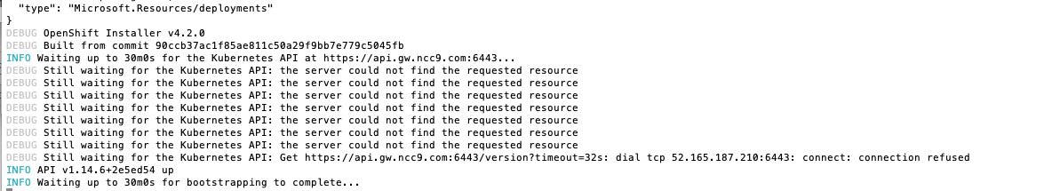
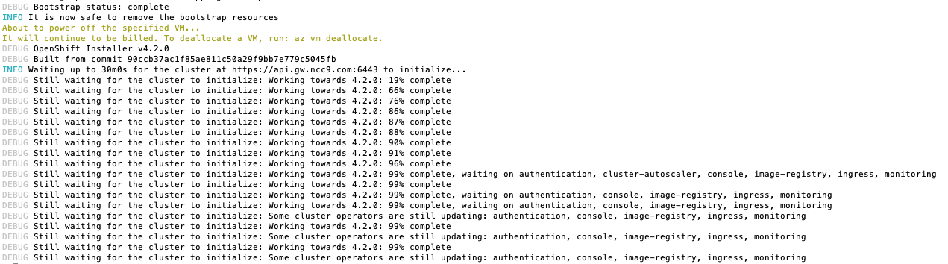
Initial Test 4.2GA with Azure Cloud Provider

Slide 5
Changes to App/InfraLB
Removed Wildcard Zone Parameter
Removed references to Wildcard zone parameter
Changed interface name to resourceGroup()App ie gswx1app
Changed setup script to precreate the public IP for the InfraLB
Added name of app loadbalancer to parameters for node creation
In node template added the ip into the app loadbalancer

Slide 6
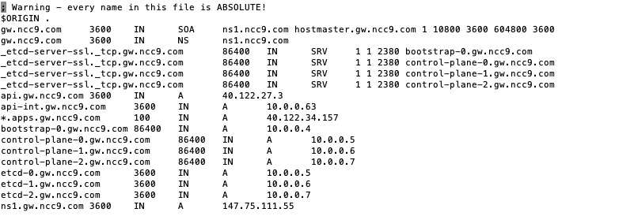
Wildcard IP For Apps

Slide 7
Minor Enhancements
Updated readme.md to point to overview
Make region a environment variable
Change default region to Central US

Slide 8
Current Status
Testings Pending
App Load Balancer/Portal
Completed
Initial Cloud Provider Test Completed
New Cards
4.3 – Test Bare Metal – In progress
Introduction/Overview Presentation
Include How To various subjects
Changing Internal IP’s
Changing Versions
Adding More Workers

Slide 9
Resolved Issues
Resolved Issues
SSH Not Working to masters – ssh key had extraneous character
Masters Not Booting – DNS Address Issue Fixed
Blockers
Azure Quota – Requested yesterday – Still not resolved

Slide 10
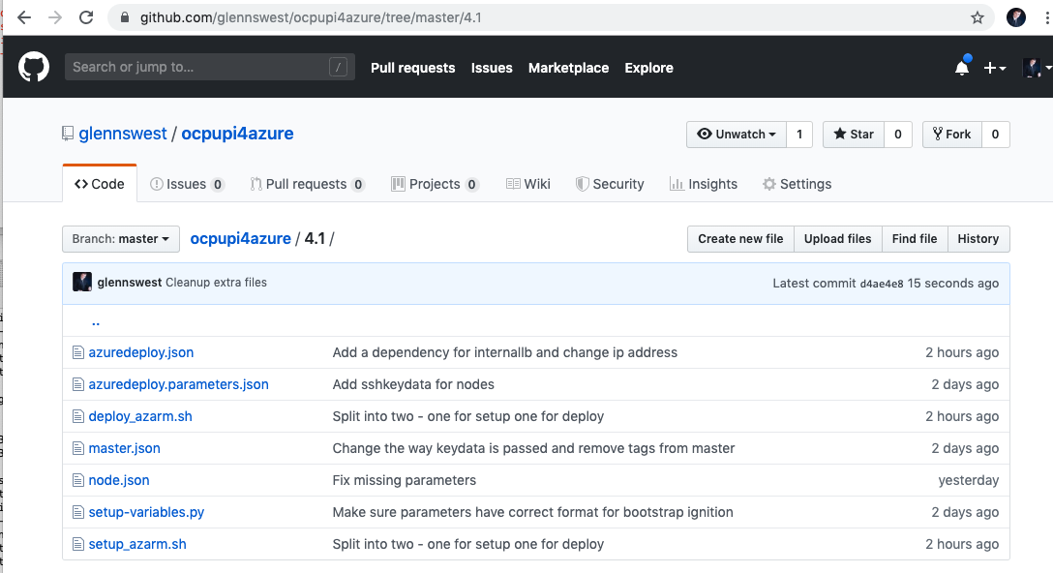
Where’s it at:
https://github.com/glennswest/ocpupi4azure/tree/master/4.1

