Slide 1

UPI ARM Sprint Demo
DEMO 2
gwest@redhat.com
Oct 11, 2019

Slide 2
WIP
Reconfigure internal load balancer to handle node boots - size 2
Fix wildcard app load balacer - size 2
Chance scripts to parametrise resource group name - size 1
Change to use 4.2 nightlies - size 2
Add azure cloud provider - size 3 – In Progresss – Pending Blocker
Dns local or automation - size 2
Add bastion for debug - size 1 - Unneeded
Work to support ci of azure arm upi - need help from someone who does ci
Cleanup of scripts

Slide 3
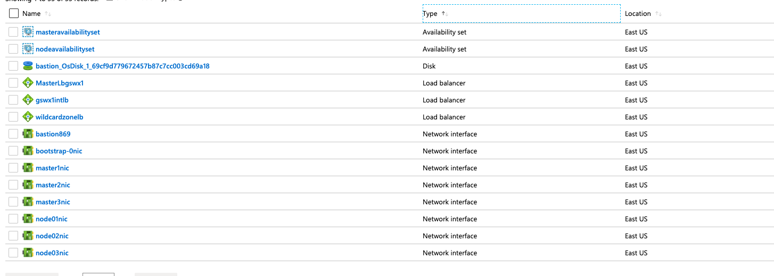
Internal Load Balancer – Created

Slide 4
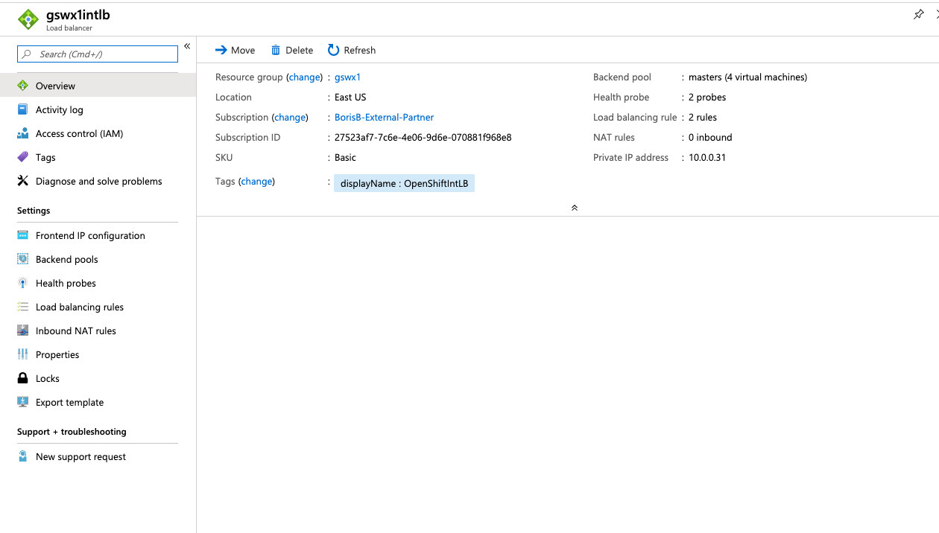
Internal Load Balancer - Working

Slide 5
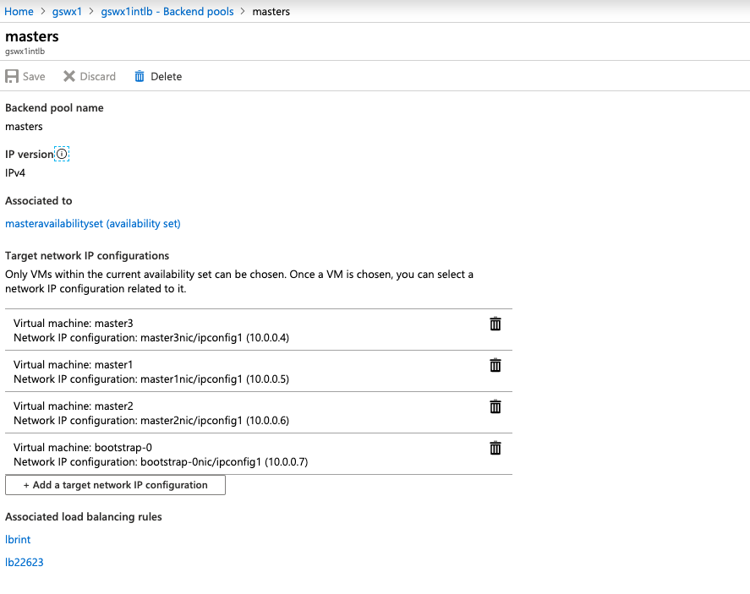
Internal Load Balancer – Backend Pool

Slide 6
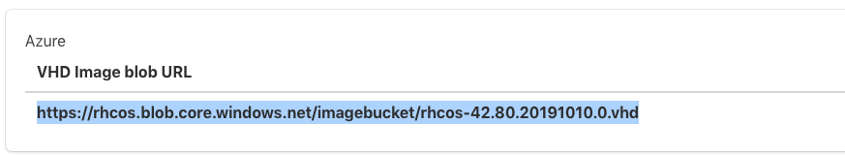
Azure VHD
Currently Azure (VHD) VM Images are just stored in a storage account
Every time you run the ARM template due to this we must “copy” the image into the resource group used by the ARM template
Note that a normal “RHEL” Image has a different mechanism, that effectively includes distribution of images to all av zones, and speeds up the vm spin up. (10-20 minutes of extra time for storage account)

Slide 7

Card – Parametertised scripts
Scripts have been changed to support giving the resource group on command line

Slide 8

Card – Move to 4.2
Changed Folder structure to be version independent
Added nightly build “Internal” script to pull installer
Changed rhcos version and storage account source
Change scripts to reflect above

Slide 9
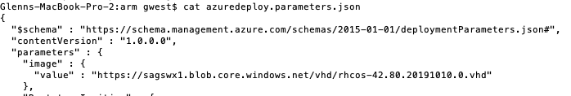
Change version of OpenShift for ARM UPI
Change the RHCOS Image name in azuredeploy.parameters.json
Change image variable in set_azarm.sh

Slide 10
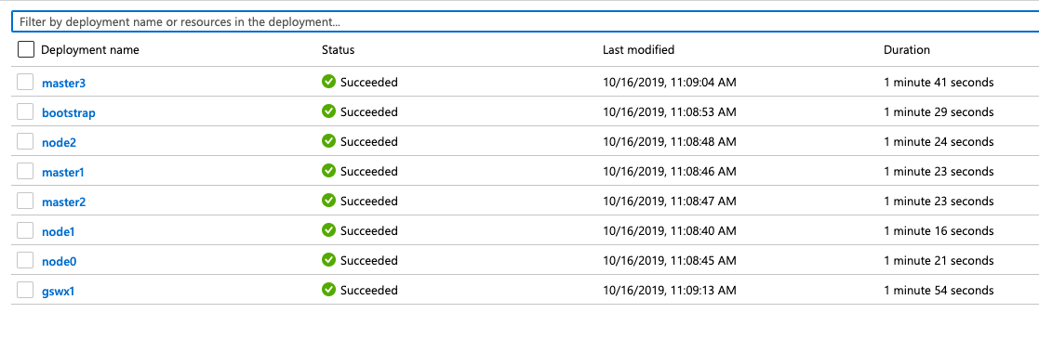
First 4.2 Nightly Deployment Success

Slide 11
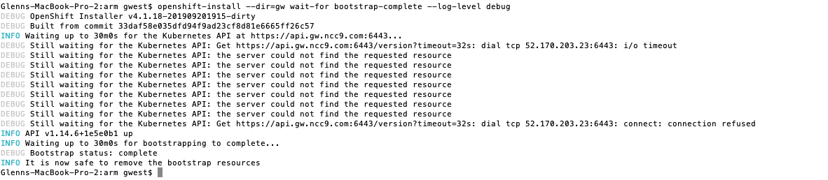
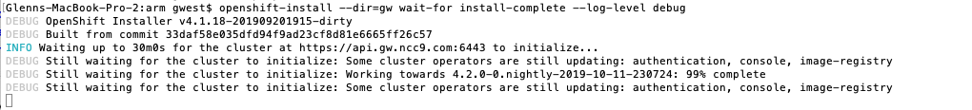
First 4.2 Bootstrap and Cluster at 99%

Slide 12
Current Status
Working:
Internal Load Balancer is Fixed and Working
Testings Pending
Azure Cloud Provider
App Load Balancer/Portal
New Cards
4.3 – Test Bare Metal – In progress
Introduction/Overview Presentation
Include How To various subjects
Changing Internal IP’s
Changing Versions
Adding More Workers

Slide 13
Resolved Issues
Resolved Issues
SSH Not Working to masters – ssh key had extraneous character
Masters Not Booting – DNS Address Issue Fixed
Blockers
Azure Quota – Requested yesterday – Still not resolved

Slide 14
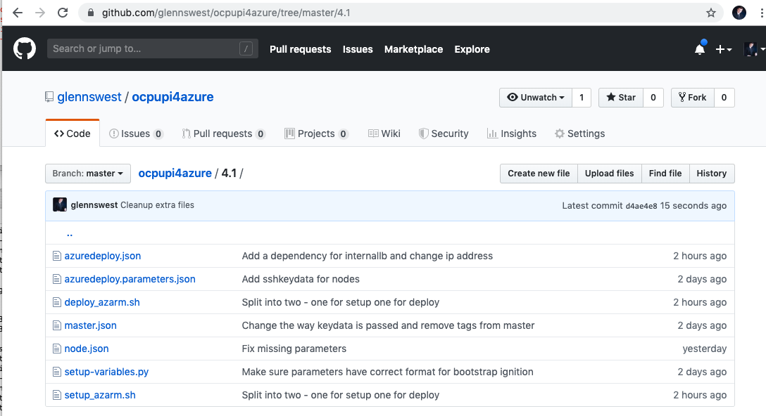
Where’s it at:
https://github.com/glennswest/ocpupi4azure/tree/master/4.1

