Slide 1
Calculation of INSPIRE Monitoring and Reporting indicators

Slide 2
M&R Indicators
Monitoring of the availability of spatial data and services (1/2)
Indicators on data set, series and services metadata
DSi1.1 | The number of spatial data sets for which metadata exist | Number of all data set and series metadata records published by the Member States in their registered discovery services.
DSi1.2 | The number of spatial data services for which metadata exist | Number of all spatial data services metadata records published by the Member States in their registered discovery services.
The INSPIRE Geoportal evaluates metadata records, obtained from all the registered services available by December 15th of every year.
For these indicators, the INSPIRE Geoportal ignores any omissions or errors in the theme keyword element.
INSPIRE Geoportal checks for duplicates: if present they are counted as one.

Slide 3
M&R Indicators
Monitoring of the availability of spatial data and services (2/2)
Priority Data Set keyword
DSi1.3 | The number of spatial data sets for which the metadata contains one or more keywords from a register provided by the Commission indicating that the spatial data set is used for reporting under the environmental legislation | Number of metadata records tagged with one or more Priority data set keywords in the metadata “Keyword” element.
Spatial Scope keyword
DSi1.4 | The number of spatial data sets for which the metadata contains a keyword from a register provided by the Commission indicating that the spatial data set covers regional territory | Number of metadata records tagged with the "Regional" value as SpatialScope keyword in the metadata "Keyword" element.
DSi1.5 | The number of spatial data sets for which the metadata contains a keyword from a register provided by the Commission indicating that the spatial data set covers national territory | Number of metadata records tagged with the “National" value as SpatialScope keyword in the metadata "Keyword" element.
For the above indicators, INSPIRE Geoportal considers every metadata record with at least one keyword ID (extracted from gmx:anchor/@xlink:href) matched against the IDs of the proper metadata code lists (Spatial Scope, Priority Data sets) values.

Slide 4
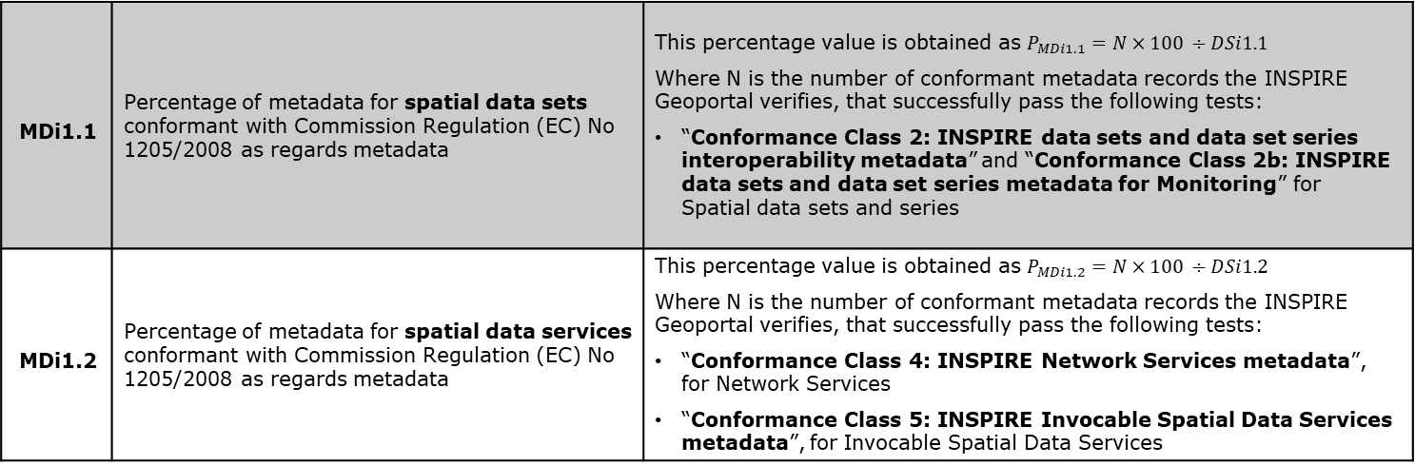
M&R Indicators
Monitoring of the conformity of metadata
Conformity of metadata, validated by the INSPIRE Reference Validator
MDi1.1 | Percentage of metadata for spatial data sets conformant with Commission Regulation (EC) No 1205/2008 as regards metadata | This percentage value is obtained as $P_{MDi1.1}=N×100 ÷DSi1.1$ Where N is the number of conformant metadata records the INSPIRE Geoportal verifies, that successfully pass the following tests: “Conformance Class 2: INSPIRE data sets and data set series interoperability metadata” and “Conformance Class 2b: INSPIRE data sets and data set series metadata for Monitoring” for Spatial data sets and series
MDi1.2 | Percentage of metadata for spatial data services conformant with Commission Regulation (EC) No 1205/2008 as regards metadata | This percentage value is obtained as $P_{MDi1.2}=N×100 ÷DSi1.2$ Where N is the number of conformant metadata records the INSPIRE Geoportal verifies, that successfully pass the following tests: “Conformance Class 4: INSPIRE Network Services metadata”, for Network Services “Conformance Class 5: INSPIRE Invocable Spatial Data Services metadata”, for Invocable Spatial Data Services
Starting from the 2020 Monitoring and Reporting exercise, only MD TG v2.0 will be accepted.

Slide 5
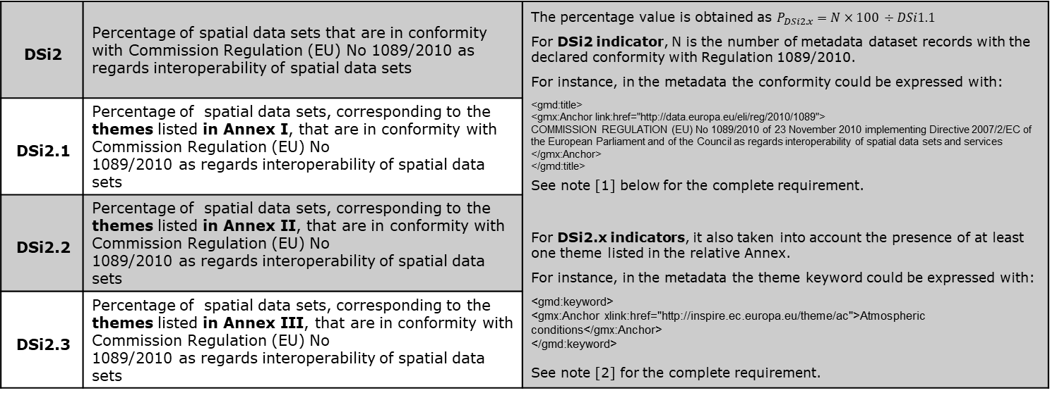
M&R Indicators
Monitoring of the conformity of spatial data sets
Declared conformity of metadata and Annex I/II/III
DSi2 | Percentage of spatial data sets that are in conformity with Commission Regulation (EU) No 1089/2010 as regards interoperability of spatial data sets | The percentage value is obtained as $P_{DSi2.x}=N×100 ÷DSi1.1$ For DSi2 indicator, N is the number of metadata dataset records with the declared conformity with Regulation 1089/2010. For instance, in the metadata the conformity could be expressed with: <gmd:title> <gmx:Anchor link:href="http://data.europa.eu/eli/reg/2010/1089"> COMMISSION REGULATION (EU) No 1089/2010 of 23 November 2010 implementing Directive 2007/2/EC of the European Parliament and of the Council as regards interoperability of spatial data sets and services </gmx:Anchor> </gmd:title> See note [1] below for the complete requirement. For DSi2.x indicators, it also taken into account the presence of at least one theme listed in the relative Annex. For instance, in the metadata the theme keyword could be expressed with: <gmd:keyword> <gmx:Anchor xlink:href="http://inspire.ec.europa.eu/theme/ac">Atmospheric conditions</gmx:Anchor> </gmd:keyword> See note [2] for the complete requirement.
DSi2.1 | Percentage of spatial data sets, corresponding to the themes listed in Annex I, that are in conformity with Commission Regulation (EU) No 1089/2010 as regards interoperability of spatial data sets
DSi2.2 | Percentage of spatial data sets, corresponding to the themes listed in Annex II, that are in conformity with Commission Regulation (EU) No 1089/2010 as regards interoperability of spatial data sets
DSi2.3 | Percentage of spatial data sets, corresponding to the themes listed in Annex III, that are in conformity with Commission Regulation (EU) No 1089/2010 as regards interoperability of spatial data sets
For the “Conformity” element, refer to chapter 2.4.1 of MD TG v2.0
For the Keywords for Spatial Data Theme, refer to chapter 3.1.2.2 of MD TG v2.0

Slide 6
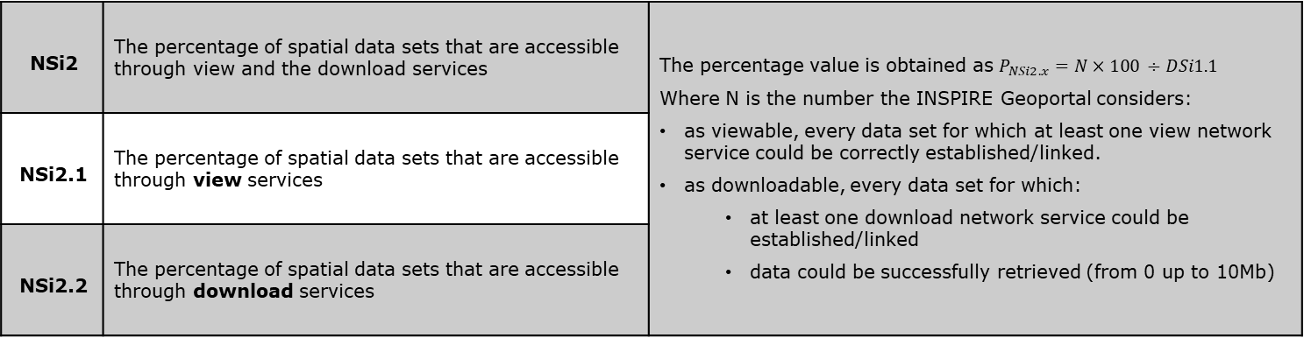
M&R Indicators
Monitoring of the accessibility of spatial data sets through view and download services
Downloadable and Viewable
NSi2 | The percentage of spatial data sets that are accessible through view and the download services | The percentage value is obtained as $P_{NSi2.x}=N×100 ÷DSi1.1$ Where N is the number the INSPIRE Geoportal considers: as viewable, every data set for which at least one view network service could be correctly established/linked. as downloadable, every data set for which: at least one download network service could be established/linked data could be successfully retrieved (from 0 up to 10Mb)
NSi2.1 | The percentage of spatial data sets that are accessible through view services
NSi2.2 | The percentage of spatial data sets that are accessible through download services
Refer to the document “Geoportal workflow for establishing links between data sets and network services” available at the “Resource Linkage checker tool” page - Click here

Slide 7
M&R Indicators
Monitoring of the conformity of network services
Declared conformity of Network Services (1/2)
NSi4 | Percentage of the network services that are in conformity with Commission Regulation (EC) No 976/2009 as regards the Network Services | The type of network service identification is based on: Metadata element “Spatial Data Service Type”, expressed for example as: <srv:serviceType> <gco:LocalName codeSpace="http://inspire.ec.europa.eu/metadata-codelist/SpatialDataServiceType">view</gco:LocalName> </srv:serviceType> Note: once the simplification option is endorsed, the necessary information about the service access point will be taken from data set metadata (Resource locator). The formulas are expressed in the next slide.
NSi4.1 | Percentage of the discovery services that are in conformity with Commission Regulation (EC) No 976/2009 as regards the Network Services
NSi4.2 | Percentage of the view services that are in conformity with Commission Regulation (EC) No 976/2009 as regards the Network Services
NSi4.3 | Percentage of the download services that are in conformity with Commission Regulation (EC) No 976/2009 as regards the Network Services
NSi4.4 | Percentage of the transformation services that are in conformity with Commission Regulation (EC) No 976/2009 as regards the Network Services

Slide 8
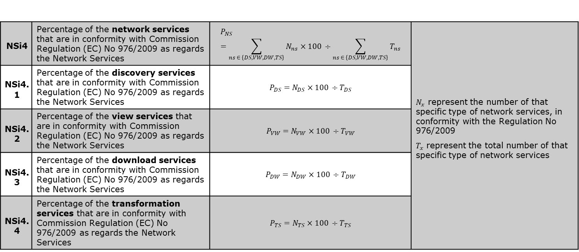
M&R Indicators
Monitoring of the conformity of network services
Declared conformity of Network Services (2/2)
NSi4 | Percentage of the network services that are in conformity with Commission Regulation (EC) No 976/2009 as regards the Network Services | $$P_{NS}=\sum_{ns ∈ \left\{DS,VW,DW,TS\right\}}{N_{ns}}×100 ÷\sum_{ns ∈ \left\{DS,VW,DW,TS\right\}}{T_{ns}}$$ | $N_{x}$ represent the number of that specific type of network services, in conformity with the Regulation No 976/2009 $T_{x}$ represent the total number of that specific type of network services
NSi4.1 | Percentage of the discovery services that are in conformity with Commission Regulation (EC) No 976/2009 as regards the Network Services | $$P_{DS}=N_{DS}×100 ÷T_{DS}$$
NSi4.2 | Percentage of the view services that are in conformity with Commission Regulation (EC) No 976/2009 as regards the Network Services | $$P_{VW}=N_{VW}×100 ÷T_{VW}$$
NSi4.3 | Percentage of the download services that are in conformity with Commission Regulation (EC) No 976/2009 as regards the Network Services | $$P_{DW}=N_{DW}×100 ÷T_{DW}$$
NSi4.4 | Percentage of the transformation services that are in conformity with Commission Regulation (EC) No 976/2009 as regards the Network Services | $$P_{TS}=N_{TS}×100 ÷T_{TS}$$

