Slide 1
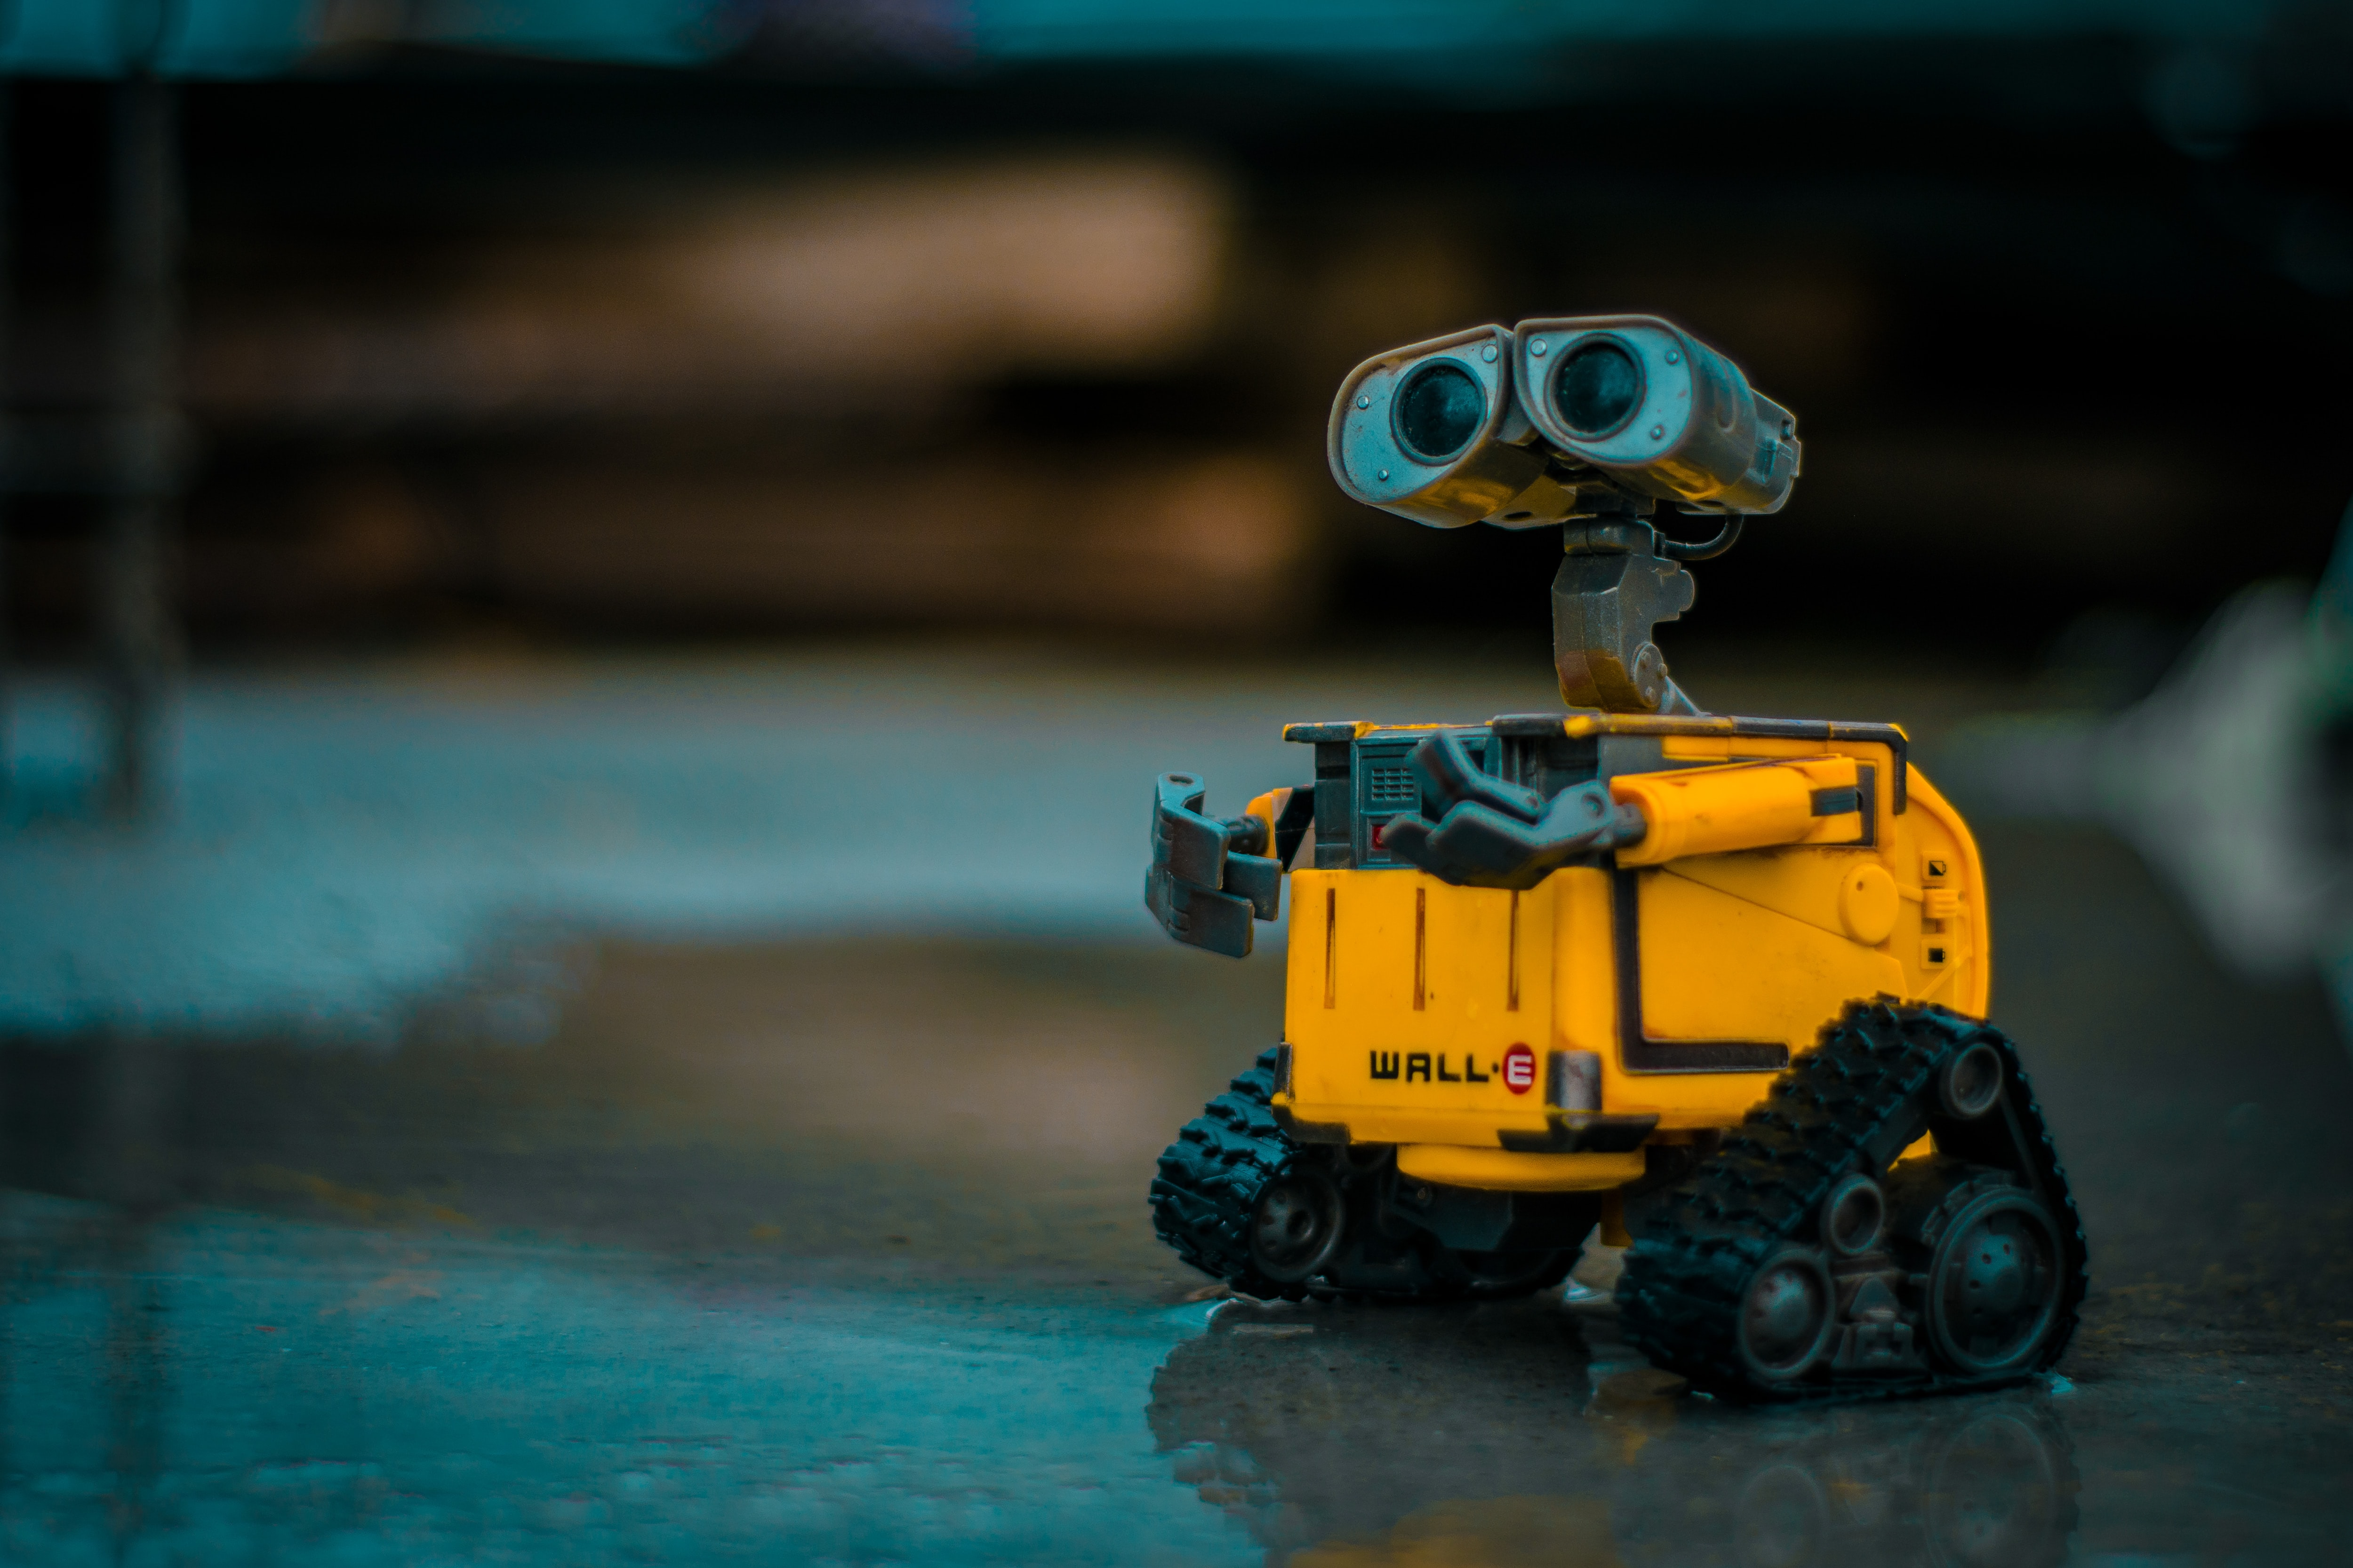
SAFE REINFORCMENT LEARNING
MILESTONE PRESENTATION II
TU Berlin, SESE: Entwurf eingebetteter Systeme 2020

Slide 2










AGENDA
Achieved and future goals
Architecture for automated testing
Environment and RL-agent
c1
Fake Environment
Quality Assurance

Slide 3
Progressreport

Slide 4
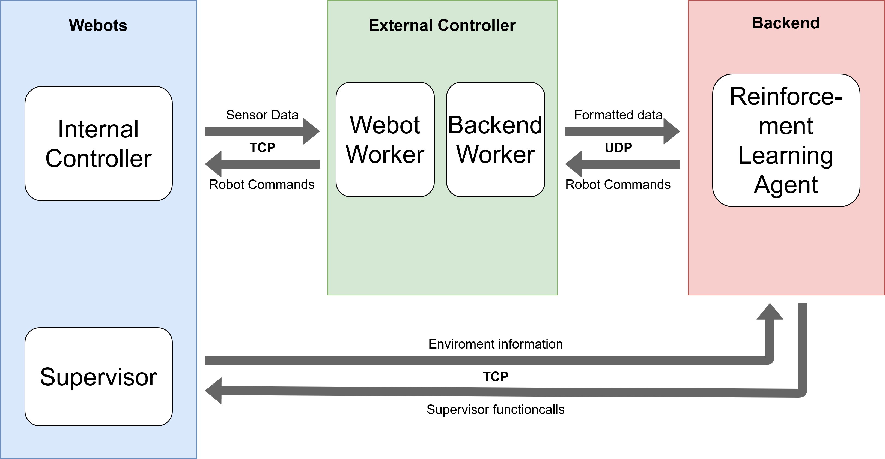
Architecture Overview

Slide 5
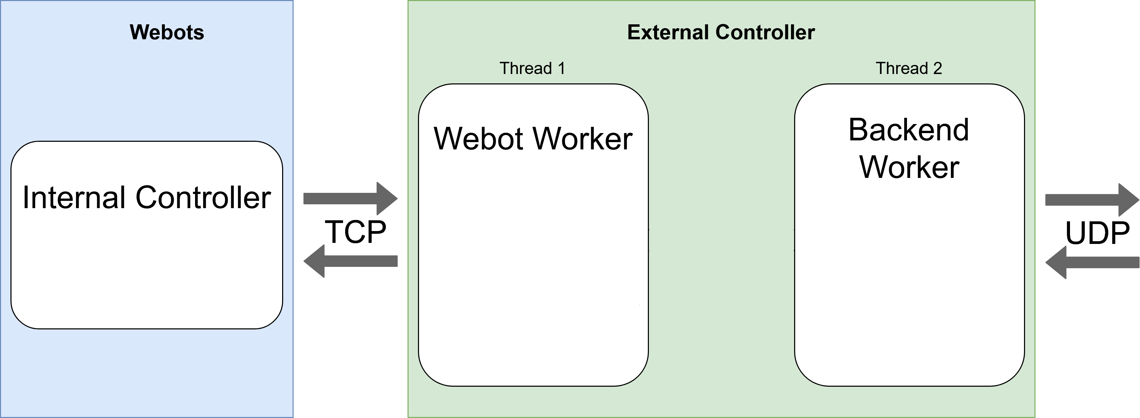
Webot-External Controller Communication (1)

Slide 6
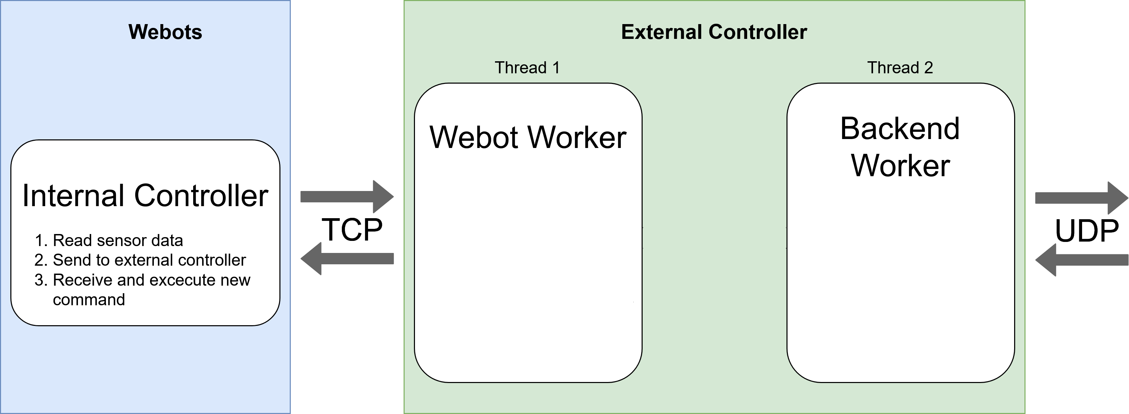
Webot-External Controller Communication (2)

Slide 7
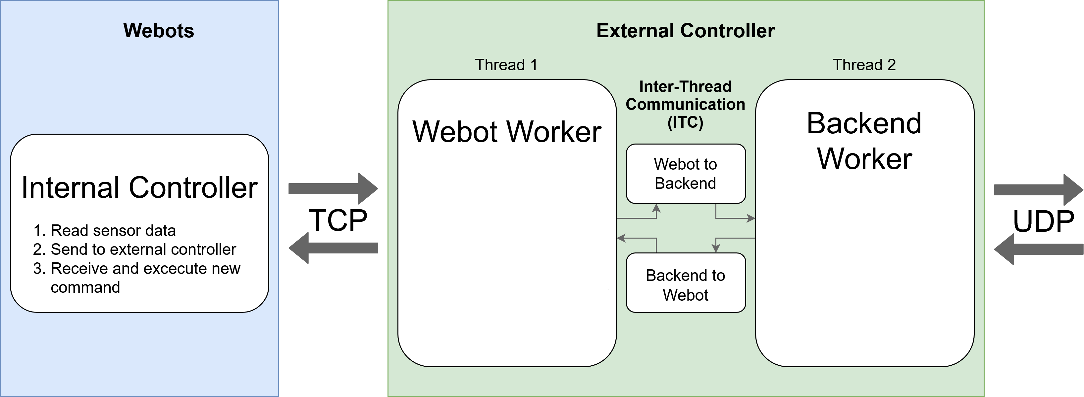
Webot-External Controller Communication (3)

Slide 8
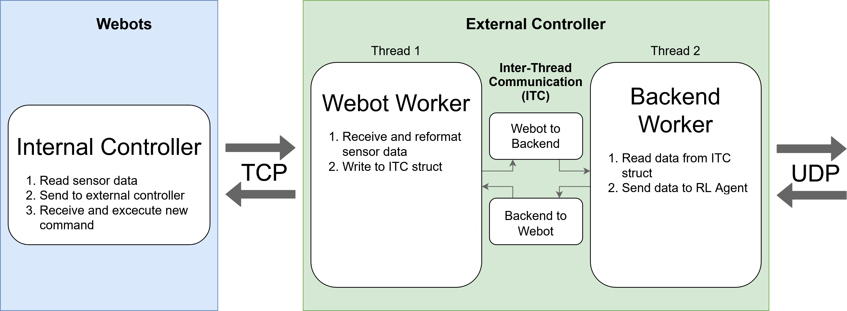
Webot-External Controller Communication (4)

Slide 9
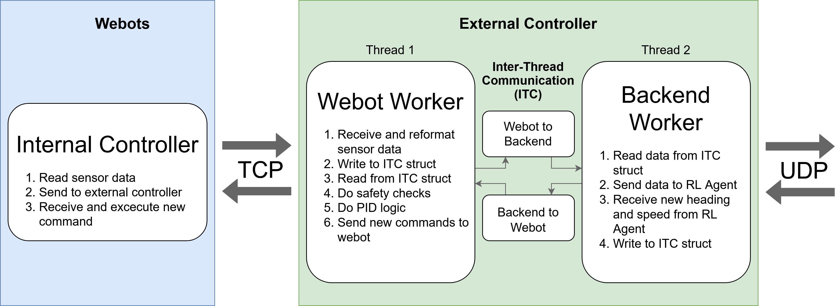
Webot-External Controller Communication (5)

Slide 10
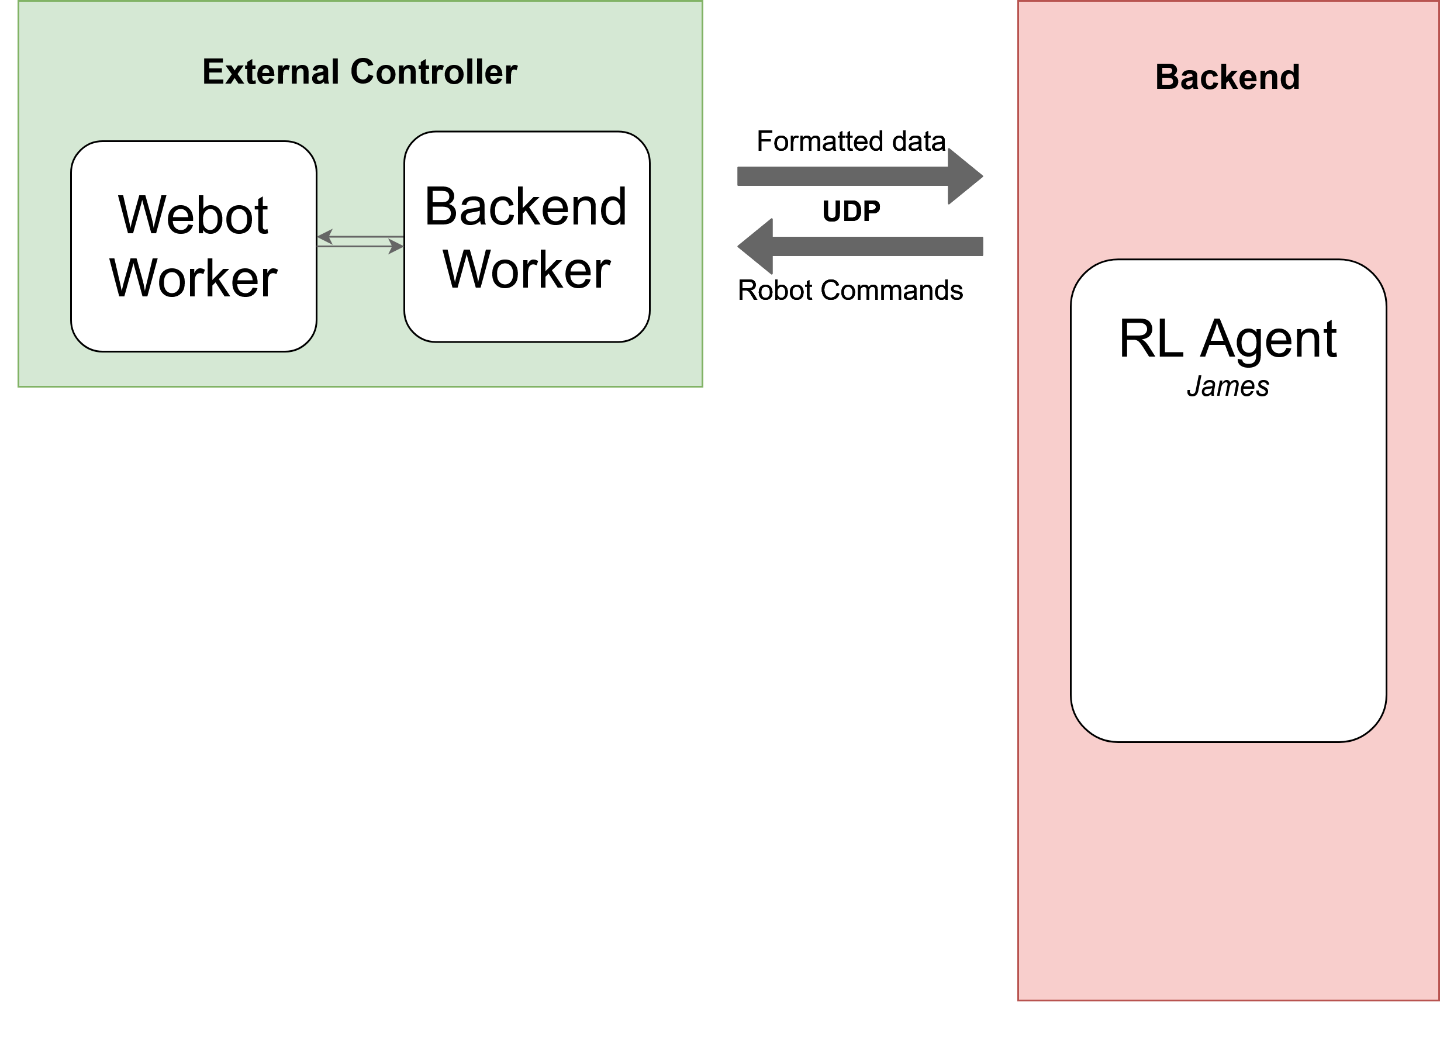
External Controller – Backend communication (1)

Slide 11
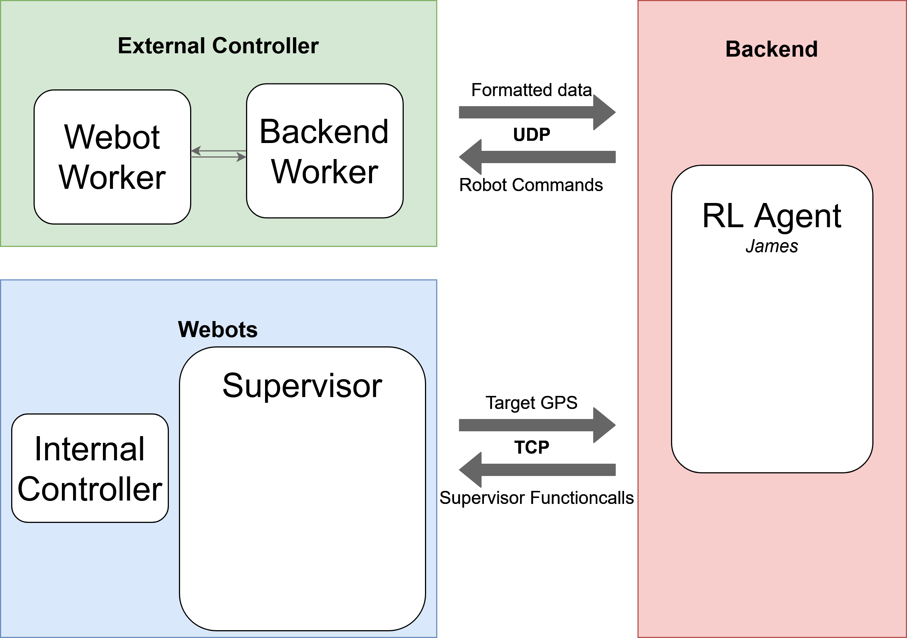
External Controller – Backend communication (2)

Slide 12
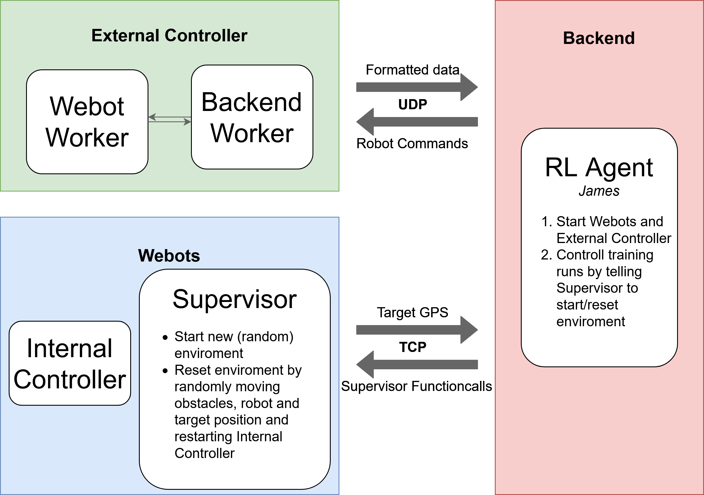
External Controller – Backend communication (3)

Slide 13
Backend
Backend
RL-Agent
action
Observation/ Reward
Environment
Data from webots/ controller
Action command

Slide 14
Environment
Why is environment necessary?
RL agent need a standard environment for training.
What is the environment for?
connection between non-backend part and RL agent, which means wrapped the data from webots/controller into standard form for openAI algorithms

Slide 15
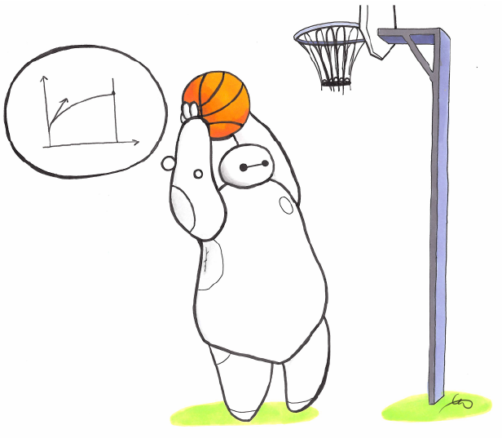
RL - Agent
How to implement?
Use Stable Baselines.
What is Stable Baselines
Stable Baselines is a set of improved implementations of Reinforcement Learning (RL) algorithms based on OpenAI Baselines.
Why use it?
do not have to implement all the algorithms by ourself
easier standardization/benchmarking
Process
Parameters setup
Model training
Model testing

Slide 16
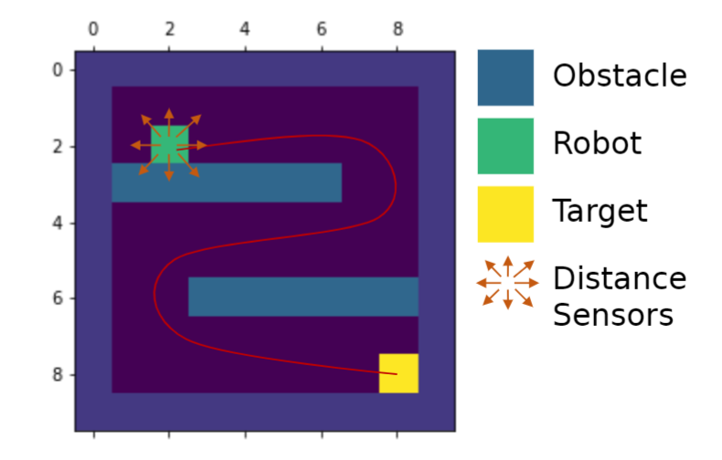
Fake Environment
State space
Current GPS location
Target GPS location
Distance sensors
Touching obstacle
Action space
4 directions(N, E, S, W)
Fixed step size
Reward function

Slide 17
Reward
Time Limits
- number of steps or time available in the webots environment
- number of requests from BE to controller for observation space.
Positive Rewards
- going closer to the goal
- staying away from obstacles
- entering the goal
Negative Rewards
- for each step used to achieve the goal
- crashing or hitting an obstacle
- get too close to an obstacle

Slide 18
Reward
Time Limits
- number of steps or time available in the webots environment
- number of requests from BE to controller for observation space.
Positive Rewards
- going closer to the goal
- staying away from obstacles
- entering the goal
Negative Rewards
- for each step used to achieve the goal
- crashing or hitting an obstacle
- get too close to an obstacle
Reward
reward_time
reward_distance
reward_goal
reward_obstacle
reward_steps

Slide 19
Quality Assurance
Coding Guideline
Code Review
Automated Testing

Slide 20
Quality Assurance
Coding Guideline
Code Review
Automated Testing
Webots/Controller
Backend
Fabian
Wladimir
Jonas
Shanshan
Mats
Per
Rui

Slide 21



Quality Assurance
Coding Guideline
Code Review
Automated Testing

