Slide 1
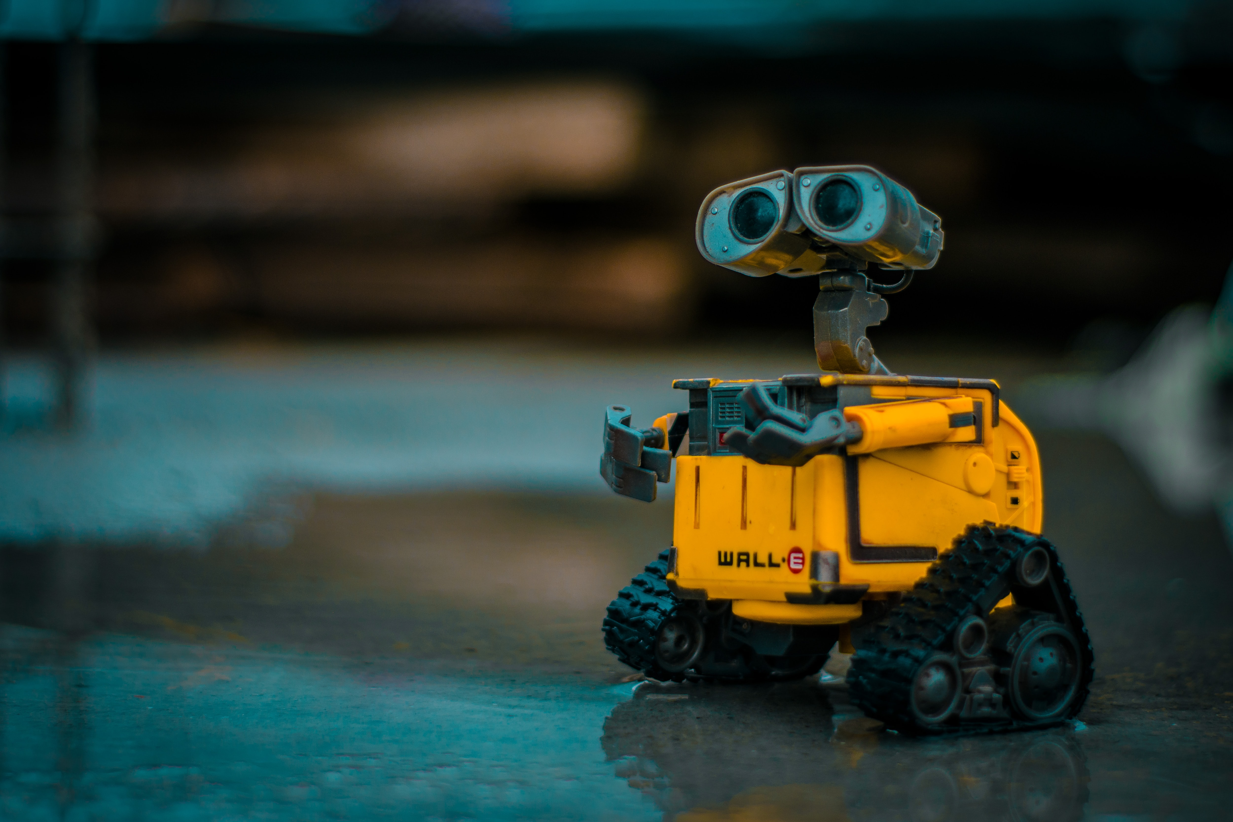
SAFE REINFORCMENT LEARNING
MILESTONE PRESENTATION II
TU Berlin, SESE: Entwurf eingebetteter Systeme 2020

Slide 2










AGENDA
Achieved and future goals
Architecture for automated testing
Algorithms and Spinningup
c1
Fake Enviroment
Quality Assurance

Slide 3
Progressreport

Slide 4
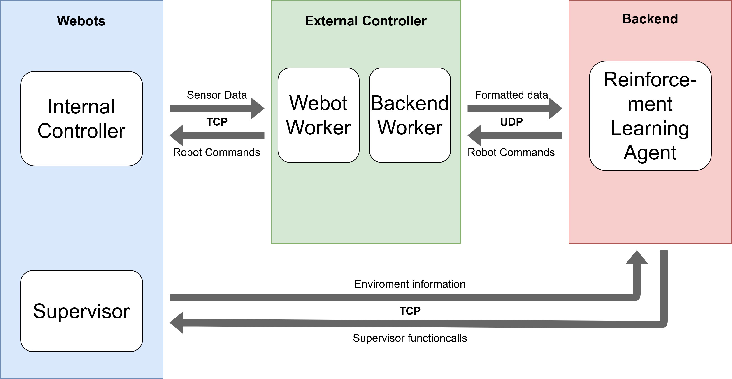
Architecture Overview

Slide 5
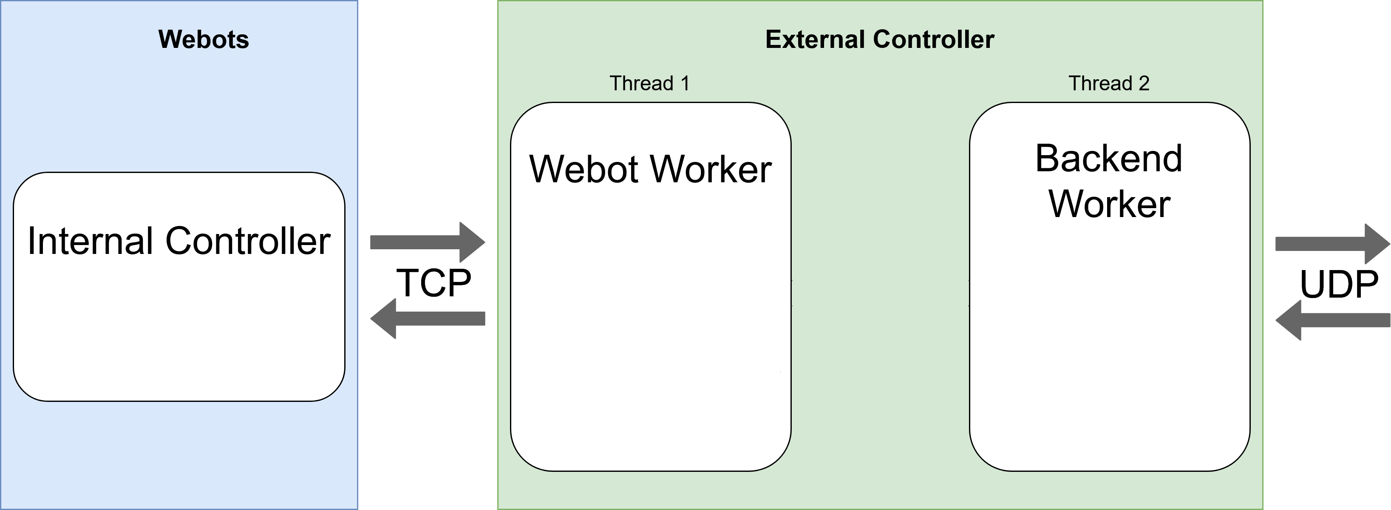
Webot-External Controller Communication (1)

Slide 6
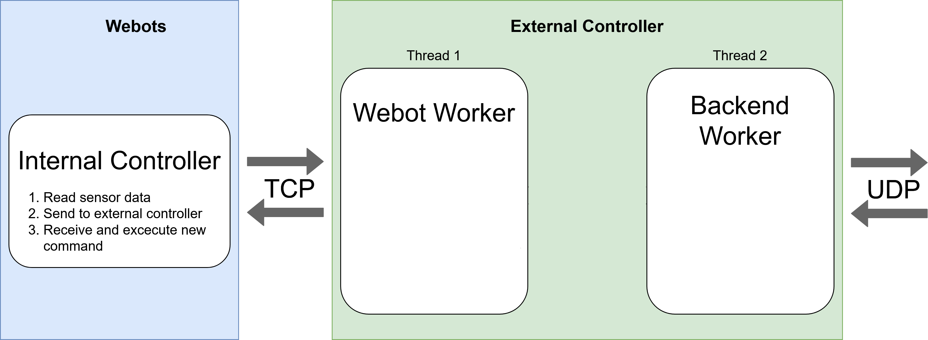
Webot-External Controller Communication (2)

Slide 7
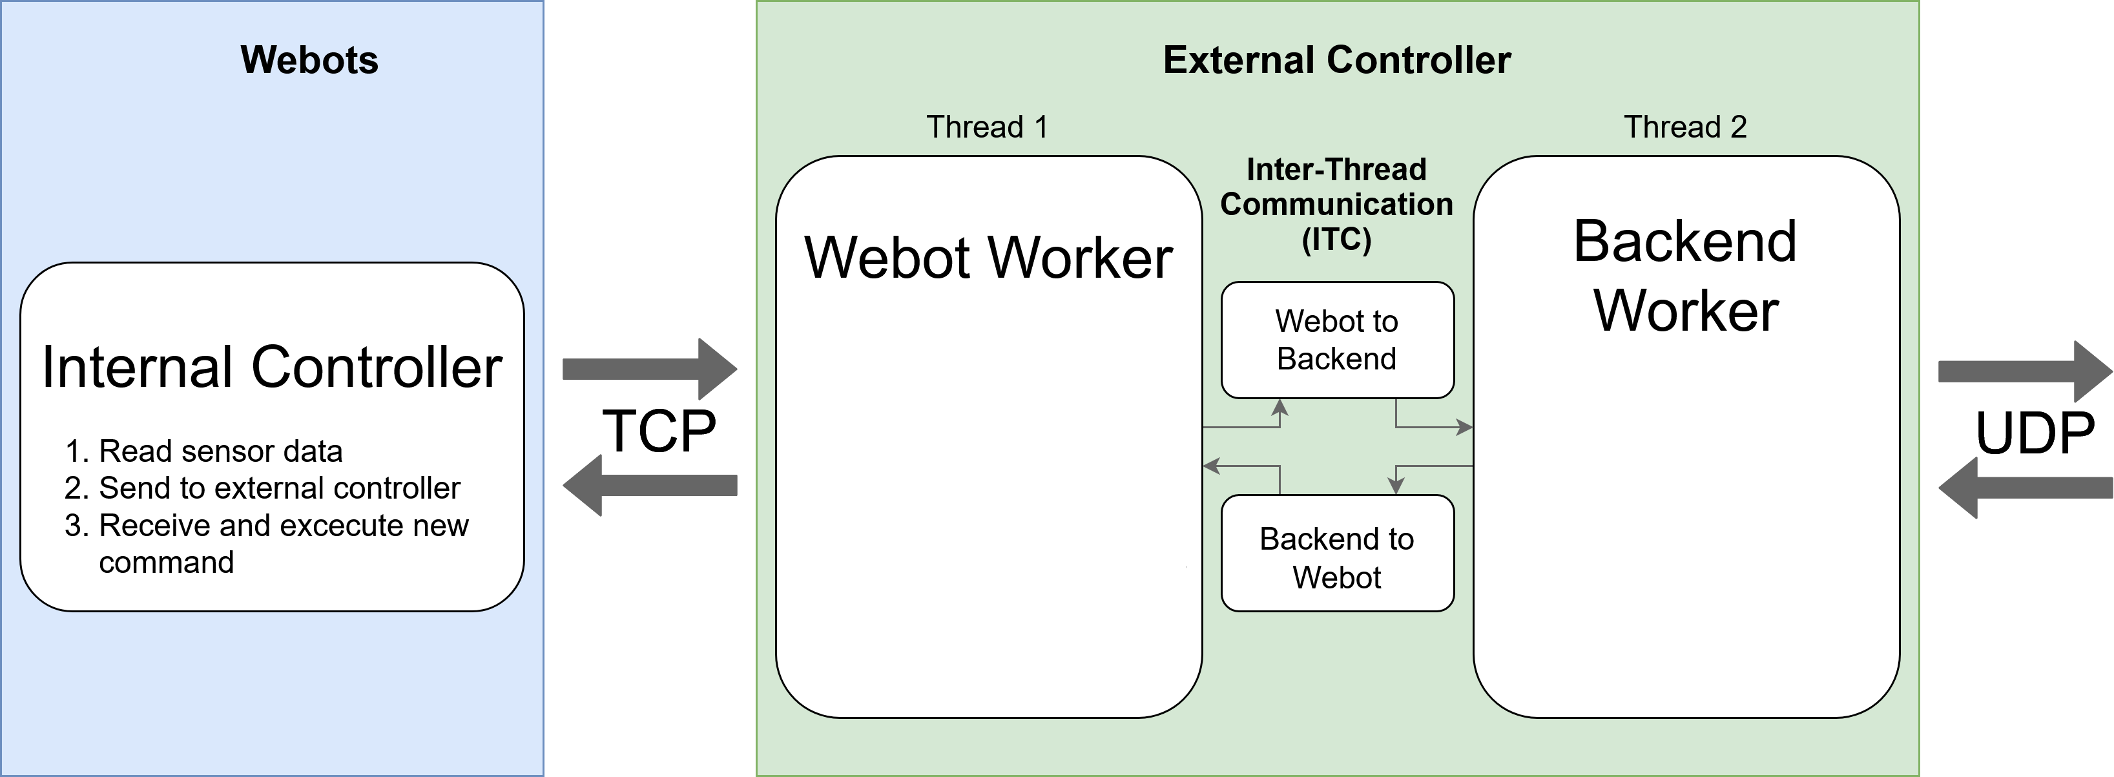
Webot-External Controller Communication (3)

Slide 8
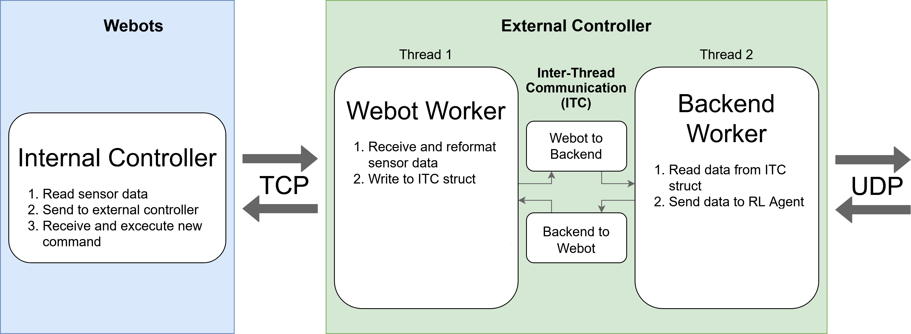
Webot-External Controller Communication (4)

Slide 9
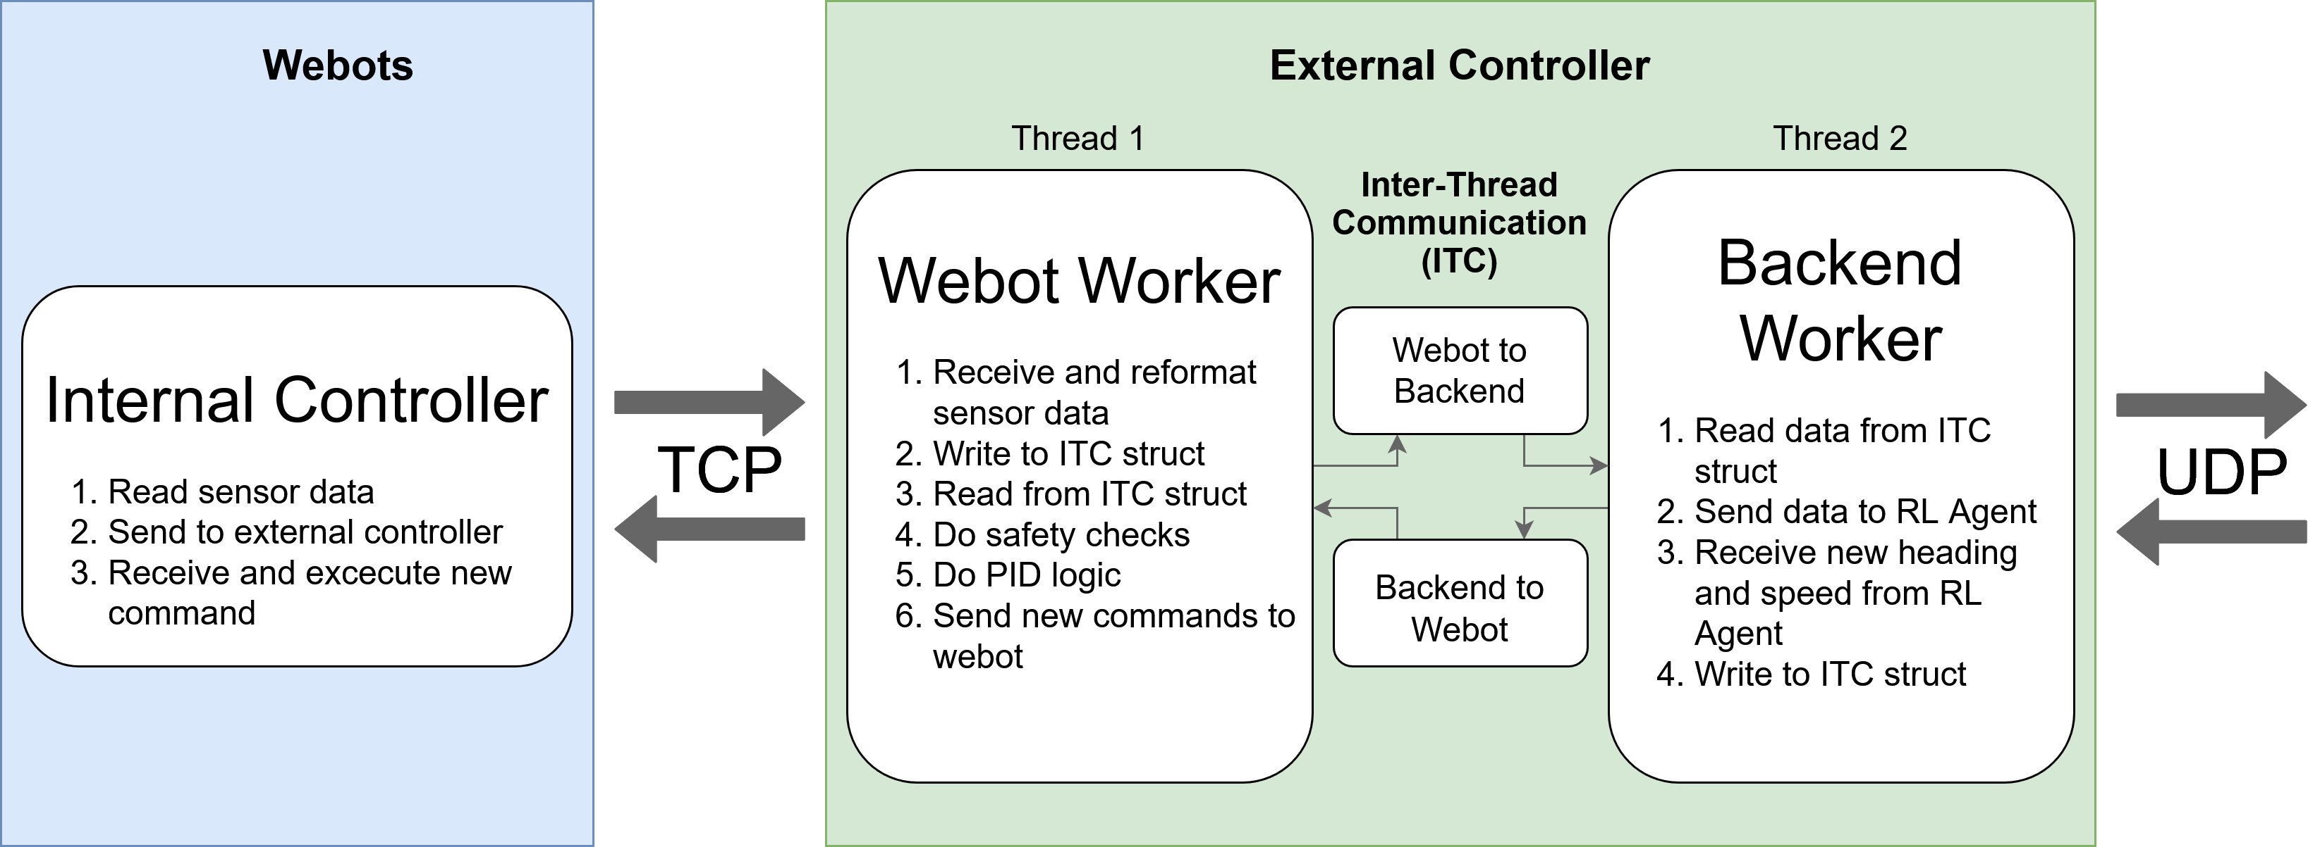
Webot-External Controller Communication (5)

Slide 10
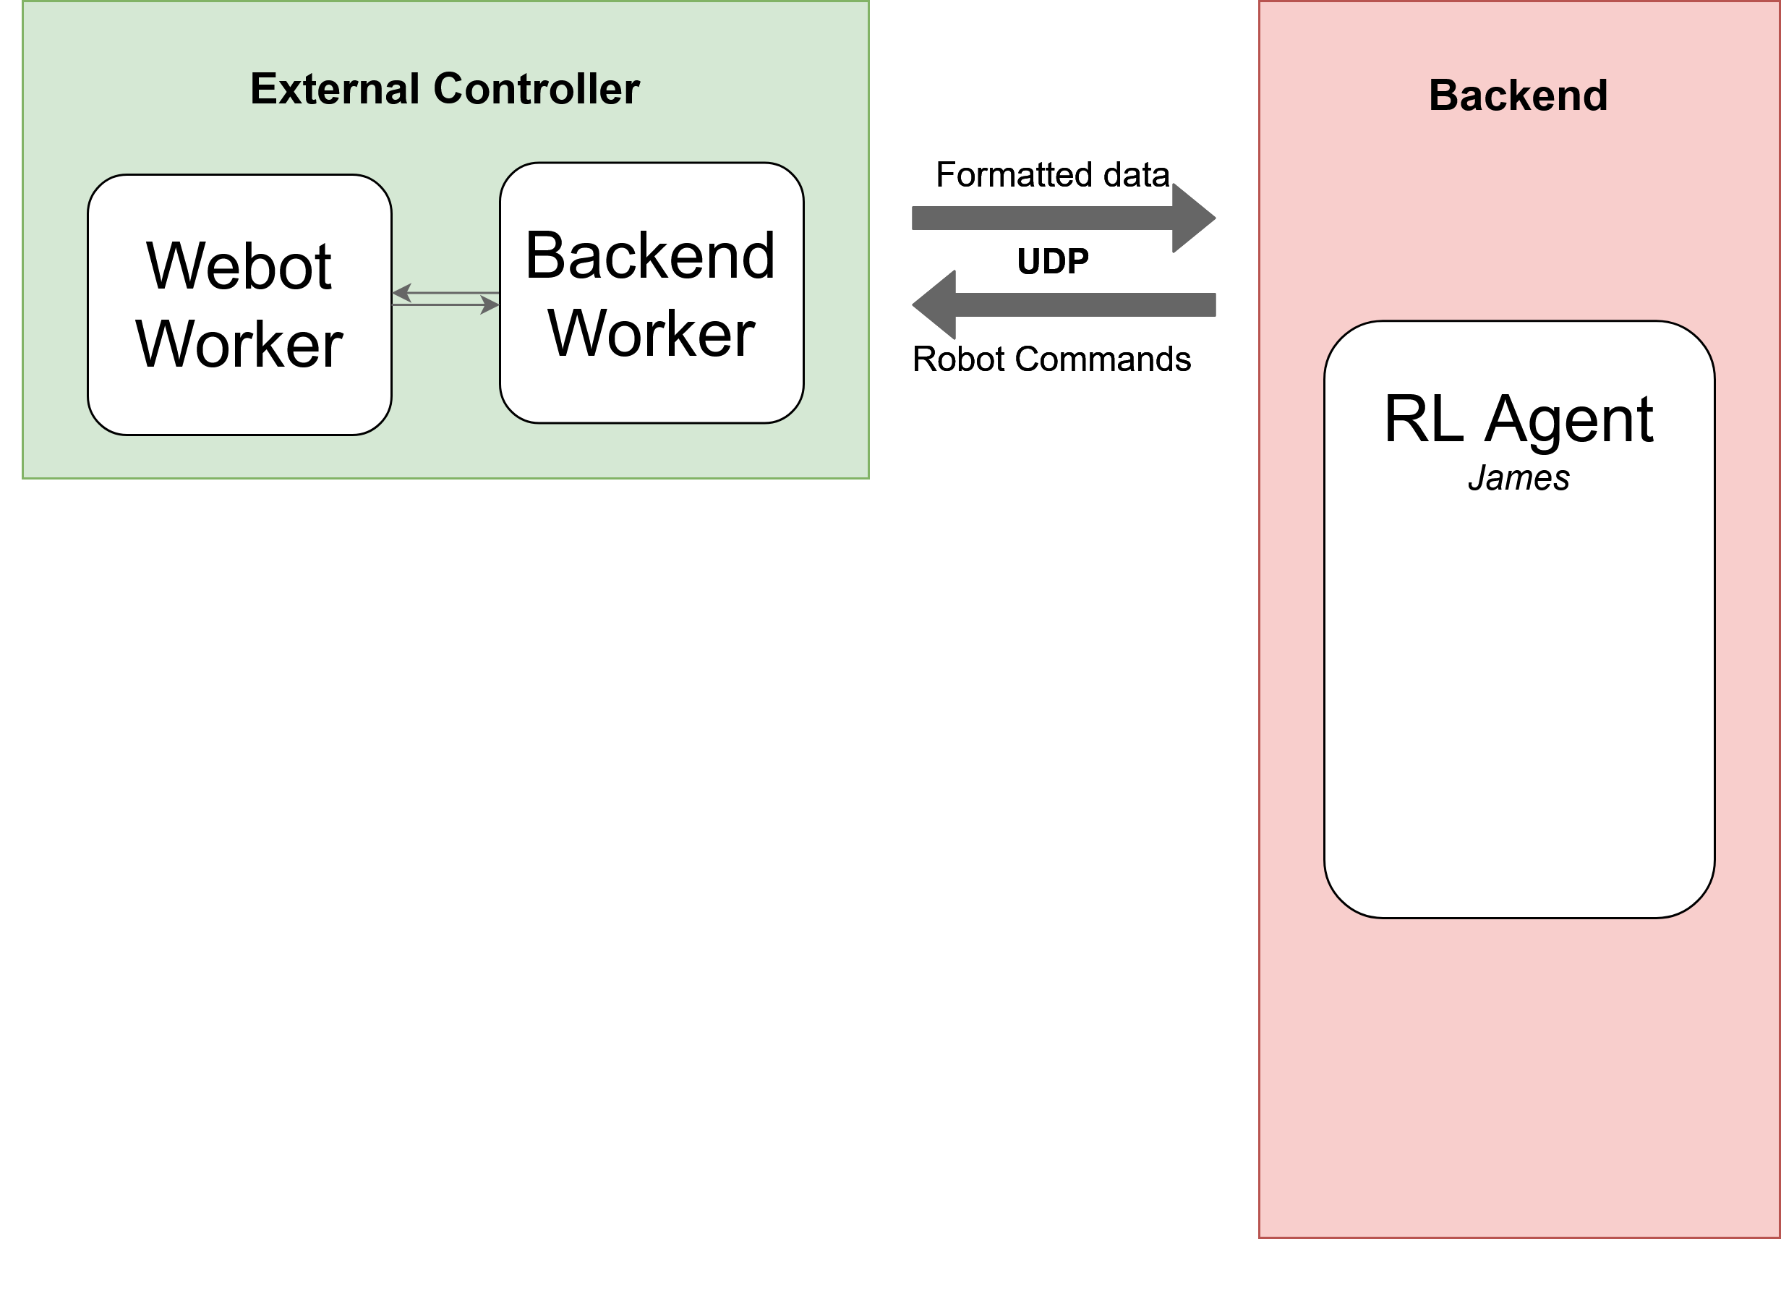
External Controller – Backend communication (1)

Slide 11
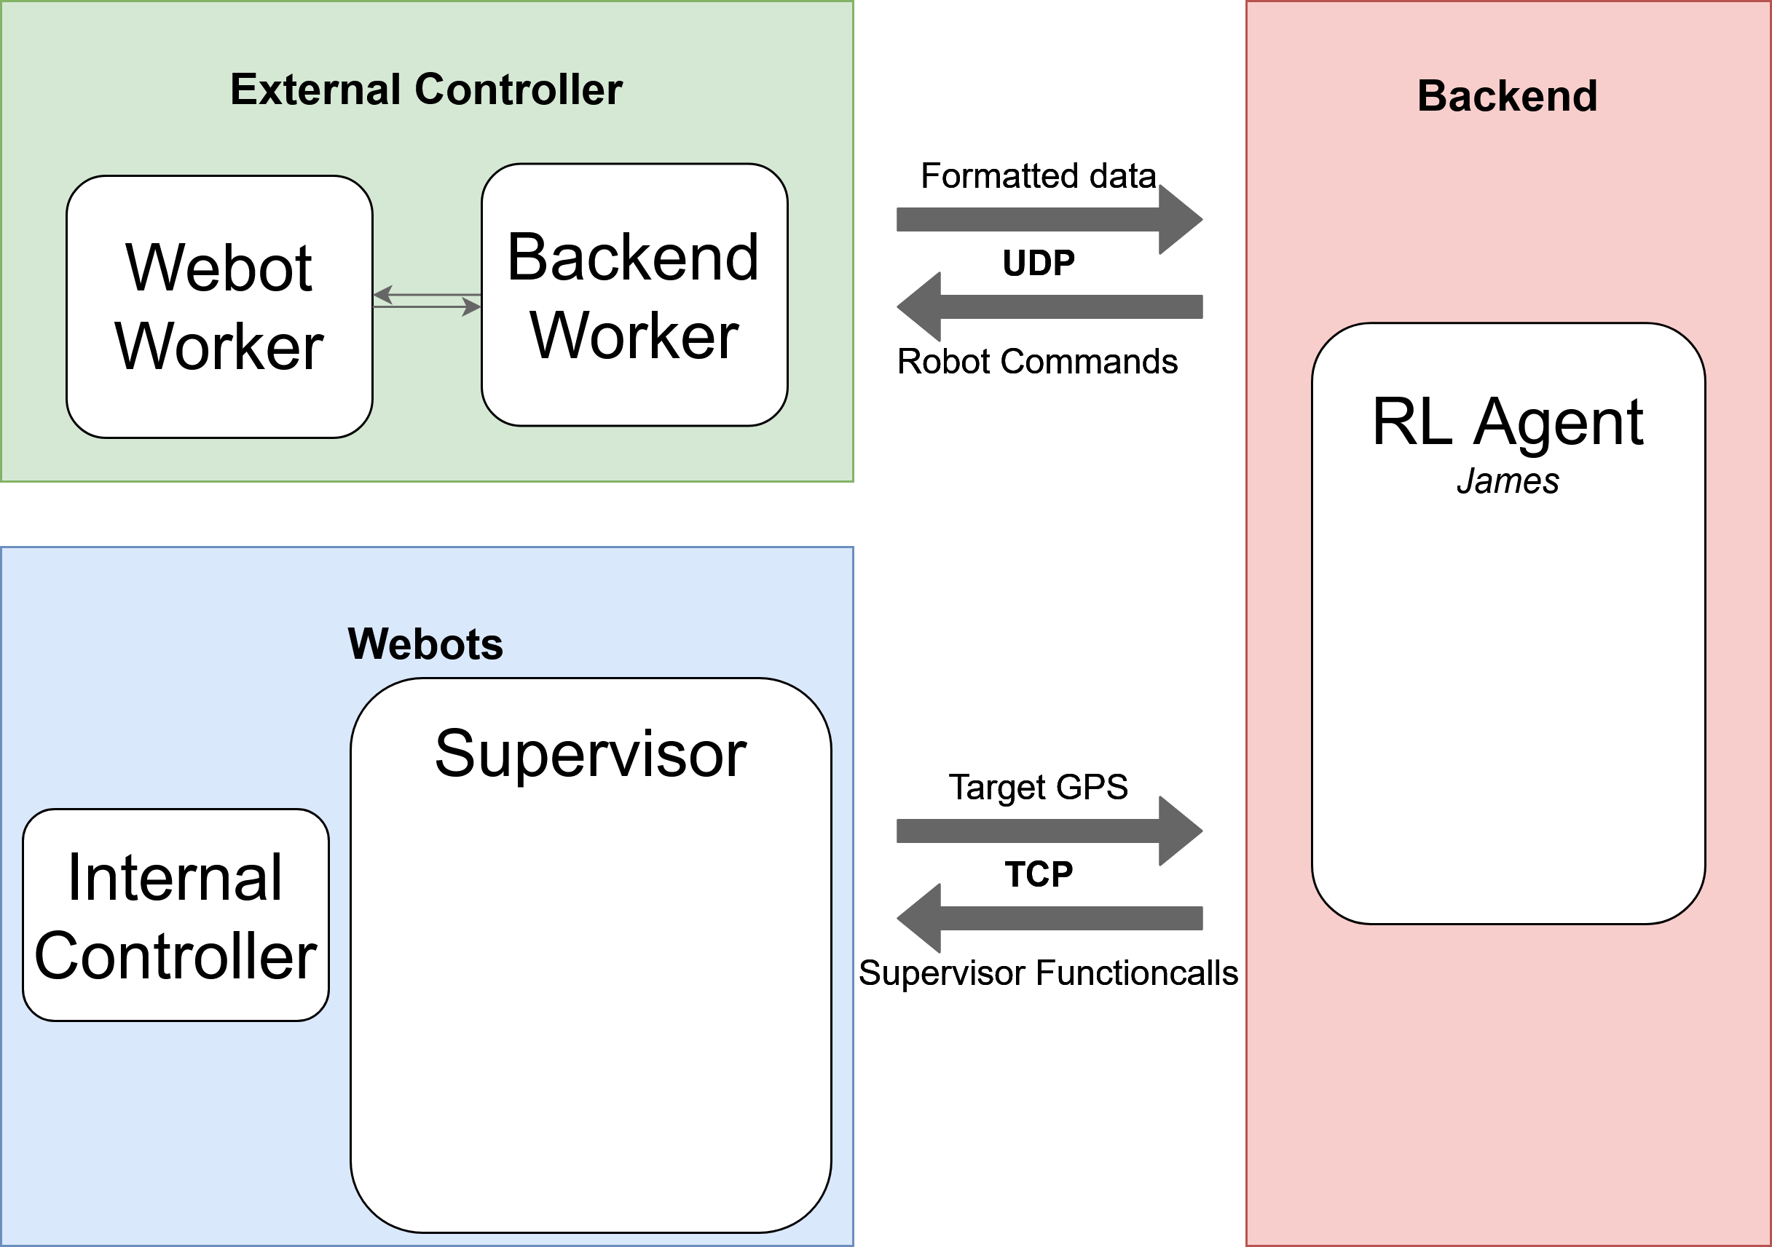
External Controller – Backend communication (2)

Slide 12
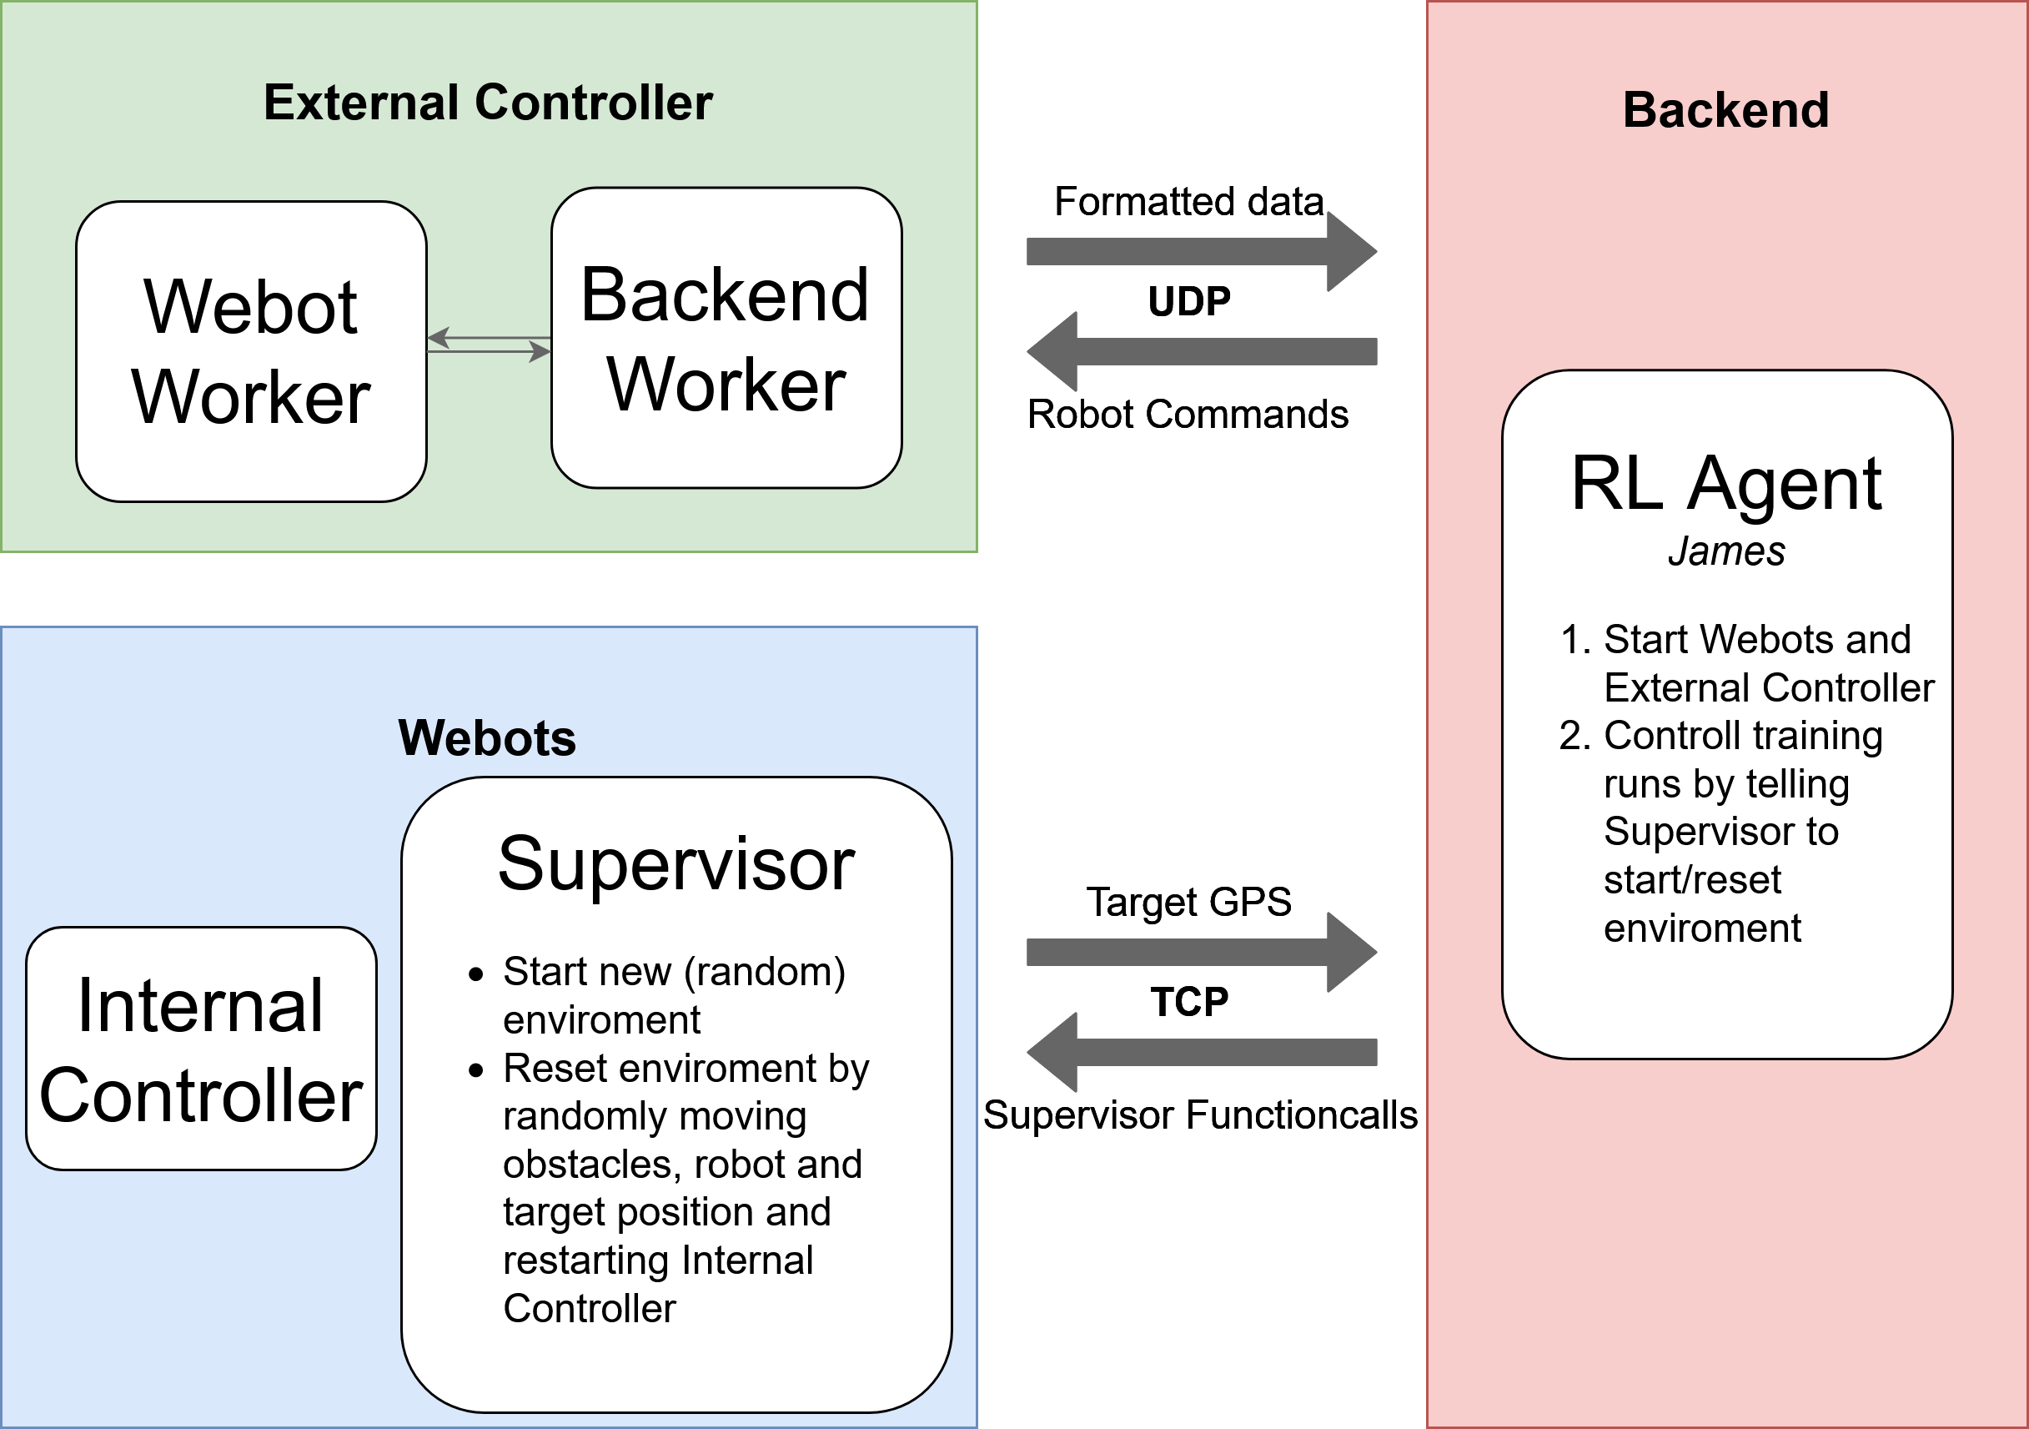
External Controller – Backend communication (3)

Slide 13
TODO Backend1

Slide 14
TODO Backend2

Slide 15
TODO QA

