Slide 1
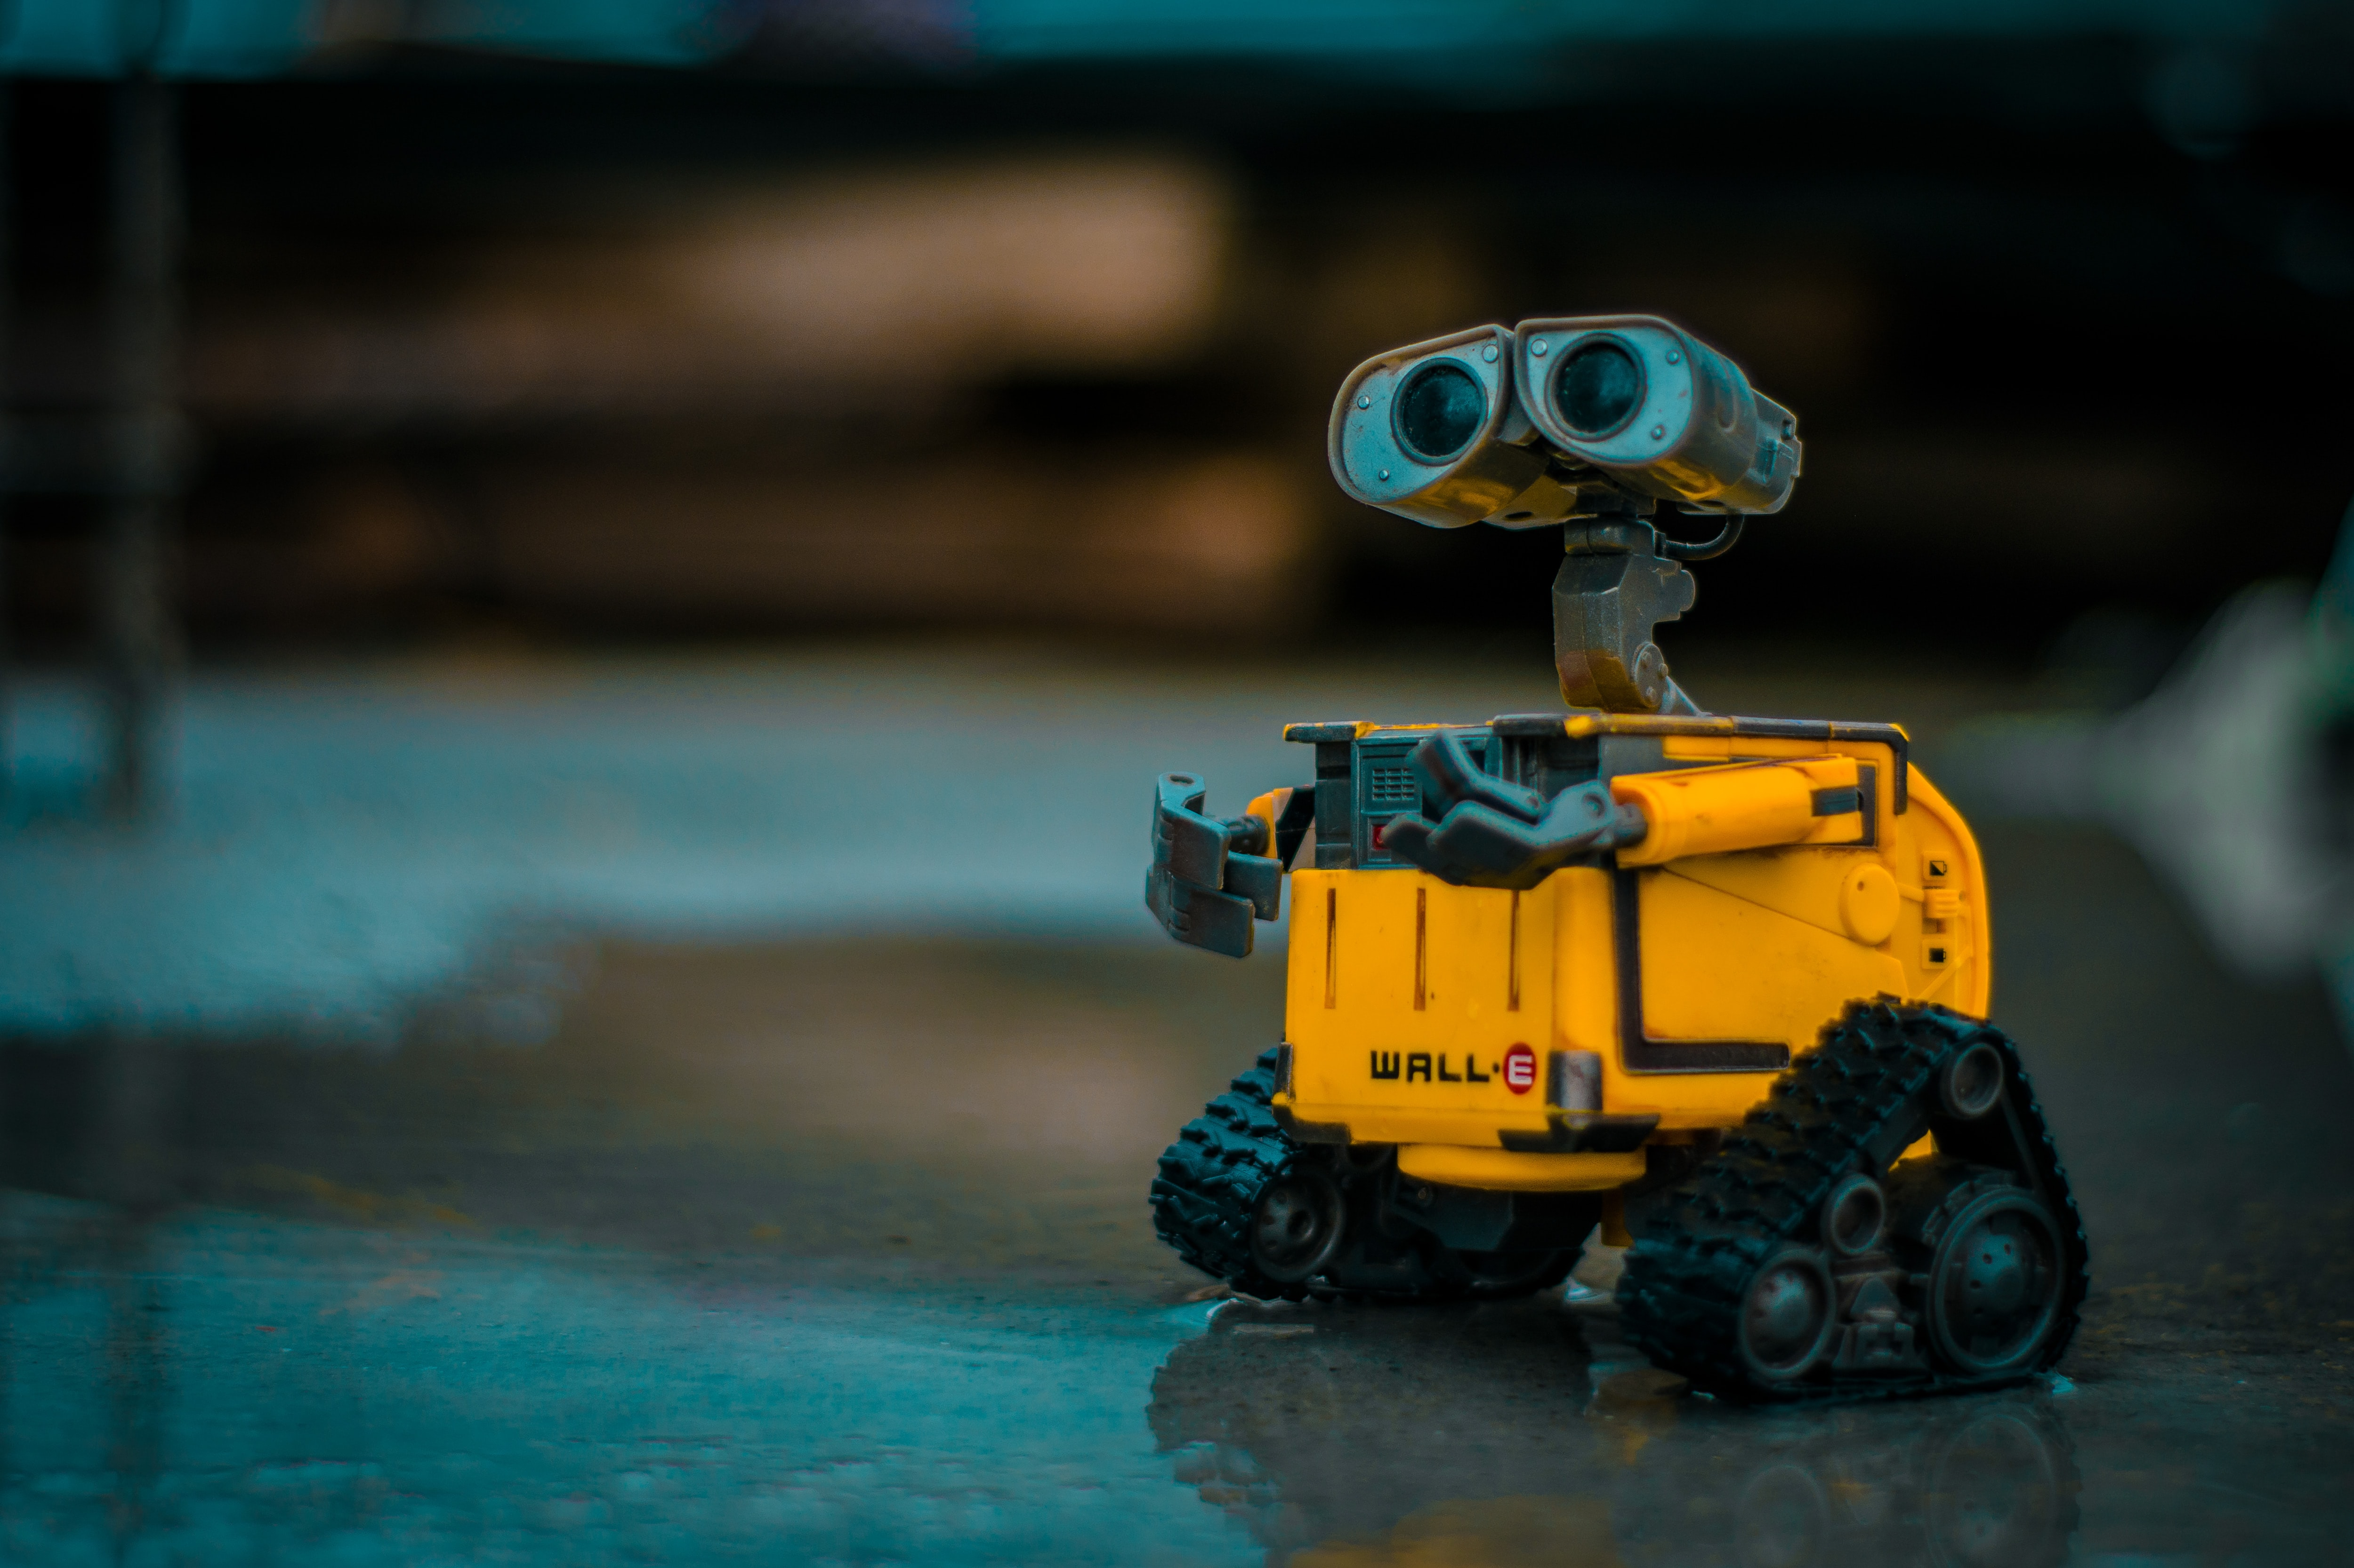
SAFE REINFORCMENT LEARNING
MILESTONE PRESENTATION I
TU Berlin, SESE: Entwurf eingebetteter Systeme 2020

Slide 2
AGENDA
The Idea
The Goal
The Process
The Plan

Slide 3




The Idea: Webots

Slide 4
The Idea: Safe Reinforcement Learning

Slide 5
The Idea: Safe Reinforcement Learning (2)

Slide 6
The Goal

Slide 7
The Process

Slide 8
The Plan: Milestones
4
3
2
1

