Slide 1
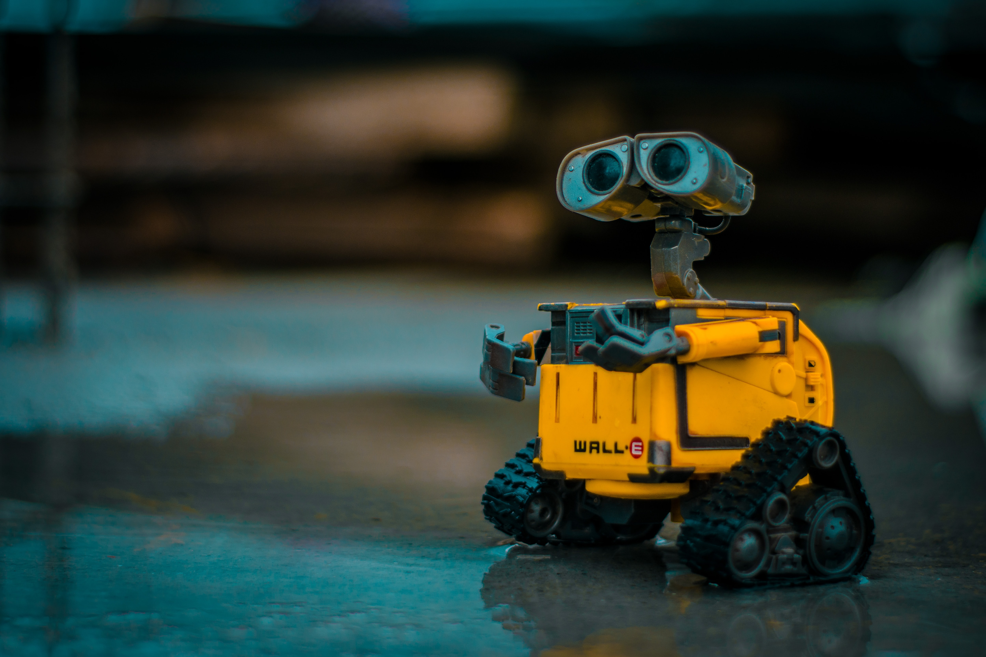
SAFE REINFORCMENT LEARNING
MILESTONE PRESENTATION II
TU Berlin, SESE: Entwurf eingebetteter Systeme 2020

Slide 2










AGENDA
Achieved and future goals
Architecture for automated testing
Environment and RL agent
c1
Fake environment
Quality assurance

Slide 3




Progressreport

Slide 4
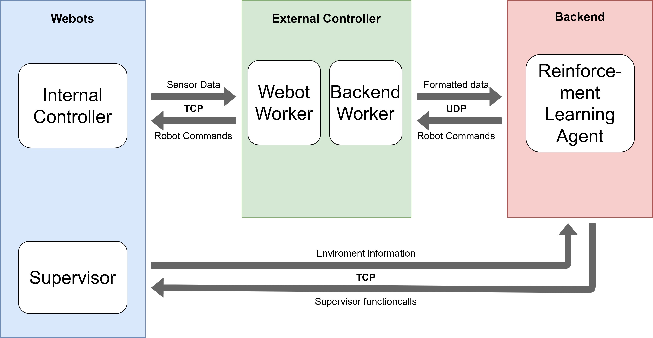

Architecture Overview

Slide 5
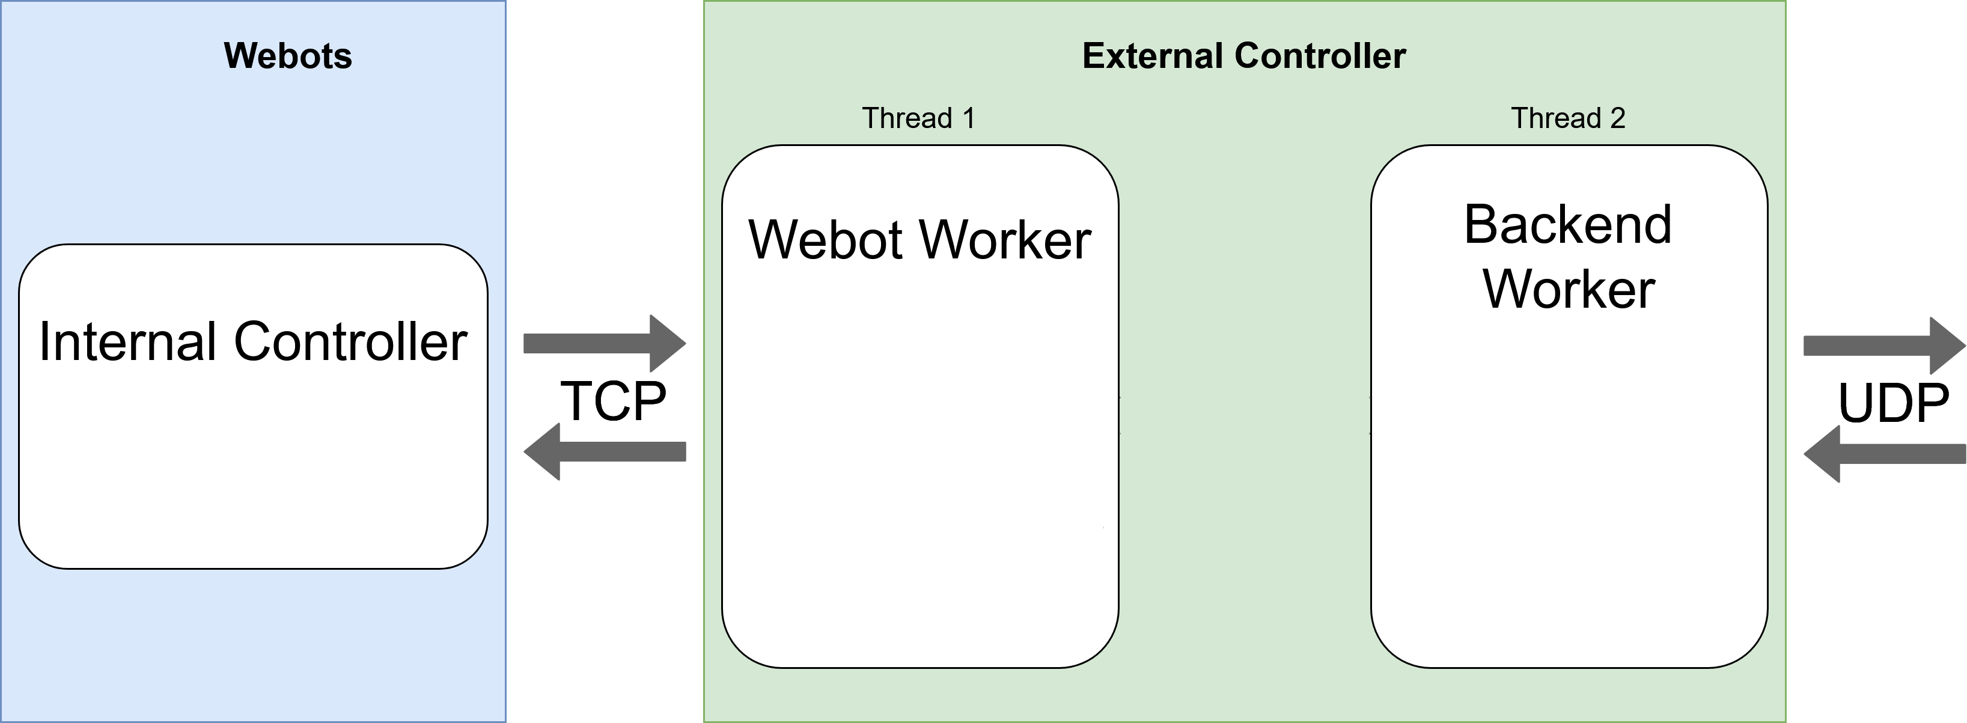
Webot-External Controller Communication (1)

Slide 6
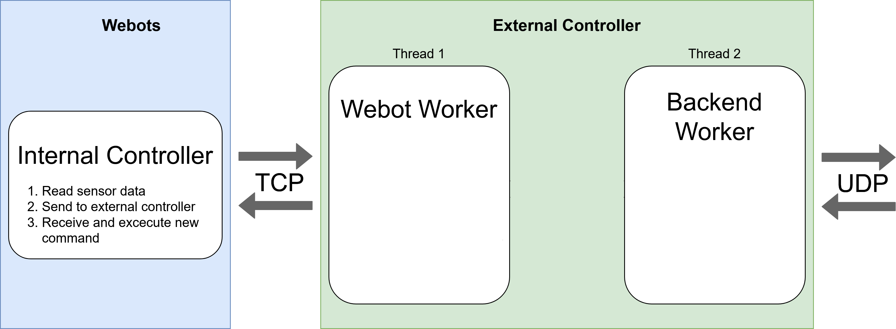
Webot-External Controller Communication (2)

Slide 7
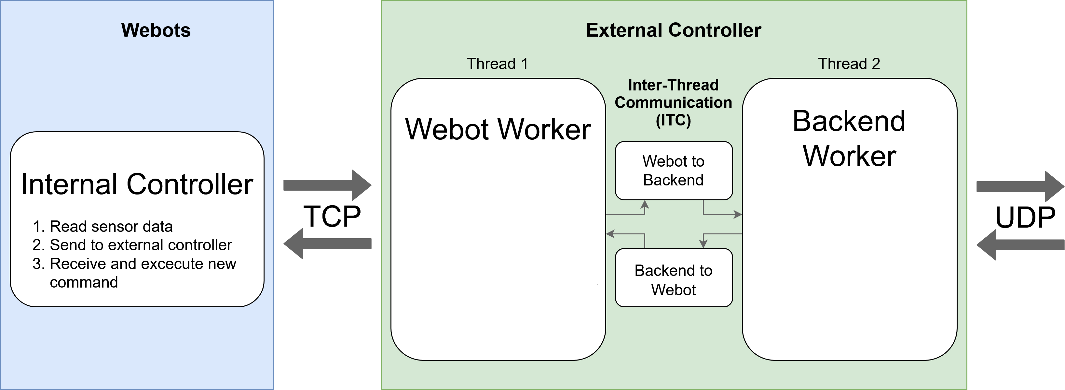
Webot-External Controller Communication (3)

Slide 8
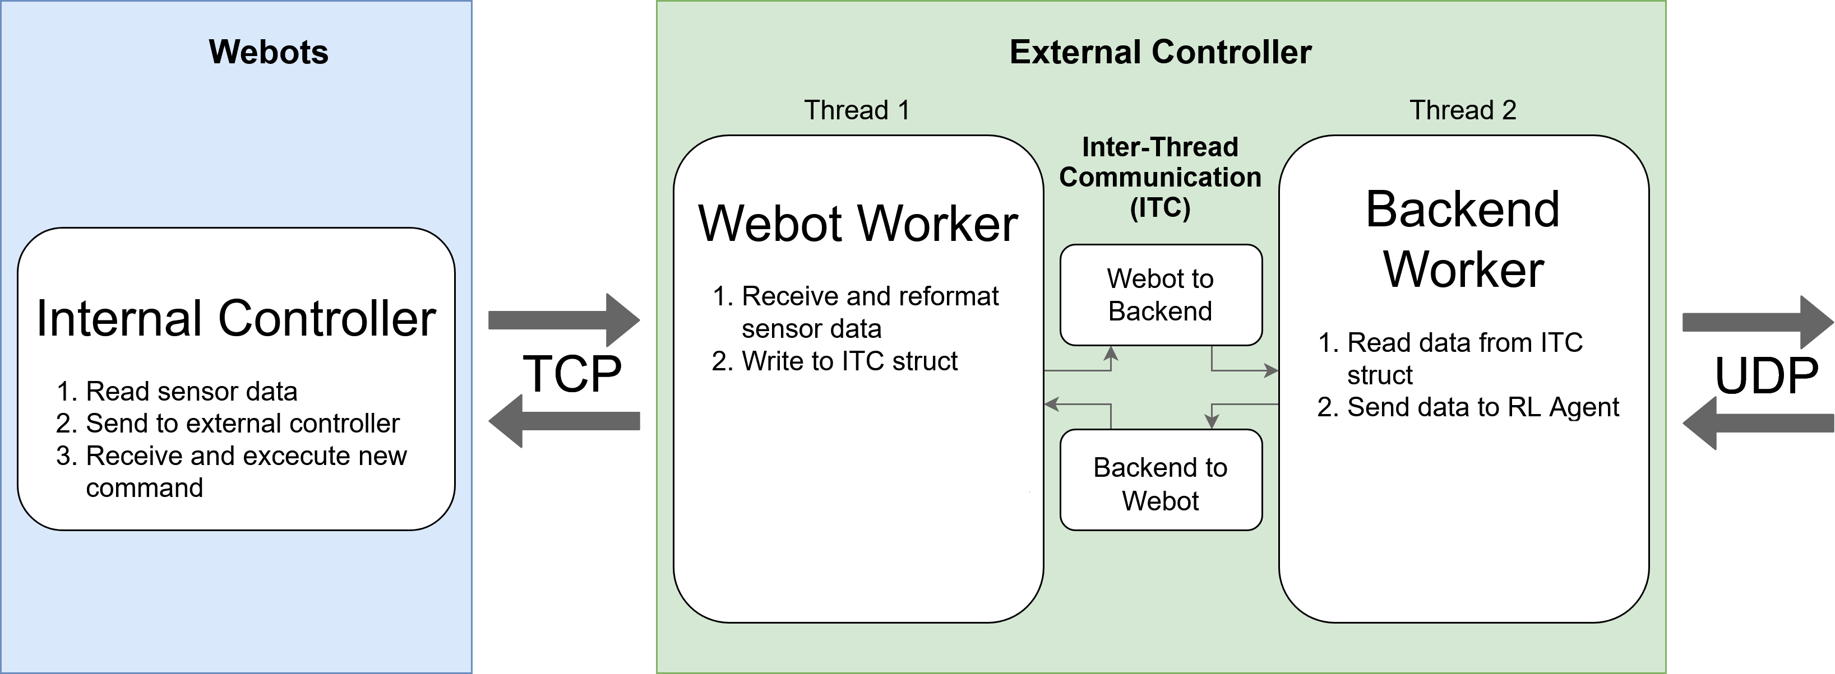
Webot-External Controller Communication (4)

Slide 9
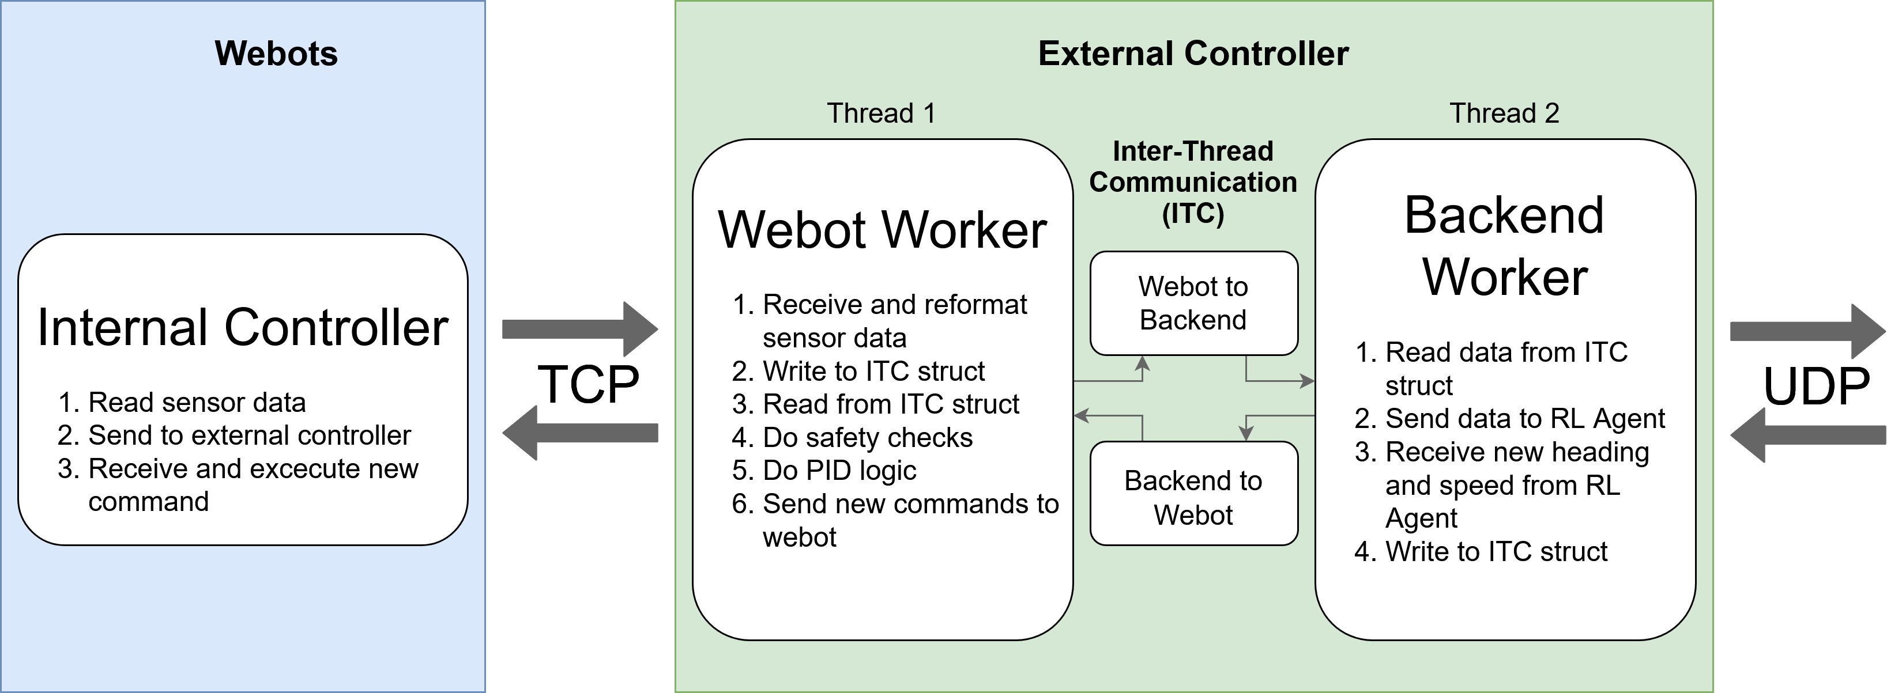
Webot-External Controller Communication (5)

Slide 10
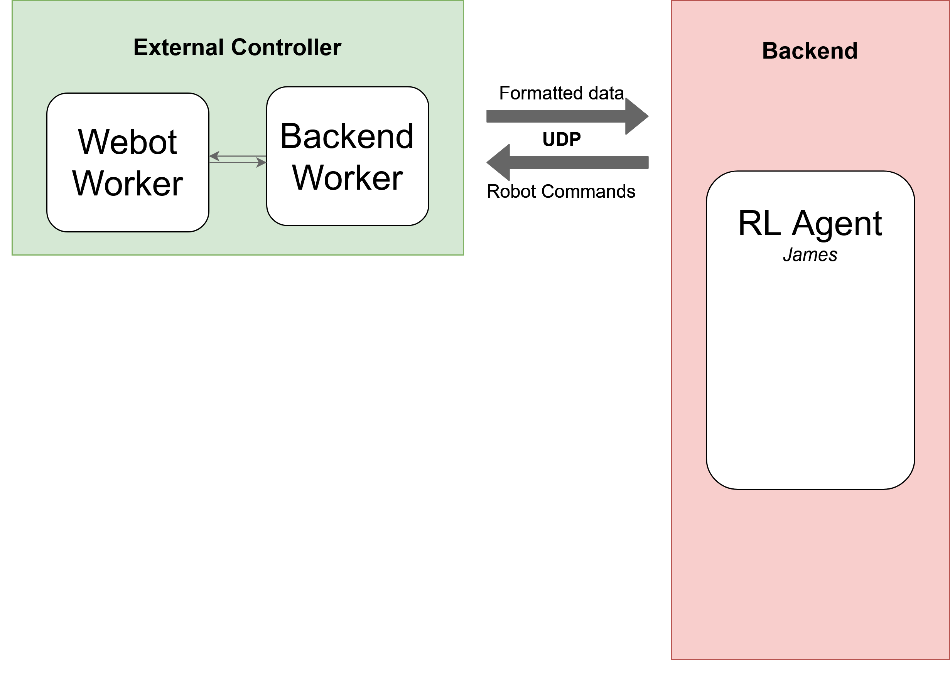
External Controller – Backend communication (1)

Slide 11
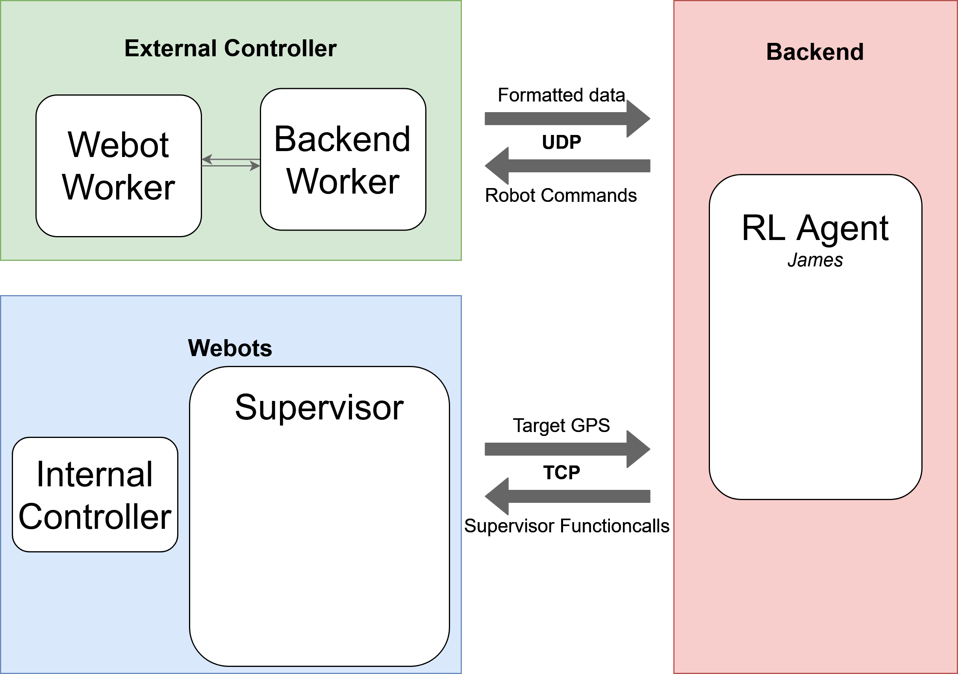
External Controller – Backend communication (2)

Slide 12
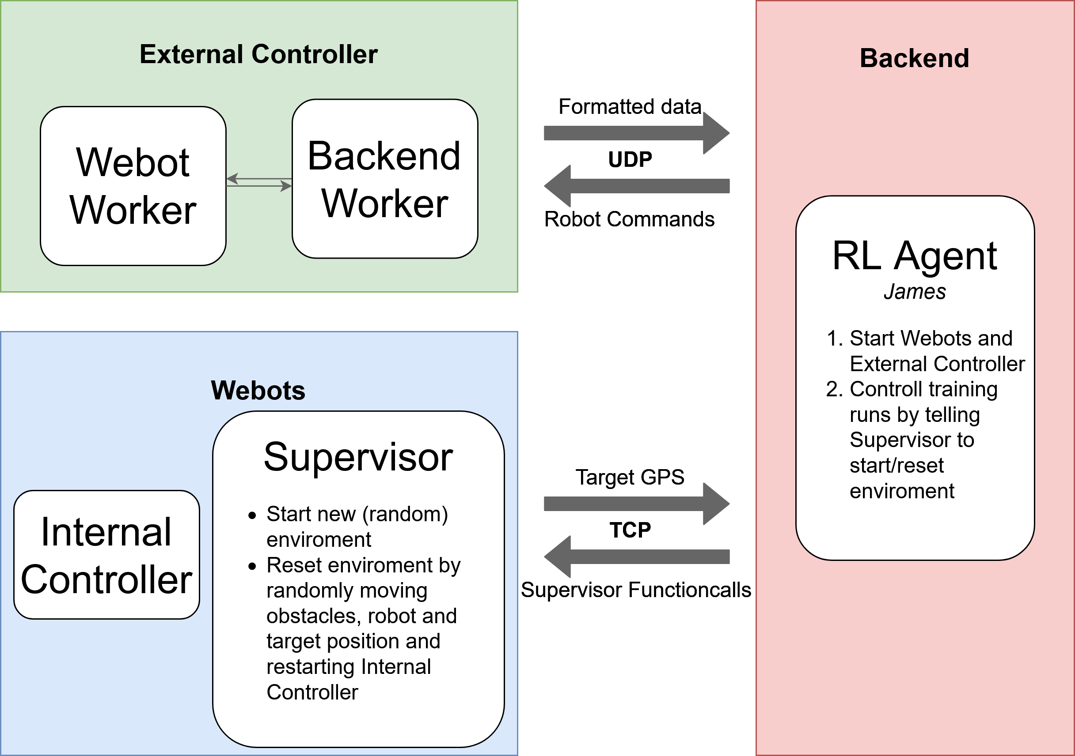
External Controller – Backend communication (3)

Slide 13
Backend
Backend
RL-Agent
Action
Observation/ Reward
Environment
Data from Webots/ Controller
Action Commands

Slide 14
Environment
Why is environment necessary?
to use the RL baselines with custom environments, they need to follow the gym interface
What is the environment?
connection between non-backend part and RL agent, which means wrapped the data from webots/controller into standard form for openAI algorithms
inherits from OpenAI Gym Class
implement the necessary methods, such as init(), step(), reset(), etc.

Slide 15
Environment
Current environment
reset function, used to create a new environment for training
observation function, uses the states from webots to setup an observation to be fed to RL agent
action space, includes speed commends and direction commends
reward class, includes several reward functions
step function, gets the current state from the external controller and sends action back

Slide 16
Environment
Current environment
reset function, used to create a new environment for training
observation function, uses the states from webots to setup an observation to be fed to RL agent
action space, includes speed commends and direction commends
reward class, includes several reward functions
step function, gets the current state from the external controller and sends action back
Goals
test reward function and optimize it
complete automated training
add more info to observation (optional)

Slide 17
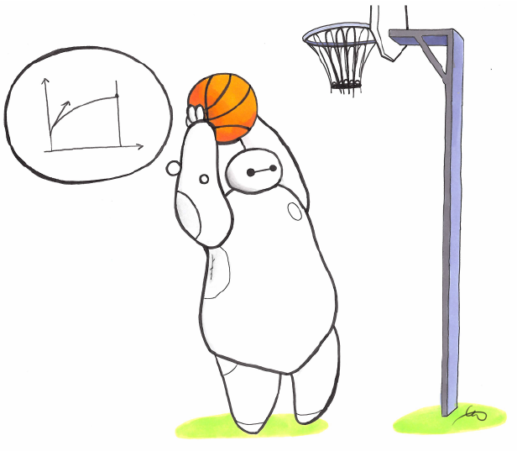
RL Agent
How to implement?
Stable Baselines
What is Stable Baselines
a set of improved implementations of Reinforcement Learning (RL) algorithms based on OpenAI Baselines
Why use it?
do not have to implement all the algorithms by ourself
easier standardization/benchmarking
Process
Parameters setup
Model training
Model testing

Slide 18
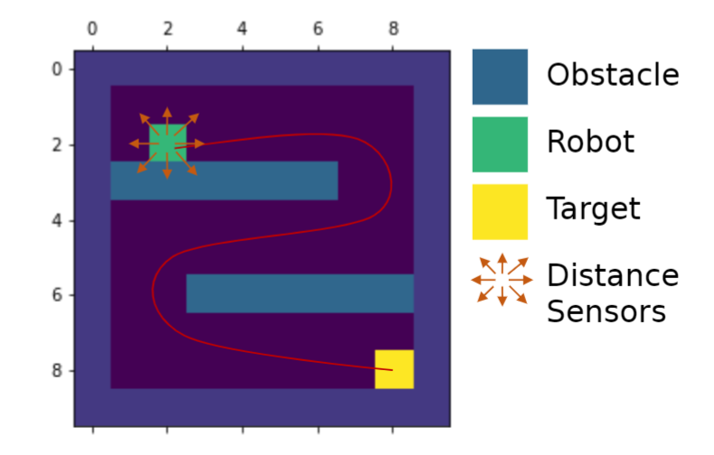
Fake Environment
State space
Current GPS location
Target GPS location
Distance sensors
Touching obstacle
Action space
4 directions(N, E, S, W)
Fixed step size
Reward function

Slide 19
Reward
Time Limit
number of steps or time available in the webots environment
number of requests from backend to controller for observation space
Positive Reward
going closer to the goal
staying away from obstacles
entering the goal
Negative Reward
for each step used to achieve the goal
crashing or hitting an obstacle
get too close to an obstacle

Slide 20
Reward
Time Limits
number of steps or time available in the webots environment
number of requests from backend to controller for observation space
Positive Rewards
going closer to the goal
staying away from obstacles
entering the goal
Negative Rewards
for each step used to achieve the goal
crashing or hitting an obstacle
get too close to an obstacle
Reward
reward_time
reward_distance
reward_goal
reward_obstacle
reward_steps

Slide 21

Quality Assurance: Coding Guideline
C/C++ Coding Guide
follow self-defined coding guidelines, includes naming conventions, file structure, etc.
Python Coding Guide
follow PEP 8 coding guidelines, use Pylint for checking

Slide 22
Quality Assurance: Code Review
Webots/Controller
Backend
Fabian
Wladimir
Jonas
Shanshan
Mats
Per
Rui

Slide 23



Quality Assurance: Automated Testing
Test Framework
Google Test for C/C++
Pytest for python
Automated Testing
Github Action

