Slide 1
project presentation
Fabian Andres Rojas Garcia 67000277
Hugo Arturo Velásquez Albañil 6700305

Slide 2
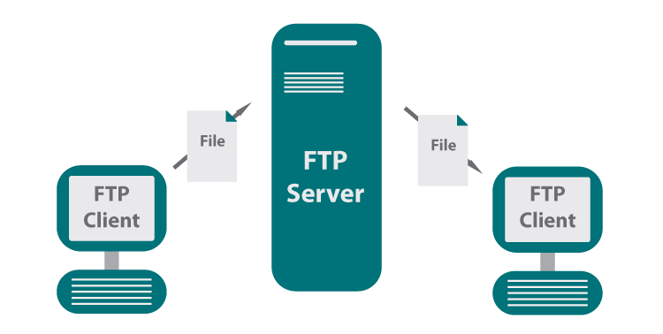

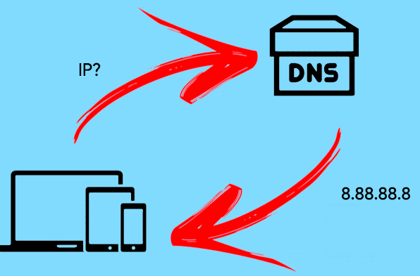


NETWORK SERVICE (1)
NETWORK SERVICE
FTP
is
file transfer
service installed on a machine that provides customers to connect
image 1
[1]
interchange of management information between network devices
to the
is
SNMP
Rfc
image 2
is
protocol operations with leaded to web services
divided
DNS
is
Translate the web address into an ip
image 3
communication between physically dispersed systems.
is
HTTP
image 4
is
synchronizes the clocks through the computer systems
NTP
image 5

Slide 3
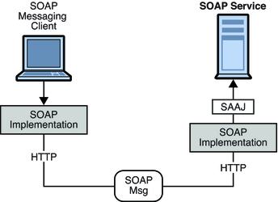
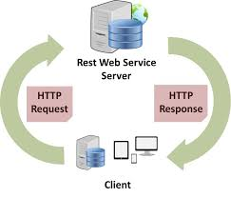
application programming interface (api)(2)
is
interface for application communication and data interaction between them
[2]
consists in
flexibility
simplify design
administration
applications uses
innovation opportunities
token
private
partners
public
focus
develop and integrate software application
grants
authentication data
most used
Local
types
JWT
JSON Web Token
remote
architecture style
Rest
web service
Soap
RESTful
protocol
image 6
image 5

Slide 4
API REST (3)
Api rest
Each resource has an identifier (URI)
Methods
HTTP
Get
Post
Put
Delete
Json
XML
plane text
Formats
[3]
Good
Internship
2XX
3XX
4XX
5XX
Codes
state-run
Security
Test
Document

Slide 5
BAYESIAN NETWORK(4)
bayesian network
probabilistic graphical model
[4]
continuous
dynamic
allows
infinite number of possibilities
contain a random variable at each time interval
discover complex joint distributions
node
arc
conditional probability table
through
directed acyclic graph
simple conditional distributions
uses
correlation
(combined probability)
chain rule
conditional independence

Slide 6
Bibliografía
[1]https://conectabell.com/servicios-red-resumen/
[2] https://www.redhat.com/es/topics/api/what-are-application-programming-interfaces
[3]https://restfulapi.net/
[4] https://www.urosario.edu.co/Administracion/documentos/investigacion/laboratorio/miller_2_3.pdf
image 1.https://blog.ipswitch.com/es/qu%C3%A9-es-el-protocolo-de-transferencia-de-archivos-ftp
image 2.https://elfreneticoinformatico.com/tarbajando-con-mibs-introduccion-snmp-interpretacion-de-oids/
image 3.https://internetpasoapaso.com/servidor-dns-no-responde-solucion/
image 4. https://upanama.e-ducativa.com/archivos/repositorio//6000/6126/html/56_http.htm
image 5.https://medium.com/@ahmetozlu93/mastering-rest-architecture-rest-architecture-details-e47ec659f6bc
image 6. https://docs.oracle.com/cd/E18930_01/html/821-2440/aeqey.html

Slide 7
Thank you

