Slide 1




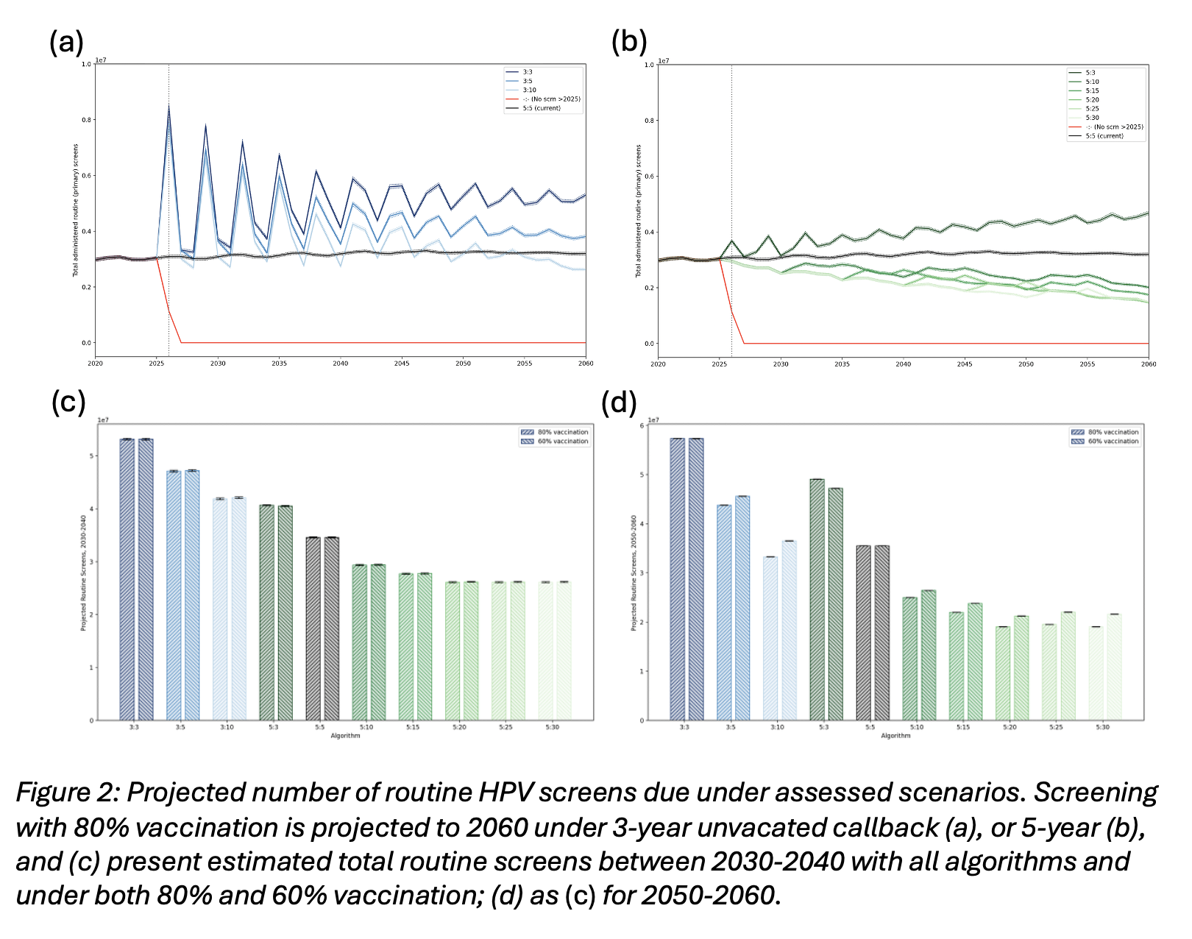
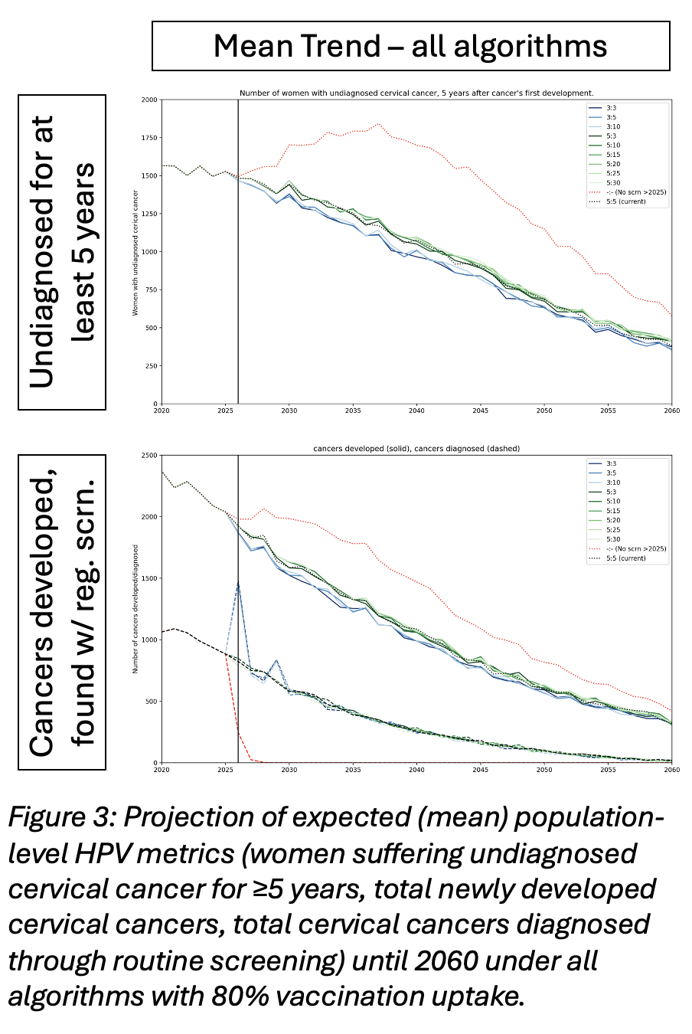
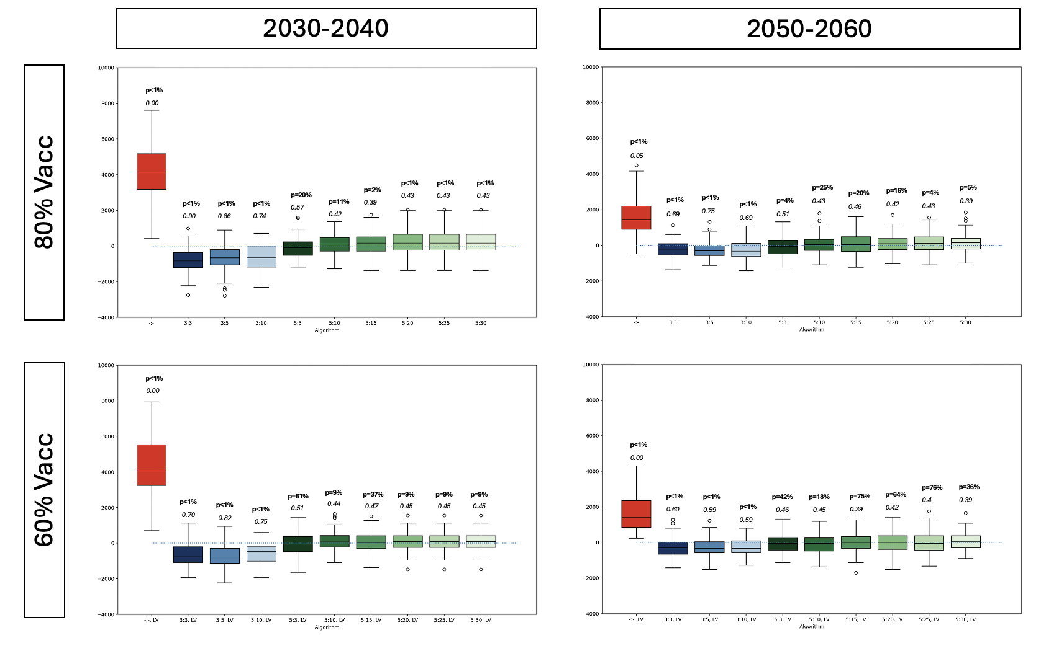
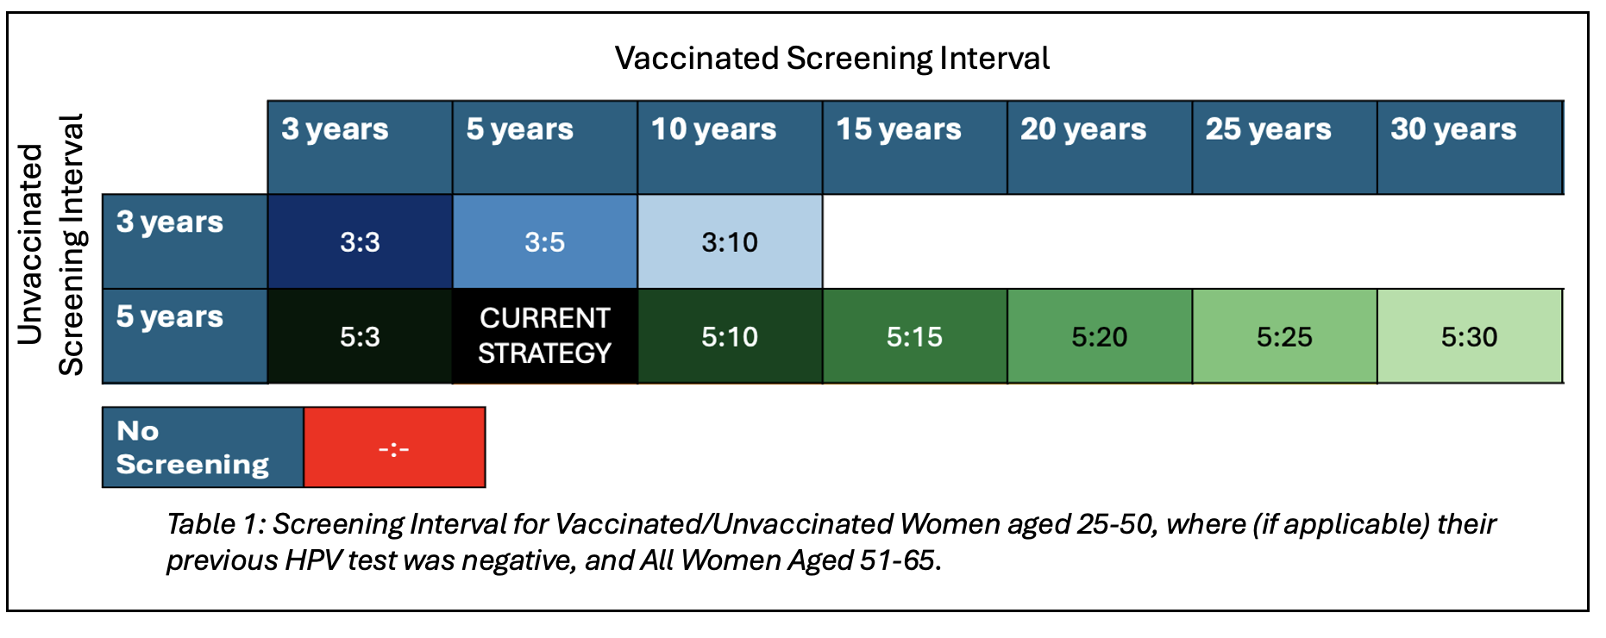
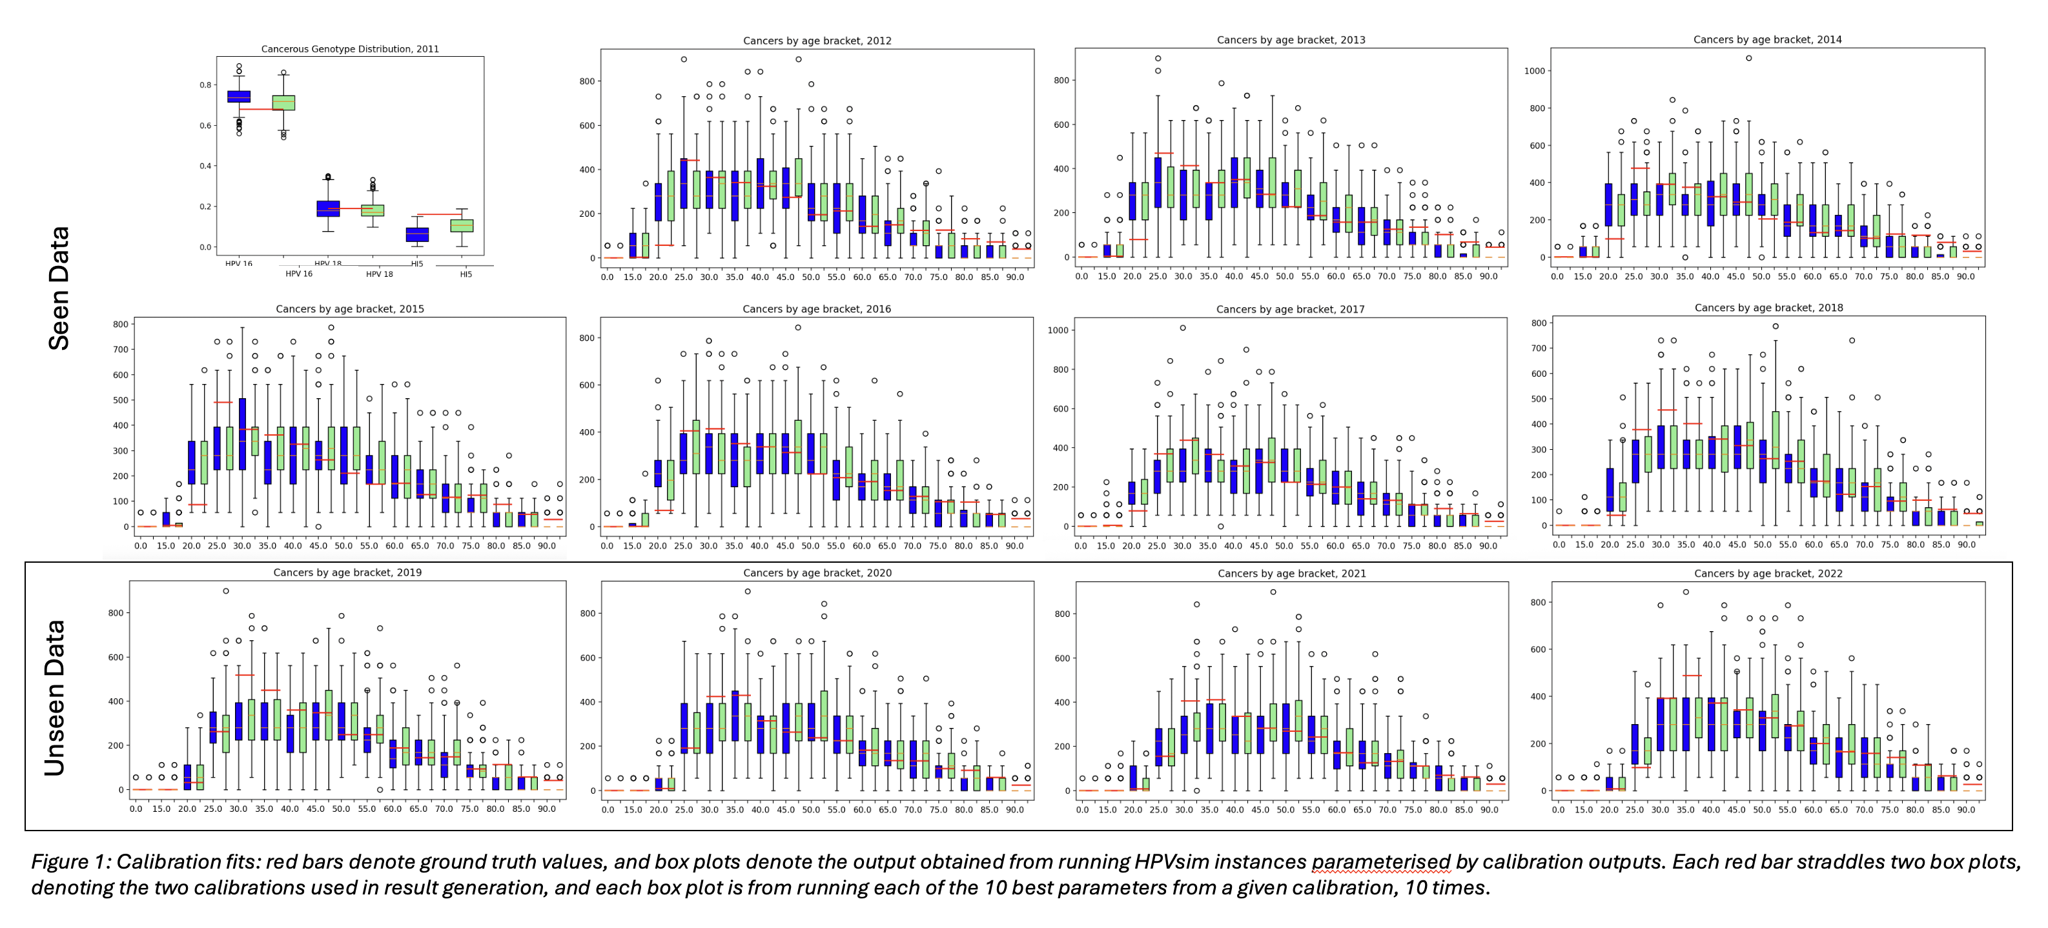
HPV Vaccination Status Should be Considered in Cervical Screening:
A Modelling Study in England
Fabian Sturman¹, Sophie Keenan¹, Kate Soldan², Robyn Stuart³, Jasmina Panovska-Griffiths¹
¹ University of Oxford, UK; ² UK Health Security Agency, London, UK; ³ Institute for Disease Modelling, Gates Foundation, USA
fabian.sturman@st-annes.ox.ac.uk, jasmina.panovska-griffiths@queens.ox.ac.uk
Introduction
Results
Cervical cancer remains a major global health issue, with an estimated 660,000 new cases and 350,000 deaths in 2022. Human Papillomavirus (HPV) is the predominant cause, accounting for c. 95% of cases.
England implemented a centralised cervical screening programme in the 1980s, with regular adjustments to improve effectiveness.
Current screening sees HPV negative (as per last test) women aged 25-65 screened every 5 years for high-risk HPV (hrHPV) genotypes, with follow-up and triage for positive cases.
Screening in England has been highly effective; however, we continue to diagnose thousands of new cases annually, with c. 680 deaths a year in England attributable to the disease (ONS, 2025; NHS England, 2025)
England has implemented nationwide HPV vaccination to children aged 12-13 since 2008, with additional nationwide catchup. The first vaccinated women have started screening, and the proportion of screened women who are vaccinated will continue to increase.
There is some consensus that vaccinated women may be screened less (e.g. every 10,15,or 20) years, with little-to-no effect on cancer metrics, however, these studies have either focussed on fully-vaccinated subpopulations or have considered screening policies which vary based on an individual’s age (‘cohort’), rather than personal vaccination status.
Vaccination uptake have been decreasing, particularly since 2020, and any adjustments to screening must be robust to a range of vaccination levels and be evaluated within a population which is only partially-vaccinated.
We investigate whether there is a benefit to individual-level adjustment of cervical screening interval according to vaccination status.
Methods
We used HPVsim, an Agent Based Model (ABM) of HPV’s transmission and natural history to model the effect of 10 proposed screening algorithms under two vaccination scenarios (80% uptake, the NHS England target, and 60% uptake, the lowest uptake seen historically).
We show that more frequent screening interval (3 compared to 5 years i.e.“3:_” algorithms) for unvaccinated women improves population-level cervical cancer outcomes for both 80% and 60% vaccination scenarios and over the period 2026-2060.
Our results suggest that decreasing the screening interval from 5 to 10 for vaccinated women does not significantly affect population-level cervical cancer outcomes (for a ground truth difference in “mean cancers over 10 years” >400, power >0.95) . This is broadly consistent with existing studies in other population/focussing on fully-vaccinated subpopulations.
All algorithms which increase the screening rate for unvaccinated women from 5-yearly to 3-yearly yield a higher screening burden in the short term. Coupled with a decreased vaccinated screening rate, and with increased vaccination levels over time, by 2050 we see a reduced screening burden for some such algorithms (3:10).
The difference in outcomes between 60% and 80% vaccination levels are subtle but become increasingly prominent over time.
We calibrated and verified HPVsim on cervical cancer diagnoses in England, by age bracket, between 2012 and 2018, and the genotype distribution of positive cervical cancer cases in 2011.
We tested our calibrated model on (unseen) cervical cancer diagnoses from 2019-2022, split by age bracket.
Robustness of results to parameters: we performed two calibrations, and used the 10-best parameters from each calibration to generate our results.
Conclusions
This is the first calibration and application of HPVsim in a High Income Country (HIC), and the first usage of HPVsim including detailed historic vaccination and screening interventions.
Our findings highlight a notable decline in cervical cancers with more frequent screening of unvaccinated women, with screening every 3 years significantly reducing future cervical cancers diagnoses.
The change in the frequency of screening for vaccinated women has very little effect on cervical cancer future outcomes, but screening vaccinated women every 5 or 10 years ensures robustness to uncertain future vaccination levels.
Our findings highlight that adopting a cervical screening strategy which is personalised to vaccination status is beneficial for reducing the future cervical cancer burden, especially in countries like the UK were vaccinated cohorts are increasingly coming to a screening age.

