Slide 1
FabxFit
CAPSTONE PROJECT
Presented By:
1. Fabian Dinesh A-Sri Manakula Vinayagar Engineering College-B.Tech Computer and Communication Engineering

Slide 2
OUTLINE
Problem Statement
Proposed System/Solution
System Development Approach
Algorithm & Deployment
Result (Output Image)
Conclusion
Future Scope
References

Slide 3
Problem Statement
Title: Developing a Personalized Fitness Chatbot Using AI
With the growing focus on health and wellness, individuals often struggle to find consistent guidance tailored to their fitness goals, routines, and limitations. Existing fitness apps can be complex, impersonal, or subscription-based, creating barriers to access. There is a need for an intelligent, conversational, and accessible virtual assistant that can deliver fitness advice, workout plans, and motivational support in real time.

Slide 4
Proposed Solution
The proposed system introduces a Fitness Chatbot – FabxFit, designed to provide personalized workout and wellness guidance using Natural Language Processing (NLP) and AI.
1. User Profile Collection
Collect age, gender, fitness level, goals (e.g., weight loss, strength), available equipment, and health conditions. The chatbot uses this data to personalize workout intensity, duration, and type, ensuring each recommendation is safe, achievable, and aligned with user objectives. Over time, the profile can be updated to reflect changes in lifestyle, preferences, or progress.
2. Intent Recognition
Use NLP to detect user intentions such as "plan my workout", "suggest diet", or "track progress". The system supports multilingual input and informal phrasing, making it accessible to a wider audience. It also learns from past interactions to improve prediction accuracy and can even detect emotional tone to offer motivational or empathetic responses when needed.

Slide 5
Proposed Solution
3. Response Generation
Dynamically generate tailored workout routines, reminders, and health tips using a trained AI model and rules-based logic. Responses are interactive and adaptive—for example, if the user skips a session, the system will adjust the next workout accordingly. Additionally, it can provide daily fitness challenges, gamified goals, and support behavior change with encouraging, habit-forming responses.
4. Interactive UI
Deploy the chatbot on a web or mobile platform for smooth and intuitive user experience. The UI supports chat-style conversations. The design focuses on simplicity, ease of navigation, and maintaining a motivating tone throughout the user journey.
5.Scalability & Integration
The solution is cloud-based, allowing easy scaling to handle large user bases with low latency.

Slide 6
System Approach
NLP & AI Modeling: Watsonx.ai & Granite 3-3-8b-instruct
Development Environment: Watsonx.ai Studio
Deployment: IBM Watsonx.ai runtime
Storage & Hosting: IBM Cloud Object Storage and Watson Machine Learning

Slide 7
Algorithm & Deployment
Intent Classification:
Used NLP pipelines to classify intents like "start workout", "recommend meal", etc.
Recommendation Logic:
Rule-based + ML model (if advanced): Maps user attributes to pre-built workout templates.
Deployment Strategy:
Backend hosted on IBM Cloud
API endpoints created for chatbot interactions

Slide 8
Algorithm & Deployment
Data Input:
User Inputs:
Age,Fitness Goal,,Preferred Workout Duration,Equipment Availability,Existing Health Conditions
Processing:
Input mapped to fitness logic (e.g., yoga for joint issues, HIIT for fat loss)
Chatbot suggests weekly plan, daily exercises, or motivational quotes

Slide 9
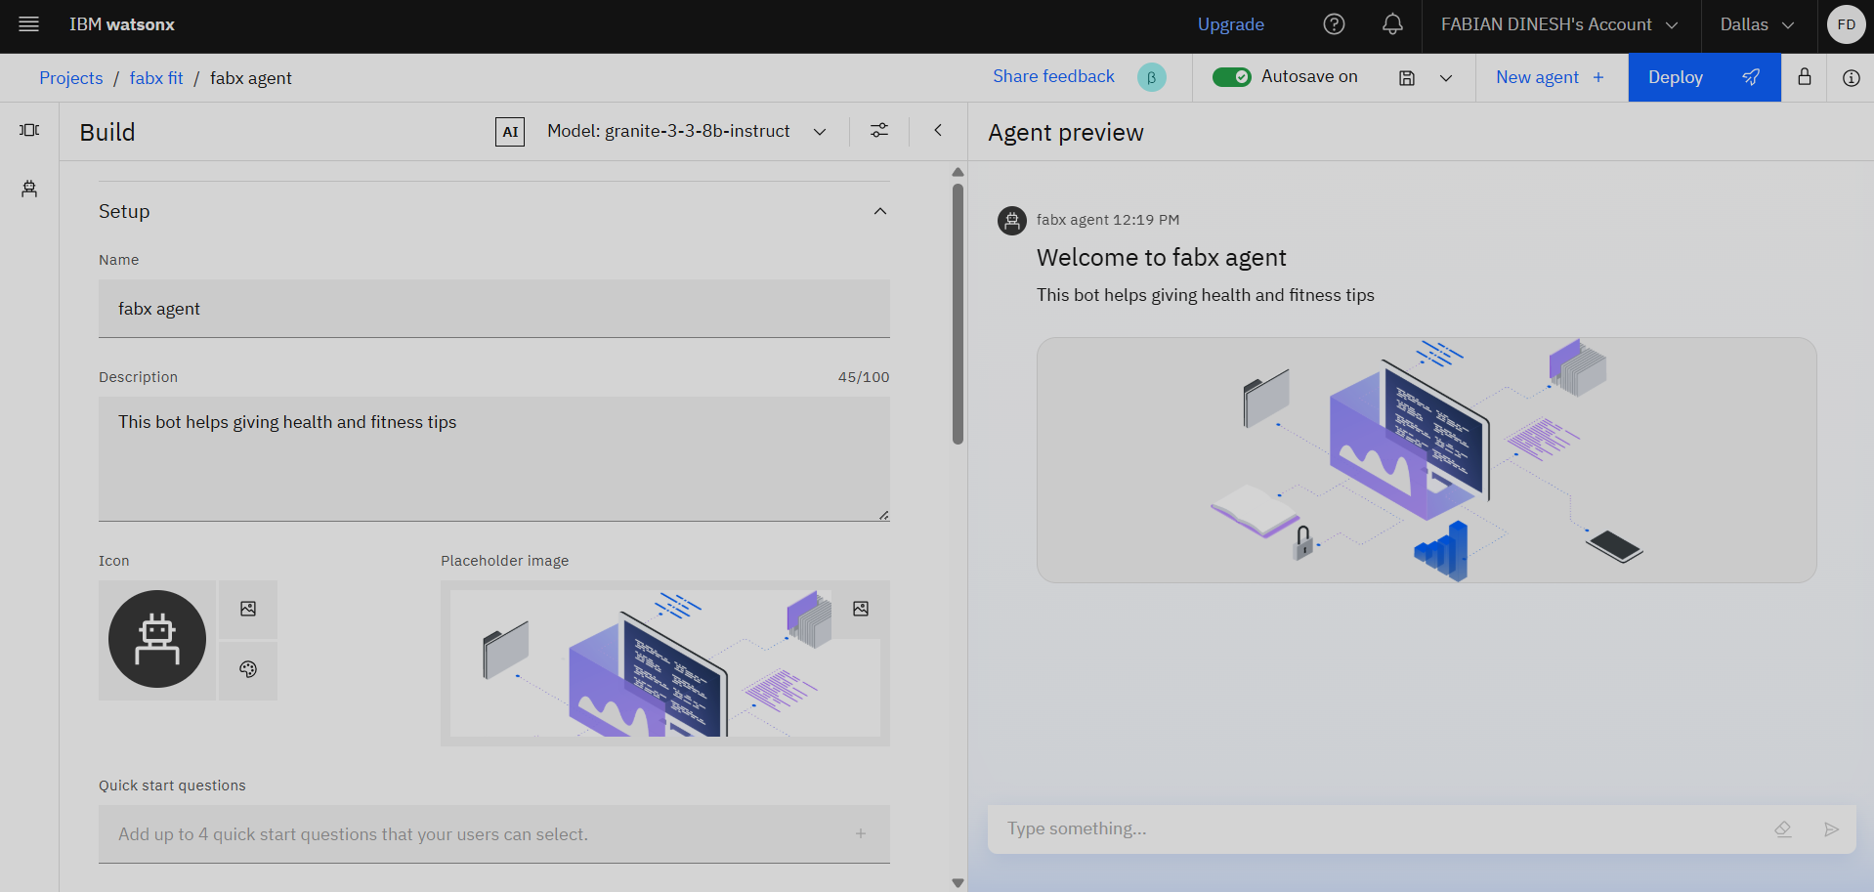
Result

Slide 10
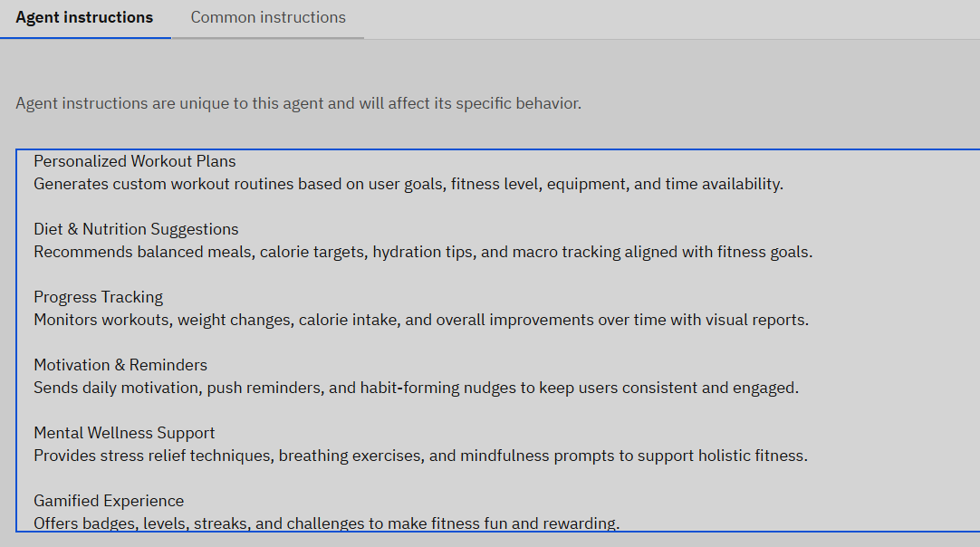
What my agent does?

Slide 11
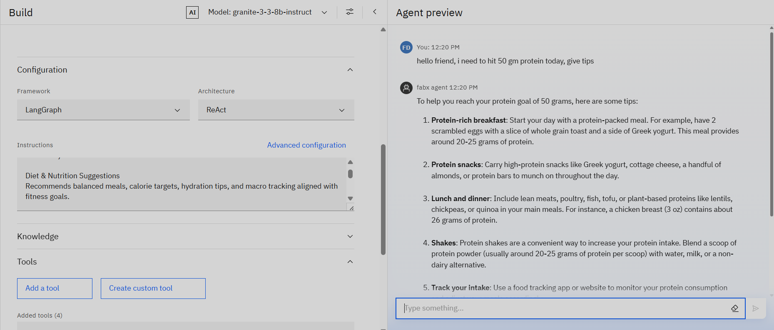
Output 1;

Slide 12
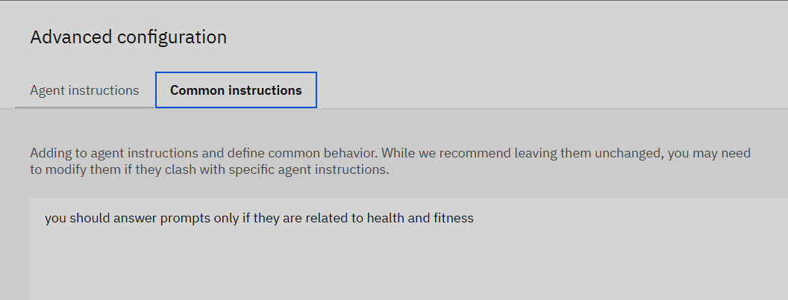
What my agent is not allowed to do?:

Slide 13
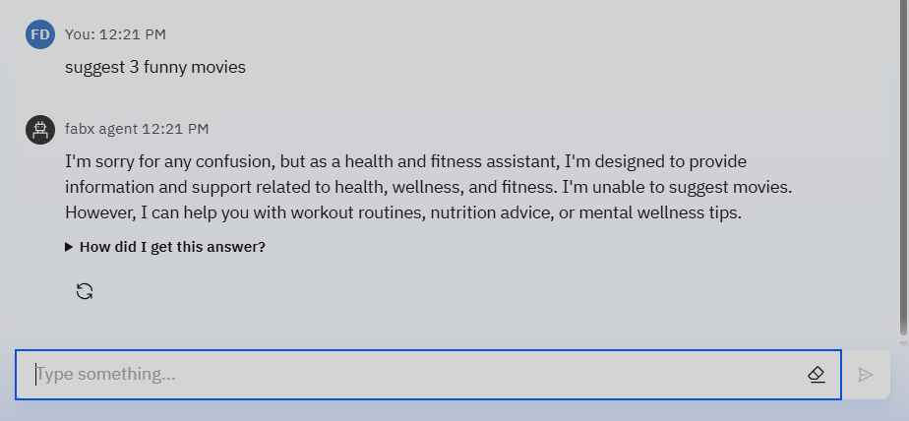
Output 2:

Slide 14
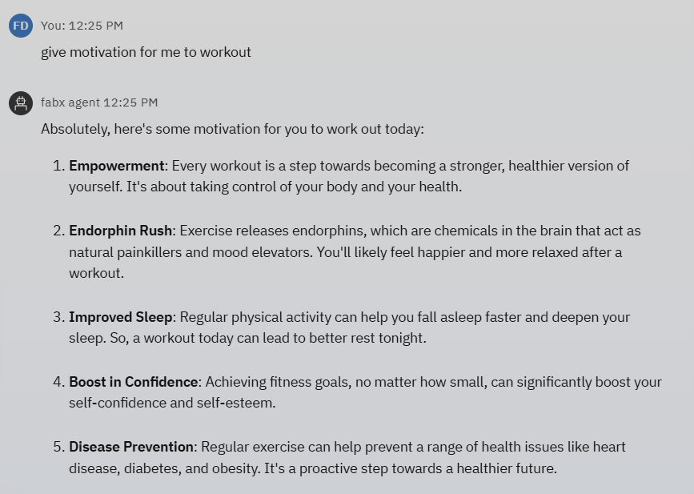
Output 3:

Slide 15
Conclusion
FabxFit proves effective in delivering personalized fitness guidance through a conversational AI approach. It simplifies fitness planning and motivates users through regular, adaptive interactions. With more user feedback and data, the system can be fine-tuned for improved recommendations and broader wellness support.

Slide 16
Future scope
Integrate wearable device data for real-time activity tracking
Add voice-based interaction using speech-to-text
Offer mental health guidance via mindfulness modules
Expand database to include diet/nutrition planning
Implement multi-language support for wider reach
Use reinforcement learning to adapt over time

Slide 17
References
[1] "Conversational AI for Healthcare and Fitness", IBM Developer Docs
[2] “Natural Language Processing with spaCy”, Explosion AI
[3] HuggingFace Transformers Documentation
[4] IBM Watson Assistant & IBM Cloud Lite Docs

Slide 18
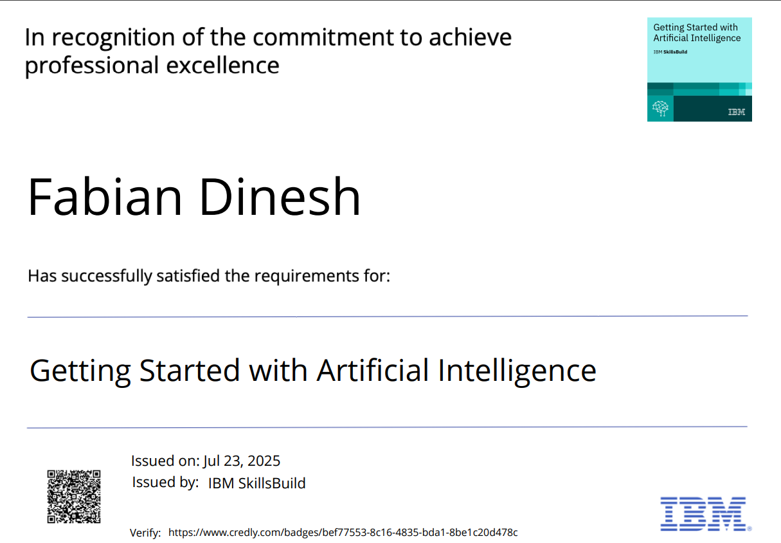
IBM Certifications

Slide 19
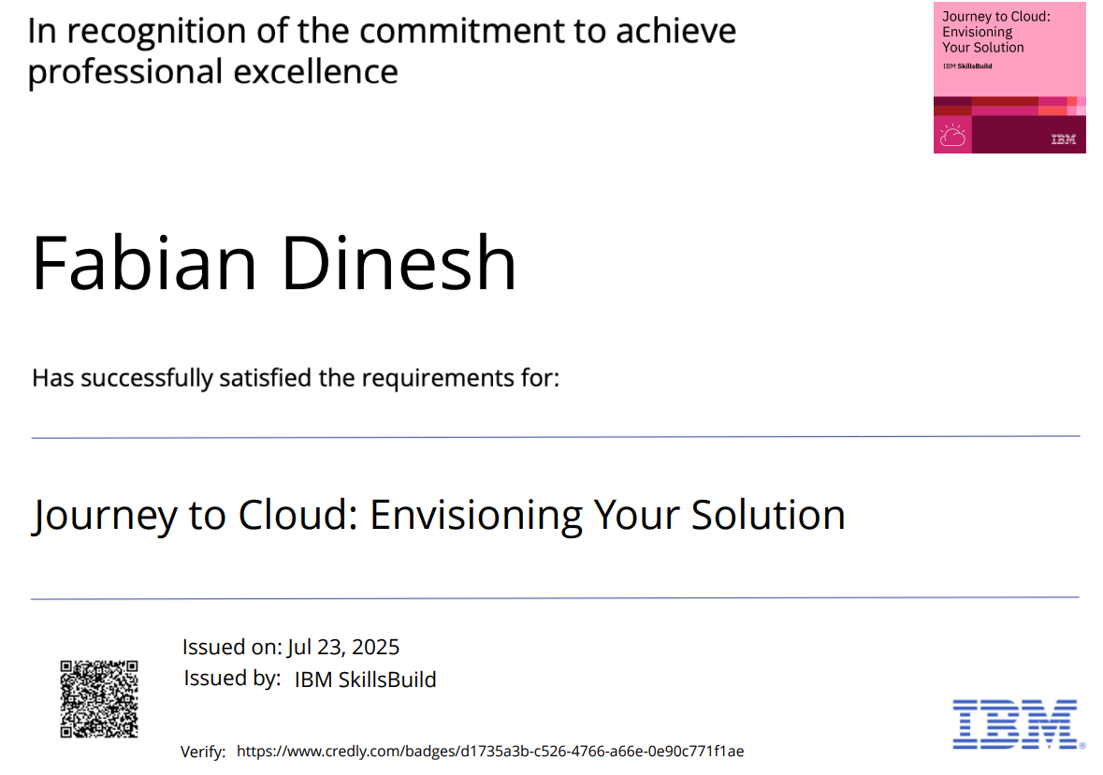
IBM Certifications

Slide 20
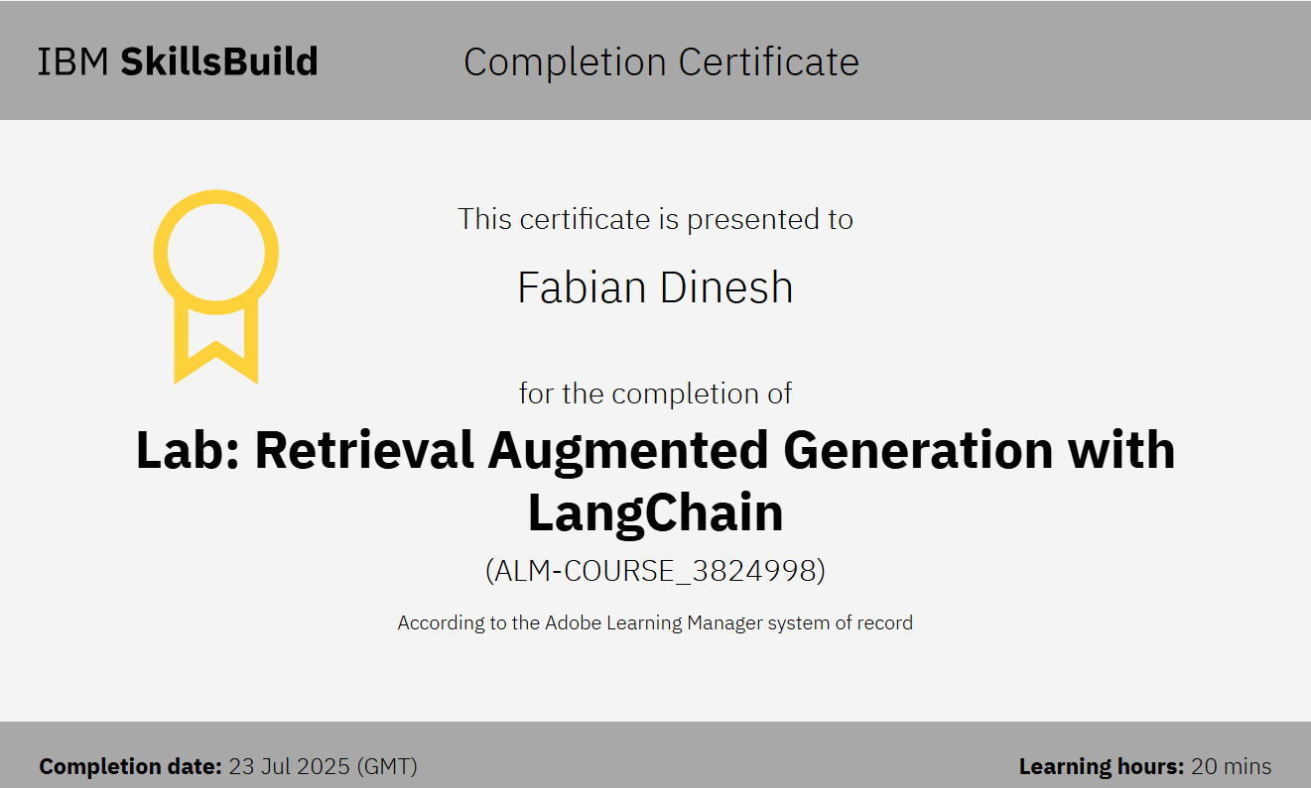
IBM Certifications

Slide 21
THANK YOU

