Slide 1
Opening a new gym in Aventura, Florida
Coursera Capstone Project

Slide 2
Situation:
A group of international investors wants to open up a gym.
They decided they want to work with luxury equipment, targeting a wealthy demographics.
They identified the area of Aventura, Florida as one where the gym is likely to succeed.
However, if they open too close to one competitor (or two), they will not be able to make as much money as they want and will in fact lose all their money and reputation.
We have been hired to minimize the competition the investor group faces by identifying every single nearby gym.

Slide 3
Our Approach:
We will use all of our learnings to come up with a useful solution in helping the investors identify at least one area of opportunity.
For this, we shall use the Foursquare API and obtain all the information of every gym and business center in the neighborhood, as well as in the surroundings.
Once we obtain the data, we will process it, clean it, organize it and present it in a crystal clear way.

Slide 4
What we started with
[{"id": "4bc098c574a9a593a33fd0f6", "name": "Spa at the Point", "location": {"lat": 25.972219619450044, "lng": -80.12583851613633, "labeledLatLngs": [{"label": "display", "lat": 25.972219619450044, "lng": -80.12583851613633}], "distance": 401, "cc": "US", "city": "Miami-Dade County", "state": "FL", "country": "United States", "formattedAddress": ["Miami-Dade County, FL", "United States"]}, "categories": [{"id": "4bf58dd8d48988d1b2941735", "name": "College Gym", "pluralName": "College Gyms", "shortName": "Gym", "icon": {"prefix": "https://ss3.4sqi.net/img/categories_v2/building/gym_", "suffix": ".png"}, "primary": true}], "referralId": "v-1590460302", "hasPerk": false}, {"id": "5b16ba6a98fbfc002cac8e7b", "name": "Winners Training Center", "location": {"address": "18260 Collins Ave", "lat": 25.945491, "lng": -80.122108, "labeledLatLngs": [{"label": "display", "lat": 25.945491, "lng": -80.122108}], "distance": 3288, "postalCode": "33160", "cc": "US", "city": "Sunny Isles Beach", "state": "FL", "country": "United States", "formattedAddress": ["18260 Collins Ave", "Sunny Isles Beach, FL 33160", "United States"]}, "categories": [{"id": "4bf58dd8d48988d175941735", "name": "Gym / Fitness Center", "pluralName": "Gyms or Fitness Centers", "shortName": "Gym / Fitness", "icon": {"prefix": "https://ss3.4sqi.net/img/categories_v2/building/gym_", "suffix": ".png"}, "primary": true}], "referralId": "v-1590460302", "hasPerk": false}, {"id": "4de12d89d4c040523eb72e62", "name“ (….)
*This is actually less than 10% of what we obtained

Slide 5
But, we do clean up well…
 | Name (of establishment) | Lat (Lattitude) | Lng (longitude)
 | Spa at the Point | 25.972220 | -80.125839
 | Acqualina Gym | 25.940874 | -80.120329
 | Empower Lift | 25.918991 | -80.159591
 | Mystic Pointe Tower 600 GYM | 25.952942 | -80.132024
 | Fitness Center At Hyde Resort & Residences | 25.986590 | -80.118515
 | Winners Training Center | 25.945491 | -80.122108
 | Fitnes Center | 25.944984 | -80.120090
 | Radius Gym | 26.012565 | -80.143425
 | Aventura Recreation Center | 25.950026 | -80.135444
 | (And many more)….

Slide 6
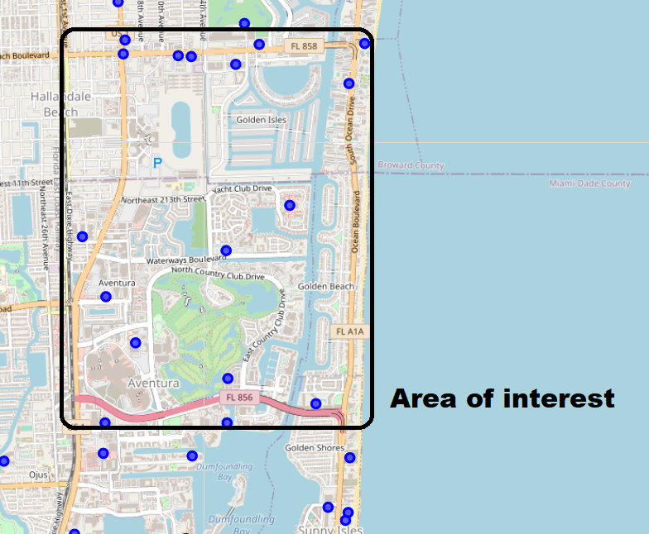
Let’s map it
Tons of gyms in the neighborhood!
Also, ton of water.
…and natural parks.
Where should we build?

Slide 7
The Approach; the shift
After considering multiple resolutions, the approach of maximizing distances from all other gyms seemed like the smartest thing to do. However, geographical limitations come into play:
What if the best spot is in the water?
What if it is inaccessible?
What if it isn’t for sale?

Slide 8
The solution: Burn them all a heat map
Realizing that there is a spectrum of possibility, and also as a way of honoring the local basketball team, the Miami Heat, we decided the best approch was then to construct a Heat Map.
By doing so, instead of coming up with one unique spot, and then another, until we maybe get one that actually Works, we created a ‘hot’ area where most of the gyms are, and area in which new gyms are more likely to flourish.
And it went like this:

Slide 9
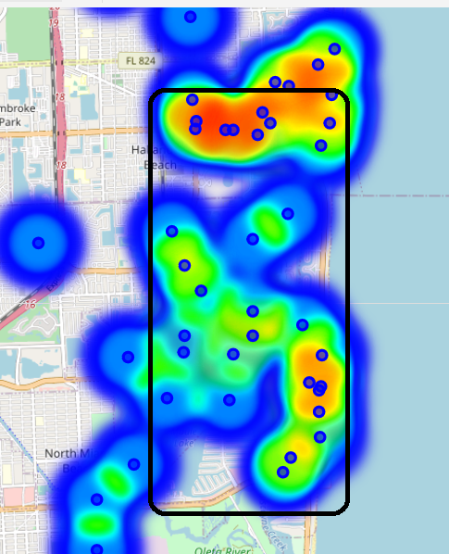
Pretty hot, right?
Most of the map looks pretty hostile towards new gyms.
However, 3 potential locations were identified

Slide 10
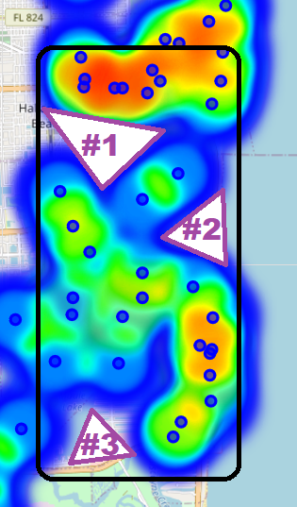
3 different areas, plenty of opportunity
Within our model, we were able to find 3 areas that are currently “gym free”.
Surface-wise, it is pretty clear that most of the neighborhood will prove to be riskier, however we also believe that there could be opportunities in the 3 regions we identified.
Since it is the same neighborhood, there is no data to further segmentate based on income status of the residents in order to help decide between the 3 of them.

Slide 11
Conclusions:
Like any business Endeavor, there are multiple risk factors to consider. Currently, our society is trending towards healthier lifestyles and this can pose a benefit to our investors, if they decide to open.
Although it is true that there are multiple gyms in the same area which could lead to lower prices, it can be also a first-hand account of the demand and success that those businesses represent in this particular area.
For future models, it would be better to adjust the weight given to businesses based on other factors such as membership fee, average customer review, perhaps hours of operations, and more, but we were unable to extract that information from Foursquare.
Although lacking much of the information we would have wanted to have, we can positively use what we obtained in order to advise our investors.

