Slide 1
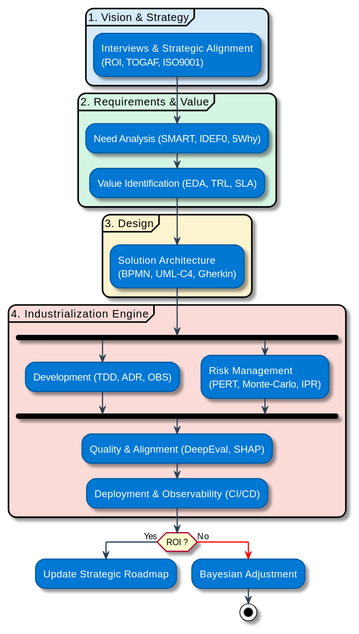
AI TECH LEAD & ArCHITECT
Fabien FURFARO (2026)
Core Mission: Bridging the gap between business ambition and production-grade AI systems.
Tech STACK
(CLOUD & EDGE AGNOSTIC)
Strategic Framing & Vision (Clarify & Identify)
Expert in Industry & Services, I translate complex operational needs into technical reality within highly constrained environments (isolated networks, security mandates). My approach focuses on identifying value and securing the end-to-end lifecycle, deploying industrial-grade solutions such as multi-agent systems and semantic ontologies.
CORE AI: LangGraph, LlamaIndex, Qdrant, vLLM, Ollama, Transformer (ViT), PyTorch, Sklearn.
DATA & ETL: SQLAlchemy, Polars, DuckDB, LanceDB, ArangoDB, Mage-ai, PydanticAI, Unstructured.io.
ROBOTICS & EDGE: Dora-rs, CAN, MQTT.
SECURITY & IAM: LiteLLM, HashiCorp Vault, Keycloak.
OPS & EVAL: SHAP, Arize Phoenix, DeepEval, MLflow, Evidently.
UI & API: Chainlit, FastAPI, React, Marimo.
CI/CD & QUALITY: GitLab CI/CD, Pydantic, SonarQube.
INFRA: Kubernetes (K8s) & Helm, Docker, OpenStack.
SAFETY: Architecture "HIL" & Quantification (MAPIE).
Engineering Excellence & Standardization (Build & Design)
I drive AI industrialization through robust MLOps/LLMOps and scalable architectural design (DAT). Leveraging deep R&D and Industrial expertise, I bridge the gap between research and production, focusing on standardization, real-time execution, and Edge/Hybrid computing. I ensure every solution is built for reliability, security, and seamless integration into complex hardware and software ecosystems.
Domain | Core Competencies & Experience
Tech Skills | Python: 12y (SOLID, TDD) • Data: 10y (ACID, MLOps) • Vision: 5y (DL) • GenAI: 5y (RAG, Agents) • DevOps: 5y (K8s, CI)
Sectors | Science & Research: 5y (PhD) • Industry & Defense: 5y
Methodology | Leadership: 4y • AI Architecture: 3y (IAF/TOGAF) • Lifecycle: 4y (Agile/V-Model)
Technical Leadership & Delivery (Roadmap & Dev)
I provide technical and operational steering for AI projects, ensuring a seamless transition from scoping to production. I manage the complete product lifecycle—from V-Model (Safran, Automotive, etc.) to Agile (Airbus, Thales, etc.)—ensuring technical consistency and mission success for major industrial accounts.
Fabien FURFARO (2026)

Slide 2
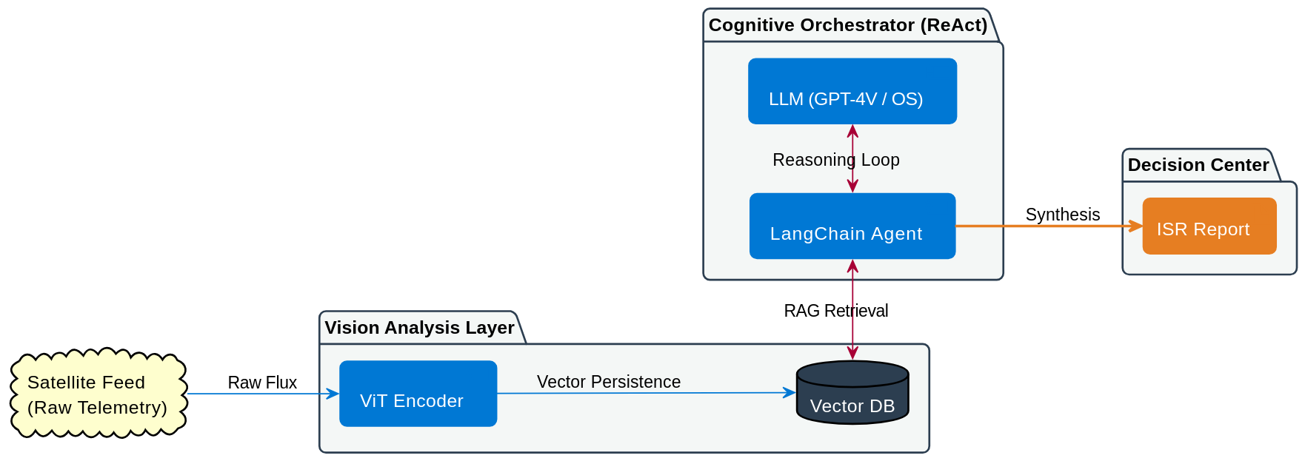
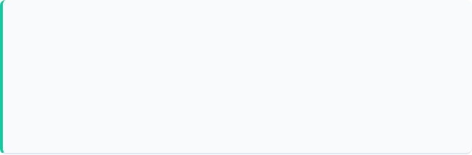
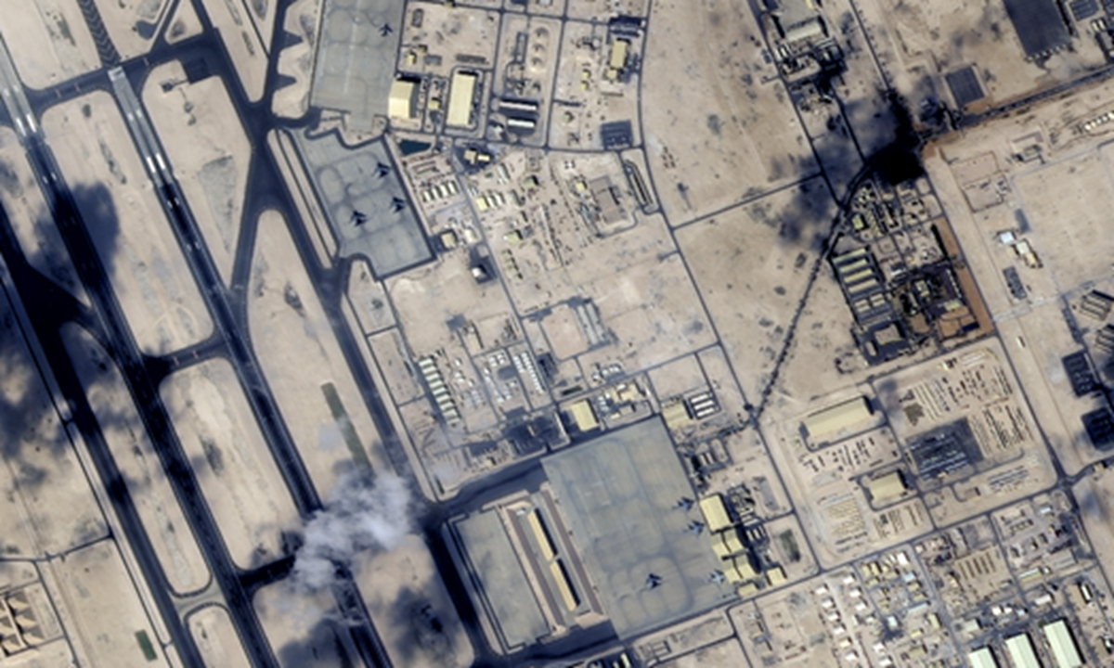
From Imagery to Actionable Intelligence
Fabien FURFARO (2026)
Accelerating satellite data exploitation for faster military decisions (AI Architect - Defense)
Client Context & Problem
Architecture
Asynchronous pipeline utilizing ViT encoders for semantic feature extraction. Persisted vector embeddings enable contextual retrieval, while ReAct agentic loops cross-reference detections with tactical ontologies to synthesize deterministic reports.
High-frequency satellite imagery (IMINT) saturation exceeds manual processing limits. This data-to-intelligence gap creates a bottleneck, resulting in critical decision latency in near-real-time (NRT) cycles.
Why Prioritized
Strategic decision loop compression. Accelerating the transition from raw sensor data to structured intelligence is a prerequisite for maintaining tactical initiative in high-intensity environments.
Solution & Rationale
Asynchronous pipeline using ViT encoders for semantic feature extraction. ReAct agentic loops cross-reference detections with tactical knowledge bases via vector search to synthesize reports.
Value / KPI
Demonstrated reduction in report latency and a increase in operational throughput per analyst.
Investment
2-month scoping and project launch phase. Focused on automated report generation and architectural alignment.
Technologies
Multimodal LLMs (GPT-4V / Apache 2.0 OS), LangChain, Python, Gitlab CI/CD, Vector DB.
Fabien FURFARO (2026)

Slide 3
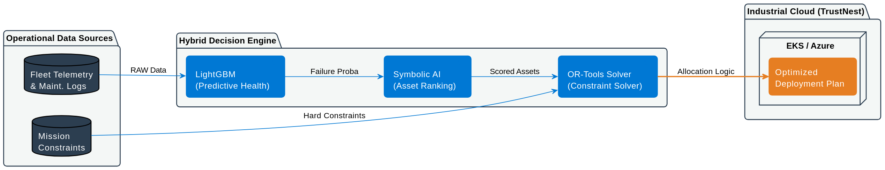
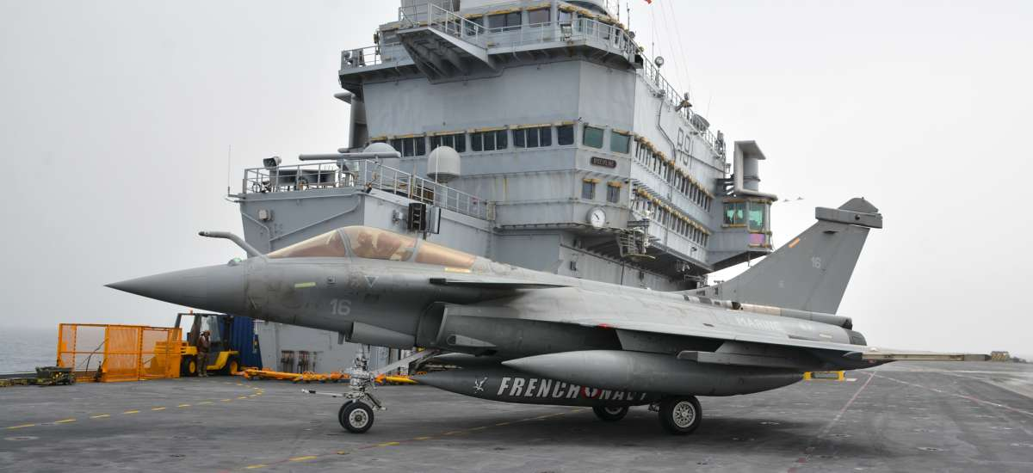
Optimizing MISSION Logistics Decisions
Fabien FURFARO (2026)
AI-driven allocation under complex operational constraints (AI Tech Lead - Defense)
Client Context & Problem
Architecture
Ingestion of operational data processed by LightGBM for predictive failure modeling. OR-Tools solve for optimal asset ranking and spare part inventory right-sizing based on mission-specific parameters.
High-intensity fleet mobility exceeds manual logistical planning capacity. Resource allocation (spare parts, maintenance) under unstable constraints results in sub-optimal mission readiness.
Why Prioritized
Strategic Paris Air Show showcase. Demonstrating operational superiority through "right stocks, right place, right time" optimization and a reduced logistical footprint while maximizing fleet availability.
Solution & Rationale
Operations Research (OR) + ML framework. OR-Tools manage deterministic constraints and rules-driven allocation, while ML/Deep Learning models handle predictive maintenance and failure detection.
Value / KPI
Reduction in logistical costs and automated calculation of mission success probabilities.
Investment
6 months | Industrialization focused on high-resilience and "TrustNest Restricted" deployment.
Technologies
OR-Tools, LightGBM, Symbolic AI (Expert), Azure, EKS (Kubernetes), Gitlab CI.
Fabien FURFARO (2026)

Slide 4
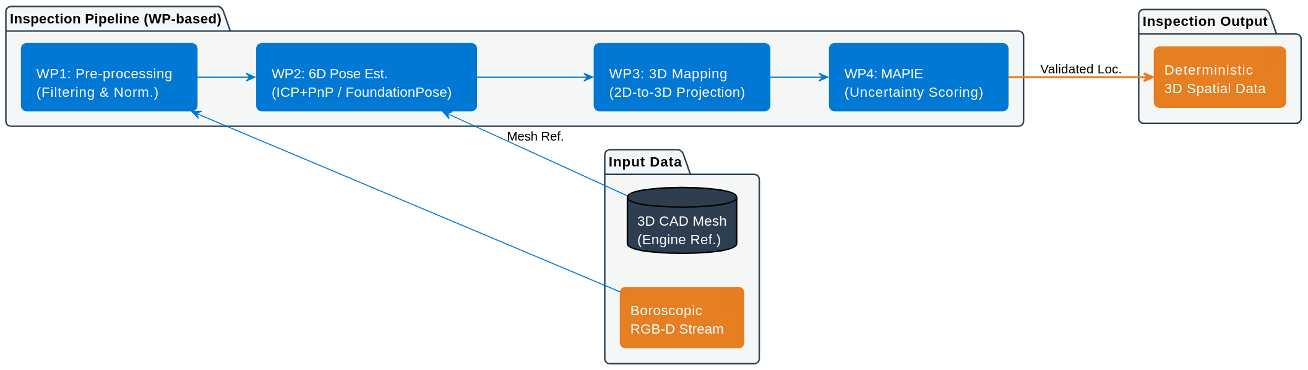
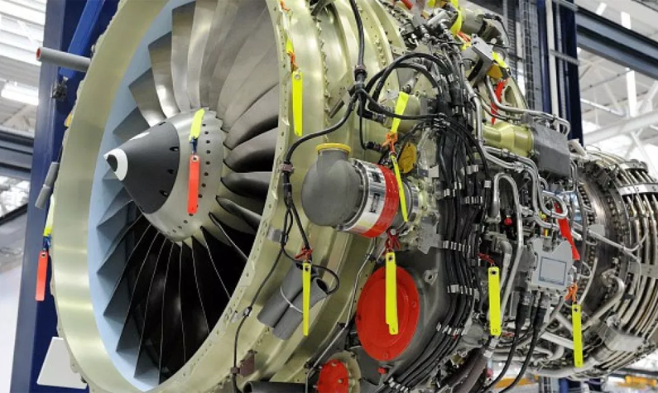
Spatial Localization of Blade Defects
Fabien FURFARO (2026)
3D-to-2D registration for automated engine inspection (AI Tech Lead & Architect - Aerospace)
Client Context & Problem
Architecture
Modular 4-Work Package (WP) structure. The pipeline estimates the camera pose relative to the mesh and projects 2D pixels into 3D space, followed by a statistical validation layer.
Boroscopic images exhibit high perspective distortion, preventing accurate mapping of 2D detections to 3D CAD models. Manual localization is insufficient for precise structural integrity assessment.
Why Prioritized
Required for high-fidelity damage tracking. Determining exact 3D coordinates is mandatory to monitor defect evolution and validate repair tolerances in turbine blade lifecycles.
Solution & Rationale
3D-to-2D registration PoC using boroscopic RGB-D data. Evaluation of Geometric (ICP + PnP) vs. Neural (FoundationPose) pipelines. Integration of MAPIE to provide rigorous uncertainty quantification for the estimated 6D pose.
Value / KPI
Millimeter-level localization accuracy with quantified confidence intervals. Transition from qualitative checks to deterministic 3D spatial data.
Investment
4-month PoC | 4 Work Packages.
Technologies
FoundationPose, ICP, PnP, MAPIE, PyTorch3D, Trimesh, Open3D.
Fabien FURFARO (2026)

Slide 5
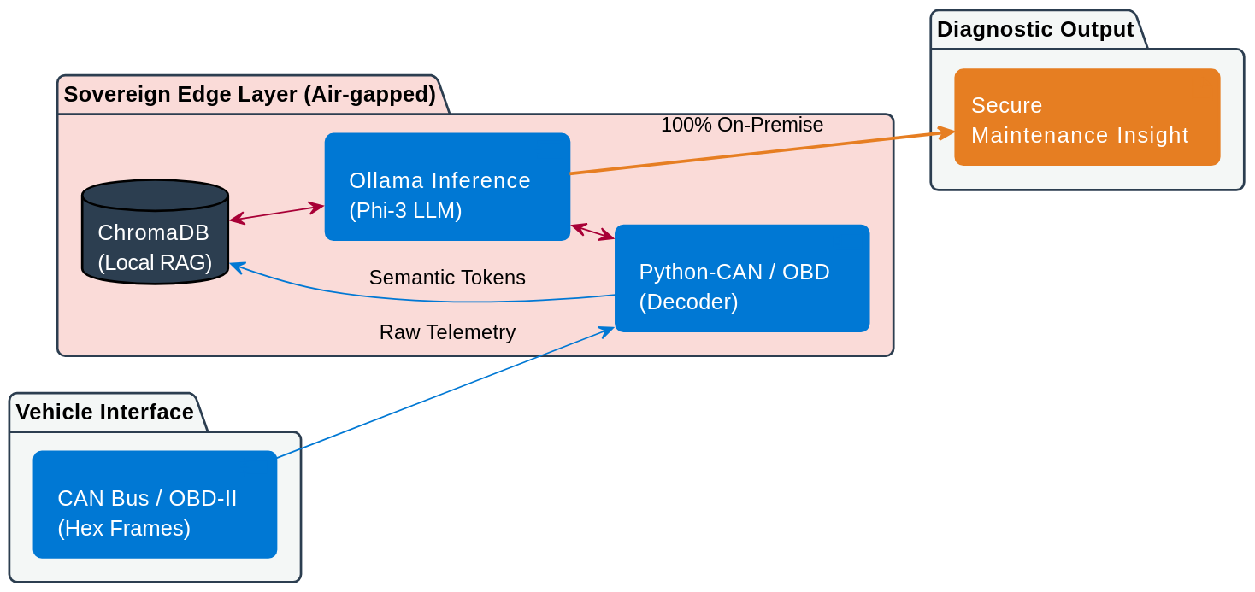
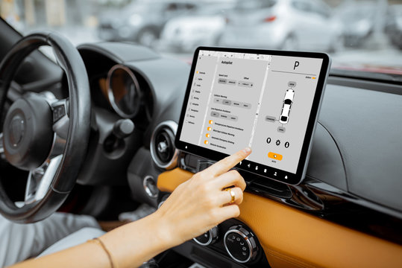
Sovereign Edge AI for Vehicle Diagnostics
Fabien FURFARO (2026)
Secure LLM deployment for confidential automotive data (AI Project Leader - Automotive)
Client Context & Problem
Architecture
Real-time ingestion of CAN/OBD frames via a Python-CAN and OBD parser. Data is indexed in ChromaDB for local RAG, allowing the model to perform diagnostic inference without external connectivity.
Automated interpretation of multi-protocol vehicle telemetry (CAN / OBD-II) under strict confidentiality. Cloud-based analysis is prohibited due to industrial IP risks and data privacy mandates.
Why Prioritized
Absolute Digital Sovereignty. Secure, air-gapped diagnostic capabilities are required for sensitive industrial missions where zero cloud access is permitted.
Solution & Rationale
Local LLM deployment using Ollama/Phi-3. A hybrid decoding pipeline translates raw hexadecimal frames and OBD-II PID codes into semantic tokens for privacy-preserving reasoning.
Value / KPI
Real-time vehicle diagnostics with 100% on-premise execution, securing industrial opportunities in highly restricted environments.
Investment
5 months | Edge AI.
Technologies
Ollama, Phi-3, ChromaDB, Python-CAN, Python-OBD, FastAPI, Docker.
Fabien FURFARO (2026)

Slide 6
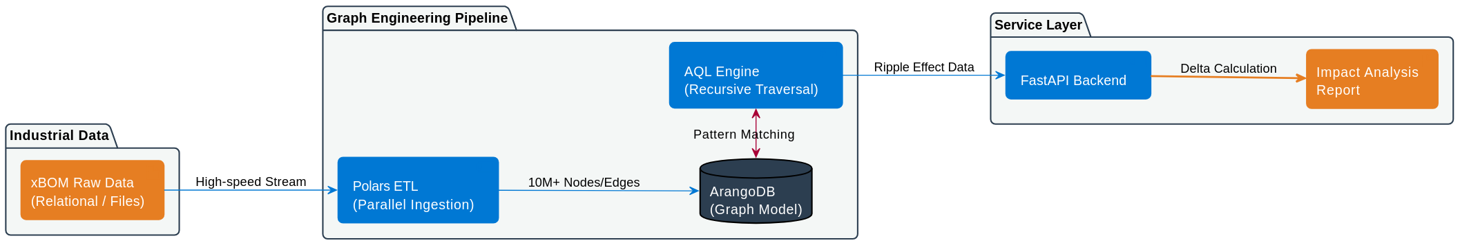
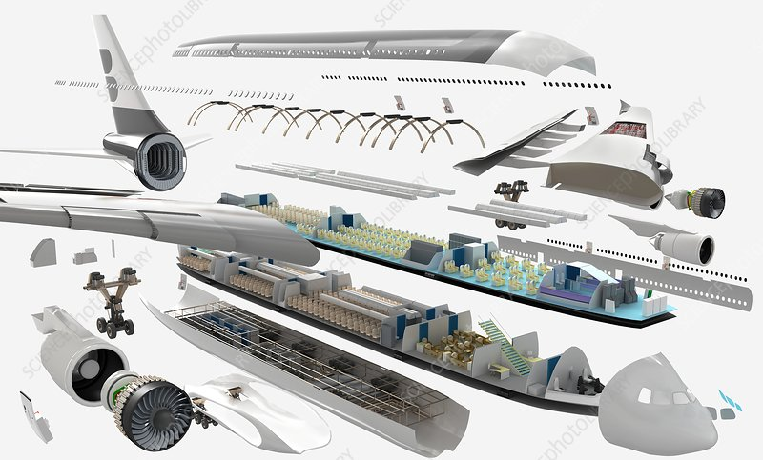
Scaling Industrial Impact Analysis with Graphs
Fabien FURFARO (2026)
Managing complex dependencies at production scale (AI Architect – Aerospace)
Client Context & Problem
Architecture
High-speed ingestion of xBOM data via Polars for parallelized ETL. Data is modeled into ArangoDB, where AQL (ArangoDB Query Language) performs recursive impact analysis, served via a FastAPI backend.
Change impact analysis across multiple Bills of Materials (xBOM) is hindered by rigid relational database structures. Navigating deep recursive dependencies (10M+ nodes) causes significant performance bottlenecks.
Why Prioritized
Risk of production line blockage. Rapidly calculating the ripple effect of a technical change is critical to maintaining industrial flow and preventing costly configuration errors.
Solution & Rationale
Migration to a Graph Database (ArangoDB) model. This natively handles complex industrial ontologies and many-to-many relationships, enabling real-time traversal of massive dependency trees.
Value / KPI
Full automation of configuration delta calculations and reduction in manual cross-referencing errors.
Investment
5-month development cycle | High-scale Data Engineering.
Technologies
ArangoDB, Polars, FastAPI, Docker, AQL.
Fabien FURFARO (2026)

Slide 7
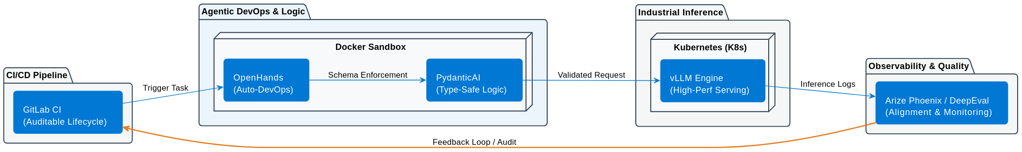
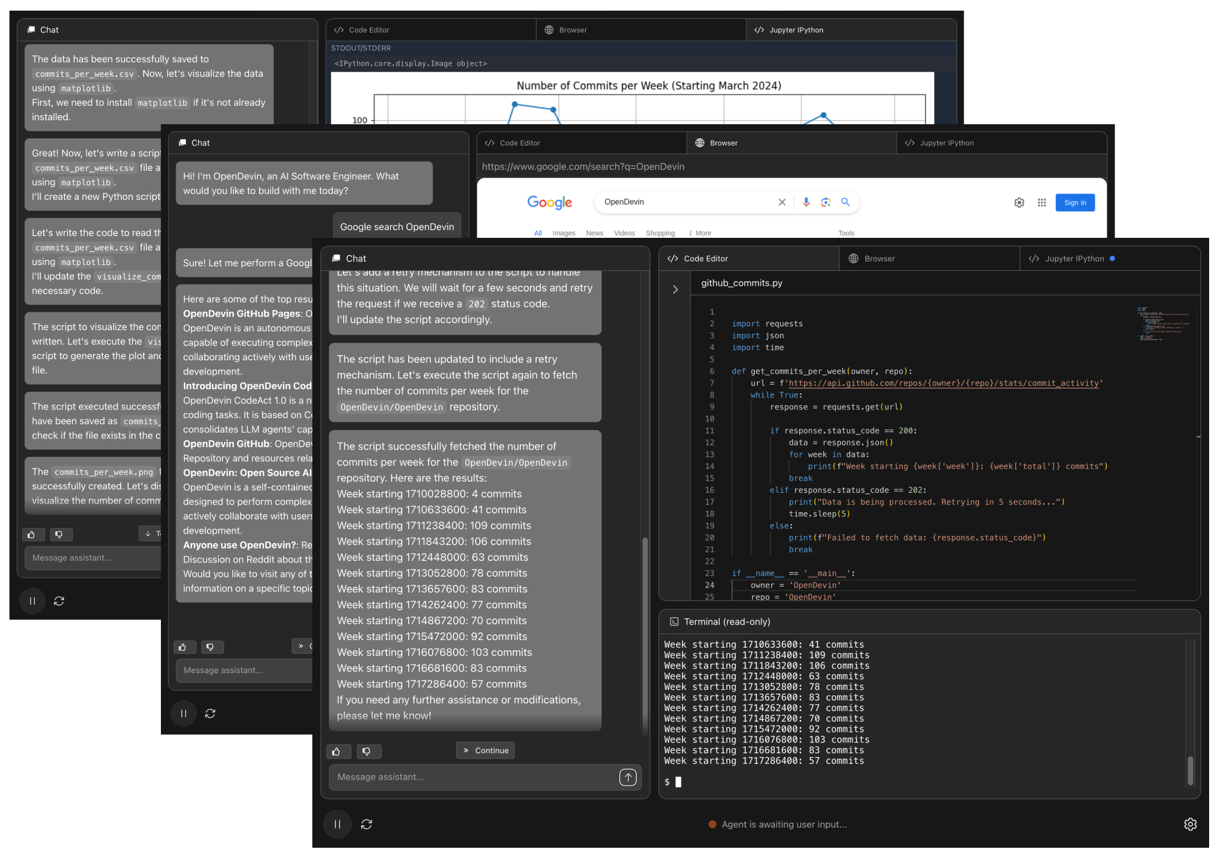
Industrializing AI at Scale
Fabien FURFARO (2026)
Building reliable and auditable GenAI systems (AI Tech Lead & Architect – AI Factory)
Client Context & Problem
Architecture
Containerized stack where OpenHands manages autonomous tasks. Logic built with PydanticAI for runtime validation of model outputs. Inference via vLLM on Kubernetes, monitored by Arize Phoenix and DeepEval for RAG quality and alignment.
Transitioning from stochastic PoCs to production-grade services often accumulates technical debt. Scaling requires addressing non-deterministic model behaviors and the lack of type-safety in agentic workflows.
Why Prioritized
Requirement for auditable AI lifecycles to ensure secure and resilient GenAI deployments under enterprise-grade loads.
Solution & Rationale
Engineering framework based on SOLID principles and TDD. Implementation of Agentic DevOps: using PydanticAI for schema-enforced, type-safe reasoning and OpenHands within Docker sandboxes to automate development and deployment tasks.
Value / KPI
Reduction in Time-to-Market (goal). Long-term operational sustainability through standardized architectures and technical mentorship.
Investment
6-month Architect mandate. (in progress)
Technologies
PydanticAI, OpenHands, Kubernetes, vLLM, Docker, Arize Phoenix, DeepEval, GitLab CI.
Fabien FURFARO (2026)

Slide 8
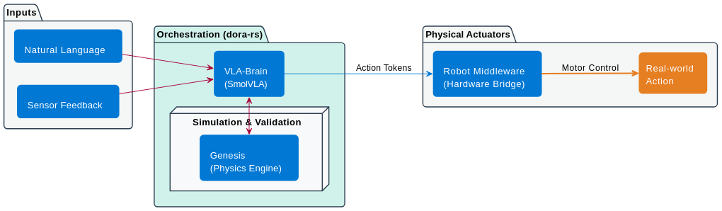
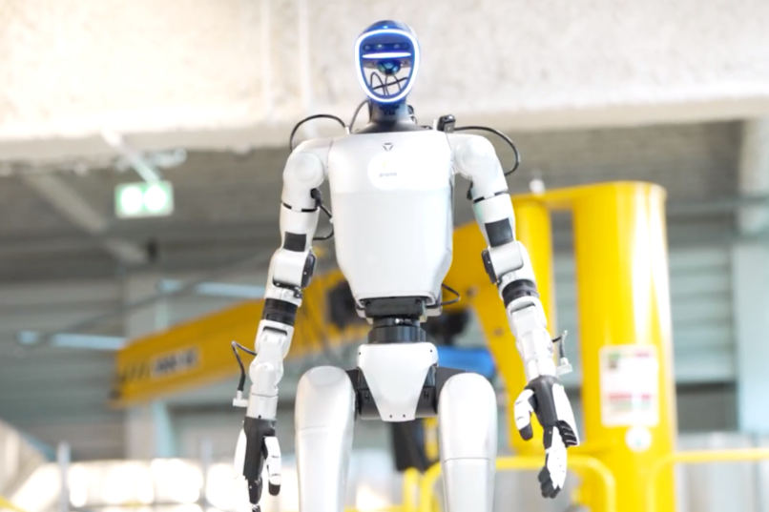
Accelerated Dynamics for Robotic Autonomy
Fabien FURFARO (2026)
Real-time VLA orchestration for autonomous vehicle control (AI Architect – AI Factory)
Client Context & Problem
Architecture
Hierarchical control loop where the VLA-Brain processes multi-modal inputs. The system interfaces with the Genesis Physics Engine for high-fidelity simulation, utilizing dora-rs for efficient message passing between the control terminal and the physical actuators.
Integrating Vision-Language-Action (VLA) policies into robotic hardware often introduces prohibitive latency. Traditional middleware overhead prevents the fluid execution of natural language instructions in dynamic environments.
Why Prioritized
High-stakes R&D for autonomous control. The objective is to achieve low-latency, end-to-end robotic autonomy where high-level linguistic commands are translated into precise physical actions in real-time.
Solution & Rationale
Orchestration via dora-rs for its high-performance, zero-copy communication capabilities. This is paired with a SmolVLA policy (LeRobot) to maintain a small memory footprint while ensuring rapid inference on edge hardware.
Value / KPI
Achieved a stable closed-loop control pipeline at 20Hz (50ms latency).
Investment
Agile R&D Project | Full-stack Robotics & AI. (In progress)
Technologies
dora-rs, Genesis Physics Engine, PyTorch, LeRobot (SmolVLA), Docker, uv.
Fabien FURFARO (2026)

