Slide 1




Hack2g2 - OWASP Top 10 2017
Web application security,
make web development great again.

Slide 2
Summary
What is OWASP
What is the Top 10
Top 10
A1
A2
…
A10
Wild card
Conclusion

Slide 3

OWASP ?
« Open Web Application Project »
Non profit organisation
Theorically impartial
For ~15 years
Aims to spread web application security
Toolset
Guides
…

Slide 4
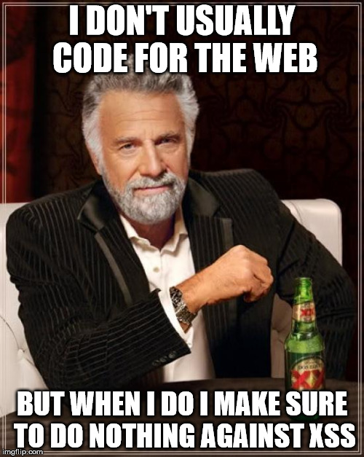
The Top 10
Since 2003
Last release was 2013
Well known « ultimate » reference …
Generalistic and limited …
… But still not always understood & followed

Slide 5



Top 10 2017 – A1
usr_name=admin&usr_password[$ne]=h4xor
Injections :
NoSQL as above
SQL
admin' OR '1'='1
LDAP
admin)(&)
…

Slide 6
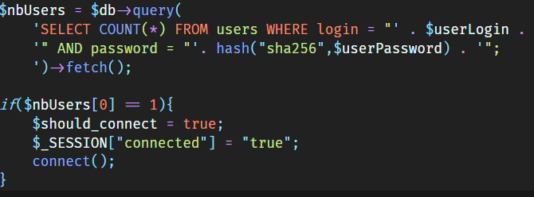
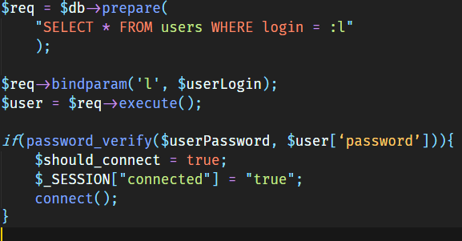
Top 10 2017 – A1 : Injections
http://php.net/manual/en/pdo.prepared-statements.php

Slide 7
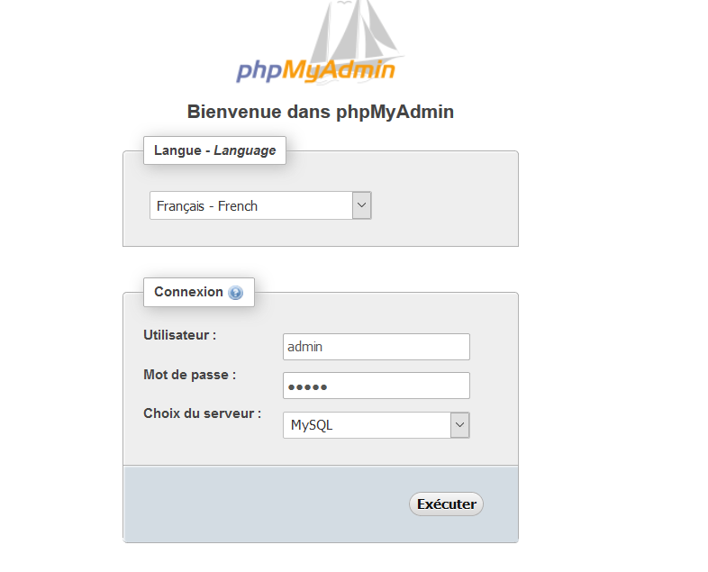
Top 10 2017 – A2
https://lol.myapp.com/index.php?session=e2ace639b6848075e9401f2ad4811df2
Broken Authentication :
Default passwords
Exposition of session ID
Poor session management
No bruteforce protection
…

Slide 8
Top 10 2017 – A2 : Broken Authentication
Use a two-step auth (password + OTP by SMS)
Change default passwords (can be harder than expected)
Use good CAPTCHA (limited)
Timeout users after an amount of login try (make it exponential)
Invalidate session ID on successfull login
if ($user_is_allowed_to_login){
session_regenerate_id(TRUE);
}

Slide 9
Top 10 2017 – A3
id | username | password | email | creation | lastaccess
1 | admin | 595ec7599e4a9c5e8a6a96f0a9fc985d | yolo@swag.com | 1515760510 | 1515761510
2 | jeanmi | f5355504c5355403b74b6fd440b96c94 | jeanmi@const.fr | 1515761040 | 1515761511
Sensitive Data Exposure :
Bad use of passwords (bad hash, no salt)
No encryption on sensitive data
No encryption on communication protocol (HTTP)
…

Slide 10
Top 10 2017 – A3 : Sensitive Data Exposure
Use strong password specialized hashing functions (Argon2 > Scrypt > Bcrypt > PBKDF2)
Use TLS with a good configuration and test it.
Don’t let users choose bad password by testing it strength.
Don’t show user the stack trace (printStackTrace in Java)
hash("sha256",$userPassword);
password_hash($userPassword, 'PASSWORD_ARGON2I');

Slide 11
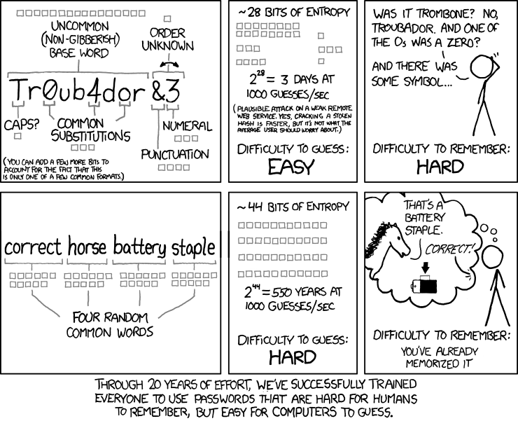

Slide 12
Top 10 2017 – A4
<?xml version="1.0"?>
<!DOCTYPE lolz [
<!ENTITY lol "lol">
<!ELEMENT lolz (#PCDATA)>
<!ENTITY lol1 "&lol;&lol;&lol;&lol;&lol;&lol;&lol;&lol;&lol;&lol;">
<!ENTITY lol2 "&lol1;&lol1;&lol1;&lol1;&lol1;&lol1;&lol1;&lol1;&lol1;&lol1;">
<!ENTITY lol3 "&lol2;&lol2;&lol2;&lol2;&lol2;&lol2;&lol2;&lol2;&lol2;&lol2;">
<!ENTITY lol4 "&lol3;&lol3;&lol3;&lol3;&lol3;&lol3;&lol3;&lol3;&lol3;&lol3;">
<!ENTITY lol5 "&lol4;&lol4;&lol4;&lol4;&lol4;&lol4;&lol4;&lol4;&lol4;&lol4;">
<!ENTITY lol6 "&lol5;&lol5;&lol5;&lol5;&lol5;&lol5;&lol5;&lol5;&lol5;&lol5;">
<!ENTITY lol7 "&lol6;&lol6;&lol6;&lol6;&lol6;&lol6;&lol6;&lol6;&lol6;&lol6;">
<!ENTITY lol8 "&lol7;&lol7;&lol7;&lol7;&lol7;&lol7;&lol7;&lol7;&lol7;&lol7;">
<!ENTITY lol9 "&lol8;&lol8;&lol8;&lol8;&lol8;&lol8;&lol8;&lol8;&lol8;&lol8;">
]>
<lolz>&lol9;</lolz>
XXE :
Bad implement ation of XML parsers
Spreading (API prevalence)
Can be used to :
DoS (as above)
Read sensitive and technical datas (/etc/passwd, …)
…

Slide 13
Top 10 2017 – A4 : XXE
Use something else than XML (JSON)
Disable inetrnal definition (internal DTD) and define strict well-defined external DTD
NOT RECOMMENDED : filter and sanitize every XML you receive. It’s hard to do well.
libxml_disable_entity_loader(true);
DocumentBuilderFactory dbf = DocumentBuilderFactory.newInstance();
dbf.setExpandEntityReferences(false);

Slide 14
Top 10 2017 – A5
https://lol.myapp.com/invoices?id=14567
Your invoice
https://lol.myapp.com/invoices?id=14569
Not your invoice
Broken Access Control :
Poor / no checking of authorization while accessing ressource
Can be :
A document (see above)
The administration functions
Almost any data you access directly

Slide 15
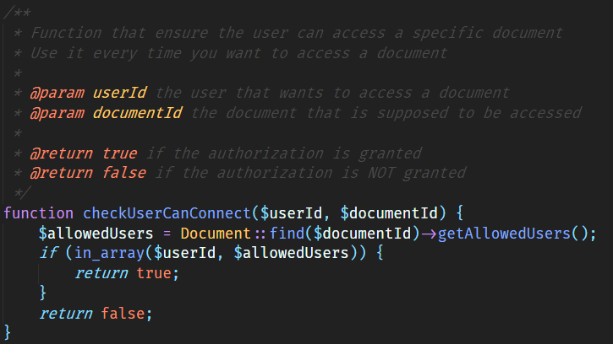
Top 10 2017 – A5 : Broken Access Control
Just ensure better SERVER SIDE checking while accessing ressources

Slide 16
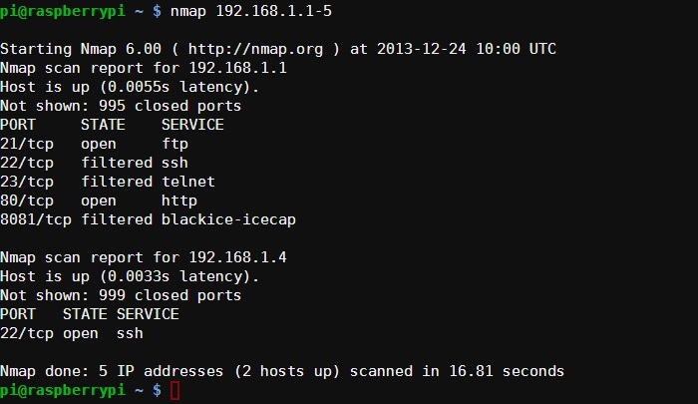
Top 10 2017 – A6
Security Misconfiguration :
Unused /useless services
Bad application security settings (CSRF tokens)
Vulnerable stack (OS, app server, …)
…

Slide 17
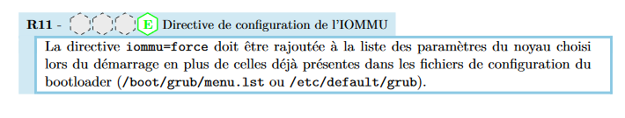
Top 10 2017 – A6 : Security Misconfiguration
Make sure your open ports are useful (SSH !)
Have security configuration rules (use referencials)
Run automated config audit
Make sure during dev you activate built-in security features

Slide 18
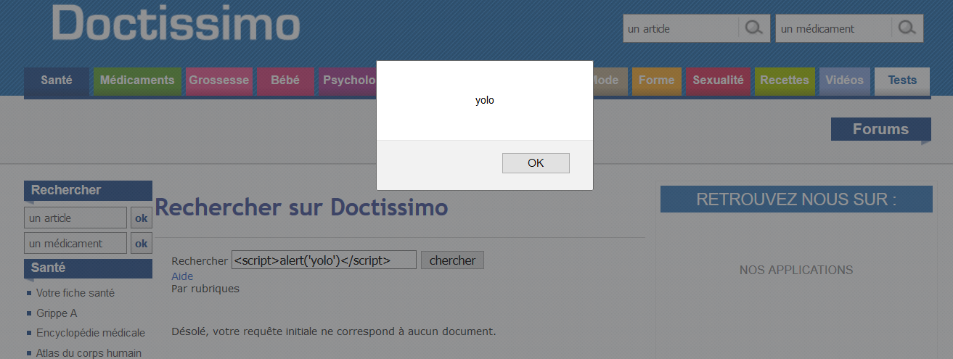
Top 10 2017 – A7
usr_name=jean-mi&title=h4xor&message=<script>stealUserSession()</script>
XSS :
Insertion of elements into HTML
Usually scripts but also can be html elements
Can be used to :
Redirect users
Steal session IDs (with Top 10 - A2)
…

Slide 19
Top 10 2017 – A7 : XSS
Automate secure variable display by :
Using template engines (Twig, Pug, Jinja2, …)
Using XSS protection systems (OWASP Java Encoder, …)
Using pre-built protections in client-side framework (Angular, React, Vue, …)
NOT RECOMMANDED : for legacy code : unautomated secure display :
<?php echo $userInputedVariable ?>
{{ userInputedVariable }}
<?php echo $userInputedVariable ?>
<?php echo htmlspecialchars($userInputedVariable) ?>

Slide 20
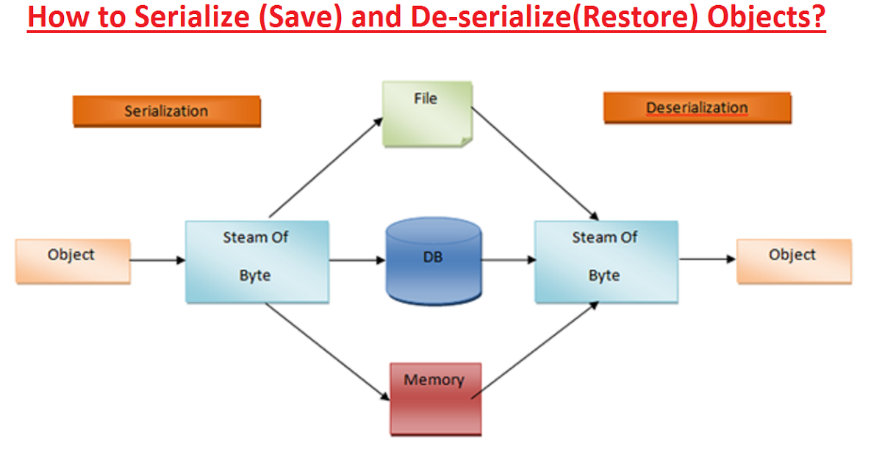
Top 10 2017 – A8
a:4:{i:0;i:132;i:1;s:7:"Mallory";i:2;s:4:"user";i:3;s:32:"b6a8b3bea87fe0e05022f8f3c88bc960";}
a:4:{i:0;i:1;i:1;s:5:"Alice";i:2;s:5:"admin";i:3;s:32:"b6a8b3bea87fe0e05022f8f3c88bc960";}
Insecure deserialization :

Slide 21
Top 10 2017 – A8 : Insecure deserialization
INSECURE
Application A
INSECURE
Client app
INSECURE
Application B
INSECURE
Do not use serialization (often easy)
Filter and sanitize user datas (not enough)
Sign your objects to ensure integrity (HMAC)
https://www.youtube.com/watch?v=nkTBwbnfesQ https://github.com/GrrrDog/Java-Deserialization-Cheat-Sheet

Slide 22
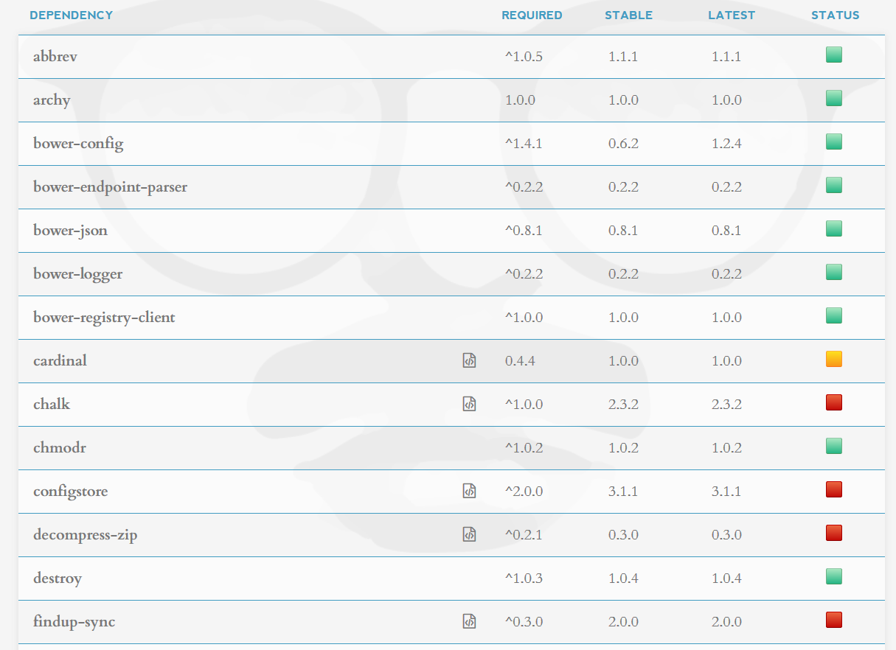
Top 10 2017 – A9
Vulnerable components :
Using « fake » component / lib
Using old versions of :
Librairies
Tools
Components (packages, bundles …)
Can lead to any other security flaw by exploiting insecure dependency
https://david-dm.org/bower/bower

Slide 23
Top 10 2017 – A9 : Vulnerable components
Remove useless dependencies
Set dependencies as relatives
"dependencies": {
"abbrev": "1.0.5",
"archy": "1.0.0",
}
"dependencies": {
"abbrev": "^1.0.5",
"archy": "^1.0.0",
}
Automatically check your dependencies

Slide 24
Top 10 2017 – A10 : Insufficient monitoring
Log pretty much everything in your app
Export your log into an other server (protect integrity)
Use your logs for monitoring – make a SOC analyse them with a SIEM solution

Slide 25
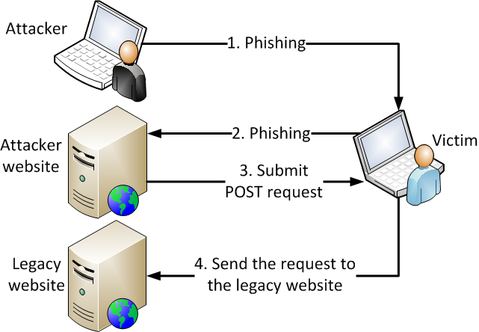
Wild card – Top 10 2013 : A8
axios({
method: 'post',
url: 'https://mybank.com/transfer-funds',
data: {
amount: 1500,
destinationAccount: this.attackerAccountId
}
});

Slide 26
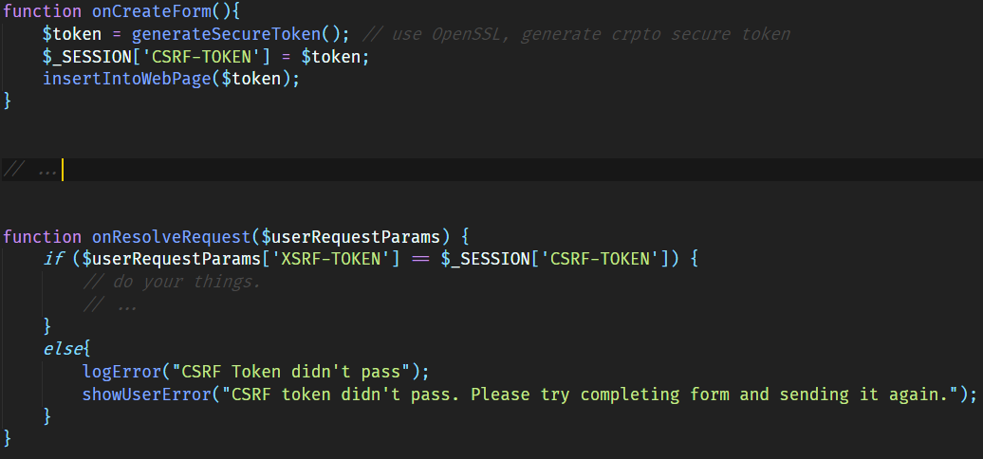
Wild card – CSRF (Top 10 2013 : A8)
Best defense is synchronizer pattern. Included in all modern frameworks

Slide 27
Conclusion
Add security if there’s time left
User Story
Develop content
Release
Test
Usability Test
Redev from test results
Technical and non-technical
Security must be present from the beginning to the end
Devs must be concerned about code security
Basic defense is often easier than expected
DON’T DO THIS

Slide 28
Ressources
https://www.owasp.org
https://www.owasp.org/images/7/72/OWASP_Top_10-2017_(en).pdf.pdf
https://www.hacksplaining.com
https://cwe.mitre.org/data/
https://www.cert.ssi.gouv.fr/information/ (FR)

Slide 29
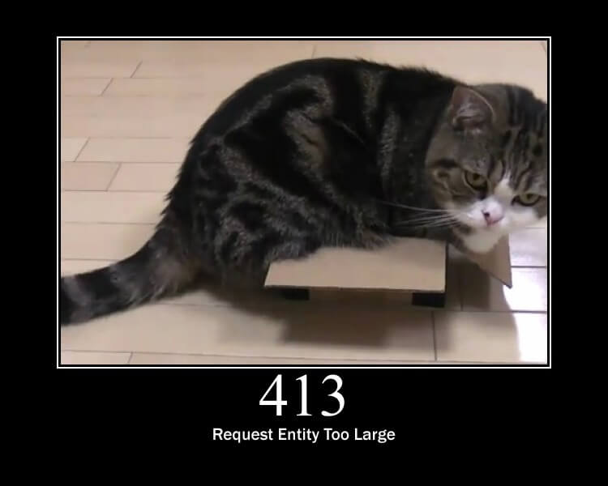
Thank you

