Slide 1
COMPANY BRAIN HACKATHON · 2026
Drift
The Company Brain that notices when it is wrong.
Live verification powered by TriggerWare
Notes:
Hi, this is Drift: a Company Brain that notices when it's wrong. In the next few minutes I'll show you why company knowledge silently goes stale, and how Drift uses TriggerWare to catch it the moment it happens.

Slide 2
THE PROBLEM
Company knowledge quietly goes stale.
STALE
Search finds the stale page instantly.
Apollo runbook · last edited Feb 10
Glean-style search ranks it, cites it, trusts it.
“Apollo uses MongoDB as its primary datastore. If latency spikes, check the MongoDB replica set.”
AI assistants repeat it with confidence.
An agent reads the runbook and answers “MongoDB”.
Memory only updates when corrected.
LIVE SERVICE CATALOG · RIGHT NOW
Agent memory changes only if someone says so.
apollo → PostgreSQL
Nobody is checking.
Drift · the Company Brain that notices when it is wrong
02
Notes:
Every company has a runbook that's quietly wrong. This one says Apollo uses MongoDB, weeks after the team migrated to PostgreSQL. Nobody lied; reality moved and the document didn't. And today's tools make it worse: search finds the stale page instantly, AI assistants repeat it with confidence, and AI memory only changes its mind when someone corrects it. Nobody is checking.

Slide 3
THE GAP
Everyone stores knowledge. Nobody verifies it.
FIND IT
REMEMBER IT
VERIFY IT
Glean · Atlassian Rovo
Zep / Graphiti · Mem0
Drift
Search and answers over company knowledge.
Long-term memory for AI agents.
Continuously checks facts against the live systems that run the company.
Retrieves whatever the page says.
Changes only when fed a contradiction.
Notices on its own when reality moves.
Drift isn’t a better Glean. It’s the missing layer that keeps any Company Brain honest.
Drift · the Company Brain that notices when it is wrong
03
Notes:
There are great tools for finding company knowledge, like Glean and Atlassian Rovo, and for giving AI agents memory, like Zep and Mem0. But none of them check whether what they store is still true. That's the gap Drift fills. We're not a better Glean; we're the missing layer that keeps any Company Brain honest.

Slide 4
HOW IT WORKS
A memory that keeps checking itself.
1
2
3
4
LEARN
WATCH
DETECT
REACT
Docs, decisions and chat become facts with a source, a trust level and a time range. Small talk and secrets are dropped.
Every checkable fact becomes a TriggerWare trigger: scheduled SQL against the live system.
When reality changes, TriggerWare pushes only the rows that changed.
Update memory and keep history. Flag stale docs, trace what depends on it, alert the owner.
TriggerWare
TriggerWare
↻ Runs continuously, on its own schedule. Nobody has to remember to update the docs.
Drift · the Company Brain that notices when it is wrong
04
Notes:
Here's how Drift works. First it learns: docs, decisions and chat become facts, each with a source, how much to trust it, and when it was true. Small talk and secrets are thrown away. Second, every fact Drift can check becomes a TriggerWare trigger: a scheduled SQL query against the live system. Third, when reality changes, TriggerWare pushes only the rows that changed. And fourth, Drift reacts: it updates memory without erasing history, flags documents that are now wrong, traces what depends on the change, and alerts the owner. Then it keeps doing that, on its own.

Slide 5
POWERED BY TRIGGERWARE
TriggerWare is the engine of the loop.
01
Reads live systems as SQL
TRIGGER · drift_acme_apollo_uses
The service catalog becomes a table Drift can query.
SELECT datastore FROM service_catalog
WHERE org = 'acme' AND service = 'apollo'
02
Detects change, pushes the delta
One trigger per fact. Drift never scrapes or diffs.
DELTA PUSHED BY TRIGGERWARE
Checks live, mid-answer
− ["MongoDB"]
+ ["PostgreSQL"]
03
Before answering, Drift re-runs that fact’s query.
Without TriggerWare: a scraper and a diff job per source. With it: one connector.
Drift · the Company Brain that notices when it is wrong
05
Notes:
TriggerWare is the engine of this loop. It does three jobs. It lets Drift read live systems as plain SQL tables. It watches for changes and pushes only what's different: here, Apollo's trigger saw MongoDB removed and PostgreSQL added, and that single row change is what sets everything else off. And it lets Drift re-check a fact in the middle of answering a question. Without TriggerWare we'd write a scraper and a change detector for every source; with it, adding a source is one connector.

Slide 6
ANSWERS YOU CAN TRUST
Every line says how it knows.
“Why did we move Apollo off MongoDB, who approved it, and what might break?”
VERIFIED
Apollo uses PostgreSQL · checked live via TriggerWare
A PLAIN AI SEARCH BOT
“Apollo uses MongoDB as its primary datastore.”
STALE
“Apollo runbook” still says MongoDB
DECISION
ADR-012: transactional joins · approved by Priya Rao
HISTORY
Apollo used MongoDB until Nov 4, 2026
Same documents. Repeats the stale runbook, with confidence.
INFERRED
Payments, Notifications and Checkout may be affected
Drift · the Company Brain that notices when it is wrong
06
Notes:
Because Drift knows where every fact came from, every line of an answer says how it knows. Verified means checked live through TriggerWare. Stale means a document still says something that's no longer true. Decision comes from a decision record, history is what used to be true, and inferred is Drift's best guess, never presented as fact. A plain AI search bot, given the same documents, just says MongoDB.

Slide 7
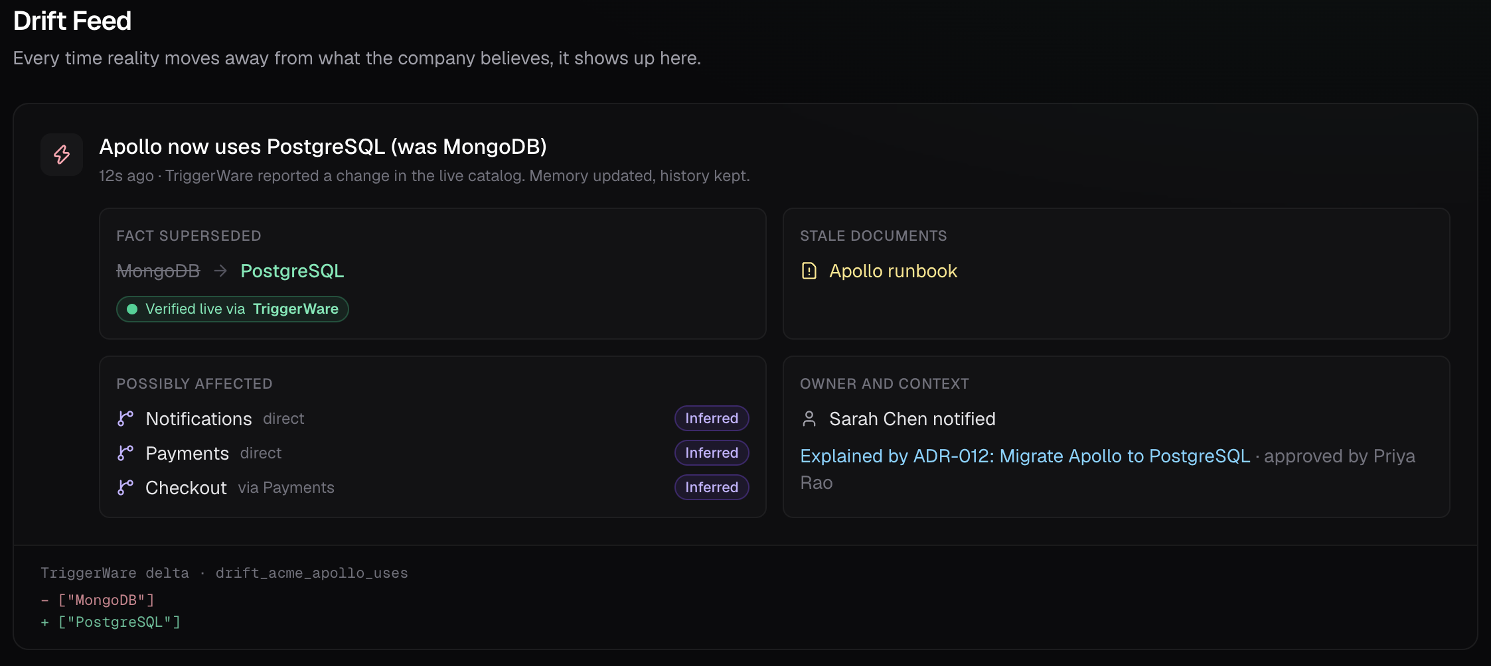
DEMO
One change in a live system.
Watch what Drift does.
1
Ask
“What database does Apollo use?” → MongoDB, verified live.
2
Change
An engineer updates the catalog: Apollo → PostgreSQL.
3
Detect
TriggerWare pushes the delta. Drift alerts in seconds.
4
Explain
Ask “why?”: stale runbook, decision, approver, blast radius.
Drift · the Company Brain that notices when it is wrong
07
Notes:
Let's see it. I'll ask Drift a question, change one value in the live system, and watch what Drift does on its own.

Slide 8
Wrong documentation doesn’t announce itself.
It waits for someone to trust it.
Drift — the Company Brain that notices when it is wrong.
Live in the demo: change detection, memory updates with history, stale flags, dependency tracing, alerts.
Synthetic: the demo company, its documents and catalog. “Check now” forces the poll so the change lands on cue.
Drift · the Company Brain that notices when it is wrong
08
Notes:
Wrong documentation doesn't announce itself; it waits for someone to trust it. Drift is a Company Brain that notices when it's wrong, and tells you before anyone gets hurt by it. Thank you.

