Slide 1
CAPSTONE PROPOSAL / GROUP 21
MoodLens
PROJECT TEAM
Group 21
FER-Based Mobile Emotion Detection
Proposal UI • Android Studio • XML • CameraX
01
Hoang Lan Dao
375910
02
Akshata Bhusal
377164
03
Fabiha Sultana Anushe
372205
SEE THE EMOTION
BEHIND THE EXPRESSION
04
Jeremy Immanuel Situmeang
374594

Slide 2
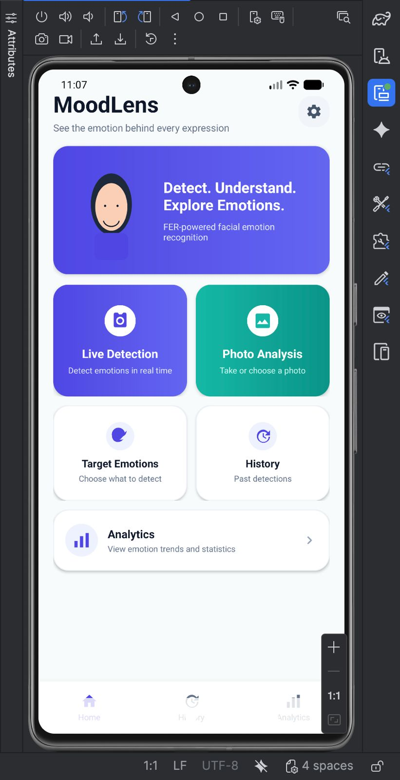
02
PRODUCT CONCEPT
A focused mobile experience
The proposal keeps the flow simple: open the app, choose a detection mode, and review results.
HOME
“MoodLens turns facial expressions into a clear, visual emotion result.”
01
02
03
04
CAMERA
FACE
FER
RESULT
Live / photo input
Locate expression
Classify emotion
Emotion + confidence
7 FER emotion classes
Confidence score
Target filters
Current UI prototype screenshot

Slide 3
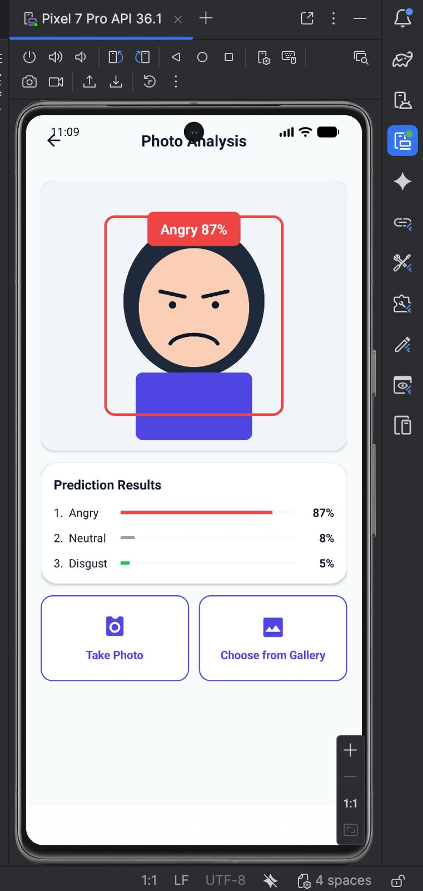
03
DETECTION EXPERIENCE
Camera-first emotion detection
PHOTO ANALYSIS UI
CameraX powers the live camera layer; the FER model returns the emotion and confidence.
Photo Analysis
LIVE DETECTION
A
CameraX
Camera preview and frame capture for real-time detection.
B
FER inference
Face region is prepared for the trained FER model.
C
Clear output
Show predicted emotion with a confidence percentage.
Happy
Sad
Angry
Fear
Surprise

Slide 4
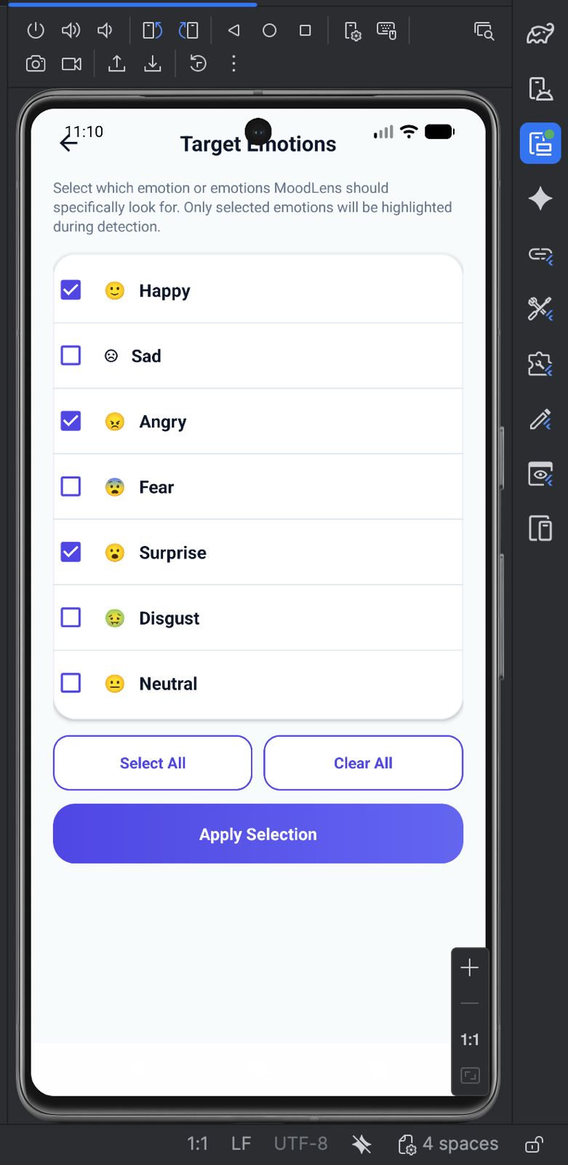
04
TARGET EMOTION FILTER
Let the user choose what to detect
One or more target emotions can be selected before detection.
TARGETS
WHY THIS FEATURE?
A more purposeful FER experience
Instead of forcing every class to matter equally, MoodLens can focus on the exact emotion — or combination of emotions — the user wants to monitor.
01
Single emotion
02
Multiple emotions
Example: detect only Happy.
Example: Happy + Surprise.
All seven FER classes remain available — the filter only changes what the app highlights.

Slide 5
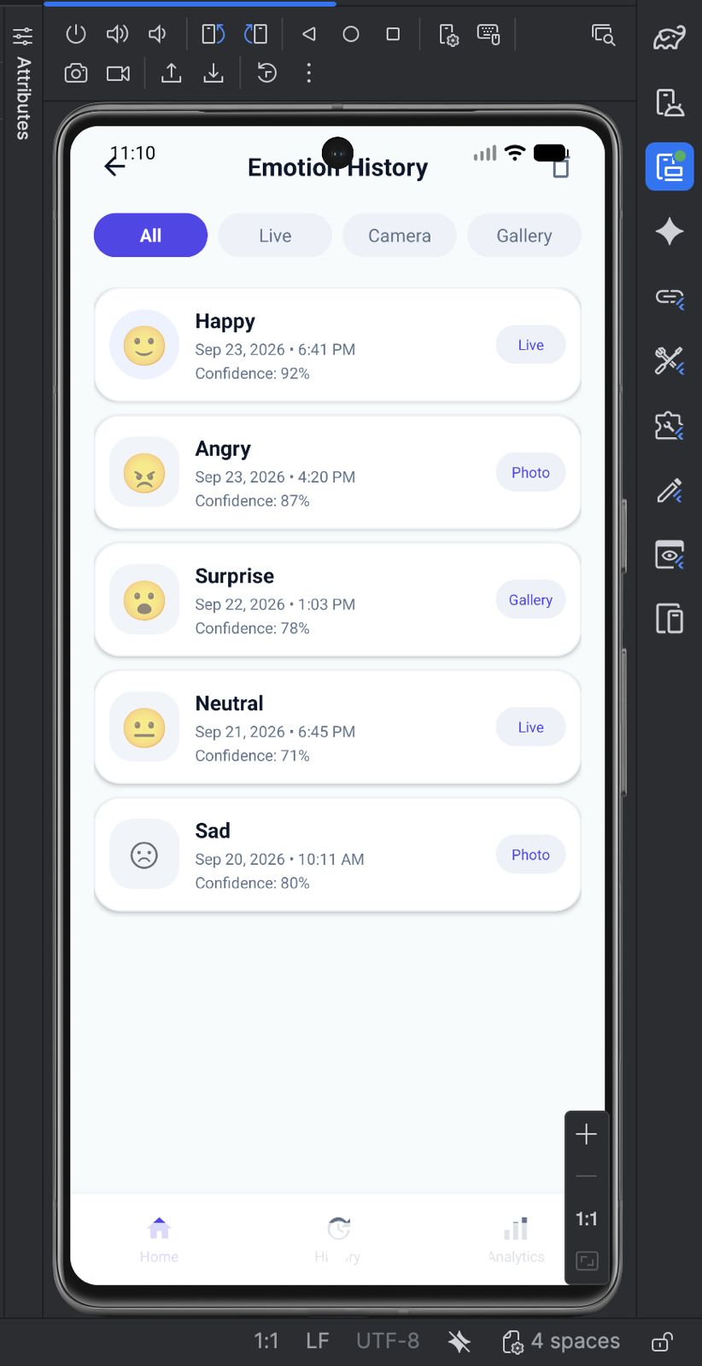
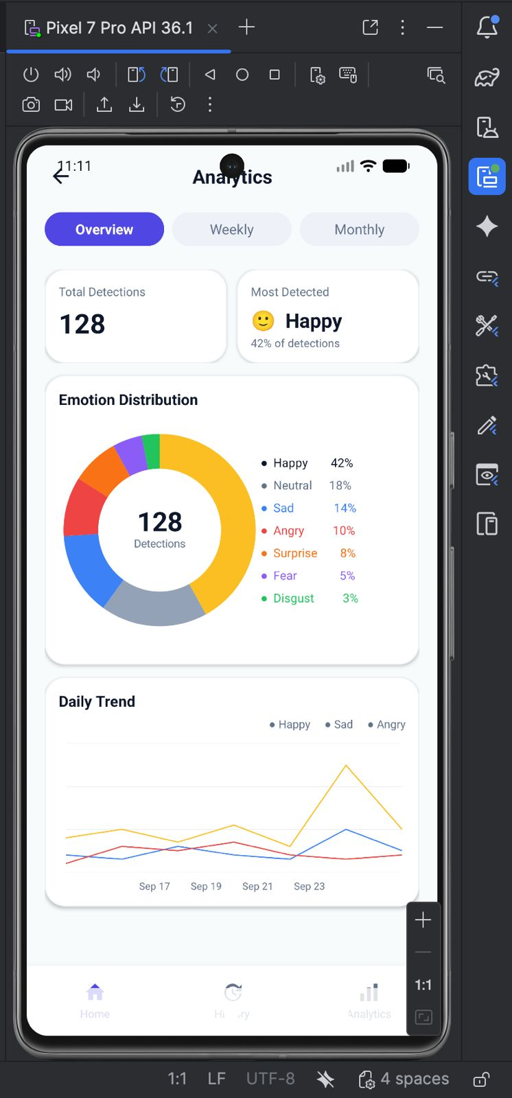
05
HISTORY & ANALYTICS
From individual detections to useful patterns
History preserves past results; analytics summarizes what the app has detected over time.
HISTORY
ANALYTICS
DETECTION
→
INSIGHT
date & time
emotion
confidence
daily / weekly trends
Local history
Charts

Slide 6
06
TECHNOLOGY PLAN
Planned Android implementation
A practical stack for moving from the proposal UI to the working capstone app.
DEV
Android Studio
LANG
Kotlin + Java
CAM
CameraX
AI
FER + TFLite
DATA
Room
Main development environment with XML layouts.
Both languages can coexist in one Android project.
AndroidX camera APIs usable from Kotlin and Java.
Train/use the FER model and run inference on-device.
Store detection history locally for analytics.
PROPOSED PIPELINE
CameraX
Face Detection
Preprocess
FER / TFLite
MoodLens UI
camera frames
find face
FER input
classify
show result
Next: connect CameraX → integrate FER model → replace demo data with real detections.

