Slide 1
Crimes Against Women in India (2001-2021)
PRESENTED BY FABINA THASNI

Slide 2
Hello everyone, and thank you for being here today.
In this presentation, we will explore data on crimes against women in India over the past 20 years.
We will look at different types of crimes, such as rape, domestic violence, and dowry deaths, and see how these crimes have changed over time and across different states.
Our aim is to provide insights that can help understand the trends and patterns in these crimes, and hopefully, contribute to efforts to make India safer for women.
Thank you for joining us, and let's get started!

Slide 3
Column Description
Unnamed: 0: Index column (can be ignored).
State: Name of the state or union territory.
Year: Year of the recorded data.
Rape: Number of rape cases.
K&A: Kidnapping and abduction cases.
DD: Dowry death cases.
AoW: Assault on women cases.
AoM: Insult to modesty cases.
DV: Domestic violence cases (by husbands or relatives).
WT: Women trafficking cases.
This dataset contains a comprehensive view of various crimes against women across different states in India over multiple years.

Slide 4
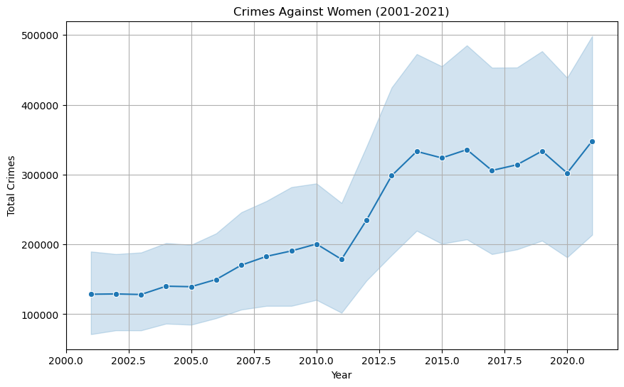
Trends in Total Crimes Against Women in India (2001-2021)
The plot shows a general increase in crimes against women from 2001 to 2021, with noticeable fluctuations and a significant rise in recent years.
Increasing Trend: The National Crime Records Bureau (NCRB) reported a continuous rise in crimes against women, with incidents of rape increasing from approximately 18,000 cases in 2001 to over 32,000 in 2021.

Slide 5
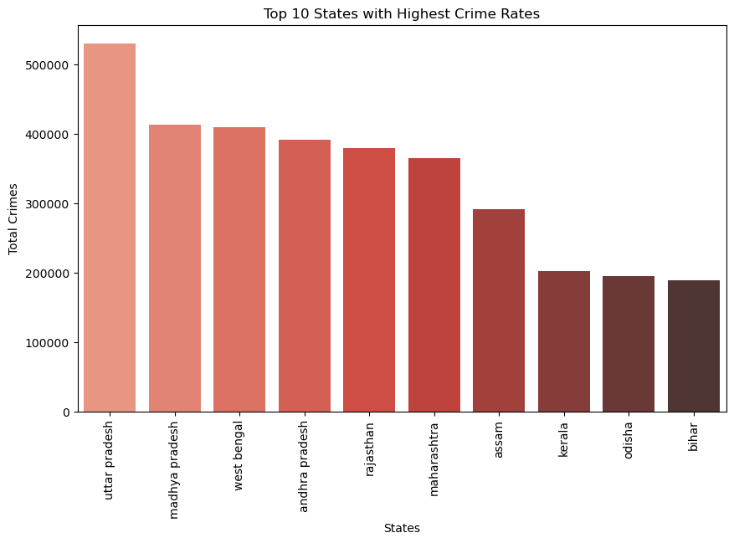
Top 10 States with the Highest Total Crimes Against Women in India (2001-2021)
Uttar Pradesh has the highest crime rate among the top 10 states in India, with a significant lead over the others.
Uttar Pradesh accounted for around 14% of total reported rapes in 2021, highlighting the need for focused interventions in these regions.

Slide 6
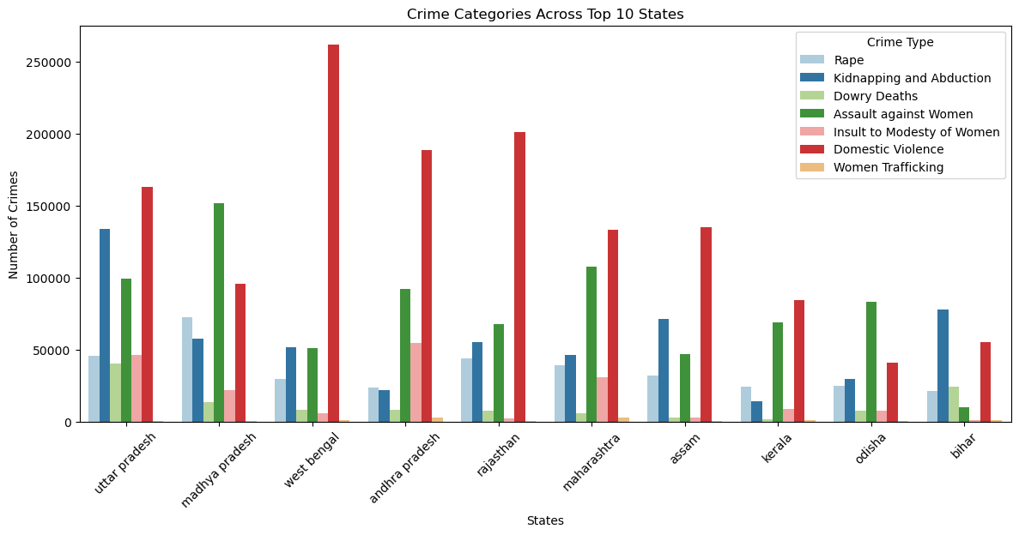
Comparison of Crimes Against Women Across Top 10 States
Here are the top 10 states witnessing the highest number of domestic violence cases.

Slide 7
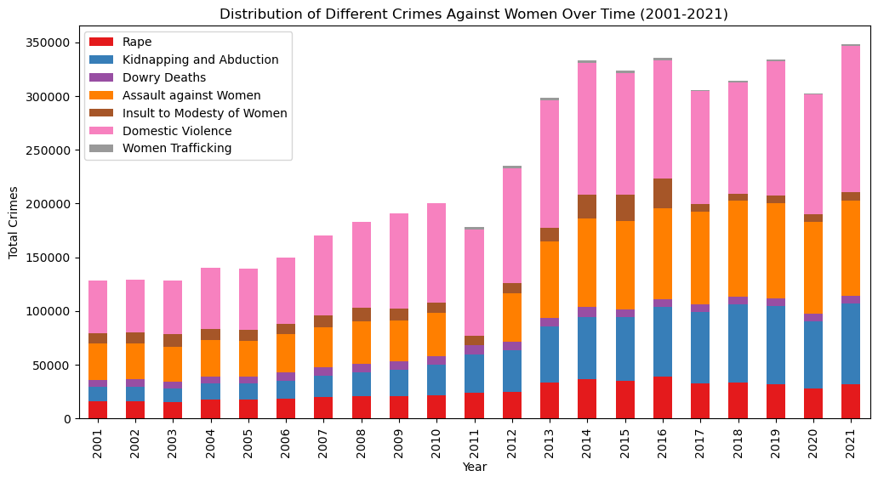
Analyzing the Distribution of Different Crimes Over Time
It shows a steady rise in crimes against women in India from 2001 to 2021, with domestic violence and sexual assault being the most common.

Slide 8
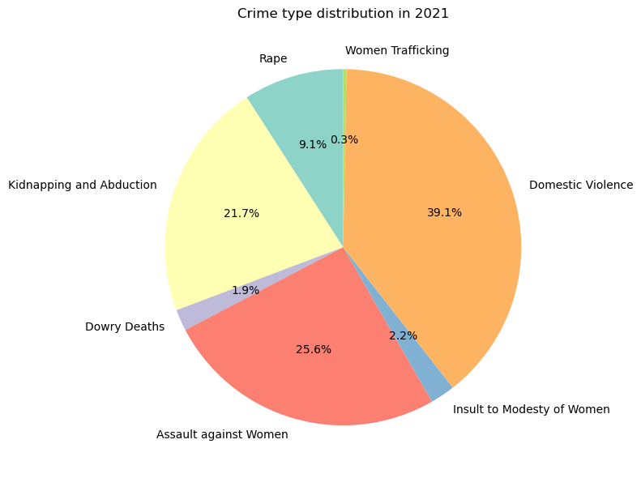
Crime Type Distribution in India (2021)
To visually represent the distribution of different crime types against women in India for the year 2021.
Domestic violence and assault against women were the most reported crimes in 2021, making up over 60% of the total
women trafficking was the least reported crime in 2021, making up only 0.3% of the total.

Slide 9
Domestic violence:
Domestic violence is a significant issue, especially during the COVID-19 lock downs, when calls to helplines increased.
For example, the National Commission for Women (NCW) received over 1,400 complaints of domestic violence in just the first month of the lockdown in 2020,
Dowry Deaths:
Although dowry deaths represent a smaller percentage in the pie chart, they remain a significant issue in rural areas and specific states like Bihar and Uttar Pradesh.

Slide 10
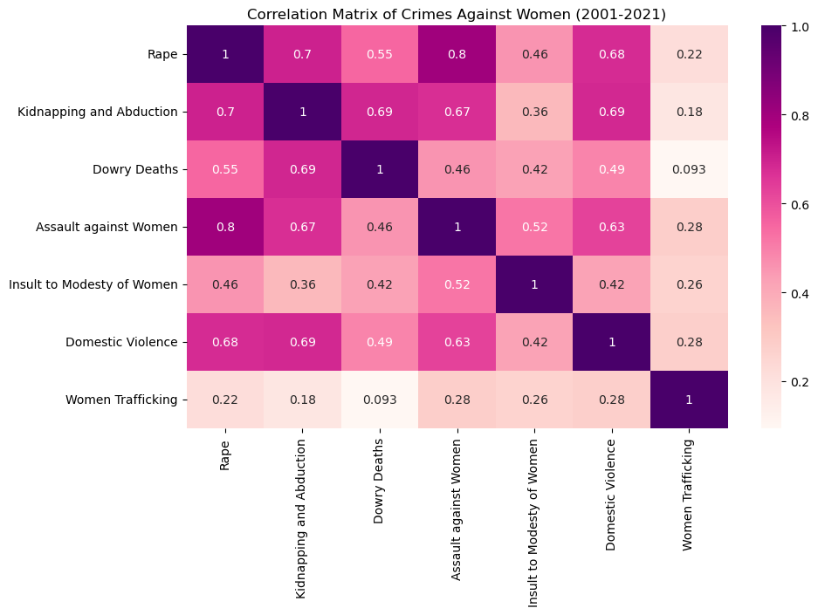
Relationship Between Different Crime Types
The correlation matrix shows that crimes like Rapes and assault against women are highly correlated, indicating they often occur together.
In contrast, women trafficking has the lowest correlation with other crimes, suggesting it occurs more independently.

Slide 11
Suggestions to Address Crimes Against Women:
Strengthen Law Enforcement: Ensure strict enforcement of laws and faster response to crime reports.
Raise Public Awareness: Conduct educational campaigns to promote gender equality and women's rights.
Enhance Victim Support: Provide more counseling, legal aid, and safe spaces for victims of violence.
Target High-Risk States: Focus resources and interventions on states with the highest crime rates.
Encourage Crime Reporting: Create safer, more accessible ways for women to report crimes without fear.

Slide 12
In conclusion, our analysis of Crimes Against Women in India (2001-2021) highlights important trends and areas that need attention.
We've discussed the rise in certain crimes and the regions most affected.
Now, we would like to open the floor for your thoughts and opinions on this issue.
Your insights are valuable, and we encourage you to share your perspectives on how we can work together to address these challenges.
Thank you for being here today, and we look forward to hearing your ideas!

