Slide 1
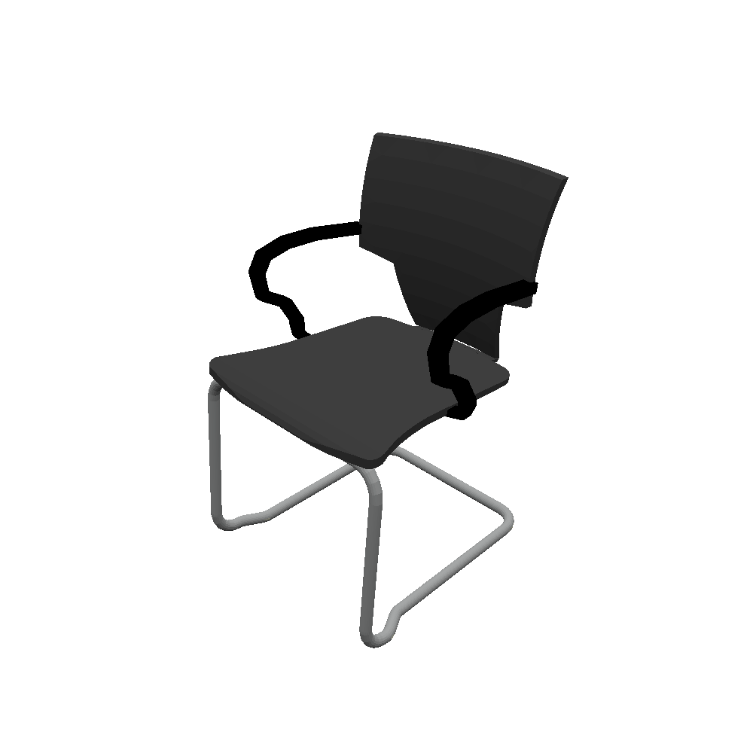
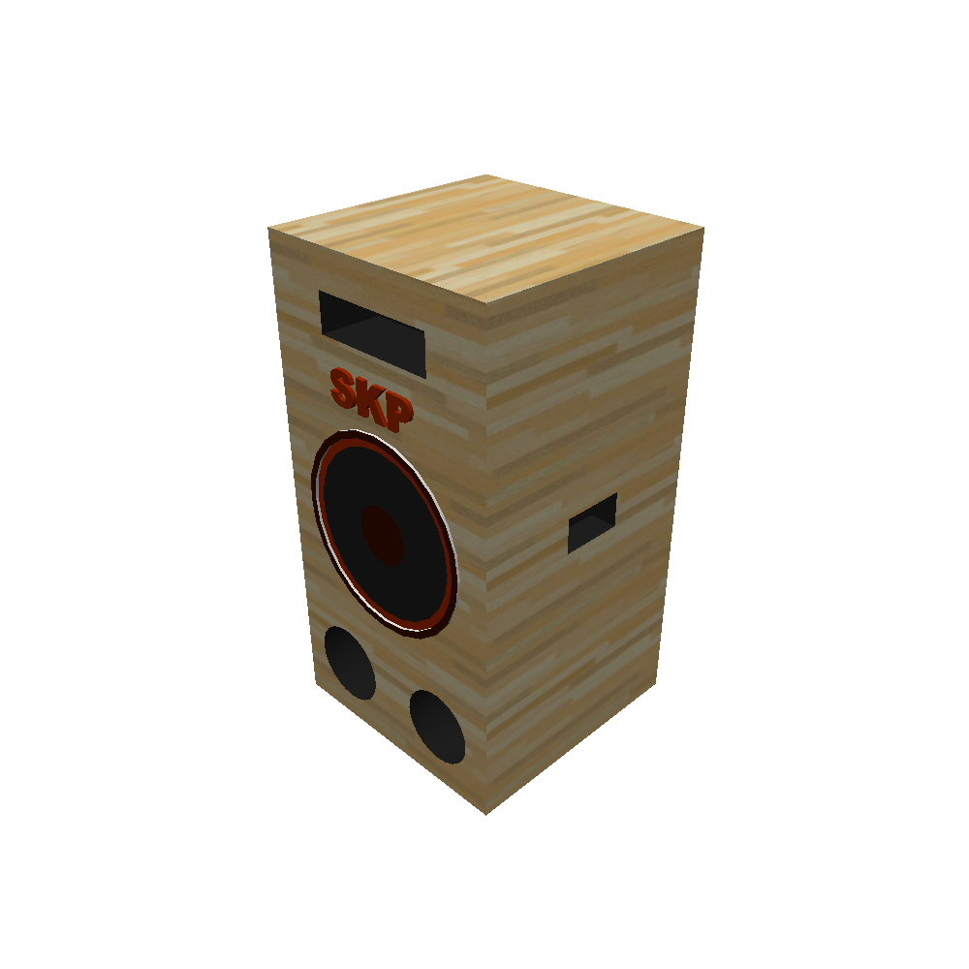
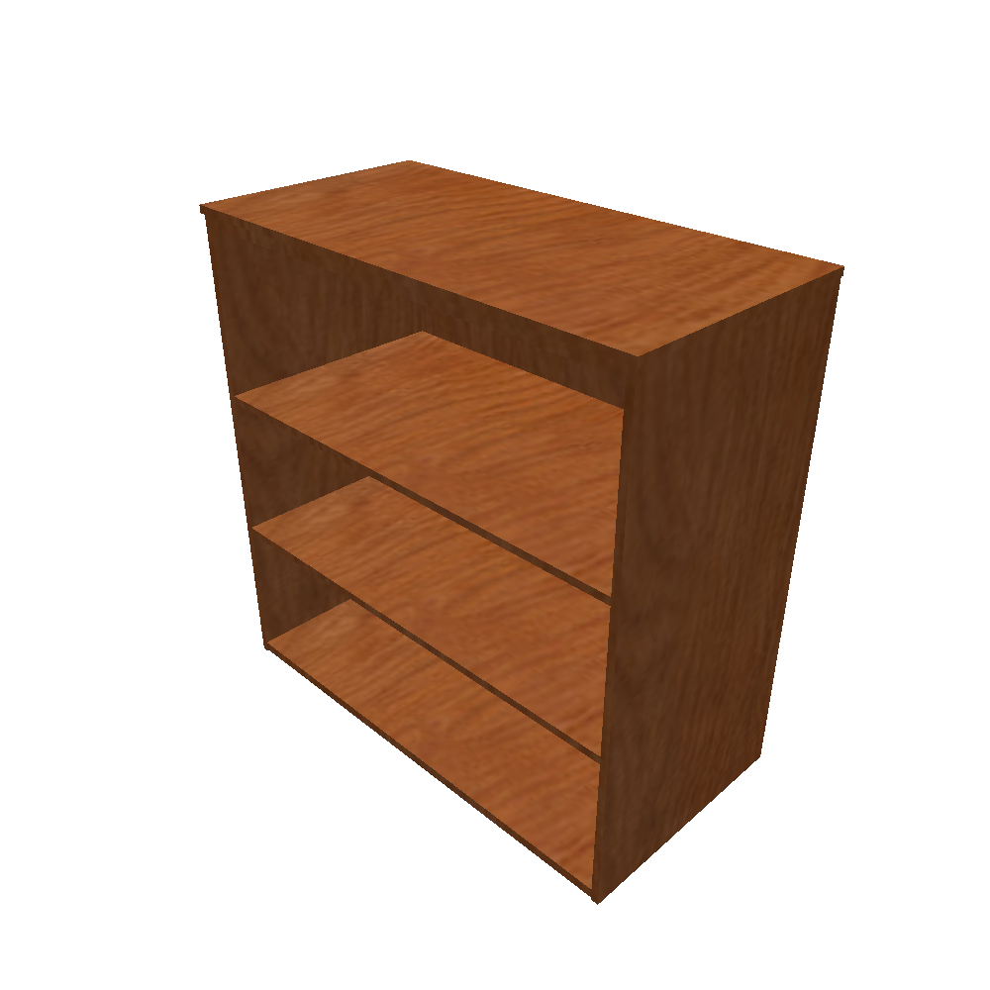
3D Retrieval
Input: natural freeform text query
Output: 3D shape corresponding to text
Database: 13 Classes of ShapeNet Core with 5 descriptions per object
this is a large brown wood bookshelf
a black chair with curved hand rests and metal legs
large free wooden speaker system with woofer
Notes:
We are based on PointClouds!

