Slide 1
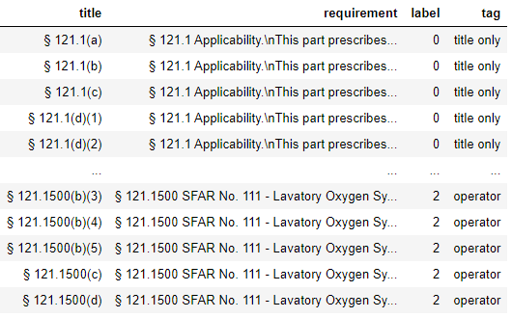
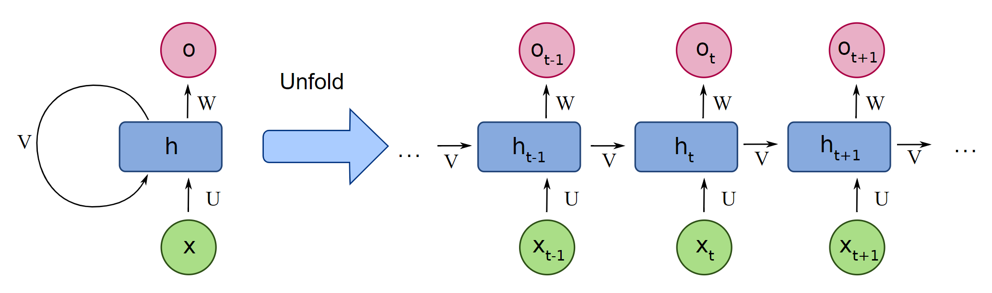
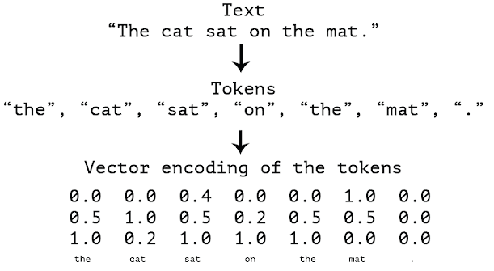
0 – “Title Only”
1 – “Aircraft”
2 – “Operator”
Recurrent Neural Network
+ padding

Slide 2
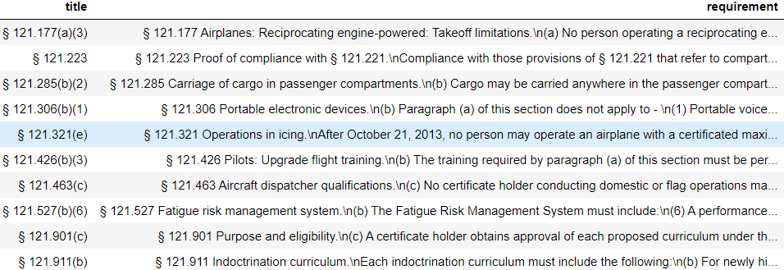
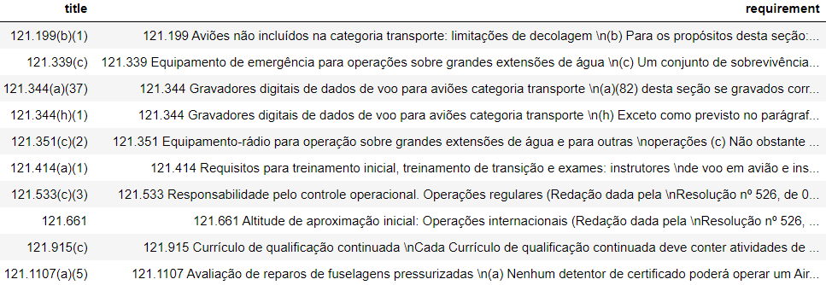
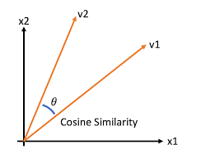
FAA FAR Part 121
ANAC RBAC 121
translate
tokenize
filter parts-of-speech
sort word importance
embed
tokenize
filter parts-of-speech
sort word importance
embed
count similar words
(high cosine similarity)
calculate superposition
(modified Jaccard index)
choose best fit
(highest Jaccard index)

