Slide 1

Gestione dello stato in Blazor
{
"Name": "Fabio Spaziani",
"Role": "Junior Architect @ Blexin",
}

Slide 2







Un grazie agli sponsor

Slide 3







E alle community che ci hanno supportato

Slide 4
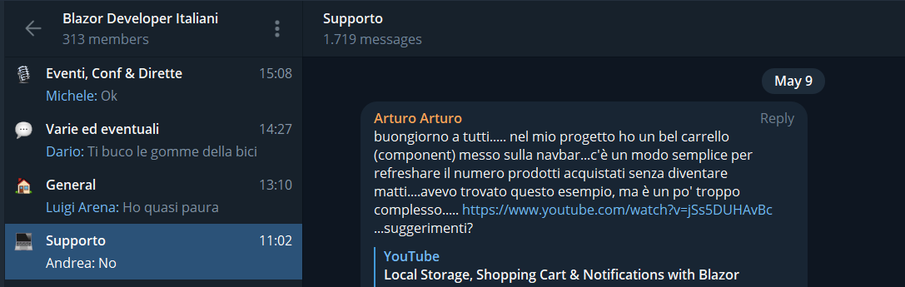

Why this talk?
D
E
https://tinyurl.com/blazordevita-telegram

Slide 5


What is state?
“Data that represents the state of the application at any given point in time”

Slide 6
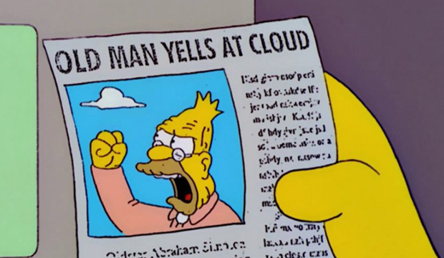
Is it a SPA problem?

Slide 7
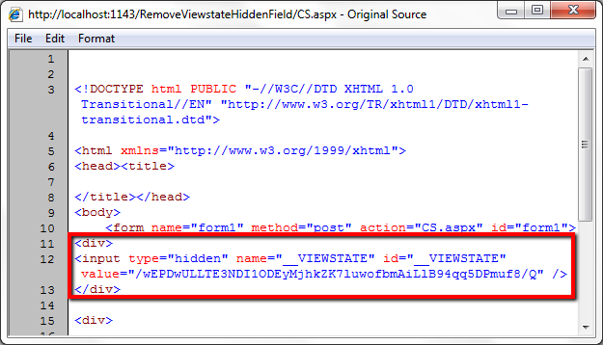
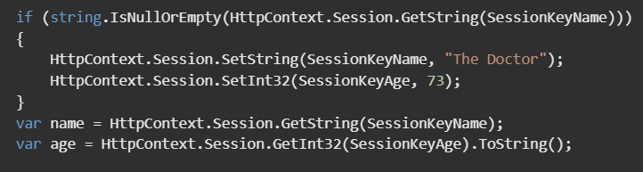
Not really..

Slide 8
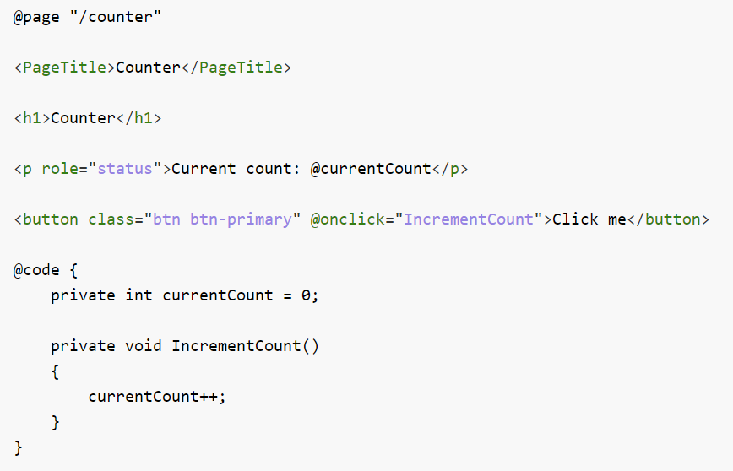
State in a Blazor Application
Local component state

Slide 9
What is State Management?
Without a central state
With a central state
Root component
State
Navbar
Cart Display
Product list
Components reading that piece of state
Component that can update a piece of state
Component that are not interested in state changes
It’s not about the data, but about how data flows in the application

Slide 10
How can we do State Management in Blazor?
StateHasChanged gives the power back to the Developer
«Blazor aims to be agnostic to specific patterns like MVVM, MVP, observability, INotifyPropertyChanged, hooks, and so on.
We designed the UI refresh mechanism so that developers can use whichever patterns they like.
The default refresh mechanism (re-render after an event) turns out to cover the great majority of cases without needing any broader pattern, but people are free to use whatever patterns they find useful»
- Steve Sanderson

Slide 11
Demo

Slide 12
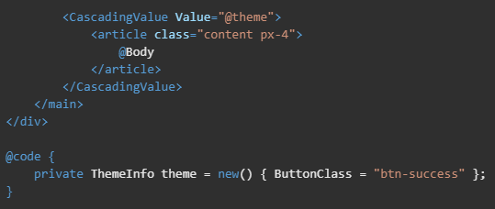
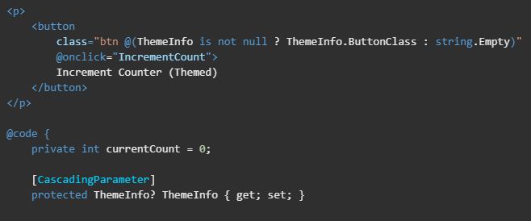
Cascading Parameters & Values
Component providing the Cascading Value
Component using the Cascading Value
Notes:
Cascading values and parameters are a way to pass a value from a component to all of its descendants without having to use traditional component parameters.
Blazor comes with a special component called CascadingValue. This component allows whatever value is passed to it to be cascaded down its component tree to all of its descendants. The descendant components can then choose to collect the value by declaring a property of the same type, decorated with the [CascadingParameter] attribute.

Slide 13
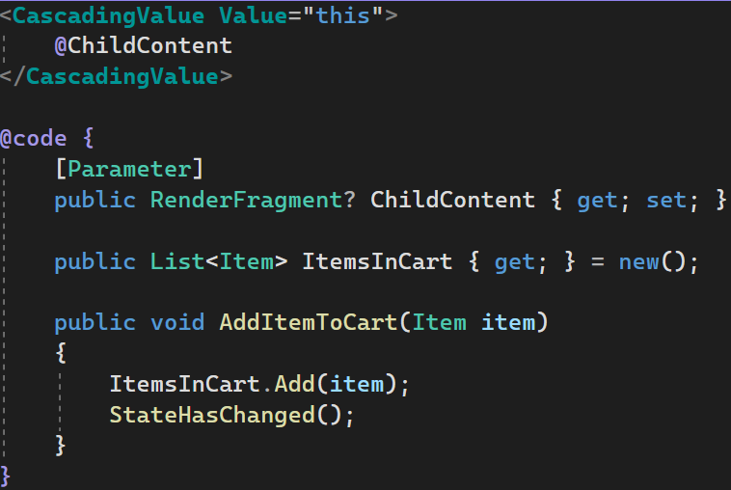
Cascading Parameters – Store
CascadingParameterCartStore.razor

Slide 14
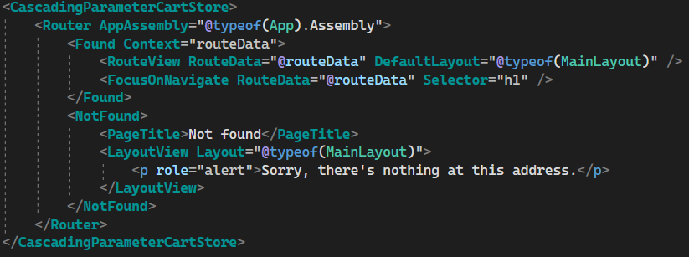
Cascading Parameters – Wire Up
App.razor

Slide 15
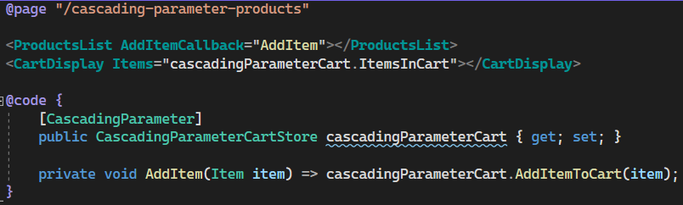
Cascading Parameters – Use in component 1/2
CascadingParameterProducts.razor

Slide 16
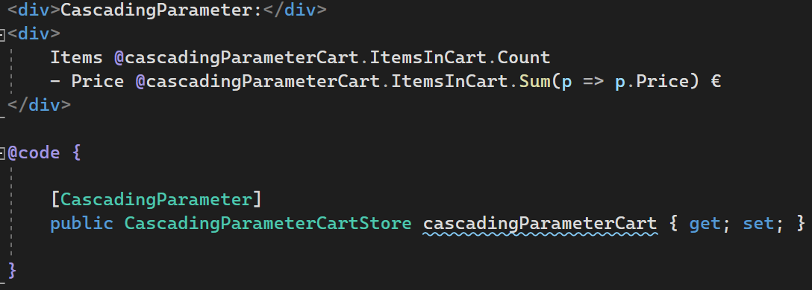
Cascading Parameters – Use in component 2/2
CartNavbar.razor

Slide 17




Cascading Parameters – Pros & Cons
PROS
CONS
Straightforward to implement
Performance issues (trade offs)
Can become a mess as the application scale
All you need is already baked into the framework
Separation of concerns

Slide 18
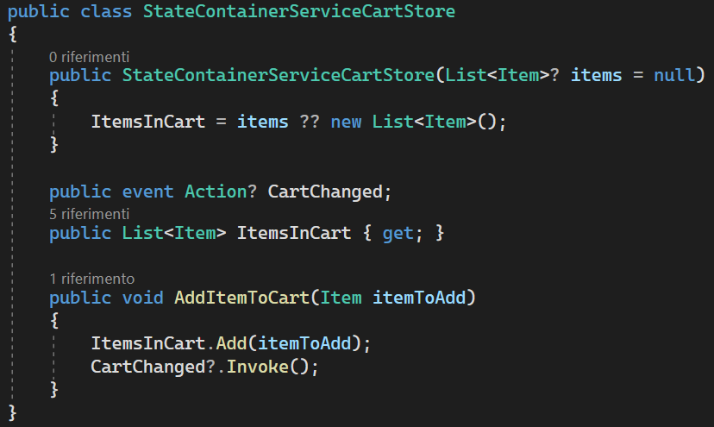

State Container Service – Wire Up & Store

Slide 19
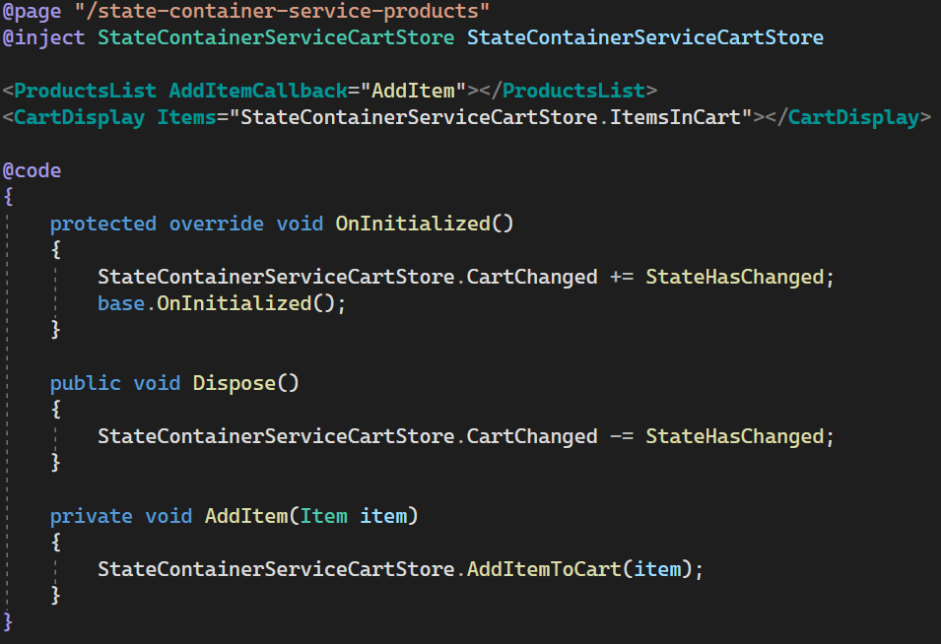
State Container Service – Use in component

Slide 20
State Container Service – Pros & Cons
PROS
CONS
All you need is already baked into the framework
Error prone
Can still become a mess as the application scale
Clear separation of concerns
Highly testable
Three.

Slide 21
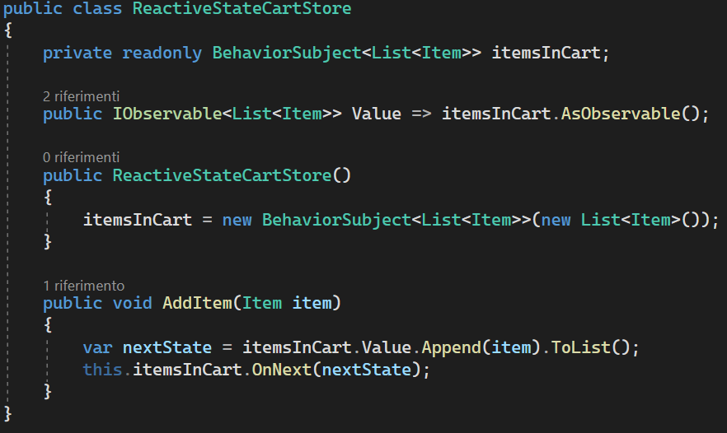
Observable State – Wire Up & Store

Slide 22
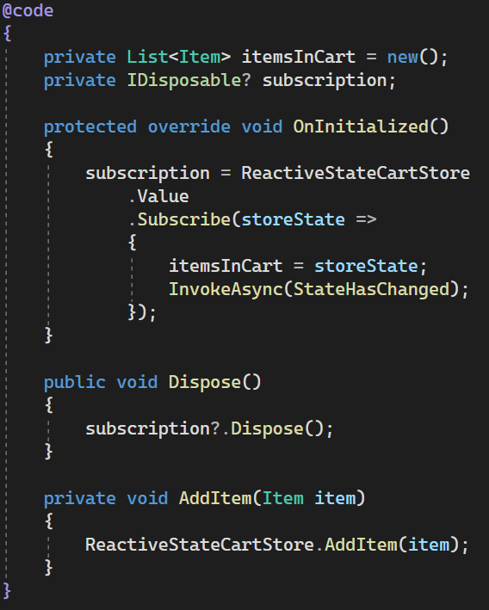
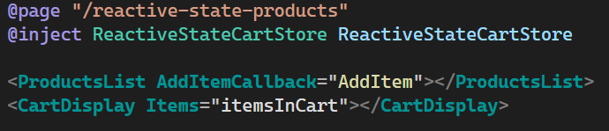
Observable State – Use in component

Slide 23
Observable State – Pros & Cons
PROS
CONS
Easily testable; business logic is totally isolated
Remember to dispose the subscription to avoid memory leaks
Huge mental shift required if new to reactive programming
Can provide good performance in fastly chaning scenarios
You still need backing fields in components (there’s no Angular’s async pipe)

Slide 24

Flux pattern
Page / Component
Action
Dispatch
Is passed to
State
Dispatcher
Computes
Reducer
Sent to
Store

Slide 25
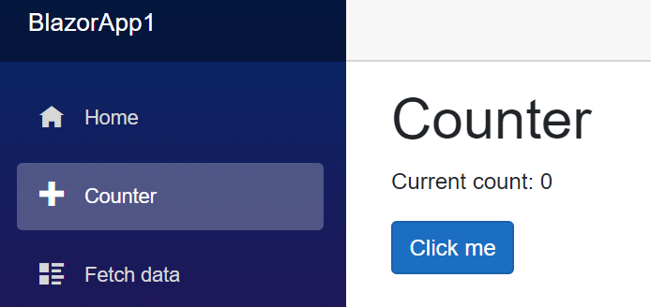
Flux pattern – Fluxor Implementation
Store
IState<Counter>
Computes
Increment Counter Action
ReduceIncrement CounterAction
IDispatcher
Sent to
Dispatch

Slide 26
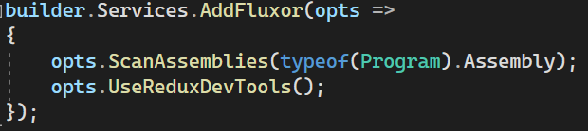
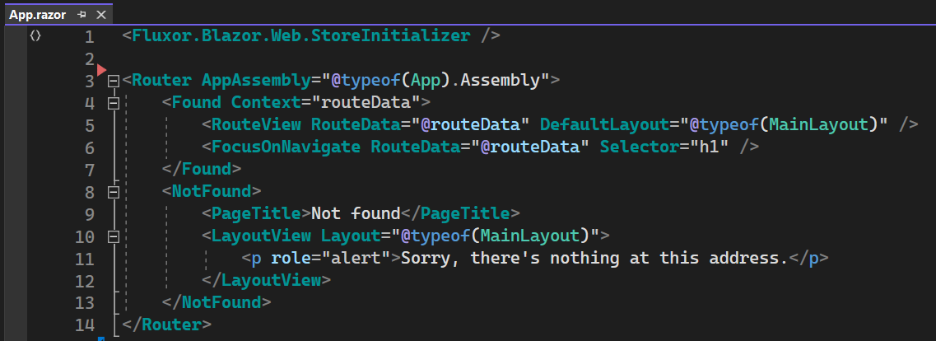
Flux pattern – Wire up

Slide 27
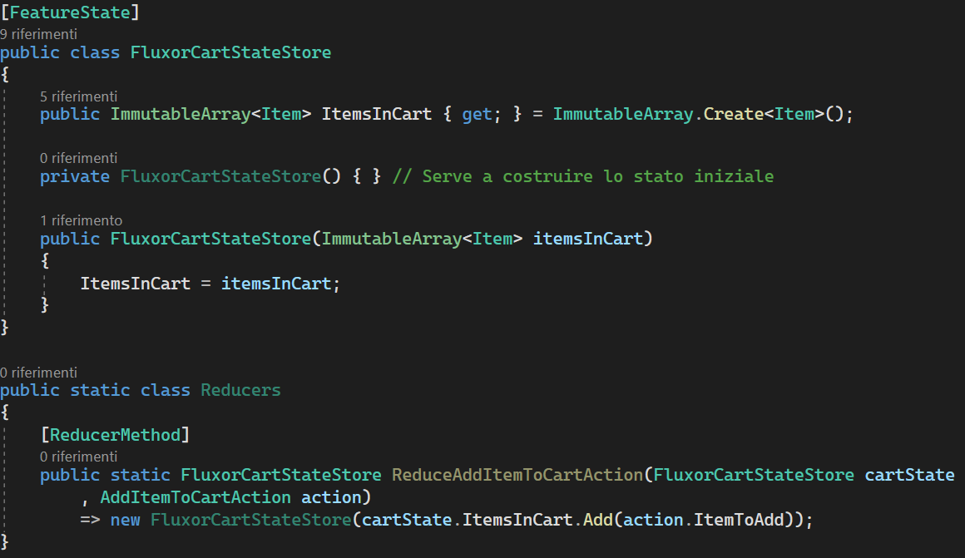
Flux pattern – State Definition

Slide 28
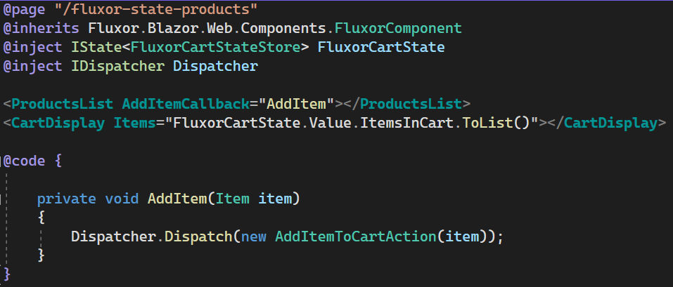
Flux pattern – Use store in a Component

Slide 29
Flux pattern –Reducers

Slide 30
Flux pattern – Pros & Cons
PROS
CONS
Strongly consistent
Verbose (and I haven’t even shown you the Effects part)
Separation of concerns
Steep learning curve
Unit testable
Component testing
ReduxDevTools
Have I already said verbose?
State slices

Slide 31
Flux pattern – Fluxor with effects
Store
Items
Items: [{"name": "name", "price": 10}]
IsLoading: false
IState<Cart>
OnInitialized
Items: [ ]
IsLoading: true
Invia
Reducer
Reducer
Dispatcher
Fetch Items in Cart Action
Fetch Items in Cart Result Action
Ascolta
Invia
Effect
Rest API

Slide 32

Wrap up

Slide 33



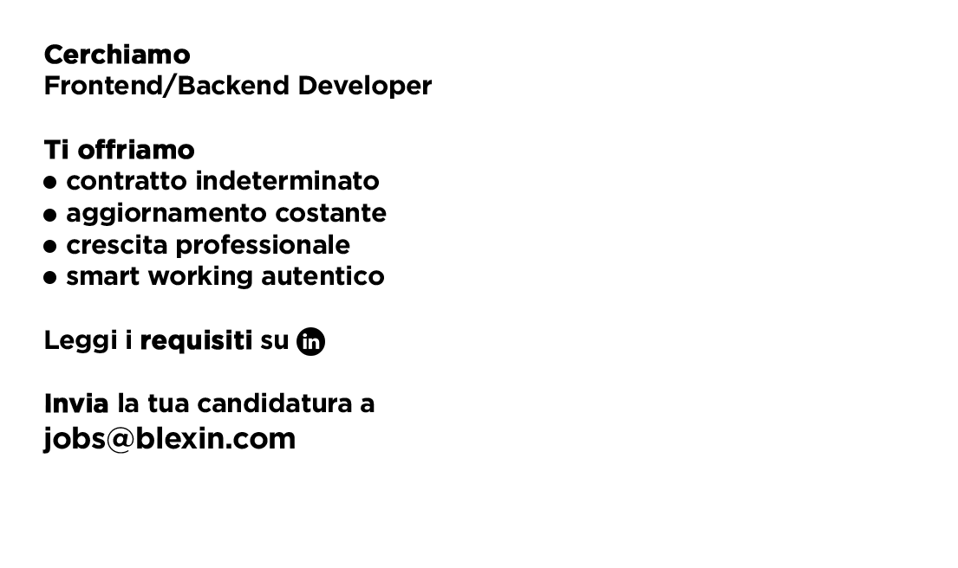


Slide 34


Questions?
{
"Name": "Fabio Spaziani",
"Role": "Junior Architect@ Blexin",
"Mail": "fabio.spaziani@blexin.com"
"GithubProfile": "https://github.com/fabio-sp"
}

Slide 35
Useful Links
BlazorDevIta blog posts
«Comunicazione fra Componenti in Blazor» by Alberto Acerbis
«Gestire lo stato dell’applicazione con Fluxor» by Fabio Spaziani
«Gestione dello stato con Fluxor: side effects e middleware» by Fabio Spaziani
GitHub repos:
This session repository
Fluxor repository

