Slide 1
DIGITAL COMMUNICATION
Unit 11 text 3

Slide 2

There is a problem with digital communication system
when there is a long series of 0 how can i know if it is the signal or if no signal is being senta at all?

Slide 3
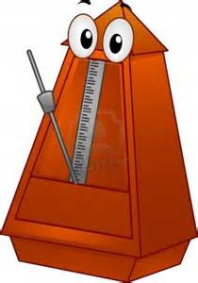
to solve this problem a timing system must be added to communication
this timing system could be asynchronous or synchronous

Slide 4
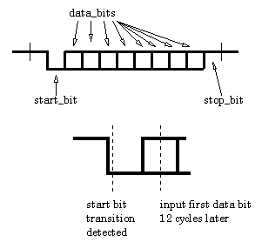
Asynchronous transmission
asynchronous transmission add one bits (called start bit) at the beginning and one bit (called stop bit) at the end of the message.

Slide 5
For example ASCII characters are transmitted using 10 bits instead of 8 (0100 0001→ 1 0100 0001 0)
Start and stop bits are 1 or 0 depending on parity bit

Slide 6
Start and stop bits must be opposite to permit user recognize when the first packet end and the second packet begin.
0100 0001→ 1 0100 0001 0

Slide 7
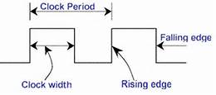
Synchronous transmission
instead synchronizes speed of transmission it uses clock signal

Slide 8
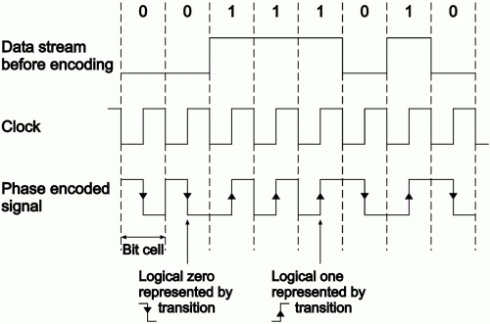
A continual stream of data is then sent between the two nodes

Slide 9
This method is quicker but it probably generates more errors
A solution to this problem include re-synchronization of the clocks and use of check digits to ensure the byte is correctly interpreted and received

Slide 10

Digital communications have got advantages and disadvantages.

Slide 11

The first advantage is the speed
this communication is faster than analog communications

Slide 12
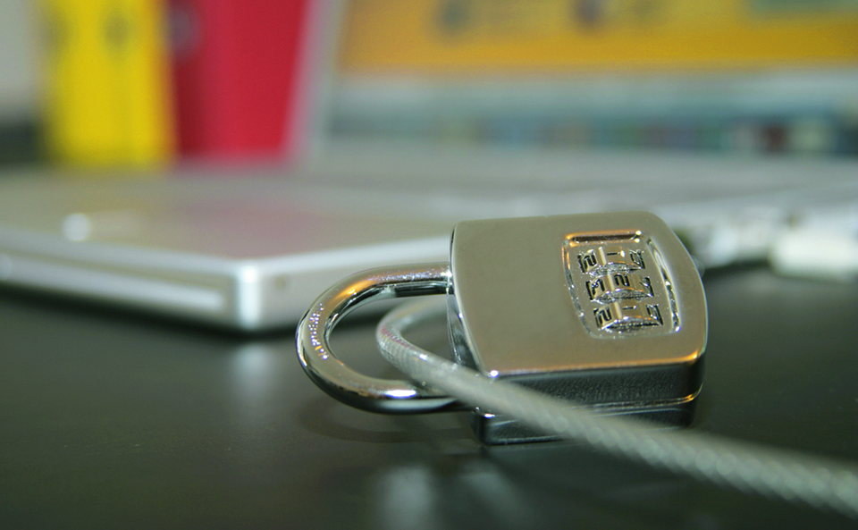
More secure. Digital data can be encrypt using an encryption method

Slide 13

Digital signals can checked for errors

Slide 14

But there aren't only advantages!!

Slide 15
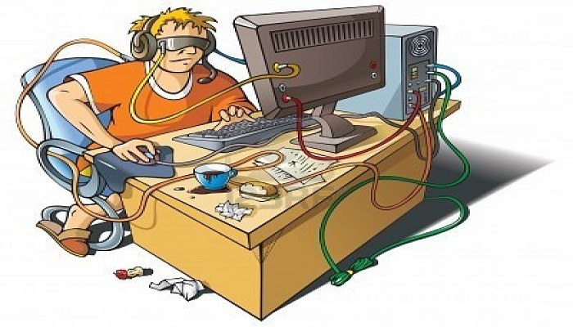
with the digital communications the people don't speak to each other but they use a technological devices to socialize.

