Slide 1
DIGITAL COMMUNICATION
Unit 11 text 3

Slide 2

There is a problem with digital communication system
when there is a long series of 0 how can i know if it is the signal or if no signal is being senta at all?

Slide 3

to solve this problem a timing system must be added to communication
this timing system could be asynchronous or synchronous

Slide 4
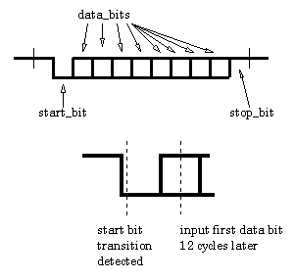
Asynchronous transmission
asynchronous transmission add one bits (called start bit) at the beginning and one bit (called stop bit) at the end of the message.

Slide 5
For example ASCII characters are transmitted using 10 bits instead of 8 (0100 0001→ 1 0100 0001 0)
Start and stop bits are 1 or 0 depending on parity bit

Slide 6
Start and stop bits must be opposite to permit user recognize when the first packet end and the second packet begin.
0100 0001→ 1 0100 0001 0

Slide 7
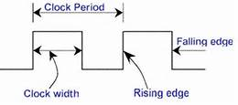
Synchronous transmission
instead synchronizes speed of transmission it uses clock signal

Slide 8
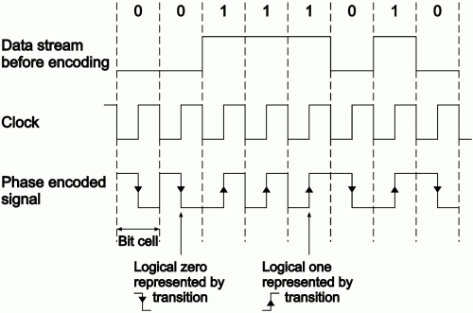
A continual stream of data is then sent between the two nodes

Slide 9
This method is quicker but it probably generates more errors
A solution to this problem include re-synchronization of the clocks and use of check digits to ensure the byte is correctly interpreted and received

