Slide 1



Introduction to Machine Learning
Comprehensive Overview and Key Concepts
Instructor Name
Date

Slide 2

Introduction to Machine Learning
Definition of Machine Learning
Importance and Applications
Types of Machine Learning

Slide 3
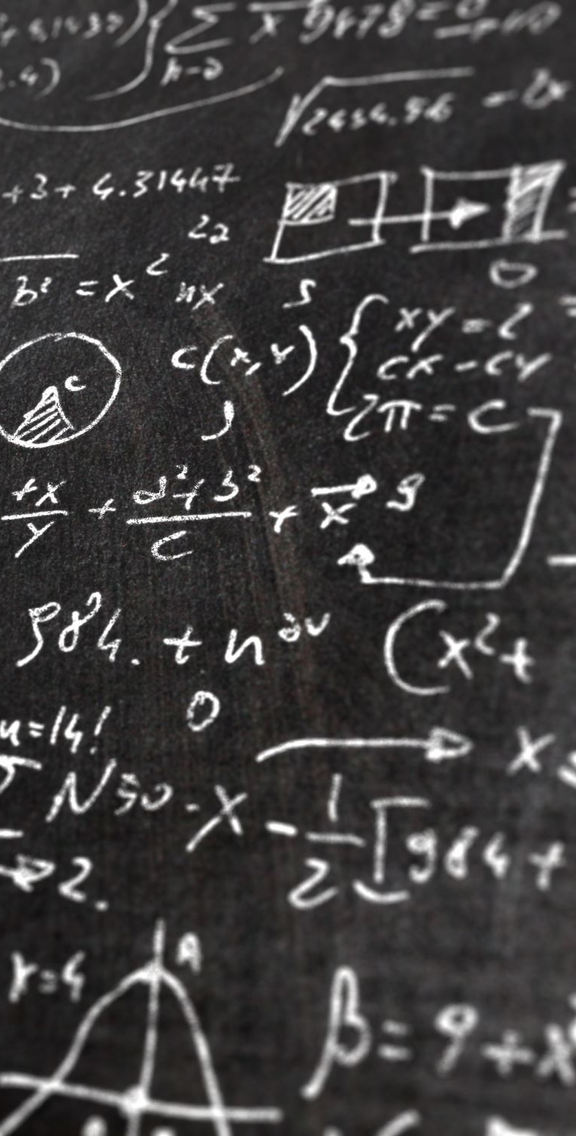
Mathematical Foundations
Linear Algebra Basics
Probability and Statistics Overview
Calculus Essentials for ML

Slide 4

Data Preprocessing
Data Cleaning Techniques
Feature Engineering
Data Normalization and Scaling

Slide 5
Supervised Learning
Introduction to Supervised Learning
Regression Techniques
Classification Methods
Evaluation Metrics

Slide 6
Unsupervised Learning
Introduction to Unsupervised Learning
Clustering Algorithms
Dimensionality Reduction Techniques
Anomaly Detection

Slide 7

Advanced Supervised Learning Algorithms
Ensemble Methods
Random Forest
Gradient Boosting
AdaBoost
Neural Networks Basics
Hyperparameter Tuning

Slide 8

Neural Networks and Deep Learning
Introduction to Neural Networks
Convolutional Neural Networks (CNNs)
Recurrent Neural Networks (RNNs)
Transfer Learning

Slide 9

Large Language Models (LLMs)
Introduction to LLMs
Key Concepts: Transformer Architecture, Attention Mechanism
Main Players in the LLM World
OpenAI
Google
Antrophic
Facebook
Microsoft
Applications and Use Cases
Ethical Considerations and Challenges

Slide 10

Model Evaluation and Validation
Cross-Validation Techniques
Bias-Variance Tradeoff
Overfitting and Underfitting

Slide 11

Practical Implementation
Tools and Libraries
TensorFlow
Keras
Scikit-learn
Model Deployment Strategies
Case Studies and Real-World Applications

Slide 12
Ethics and Best Practices
Ethical Considerations in Machine Learning
Fairness, Accountability, and Transparency
Future Trends in Machine Learning

Slide 13

Conclusion
Recap of Key Topics
Final Thoughts
Q&A Session

Slide 14

References and Further Reading
Suggested Books and Articles
Online Resources and Courses

