Slide 1


Neural Networks Training
Fabio Antonini
Università degli Studi dell’Aquila

Slide 2

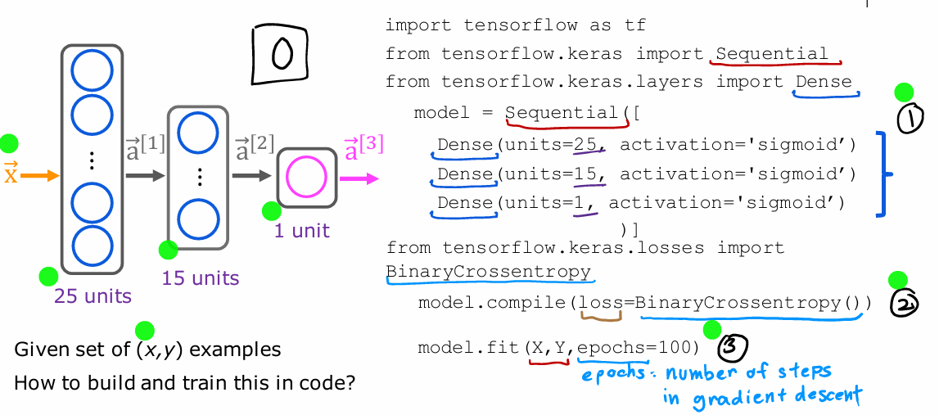

Train a Neural Network in TensorFlow
Notes:
In the last lecture you learned how to carry out inference in the neural network. Now, we're going to go over training of a neural network. I think being able to take your own data and train your own neural network on it is really fun. This week, we'll look at how you could do that. Let's dive in. Let's continue with our running example of handwritten digit recognition recognizing this image as zero or a one. Here we're using the neural network architecture that you saw last week, where you have an input X, that is the image, and then the first hidden
layer was 25 units, second hidden layer with 15 units, and then one output unit. If you're given a training set of examples comprising images X, as was the ground truth label Y, how would you train the parameters of this neural network? Let me go ahead and show you the code that you can use in TensorFlow to train this network. Then in the next few
videos after this, we'll dive into details to explain what the code is actually doing. This is a code you write. This first part may look familiar from the previous week where you are asking TensorFlow to sequentially string together these three layers of a neural network. The first hidden layer with 25 units and sigmoid activation, the second hidden layer, and then finally
the output layer. Nothing new here relative to what you saw last week. Second step is you're to ask TensorFlow to compile the model. The key step in asking TensorFlow to compile
the model is to specify what is the loss function you want to use. In this case we'll use something that goes by the Arcane name of sparse categorical crossentropy. We'll see more in the next lecture what this really is. Then having specified the loss function, the third step is to call the fit function, which tells TensorFlow to fit the model that you specified in step 1 using the loss of the cost function that you specified in step 2 to the dataset X, Y. Back in the first course when we talked about gradient descent, we had to decide how many steps to run gradient descent or how long to run gradient descent, so epochs is a technical term for how many steps of a learning algorithm like gradient descent you may want to run. That's it. Step 1 is
to specify the model, which tells TensorFlow how to compute for the inference. Step 2 compiles the model using a specific loss function, and step 3 is to train the model. That's how you can train a neural network in TensorFlow. As usual, I hope that you people are not just call these lines of code to train the model, but that you also understand what's actually going on behind these lines of code, so you don't just call it without really understanding what's going on. I think this is important because when you're running a learning algorithm, if it doesn't work initially, having that conceptual mental framework of what's really going on will help you debug whenever things don’t work the way you expect. With that, let's go on to the next slide, where we'll dive more deeply into what these steps in the TensorFlow implementation are actually doing.

Slide 3
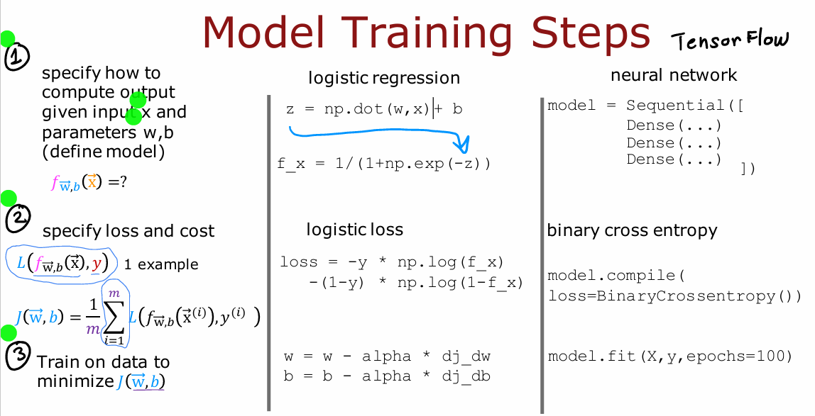
Training details
Notes:
Let's take a look at the details of what the TensorFlow code for training a neural network is actually doing. Let's dive in. Before looking at the details of training in neural network, let's recall how you had trained a logistic regression model in the previous lecture. Step 1 of building a logistic regression model was you would specify how to compute the output given the input feature x and the parameters w and b. Previously we said the logistic regression function predicts f of x is equal to G. The sigmoid function applied to W. product X plus B which was the sigmoid function applied to W.X plus B. If Z is the dot product of W of X plus B, then F of X is 1 over 1 plus e to the negative z, so those first step were to specify what is the input to output function of logistic regression, and that depends on both the input x and the parameters of the model. The second step we had to do to train the linear regression
model was to specify the loss function and also the cost function, so you may recall that the loss function said, if religious regression opus f of x and the ground truth label, the actual label and a training set was y then the loss on that single training example was negative y log f of x minus one minus y times log of one minus f of x. This was a measure of how well is logistic regression doing on a single training example x comma y. Given this definition of a loss function, we then define the cost function, and the cost function was a function of the parameters W and B, and that was just the average that is taking an average overall M training examples of the loss function computed on the M training examples, X1, Y1 through XMYM, and remember that in the convention we're using the loss function is a function of the output of the learning algorithm and the ground truth label as computed over a single
training example whereas the cost function J is an average of the loss function computed over your entire training set. That was step two of what we did when building up logistic regression. Then the third and final step to train a logistic regression model was to use an algorithm specifically gradient descent to minimize that cost function J of WB to minimize it as a function of the parameters W and B. We minimize the cost J as a function of the parameters using gradient descent where W is updated as W minus the learning rate alpha times the derivative of J with respect to W. And B similarly is updated as B minus the learning rate alpha times the derivative of J with respect to B. If these three steps. Step one, specifying how to compute the outputs given the input X and parameters, step 2 specify loss and costs, and step three minimize the cost function we trained logistic regression. The same three steps is how we can train a neural network in TensorFlow. Now let's look at how these three steps map to training a neural network. We'll go over this in greater detail on the next three slides
but really briefly.
Step one is specify how to compute the output given the input x and parameters W and B that's done with this code snippet which should be familiar from last week of specifying the neural network and this was actually enough to specify the computations needed in forward propagation or for the inference algorithm for example. The second step is to compile the model and to tell it what loss you want to use, and here's the code that you use to specify this loss function which is the binary cross entropy loss function, and once you specify this
loss taking an average over the entire training set also gives you the cost function for the neural network, and then step three is to call function to try to minimize the cost as a function of the parameters of the neural network. Let's look in greater detail in these three steps in the context of training a neural network.
The first step,
specify how to compute the output given the input
x and parameters w and b. This code snippet specifies the entire architecture
of the neural network. It tells you that there are 25 hidden units in the
first hidden layer, then the 15 in the next one, and then one output unit and that we're using the
sigmoid activation value. Based on this code snippet, we know also what are
the parameters w1, v1 though the first
layer parameters of the second layer and
parameters of the third layer. This code snippet specifies the entire architecture of the neural network and therefore tells TensorFlow
everything it needs in order to compute the
output x as a function. In order to compute
the output a 3 or f of x as a function of the
input x and the parameters, here we have written w l and
b l. Let's go on to step 2. In the second step, you have to specify what
is the loss function. That will also define the cost function we use to
train the neural network. For the MNIST 01 digit classification
problem is a binary classification problem
and most common by far, loss function to use
is this one is actually the same loss function
as what we had for logistic regression is
negative y log f of x minus 1 minus y times
log 1 minus f of x, where y is the
ground truth label, sometimes also called
the target label y, and f of x is now the output
of the neural network. In the terminology
of TensorFlow, this loss function is called
binary cross entropy. The syntax is to
ask TensorFlow to compile the neural network
using this loss function. Another historical note, carers was originally
a library that had developed independently of TensorFlow is actually totally separate project
from TensorFlow. But eventually it got
merged into TensorFlow, which is why we have tf.Keras library.losses dot the name
of this loss function. By the way, I don't
always remember the names of all the loss
functions and TensorFlow, but I just do a quick
web search myself to find the right name and then
I plug that into my code. Having specified the loss with respect to a single
training example, TensorFlow knows that
it costs you want to minimize is then the average, taking the average over all m training examples of the loss on all of the
training examples. Optimizing this cost
function will result in fitting the neural network to your binary classification data. In case you want to solve a regression problem rather than a classification problem. You can also tell
TensorFlow to compile your model using a
different loss function. For example, if you have a regression problem and if you want to minimize
the squared error loss. Here is the squared error loss. The loss with respect to if your learning
algorithm outputs f of x with a target or
ground truth label of y, that's 1/2 of the squared error. Then you can use this loss
function in TensorFlow, which is to use the maybe more
intuitively named mean squared error loss function. Then TensorFlow will try to minimize the mean squared error. In this expression, I'm
using j of capital w comma capital b to denote
the cost function. The cost function is a function of all the parameters
into neural network. You can think of capital W
as including W1, W2, W3. All the W parameters and the
entire new network and be as including b1, b2, and b3. If you are optimizing the cost function
respect to w and b, if we tried to optimize
it with respect to all of the parameters
in the neural network. Up on top as well, I had written f of x as the
output of the neural network, but we can also write f of w b if we want to emphasize that the output of the neural network as a function of x depends on all the parameters in all the layers of
the neural network. That's the loss function
and the cost function. In TensorFlow,
this is called the binary cross-entropy
loss function. Where does that name come from? Well, it turns out in
statistics this function on top is called the
cross-entropy loss function, so that's what
cross-entropy means, and the word binary just reemphasizes or
points out that this is a binary classification
problem because each image is either
a zero or a one. Finally, you will ask TensorFlow to minimize
the cross-function. You might remember the
gradient descent algorithm from the first course. If you're using
gradient descent to train the parameters
of a neural network, then you are repeatedly, for every layer l and
for every unit j, update wlj according to wlj minus the learning rate alpha times the
partial derivative with respect to that parameter
of the cost function j of wb and similarly for
the parameters b as well. After doing, say, 100 iterations of gradient
descent, hopefully, you get to a good value
of the parameters. In order to use
gradient descent, the key thing you need to compute is these partial
derivative terms. What TensorFlow does, and, in fact, what is standard
in neural network training, is to use an algorithm
called backpropagation in order to compute these
partial derivative terms. TensorFlow can do all of
these things for you. It implements
backpropagation all within this function called fit. All you have to do is
call model.fit, x, y as your training set, and tell it to do so for 100
iterations or 100 epochs. In fact, what you see later
is that TensorFlow can use an algorithm that
is even a little bit faster than
gradient descent, and you'll see more about
that later this week as well. Now, I know that we're
relying heavily on the TensorFlow library in order to implement a neural network. One pattern I've seen across multiple ideas is as
the technology evolves, libraries become more mature, and most engineers
will use libraries rather than implement
code from scratch. There have been
many other examples of this in the
history of computing. Once, many decades ago, programmers had to implement their own sorting
function from scratch, but now sorting
libraries are quite mature that you probably call someone else's
sorting function rather than implement
it yourself, unless you're taking a
computing class and I ask you to do it as an exercise. Today, if you want to compute the square
root of a number, like what is the square
root of seven, well, once programmers had to write their own code
to compute this, but now pretty
much everyone just calls a library to
take square roots, or matrix operations, such as multiplying
two matrices together. When deep learning was
younger and less mature, many developers, including me, were implementing
things from scratch using Python or C++ or
some other library. But today, deep learning
libraries have matured enough that most developers
will use these libraries, and, in fact, most commercial implementations
of neural networks today use a library like
TensorFlow or PyTorch. But as I've mentioned, it's still useful to
understand how they work under the hood so that if something
unexpected happens, which still does with
today's libraries, you have a better chance
of knowing how to fix it. Now that you know how to
train a basic neural network, also called a
multilayer perceptron, there are some things
you can change about the neural network that will
make it even more powerful. In the next video, let's take a look
at how you can swap in different
activation functions as an alternative to the sigmoid activation
function we've been using. This will make your
neural networks work even much better.

Slide 4
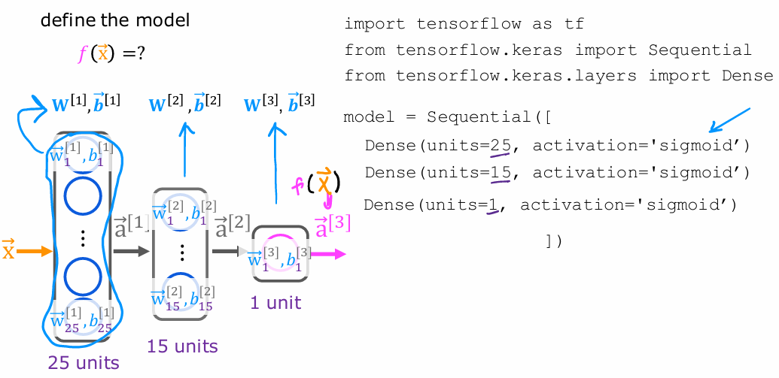
1. Create the model
Notes:
The first step, specify how to compute the output given the input x and parameters w and b. This code snippet specifies the entire architecture of the neural network. It tells you that there are 25 hidden units in the first hidden layer, then the 15 in the next one, and then one output unit and that we're using the sigmoid activation value. Based on this code snippet, we know also what are the parameters w1, v1 though the first layer parameters of the second layer and parameters of the third layer. This code snippet specifies the entire architecture of the neural network and therefore tells TensorFlow everything it needs to compute the output x as a function. To compute the output a 3 or f of x as a function of the
input x and the parameters, here we have written w l and b l. Let's go on to step 2.

Slide 5
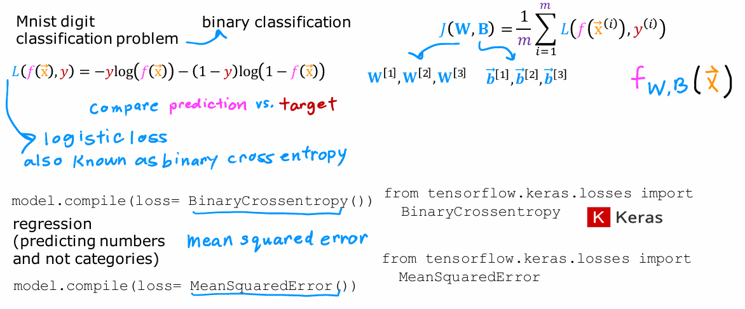
2. Loss and cost functions
Notes:
In the second step, you have to specify what is the loss function. That will also define the cost function we use to train the neural network. For the MNIST 01 digit classification
problem is a binary classification problem and most common by far, loss function to use is this one is actually the same loss function as what we had for logistic regression is
negative y log f of x minus 1 minus y times log 1 minus f of x, where y is the ground truth label, sometimes also called the target label y, and f of x is now the output of the neural network. In the terminology of TensorFlow, this loss function is called binary cross entropy. The syntax is to ask TensorFlow to compile the neural network using this loss function. Another historical note, Kera was originally a library that had developed independently of TensorFlow is actually totally separate project from TensorFlow. But eventually it got
merged into TensorFlow, which is why we have tf.Keras library.losses dot the name of this loss function. By the way, I don’t always remember the names of all the loss
functions and TensorFlow, but I just do a quick web search myself to find the right name and then I plug that into my code. Having specified the loss with respect to a single
training example, TensorFlow knows that it costs you want to minimize is then the average, taking the average over all m training examples of the loss on all of the
training examples. Optimizing this cost function will result in fitting the neural network to your binary classification data. In case you want to solve a regression problem rather than a classification problem. You can also tell TensorFlow to compile your model using a different loss function. For example, if you have a regression problem and if you want to minimize
the squared error loss. Here is the squared error loss. The loss with respect to if your learning algorithm outputs f of x with a target or ground truth label of y, that's 1/2 of the squared error. Then you can use this loss function in TensorFlow, which is to use the maybe more intuitively named mean squared error loss function. Then TensorFlow will try to minimize the mean squared error. In this expression, I’m using j of capital w comma capital b to denote the cost function is a function of all the parameters into neural network. You can think of capital W as including W1, W2, W3. All the W parameters and the entire new network and be as including b1, b2, and b3. If you are optimizing the cost function respect to w and b, if we tried to optimize it with respect to all of the parameters in the neural network. Up on top as well, I had written f of x as the output of the neural network, but we can also write f of w b if we want to emphasize that the output of the neural network as a function of x depends on all the parameters in all the layers of the neural network. That's the loss function and the cost function. In TensorFlow, this is called the binary cross-entropy loss function. Where does that name come from? Well, it turns out in statistics this function on top is called the cross-entropy loss function, so that's what cross-entropy means, and the word binary just reemphasizes or points out that this is a binary classification problem because each image is either
a zero or a one.

Slide 6
Grazie per l’attenzione
Fabio Antonini
Università degli Studi dell’Aquila
mario.rossi@univaq.it

