Slide 1


Classification
Fabio Antonini - Giulio Antonini
Università degli Studi dell’Aquila
Introduction to Machine Learning for Engineers

Slide 2

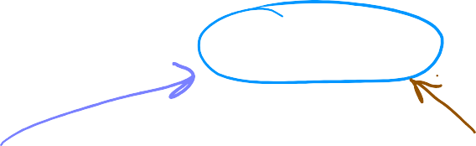
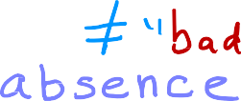
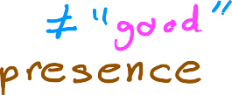

Motivations
Classification
Question
Answer “𝑦”
Is this email spam? no yes Is the transaction fraudulent?no yes Is the tumor malignant? no yes
𝑦 can only be one of two values
false true
0 1
“binary classification”
Useful classification
Class = category
“negative class”
“positive class”
Notes:
This week, you learn about classification where your output variable y can take on only one of a small handful of possible values instead of any number in an infinite range of numbers. It turns out that linear regression is not a good algorithm for classification problems. Let's take a look at why and this will lead us into a different
algorithm called logistic regression. Which is one of the most popular and most widely used learning algorithms today. Here are some examples of
classification problems recall the example of trying to figure out whether an email is spam. So the answer you want to output is going to be either a no or a yes. Another example would be figuring out if an online financial transaction is fraudulent. Fighting online financial fraud is something I once worked on and it was strangely exhilarating. Because I knew there were forces out there trying to steal money and my team's job was to stop them. So the problem is given a financial transaction. Can your learning algorithm figure out is this transaction fraudulent, such as what this credit card stolen? Another example we’ve touched on before was trying to classify a tumor as malignant versus not. In each of these problems the variable that you want to predict can only be one of two possible values. No or yes. This type of classification problem where there are only two possible outputs is called binary classification. Where the word binary refers to there being only two possible classes or two possible categories. In these problems I will use the terms class and category relatively interchangeably. They mean basically the same thing. By convention we can refer to these two classes or categories in a few common ways. We often designate clauses as no or yes or sometimes equivalently false or true or very commonly using the numbers zero or one. Following the common convention in computer science with zero denoting falls and one denoting true. I'm usually going to use the numbers zero and one to represent the answer y. Because that will fit in most easily with the types of learning algorithms we want to implement. But when we talk about it will often say no or yes or false or true as well. One of the technologies commonly used is to call the false or zero class. The negative class and the true or the one class, the positive class. For example, for spam classification, an email that is not spam may be referred to as a negative example. Because the output to the question of is a spam. The output is no or zero. In contrast, an email that has spam might be referred to as a positive training example. Because the answer to is it spam is yes or true or one to be clear, negative and positive. Do not necessarily mean bad versus good or evil versus good. It's just that negative and positive examples are used to convey the concepts of absence or zero or false vs the presence or true or one of something you might be looking for. Such as the absence or presence of the spam illness or the spam property of an email or the absence of presence of broadening activity or absence of presence of malignancy of the tumor. Between non spam and spam emails. Which one you call false or zero and which one you call true or one is a little bit arbitrary. Often either choice could work. So, different engineer might actually swap it around and have the positive class B. The presence of a good email or the possible causes be the presence of a real financial transaction or a healthy patient. So how do you build a classification algorithm?
Examples of classification problems are things like: identifying email as Spam or Not Spam or determining if a tumor is malignant or benign. In particular, these are examples of binary classification where there are two possible outcomes. Outcomes can be described in pairs of 'positive'/'negative' such as 'yes'/'no, 'true'/'false' or '1'/'0'.
Plots of classification data sets often use symbols to indicate the outcome of an example. In the plots below, 'X' is used to represent the positive values while 'O' represents negative outcomes.

Slide 3









Motivations
(yes) 1
malignant?
(no) 0
tumor size 𝑥
(diameter in cm)
benign
malignant
benign
malignant
Notes:
Here's the example of a training set for classifying if the tumor is malignant. A class one, positive class, yes class or benign, class zero or negative class. I plotted both the tumor size on the horizontal axis as well as the label Y on the vertical axis. By the way, in week one, when we first talked about classification. This is how we previously visualized it on the number line except that now we're calling the classes zero. And one and plotting them on the vertical axis.
Note in the plots above:
In the single variable plot, positive results are shown both a red 'X's and as y=1. Negative results are blue 'O's and are located at y=0.
Recall in the case of linear regression, y would not have been limited to two values but could have been any value.
In the two-variable plot, the y axis is not available. Positive results are shown as red 'X's, while negative results use the blue 'O' symbol.
Recall in the case of linear regression with multiple variables, y would not have been limited to two values and a similar plot would have been three-dimensional.

Slide 4




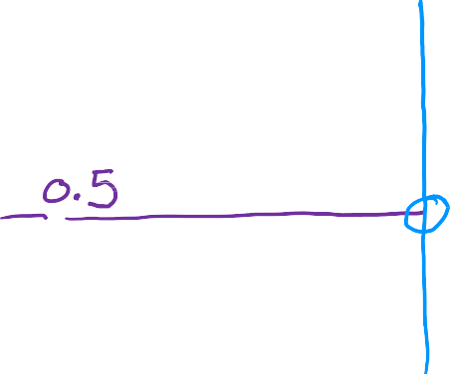

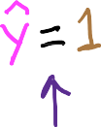





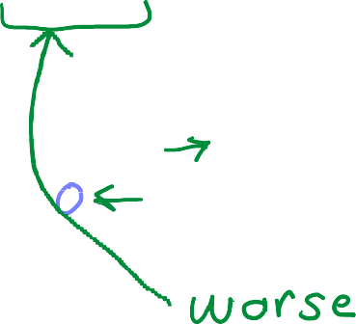





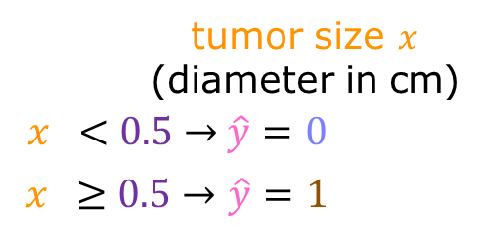
Motivations
^{𝑓}𝑤,𝑏
𝑥 = 𝑤𝑥 + 𝑏
^{𝑓}𝑤,𝑏
𝑥 = 𝑤𝑥 + 𝑏
(yes) 1
threshold
malignant?
(no) 0
tumor size 𝑥
(diameter in cm)
𝑥 < 0.5 → $\hat{y}$ = 0
𝑥 ≥ 0.5 → $\hat{y}$ = 1
if 𝑓_{𝑤,𝑏}
if 𝑓_{𝑤,𝑏}
Next: logistic regression used for classification
Lab: C1_W3_Lab01_Classification_Soln.ipynb
Notes:
Now, one thing you could try on this training set is to apply the album you already know, linear regression and try to fit a straight line to the data. If you do that, maybe the straight line looks like this, right? And that's your F effects. Linear regression predicts not just the values zero and one. But all numbers between zero and one or even less than zero or greater than one. But here we want to predict categories. One thing you could try is to pick a threshold of say 0.5. So that if the model outputs a value below 0.5, then you predict why equal zero or not malignant. And if the model outputs a number equal to or greater than 0.5,
then predict Y equals one or malignant. Notice that this threshold value of 0.5 intersects the best fit straight line at this point. So if you draw this vertical line here, everything to the left ends up with a prediction of y equals zero. And everything on the right ends up with the prediction of y equals one. Now, for this particular data set it looks like linear regression could do something reasonable.
But now let's see what happens if your dataset has one more training example. This one way over here on the right. Let's also extend the horizontal axis. Notice that this training example shouldn't really change how you classify the data points. This vertical dividing line that we drew just now still makes sense as the cut off where tumors smaller than this should be classified as zero. And tumors greater than this should be classified as one. But once you've added this extra training example on the right. The best fit line for linear regression will shift over like this. And if you continue using the threshold of 0.5, you now notice that everything to the left of this point is predicted at zero non malignant. And everything to the right of this point is predicted to be one or malignant. This isn't what we want because adding
that example way to the right shouldn't change any of our conclusions about how to classify malignant versus benign tumors. But if you try to do this
with linear regression, adding this one example which feels like it shouldn't be changing anything. It ends up with us learning a much worse
function for this classification problem. Clearly, when the tumor is large, we want the algorithm to classify it as malignant. So what we just saw was linear
regression causes the best fit line. When we added one more example to the right to shift over. And does the dividing line also called the decision boundary to shift over to the right. You learn more about the decision boundary in the next slides, you also learn about an algorithm called logistic regression. Where the output value of the outcome will always be between zero and one. And the average will avoid these problems that we're seeing on this slide. By the way one thing confusing about the name logistic regression is that even though it has the word of regression in it is actually used for classification. Don't be confused by the name which
was given for historical reasons. It's actually used to solve binary classification problems with output label y is either zero or one. In the upcoming optional lab you also get to take a look at what happens when you try to use linear regression for classification. Sometimes you get lucky and it may work but often it will not work well. Which is why I don't use linear regression myself for classification. In the optional lab, you see an interactive plot that attempts to classify between two categories. And hopefully notice how this often doesn't work very well. Which is okay because that motivates the need for a different model to do classification talks. So please check out this optional lab and after that we're going to the next slides to look at logistic regression for classification.
we can start by using our linear regression model, $f_{\mathbf{w},b}(\mathbf{x}^{(i)}) = \mathbf{w} \cdot \mathbf{x}^{(i)} + b$, to predict $y$ given $x$. - However, we would like the predictions of our classification model to be between 0 and 1 since our output variable $y$ is either 0 or 1. - This can be accomplished by using a "sigmoid function" which maps all input values to values between 0 and 1. Let's implement the sigmoid function and see this for ourselves.

Slide 5
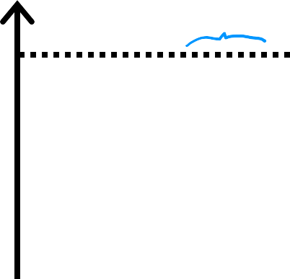




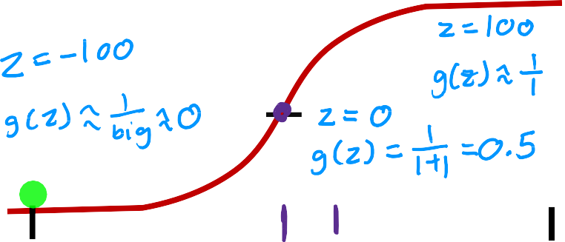







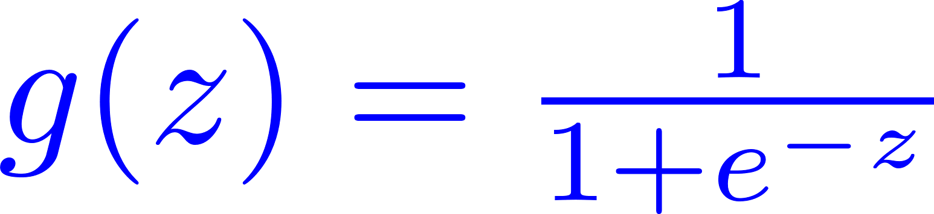
Logistic regression
Want outputs between 0 and 1
(yes) 1
threshold
malignant?
1
0.5
0
sigmoid function
logistic function
outputs between 0 and 1
𝑧
3
(no) 0
tumor size 𝑥
(diameter in cm)
-3
₌ 1
𝑔 𝑧
0 < 𝑔 𝑧 < 1
1+𝑒^{−𝑧}
The formula for a sigmoid function is as follows:
z (the input to the sigmoid function), is the output of a linear regression model.
Notes:
Let's talk about logistic regression, which is probably the single most widely used classification algorithm in the world. This is something that I use
all the time in my work. Let's continue with the example of classifying whether a tumor is malignant. Whereas before we're going to use the label 1 or yes to the positive class to represent malignant tumors, and zero or no and negative examples to represent benign tumors. Here's a graph of the dataset where the horizontal axis is the tumor size and the vertical axis takes on only values of 0 and 1, because is a classification problem. You saw in the last slides that linear regression is not a good algorithm for this problem. In contrast, what logistic regression we end up doing is fit a curve that looks like this, S-shaped curve to this dataset. For this example, if a patient comes in with a tumor of this size, which I'm showing on the x-axis, then the algorithm will output 0.7 suggesting that is
closer or maybe more likely to be malignant and benign. Will say more later what 0.7 actually means in this context. But the output label y is never 0.7 is only ever 0 or 1. To build out to the logistic regression algorithm, there's an important mathematical function I like to describe which is called the Sigmoid function, sometimes also referred to as the logistic function. The Sigmoid function looks like this. Notice that the x-axis of the graph on the left and right are different. In the graph to the left on the x-axis is the tumor size, so is all positive numbers. Whereas in the graph on the right, you have 0 down here, and the horizontal axis takes on both negative and positive values and have label the horizontal axis Z.

Slide 6


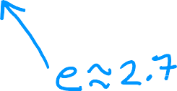
Logistic regression
Want outputs between 0 and 1
^{𝑓}w,𝑏
x
w ∙ x + 𝑏
1
𝑧 =
0.5
₌ 1
0
sigmoid function
logistic function
𝑧
3
𝑔 𝑧
1+𝑒^{−𝑧}
-3
1
x = 𝑔(w ∙ x + 𝑏) =
_{1 + 𝑒}−
^{𝑓}w,𝑏
w∙x+𝑏
outputs between 0 and 1
“logistic regression”
₌ 1
𝑔 𝑧
0 < 𝑔 𝑧 < 1
1+𝑒^{−𝑧}
Notes:
I'm showing here just a range of negative 3 to plus 3. So the Sigmoid function outputs value is between 0 and 1. If I use g of z to denote this function, then the formula of g of z is equal to 1 over 1 plus e to the negative z. Where here e is a mathematical constant that takes on a value of about 2.7, and so e to the
negative z is that mathematical constant to the power of negative z. Notice if z where really be, say a 100, e to the negative z is e to the negative 100 which
is a tiny number. So this ends up being 1 over 1 plus a tiny little number, and so the denominator will be basically very close to 1. Which is why when z is large, g of z that is a Sigmoid function of z is going to be very close to 1. Conversely, you can also check for yourself that when z is a very large negative number, then g of z becomes 1 over a giant number, which is why g of z is very close to 0. That's why the sigmoid function has this shape where it starts very close to zero and slowly builds up or grows to the value of one. Also, in the Sigmoid function when z is equal to 0, then e to the negative z is e to the negative 0 which is equal to 1, and so g of z is equal to 1 over 1 plus 1 which is 0.5, so that's why it passes the vertical axis at 0.5. Now, let's use this to build up to the logistic regression algorithm. We're going to do this in two steps. In the first step, I hope you remember that a straight line function, like a linear regression function can be defined as w. product of x plus b. Let's store this value in a variable which I’m going to call z, and this will turn out to be the same z as the one you saw on the previous slide, but we'll get to
that in a minute. The next step then is to take this value of z and pass it to the Sigmoid function, also called the logistic function, g. Now, g of z then outputs a value
computed by this formula, 1 over 1 plus e to the negative z. There's going to be between 0 and 1. When you take these two equations and put them together, they then give you the logistic regression model f of x, which is equal to g of wx plus b. Or equivalently g of z, which is equal to this formula over here. This is the logistic
regression model, and what it does is it inputs feature or set of features X and outputs a number between 0 and 1.
As you can see, the sigmoid function approaches 0 as z goes to large negative values and approaches 1 as z goes to large positive values.
A logistic regression model applies the sigmoid to the familiar linear regression model as g(z) with z=wx+b.

Slide 7
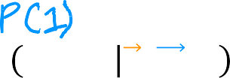
Interpretation of logistic regression output
1
^{𝑓}w,𝑏
x =
_{1 + 𝑒}−
𝑓_{w,𝑏} x = 𝑃 𝑦 = 1 x; w,𝑏
Probability that 𝑦 is 1,
given input x, parameters w,𝑏
w∙x+𝑏
“probability” that class is 1
Example:
𝑥 is “tumor size”
𝑦 is 0 (not malignant)
or 1 (malignant)
𝑃(𝑦 = 0) + 𝑃(𝑦 = 1) = 1
^{𝑓}w,𝑏
x = 0.7
70% chance that 𝑦 is 1
Notes:
Next, let's take a look at how to interpret the output of logistic regression. We'll return to the tumor classification example. The way I encourage
you to think of logistic regressions output is to think of it as outputting the probability that the class or the label y will be equal to 1 given a certain input x. For example, in this application, where x is the tumor size and y is either 0 or 1, if you have a patient come in and she has a tumor of a certain size x, and if based on this input x, the model I'll plus 0.7, then what that means is that the model is predicting or the model thinks there's a 70 percent chance that the true label y would be equal to 1 for this patient. In other words, the model is telling us that it thinks the patient has a 70 percent chance of the tumor turning
out to be malignant. Now, let me ask you a question. See if you can get this right. We know that y has to be either 0 or 1, so if y has a 70 percent
chance of being 1, what is the chance that it is 0? So y has got to be either 0 or 1, and thus the probability of it being 0 or 1 these two numbers have to add up to one or to a 100 percent chance. That's why if the chance of y being 1 is 0.7 or 70 percent chance, then the chance of it being 0 has got to be 0.3 or 30 percent chance. If someday you read research papers or blog pulls of all logistic regression, sometimes you see this notation that f of x is equal to p of y equals 1 given the input features x and with parameters w and b.
What the semicolon here is used to denote is just that w and b are parameters that affect this computation of what is the probability of y being equal to 1 given the input feature x? For the purpose of this class, don't worry too much about what this vertical line and what the semicolon mean. You don't need to remember or follow any of this mathematical notation for this class. I'm mentioning this only because you may see this in other places. In the optional lab that follows this video, you also get to see how the Sigmoid function is implemented in code. You can see a plot that uses the Sigmoid function so as to do better on the
classification tasks that you saw in the previous optional lab. Remember that the code will be provided to you, so you just have to run it. I hope you take a look and
get familiar with the code.
You now know what is the logistic regression model as well as the mathematical formula that defines logistic regression. For a long time, a lot of Internet advertising
was actually driven by basically a slight variation of logistic regression. This was very lucrative for some large companies, and this is basically the algorithm that decided what ad was shown to you and many others on some large websites. Now, there's, even more, to learn about this algorithm. In the next slides, we'll take a look at the details of logistic regression. We'll look at some visualizations and also examines something called the decision boundary. This will give you a
few different ways to map the numbers that this model outputs, such as 0.3, or 0.7, or 0.65 to a prediction of whether y is actually 0 or 1. Let's go on to the
next slides to learn more about logistic regression.

Slide 8
Decision boundary
1
→→
1
g(z)
→
f
( )
→
x = g( w x + b) =
w,b
−(→w →x + b)
0.5
1 + e
= &₍y = 1 '; →w ,b₎
0
z
Threshold
→
^{f→}w ,b(x)
Is f→_{w ,b}(→x ) ≥ 0.5?
Yes: y^ = 1
When is
f→_{w ,b}(→x ) ≥ 0.g 5(?z) ≥ 0.5
z ≥ 0
→w→x + b ≥ 0
y^ = 1
z = →w →x + b
No: y^ = 0
z < 0
→w→x + b < 0
1
1 + e^{−z}
g(z) =
_{y}^
= 0
Andrew Ng
Lab: C1_W3_Lab02_Sigmoid_function_Soln.ipynb
Notes:
Now, let's take a look at the decision boundary to get a better sense of how logistic regression is computing these predictions. To recap, here's how the logistic regression models outputs are computed in two steps. In the first step, you compute z as w.x plus b. Then you apply the Sigmoid function g to this value z. Here again, is the formula for the Sigmoid function.
Another way to write this is we can say f of x is equal to g, the Sigmoid function, also called the logistic function, applied to w.x plus b, where this is of course, the value of z. If you take the definition of the Sigmoid function and plug in the definition of z, then you find that f of x is equal to this formula over here, 1 over 1 plus e to the negative z, where z is wx plus b. You may remember we said in the previous video that we interpret this as the probability that y is equal to 1 given x and with
parameters w and b. This is going to be a number like maybe a 0.7 or 0.3. Now, what if you want to learn the algorithm to predict. Is the value of y going
to be zero or one? Well, one thing you might do is set a threshold above which you predict y is one, or you set y hat to prediction to be equal to one and below which you might say y hat, my prediction is going to be equal to zero.
A common choice would be to pick a threshold of 0.5 so that if f of x is greater than or equal to 0.5, then predict y is one. We write that prediction as y hat equals 1, or if f of x is less than 0.5, then predict y is 0, or in other words, the prediction y hat is equal to 0. Now, let's dive deeper into when the model would predict one. In other words, when is f of x greater than or equal to 0.5.
We'll recall that f of x is just equal to g of z. So f is greater than or equal to 0.5 whenever g of z is greater than or equal to 0.5. But when is g of z greater
than or equal to 0.5? Well, here's a Sigmoid function over here. So g of z is greater than or equal to 0.5 whenever z is greater than or equal to 0. That is whenever z is on the right half of this axis.
Finally, when is z greater than or equal to zero? Well, z is equal to w.x plus b, so z is greater than or equal to zero whenever w.x plus b is greater than or equal to zero. To recap, what you've seen here is that the model predicts 1 whenever w.x plus b is greater than or equal to 0.
Conversely, when w.x plus b is less than zero, the algorithm predicts y is 0. Given this, let's now visualize how the model
makes predictions.

Slide 9
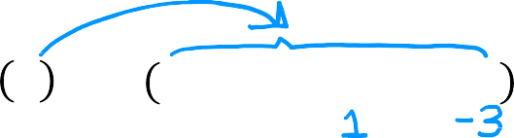

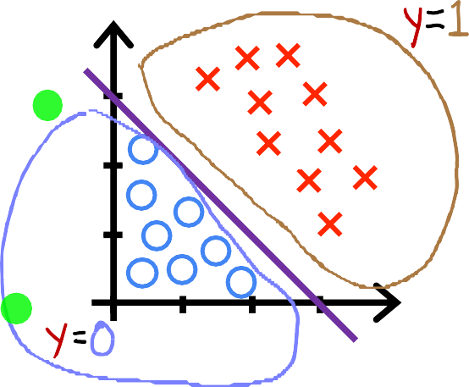
Decision boundary
^{𝑓}w,𝑏
x = 𝑔 𝑧 = 𝑔 𝑤₁𝑥₁ + 𝑤₂𝑥₂ + 𝑏
Decision boundary
𝑧 = w ∙ x + 𝑏 = 0
𝑧 = 𝑥₁ + 𝑥₂ − 3 = 0
𝑥₁ + 𝑥₂ = 3
𝑥₂
3
𝑥₁ + 𝑥₂ ≥ 3
𝑥₁ + 𝑥₂ < 3
2
1
1 2 3
𝑥₁
Notes:
I'm going to take an example of a classification problem where you have two features, x1 and x2 instead of just one feature. Here's a training set where
the little red crosses denote the positive examples and the little blue circles denote negative examples. The red crosses corresponds to y equals 1, and the blue circles
correspond to y equals 0. The logistic regression model will make predictions using this function f of x equals g of z, where z is now this expression over here, w1x1 plus w2x2 plus b, because we have two features x1 and x2. Let's just say for this example that the value of the parameters are w1 equals 1, w2 equals 1, and b
equals negative 3.
Let's now take a look at how logistic regression makes predictions. In particular, let’s figure out when wx plus b is greater than equal to 0 and when wx plus
b is less than 0. To figure that out, there's a very interesting line to look at, which is when wx plus b is exactly equal to 0. It turns out that this line is also called the decision boundary because that's the line where you're just almost neutral about whether y is 0 or y is 1. Now, for the values of the parameters w_1, w_2, and b that we had written down above, this decision boundary is just x_1 plus x_2 minus 3. When is x_1 plus x_2 minus 3 equal to 0? Well, that will correspond to the line x_1 plus x_2 equals 3, and that is this line shown over here. This line turns out to be the decision boundary, where if the features x are to the right of this line, logistic regression would predict 1 and to the left of this line, logistic regression with predicts 0. In other words, what we have just visualize is the decision boundary for logistic regression when the parameters w_1, w_2, and b are 1,1 and negative 3. Of course, if you had a different choice of the parameters, the decision boundary
would be a different line.

Slide 10

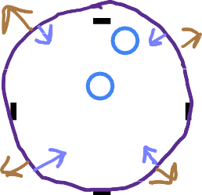






Non-linear decision boundaries
𝑥₂
𝑥 ² + 𝑥₂ ² ≥ 1
1
$$\hat{y}=1$$
𝑓_{w,𝑏} x = 𝑔 𝑧 = 𝑔(
𝑤₁𝑥 ² + 𝑤₂𝑥 ²+b
1 2
)
1
decision boundary
𝑧 = 𝑥 ² + 𝑥 ² − 1 = 0
1 2
𝑥₁
−1
1
𝑥 ² + 𝑥 ² = 1
1 2
−1
𝑥₁ ² + 𝑥₂ ² < 1
$$\hat{y}=0$$
Notes:
Now let's look at a more complex example where the decision boundary is no longer a straight line. As before, crosses denote the class y equals 1, and the little circles denote the class y equals 0. Earlier last week, you saw how to use polynomials in linear regression, and you can do the same in logistic regression. This set z to be w_1, x_1 squared plus w_2, x_2 squared plus b. With this choice of features, polynomial features into a logistic regression. F of x, which equals g of z, is now g of this expression over here. Let's say that we ended up choosing w_1 and w_2 to be 1 and b to be negative 1. Z is equal to 1 times x_1 squared plus 1 times
x_2 squared minus 1. The decision boundary, as before, will correspond to when z is equal to 0. This expression will be equal to 0 when x_1 squared plus x_2
squared is equal to 1. If you plot on the diagram on the left, the curve corresponding to x_1 squared plus x_2 squared equals 1, this turns out to be the circle. When x_1 squared plus x_2 squared is greater than or equal to 1, that's this area outside the circle and that's when you predict y to be 1. Conversely, when x_1 squared plus x_2 squared is less than 1, that's this area inside the circle and that's when you predict y to be 0.

Slide 11


Non-linear decision boundaries
x₂
x₁
f→_{w ,b}(→x ) = g(z) = g(w₁x₁ + w₂x₂
2
2
+w x + w x
x + w x
3 4 1 2
5
1
2
3
+ w x +⋯+ b)
6
1
x₂
x₁
Lab: C1_W3_Lab03_Decision_Boundary_Soln.ipynb
Notes:
Can we come up with even more complex decision boundaries than these? Yes, you can. You can do so by having even higher-order polynomial terms. Say z is w_1, x_1 plus w_2, x_2 plus w_3, x_1 squared plus w_4, x_1, x_2 plus w_5, x_2 squared. Then it's possible you can get even more complex decision boundaries.
The model can define decision boundaries, such as this example, an ellipse just like this, or with a different choice of the parameters. You can even get more
complex decision boundaries, which can look like functions that maybe looks like that. So this is an example of an even more complex decision boundary than the ones we’ve seen previously. This implementation of logistic regression will predict y equals 1 inside this shape and outside the shape will predict y equals 0. With these polynomial features, you can get very complex decision boundaries. In other words, logistic regression can learn to fit pretty complex data. Although if you were to not include any of these higher-order polynomials, so if the only features you use are x_1, x_2, x_3, and so on, then the decision boundary for logistic regression will always be linear, will always be a straight line.

Slide 12



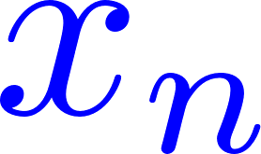



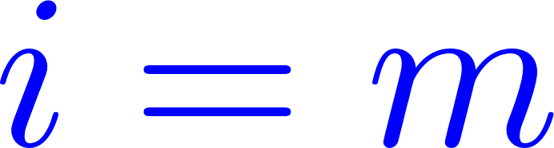
Cost function for logistic regression
tumor size (cm)
… patient’s age malignant?
𝑖 = 1, … , 𝑚
𝑗 = 1, … , 𝑛
10 |  | 52 | 1
2 |  | 73 | 0
5 |  | 55 | 0
12 |  | 49 | 1
… |  | … | …
target 𝑦 is 0 or 1
1
𝑓_{w,𝑏} x =
_{1 + 𝑒}− w∙x+𝑏
How to choose w = [^{𝑤}1
𝑤₂ ⋯
^{𝑤}𝑛] and 𝑏?
Notes:
Remember that the cost function gives you a way to measure how well a specific set of parameters fits the training data. Thereby gives you a way to try to choose better parameters. In this slides, we'll look at how the squared error cost function is not an ideal cost function for logistic regression.
We'll take a look at a different cost function that can help us choose better parameters for logistic regression.
Here's what the training set for our logistic regression model might look like.
Where here each row might correspond to patients that was paying a visit to the doctor and one dealt with some diagnosis. As before, we'll use m to denote the number of training examples. Each training example has one or more features, such as the tumor size, the patient's age, and so on for a total of n features.
Let's call the features X_1 through X_n. Since this is a binary classification task, the target label y takes on only two values, either 0 or 1.
Finally, the logistic regression model is defined by this equation.
The question you want to answer is, given this training set, how can you choose parameters w and b?

Slide 13





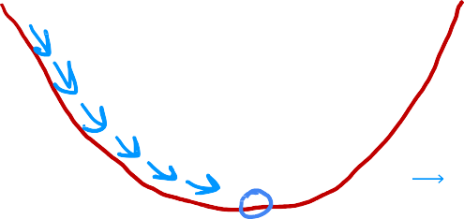
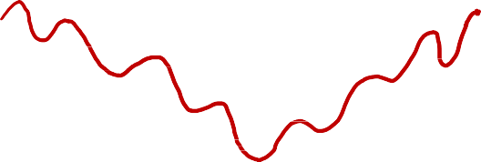

Cost function for logistic regression
Squared error cost
average of training set
_{x} 𝑖
, 𝑦 ^{𝑖}
^{𝐿 𝑓}w,𝑏
linear regression
logistic regression
𝑓_{w,𝑏} x = w ∙ x + 𝑏
1
^{𝑓}w,𝑏 ^{x}
=
_{1 + 𝑒}− w∙x+𝑏
𝐽 w, 𝑏
convex
𝐽 w, 𝑏
non-convex
w, b
w, 𝑏
Notes:
Recall for linear regression, this is the squared error cost function. The only thing I’ve changed is that I put the one half inside the summation instead of
outside the summation. You might remember that in the case of linear regression, where f of x is the linear function, w dot x plus b. The cost function
looks like this, is a convex function or a bowl shape or hammer shape.
Gradient descent will look like this, where you take one step, one step, and so on to converge at the global minimum.
Now you could try to use the same cost function for logistic regression.
But it turns out that if I were to write f of x equals 1 over 1 plus e to the negative wx plus b and plot the cost function using this value of f of x, then the cost will
look like this. This becomes what's called a non-convex cost function is not convex.
What this means is that if you were to try to use gradient descent, there are lots of local minima that you can get sucking. It turns out that for
logistic regression, this squared error cost function is not a good choice. Instead, there will be a different cost function that can make the cost function
convex again. The gradient descent can be guaranteed to converge to the global minimum. The only thing I've changed is that I put the one half inside the summation instead of outsi
In order to build a new cost function, one that we'll use for logistic regression. I'm going to change a little bit the definition of the cost function J of w and b. In particular, if you look inside this summation, let's call this term inside the loss on a single training example. I'm going to denote the loss via this capital L and as a function of the prediction of the learning algorithm, f of x as well as of the true label y. The loss given the predictor f of x and the true label y is equal in this case to 1.5 (?) of the squared difference. We'll see shortly that by choosing a different form for this loss function, will be able to keep the overall cost function, which is 1 over n times the sum of these loss functions to be a convex function. de the summation. This will make the math you see later on this slide a little bit simpler.

Slide 14





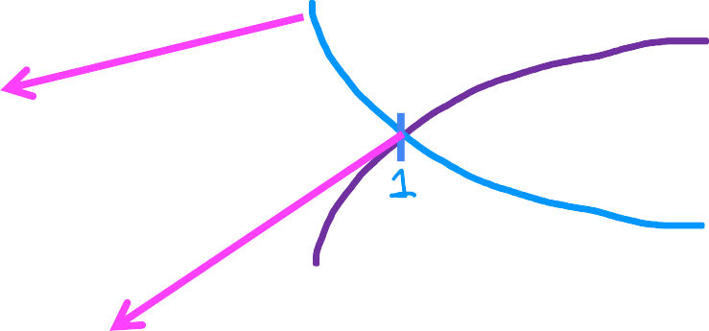












Cost function for logistic regression
Logistic loss function
log 𝑓
^{𝐿 𝑓}w,𝑏
_{x} 𝑖
, 𝑦 ^{𝑖}
𝑓
if 𝑦 ^{𝑖} = 1
−log 𝑓
Loss is lowest when
_{x} 𝑖
_{x} 𝑖
⁰ 0.1
0.5
1
_{x} 𝑖
_{x} 𝑖
As 𝑓
→ 1 then loss → 0
→ 0 then loss → ∞
^{𝑓}w,𝑏
^{𝑓}w,𝑏
predicts
w,𝑏
As 𝑓
close to true label 𝑦 ^{𝑖} .
w,𝑏
Andrew Ng
Notes:
Now, the loss function inputs f of x and the true label y and tells us how well we’re doing on that example. I'm going to just write down here at the definition of
the loss function we'll use for logistic regression. If the label y is equal to 1, then the loss is negative log of f of x and if the label y is equal to 0, then the loss is negative log of 1 minus f of x.
Let's take a look at why this loss function hopefully makes sense. Let's first consider the case of y equals 1 and plot what this function looks like to gain some intuition about what this loss function is doing. Remember, the loss function measures how well you're doing on one training example and is by summing up the losses on all of the training examples that you then get, the cost function, which measures how well you're doing on the entire training set.
If you plot log of f, it looks like this curve here, where f here is on the horizontal axis. A plot of a negative of the log of f looks like this, where we just flip the curve
along the horizontal axis. Notice that it intersects the horizontal axis at f equals 1 and continues downward from there. Now, f is the output of logistic regression. Thus, f is always between zero and one because the output of logistic regression is always between zero and one. The only part of the function that's relevant is therefore this part over here, corresponding to f between 0 and 1.
Let's zoom in and take a closer look at this part of the graph. If the algorithm predicts a probability close to 1 and the true label is 1, then the loss is very small. It's pretty much 0 because you're very close to the right answer. Now continue with the example of the true label y being 1, say everything is a malignant tumor. If the algorithm predicts 0.5, then the loss is at this point here, which is a bit higher but not that high. Whereas in contrast, if the algorithm were to have outputs at 0.1 if it thinks that there is only a 10 percent chance of the tumor being malignant but y really is 1. If really is malignant, then the loss is this much higher value over here.
When y is equal to 1, the loss function incentivizes or nurtures, or helps push the algorithm to make more accurate predictions because the loss is lowest, when it predicts values close to 1.

Slide 15






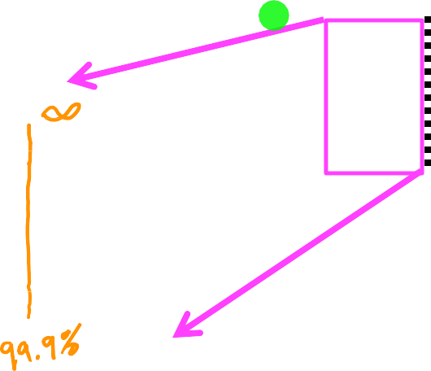


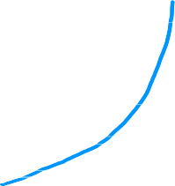










Cost function for logistic regression
Logistic loss function
−log 1 − 𝑓
As 𝑓_{w,𝑏}
_{x} 𝑖
→ 0 then loss → 0
𝑓
^{𝐿 𝑓}w,𝑏
_{x} 𝑖
, 𝑦 ^{𝑖}
if 𝑦 ^{𝑖} = 0
The further prediction
_{x} 𝑖
is from
^{𝑓}w,𝑏
0
As 𝑓_{w,𝑏}
^{𝑓}w,𝑏
_{x} 𝑖
target 𝑦 ^{𝑖} , the higher the loss.
1
_{x} 𝑖
→ 1 then loss → ∞
Lab: C1_W3_Lab04_LogisticLoss_Soln.ipynb
Notes:
Now on this slide, we'll be looking at what the loss is when y is equal to 1. On this slide, let's look at the second part of the loss function corresponding to when y is equal to 0. In this case, the loss is negative log of 1 minus f of x. When this function is plotted, it actually looks like this.
The range of f is limited to 0 to 1 because logistic regression only outputs values between 0 and 1. If we zoom in, this is what it looks like. In this plot, corresponding to y equals 0, the vertical axis shows the value of the loss for different values of f of x. When f is 0 or very close to 0, the loss is also going to be very small which means that if the true label is 0 and the model's prediction is very close to 0, well, you nearly got it right so the loss is appropriately very close to 0. The larger the value of f of x gets, the bigger the loss because the prediction is further from the true label 0. In fact, as that prediction approaches 1, the loss actually approaches infinity.
Going back to the tumor prediction example just says if the model predicts that the patient's tumor is almost certain to be malignant, say, 99.9 percent chance of malignancy, that turns out to actually not be malignant, so y equals 0 then we penalize the model with a very high loss. In this case of y equals 0, so this is in the case of y equals 1 on the previous slide, the further the prediction f of x is away from the true value of y, the higher the loss. In fact, if f of x approaches 0, the loss here actually goes really large and in fact approaches infinity. When the true label is 1, the algorithm is strongly incentivized not to predict something too close to 0.

Slide 16
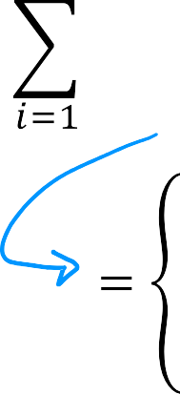
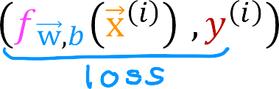





Cost function for logistic regression
Cost
Convex→ can reach a gloabal minimum
Find w, b that minimize cost J
Lab: C1_W3_Lab05_Cost_Function_Soln.ipynb
Notes:
In this slides, you saw why the squared error cost function doesn't work well for logistic regression. We also defined the loss for a single training example and came up with a new definition for the loss function for logistic regression. It turns out that with this choice of loss function, the overall cost function will be convex and thus you can reliably use gradient descent to take you to the global minimum. Proving that this function is convex, it's beyond the scope of this cost.
You may remember that the cost function is a function of the entire training set and is, therefore, the average or 1 over m times the sum of the loss function on the individual training examples. The cost on a certain set of parameters, w and b, is equal to 1 over m times the sum of all the training examples of the loss on the training examples. If you can find the value of the parameters, w and b, that minimizes this, then you'd have a pretty good set of values for the parameters w and b for logistic regression. In the upcoming optional lab, you'll get to take a look at how the squared error cost function doesn't work very well for classification, because you see that the surface plot results in a very wiggly costs surface with many local minima.
Then you'll take a look at the new logistic loss function. As you can see here, this produces a nice and smooth convex surface plot that does not have all those local minima. Please take a look at the cost and the plots after this video. In the next slides, let's go back and take the loss function for a single train example and use that to define the overall cost function for the entire training set. We'll also figure out a simpler way to write out the cost function, which will then later allow us to run gradient descent to find good parameters for logistic regression.

Slide 17








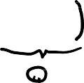



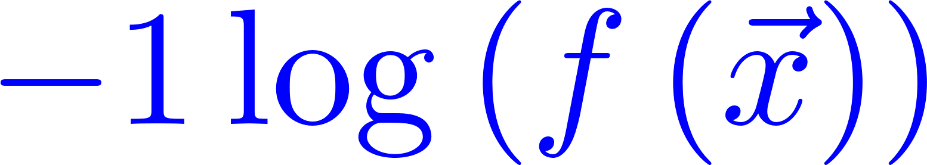
Simplified cost function for logistic regression
Simplified loss function
_{x} 𝑖
, 𝑦 ^{𝑖}
= − 𝑦 ^{𝑖} log
_{x} 𝑖
− 1 − 𝑦 ^{𝑖} log
1 − 𝑓_{w,𝑏}
_{x} 𝑖
^{𝐿 𝑓}w,𝑏
^{𝑓}w,𝑏
if 𝑦 ^{𝑖} = 1:
_{x} 𝑖
, 𝑦 ^{𝑖} =
^{𝐿 𝑓}w,𝑏
Notes:
We saw the loss function and the cost function for logistic regression. Now you'll see a slightly simpler way to write out the loss and cost functions, so that the implementation can be a bit simpler when we get to gradient descent for fitting the parameters of a logistic regression model. Let's take a look.
As a reminder, here is the loss function that we had defined before for logistic regression. Because we're still working on a binary classification problem, y is either zero or one. Because y is either zero or one and cannot take on any value other than zero or one, we'll be able to come up with a simpler way to write this loss function. You can write the loss function as follows. Given a prediction f of x and the target label y, the loss equals negative y times log of f minus 1 minus y times log of 1 minus f. It turns out this equation, which we just wrote in one line, is completely equivalent to this more complex formula up here. Let's see why this is the case.
Remember, y can only take on the values of either one or zero. In the first case, let's say y equals 1. This first y over here is one and this 1 minus y is 1 minus 1, which is therefore equal to 0. So the loss becomes negative 1 times log of f of x minus 0 times a bunch of stuff. That becomes zero and goes away. When y is equal to 1, the loss is indeed the first term on top, negative log of f of x.

Slide 18










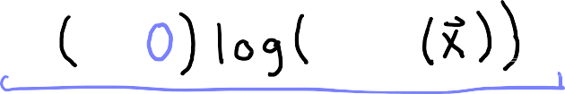




Simplified cost function for logistic regression
Simplified loss function
$$−log$$
$$−log$$
_{x} 𝑖
, 𝑦 ^{𝑖}
= − 𝑦 ^{𝑖} log
_{x} 𝑖
− 1 − 𝑦 ^{𝑖} log
1 − 𝑓_{w,𝑏}
_{x} 𝑖
^{𝐿 𝑓}w,𝑏
^{𝑓}w,𝑏
if 𝑦 ^{𝑖} = 1:
_{x} 𝑖
, 𝑦 ^{𝑖} =
^{𝐿 𝑓}w,𝑏
if 𝑦 ^{𝑖} = 0:
_{x} 𝑖
, 𝑦 ^{𝑖} =
^{𝐿 𝑓}w,𝑏
Notes:
Let's look at the second case, when y is equal to 0. In this case, this y here is equal to 0, so this first term goes away, and the second term is 1 minus 0 times that
logarithmic term. The loss becomes this negative 1 times log of 1 minus f of x. That's just equal to this second term up here. In the case of y equals 0, we also get back the original loss function as defined above. What you see is that whether y is one or zero, this single expression here is equivalent to the more
complex expression up here, which is why this gives us a simpler way to write the loss with just one equation without separating out these two cases,
like we did on top.

Slide 19
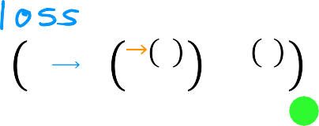
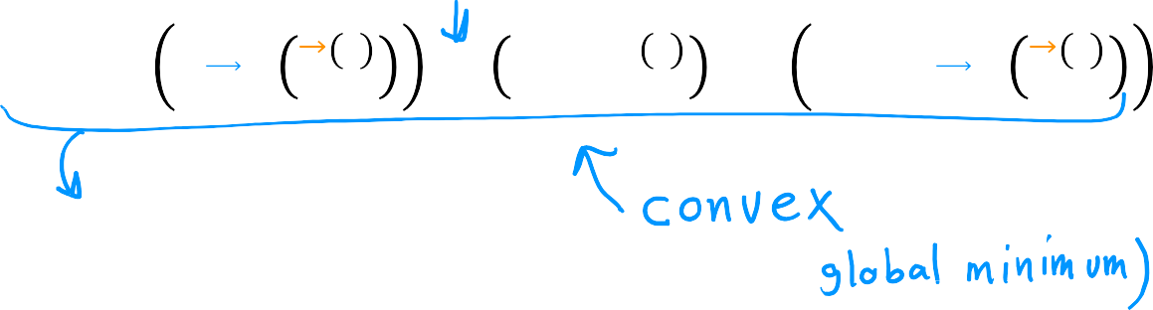


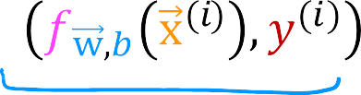













Simplified cost function for logistic regression
Simplified cost function
_{x} 𝑖
, 𝑦 ^{𝑖} = − 𝑦 ^{𝑖} log
_{x} 𝑖
− 1 − 𝑦 ^{𝑖}
log 1 − 𝑓_{w,𝑏}
_{x} 𝑖
^{𝐿 𝑓}w,𝑏 ^{𝑓}w,𝑏
𝐽 w, 𝑏 =
Notes:
Using this simplified loss function, let's go back and write out the cost function for logistic regression. Here again is the simplified loss function. Recall that the cost J is just the average loss, average across the entire training set of m examples. So it's 1 over n times the sum of the loss from i equals 1 to m. If you plug in the definition for the simplified loss from above, then it looks like this, 1 over m times the sum of this term above. If you bring the negative signs and move them outside, then you end up with this expression over here, and this is the cost function.
The cost function that pretty much everyone uses to train logistic regression. You might be wondering, why do we choose this particular function when there could be tons of other costs functions we could have chosen? Although we won’t have time to go into great detail on this in this class, I'd just like to mention that this particular cost function is derived from statistics using a statistical principle called maximum likelihood estimation, which is an idea from statistics on how to efficiently find parameters for different models.
This cost function has the nice property that it is convex. But don't worry about learning the details of maximum likelihood. It's just a deeper rationale and justification behind this particular cost function.
The upcoming optional lab will show you how the logistic cost function is implemented in code. I recommend taking a look at it, because you implement this later into practice lab at the end of the week. This upcoming optional lab also shows you how two different choices of the parameters will lead to different cost calculations. You can see in the plot that the better fitting blue decision boundary has a lower cost relative to the magenta decision boundary. So with the simplified cost function, we're now ready to jump into applying gradient descent to logistic regression.

Slide 20
Gradient Descent Implementation
Training logistic regression
Find w, 𝑏
Given new x, output 𝑓 x =
1
w,𝑏
_{1+𝑒}−(w∙x+𝑏)
𝑃 𝑦 = 1 x; w, 𝑏
Notes:
To fit the parameters of a logistic regression model, we're going to try to find the values of the parameters w and b that minimize the cost function J of w and b, and we'll again apply gradient descent to do this. Let's take a look at how. We’ll focus on how to find a good choice of the parameters w and b.
After you've done so, if you give the model a new input, x, say a new patients at the hospital with a certain tumor size and age, then these are diagnosis. The model can then make a prediction, or it can try to estimate the probability that the label y is one.

Slide 21








Gradient Descent Implementation
Gradient descent
repeat {
𝜕
𝜕
1
$$\sum_{i=1}^{m}{}$$
_{x} 𝑖
j=1…m
𝐽 w, 𝑏
𝐽 w, 𝑏 =
𝑓
− 𝑦 ^{𝑖} )𝑥 ^{𝑖}
𝑤_{𝑗} = 𝑤_{𝑗} − 𝛼
𝜕𝑤_{𝑗}
𝑚
w,𝑏
𝑗
𝜕𝑤
𝑗
𝜕
𝑏 = 𝑏 − 𝛼 𝐽 w, 𝑏
$$\sum_{i=1}^{m}{}$$
𝜕
1
_{x} 𝑖
𝜕𝑏
𝐽 w, 𝑏 =
𝑓
− 𝑦 ^{𝑖} )
𝜕𝑏
𝑚
w,𝑏
}
simultaneous updates
Notes:
The average you can use to minimize the cost function is gradient descent. Here again is the cost function. If you want to minimize the cost j as a function of w and b, well, here's the usual gradient descent algorithm, where you repeatedly update each parameter as the 0 value minus Alpha, the learning rate times this derivative term.
Let's take a look at the derivative of j with respect to w_j. This term up on top here, where as usual, j goes from one through n, where n is the number of features. If someone were to apply the rules of calculus, you can show that the derivative with respect to w_j of the cost function capital J is equal to this expression over here, is 1 over m times the sum from 1 through m of this error term. That is f minus the label y times x_j. Here are just x I j is the j feature of training example i. Now let's also look at the derivative of j with respect to the parameter b. It turns out to be this expression over here. It's quite similar to the expression above, except that it is
not multiplied by this x superscript I subscript j at the end. Just as a reminder, similar to what you saw for linear regression, the way to carry out these updates is to use simultaneous updates, meaning that you first compute the right-hand side for all of these updates and then simultaneously overwrite all the values on
the left at the same time. Let me take these derivative expressions here and plug them into these terms here. This gives you gradient descent for logistic regression.

Slide 22


Gradient Descent Implementation
Gradient descent for logistic regression
repeat {
1
$$\sum_{i=1}^{m}{}$$
Looks like linear regression!
_{x} 𝑖
𝑤_{𝑗} = 𝑤_{𝑗} − 𝛼
𝑓
− 𝑦 ^{𝑖} )𝑥 ^{𝑖}
𝑚
w,𝑏
𝑗
𝑏 = 𝑏 − 𝛼
$$\sum_{i=1}^{m}{}$$
1
_{x} 𝑖
Same concepts:
𝑓
− 𝑦 ^{𝑖} )
𝑚
w,𝑏
Monitor gradient descent (learning curve)
Vectorized implementation
Feature scaling
}
simultaneous updates
x = w ∙ x + 𝑏
1
Linear regression
^{𝑓}w,𝑏
Logistic regression
𝑓 x
=
w,𝑏
_{1 + 𝑒}(−w∙x+𝑏)
Lab: C1_W3_Lab06_Gradient_Descent_Soln.ipynb
Lab: C1_W3_Lab07_Scikit_Learn_Soln.ipynb
Notes:
Now, one funny thing you might be wondering is, that's weird. These two equations look exactly like the average we had come up with previously for
linear regression so you might be wondering, is linear regression actually secretly the same as logistic regression? Well, even though these equations look the same, the reason that this is not linear regression is because the definition for the function f of x has changed. In linear regression, f of x is, this is wx plus b. But in logistic regression, f of x is defined to be the sigmoid function applied to wx plus b. Although the algorithm written looked the same for both linear regression and logistic regression, actually they're two very different algorithms because the definition for f of x is not the same. When we talked about gradient descent for linear regression previously, you saw how you can monitor a gradient descent to make sure it converges. You can just apply the same method for logistic regression to make sure it also converges. I've written out these updates as if you're updating the parameters w_j one parameter at a time. Similar to the discussion on vectorized implementations of linear regression, you can also use vectorization to make gradient descent run faster for logistic regression. I won't dive into the details of the vectorized implementation in this video. But you can also learn more about it and see the code in the optional labs. Now you know how to implement gradient descent for logistic regression. You might also remember feature scaling when we were using linear regression. Where you saw how feature scaling, that is scaling all
the features to take on similar ranges of values, say between negative 1 and plus 1, how they can help gradient descent to converge faster. Feature scaling
applied the same way to scale the different features to take on similar ranges of values can also speed up gradient descent for logistic regression. In the upcoming optional lab, you also see how the gradient for the logistic regression can be calculated in code. This will be useful to look at because you also implement this in the practice lab at the end of this week. After you run gradient descent in this lab, there'll be a nice set of animated plots that show gradient descent in action. You see the sigmoid function, the contour plot of the cost, the 3D surface plot of the cost, and the learning curve or evolve as gradient descent runs.
There will be another optional lab after that, which is short and sweet, but also very useful because they’re showing you how to use the popular scikit-learn library to train the logistic regression model for classification.
Many machine learning practitioners in many companies today use scikit-learn regularly as part of their job. I hope you check out the scikit-learn function as well and take a look at how that is used. That's it. You should now know how to implement logistic regression. This is a very powerful and very widely used learning algorithm and you now know how to get it to work yourself.

Slide 23
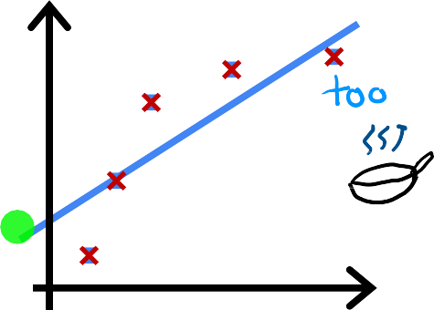
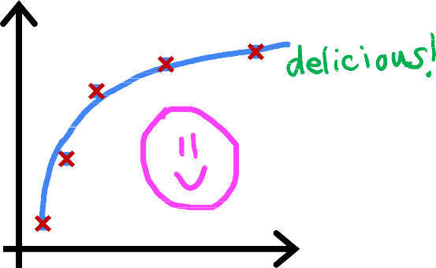
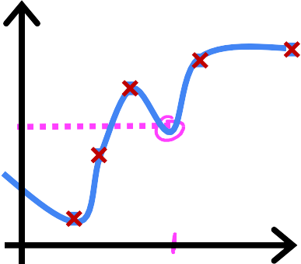

















Regularization to Reduce Overfitting – The Problem of Overfitting
Regression example
price
price
price
size
𝑤₁𝑥 + 𝑏
size
𝑤₁𝑥 + 𝑤₂𝑥 ² + 𝑏
size
𝑤 𝑥 + 𝑤 𝑥 ² + 𝑤 𝑥 ³ + 𝑤 𝑥 ⁴ + 𝑏
1 2 3 4
Does not fit the training set well
Fits training set pretty well
Fits the training set extremely well
High bias
Generalization
High variance
Notes:
Now you've seen a couple of different learning algorithms, linear regression and logistic regression. They work well for many tasks. But sometimes in an application, the algorithm can run into a problem called overfitting, which can cause it to perform poorly. What I like to do now is to show you what is overfitting, as well as a closely-related, almost opposite problem called underfitting. In the next videos after this, I'll share with you some techniques for accuracy overfitting. In particular, there’s a method called regularization. Very useful technique. I use it all the time.
Then regularization will help you minimize this overfitting problem and get your learning algorithms to work much better. Let's take a look at what is overfitting?
To help us understand what is overfitting. Let's take a look at a few examples. Let's go back to our original example of predicting housing prices with linear regression. Where you want to predict the price as a function of the size of a house. To help us understand what is overfitting, let's take a look at a
linear regression example. I'm going to go back to our original running example of predicting housing prices with linear regression.
Suppose your data-set looks like this, with the input feature x being the size of the house, and the value, y that you're trying to predict the price of the house. One thing you could do is fit a linear function to this data. If you do that, you get a straight line fit to the data that maybe looks like this. But this isn’t a very good model. Looking at the data, it seems pretty clear that as the size of the house increases, the housing process flattened out. This algorithm does not fit the training data very well. The technical term for this is the model is underfitting the training data.
Another term is the algorithm has high bias. You may have read in the news about some learning algorithms really, unfortunately, demonstrating bias against certain ethnicities or certain genders. In machine learning, the term bias has multiple meanings. Checking learning algorithms for bias based on characteristics
such as gender or ethnicity is absolutely critical. But the term bias has a second technical meaning as well, which is the one I'm using here, which is if the algorithm
has underfit the data, meaning that it’s just not even able to fit the training set that well. There's a clear pattern in the training data that the algorithm is just
unable to capture. Another way to think of this form of bias is as if the learning algorithm has a very strong preconception, or we say a very strong bias, that the housing prices are going to be a completely linear function of the size despite data to the contrary. This preconception that
the data is linear causes it to fit a straight line that fits the data poorly, leading it to underfitted data.
Now, let's look at a second variation of a model, which is if you insert for a quadratic function at the data with two features, x and x^2, then when you fit the
parameters W1 and W2, you can get a curve that fits the data somewhat better. Maybe it looks like this. Also, if you were to get a new house, that's not in this set of
five training examples. This model would probably do quite well on that new house. If you're real estate agents, the idea that you want your learning
algorithm to do well, even on examples that are not on the training set, that’s called generalization. Technically we say that you want your learning algorithm
to generalize well, which means to make good predictions even on brand new examples that it has never seen before. These quadratic models seem to fit the training set not perfectly, but pretty well. I think it would generalize well to new examples.
Now let's look at the other extreme. What if you were to fit a fourth-order polynomial to the data? You have x, x^2, x^3, and x^4 all as features. With this fourth
for the polynomial, you can actually fit the curve that passes through all five of the training examples exactly. You might get a curve that looks like this. This, on one hand, seems to do an extremely good job fitting the training data because it passes through all of the training data perfectly. In fact, you'd be able to choose parameters that will result in the cost function being exactly equal to zero because the errors are zero on all five training examples. But this is a very wiggly curve, its going up and down all over the place. If you have this whole size right here, the model would predict that this house is cheaper than houses that are smaller than it. We don't think that this is a particularly good model for predicting housing prices. The technical term is that we'll say this model has overfit the data, or this model has an overfitting problem. Because even though it fits the training set very well, it has fit the data almost too well, hence is overfit. It does not look
like this model will generalize to new examples
that's never seen before.
Another term for this is that the algorithm has high variance. In machine learning, many people will use the terms over-fit and high-variance
almost interchangeably. We'll use the terms underfit and high bias almost interchangeably. The intuition behind overfitting or high-variance is
that the algorithm is trying very hard to fit every single training example. It turns out that if your training set were just even a little bit different, say one holes was priced just a little bit more little bit less, then the function that the algorithm fits could end up being totally different.
If two different machine learning engineers were to fit this fourth-order polynomial model, to just slightly different datasets, they couldn't end up with
totally different predictions or highly variable predictions. That's why we say the algorithm has high variance. Contrasting this rightmost model with the one in the middle for the same house, it seems, the middle model gives them much more reasonable prediction for price. There isn't really a name for this case in the middle, but I'm just going to call this just right, because it is neither underfit nor overfit. You can say that the goal machine learning is to find a model that hopefully is neither underfitting nor overfitting. In other words, hopefully, a model that has neither high bias nor high variance.
When I think about underfitting and overfitting, high bias and high variance. I'm sometimes reminded of the children's story of Goldilocks and the Three
Bears in this children's tale, a girl called Goldilocks visits the home of a bear family. There's a bowl of porridge that's too cold to taste and so that's no good. There's also a bowl of porridge that's too hot to eat. That's no good either. But there's a bowl of porridge that is neither too cold nor too hot. The temperature
is in the middle, which is just right to eat.
To recap, if you have too many features like the fourth-order polynomial on the right, then the model may fit the training set well, but almost too well or overfit
and have high variance. On the flip side if you have too few features, then in this example, like the one on the left, it underfits and has high bias. In this example, using quadratic features x and x squared, that seems to be just right.

Slide 24
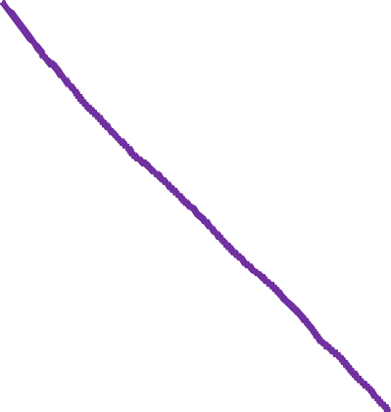











































Regularization to Reduce Overfitting – The Problem of Overfitting
Classification
𝑥₂
𝑥₂
𝑥₂
𝑥₁
𝑧 = 𝑤₁𝑥₁ + 𝑤₂𝑥₂ + 𝑏
𝑥₁
𝑧 = 𝑤₁𝑥₁ + 𝑤₂𝑥₂
𝑥₁
𝑧 = 𝑤₁𝑥₁ + 𝑤₂𝑥₂
𝑓_{w,𝑏} x = 𝑔 𝑧
+𝑤₃𝑥 ² + 𝑤₄𝑥 ²
+𝑤 𝑥 ²𝑥 + 𝑤 𝑥 ²𝑥 ²
1 2
3 1 2 4 1 2
+𝑤₅𝑥₁𝑥₂ + 𝑏
+𝑤₅𝑥 ²𝑥³ + 𝑤₆𝑥 ³𝑥₂
𝑔 is the sigmoid function
1 2
+ ⋯ + 𝑏
1
Notes:
So far we've looked at underfitting and overfitting for linear regression model. Similarly, overfitting applies a classification as well. Here's a classification example with two features, x_1 and x_2, where x_1 is maybe the tumor size and x_2 is the age of patient.
We're trying to classify if a tumor is malignant or benign, as denoted by these crosses and circles, one thing you could do is fit a logistic regression model. Just a simple model like this, where as usual, g is the sigmoid function and this term here inside is z. If you do that, you end up with a straight line as the decision boundary. This is the line where z is equal to zero that separates the positive and negative examples. This straight line doesn't look terrible. It looks okay, but it doesn't look like a very good fit to the data either. This is an example of underfitting or of high bias. Let's look at another example. If you were to add to your features these quadratic terms, then z becomes this new term in the middle and the decision boundary, that is where z equals zero can look more like this, more like an ellipse or part of an ellipse. This is a pretty good fit to the data, even though it does not perfectly classify every single training example in the training set. Notice how some of these crosses get classified among the circles. But this model looks pretty good. I'm going to call it just right. It looks like this generalized pretty well to new patients. Finally, at the other extreme, if you were to fit a very high-order polynomial with many features like these, then the model may try really hard and contoured or twist itself to find a decision boundary that fits your training data perfectly. Having all these higher-order polynomial features allows the algorithm to choose this really over the complex decision boundary.
If the features are tumor size in age, and you're trying to classify tumors as malignant or benign, then this doesn’t really look like a very good model for
making predictions. Once again, this is an instance of overfitting and high variance because its model, despite doing very well on the training set, doesn't look like it'll
generalize well to new examples. Now you've seen how an algorithm can underfit or have high bias or overfit and have high variance. You may want to know
how you can give get a model that is just right. In the next video, we'll look at some ways you can address the issue of overfitting. We'll also touch on some ideas relevant for using underfitting.

Slide 25





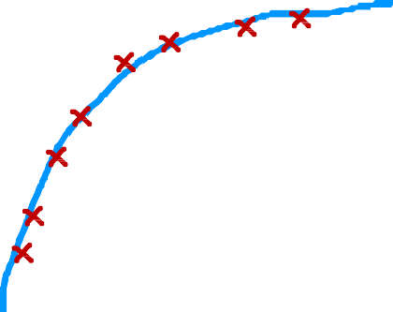

Regularization to Reduce Overfitting – Addressing Overfitting
Collect more training examples
price
price
size
size
Notes:
Later in this specialization, we'll talk about debugging and diagnosing things that can go wrong with learning algorithms. You'll also learn about
specific tools to recognize when overfitting and underfitting may be occurring. But for now, when you think overfitting has occurred, lets talk about what you
can do to address it. Let's say you fit a model and it has high variance, is overfit. Here's our overfit house price prediction model. One way to address
this problem is to collect more training data, that's one option. If you're able to get more data, that is more training examples on sizes and prices of houses, then with the larger training set, the learning algorithm will learn to fit a function that is less wiggly. You can continue to fit a high order polynomial or some of the function with a lot of features, and if you have enough training examples, it will still do okay.
To summarize, the number one tool you can use against overfitting is to get more training data. Now, getting more data isn't always an option. Maybe only so many houses have been sold in this location, so maybe there just isn’t more data to be add. But when the data is available, this can work really well.

Slide 26
















Regularization to Reduce Overfitting – Addressing Overfitting
Select features to include/exclude
size | bedrooms | floors | age | avg | … | distance to | price
 |  |  |  | income |  | coffee shop
all features
selected features
disadvantage
insufficient data
useful features could be lost
Notes:
A second option for addressing overfitting is to see if you can use fewer features. In the previous slides, our models features included the size x, as well as the size squared, and this x squared, and x cubed and x^4 and so on. These were a lot of polynomial features. In that case, one way to reduce overfitting is to just not use so many of these polynomial features.
But now let's look at a different example. Maybe you have a lot of different features of a house of which to try to predict its price, ranging from the size, number of bedrooms, number of floors, the age, average income of the neighborhood, and so on and so forth, total distance to the nearest coffee shop. It turns out that if you have a lot of features like these but don't have enough training data, then your learning algorithm may also overfit to your training set. Now instead of using all 100 features, if we were to pick just a subset of the most useful ones, maybe size, bedrooms, and the age of the house. If you think those are the most relevant features, then using just that smallest subset of features, you may find that your model no longer overfits as badly. Choosing the most appropriate set of features to use is sometimes also called feature selection. One way you could do so is to use your intuition to choose what you think is the best set of features, what's most relevant for predicting the price.
Now, one disadvantage of feature selection is that by using only a subset of the features, the algorithm is throwing away some of the information that you have about the houses. For example, maybe all of these features, all 100 of them are actually useful for predicting the price of a house. Maybe you don't want to throw away some of the information by throwing away some of the features. Later in Course 2, you'll also see some algorithms for automatically choosing the most appropriate set of features to use for our prediction task. Now, this takes us to the third option for reducing overfitting.

Slide 27






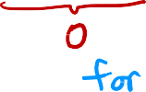







Regularization to Reduce Overfitting – Addressing Overfitting
Regularization
Reduce the size of parameters 𝑤_{𝑗}
price
price
features
𝑓 𝑥 = 28𝑥 − 385𝑥 ² + 39𝑥 ³ − 174𝑥 ⁴ + 100
features
𝑓 𝑥 = 13𝑥 − 0.23𝑥 ² + 0.000014𝑥 ³ − 0.0001 𝑥 ⁴ + 10
Notes:
This technique, which we’ll look at in even greater depth in the next slides is called regularization. If you look at an overfit model, here's a model using polynomial features: x, x squared, x cubed, and so on. You find that the parameters are often relatively large. Now if you were to eliminate some of these features, say, if you were to eliminate the feature x4, that corresponds to setting this parameter to 0. So setting a parameter to 0 is equivalent to eliminating a feature, which is what we saw on the previous slide.
It turns out that regularization is a way to more gently reduce the impacts of some of the features without doing something as harsh as eliminating it outright. What regularization does is encourage the learning algorithm to shrink the values of the parameters without necessarily demanding that the parameter is set to exactly 0. It turns out that even if you fit a higher order polynomial like this, so long as you can get the algorithm to use smaller parameter values: w1, w2, w3, w4.
You end up with a curve that ends up fitting the training data much better. So what regularization does, is it lets you keep all of your features, but they just prevents the features from having an overly large effect, which is what sometimes can cause overfitting. By the way, by convention, we normally just reduce the size of the wj parameters, that is w1 through wn. It doesn't make a huge
difference whether you regularize the parameter b as well, you could do so if you want or not if you don't. I usually don't and it's just fine to regularize w1, w2, all the way to wn, but not really encourage
b to become smaller. In practice, it should make very little difference whether you also regularize b or not.

Slide 28




Regularization to Reduce Overfitting – Addressing Overfitting
Addressing overfitting
Options
Collect more data
Select features
Feature selection
Reduce size of parameters
“Regularization”
Lab: C1_W3_Lab08_Overfitting_Soln.ipynb
Notes:
To recap, these are the three ways for addressing overfitting.
One, collect more data. If you can get more data, this can really help reduce overfitting. Sometimes that's not possible.
In which case, some of the options are, two, try selecting and using only a subset of the features. You'll learn more about feature selection in Course 2.
Three would be to reduce the size of the parameters using regularization. This will be the subject of the next slides as well.
Just for myself, I use regularization all the time. So this is a very useful technique for training learning algorithms, including neural networks specifically, which you'll see later in
this specialization as well. I hope you'll also check out the optional lab on overfitting. In the lab, you'll be able to see different examples of overfitting and adjust those examples by clicking on
options in the plots. You'll also be able to add your own data points by clicking on the plot and see how that changes the curve that is fit. You can also try examples for both regression and classification and you will change the degree of the polynomial to be x, x squared, x cubed, and so on. The lab also lets you play with two different options for addressing overfitting. You can add additional
training data to reduce overfitting and you can also select which features to include or to exclude as another way to try to reduce overfitting. Please take a look at a lab, which I hope will help you
build your intuition about overfitting as well as some methods for addressing it. You also saw the idea of regularization at a relatively high level.
All of these details on regularization may not make sense to you yet. But in the next slides, we'll start to formulate exactly how to apply regularization and exactly what regularization means.
Then we'll start to figure out how to make this work with our learning algorithms to make linear regression and logistic regression, and in the future, other algorithms as well avoid overfitting.

Slide 29
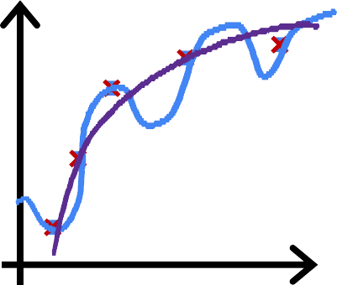



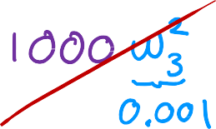
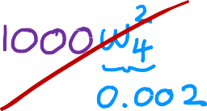


Regularization to Reduce Overfitting – Cost Function with Regularization
Intuition
price
price
size
𝑤₁𝑥 + 𝑤₂𝑥 ² + 𝑏
make 𝑤₃, 𝑤₄ really small (≈ 0)
size
𝑤₁𝑥 + 𝑤₂𝑥 ² + 𝑤₃𝑥 ³ + 𝑤₄𝑥 ⁴ + 𝑏
𝑚
1
min 𝑓
_{x} 𝑖
2
w,𝑏
− 𝑦 ^{𝑖}
w,𝑏 2𝑚
𝑖=1
Notes:
In the last video we saw that regularization tries to make the parental values W1 through WN small to reduce overfitting.
Now, we'll build on that intuition and developed a modified cost function for your learning algorithm that can use to actually apply regularization.
Let's jump in, recall this example from the previous slides in which we saw that if you fit a quadratic function to this data, it gives a pretty good fit.
But if you fit a very high-order polynomial, you end up with a curve that overfits the data. But now consider the following, suppose that you had a way to make the parameters W3 and W4 really, really small. Say close to 0. Here's what I mean. Let's say instead of minimizing this objective function, this is a cost function for
linear regression. Let's say you were to modify the cost function and add to it 1000 times W3 squared plus 1000 times W4 squared.
And here I'm just choosing 1000 because it's a big number but any other really large number would be okay. So with this modified cost function, you could in fact be penalizing the model if W3 and W4 are large. Because if you want to minimize this function, the only way to make this new cost function small is if W3 and W4 are both small, right? Because otherwise this 1000 times W3 squared and 1000 times W4 square terms are going to be really, really big. So when you minimize this function, you're going to end up with W3 close to 0 and W4 close to 0. So we're effectively nearly canceling out the effects of the features execute and extra power of 4 and getting rid of these two terms over here. And if we do that, then we end up with a fit to the data that's much closer to the quadratic function, including maybe just tiny contributions from the features x cubed and extra 4. And this is good because it's a much better fit to the data compared to if all the parameters could be large and you end up with this weekly quadratic function more generally, here's the idea behind regularization.
The idea is that if there are smaller values for the parameters, then that's a bit like having a simpler model. Maybe one with fewer features, which is therefore less prone to overfitting. On the last slide we penalize or we say we regularized only W3 and W4. But more generally, the way that regularization tends to be implemented is if you have a lot of features, say a 100 features, you may not know which are the most important features and which ones to penalize. So the way regularization is typically implemented is to penalize all of the features or more precisely, you penalize all the WJ parameters and it's possible to show that this will
usually result in fitting a smoother simpler, less weekly function that's less prone to overfitting.

Slide 30












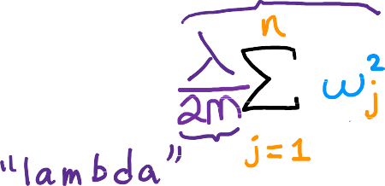
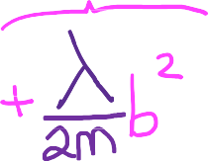









Regularization to Reduce Overfitting – Cost Function with Regularization
Regularization
small values 𝑤₁, 𝑤₂, ⋯ , 𝑤_{𝑛}, 𝑏
simpler model
less likely to overfit
size | bedrooms | floors | age | avg | … | distance to | price
 |  |  |  | income |  | coffee shop
𝑤₁ , 𝑤₁, 𝑤₂, ⋯ , 𝑤₁₀₀, 𝑏
Notes:
So for this example, if you have data with 100 features for each house, it may be hard to pick an advance which features to include and which ones to exclude.
So let's build a model that uses all 100 features. So you have these 100 parameters W1 through W100, as well as 100 and first parameter B. Because we don't know which of these parameters are going to be the important ones. Let's penalize all of them a bit and shrink all of them by adding this new term lambda times the sum from J equals 1 through n where n is 100. The number of features of wj squared. This value lambda here is the Greek alphabet lambda and it's also called
a regularization parameter. So similar to picking a learning rate alpha, you now also have to choose a number for lambda.
A couple of things I would like to point out by convention, instead of using lambda times the sum of wj squared. We also divide lambda by 2m so that both the 1st and 2nd terms here are scaled by 1 over 2m. It turns out that by scaling both terms the same way it becomes a little bit easier to choose a good value for lambda. And in particular you find that even if your training set size growth, say you find more training examples. So m the training set size is now bigger. The same value of lambda that you’ve picked previously is now also more likely to continue to work if you have this extra scaling by 2m.

Slide 31

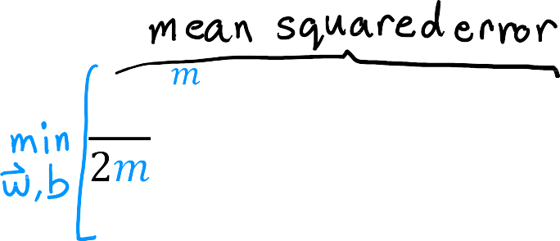
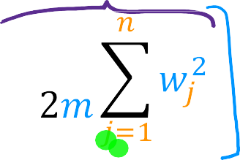









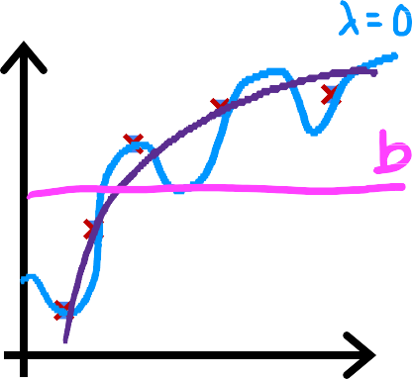








Regularization to Reduce Overfitting – Cost Function with Regularization
Regularization
choose 𝜆 = 10¹⁰
price
^{𝑓}w,𝑏
x = 𝑤₁𝑥 + 𝑤₂𝑥² + 𝑤₃ 𝑥³ + 𝑤₄𝑥⁴ + 𝑏
Notes:
Also by the way, by convention we're not going to penalize the parameter b for being large. In practice, it makes very little difference whether you do or not. And some machine learning engineers and actually some learning algorithm implementations will also include lambda over 2m times the b squared term. But this makes very little difference in practice and the more common convention which was used in this course is to regularize only the parameters w rather than the parameter b.
So to summarize in this modified cost function, we want to minimize the original cost, which is the mean squared error cost plus additionally, the second term which is called the regularization term. And so this new cost function trades off two goals that you might have. Trying to minimize this first term encourages the algorithm to fit the training data well by minimizing the squared differences of the predictions and the actual values. And try to minimize the second term. The algorithm also tries to keep the parameters wj small, which will tend to reduce overfitting.
The value of lambda that you choose, specifies the relative importance or the relative trade off or how you balance between these two goals. Let's take a look at what different values of lambda will cause you're learning algorithm to do.
Let's use the housing price prediction example using linear regression. So F of X is the linear regression model. If lambda was set to be 0, then you're not using the regularization term at all because the regularization term is multiplied by 0. And so if lambda was 0, you end up fitting this overly wiggly, overly complex curve and it over fits. So that was one extreme of if lambda was 0.
Let's now look at the other extreme. If you said lambda to be a really, really, really large number, say lambda equals 10 to the power of 10, then you're placing a very heavy weight on this regularization term on the right. And the only way to minimize this is to be sure that all the values of w are pretty much very close to 0. So if lambda is very, very large, the learning algorithm will choose W1, W2, W3 and W4 to be extremely close to 0 and thus F of X is basically equal to b and so the learning algorithm fits a horizontal straight line and under fits.
To recap, if lambda is 0, this model will overfit. If lambda is enormous, like 10 to the power of 10. This model will underfit. And so what you want is some value of
lambda that is in between that more appropriately balances these first and second terms of trading off, minimizing the mean squared error and keeping the parameters small. And when the value of lambda is not too small and not too large, but just right, then hopefully you end up able to fit a 4th order polynomial, keeping all of these features, but with a function that looks like this. So that's how regularization works.
When we talk about model selection, later into specialization will also see a variety of ways to choose good values for lambda. In the next slides will flesh out
how to apply regularization to linear regression and logistic regression, and how to train these models with great in dissent with that, you'll be able to avoid
overfitting with both of these algorithms.

Slide 32







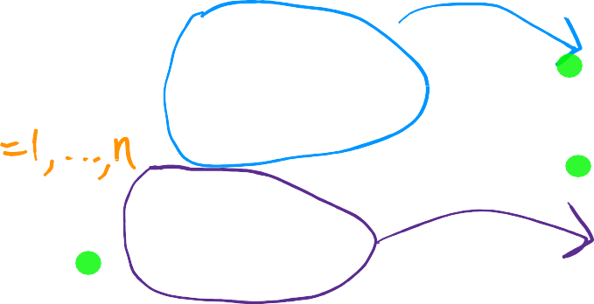
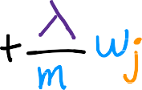





Regularization to Reduce Overfitting – Regularized Linear Regression
Regularized linear regression
Gradient descent
repeat {
𝜕
𝑤_{𝑗} = 𝑤_{𝑗} − 𝛼
𝐽 w, 𝑏
𝜕𝑤
𝑗
𝜕
𝑏 = 𝑏 − 𝛼
𝐽 w, 𝑏
𝜕𝑏
} simultaneous update
Notes:
In this next slides, we'll figure out how to get gradient descent to work with regularized linear regression. Let's jump in.
Here Is a cost function we've come up with in the last slides for regularized linear regression. The first part is the usual squared error cost function, and now you have this additional regularization term, where Lambda is the regularization parameter, and you'd like to find parameters w and b that minimize the regularized cost function.
Previously we were using gradient descent for the original cost function, just the first term before we added that second regularization term, and previously, we had the following gradient descent algorithm, which is that we repeatedly update the parameters w, j, and b for j equals 1 through n according to this formula and b is also updated similarly. Again, Alpha is a very small positive number called the learning rate. In fact, the updates for a regularized linear regression look exactly the same, except that now the cost, J, is defined a bit differently. Previously the derivative of J with respect to w_j was given by this expression over here, and the derivative respect to b was given by this expression over here.
Now that we've added this additional regularization term, the only thing that changes is that the expression for the derivative with respect to w_j ends up with one
additional term, this plus Lambda over m times w_j. And in particular for the new definition of the cost function j, these two expressions over here, these are the new derivatives of J with respect to w_j and the derivative of J with respect to b.
Recall that we don't regularize b, so we're not trying to shrink B. That's why the updated b remains the same as before, whereas the updated w changes because the regularization term causes us to try to shrink w_j.

Slide 33






Regularization to Reduce Overfitting – Regularized Linear Regression
Implementing gradient descent
repeat {
} simultaneous update
Notes:
Let's take these definitions for the derivatives and put them back into the expression on the left to write out the gradient descent algorithm for regularized linear regression. To implement gradient descent for regularized linear regression, this is what you would have your code do. Here is the update for w_j, for j equals 1 through n, and here's the update for b.
As usual, please remember to carry out simultaneous updates for all of these parameters. Now, in order for you to get this algorithm to work, this is all you need to know. But what I like to do in the remainder of this video is to go over some optional material to convey a slightly deeper intuition about what this formula
is actually doing, as well as chat briefly about how these derivatives are derived.
The rest of this lecture is completely optional. It's completely okay if you skip the rest of this video, but if you have a strong interest in math, then stick with me. It is always nice to hang out with you here, and through these equations, perhaps you can build a deeper intuition about what the math and what the derivatives
are doing as well.

Slide 34











Regularization to Reduce Overfitting – Regularized Linear Regression
Implementing gradient descent
repeat {
} simultaneous update
𝜆
𝑤_{𝑗} 1 − 𝛼 _{𝑚}
Notes:
Let's look at the update rule for w_j and rewrite it in another way.
We're updating w_j as 1 times w_j minus Alpha times Lambda over m times w_j. I've moved the term from the end to the front here. Then minus Alpha times 1 over m, and then the rest of that term over there. We just rearranged the terms a little bit. If we simplify, then we’re saying that w_j is updated as w_j times 1 minus Alpha
times Lambda over m, minus Alpha times this other term over here. You might recognize the second term as the usual gradient descent update for unregularized
linear regression. This is the update for linear regression before we had regularization, and this is the term we saw in Week 2 of this course.
The only change we add regularization is that instead of w_j being set to be equal to w_j minus Alpha times this term is now w times this number
minus the usual update. This is what we had in Week 1 of this course. What is this first term over here? Well, Alpha is a very small positive number, say 0.01. Lambda is usually a small number, say 1 or maybe 10. Let's say lambda is 1 for this example and m is the training set size, say 50.
When you multiply Alpha Lambda over m, say 0.01 times 1 divided by 50, this term ends up being a small positive number , say 0.0002, and thus, 1 minus Alpha Lambda over m is going to be a number just slightly less than 1, in this case, 0.9998. The effect of this term is that on every single iteration of gradient descent, you're taking w_j and multiplying it by 0.9998, that is by some numbers slightly less than one and for carrying out the usual update.
What regularization is doing on every single iteration is you're multiplying w by a number slightly less than 1, and that has the effect of shrinking the value of w_j
just a little bit. This gives us another view on why regularization has the effect of shrinking the parameters w_j a little bit on every iteration, and so that's how
regularization works.

Slide 35





















Regularization to Reduce Overfitting – Regularized Linear Regression
How we get the derivative term (optional)
𝜕
𝐽 w, 𝑏 =
𝜕𝑤_{𝑗}
Notes:
If you're curious about how these derivative terms were computed, I've just one last optional slide that goes through just a little bit of a calculation of the
derivative term. Again, this slide and the rest of this lecture are completely optional, meaning you won’t need any of this to do the practice labs
and the quizzes. Let's step through quickly to derivative calculation.
The derivative of J with respect to w_j looks like this. Recall that f of x for linear regression is defined as w dot x plus b or w dot product x plus b. It turns out that by
the rules of calculus, the derivatives look like this, is 1 over 2m times the sum i equals 1 through m of w dot x plus b minus y times 2x_j plus the derivative of the regularization term, which is Lambda over 2m times 2 w_j.
Notice that the second term does not have the summation term from j equals 1 through n anymore. The 2's cancel out here and here, and also here and here. It simplifies to this expression over here.
Finally, remember that wx plus b is f of x, and so you can rewrite it as this expression down here. This is why this expression is used to compute the gradient in
regularized linear regression. You now know how to implement regularized linear regression. Using this, you really reduce overfitting when you have a lot of features and a relatively small training set. This should let you get linear regression to work much better on many problems. In the next lecture, we'll take this regularization
idea and apply it to logistic regression to avoid overfitting for logistic regression as well.

Slide 36











Regularization to Reduce Overfitting – Regularized Logistic Regression
Regularized logistic regression
𝑧 = 𝑤₁𝑥₁ + 𝑤₂𝑥₂
+𝑤₃𝑥 ²𝑥₂ + 𝑤₄𝑥 ²𝑥 ²
1 1 2
+𝑤₅𝑥 ²𝑥 ³ + ⋯ + 𝑏
𝑥₂
1 2
1
x =
1 + 𝑒^{−𝑧}
^{𝑓}w,𝑏
𝑥₁
Cost function
+ 1 − 𝑦 ^{𝑖} log 1 − 𝑓
𝑚
1
𝐽 w, 𝑏 = − 𝑦 ^{𝑖} log 𝑓
_{x} 𝑖
_{x} 𝑖
𝑚
w,𝑏
w,𝑏
𝑖=1
𝐽 w, 𝑏

Slide 37




















Regularization to Reduce Overfitting – Regularized Logistic Regression
Regularized logistic regression
𝑚
𝑛
1
𝐽 w, 𝑏 = − ෍ 𝑦 ^{𝑖} log 𝑓
_{x} 𝑖
_{x} 𝑖
𝜆
w,𝑏
+ 1 − 𝑦 ^{𝑖} log 1 − 𝑓
w,𝑏
+ ෍ 𝑤 ²
𝑚
2𝑚
𝑗
𝑖=1
𝑗=1
Gradient descent
repeat {
𝜕
𝑤_{𝑗} = 𝑤_{𝑗} − 𝛼
𝐽 w, 𝑏
𝜕𝑤
𝑗
𝜕
𝑏 = 𝑏 − 𝛼
}
𝐽 w, 𝑏
𝜕𝑏

Slide 38
Grazie per l’attenzione
Fabio Antonini
Università degli Studi dell’Aquila

