Slide 1


Neural Networks
Fabio Antonini
Università degli Studi dell’Aquila

Slide 2

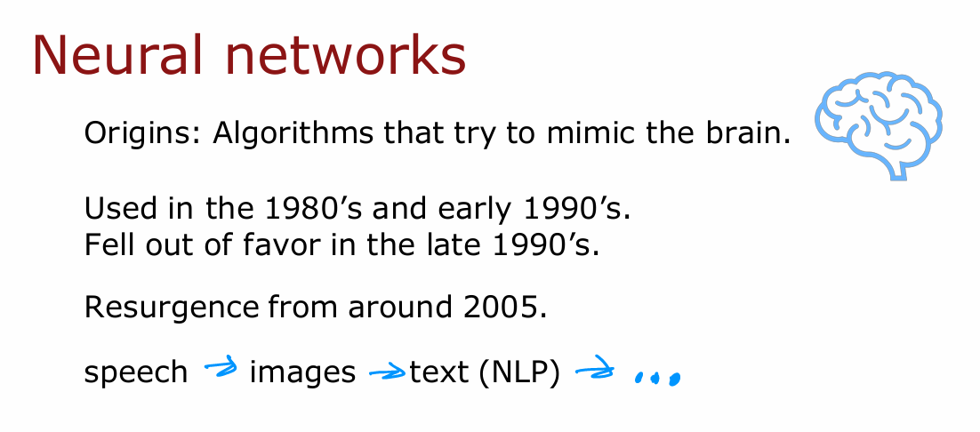

Neural Networks Intuition
Notes:
When neural networks were first invented many decades ago, the original motivation was to write software that could mimic how the human brain or how the biological brain
learns and thinks. Even though today, neural networks, sometimes also called artificial neural networks, have become very different than how any of us might think about how the brain actually works and learns. Some of the biological motivations still remain in the way we think about artificial neural networks or computer neural networks today. Let's start by taking a
look at how the brain works and how that relates to neural networks. The human brain, or maybe more generally, the biological brain demonstrates a higher level or more capable level of intelligence and anything else would be on the bill so far. So neural networks has started with the motivation of trying to build software to mimic the brain. Work in neural networks had started back in the 1950s, and then it fell out of favour for a while. Then in the 1980s and early 1990s, they gained in popularity again and showed tremendous traction
in some applications like handwritten digit recognition, which were used even backed then to read postal codes for writing mail and for reading dollar figures in handwritten checks. But then it fell out of favour again in the late 1990s. It was from about 2005 that it enjoyed a resurgence and also became re-branded little bit with deep learning. One of the things that surprised me back then was deep learning and neural networks meant very similar things. But maybe under appreciated at the time that the term deep learning, just sounds much better because it's deep and this learning. So that turned out to be the brand that took off in the last decade or decade and a half. Since then, neural networks have revolutionized application area after application area. I think the first application area that modern neural networks or deep learning, had a huge impact on was probably speech recognition, where we started to see much better speech recognition systems due to modern deep learning and authors such as [inaudible] and Geoff Hinton were instrumental to this, and then it started to make
inroads into computer vision. Sometimes people still speak of the ImageNet moments in 2012, and that was maybe a bigger splash where then [inaudible] draw their imagination and had a big impact on computer vision. Then the next few years, it made us inroads into texts or into natural language processing, and so on and so forth. Now, neural networks are
used in everything from climate change to medical imaging to online advertising to product recommendations and really lots of application areas of machine learning now use neural networks.

Slide 3
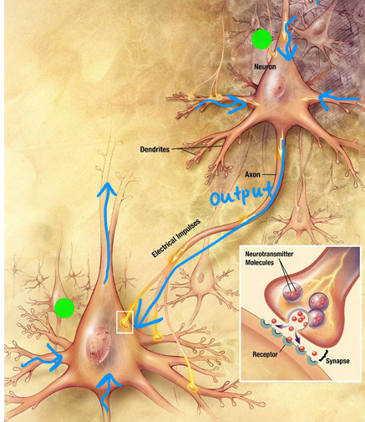
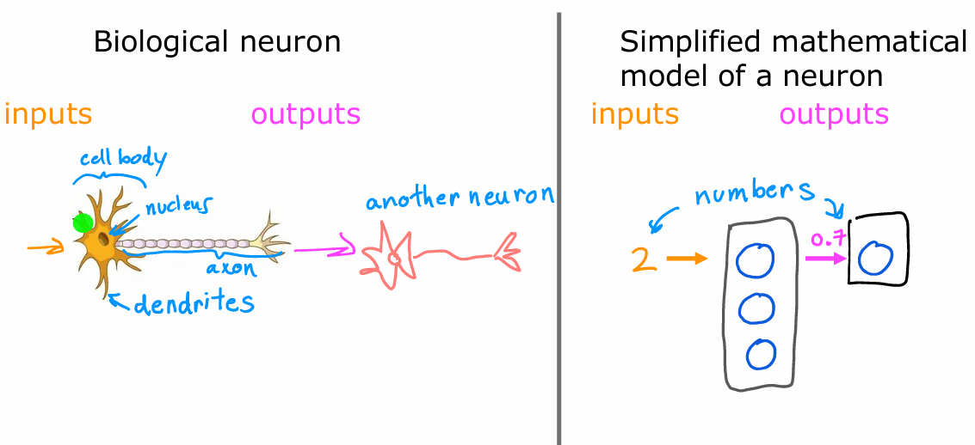
Neurons in the brain
Notes:
Even though today’s neural networks have almost nothing to do with how the brain learns, there was the early motivation of trying to build software to mimic the brain. So how does the brain work? Here's a diagram illustrating what neurons in a brain look like. All of human thought is from neurons like this in your brain and mine, sending electrical impulses and sometimes forming new connections of other neurons. Given a neuron like this one, it has a number of inputs where it receives electrical impulses from other neurons, and then this neuron that I've circled carries out some computations and will then send this outputs to other neurons by this electrical impulses, and this upper neuron’s output in turn becomes the input to this neuron down below, which again aggregates inputs from multiple other neurons to then maybe send its own output, to yet other neurons, and this is the stuff of which human thought is made. Here's a simplified diagram of a biological neuron. A neuron comprises a cell body shown here on the left, and if you have taken a class in biology, you may recognize this to be the nucleus of the neuron. As we saw on the previous slide, the neuron has different inputs. In a biological neuron, the input wires are called the dendrites, and it then occasionally sends electrical impulses to other neurons via the output wire, which is called the axon. Don't worry about these biological terms. If you saw them in a biology class, you may remember them, but you don't really need to memorize any of these terms for the purpose of building artificial neural networks. But this biological neuron may then send electrical impulses that become the input to another neuron. So, the artificial neural network uses a very simplified Mathematical model of what a biological neuron does. I'm going to draw a little circle here to denote a single neuron. What a neuron does is it takes some inputs, one or more inputs, which are just numbers. It does some computation and it outputs
some other number, which then could be an input to a second neuron, shown here on the right. When you're building an artificial neural network or deep learning algorithm, rather than building one neuron at a time, you often want to simulate many such neurons at the same time. In this diagram, I’m drawing three neurons. What these neurons do collectively is
input a few numbers, carry out some computation, and output some other numbers. Now, at this point, I'd like to give one big caveat, which is that even though I made a loose analogy between biological neurons and artificial neurons, I think that today we have almost no idea how the human brain works. In fact, every few years, neuroscientists make some
fundamental breakthrough about how the brain works. I think we'll continue to do so for the foreseeable future. That to me is a sign that there are many breakthroughs
that are yet to be discovered about how the brain actually works, and thus attempts to blindly mimic what we know of the human brain today, which is frankly very little, probably won't get us that far toward building raw intelligence. Certainly not with our current level of knowledge in neuroscience. Having said that, even with these extremely simplified models of a neuron, which we'll talk about, we'll be able to build really powerful deep learning algorithms. So, as you go deeper into neural networks and into deep learning, even though the origins were biologically motivated, don't take the biological motivation too seriously. In fact, those of us that do research in deep learning have shifted away from looking to biological motivation that much. But instead, they're just using engineering principles to figure out how to build algorithms that are more effective. But I think it might still be fun to speculate and think about how biological neurons work every now and then. The ideas of neural networks have been around for many decades.

Slide 4
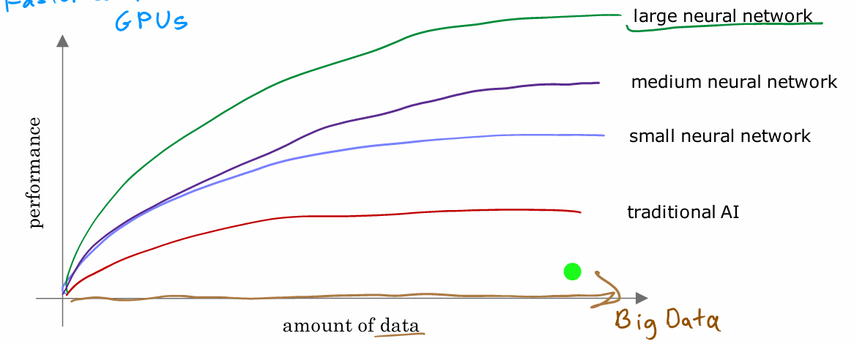
Why Now
Notes:
Why is it that only in the last handful of years that neural networks have really taken off?" This is a picture I draw for them when I'm
asked that question and that maybe you could draw for others as well if they ask you that question. Let me plot on the horizontal axis the amount of data you have for a problem, and on the vertical axis, the performance or the accuracy of a learning algorithm applied to that problem. Over the last couple of decades, with the rise of the Internet, the rise of mobile phones, the digitalization of our society, the amount of data we have for a lot of applications has steadily marched to the right. Lot of records that use P on paper, such as if you order something rather than it being on a piece of paper, there's much more likely to be a digital record. Your health record, if you see a doctor, is much more likely to be digital now compared to on pieces of paper. So, in many application areas, the amount of digital data has exploded. What we saw was with traditional machine-learning algorithms, such as logistic regression and linear regression, even as you fed those algorithms more data, it was very difficult to get the performance to keep on going up. So it was as if the traditional learning
algorithms like linear regression and logistic regression, they just weren't able to scale with the amount of data we could now feed it and they weren't able to take effective advantage of all this data we had for different applications. What AI researchers started to observe was that if you were to train a small neural network on this dataset, then the performance maybe looks like this. If you were to train a medium-sized neural network, meaning one with more neurons in it, its performance may look like that. If you were to train a very large neural network, meaning one with a lot of these artificial neurons, then for some applications the performance will just keep on going up. So this meant two things, it meant that for
a certain class of applications where you do have a lot of data, sometimes you hear the term big data toss around, if you're able to train a very large neural network to take advantage of that huge amount of data you have, then you could attain performance on anything ranging from speech recognition, to image recognition, to natural language processing applications and many more, they just were not possible with earlier generations of learning algorithms. This caused deep learning algorithms to take off, and this too is why faster computer processors, including the rise of GPUs or graphics processor units. This is hardware originally designed to generate nice-looking computer graphics, but turned out to be really powerful for deep learning as well. That was also a major force in allowing deep learning algorithms to become what it is today. That's how neural networks got started, as well as why they took off so quickly in the last several years. Let's now dive more deeply into the details of how neural network actually works.

Slide 5
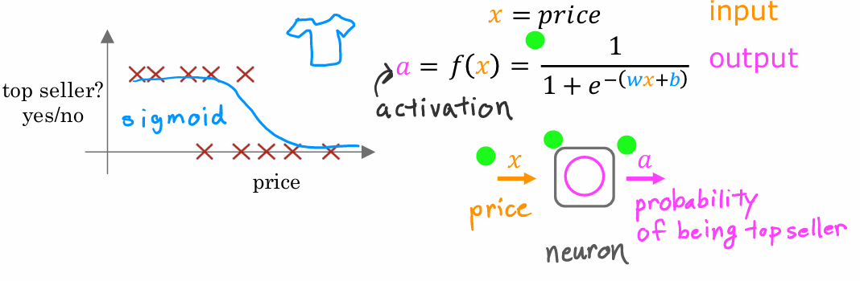
Demand Prediction: a simple example
- Neural networks predict if a product, like a T-shirt, will be a top seller based on its price.
- Logistic regression fits a sigmoid function to the data, helping retailers plan inventory and marketing.
- The algorithm acts like a simplified neuron, computing the probability of an item being a top seller.
- Neural networks are built by connecting multiple such simplified neurons together.
Notes:
To illustrate how
neural networks work, let's start with an example. We'll use an example from demand prediction in which you look at the product
and try to predict, will this product be
a top seller or not? Let's take a look. In this example, you're
selling T-shirts and you would like to know if a particular T-shirt
will be a top seller, yes or no, and you
have collected data of different t-shirts that
were sold at different prices, as well as which ones
became a top seller. This type of application is used by retailers today in order to plan better inventory levels as well as marketing campaigns. If you know what's likely to be a top seller, you would plan, for example, to just purchase more of that
stock in advance. In this example,
the input feature x is the price of the T-shirt, and so that's the input to
the learning algorithm. If you apply logistic
regression to fit a sigmoid function to the data that might
look like that then the outputs of your prediction
might look like this, 1/1 plus e to the
negative wx plus b. Previously, we had
written this as f of x as the output of
the learning algorithm. In order to set us up to
build a neural network, I'm going to switch the
terminology a little bit and use the alphabet a to denote the output of this logistic
regression algorithm. The term a stands
for activation, and it's actually a
term from neuroscience, and it refers to how
much a neuron is sending a high output to other
neurons downstream from it. It turns out that this logistic regression units or this little logistic
regression algorithm, can be thought of as a very simplified model of a
single neuron in the brain. Where what the neuron does is it takes us
input the price x, and then it computes
this formula on top, and it outputs the number a, which is computed
by this formula, and it outputs the probability of this T-shirt
being a top seller. Another way to think
of a neuron is as a tiny little computer whose only job is to input
one number or a few numbers, such as a price, and then
to output one number or maybe a few other
numbers which in this case is the probability of the T-shirt
being a top seller. A logistic regression
algorithm is much simpler than what any biological neuron in your
brain or mine does. Which is why the artificial
neural network is such a vastly oversimplified
model of the human brain. Even though in
practice, as you know, deep learning algorithms
do work very well. Given this description
of a single neuron, building a neural network now it just requires taking a bunch of these neurons and wiring them together or putting
them together.

Slide 6
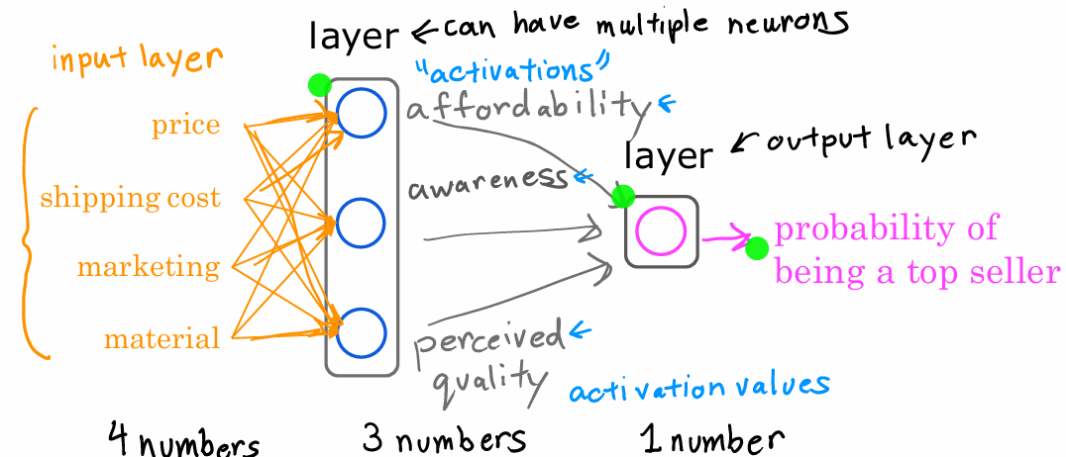
Demand Prediction: a more complex example
Notes:
Let's now look at a
more complex example of demand prediction. In this example, we're
going to have four features to predict whether or not
a T-shirt is a top seller. The features are the
price of the T-shirt, the shipping costs, the amounts of marketing of that
particular T-shirt, as well as the material quality, is this a high-quality, thick cotton versus maybe
a lower quality material? Now, you might suspect
that whether or not a T-shirt becomes a top seller actually depends
on a few factors. First, one is the
affordability of this T-shirt. Second is, what's the degree of awareness of this T-shirt
that potential buyers have? Third is perceived quality to bias or potential bias saying this is a
high-quality T-shirt. What I'm going to do is create
one artificial neuron to try to estimate the
probability that this T-shirt is perceive
as highly affordable. Affordability is mainly a
function of price and shipping costs because the
total amount of the pay is some of the price
plus the shipping costs. We're going to use a
little neuron here, a logistic regression unit
to input price and shipping costs and predict do people
think this is affordable? Second, I'm going to create another artificial
neuron here to estimate, is there high awareness of this? Awareness in this case is mainly a function of the
marketing of the T-shirt. Finally, going to create
another neuron to estimate do people perceive
this to be of high quality, and that may mainly
be a function of the price of the T-shirt and
of the material quality. Price is a factor here because fortunately
or unfortunately, if there's a very
high priced T-shirt, people will sometimes perceive that to be of high
quality because it is very expensive than maybe people think it's going
to be of high-quality. Given these estimates of
affordability, awareness, and perceived quality we
then wire the outputs of these three neurons to another
neuron here on the right, that then there's another
logistic regression unit. That finally inputs
those three numbers and outputs the probability of this t-shirt being a top seller. In the terminology
of neural networks, we're going to group these three neurons together
into what's called a layer. A layer is a grouping
of neurons which takes as input the same
or similar features, and that in turn outputs
a few numbers together. These three neurons on the left form one layer which is why I drew them
on top of each other, and this single neuron on
the right is also one layer. The layer on the left
has three neurons, so a layer can have multiple
neurons or it can also have a single neuron as in the case of this
layer on the right. This layer on the
right is also called the output layer
because the outputs of this final neuron is the output probability predicted
by the neural network. In the terminology of neural networks we're
also going to call affordability
awareness and perceive quality to be activations. The term activations comes
from biological neurons, and it refers to the degree that the biological
neuron is sending a high output value or sending many electrical impulses to other neurons to the
downstream from it. These numbers on
affordability, awareness, and perceived quality are the activations of these
three neurons in this layer, and also this output
probability is the activation of this neuron
shown here on the right. This particular neural network therefore carries out
computations as follows. It inputs four numbers then this layer of the
neural network uses those four numbers to compute the new numbers also
called activation values. Then the final layer, the output layer of the
neural network used those three numbers to
compute one number. In a neural network this list of four numbers is also
called the input layer, and that's just a
list of four numbers. Now, there's one simplification I'd like make to
this neural network. The way I've
described it so far, we had to go through the
neurons one at a time and decide what inputs it would
take from the previous layer. For example, we said
affordability is a function of just price and shipping
costs and awareness is a function of just
marketing and so on, but if you're building
a large neural network it'd be a lot of work
to go through and manually decide which neurons should take which
features as inputs. The way a neural network
is implemented in practice each neuron
in a certain layer; say this layer in the middle, will have access
to every feature, to every value from
the previous layer, from the input layer which is
why I'm now drawing arrows from every input
feature to every one of these neurons shown
here in the middle. You can imagine that if
you're trying to predict affordability and it knows what's the price shipping
cost marketing and material, may be you'll learn to ignore marketing and material
and just figure out through setting the
parameters appropriately to only focus on the subset
of features that are most relevant to affordability. To further simplify
the notation and the description of this
neural network I'm going to take these four
input features and write them as a vector x, and we're going to view the
neural network as having four features that comprise
this feature vector x. This feature vector is
fed to this layer in the middle which then computes
three activation values. That is these numbers and these three activation values in turn becomes
another vector which is fed to this final
output layer that finally outputs the probability of this t-shirt to
being a top seller. That's all a neural network is. It has a few layers
where each layer inputs a vector and outputs
another vector of numbers. For example, this layer
in the middle inputs four numbers x and outputs three numbers
corresponding to affordability, awareness, and
perceived quality. To add a little bit
more terminology, you've seen that this
layer is called the output layer and this layer is
called the input layer. To give the layer in the
middle a name as well, this layer in the middle
is called a hidden layer. I know that this is
maybe not the best or the most intuitive name but that terminology comes from that's when you have
a training set. In a training set, you get to observe both x and y. Your data set tells you
what is x and what is y, and so you get data that tells you what are the correct inputs
and the correct outputs. But your dataset
doesn't tell you what are the correct values
for affordability, awareness, and
perceived quality. The correct values
for those are hidden. You don't see them
in the training set, which is why this layer in the middle is called
a hidden layer.

Slide 7
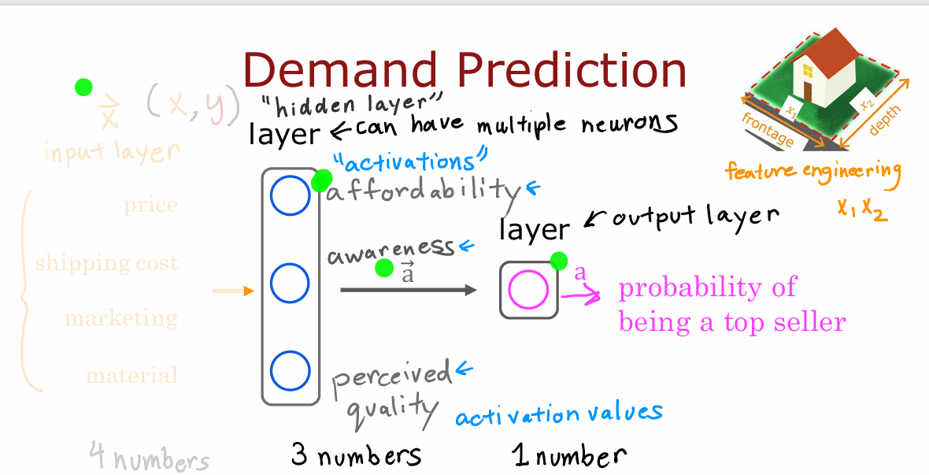
Demand Prediction: relevant features from data
- Neural networks can learn their own features, making predictions more accurate without manual feature engineering.
- An input layer with a vector of features is processed by a hidden layer, outputting a new set of features.
- This hidden layer outputs three numbers that the neural network uses to make a final prediction.
- The neural network's ability to automatically determine relevant features from data makes it a powerful learning algorithm.
Notes:
I'd like to share with you
another way of thinking about neural networks
that I've found useful for building my intuition about it. Just let me cover up the
left half of this diagram and see what we're left with. What you see here
is that there is a logistic regression
algorithm or logistic regression unit
that is taking as input, affordability, awareness, and perceived
quality of a t-shirt, and using these three
features to estimate the probability of the
t-shirt being a top seller. This is just
logistic regression. But the cool thing about this is rather than using
the original features, price, shipping cost,
marketing, and so on, is using maybe better set of features,
affordability, awareness, and perceived quality,
that are hopefully more predictive of whether or not this t-shirt will
be a top seller. One way to think of
this neural network is, just logistic regression. But as a version of
logistic regression, they can learn its
own features that makes it easier to make
accurate predictions. In fact, you might remember
from the previous week, this housing example
where we said that if you want to predict
the price of the house, you might take the frontage or the width of lots
and multiply that by the depth of a
lot to construct a more complex feature, x_1 times x_2, which was the size of the lawn. There we were doing manual
feature engineering where we had to look
at the features x_1 and x_2 and decide by
hand how to combine them together to come up
with better features. What the neural network
does is instead of you needing to manually
engineer the features, it can learn, as
you'll see later, its own features to make the learning problem
easier for itself. This is what makes neural networks one of the most powerful learning
algorithms in the world today. To summarize, a neural network, does this, the input layer
has a vector of features, four numbers in this example, it is input to the hidden layer, which outputs three numbers. I'm going to use a
vector to denote this vector of activations that this hidden layer outputs. Then the output layer
takes its input to three numbers and
outputs one number, which would be the
final activation, or the final prediction
of the neural network. One note, even
though I previously described this neural network
as computing affordability, awareness, and
perceived quality, one of the really nice
properties of a neural network is when you train it from data, you don't need to go in to explicitly decide
what other features, such as affordability and so on, that the neural network should compute instead or
figure out all by itself what are the features it wants to use in
this hidden layer. That's what makes it such a
powerful learning algorithm. You've seen here one example
of a neural network and this neural network has a single layer that
is a hidden layer.

Slide 8
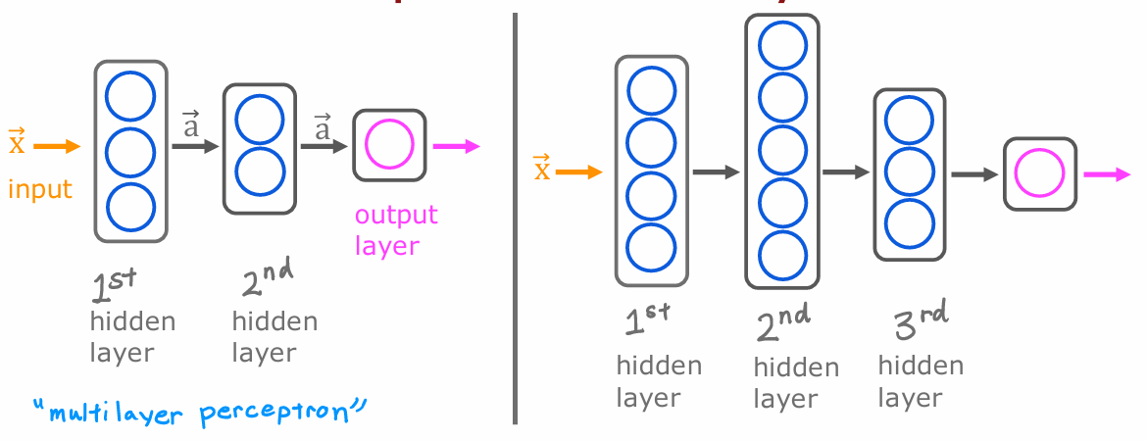
Multiple Hidden Layers
- Neural networks can have multiple hidden layers, each transforming the input into a set of activation values for the next layer.
- The architecture, including the number of hidden layers and neurons per layer, significantly impacts the performance of the neural network.
- Multilayer perceptron refers to neural networks with multiple layers.
Notes:
Let's take a look at
some other examples of neural networks,
specifically, examples with more
than one hidden layer. Here's an example. This neural network has an input feature vector X that is fed to one hidden layer. I'm going to call this
the first hidden layer. If this hidden layer
has three neurons, it will then output a vector
of three activation values. These three numbers can then be input to the second
hidden layer. If the second hidden layer has two neurons to logistic units, then this second
hidden there will output another vector of now two activation values
that maybe goes to the output layer that then outputs the neural
network's final prediction. Here's another example. Here's a neural network that it's input goes to
the first hidden layer, the output of the
first hidden layer goes to the second hidden layer, goes to the third hidden layer, and then finally to
the output layer. When you're building
your own neural network, one of the decisions
you need to make is how many hidden layers do you want and how many neurons do you want each hidden
layer to have. This question of how
many hidden layers and how many neurons
per hidden layer is a question of the architecture
of the neural network. You'll learn later in
this course some tips for choosing an appropriate
architecture for a neural network. But choosing the right number of hidden layers and number of hidden units per layer can have an impact on the performance of a learning algorithm as well. Later in this course,
you'll learn how to choose a good architecture for your
neural network as well. By the way, in some
of the literature, you see this type of
neural network with multiple layers like this
called a multilayer perceptron. If you see that, that just
refers to a neural network that looks like what you're
seeing here on the slide. That's a neural network. I know we went through
a lot in this video. Thank you for sticking with me. But you now know how a
neural network works. In the next video, let's take a look
at how these ideas can be applied to other
applications as well. In particular, we'll
take a look at the computer vision application
of face recognition.

Slide 9
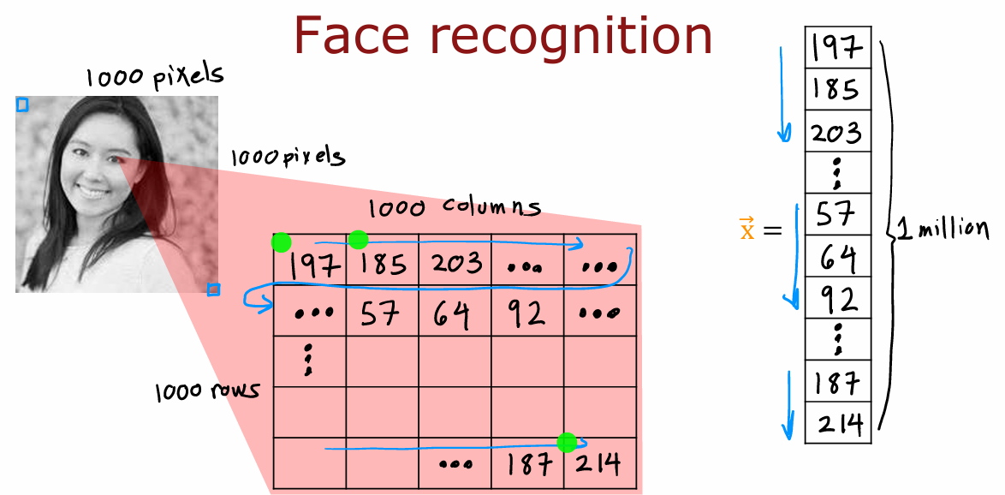
Face recognition (1/2)
Notes:
Let's take a look at how you
can apply a similar type of idea to computer vision
application. Let's dive in. If you're building a face
recognition application, you might want to train a neural network that takes
as input a picture like this and outputs the identity of the person in the picture. This image is 1,000
by 1,000 pixels. Its representation
in the computer is actually as 1,000 by 1,000 grid, or also called 1,000 by 1,000 matrix of pixel
intensity values. In this example, my pixel intensity values or pixel brightness values, goes from 0-255 and so 197 here would be the brightness of the pixel in the very upper
left of the image, 185 is brightness of the
pixel, one pixel over, and so on down to 214 would be the lower
right corner of this image. If you were to take these pixel intensity values and unroll them into a vector, you end up with a
list or a vector of a million pixel
intensity values. One million because 1,000 by 1,000 square gives you
a million numbers. The face recognition problem is, can you train a neural network that takes as input a
feature vector with a million pixel
brightness values and outputs the identity of
the person in the picture. This is how you might build a neural network to
carry out this task.

Slide 10
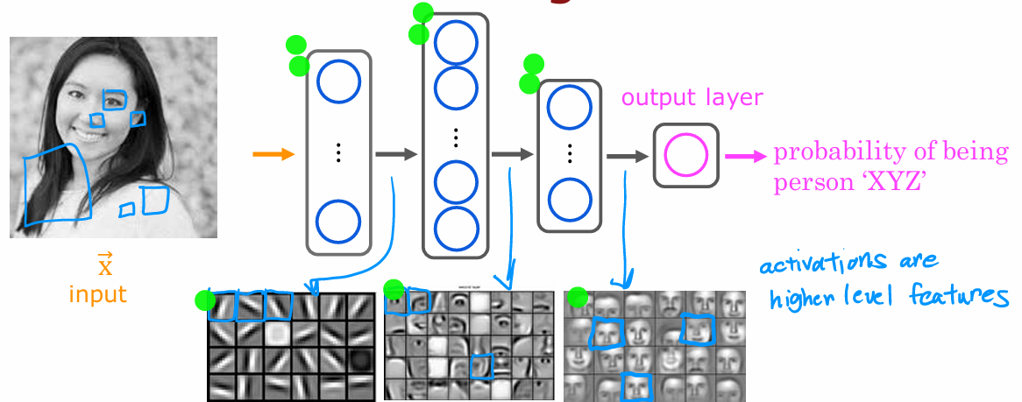
Face recognition (2/2)
- Neural networks process images through multiple hidden layers, each extracting different features.
- The first hidden layer detects basic elements like lines and edges, while subsequent layers identify more complex features like parts of faces.
- Higher hidden layers combine these features to detect larger face shapes, helping the output layer estimate the identity of a person.
- The network autonomously learns to identify these features from data without explicit instructions.
Notes:
The input image X is fed
to this layer of neurons. This is the first hidden layer, which then extract
some features. The output of this
first hidden layer is fed to a second hidden layer and that output is fed to a third layer and then
finally to the output layer, which then estimates, say the probability of this
being a particular person. One interesting
thing would be if you look at a neural network
that's been trained on a lot of images of
faces and to try to visualize what are these hidden layers,
trying to compute. It turns out that when you train a system like this
on a lot of pictures of faces and you peer at the different neurons
in the hidden layers to figure out what they may be computing this is
what you might find. In the first hidden layer, you might find one
neuron that is looking for the low vertical line or
a vertical edge like that. A second neuron looking for a oriented line or
oriented edge like that. The third neuron
looking for a line at that orientation, and so on. In the earliest layers
of a neural network, you might find that the
neurons are looking for very short lines or very
short edges in the image. If you look at the
next hidden layer, you find that these neurons
might learn to group together lots of little short lines and little short edge segments in order to look for
parts of faces. For example, each of these
little square boxes is a visualization of what that
neuron is trying to detect. This first neuron
looks like it's trying to detect the presence or absence of an eye in a certain
position of the image. The second neuron,
looks like it's trying to detect like a corner of a nose and maybe
this neuron over here is trying to detect
the bottom of a nose. Then as you look
at the next hidden layer in this example, the neural network
is aggregating different parts of faces to then try to detect presence
or absence of larger, coarser face shapes. Then finally, detecting how much the face corresponds to
different face shapes creates a rich set of features
that then helps the output layer try to determine the identity
of the person picture. A remarkable thing about the neural network
is you can learn these feature detectors at the different hidden
layers all by itself. In this example, no
one ever told it to look for short little
edges in the first layer, and eyes and noses
and face parts in the second layer and then more complete face shapes
at the third layer. The neural network is able
to figure out these things all by itself from data. Just one note, in
this visualization, the neurons in the
first hidden layer are shown looking at relatively small windows
to look for these edges. In the second hidden layer
is looking at bigger window, and the third hidden layer is looking at even bigger window. These little neurons
visualizations actually correspond
to differently sized regions in the image.

Slide 11
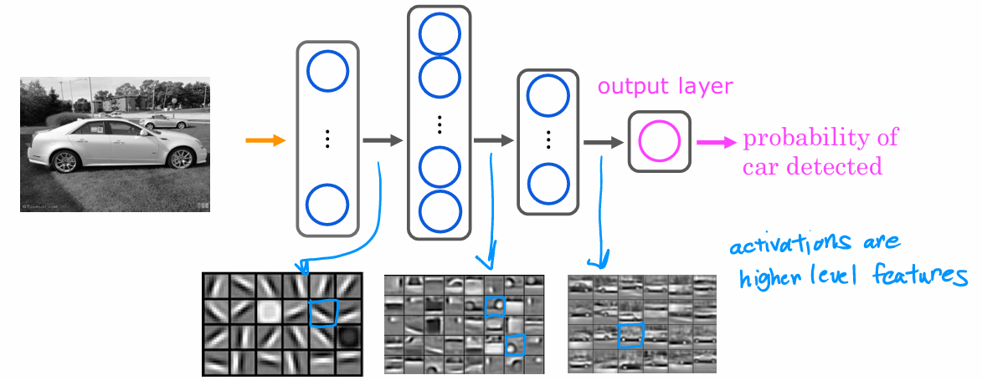
Car recognition
1. Training a neural network on different datasets, such as car images, enables it to learn distinct features for various tasks.
2. The network identifies edges in the first layer, parts of objects in the second layer, and complete shapes in the third layer.
3. Feeding different data allows the network to adapt and detect features specific to tasks like car detection or person recognition.
Notes:
Just for fun, let's see
what happens if you were to train this neural network
on a different dataset, say on lots of pictures of cars, picture on the side. The same learning algorithm
is asked to detect cars, will then learn edges
in the first layer. Pretty similar but then they'll learn to detect parts of cars in the second hidden
layer and then more complete car shapes in
the third hidden layer. Just by feeding it
different data, the neural network
automatically learns to detect very different features
so as to try to make the predictions
of car detection or person recognition
or whether there's a particular given task
that is trained on. That's how a neural
network works for computer vision application. In fact, later this week, you'll see how you can build a neural network
yourself and apply it to a handwritten digit
recognition application. So far we've been going
over the description of intuitions of neural networks to give you a feel
for how they work. In the next video, let's look more deeply into
the concrete mathematics and a concrete implementation
of details of how you actually build one or more
layers of a neural network, and therefore how
you can implement one of these things yourself.

Slide 12
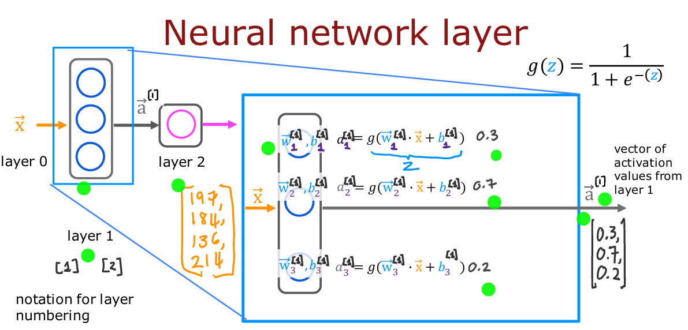



Neural Network layer
Notes:
The fundamental building block of most modern neural networks is a layer of neurons. In this lecture, you’ll learn how to construct a layer of neurons and once you have that down, you’d be able to take those building blocks and put them together to form a large neural network. Let’s take a look at how a layer of neurons works. Here’s the example we had from the demand prediction example where we had four input features that were set to this layer of three neurons in the hidden layer that then sends its output to this output layer with just one neuron. Let’s zoom in to the hidden layer to look at its computations. This hidden layer inputs four numbers and these four numbers are inputs to each of the three neurons. Each of these three neurons is just implementing a little logistic regression unit or a little bit logistic regression function. Take this first neuron. It has two parameters, w and b. In fact, to denote that, this is the first hidden unit, I’m going to subscript this as w1, b1.
z value is that you have learned about in logistic regression in the previous course, and g(z) is the familiar logistic function, 1 1+e−z . Maybe this ends up being a number 0.3 and that’s the activation value a of the first neuron. To denote that this is the first neuron, I’m also going to add a subscript a[1] 1 over here, and so a[1] 1 may be a number like 0.3. There’s a 0.3 chance of this being highly affordable based on the input features. Now let’s look at the second neuron. The second neuron has parameters w2 and b2.
The result of the computation may be some other number, say 0.7. Because in this example, there’s a 0.7 chance that we think the potential buyers will be aware of this t-shirt. Similarly, the third neuron has a third set of parameters w3, b3. Similarly, it computes an activation value a3 equals 0.2. In this example, these three neurons output 0.3, 0.7, and 0.2, and this vector of three numbers becomes the vector of activation values⃗(a), that is then passed to the final output layer of this neural network. Now, when you build neural networks with multiple layers, it’ll be useful to give the layers different numbers. By convention, the (first) hidden layer is called layer 1 of the neural network and the output layer is called layer 2 of the neural network. The input layer is also sometimes called layer 0 and today, there are neural networks that can have dozens or even hundreds of layers. But in order to introduce notation to help us distinguish between the different layers, I’m going to use superscript square bracket 1 to index into different layers. In particular, a superscript in square brackets 1, I’m going to use, that’s a notation to denote the output of layer 1 of this hidden layer of this neural network. I know maybe this notation is getting a little bit cluttered. But the thing to remember is whenever you see this superscript [1], that just refers to a quantity that is associated with layer 1 of the neural network. If you see superscript [2], that refers to a quantity associated with layer 2 of the neural network and similarly for other layers as well, including layer 3, layer 4 and so on for neural networks with more layers. That’s the computation of layer 1 of this neural network. Its output is this activation vector, a[1] and I’m going to copy this over here because this output a1 becomes the input to layer 2. Now let’s zoom into the computation of layer 2 of this neural network, which is also the output layer. The input to layer 2 is the output of layer 1, so a1 is this vector 0.3, 0.7, 0.2 that we just computed in the previous part of this picture. Because the output layer has just a single neuron, all it does is it computes a1^2.
a1 that is the output of this first and only neuron. If this results in a number, say 0.84, then that becomes the output layer of the neural network. In this example, because the output layer has just a single neuron, this output is just a scalar, is a single number rather than a vector of numbers. Sticking with our notational convention from before, we’re going to use a superscript in [2], to denote the quantities associated with layer 2 of this neural network, so a[2] is the output of this layer, and so I’m going to also copy this here as the final output of the neural network.

Slide 13
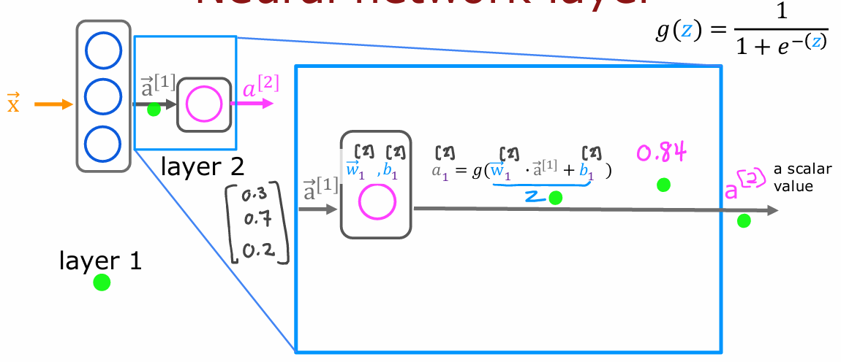

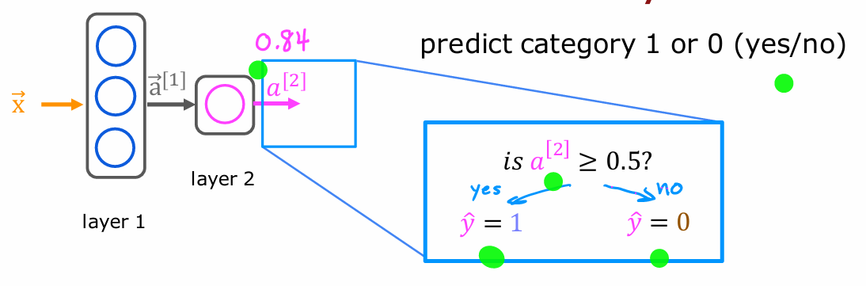
Neural Network layer
Notes:
Once the neural network has computed a[2], there is one final optional step that you can choose to implement or not, which is if you want a binary prediction, 1 or 0, is this a top seller? Yes or no? If it’s greater than 0.5, you can predict ˆ y equals 1 and if it is less than 0.5, then predict your ˆ y hat equals 0. We saw this threshold as well when you learned about logistic regression in the first part of the course. If you wish, this then gives you the final prediction ˆ y as either one or zero, if you don’t want just the probability of it being a top seller. So that’s how a neural network works. Every layer inputs a vector of numbers and applies a bunch of logistic regression units to it, and then computes another vector of numbers that then gets passed from layer to layer until you get to the final output layers computation, which is the prediction of the neural network. Then you can either threshold at 0.5 or not to come up with the final prediction. With that, let’s go on to use this foundation we’ve built now to look at some even more complex, even larger neural network models. I hope that by seeing more examples, this concept of layers and how to put them together to build a neural network will become even clearer

Slide 14
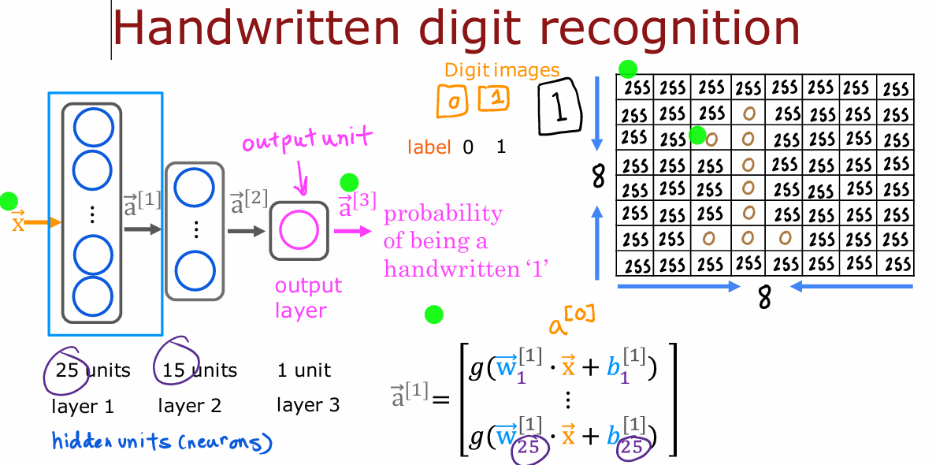
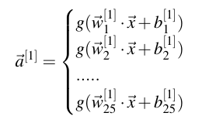
Inference: making predictions (forward propagation)
Notes:
Let’s take what we’ve learned and put it together into an algorithm to let your neural network make inferences or make predictions. This will be an algorithm called forward propagation. Let’s take a look. I’m going to use as a motivating example, handwritten digit recognition. And for simplicity we are just going to distinguish between the handwritten digits zero and one. So it’s just a binary classification problem where we’re going to input an image and classify, is this the digit zero or the digit one? And you get to play with this yourself later in the practice lab as well. For the example of the slide, I’m going to use an eight-by-eight image. And so this image of a one is this grid or matrix of eight by eight or 64-pixel intensity values where 255 denotes a bright white pixel and zero would denote a black pixel. And different numbers are different shades of gray in between the shades of black and white. Given these 64 input features, we’re going to use the neural network with two hidden layers. Where the first hidden layer has 25 neurons or 25 units. Second hidden layer has 15 neurons or 15 units. And then finally the output layer or outputs unit, what’s the chance of this being 1 versus 0?. So let’s step through the sequence of computations that in your neural network will need to make to go from the input X, this eight by eight or 64 numbers to the predicted probability⃗a[3]. The first computation is to go from X to⃗a1, and that’s what the first layer of the first hidden layer does.

Slide 15
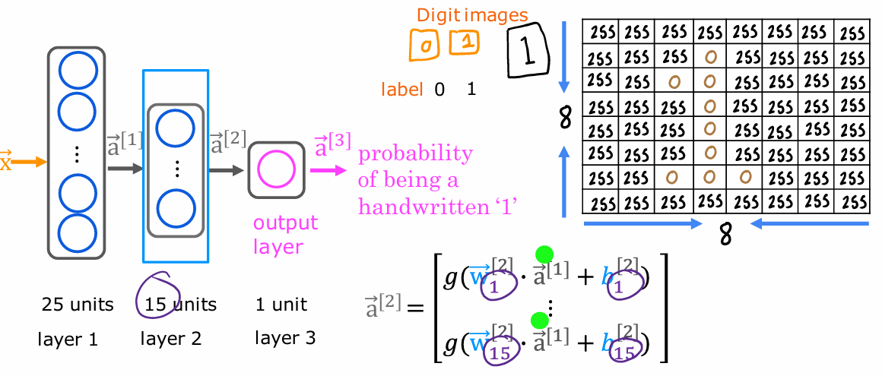
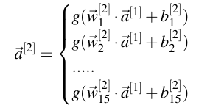
Inference: making predictions (forward propagation)
Notes:
Notice that a one has 25 numbers because this hidden layer has 25 units. Which is why the parameters go from w1 through w25 as well as b1 through b25. And I’ve written x here but I could also have written a[0] here because by convention the activation of layer zero, that is a0 is equal to the input feature value x. The next step is to compute⃗a[2]. Looking at the second hidden layer, it then carries out this computation where⃗a[2] is a function of⃗a[1]. Notice that layer two has 15 neurons or 15 units, which is why the parameters here run from w1 through w15 and b1 through b15. Now we’ve computed⃗a[2].

Slide 16
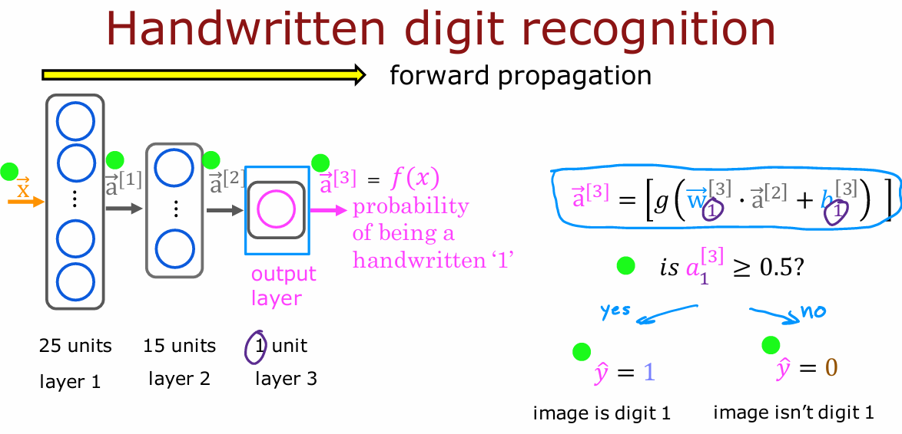
Inference: making predictions (forward propagation)
Notes:
The Final step is then to compute⃗a[3] and we do so use a very similar computation. Only now, this third layer, the output layer has just one unit, which is why there’s just one output here. So a[3] is just a scalar. And finally, you can optionally take a[3] 1 and threshold it at 4.5 to come up with a binary classification label. Is this the digit 1? Yes or no? So the sequence of computations first takes x and then computes a[1], and then computes a[2], and then computes a[3], which is also the output of the neural networks. You can also write that as f(x). So remember when we learned about linear regression and logistic regression, we use f(x) to denote the output of linear regression or logistic regression. So we can also use f(x) to denote the function computed by the neural network as a function of x. Because this computation goes from left to right, you start from x and compute a[1], then a[2], then a[3]. This is also called forward propagation because you’re propagating the activations of the neurons. So you’re making these computations in the forward direction from left to right. And this is in contrast to a different algorithm called backward propagation or back propagation, which is used for learning. And that’s something you learn about next lecture. And by the way, this type of neural network architecture where you have more hidden units initially and then the number of hidden units decreases as you get closer to the output layer. There’s also a pretty typical choice when choosing neural network architectures. And you see more examples of this in the practice lab as well. So that’s neural network inference using the forward propagation algorithm. And with this, you’d be able to download the parameters of a neural network that someone else had trained and posted on the Internet. And you’d be able to carry out inference on your new data using their neural network. Now that you’ve seen the math and the algorithm, let’s take a look at how you can actually implement this in Tensorflow. Specifically, let’s take a look at this in the next chapter.

Slide 17
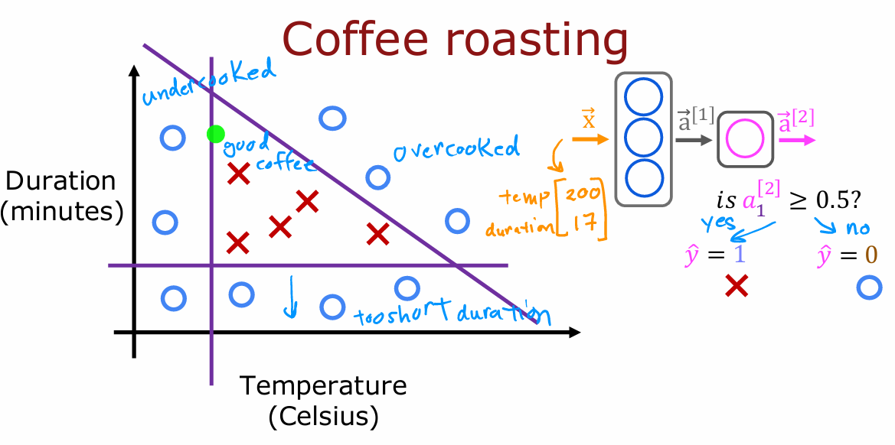
Inference in code: Coffee Roasting
The roasting process involves controlling temperature and duration to achieve good-tasting coffee.
A dataset of temperatures, durations, and quality labels can help train a neural network to optimize roasting.
Given temperature and duration as input features, the neural network can infer whether the coffee will be good or bad.
TensorFlow is a leading framework for implementing deep learning algorithms, similar to PyTorch.
Neural networks can be applied to various applications, including optimizing home coffee bean roasting.
Notes:
TensorFlow is one of the leading frameworks to implementing deep learning algorithms. The other popular tool is PyTorch. But we’re going to focus in this course on TensorFlow. In this lecture, let’s take a look at how you can implement inferencing code using TensorFlow. Let’s dive in. One of the remarkable things about neural networks is the same algorithm can be applied to so many different applications. For this lecture and in some of the labs for you to see what the neural network is doing, I’m going to use another example to illustrate inference. Let’s suppose that you like to roast coffee beans yourself at home. Can the learning algorithm help optimize the quality of the beans you get from a roasting process like this? When you’re roasting coffee, two parameters you get to control are the temperature at which you’re heating up the raw coffee beans to turn them into nicely roasted coffee beans, as well as the duration or how long are you going to roast the beans. In this slightly simplified example, we’ve created the datasets of different temperatures and different durations, as well as labels showing whether the coffee you roasted is good-tasting coffee. Where cross here, the positive cross y equals 1 corresponds to good coffee, and all the negative cross corresponds to bad coffee. It looks like a reasonable way to think of this dataset is if you cook it at too lower temperature, it doesn’t get roasted and it ends up undercooked. If you cook it, not for long enough, the duration is too short, it’s also not a nicely roasted set of beans. Finally, if you were to cook it either for too long or for too higher temperature, then you end up with overcooked beans. They’re a little bit burnt beans. There’s not good coffee either. It’s only points within this little triangle here that corresponds to good coffee. This example is simplified a bit from actual coffee roasting. Even though this example is a simplified one for the purpose of illustration, there have actually been serious projects using machine learning to optimize coffee roasting as well. The task is given a feature vector x with both temperature and duration, say 200 degrees Celsius for 17 minutes, how can we do inference in a neural network to get it to tell us whether or not this temperature and duration setting will result in good coffee or not? It looks like this. We’re going to set x to be an array of two numbers. The input features 200 degrees Celsius and 17 minutes.

Slide 18
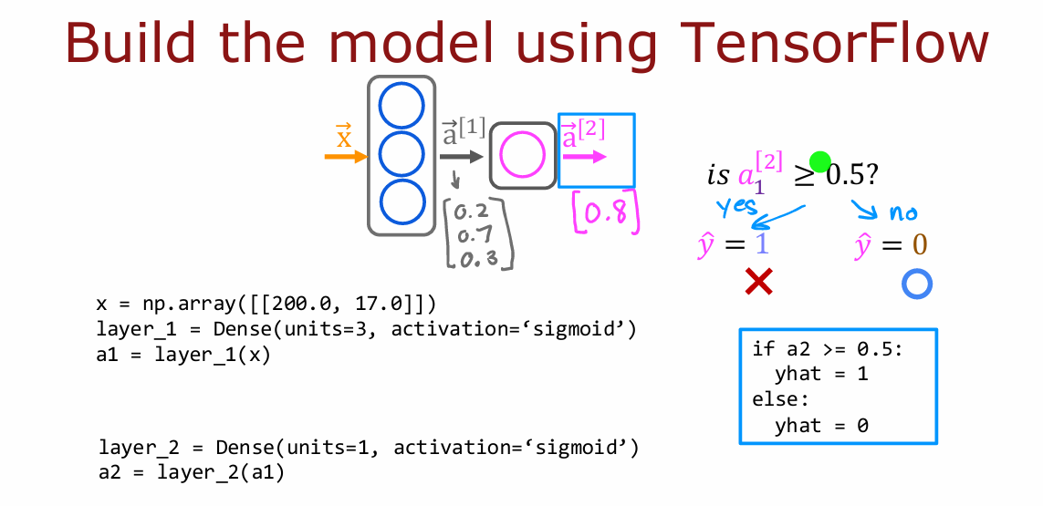
Inference in code: Coffee Roasting
C2_W1_Lab02_CoffeeRoasting_TF.ipynb
C2_W1_Lab03_CoffeeRoasting_Numpy.ipynb
C2_W1_Lab04_Handwritten_Recognition.ipynb
Notes:
Layer 1 creates a hidden layer of neurons with three hidden units, and using as the activation function, the sigmoid function, and dense here is just the name of this layer. Then finally, to compute the activation values a[1], you would write a[1] equals Layer 1 applied to the input features x. Then you create Layer 1 as this f irst hidden layer, the neural network, as dense open parenthesis units 3, which means three units or three hidden units in this layer using as the activation function, the sigmoid function. Dense is another name for the layers of a neural network that we’ve learned about so far. As you learn more about neural networks, you learn about other types of layers as well. But for now, we’ll just use the dense layer, which is the layer type you’ve learned about in the last few chapters for all of our examples. Next, you compute a[1] by taking Layer 1, which is actually a function, and applying this function Layer 1 to the values of x. That’s how you get a[1], which is going to be a list of three numbers because Layer 1 had three units. So, a[1] here may, just for the sake of illustration, be 0.2, 0.7, 0.3. Next, for the second hidden layer, Layer 2, would be dense. Now this time it has one unit and again to sigmoid activation function, and you can then compute a[2] by applying this Layer 2 function to the activation values from Layer 1 to a[1]. That will give you the value of a[2], which for the sake of illustration is maybe 0.8. Finally, if you wish to threshold it at 0.5, then you can just test if a[2] is greater and equal to 0.5 and set ˆ (y) equals to one or zero positive or negative cross accordingly. That’s how you do inference in the neural network using TensorFlow. There are some additional details that I didn’t go over here, such as how to load the TensorFlow library and how to also load the parameters w and b of the neural network.

Slide 19
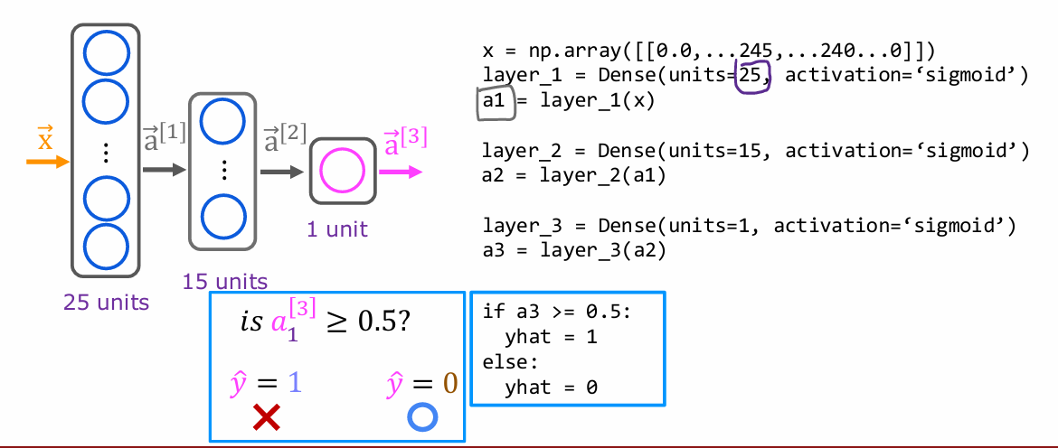
Inference in code: Model for digit classification
Notes:
Let’s look at one more example and we’re going to go back to the handwritten digit classification problem. In this example, x is a list of the pixel intensity values. So x is equal to a numpy array of this list of pixel intensity values. Then to initialize and carry out one step of forward propagation, Layer 1 is a dense layer with 25 units and the sigmoid activation function. You then compute a[1] equals the Layer 1 function applied to x. To build and carry out inference through the second layer, similarly, you set up Layer 2 as follows, and then compute a[2] as Layer 2 applied to a[1]. Then finally, Layer 3 is the third and final dense layer. Then finally, you can optionally threshold a[3] to come up with a binary prediction for (y) ˆ. That’s the syntax for carrying out inference in TensorFlow. One thing I briefly alluded to is the structure of the numpy arrays.
TensorFlow treats data in a certain way that is important to get right. In the next lecture, let’s take a look at how TensorFlow handles data

Slide 20
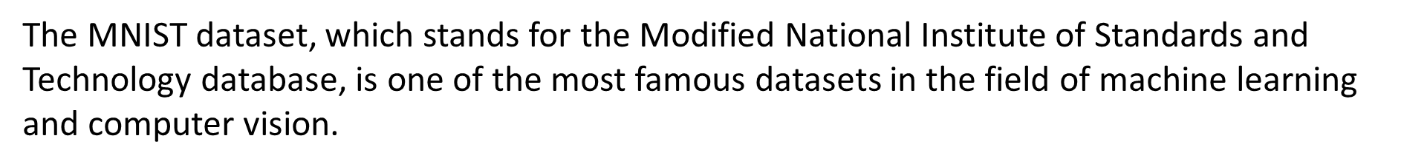
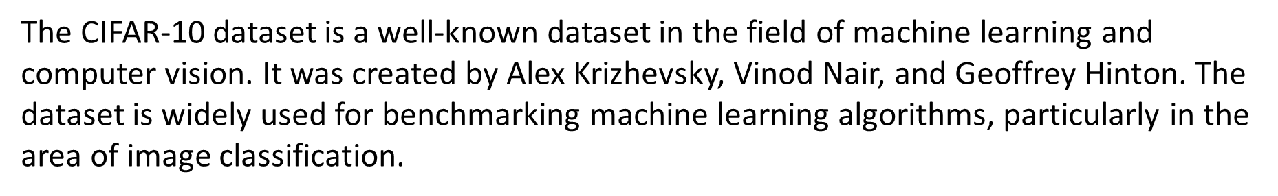
Additional Jupyter Notebooks: MNIST and CIFAR-10

Slide 21
Additional Resources for ML: Medium.com
1. Medium is an online publishing platform founded by Evan Williams in 2012.
2. It hosts a variety of content, including personal essays and professional articles.
3. Medium features numerous machine learning (ML) resources, such as articles, tutorials, case studies, and research paper summaries.
4. Interaction features include claps, responses, and highlighting important sections.
5. Popular ML-related publications include Towards Data Science, The Startup, and Analytics Vidhya.
6. Medium offers both free and paid content, with membership costing $5/month or $50/year.
7. Writers can publish and monetize their content through the Medium Partner Program.
8. Website: [Medium](https://medium.com)

Slide 22
Additional Resources for ML: Google Colab
1. **Free Access to GPU and TPU**: Offers free GPU and TPU resources for accelerated computations, ideal for deep learning.
2. **Jupyter Notebook Environment**: Provides a familiar interface to combine code, text, images, and visualizations.
3. **Cloud Storage Integration**: Integrates with Google Drive for easy saving and loading of notebooks and datasets.
4. **Pre-installed Libraries**: Includes popular Python libraries like TensorFlow, PyTorch, NumPy, and pandas.
5. **Collaborative Features**: Allows multiple users to work on the same notebook simultaneously.
6. **Interactive Visualizations**: Supports libraries like Matplotlib, Seaborn, and Plotly for creating and interacting with visualizations.
7. **Machine Learning Integration**: Optimized for ML workflows with built-in support for ML libraries and tools.
8. **Easy Sharing**: Notebooks can be shared easily via a link, facilitating collaboration and dissemination.
### Additional Resources
- **Website**: [Google Colab](https://colab.research.google.com)
- **Documentation**: [Google Colab Documentation](https://colab.research.google.com/notebooks/intro.ipynb)

Slide 23

Neural Networks Trivia

Slide 24
Grazie per l’attenzione
Fabio Antonini
Università degli Studi dell’Aquila

