Slide 1


Linear Regression
Giulio Antonini
Università degli Studi dell’Aquila

Slide 2

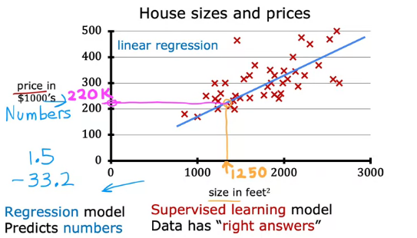

Linear Regression – Introduction
In this lecture, we’ll look at what the overall process of supervised learning is like.
Specifically, you see the first model of this course, Linear Regression Model.
Linear regression means fitting a straight line to your data.
Say you want to predict the price of a house based on the size of the house.
We’re going to use a dataset on house sizes and prices.
Your model will fit a straight line to the data.
Linear regression model is a particular type of supervised learning model.

Slide 3
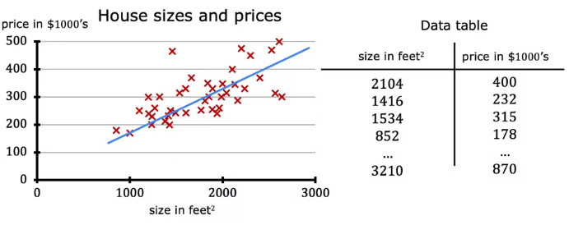
Linear Regression – Plot vs Table
- In addition to visualizing this data as a plot, there’s one other way of looking at the data that would be useful, and that’s a data table.
- The data comprises a set of inputs, such as the size of the house, and outputs, such as the price.
- The horizontal and vertical axes correspond to two columns in the table: the size and the price.
- For example, the first row of the table is a house with size 2,104 square feet, sold for $400,000.
- As you get familiar with machine learning terminology, this notation will be useful throughout your journey in machine learning.

Slide 4
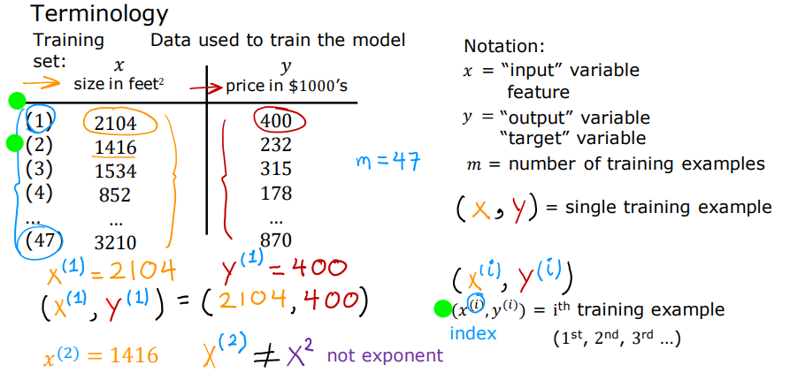
Linear Regression – Terminology
In Machine Learning, the standard notation to denote the input is lowercase x, called the input variable or feature.
The standard notation to denote the output variable, also called the target variable, is lowercase y.
The dataset has one row for each house, and in this training set, there are 47 rows, each representing a different training example.
To indicate a single training example, we use the notation (x, y), such as (2104, 400) for the first example.
The superscript tells us the ith training example, like x^(1) = 2104 and y^(1) = 400, where the superscript is an index, not exponentiation.

Slide 5
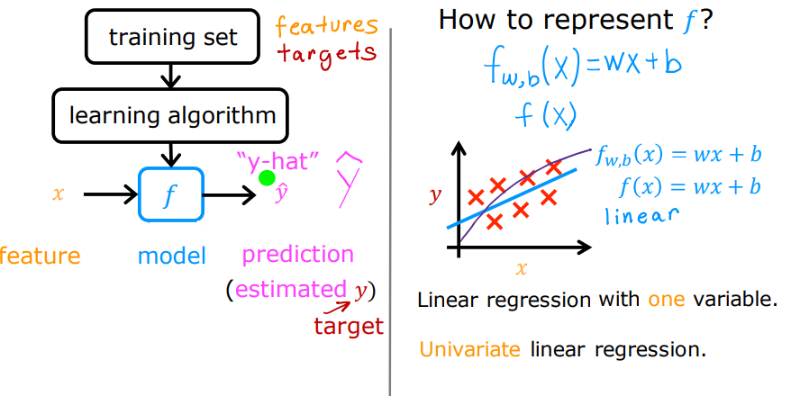
Linear Regression – Terminology
A training set in supervised learning includes both the input features, such as the size of the house, and the output targets, such as the price of the house."
To train the model, you feed the training set, both the input features and the output targets, to your learning algorithm.
The supervised learning algorithm will produce a function, written as lowercase f, which takes a new input x and outputs an estimate or prediction, written as ŷ.
The function f is called the model. x is called the input feature, and the output of the model is the prediction, ŷ.
When the symbol is just the letter y, it refers to the target, which is the actual true value in the training set, while ŷ is an estimate.

Slide 6

Linear Regression – Function
w and b: Numbers determining the prediction based on input feature x.
Function fw,b(x): Takes x as input and outputs a prediction ˆy.
Graphing: Plot input feature x (horizontal axis) and output target y (vertical axis) to learn from data and generate a best-fit line.
Linear Function: f(x) = wx + b predicts y using a straight line, foundational for more complex models.
Linear Regression: This model is called linear regression, specifically univariate linear regression with one variable, x (e.g., house size).
To familiarize with this topic, let’s have a look at the following Jupyter Notebook.
Lab: C1_W1_Lab03_Model_Representation_Soln.ipynb
Notes:
We’ll define w and b soon, but for now, they are numbers determining the prediction ˆy based on input x. The function fw,b(x) or simply f(x) makes predictions using the values of w and b. We plot the training set with x on the horizontal axis and y on the vertical axis to learn and generate a best-fit line, which is the linear function f(x) = wx + b. This simple linear regression model, also called univariate linear regression, predicts y using one input variable x, such as the size of a house. Later, we’ll explore models using multiple features.

Slide 7
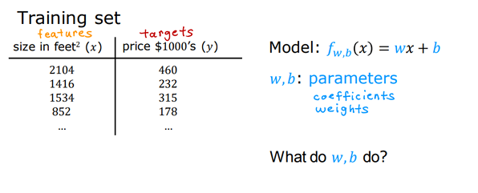
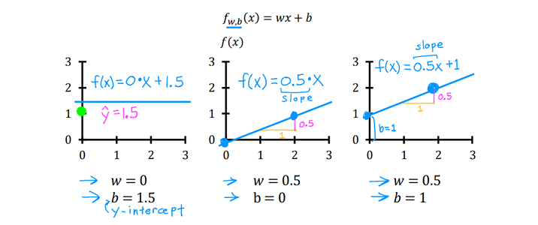
Linear Regression – Cost Function
Cost Function: Key step to implement linear regression; measures model performance and guides improvement.
Training Set: Contains input features x and output targets y.
Linear Function: Model used to fit the training set is fw,b(x) = wx + b.
Parameters: w and b, also known as coefficients or weights, are adjustable variables during training.
Purpose: Adjusting parameters improves the model's accuracy.
Notes:
In order to implement linear regression the first key step is first to define something called a cost function. This is something we’ll build in this section, and the cost function
will tell us how well the model is doing so that we can try to get it to do better. Let’s look at what this means. Recall that you have a training set that contains input features
x and output targets y. The model you’re going to use to fit this training set is this linear function fw,b(x) = wx+b To introduce a little bit more terminology the w and b are
called the parameters of the model. In machine learning parameters of the model are the variables you can adjust during training in order to improve the model. Sometimes
you also hear the parameters w and b referred to as coefficients or as weights.

Slide 8


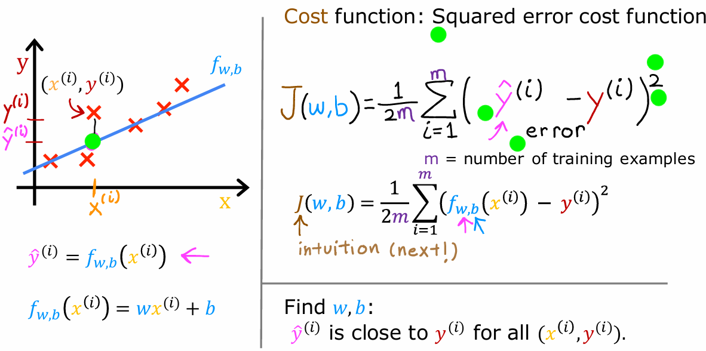
Linear Regression – Cost Function
Notes:
Now the question is how do you find values for w and b so that the prediction y^i is close to the true target yi for many or maybe all training examples xi,yi. To answer that question, let’s first take a look at how to measure how well a line fits the training data. To do that, we’re going to construct a cost function. The cost function takes the prediction y^ and compares it to the target y by taking y^−y. This difference is called the error, we’re measuring how far off to prediction is from the target. Next, let’s computes the square of this error. Also, we’re going to want to compute this term for different training examples i in the training set. When measuring the error, for example i, we’ll compute this squared error term. Finally, we want to measure the error across the entire training set. In particular, let’s sum up the squared errors.
We’ll sum from i =1,2,3... all the way up to m and remember that m is the number of training examples, which is 47 for this dataset. Notice that if we have more training examples m is larger and your cost function will calculate a bigger number. To build a cost function that doesn’t automatically get bigger as the training set size gets larger by convention, we will compute the average squared error instead of the total squared error and we do that by dividing by m like this. Just one last thing. By convention, the cost function that machine learning people use actually divides by 2m. The extra division by 2 is just meant to make some of our later calculations look neater, but the cost function still works whether you include this division by 2 or not. This expression right here is the cost function and we’re going to write J(wb) to refer to the cost function. This is also called the squared error cost function, and it’s called this because you’re taking the square of these error terms. In machine learning different people will use different cost functions for different applications, but the squared error cost function is by far the most commonly used one for linear regression and for that matter, for all regression problems where it seems to give good results for many applications. Just as a reminder, the prediction y hat is equal to the outputs of the model f at x.
Eventually we’re going to want to find values of w and b that make the cost function small. But before going there, let’s first gain more intuition about what J(wb) is really computing. But what exactly is it doing?

Slide 9
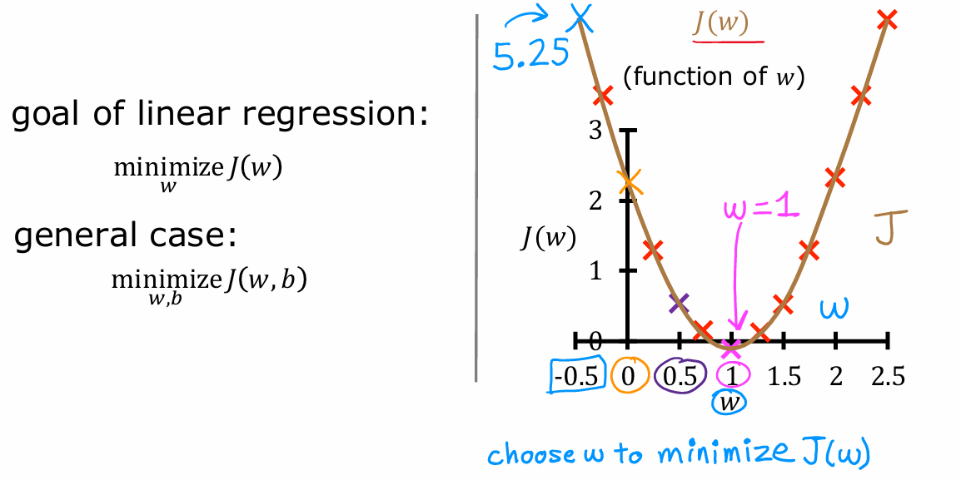
Linear Regression – Cost Function
Notes:
For the given training set, that choice for a value of w corresponds to a single point on the graph on the right because for each value of w, you can calculate the cost J(w). For each value of w you wind up with a different line and its corresponding costs, J(w), and you can use these points to trace out this plot on the right. Given this, how can you choose the value of w that results in the function f, fitting the data well? Well, as you can imagine, choosing a value of w that causes J(w) to be as small as possible seems like a good bet. J is the cost function that measures how big the squared errors are, so choosing w that minimizes these squared errors, makes them as small as possible, will give us a good model. In this example, if you were to choose the value of w that results in the smallest possible value of J(w) you’d end up picking w = 1. As you can see, that’s actually a pretty good choice. This results in the line that fits the training data very well. That’s how in linear regression you use the cost function to find the value of w that minimizes J. In the more general case where we had parameters w and b rather than just w, you f ind the values of w and b that minimize J. As you vary w or vary w and b you end up with different straight lines and when that straight line passes across the data, the function J is small. The goal of linear regression is to find the parameters w or w and b

Slide 10
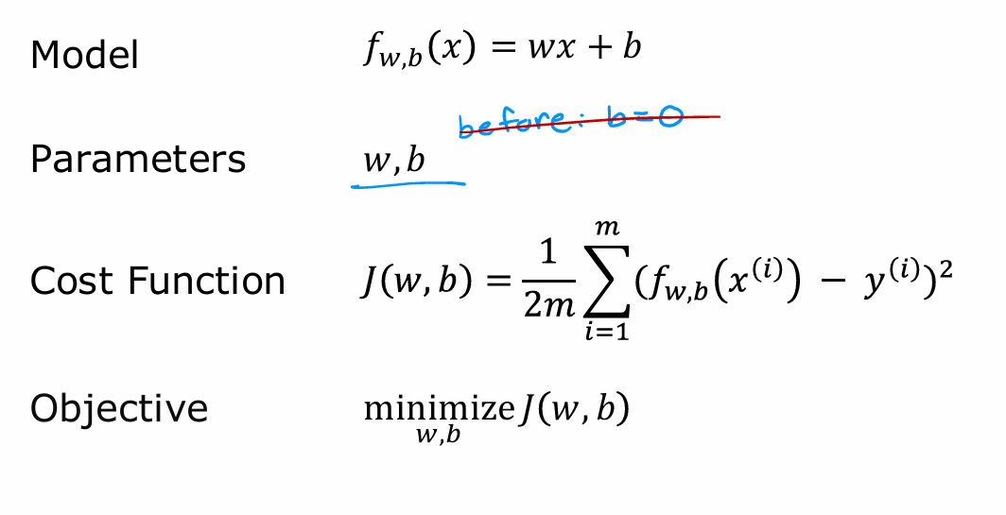
Linear Regression – Cost Function Recap
Notes:
In the previous chapter, you saw one visualization of the cost function J(w) or J(w,b). Let’s look at some further richer visualizations so that you can get an even better intuition about what the cost function is doing. There’s the model, the model’s parameters w and b, the cost function J(w,b), as well as the goal of linear regression, which is to minimize the cost function J(w,b) over parameters w and b. In the last paragraph, we had temporarily set b to zero in order to simplify the visualizations. Now, let’s go back to the original model with both parameters w and b. Same as last time, we want to get a visual understanding of the model function, f(x), shown on the left of the Fig. 3.14, and how it relates to the cost function J(w,b), shown on the right of the same picture. Here’s a training set of house sizes and prices. Let’s say you pick one possible function of x. Here, I’ve set w = 0.06 and b=50, so that f(x)=0.06x+50. Note that this is not a particularly good model for this training set, is actually a pretty bad model. It seems to consistently underestimate housing prices. Given these values for w and b let’s look at what the cost function J(w,b) may look like. Recall what we saw last time was when you had only w, because we temporarily set b to zero to simplify things, but then we had come up with a plot of the cost function that look like this as a function of w only. When we had only one parameter, w, the cost function had a U-shaped curve, shaped a bit like a soup bowl. Now, in this housing price example that we have, we have two parameters, w and b. The plots becomes a little more complex. It turns out that the cost function also has a similar shape like a soup bowl, except in three dimensions instead of two. In fact, depending on your training set, the cost function will look something like this. What you see here is a 3D-surface plot where the axes are labeled w and b. As you vary w and b, which are the two parameters of the model, you get different values for the cost function J(w,b). This is a lot like the U-shaped curve you saw previously, except instead of having one parameter w as input for the J, you now have two parameters, w and b as inputs into this soup bowl or this hammock-shaped function J. I just want to point out that any single point on this surface represents some particular choice of w and b. For example, if w = −10 and b=−15, then the height of the surface above this point is the value of J when w = −10 and b=−15

Slide 11
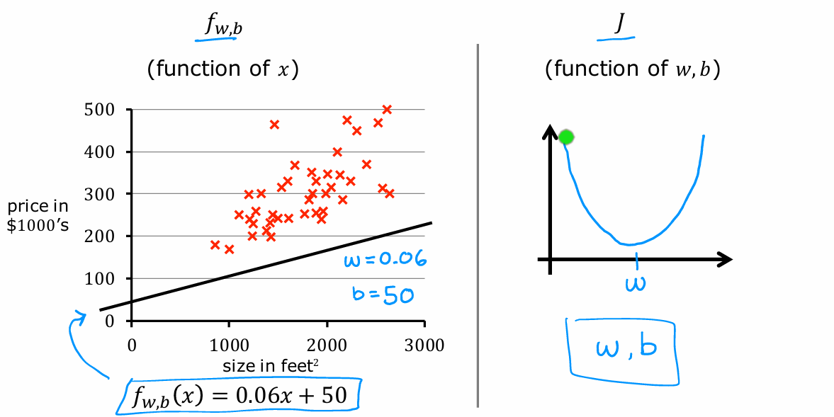
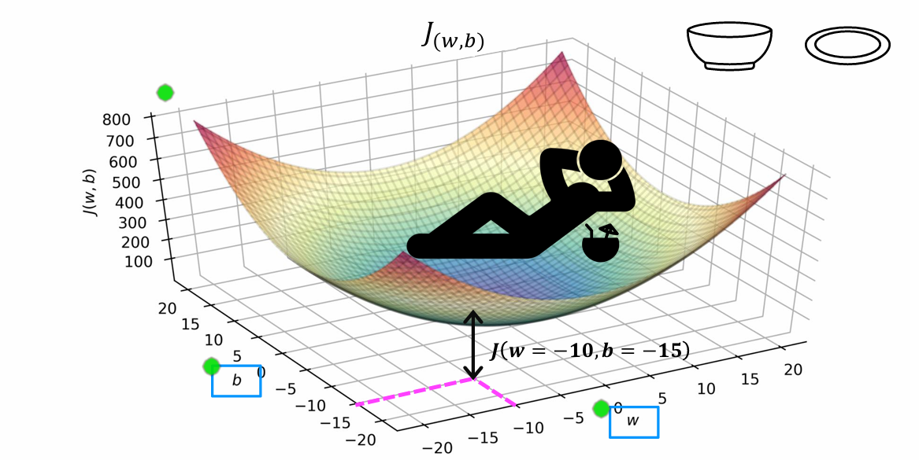
Linear Regression – Cost Function Visualization
Lab: C1_W1_Lab04_Cost_function_Soln.ipynb
Notes:
In the lab called "C1_W1_Lab04_Cost_function_Soln.ipynb", you will be able to see this in 3D and spin around the surface yourself and it’ll look more obviously bowl shaped there. Let’s try to relate the contour plot with the fw,b(x) model and the Cost Function J. Next, here on the upper right is a contour plot of this exact same cost function as that shown at the bottom. The two axes on this contour plots are b, on the vertical axis, and w on the horizontal axis. What each of these ovals, also called ellipses, shows, is the center points on the 3D surface which are at the exact same height. In other words, the set of points which have the same value for the cost function J. To get the contour plots, you take the 3D surface at the bottom and you use a knife to slice it horizontally. You take horizontal slices of that 3D surface and get all the points, they’re at the same height. Therefore, each horizontal slice ends up being shown as one of these ellipses or one of these ovals. In the figure on the upper left, you see also that these three points correspond to different functions, f, all three of which are actually pretty bad for predicting housing prices in this case. Now, the bottom of the bowl, where the cost function J is at a minimum, is the point at the center of this concentric ovals. It turns out that the contour plots are a convenient way to visualize the 3D cost function J, but in a way, there’s plotted in just 2D.

Slide 12
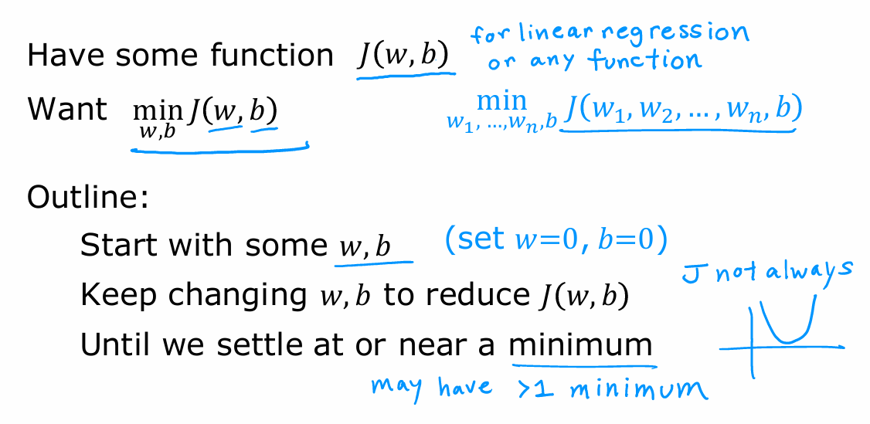
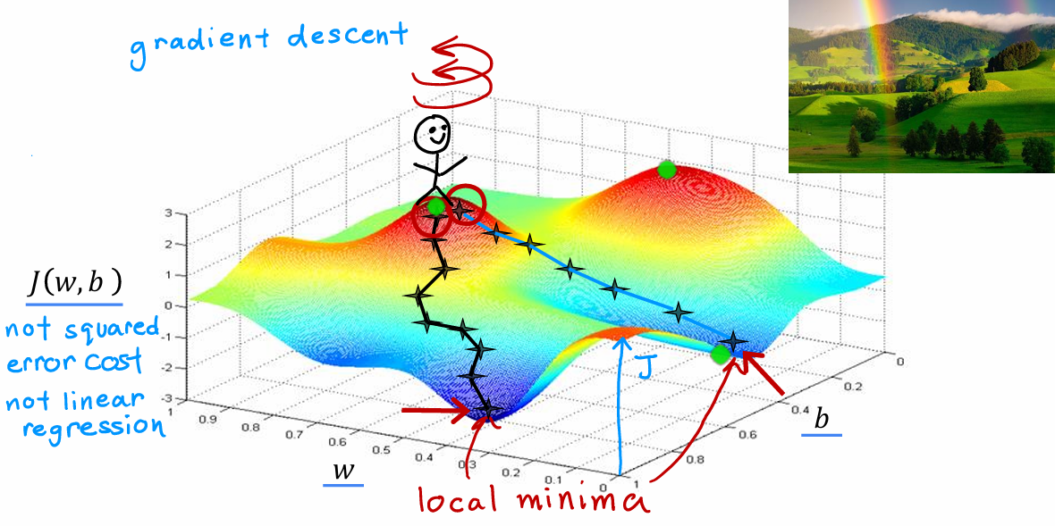
Linear Regression – Gradient Descent
Our target is to find the values w and b to minimize J(w,b)
W can be a vector (multiple features)
Linear Regression Cost Function is convex: it has just one global minimum
Other Cost functions can have multiple local minima
Notes:
In the last paragraph, we saw visualizations of the cost function J and how you can try different choices of the parameters w and b and see what cost value they get you. It would be nice if we had a more systematic way to find the values of w and b, that results in the smallest possible cost, J(w,b). It turns out there’s an algorithm called gradient descent that you can use to do that. Gradient descent is used all over the place in machine learning, not just for linear regression, but for training for example some of the most advanced neural network models, also called deep learning models. Learning the gradient descent will set you up with one of the most important building blocks in machine learning. Here’s an overview of what we’ll do with gradient descent. You have the cost function J(w,b) that you want to minimize. In the example we’ve seen so far we saw just the cost function for linear regression (see Fig.3.20, but it turns out that gradient descent is an algorithm that you can use to try to minimize any function, not just a cost function for linear regression. Just to make this discussion on gradient descent more general, it turns out that gradient descent applies to more general functions, including other cost functions that work with models that have more than two parameters. For instance, if you have a cost function J as a function of w1, w2 up to wn and b, your objective is to minimize J over the parameters w1 to wn and b. In other words, you want to pick values for w1 through wn and b, that gives you the smallest possible value of J. It turns out that gradient descent is an algorithm that you can apply to try to minimize this cost function j as well. What you’re going to do is just to start off with some initial guesses for w and b. In linear regression, it won’t matter too much what the initial value are, so a common choice is to set them both to 0. For example, you can set w =0 and b=0as the initial guess. With the gradient descent algorithm, what you’re going to do is, you’ll keep on changing the parameters w and b a bit every time to try to reduce the cost J(w,b) until hopefully J settles at or near a minimum. One thing we should note is that for some functions J that may not be a bow shape or a hammock shape, it is possible to be more than one possible minimum. Let’s take a look at an example of a more complex surface plot J to see what gradient is doing. This cost function, you always end up with a bow shape or a hammock shape. But this is a type of cost function you might get if you’re training a neural network model. Notice the axes, that is w and b on the bottom axis. For different values of w and b, you get different points on this surface, J(w,b), where the height of the surface at some point is the value of the cost function. Now, let’s imagine that this surface plot is actually a view of a slightly hilly outdoor park or a golf course where the high points are hills and the low points are valleys like so. I’d like you to imagine if you will, that you are physically standing at one of the top points on the hill. Your goal is to start up here and get to the bottom of one of these valleys as efficiently as possible. What the gradient descent algorithm does is to spin around 360 degrees and look around and ask yourself, if I were to take a tiny little step in one direction, and I want to go downhill as quickly as possible to or one of these valleys. What direction do I choose to take that little step? Mathematically, this is the direction of steepest descent. It means that when you take a tiny baby little step, this takes you downhill faster than a tiny little baby step you could have taken in any other direction. After taking this first step, you’re now at a new point on the hill. Now let’s repeat the process. Standing at this new point, you’re going to again spin around 360 degrees and ask yourself, in what direction will I take the next little baby step in order to move downhill? If you do that and take another step, you end up moving a bit in that direction and you can keep going. From this new point, you can again look around and decide what direction would take you downhill most quickly. Take another step, another step, and so on, until you find yourself at the bottom of this valley, at this local minimum. What you just did was go through multiple steps of gradient descent. It turns out, gradient descent has an interesting property. Remember that you can choose a starting point at the surface by choosing starting values for the parameters w and b. When you perform gradient descent a moment ago, you had started at one point. Now, imagine if you try gradient descent again, but this time you choose a different starting point by choosing parameters that place your starting point just a couple of steps to the right over here. If you then repeat the gradient descent process, which means you look around, take a little step in the direction of steepest ascent. Then you again look around, take another step, and so on. If you were to run gradient descent this second time, starting just a couple steps in the right of where we did it the first time, then you end up in a totally different valley. This different minimum over here on the right. The bottoms of both the first and the second valleys are called local minima. Because if you start going down the first valley, gradient descent won’t lead you to the second valley, and the same is true if you started going down the second valley, you stay in that second minimum and not find your way into the first local minimum. This is an interesting property of the gradient descent algorithm, and you see more about this later.

Slide 13
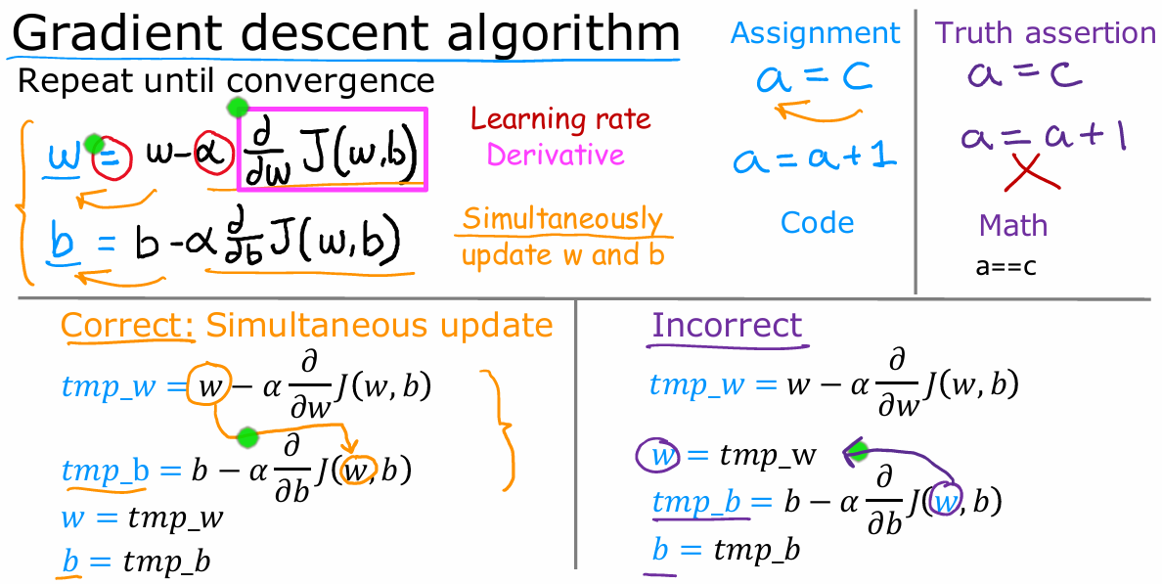
Linear Regression – Implementing Gradient Descent
Notes:
Let’s take a look at how you can actually implement the gradient descent algorithm. Let me write down the gradient descent algorithm. On each step, w, the parameter, is updated to w−αdJ(w,b) dw . Now, this dive more deeply into what the symbols in this equation means. The symbol here is the Greek alphabet α. In this equation, Alpha is also called the learning rate. The learning rate is usually a small positive number between 0 and 1 and it might be say, 0.01. What α does is, it basically controls how big of a step you take downhill. If α is very large, then that corresponds to a very aggressive gradient descent procedure where you’re trying to take huge steps downhill. If α is very small, then you’d be taking small baby steps downhill. We’ll come back later to dive more deeply into how to choose a good learning rate α. Finally, that’s the derivative term of the cost function J. For now, you can think of this derivative term that I drew a magenta box around as telling you in which direction you want to take your baby step. In combination with the learning rate α, it also determines the size of the steps you want to take downhill. Remember your model has two parameters, not just w, but also b. You also have an assignment operations update the parameter b that looks very similar. b is assigned the b−αdJ(w,b) db . Remember in the graph of the surface plot where you’re taking baby steps until you get to the bottom of the value, well, for the gradient descent algorithm, you’re going to repeat these two update steps until the algorithm converges. By converges, I mean that you reach the point at a local minimum where the parameters wand b no longer change much with each additional step that you take.
Now, there’s one more subtle detail about how to correctly in semantic gradient descent, you’re going to update two parameters, w and b. This update takes place for both parameters, w and b. One important detail is that for gradient descent, you want to simultaneously update w and b, meaning you want to update both parameters at the same time. What I mean by that, is that in this expression, you’re going to update w from the old w to a new w, and you’re also updating b from its oldest value to a new value of b. The way to implement this is to compute the right side, computing this thing for w and b, and simultaneously at the same time, update w and b to the new values. That’s gradient descent. In the next chapter, we’ll go into details of the derivative term which you saw in the current one, but that we didn’t really talk about in detail.

Slide 14
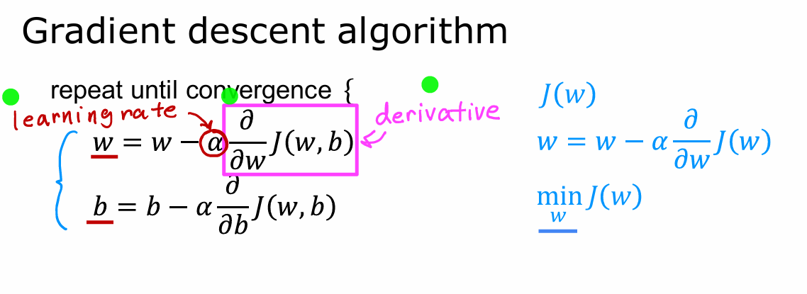
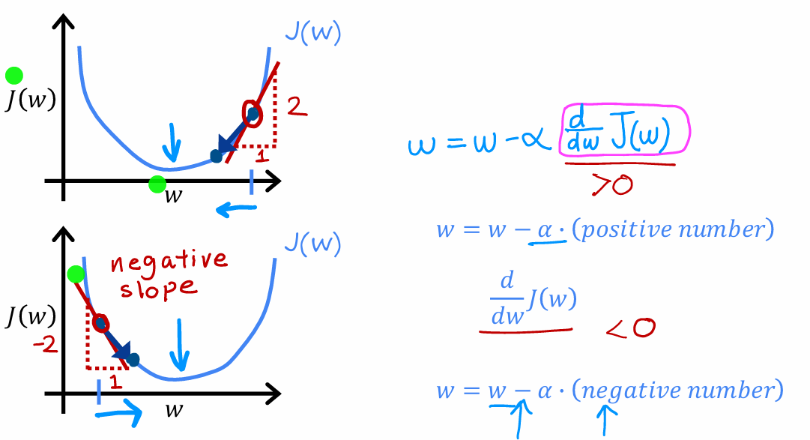
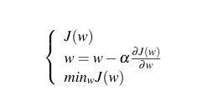
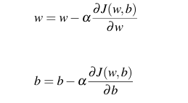
Linear Regression – Implementing Gradient Descent
Notes:
Now let’s dive more deeply in gradient descent to gain better intuition about what it’s doing and why it might make sense. As a reminder, this variable, this Greek symbol α, is the learning rate. The learning rate controls how big of a step you take when updating the model’s parameters, w and b. What we’re going to focus on now is get more intuition about what this learning rate and what this derivative are doing and why when multiplied together like this, it results in updates to parameters w and b. In order to do this let’s use a slightly simpler example where we work on minimizing just one parameter (number). You’re trying to minimize the cost by adjusting the parameter w. This is like our previous example where we had temporarily set b equal to 0 with one parameter w instead of two. You can look at two-dimensional graphs of the cost function J, instead of three dimensional graphs. Let’s look at what gradient descent does on just function J(w). On the horizontal axis there is parameter w, and on the vertical axis is the cost J(w). Nowlet’s initialize gradient descent with some starting value for w. Let’s initialize it at the location shown in the picture 3.23. Let’s look at what this derivative term here means. A way to think about the derivative at this point on the line is to draw a tangent line, which is a straight line that touches this curve at that point. The slope of this line is the derivative of the function J at this point. To get the slope, you can draw a little triangle If you compute the height divided by the width of this triangle, that is the slope. For example, this slope might be 2 over 1, for instance and when the tangent line is pointing up and to the right, the slope is positive, which means that this derivative is a positive number, so is greater than 0. The updated w is going to be w minus the learning rate times some positive number. The learning rate is always a positive number. If you take w minus a positive number, you end up with a new value for w, that’s smaller. On the graph, you’re moving to the left, you’re decreasing the value of w. You may notice that this is the right thing to do if your goal is to decrease the cost J, because when we move towards the left on this curve, the cost J decreases, and you’re getting closer to the minimum for J, which is over here. So far, gradient descent, seems to be doing the right thing. Now, let’s look at another example. Let’s take the same function J(w) as above, and now let’s say that you initialized gradient descent at a different location. Say by choosing a starting value for wthat’s on the left. Now the slope of this line is a derivative of J at this point. But this tangent line is sloping down into the right. This lines sloping down into the right has a negative slope. In other words, the derivative of J at this point is a negative number. For instance, if you draw a triangle, then the height like this is negative 2 and the width is 1, the slope is negative 2 divided by 1, which is negative 2, which is a negative number. When you update w, you get w minus the learning rate times a negative number. This means you subtract from w, a negative number. But subtracting a negative number means adding a positive number, and so you end up increasing w, because subtracting a negative number is the same as adding a positive number to w. This step of gradient descent causes w to increase, which means you’re moving to the right of the graph and your cost J has decrease down to here. Again, it looks like gradient descent is doing something reasonable, is getting you closer to the minimum. Hopefully, these last two examples show some of the intuition behind what a derivative term is doing and why this host gradient descent change w to get you closer to the minimum. One other key quantity in the gradient descent algorithm is the learning rate α. How do you choose α? What happens if it’s too small or what happens when it’s too big?

Slide 15
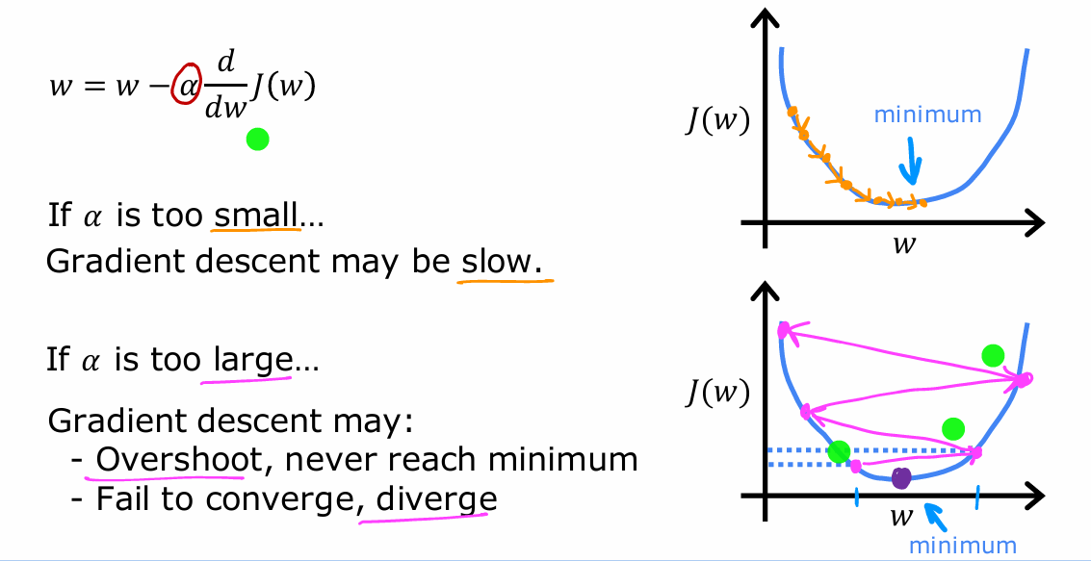
Linear Regression – Learning Rate
Notes:
The choice of the learning rate, α will have a huge impact on the efficiency of your implementation of gradient descent. If α, the learning rate is chosen poorly rate of descent may not even work at all. In this section, let’s take a deeper look at the learning rate. This will also help you choose better learning rates for your implementations of gradient descent. To learn more about what the learning rate α is doing, let’s see what could happen if the learning rate α is either too small or if it is too large. For the case where the learning rate is too small, let’s take a look at the graph in the upper right corner of the Fig.3.24 On the horizontal axis is w and the vertical axis is the cost J. If the learning rate is too small, then what happens is that you multiply your derivative term by some really, really small number. So you’re going to be multiplying by number alpha. That’s really small, like 0.0000001. And so you end up taking a very small baby step like in the picture. Then from the the initial point point you’re going to take another tiny tiny little baby step. But because the learning rate is so small, the second step is also just minuscule. The outcome of this process is that you do end up decreasing the cost J but incredibly slowly, until you finally approach the minimum. But as you may notice you’re going to need a lot of steps to get to the minimum. So to summarize if the learning rate is too small, then gradient descents will work, but it will be slow. It will take a very long time because it’s going to take these tiny tiny baby steps. Now, let’s look at a different case. What happens if the learning rate is too large? In this case the graph is in lower right corner of Fig.3.24 Here’s another graph of the cost function. And let’s say we start grating descent with w at this value close to the minimum. But if the learning rate is too large then you update w with a very giant step. So you move from the initial point on the left, all the way to a point on the right. And now the cost function J has actually gotten worse. It has increased because it started out at a value and after one step, it actually increased to a bigger value. Now the derivative at this new point says to decrease w but when the learning rate is too big, then you may take a huge step. So as you may notice you’re actually getting further and further away from the minimum. So if the learning rate is too large, then gradient descent may overshoot and may never reach the minimum. And another way to say that is that gradient descent may fail to converge and may even diverge. You may be wondering what happen when your parameter w is already at the point so that your cost J is already at a local minimum. What happen to the step of gradient descent if you’ve already reached a minimum? So this is a tricky one.

Slide 16
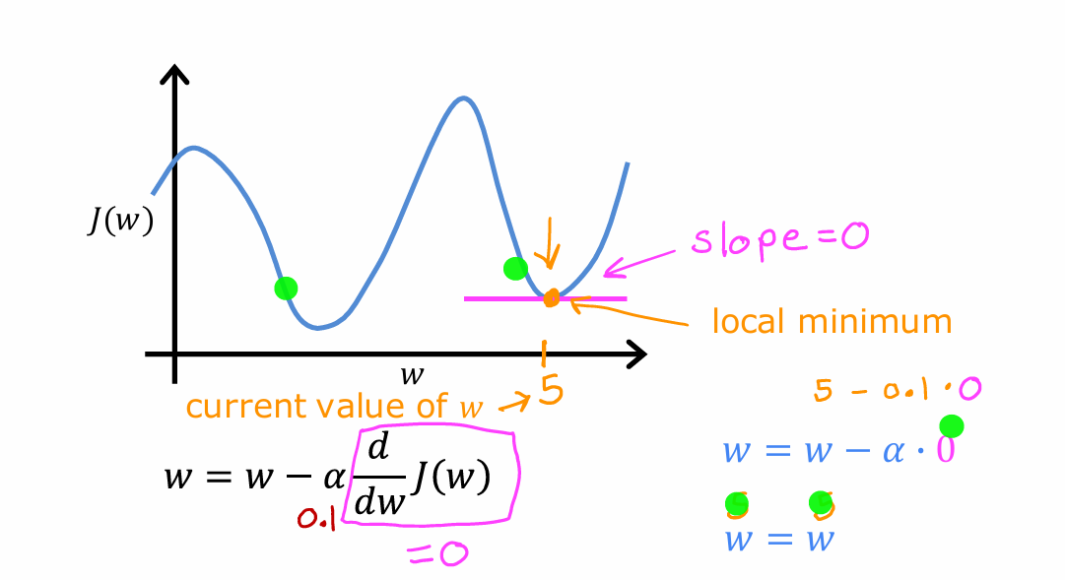
Linear Regression – Learning Rate Local Minimum
Notes:
But let’s work through this together. Let’s suppose you have some cost function J shown in Fig.3.25. that isn’t a square error cost function and this cost function has two local minima corresponding to the two valleys that you see in the graph. Now let’s suppose that after some number of steps of gradient descent, your parameter w is equal to five. This means that you’re at a point on the cost function J and that happens to be a local minimum. The slope of this line is zero and thus the derivative term is equal to zero for the current value of w. And so your grading descent update becomes w is updated to w minus the learning rate times zero. We’re here that’s because the derivative term is equal to zero. So this means that if you’re already at a local minimum, gradient descent leaves w unchanged. So if your parameters have already brought you to a local minimum, then further gradient descent steps to absolutely nothing. It doesn’t change the parameters which is what you want because it keeps the solution at that local minimum. This also explains why gradient descent can reach a local minimum, even with a fixed learning rate alpha.

Slide 17
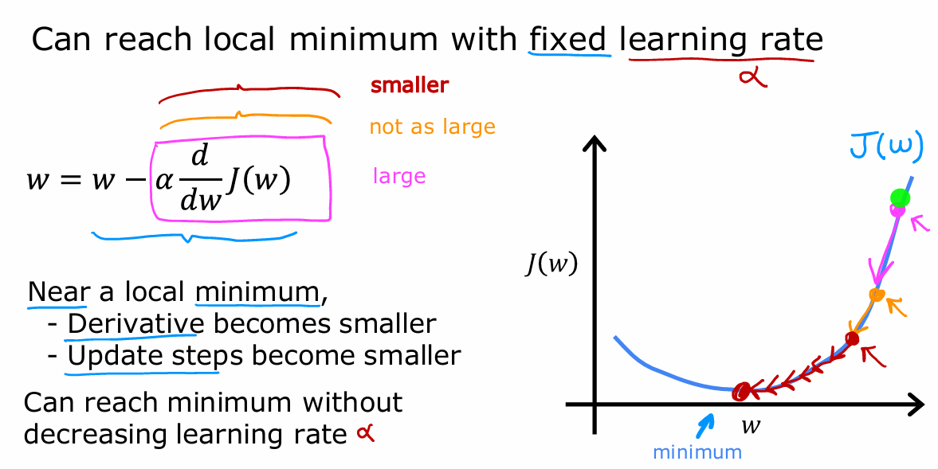
Linear Regression – Fixed Learning Rate
Notes:
Let’s look at another example. In the Fig.3.26 the cost function J(w) that we want to minimize is shown. Let’s initialize gradient descent up at the point on the right. If we take one update step, maybe it will take us to a lower point and because this derivative is pretty large, grading descent takes a relatively big step right. Now, we’re at this second point where we take another step. And you may notice that the slope is not as steep as it was at the first point. So the derivative isn’t as large. And so the next update step will not be as large as that first step. Now, read this third point here and the derivative is smaller than it was at the previous step and will take an even smaller step as we approach the minimum. The gradient descent gets closer and closer to zero. So as we run gradient descent, eventually we’re taking very small steps until you finally reach a local minimum. So just to recap, as we get nearer a local minimum gradient descent will automatically take smaller steps. And that’s because as we approach the local minimum, the derivative automatically gets smaller. And that means the update steps also automatically gets smaller. Even if the learning rate α is kept at some fixed value. So that’s the gradient descent algorithm. You can use it to try to minimize any cost function J, not just the mean squared error cost function that we’re using for the new regression. In the next chapter, we’re going to take the function J and set that back to be exactly the linear regression models cost function, the mean squared error cost function that we come up with earlier. Putting together gradient descent with this cost function that will give you your first learning algorithm, the linear regression algorithm.

Slide 18
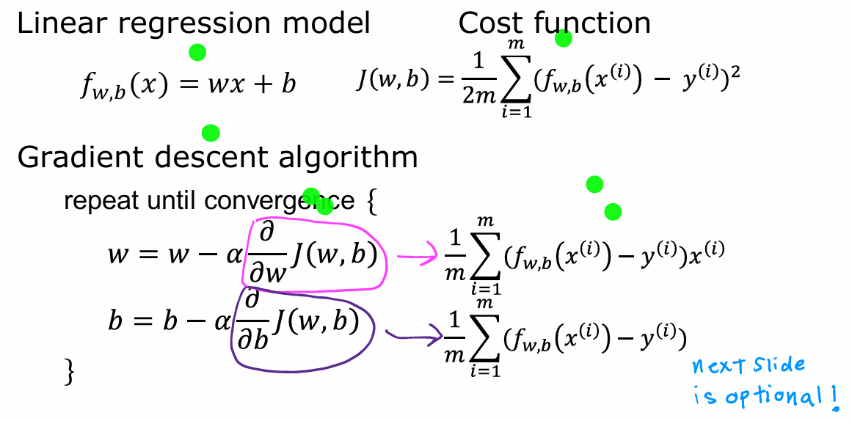
Linear Regression – Gradient Descent for Linear Regression
Repeat unitil convergence
Notes:
Previously, you took a look at the linear regression model and then the cost function, and then the gradient descent algorithm. In this paragraph, we’re going to pull out together and use the squared error cost function for the linear regression model with gradient descent. This will allow us to train the linear regression model to fit a straight line to achieve the training data. Let’s get to it. Here’s the linear regression model. To the right is the squared error cost function. Below is the gradient descent algorithm. The derivative with respect to w is this 1 over m, sum of i equals 1 through m. Then the error term, that is the difference between the predicted and the actual values times the input feature x(i). The derivative with respect to b is this formula over here, which looks the same as the equation above, except that it doesn’t have that x(i) term at the end. If you use these formulas to compute these two derivatives and implements gradient descent this way, it will work. Now you have these two expressions for the derivatives. You can plug them into the gradient descent algorithm. Here’s the gradient descent algorithm for linear regression. You repeatedly carry out these updates to w and b until convergence. Remember that this f(x) = wx+b is a linear regression model. Just as a reminder, you want to update w and b simultaneously on each step. Now, let’s get familiar with how gradient descent works. One the issue we saw with gradient descent is that it can lead to a local minimum instead of a global minimum. Whether global minimum means the point that has the lowest possible value for the cost function J of all possible points. You may recall this surface plot that looks like an outdoor park This function has more than one local minimum.

Slide 19
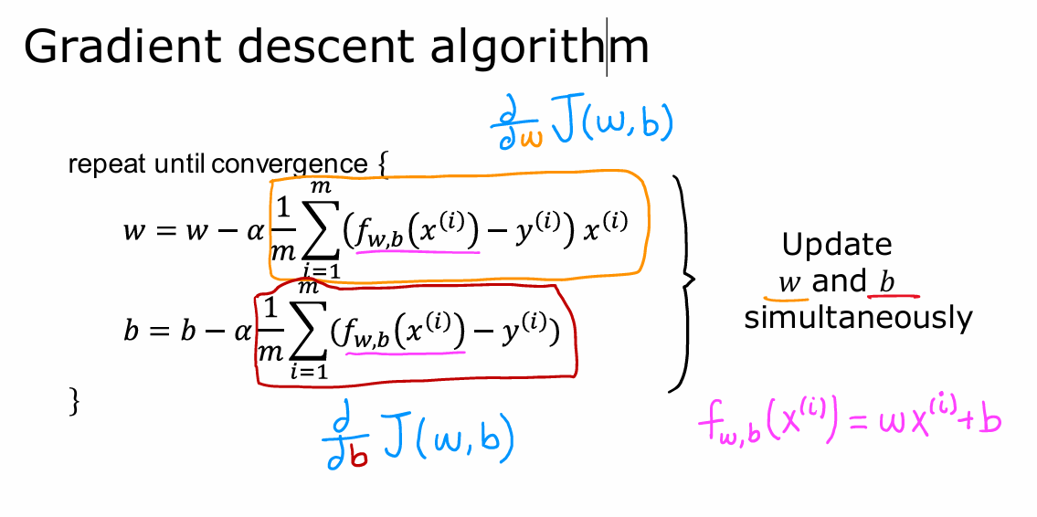
Linear Regression – Gradient descent algorithm
"C1_W1_Lab05_Gradient_Descent_Soln.ipynb".

Slide 20
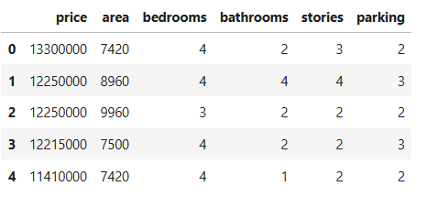
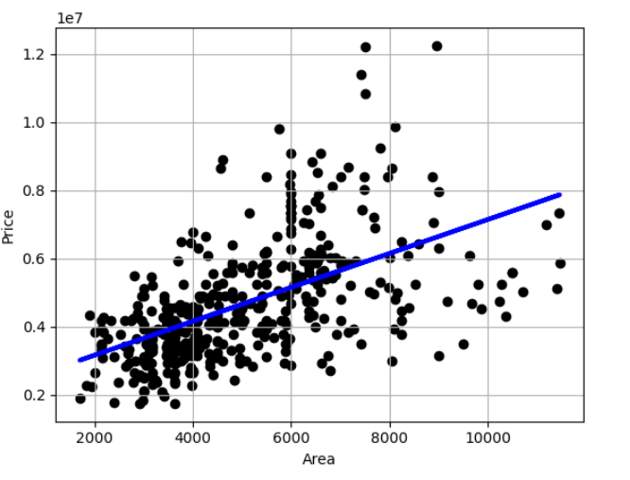
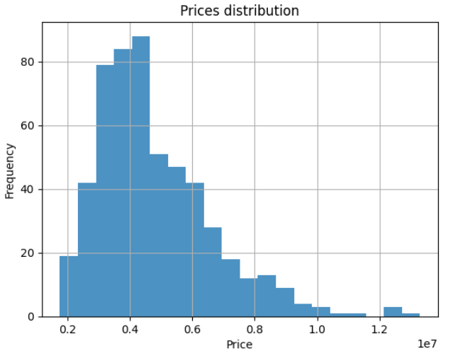
Linear Regression with Scikit-Learn
"C1_W1_Lab05_Gradient_Descent_Soln.ipynb".

Slide 21
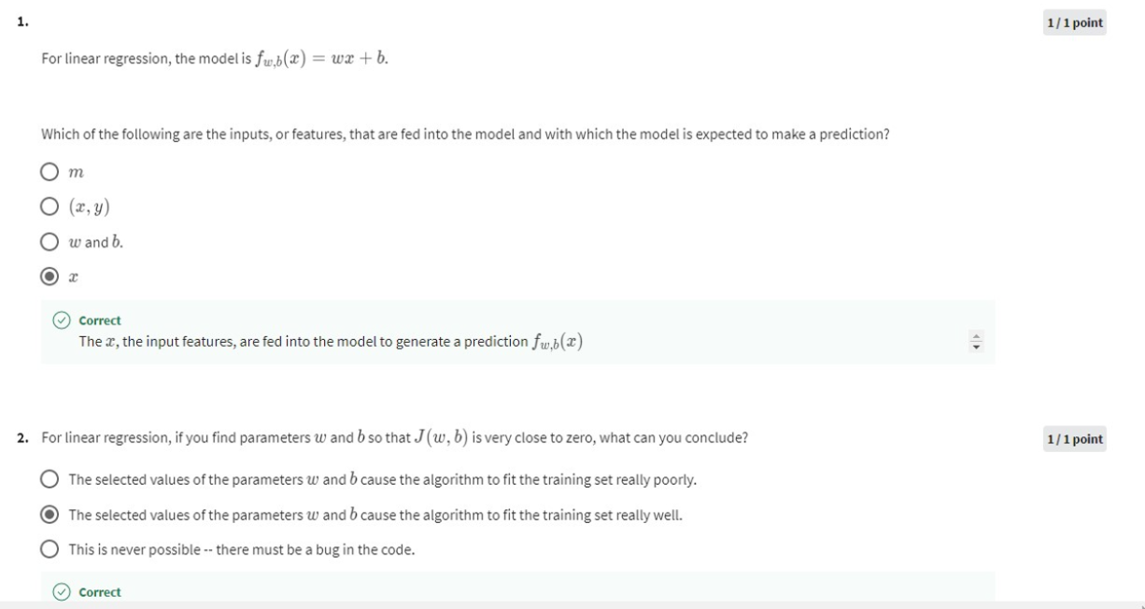
Linear Regression Quiz

Slide 22
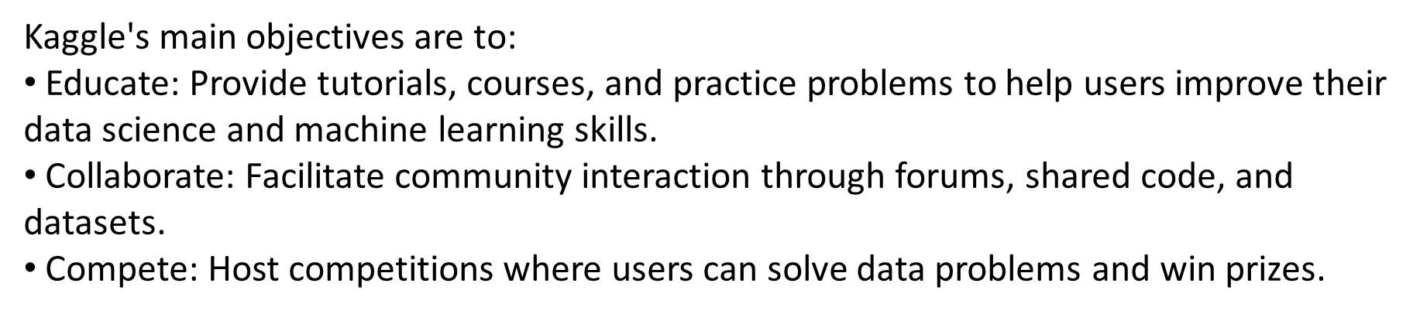
Best resources for Machine Learning
Kaggle: Your Home for Data Science
C1_W1_Lab07_Introduction to Kaggle.ipynb

Slide 23
Grazie per l’attenzione
Fabio Antonini
Università degli Studi dell’Aquila
mario.rossi@univaq.it

