Slide 1


Introduction to Machine Learning
for
Engineers
Giulio Antonini - Fabio Antonini
Università degli Studi dell’Aquila

Slide 2

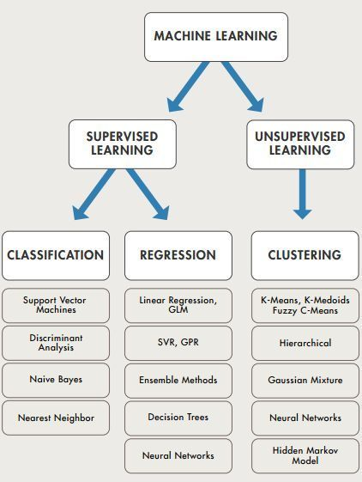



Course purpose and prerequisites
This course aims to offer a first introduction to this emerging technology.
The goal is to illustrate the basic concepts and provide the tools to be able to move in data analysis guided by machine learning systems.
This book assumes that you have some Python programming experience and that you are familiar with Python’s main scientific libraries, in particular NumPy, Pandas, and Matplotlib.
Also, if you care about what’s under the hood you should have a reasonable understanding of college-level math as well (calculus, linear algebra, probabilities, and statistics).
The course will have a very practice-oriented form. For this reason, numerous examples (Jupyter Notebooks) related to the various topics covered will be provided.
Notes:
If you don’t know Python yet, http://learnpython.org/ is a great place to start. The official tutorial on python.org is also quite good.
If you have never used Jupyter, a dedicated chapter will guide you through installation and the basics: it is a great tool to have in your toolbox.

Slide 3


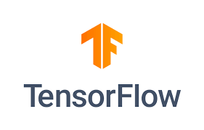
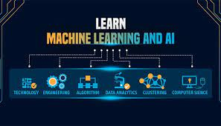

Objective and approach
This course assumes that you know close to nothing about Machine Learning.
Its goal is to give you the concepts, the intuitions, and the tools you need to actually implement programs capable of learning from data.
As researcher involved in Engineering subjects you will use for sure some ML model developed by anyone else. The main target it to provide you with a rich toolset to tackle your specific ML projects
The course favors a hands-on approach, growing an intuitive understanding of Machine Learning through concrete working examples and just a little bit of theory
While you can attend this course without picking up your laptop, we highly recommend you experiment with the code examples that will be provided.
Notes:
We will cover a large number of techniques, from the simplest and most commonly used (such as linear regression) to some of the Deep Learning techniques that regularly win competitions. Rather than implementing our own toy versions of each algorithm, we will be using actual production-ready Python frameworks: 1. Scikit-Learn is very easy to use, yet it implements many Machine Learning algorithms efficiently, so it makes for a great entry point to learn Machine Learning. 2. TensorFlow is a more complex library for distributed numerical computation. It makes it possible to train and run very large neural networks efficiently by distributing the computations across potentially hundreds of multi-GPU servers. TensorFlow was created at Google and supports many of their large-scale Machine Learning applications. It was open sourced in November 2015. 3. Keras is a high level Deep Learning API that makes it very simple to train and run neural networks. It can run on top of either TensorFlow, Theano or Microsoft Cognitive Toolkit (formerly known as CNTK). TensorFlow comes with its own implementation of this API, called tf.keras, which provides support for some advanced TensorFlow features (e.g., to efficiently load data). The course favors a hands-on approach, growing an intuitive understanding of Machine Learning through concrete working examples and just a little bit of theory. While you can attend this course without picking up your laptop, we highly recommend you experiment with the code examples that will be provided.

Slide 4
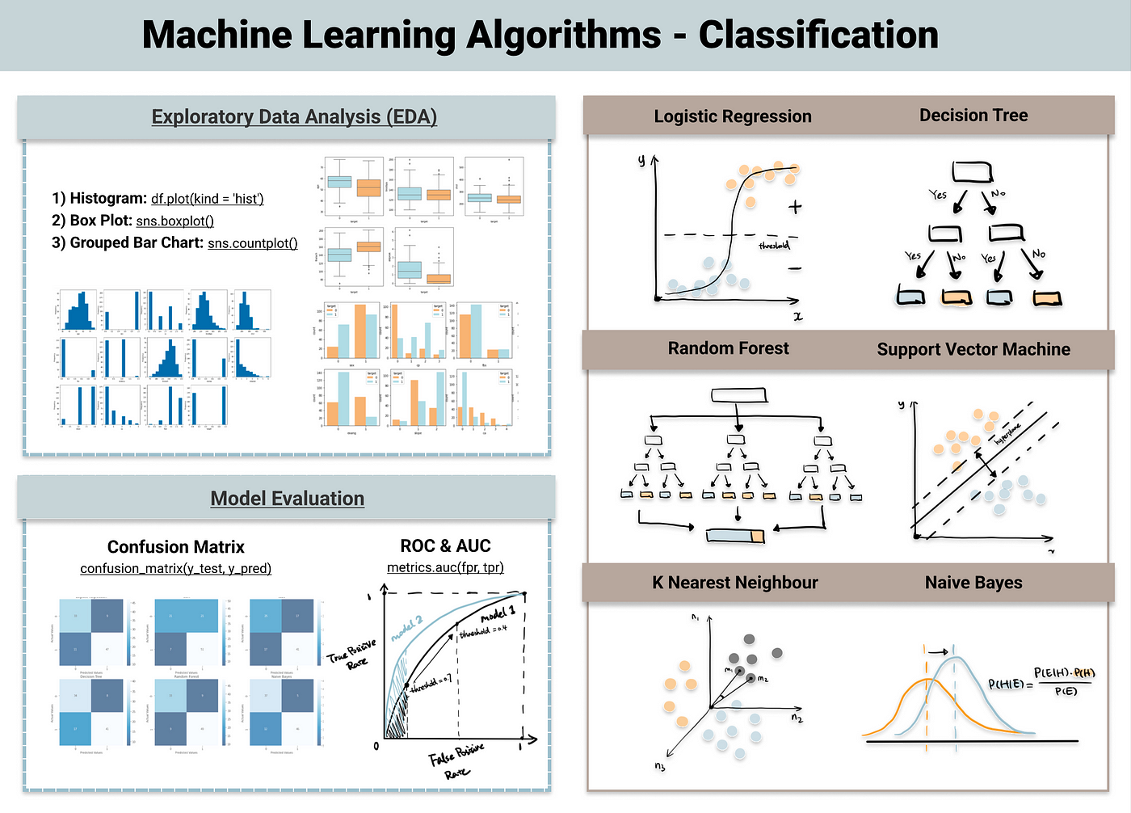
Main topics of the Course (1/2)
1. What is Machine Learning? What problems does it try to solve? Supervised vs Unsupervised ML.
2. The main steps in a typical Machine Learning project.
3. Learning by fitting a model to data.
4. Optimizing a cost function.
5. Handling, cleaning, and preparing data.
6. Selecting and engineering features.
7. Selecting a model and tuning hyperparameters using cross-validation.
8. The main challenges of Machine Learning, in particular underfitting and overfitting (the bias/variance tradeoff).
9. Reducing the dimensionality of the training data to fight the curse of dimensionality.
Notes:
What is Machine Learning? What problems does it try to solve? What are the main categories and fundamental concepts of Machine Learning systems? 2. The main steps in a typical Machine Learning project. 3. Learning by fitting a model to data. 4. Optimizing a cost function. 5. Handling, cleaning, and preparing data. 6. Selecting and engineering features. 7. Selecting a model and tuning hyperparameters using cross-validation. 8. The main challenges of Machine Learning, in particular underfitting and overfitting (the bias/variance tradeoff). 9. Reducing the dimensionality of the training data to fight the curse of dimensionality. 10. The most common learning algorithms: Linear and Polynomial Regression, Logistic Regression, k-Nearest Neighbors, Support Vector Machines, Decision Trees, Random Forests, and Ensemble methods. 11. What are neural nets? What are they good for? 12. Building and training neural nets using TensorFlow and Keras. 13. The most important neural net architectures: feedforward neural nets, convolutional nets, recurrent nets, long short-term memory (LSTM) nets, autoencoders and generative adversarial networks (GANs). 14. Techniques for training deep neural nets. 15. Scaling neural networks for large datasets.

Slide 5
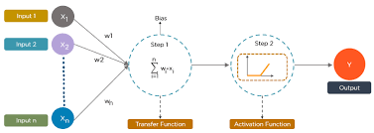
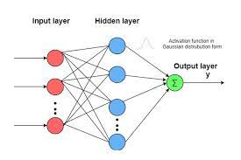
Main topics of the Course (2/2)
10. The most common learning algorithms: Linear and Polynomial Regression,
Logistic Regression,
k-Nearest Neighbors,
Decision Trees,
Random Forests
Ensemble methods.
11. What are neural nets? What are they good for?
12. Building and training neural nets using TensorFlow and Keras.
13. The most important neural net architectures: feedforward neural nets
convolutional nets
recurrent nets
long short-term memory (LSTM) nets
autoencoders
14. Techniques for training deep neural nets.
15. Scaling neural networks for large datasets.
16. Introduction to Large Language Modem (LLM)
Notes:
What is Machine Learning? What problems does it try to solve? What are the main categories and fundamental concepts of Machine Learning systems? 2. The main steps in a typical Machine Learning project. 3. Learning by fitting a model to data. 4. Optimizing a cost function. 5. Handling, cleaning, and preparing data. 6. Selecting and engineering features. 7. Selecting a model and tuning hyperparameters using cross-validation. 8. The main challenges of Machine Learning, in particular underfitting and overfitting (the bias/variance tradeoff). 9. Reducing the dimensionality of the training data to fight the curse of dimensionality. 10. The most common learning algorithms: Linear and Polynomial Regression, Logistic Regression, k-Nearest Neighbors, Support Vector Machines, Decision Trees, Random Forests, and Ensemble methods. 11. What are neural nets? What are they good for? 12. Building and training neural nets using TensorFlow and Keras. 13. The most important neural net architectures: feedforward neural nets, convolutional nets, recurrent nets, long short-term memory (LSTM) nets, autoencoders and generative adversarial networks (GANs). 14. Techniques for training deep neural nets. 15. Scaling neural networks for large datasets.

Slide 6
Preface
A bit of history
The Analytical Engine (Ada Lovelace)
” It can do whatever we know how to order it to perform”
1950: Alan Turing’s “Computing Machinery and Intelligence” Can general-purpose computers be capable of learning and originality? Turing came to the conclusion that they could.
1954: the first experiments in machine translation
1955: Samuel wrote a program that could checkers game
1957: Rosenblatt invented ‘perceptrons’
AI winters and hypes AI History: https://youtu.be/Suevq-kZdIw
1st AI winter (1974 – 1980): low compute power 2nd AI Winter: expert systems failed, a new paradigm was required
Notes:
Although visionary and far ahead of its time, the Analytical Engine wasn’t meant as a general-purpose computer when it was designed in the 1830s and 1840s, because the concept of general-purpose computation was yet to be invented. Ada Lovelace remarked on the invention, “The Analytical Engine has no pretensions whatever to originate anything. It can do whatever we know how to order it to perform. Its province is to assist us in making available what we’re already acquainted with.” His remark was later quoted by AI pioneer Alan Turing as“Lady Lovelace’s objection” in his landmark 1950 paper “Computing Machinery and Intelligence,” which introduced the Turing test as well as key concepts that would come to shape AI. Turing was quoting Ada Lovelace while pondering whether general-purpose computers could be capable of learning and originality, and he came to the conclusion that they could. In 1954, one of the first experiments in machine translation was executed. It used a 250-word dictionary for translation combined with syntactical analysis. Translations between English and Russian were demonstrated.
In 1955, Arthur Samuel wrote a program that could play checkers very well. A year later, it even appeared on television. It used a combination of a tree search with heuristics and learned weights. Samuel handcrafted the heuristics inspired by a book from checkers experts. He used a learning algorithm he called “temporal-difference learning” where the weights are adjusted using the “error” between the score initially calculated and the score after the search was completed.
In 1957, Rosenblatt invented perceptrons, a type of neural network where binary neural units are connected via adjustable weights. He was inspired by the work of neuroscience in the 1940s, which led him to create a crude replication of the neurons in the brain. The Lighthill report (published in 1973) was an evaluation of the current state of AI at that time written for the British Science Research Council. The report came to the conclusion that the promises of AI researchers were exaggerated
The first AI winter: https://towardsdatascience.com/history-of-the-first-ai-winter-6f8c2186f80b The second AI winter: https://towardsdatascience.com/history-of-the-second-ai-winter-406f18789d45

Slide 7
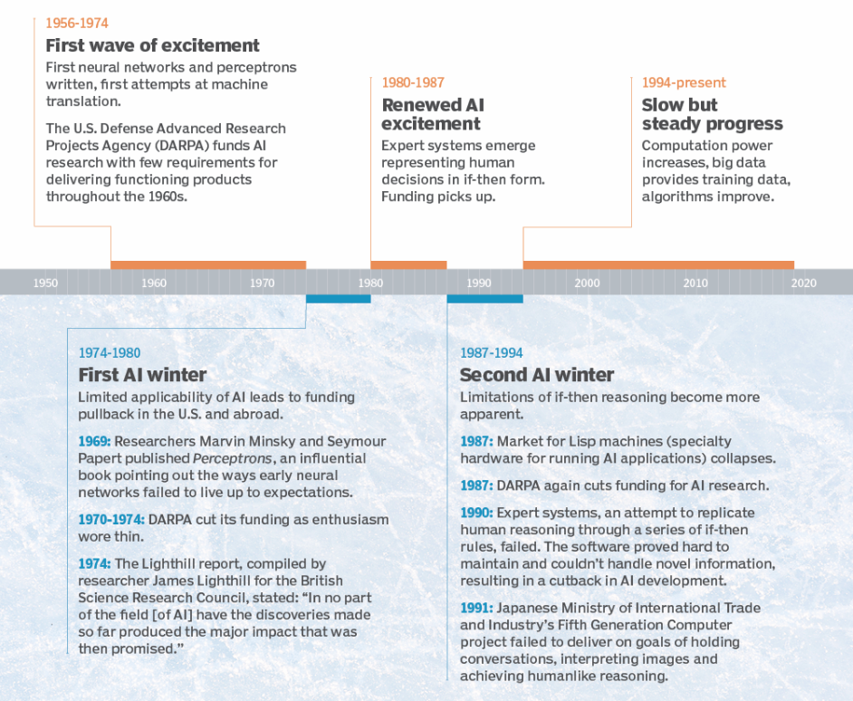
AI hypes and winters
Notes:
The main causes behind AI winters
Historically, AI winters have occurred because vendor promises have fallen short and AI initiatives have been more complicated to carry out than promised. When AI-washed products fail to deliver a significant return on investment (ROI), buyers become disappointed and direct their attention elsewhere.
AI winters occur when the hype behind AI research and development starts to stagnate. They also happen when the functions of AI stop being commercially viable. The promises generated by new techniques tend to create a large amount of buzz and raise the public's expectations. Businesses and organizations invest a lot of money based on these expectations, and gradually over time, if the new technology fails to deliver on those expectations, they lose interest in AI. If organizations begin to withdraw funding, it's a sign of waning interest and an impending AI winter.

Slide 8
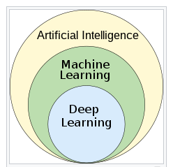
Artificial Intelligence, Machine Learning, Deep Learning
Artificial intelligence is a generic term associated with a set of techniques that can process data to provide predictions and decisions (even some techniques not based on ‘learning’).
Machine Learning is one of the most powerful artificial intelligence techniques, capable of efficiently handling and analyzing large amounts of data, to provide accurate predictions, automated decisions and deliver unprecedented business.
Deep learning is part of a broader family of machine learning methods based on artificial neural networks with representation learning. The adjective "deep" in deep learning refers to the use of multiple layers in the network.
Notes:
A machine-learning system is trained rather than explicitly programmed. It’s presented with many examples relevant to a task, and it finds statistical structure in these examples that eventually allows the system to come up with rules for automating the task. For instance, if you wished to automate the task of tagging your vacation pictures, you could present a machine-learning system with many examples of pictures already tagged by humans, and the system would learn statistical rules for associating specific pictures to specific tags.
Deep-learning architectures such as deep neural networks, deep belief networks, deep reinforcement learning, recurrent neural networks, convolutional neural networks and
Transformers have been applied to fields including computer vision, speech recognition, natural language processing, machine translation, bioinformatics, drug design, medical image analysis, climate science, material inspection and board game programs, where they have produced results comparable to and in some cases surpassing human expert performance.
Artificial neural networks (ANNs) were inspired by information processing and distributed communication nodes in biological systems. ANNs have differences
from biological brains. Specifically, artificial neural networks tend to be static and symbolic, while the biological brain of most living organisms is dynamic (plastic) and
analogue.
The adjective "deep" in deep learning refers to the use of multiple layers in the network. Early work showed that a linear perceptron cannot be a universal classifier, but that a
network with a nonpolynomial activation function with one hidden layer of unbounded width can. Deep learning is a modern variation which is concerned with an unbounded number of layers of bounded size, which permits practical application and optimized implementation, while retaining theoretical universality under mild conditions. In deep learning the layers are also permitted to be heterogeneous and to deviate widely from biologically informed connectionist models, for the sake of efficiency, trainability and understandability, hence, the "structured" part.

Slide 9
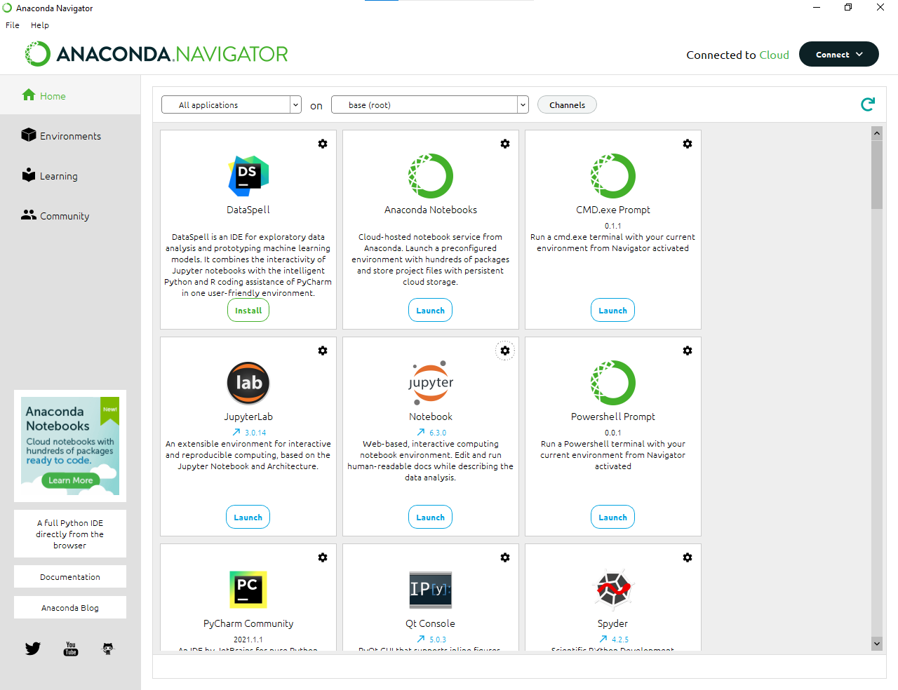
Setting up your working environment
Requirements
Python
ScikitLearn
Numpy
Scipy
Pandas
Git client: git (linux), SourceTree (Windows)
The easy way for Windows, but also for Linux: Anaconda, https://www.anaconda.com/download
An alternative way for Linux users: Virtual Machine running Ubuntu (from 18.04 upwards)
The hard way for Windows, but also for Linux: Docker. Docker is a platform designed to help developers build, share, and run modern applications.
Slides, Notebooks, Papers of the course are available for download at https://github.com/fabioantonini/introduction-machine-learning-for-engineers
Notes:
Jupyter Docker Stacks (https://github.com/jupyter/docker-stacks) are a set of ready-to run Docker images containing Jupyter applications and interactive computing tools

Slide 10
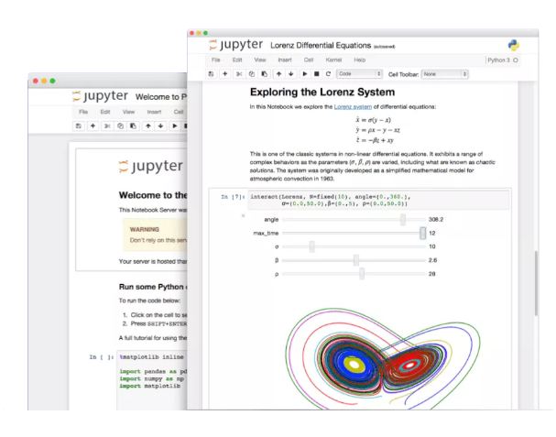
Jupyter Notebook (https://jupyter.org/)
The Jupyter Notebook is the original web application for creating and sharing computational documents. It offers a simple, streamlined, document-centric experience.
Language of choice. Jupyter supports over 40 programming languages, including Python, R, Julia, and Scala.
Interactive output. Your code can produce rich, interactive output: HTML, images, videos, LaTeX, and custom MIME types.
Big data integration. Leverage big data tools, such as Apache Spark, from Python, R, and Scala. Explore that same data with pandas, scikit-learn, ggplot2, and TensorFlow.
Some helpful links:
‘Jupyter for Computational Science and Data Science’: https://fangohr.github.io/blog/jupyter-for-computational-science-and-data-science.html
‘Why Data Scientists Should use Jupyter Notebooks with Moderation’: https://towardsdatascience.com/why-data-scientists-should-use-jupyter-notebooks-with-moderation-808900a69eff
An example of Jupiter Notebook is available from the Course repository resources “Lectures\Introduction\Notebooks\C1_W1_Lab01_Python_Jupyter_Soln.ipynb“. Let’s jump into it.
Notes:
See this article https://fangohr.github.io/blog/jupyter-for-computational-science-and-data-science.html ‘Jupyter for Computational Science and Data Science’. It explains very well why Jupyter Notebooks have been widely adopted in the scientific community.
Also, this resource https://towardsdatascience.com/why-data-scientists-should-use-jupyter-notebooks-with-moderation-808900a69eff is valid ‘Why Data Scientists Should use Jupyter Notebooks with Moderation’.
The James Webb Telescope uses Jupyter Notebook. Look at this link https://jwst-docs.stsci.edu/jwst-post-pipeline-data-analysis/data-analysis-example-jupyter-notebooks.
Some helpful hints about the Markdown syntax are available at Markdown for Jupyter notebooks cheatsheet https://www.ibm.com/docs/en/watson-studio-local/1.2.3?topic=notebooks-markdown-jupyter-cheatsheet

Slide 11
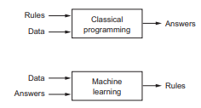
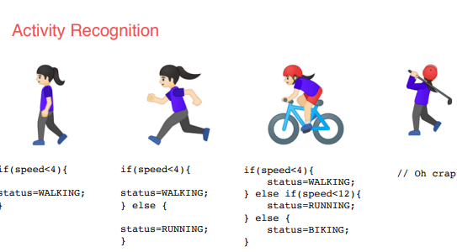
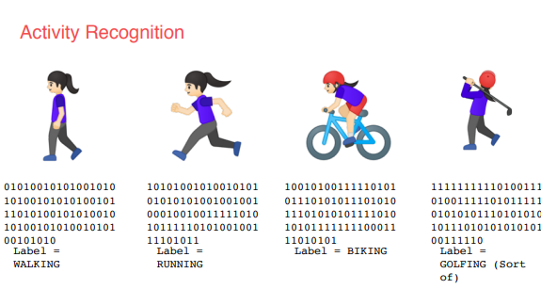
A new paradigm (1/2)
Rules vs patterns
When the rule is not clear or well defined the old approach fails.
According to the new approach, Machine Learning based, the rules are learnt from data (sensors data in this case)
Notes:
So, consider this example, activity recognition. If I’m building a device that detects if somebody is walking and I have data about their speed, I might write code like this and if they’re running well that’s a faster speed so I could adapt my code to this and if they’re biking, well that’s not too bad either. I can adapt my code like this. But then I have to do golf recognition too, now my concept becomes broken. But not only that, doing it by speed alone of course is quite naive. We walk and run at different speeds uphill and downhill and other people walk and run at different speeds to us. So, let’s go back to this diagram. Ultimately machine learning is very similar but we’re just flipping the axes. So instead of me trying to express the problem as rules when often that isn’t even possible, I’ll have to compromise. The new paradigm is that I get lots and lots of examples and then I have labels on those examples and I use the data to say this is what walking looks like, this is what running looks like, this is what biking looks like and yes, even this is what golfing looks like. So, then it becomes answers and data in with rules being inferred by the machine. A machine learning algorithm then figures out the specific patterns in each set of data that determines the distinctiveness of each. That’s what’s so powerful and exciting about this programming paradigm. It’s more than just a new way of doing the same old thing. It opens up new possibilities that were infeasible to do before

Slide 12
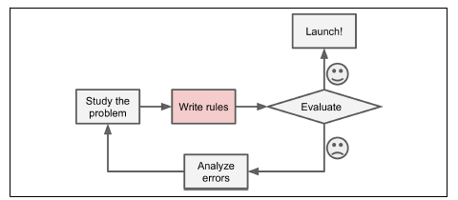
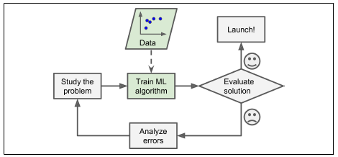
A new paradigm (2/2)
Rules approach
Machine learning approach
To summarize, Machine Learning is great for:
• Problems for which existing solutions require a lot of hand-tuning or long lists of
rules: one Machine Learning algorithm can often simplify code and perform better.
• Complex problems for which there is no good solution at all using a traditional
approach: the best Machine Learning techniques can find a solution.
• Fluctuating environments: a Machine Learning system can adapt to new data.
• Getting insights about complex problems and large amounts of data.

Slide 13
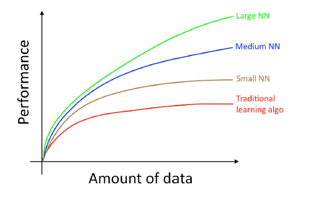
Scale drives machine learning progress
Many of the ideas of deep learning (neural networks) have been around for decades. Why are
these ideas taking off now?
Two of the biggest drivers of recent progress have been:
• Data availability
• Computational scale
Notes:
Data availability. People are now spending more time on digital devices (laptops, mobile
devices). Their digital activities generate huge amounts of data that we can feed to our learning algorithms.
• Computational scale. We started just a few years ago to be able to train neural
networks that are big enough to take advantage of the huge datasets we now have.
In detail, even as you accumulate more data, usually the performance of older learning
algorithms, such as logistic regression, “plateaus.” This means its learning curve “flattens
out,” and the algorithm stops improving even as you give it more data.
Here, by “Small NN” we mean a neural network with only a small number of hidden units/layers/parameters. Finally, if you train larger and larger neural networks, you can obtain even better performance.
Thus, you obtain the best performance when you (i) Train a very large neural network, so that you are on the green curve above; (ii) Have a huge amount of data. Many other details such as neural network architecture are also important, and there has been much innovation here. But one of the more reliable ways to improve an algorithm’s performance today is still to (i) train a bigger network and (ii) get more data.

Slide 14
Machine Learning applications
Application | Type | Implementation
Analyzing images of products on a production line to automatically classify them | This is image classification, typically performed using convolutional neural networks | CNN
Detecting tumors in brain scans | This is semantic segmentation, where each pixel in the image is classified | CNN
Automatically classifying news articles | This is natural language processing (NLP), and more specifically text classification | LLM, RNN, CNN
Automatically flagging offensive comments on discussion forums | This is also text classification, using the same NLP tools | LLM, RNN, CNN
Summarizing long documents automatically | This is a branch of NLP called text summarization, again using the same tools | LLM, RNN, CNN
Creating a chatbot or a personal assistant | This involves many NLP components | LLM
Forecasting your company’s revenue next year, based on many performance metrics | This is a regression task (i.e., predicting values) | Linear Regression or Polynomial Regression model , regression SVM, regression Random Forest, or an artificial neural network
Making your app react to voice commands | This is speech recognition | RNNs, CNNs, or Transformers
Detecting credit card fraud | This is anomaly detection | Autoencoders
Notes:
Analyzing images of products on a production line to automatically classify them. This is image classification, typically performed using convolutional neural networks (CNNs) 2. Detecting tumors in brain scans. This is semantic segmentation, where each pixel in the image is classified (as we want to determine the exact location and shape of tumors), typically using CNNs as well. 3. Automatically classifying news articles This is natural language processing (NLP), and more specifically text classification, which can be tackled using recurrent neural networks (RNNs), CNNs, Transformers. 4. Automatically flagging offensive comments on discussion forums. This is also text classification, using the same NLP tools. 5. Summarizing long documents automatically. This is a branch of NLP called text summarization, again using the same tools. 6. Creating a chatbot or a personal assistant This involves many NLP components, including natural language understanding (NLU) and question-answering modules. 7. Forecasting your company’s revenue next year, based on many performance metrics This is a regression task (i.e., predicting values) that may be tackled using any regression model, such as a Linear Regression or Polynomial Regression model , a regression SVM, a regression Random Forest, or an artificial neural network. If you want to take into account sequences of past performance metrics, you may want to use RNNs, CNNs, or Transformers. 8. Making your app react to voice commands This is speech recognition, which requires processing audio samples: since they are long and complex sequences, they are typically processed using RNNs, CNNs, or Transformers (see Chapters 15 and 16). 9. Detecting credit card fraud This is anomaly detection. 10. Segmenting clients based on their purchases so that you can design a different marketing strategy for each segment. This is clustering. 11. Representing a complex, high-dimensional dataset in a clear and insightful diagram This is data visualization, often involving dimensionality reduction techniques. 12. Recommending a product that a client may be interested in, based on past purchases. This is a recommender system. One approach is to feed past purchases (and other information about the client) to an artificial neural network and get it to output the most likely next purchase. This neural network would typically be trained on past sequences of purchases across all clients. 13. Building an intelligent bot for a game. This is often tackled using Reinforcement Learning which is a branch of Machine Learning that trains agents (such as bots) to pick the actions that will maximize their rewards over time (e.g., a bot may get a reward every time the player loses some life points), within a given environment (such as the game). The famous AlphaGo program that beat the world champion at the game of Go was built using RL.

Slide 15
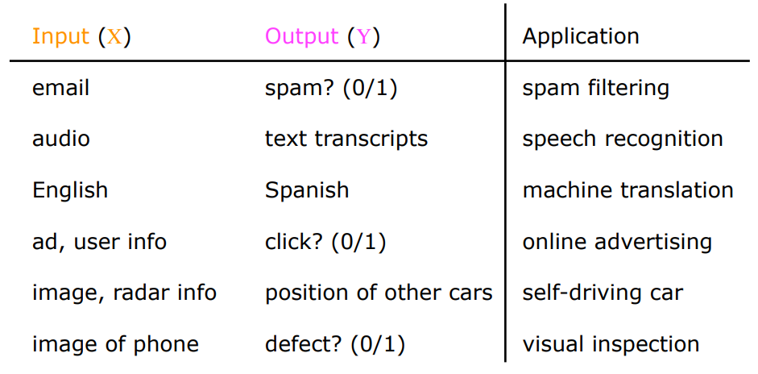
Supervised Learning Examples

Slide 16
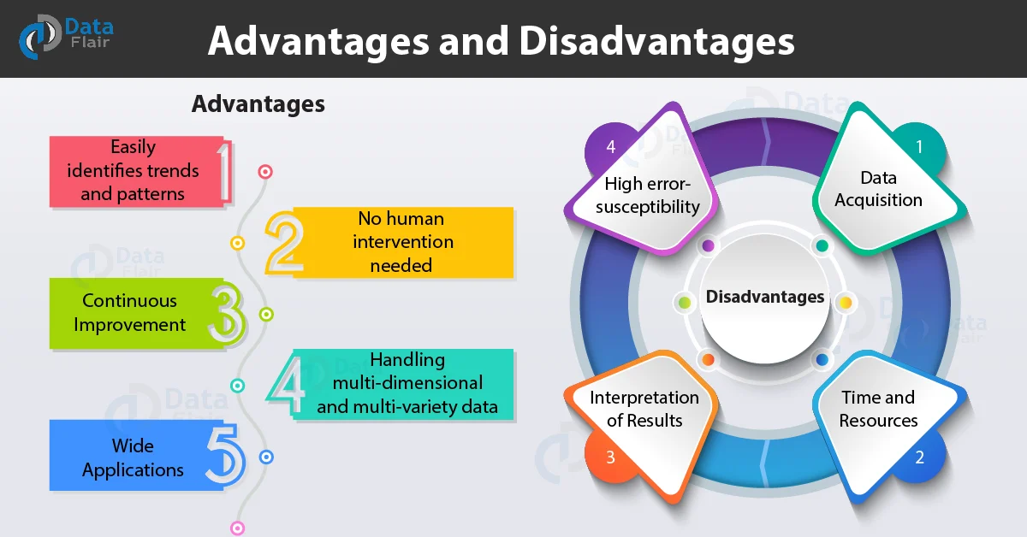
Advantages and Disadvantages of Machine Learning
Advantages
Easily identifies trends and patterns
No human intervention needed
Continuous Improvement
Handling multi-dimensional and multi-variety data
Wide Applications
Disadvantages
Data Acquisition
Time and Resources
Interpretation of Results
High error-susceptibility
More space required
Elimination of Human Interface
Changing Nature of Jobs
Notes:
https://data-flair.training/blogs/advantages-and-disadvantages-of-machine-learning/
1. Easily identifies trends and patterns
Machine Learning can review large volumes of data and discover specific trends and patterns that would not be apparent to humans. For instance, for an e-commerce website like Amazon, it serves to understand the browsing behaviors and purchase histories of its users to help cater to the right products, deals, and reminders relevant to them. It uses the results to reveal relevant advertisements to them.
2. No human intervention needed (automation)
With ML, you don’t need to babysit your project every step of the way. Since it means giving machines the ability to learn, it lets them make predictions and also improve the algorithms on their own. A common example of this is anti-virus softwares; they learn to filter new threats as they are recognized. ML is also good at recognizing spam.
3. Continuous Improvement
As ML algorithms gain experience, they keep improving in accuracy and efficiency. This lets them make better decisions. Say you need to make a weather forecast model. As the amount of data you have keeps growing, your algorithms learn to make more accurate predictions faster.
4. Handling multi-dimensional and multi-variety data
Machine Learning algorithms are good at handling data that are multi-dimensional and multi-variety, and they can do this in dynamic or uncertain environments.
5. Wide Range of Applicability
This technology has a very wide range of applications. Machine learning plays a role in almost every field, like hospitality, ed-tech, medicine, science, banking, and business. It creates more opportunities.
Disadvantages
1. Data Acquisition
Machine Learning requires massive data sets to train on, and these should be inclusive/unbiased, and of good quality. There can also be times where they must wait for new data to be generated.
2. Time and Resources
ML needs enough time to let the algorithms learn and develop enough to fulfill their purpose with a considerable amount of accuracy and relevancy. It also needs massive resources to function. This can mean additional requirements of computer power for you.
3. Interpretation of Results
Another major challenge is the ability to accurately interpret results generated by the algorithms. You must also carefully choose the algorithms for your purpose.
4. High error-susceptibility
Machine Learning is autonomous but highly susceptible to errors. Suppose you train an algorithm with data sets small enough to not be inclusive. You end up with biased predictions coming from a biased training set. This leads to irrelevant advertisements being displayed to customers. In the case of ML, such blunders can set off a chain of errors that can go undetected for long periods of time. And when they do get noticed, it takes quite some time to recognize the source of the issue, and even longer to correct it.
6. Elimination of Human Interface
Automation, Artificial Intelligence, and Machine Learning have eliminated human interface from some work. It has eliminated employment opportunities. Now, all those works are conducted with the help of artificial intelligence and machine learning.
7. Changing Nature of Jobs
With the advancement of machine learning, the nature of the job is changing. Now, all the work are done by machine, and it is eating up the jobs for human which were done earlier by them. It is difficult for those without technical education to adjust to these changes.

Slide 17
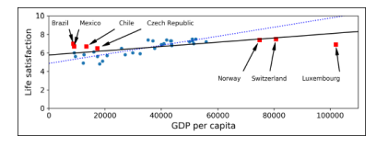
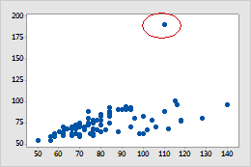
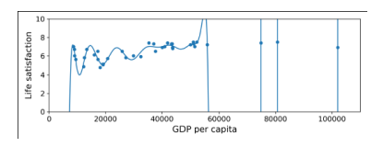
Main challenges of ML
Insufficient Quantity of Training Data
Nonrepresentative Training Data
Poor-Quality Data
Irrelevant Features
Overfitting the Training Data
Underfitting the Training Data
Data mismatch
Notes:
Insufficient Quantity of Training Data
For a toddler to learn what an apple is, all it takes is for you to point to an apple and say “apple” (possibly repeating this procedure a few times). Now the child is able to recognize apples in all sorts of colors and shapes. Genius. Machine Learning is not quite there yet; it takes a lot of data for most Machine Learning algorithms to work properly. Even for very simple problems you typically need thousands of examples, and for complex problems such as image or speech recognition you may need millions of examples (unless you can reuse parts of an existing model).
Nonrepresentative Training Data
In order to generalize well, it is crucial that your training data be representative of the new cases you want to generalize to. This is true whether you use instance-based learning or model-based learning. For example, the set of countries we used earlier for training the linear model was not perfectly representative; a few countries were missing. If you train a linear model on this data, you get the solid line, while the old model is represented by the dotted line. As you can see, not only does adding a few missing countries significantly alter the model, but it makes it clear that such a simple linear model is probably never going to work well. It seems that very rich countries are not happier than moderately rich countries (in fact they seem unhappier), and conversely some poor countries seem happier than many rich countries. By using a non-representative training set, we trained a model that is unlikely to make accurate predictions, especially for very poor and very rich countries. It is crucial to use a training set that is representative of the cases you want to generalize to. This is often harder than it sounds: if the sample is too small, you will have sampling noise (i.e., non-representative data as a result of chance), but even very large samples can be non-representative if the sampling method is flawed. This is called sampling bias.
Poor-Quality Data
Obviously, if your training data is full of errors, outliers, and noise (e.g., due to poor quality measurements), it will make it harder for the system to detect the underlying patterns, so your system is less likely to perform well. It is often well worth the effort to spend time cleaning up your training data. The truth is, most data scientists spend a significant part of their time doing just that. For example: 1. If some instances are clearly outliers, it may help to simply discard them or try to fix the errors manually. 2. If some instances are missing a few features (e.g., 5specify their age), you must decide whether you want to ignore this attribute altogether, ignore these instances, fill in the missing values (e.g., with the median age), or train one model with the feature and one model without it, and so on.
Irrelevant Features
As the saying goes: garbage in, garbage out. Your system will only be capable of learning if the training data contains enough relevant features and not too many irrelevant ones. A critical part of the success of a Machine Learning project is coming up with a good set of features to train on. This process, called feature engineering, involves: Feature selection: selecting the most useful features to train on among existing features. 1. Feature extraction: combining existing features to produce a more useful one (as we saw earlier, dimensionality reduction algorithms can help). 2. Creating new features by gathering new data. Now that we have looked at many examples of bad data, let’s look at a couple of exam- ples of bad algorithms.
Overfitting the Training Data
Overgeneralizing is something that we humans do all too often, and unfortunately machines can fall into the same trap if we are not careful. In Machine Learning this is called overfitting: it means that the model performs well on the training data, but it does not generalize well. shows an example of a high-degree polynomial life satisfaction model that strongly overfits the training data. Even though it performs much better on the training data than the simple linear model, would you really trust its predictions? Complex models such as deep neural networks can detect subtle patterns in the data, but if the training set is noisy, or if it is too small (which introduces sampling noise), then the model is likely to detect patterns in the noise itself. Obviously these patterns will not generalize to new instances. For example, say you feed your life satisfaction model many more attributes, including uninformative ones such as the country’s name. In that case, a complex model may detect patterns like the fact that all countries in the training data with a w in their name have a life satisfaction greater than 7: New Zealand (7.3), Norway (7.4), Sweden (7.2), and Switzerland (7.5). How confident are you that the W-satisfaction rule generalizes to Rwanda or Zimbabwe? Obviously this pattern occurred in the training data by pure chance, but the model has no way to tell whether a pattern is real or simply the result of noise in the data. Overfitting happens when the model is too complex relative to the amount and noisiness of the training data. The possible solutions are: 1. To simplify the model by selecting one with fewer parameters (e.g., a linear model rather than a high-degree polynomial model), by reducing the number of attributes in the training data or by constraining the model 2. To gather more training data 3. To reduce the noise in the training data (e.g., fix data errors and remove outliers).
Underfitting the Training Data
As you might guess, underfitting is the opposite of overfitting: it occurs when your model is too simple to learn the underlying structure of the data. For example, a linear model of life satisfaction is prone to underfit; reality is just more complex than the model, so its predictions are bound to be inaccurate, even on the training examples. The main options to fix this problem are: 1. Selecting a more powerful model, with more parameters 2. Feeding better features to the learning algorithm (feature engineering) 3. Reducing the constraints on the model (e.g., reducing the regularization hyperparameter).
Data mismatch
In some cases, it is easy to get a large amount of data for training, but it is not perfectly representative of the data that will be used in production. For example, suppose you want to create a mobile app to take pictures of flowers and automatically determine their species. You can easily download millions of pictures of flowers on the web, but they won’t be perfectly representative of the pictures that will actually be taken using the app on a mobile device. Perhaps you only have 10,000 representative pictures (i.e., actually taken with the app). In this case, the most important rule to remember is that the validation set and the test must be as representative as possible of the data you expect to use in production, so they should be composed exclusively of representative pictures: you can shuffle them and put half in the validation set, and half in the test set (making sure that no duplicates or near-duplicates end up in both sets). After training your model on the web pictures, if you observe that the performance of your model on the validation set is disappointing, you will not know whether this is because your model has overfit the training set, or whether this is just due to the mismatch between the web pictures and the mobile app pictures. One solution is to hold out part of the training pictures (from the web) in yet another set that Andrew Ng calls the train-dev set. After the model is trained (on the training set, not on the train-dev set), you can evaluate it on the train-dev set: if it performs well, then the model is not overfitting the training set, so if performs poorly on the validation set, the problem must come from the data mismatch. You can try to tackle this problem by preprocessing the web images to make them look more like the pictures that will be taken by the mobile app, and then retraining the model. Conversely, if the model performs poorly on the train-dev set, then the model must have overfit the training set, so you should try to simplify or regularize the model, get more training data and clean up the training data, as discussed earlier.

Slide 18
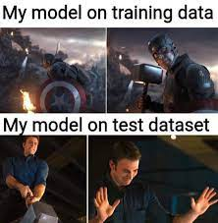
Testing and Validating
The only way to know how well a model will generalize to new cases is to actually try it out on new cases.
One way to do that is to put your model in production and monitor
how well it performs.
A better option is to split your data into two sets: the training set and the test set.
As these names imply, you train your model using the training set, and you test it using the test set.
If the training error is low (i.e., your model makes few mistakes on the training set) but the generalization error is high, it means that your model is overfitting the training data.
Notes:
Testing and validating
The only way to know how well a model will generalize to new cases is to actually try it out on new cases. One way to do that is to put your model in production and monitor how well it performs. This works well, but if your model is horribly bad, your users will complain—not the best idea. A better option is to split your data into two sets: the training set and the test set. As these names imply, you train your model using the training set, and you test it using the test set. The error rate on new cases is called the generalization error (or out of sample error), and by evaluating your model on the test set, you get an estimate of this error. This value tells you how well your model will perform on instances it has never seen before. If the training error is low (i.e., your model makes few mistakes on the training set) but the generalization error is high, it means that your model is overfitting the training data. It is common to use 80% of the data for training and hold out 20% for testing. However, this depends on the size of the dataset: if it contains 10 million instances, then holding out 1% means your test set will contain 100,000 instances: that’s probably more than enough to get a good estimate of the generalization error.

Slide 19
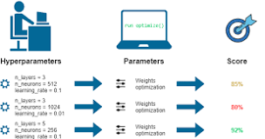
Hyperparameter Tuning and Model Selection
A hyperparameter is a machine learning parameter whose value is chosen before a learning algorithm is trained.
Hyperparameters are parameters whose values control the learning process and determine the values of model parameters that a learning algorithm ends up learning. The prefix ‘hyper_’ suggests that they are ‘top-level’ parameters that control the learning process and the model parameters that result from it.
Hyperparameters should not be confused with parameters. In machine learning, the label parameter is used to identify variables whose values are learned during training
Train-test split ratio
Learning rate in optimization algorithms (e.g. gradient descent)
Choice of optimization algorithm (e.g., gradient descent, stochastic gradient descent, or Adam optimizer)
Choice of activation function in a neural network (nn) layer (e.g. Sigmoid, ReLU, Tanh)
The choice of cost or loss function the model will use
Number of hidden layers in a nn
Number of activation units in each layer
The drop-out rate in nn (dropout probability)
Number of iterations (epochs) in training a nn
Number of clusters in a clustering task
Kernel or filter size in convolutional layers
Pooling size
Batch size
Notes:
https://towardsdatascience.com/parameters-and-hyperparameters-aa609601a9ac
Hyperparameters
Hyperparameters are parameters whose values control the learning process and determine the values of model parameters that a learning algorithm ends up learning. The prefix ‘hyper_’ suggests that they are ‘top-level’ parameters that control the learning process and the model parameters that result from it.
As a machine learning engineer designing a model, you choose and set hyperparameter values that your learning algorithm will use before the training of the model even begins. In this light, hyperparameters are said to be external to the model because the model cannot change its values during learning/training.
Hyperparameters are used by the learning algorithm when it is learning but they are not part of the resulting model. At the end of the learning process, we have the trained model parameters which effectively is what we refer to as the model. The hyperparameters that were used during training are not part of this model. We cannot for instance know what hyperparameter values were used to train a model from the model itself, we only know the model parameters that were learned.
Basically, anything in machine learning and deep learning that you decide their values or choose their configuration before training begins and whose values or configuration will remain the same when training ends is a hyperparameter.
Parameters
Parameters on the other hand are internal to the model. That is, they are learned or estimated purely from the data during training as the algorithm used tries to learn the mapping between the input features and the labels or targets.
Model training typically starts with parameters being initialized to some values (random values or set to zeros). As training/learning progresses the initial values are updated using an optimization algorithm (e.g. gradient descent). The learning algorithm is continuously updating the parameter values as learning progress but hyperparameter values set by the model designer remain unchanged.
At the end of the learning process, model parameters are what constitute the model itself.
Examples of parameters
The coefficients (or weights) of linear and logistic regression models.
Weights and biases of a nn
The cluster centroids in clustering
Simply put, parameters in machine learning and deep learning are the values your learning algorithm can change independently as it learns and these values are affected by the choice of hyperparameters you provide. So you set the hyperparameters before training begins and the learning algorithm uses them to learn the parameters. Behind the training scene, parameters are continuously being updated and the final ones at the end of the training constitute your model.
Therefore, setting the right hyperparameter values is very important because it directly impacts the performance of the model that will result from them being used during model training. The process of choosing the best hyperparameters for your model is called hyperparameter tuning and in the next article, we will explore a systematic way of doing hyperparameter tuning.
Conclusion
I trust that you now have a clear understanding of what hyperparameters and parameters exactly are and understand that hyperparameters have an impact on the parameters your model learns. I will be following this up with a detailed practical article on hyperparameter tuning.

Slide 20
Training, Validation and Test Sets
Training set — Which you run your learning algorithm on.
Dev (development) set — Which you use to tune parameters, select features, and make other decisions regarding the learning algorithm. Sometimes also called the hold-out cross validation set.
Test set — which you use to evaluate the performance of the algorithm, but not to make any decisions regarding what learning algorithm or parameters to use.
Train/Dev/Test 60/20/20 % for small dataset (thousands of samples)
Train/Dev/Test 98/1/1 % for big dataset (ten thousands of samples or more)
Be sure that Dev and Test sets come from the same distribution
Choose dev and test sets to reflect data you expect to get in the future and want to do well on
Notes:
So evaluating a model is simple enough: just use a test set. Now suppose you are hesitating
between two models (say a linear model and a polynomial model): how can
you decide? One option is to train both and compare how well they generalize using
the test set.
Now suppose that the linear model generalizes better, but you want to apply some
regularization to avoid overfitting. The question is: how do you choose the value of
the regularization hyperparameter? One option is to train 100 different models using
100 different values for this hyperparameter. Suppose you find the best hyperparameter
value that produces a model with the lowest generalization error, say just 5% error.
So you launch this model into production, but unfortunately it does not perform as
well as expected and produces 15% errors. What just happened?
The problem is that you measured the generalization error multiple times on the test
set, and you adapted the model and hyperparameters to produce the best model for
that particular set. This means that the model is unlikely to perform as well on new
data.
A common solution to this problem is called holdout validation: you simply hold out
part of the training set to evaluate several candidate models and select the best one.
The new heldout set is called the validation set (or sometimes the development set, or
dev set). More specifically, you train multiple models with various hyperparameters
on the reduced training set (i.e., the full training set minus the validation set), and
you select the model that performs best on the validation set. After this holdout validation
process, you train the best model on the full training set (including the validation
set), and this gives you the final model. Lastly, you evaluate this final model on
the test set to get an estimate of the generalization error.
This solution usually works quite well. However, if the validation set is too small, then
model evaluations will be imprecise: you may end up selecting a suboptimal model by
mistake. Conversely, if the validation set is too large, then the remaining training set
will be much smaller than the full training set. Why is this bad? Well, since the final
model will be trained on the full training set, it is not ideal to compare candidate
models trained on a much smaller training set. It would be like selecting the fastest
sprinter to participate in a marathon. One way to solve this problem is to perform
repeated cross-validation, using many small validation sets. Each model is evaluated
once per validation set, after it is trained on the rest of the data. By averaging out all
the evaluations of a model, we get a much more accurate measure of its performance.
However, there is a drawback: the training time is multiplied by the number of validation
sets.

Slide 21
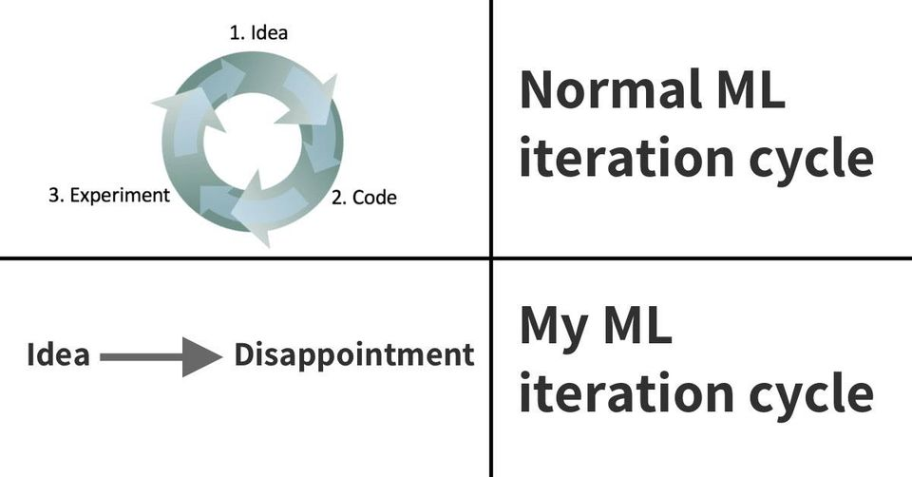

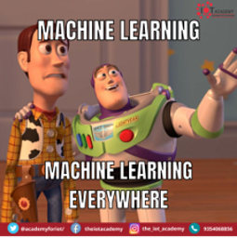
Machine Learning Lifecycle
AI is the new Electricity
Electricity had once transformed countless industries: transportation, manufacturing, healthcare, communications, and more
AI will now bring about an equally big transformation.

Slide 22
Thank you for the attention
Fabio Antonini
Università degli Studi dell’Aquila

