Slide 1
Lesson 9: Neural Networks
Technologies for Artificial Intelligence
Fabio Antonini, Università degli Studi dell’Aquila

Slide 2
Agenda
A boundary whose shape is learned, not chosen in advance
One neuron is one line, and exactly where that runs out
Forward propagation, and backpropagation derived right to left
Softmax, activations, and the vanishing gradient
Initialisation, optimisers, regularisation: the failure modes
Notes:
Frame the whole three hours before any content. Every model this course has built so far drew a boundary whose shape was fixed before the data arrived: logistic regression a straight line, a decision tree axis-parallel boxes, a kernel machine a curve out of a family somebody chose when they picked the kernel. Today the shape itself is learned, and that is the single idea of the lesson.
Say what the lesson deliberately is not: it is not a survey of architectures, and there is no result here that needs a graphics card. Three hours is enough to derive backpropagation properly, implement it from scratch, and meet the handful of failure modes that account for most of the time anyone ever spends debugging a network. That is a better use of the time than a tour.
Two of today’s three datasets come from a fictional sensor maker, Meridian Instruments; the third is real handwritten digits. Handout section 1.

Slide 3
Exercise 8, before we start
What counts is what the metric could see, not the score itself
The gap to watch for: a silhouette score taken as proof that a clustering is right, when it only rewards round, well-separated groups
Today the same obligation returns in a new form: a network will reach a high training accuracy very quickly, and that number on its own says almost nothing
Notes:
Nothing to collect and nothing to hand back - discuss it. Ask what the silhouette score was taken to prove, and listen for it being treated as validation of the clustering, which is precisely the blind spot section 4 of that lesson was about.
Link forward deliberately. Today’s methods are the easiest in the whole course to make look like they work: a network with enough units will drive its training loss to essentially zero on any dataset you hand it, including one with random labels. Everything in this lesson that reads as caution - the seed-to-seed spreads in every table, the ceiling of 0.97, the selection-bias number in section 2 - is there because of that.

Slide 4
What a network adds
Boundaries so far had a shape fixed in advance
A line; axis-parallel boxes; a curve from a chosen kernel
A network learns the shape of the boundary itself
Everything else today makes that possible, or stops it going wrong
No architecture tour, no hardware, no network call
Notes:
This is the one-sentence thesis of the lesson and it is worth saying slowly, because students often arrive believing that what makes a network special is its size. It is not. It is that the family of boundaries is not fixed before training starts.
Put the question to the room: given lesson 6’s kernel machines, which also draw curved boundaries, what is actually different here? The answer is who chose the family - with a kernel you did, in advance, and if you chose badly no amount of data repairs it; with a hidden layer the data chooses.
Handout section 1.

Slide 5
Three problems, and a ceiling of 0.97
Acceptance test: two axes, one pass/fail verdict
Two-channel drift: the exclusive-or (XOR) function
Handwritten digits: 1,797 images, ten classes, real
The rig is wrong on 3% of units, so every score today is read against a ceiling of 0.97
A line scores 0.55 on acceptance and 0.93 on digits
Notes:
Introduce all three problems at once, because the contrast between them is what keeps this lesson from simply advertising neural networks. On the acceptance data a linear model scores 0.55 and a network 0.94 - a 39-point gap. On the digits a linear model scores 0.93 and the best network here 0.97 - three and a half points. A lesson that only showed problems where networks win would teach the opposite of what is true.
The 3% rig error is the number to keep visible all afternoon. The two synthetic datasets publish their generating rules as TRUE_* constants in Notebooks/instrument_data.py, which is why this lesson can quote both what a model scores and what it actually learned - a comparison Meridian’s own engineers could never make.
Ask the room: if the measuring instrument is wrong 3% of the time, what is the best accuracy any classifier can be scored at? Handout section 1.1.

Slide 6
The perceptron, and a unit you already have
Rosenblatt, 1958: weights, a bias, “output 1 if the sum is positive”
Swap the threshold for a sigmoid: lesson 4’s logistic unit, LogisticRegression
What is new: the unit becomes a component of a larger network
Undecided at 0.5 means the weighted sum is zero
A line in two dimensions, a hyperplane in general
Notes:
Nothing on this slide is new mathematics, and saying so out loud is the point: students should feel that they already own the building block, so that the only genuinely new idea today is the stacking.
Land the last two bullets carefully, because everything in the next twenty minutes depends on them. Everything a single neuron can express is “which side of this line are you on, and how far”. Not “is this point unusual”, not “is this point inside a region” - one side of one line.
Handout section 2.1.

Slide 7
A neuron is a line
Notes:
Read it out in words rather than in symbols: take a weighted sum of the inputs, add a bias, squash it into the interval from zero to one. The squashing does not change which side of the line a point is on - the sigmoid is monotone - so the boundary is still exactly the straight line where the weighted sum vanishes.
The whole of the next segment is an attempt to solve, with this object, a problem that a line cannot solve. Handout section 2.1.

Slide 8
Meridian’s acceptance test
Two calibration axes: a gain offset in decibels, a phase offset in degrees
It passes when both offsets are jointly small enough for one global firmware correction
3,000 sensors: train_test_split keeps 2,250 to train, then StandardScaler
So the accept region is the inside of a closed curve
And no straight line encloses anything
Notes:
Describe the physical situation before any picture: this is a real shape of industrial problem, not a toy built to embarrass linear models. The firmware applies one correction, so a unit is usable when the pair of offsets is small together, not when either one is small on its own.
Ask the room to predict, before the next slide, what the accept region will look like once each axis is divided by its own production spread. Most will say “a box”, because two tolerances sounds like two independent thresholds. The answer is a circle, and the reason is on the slide after next.
Handout section 1.1 and section 2.2.

Slide 9
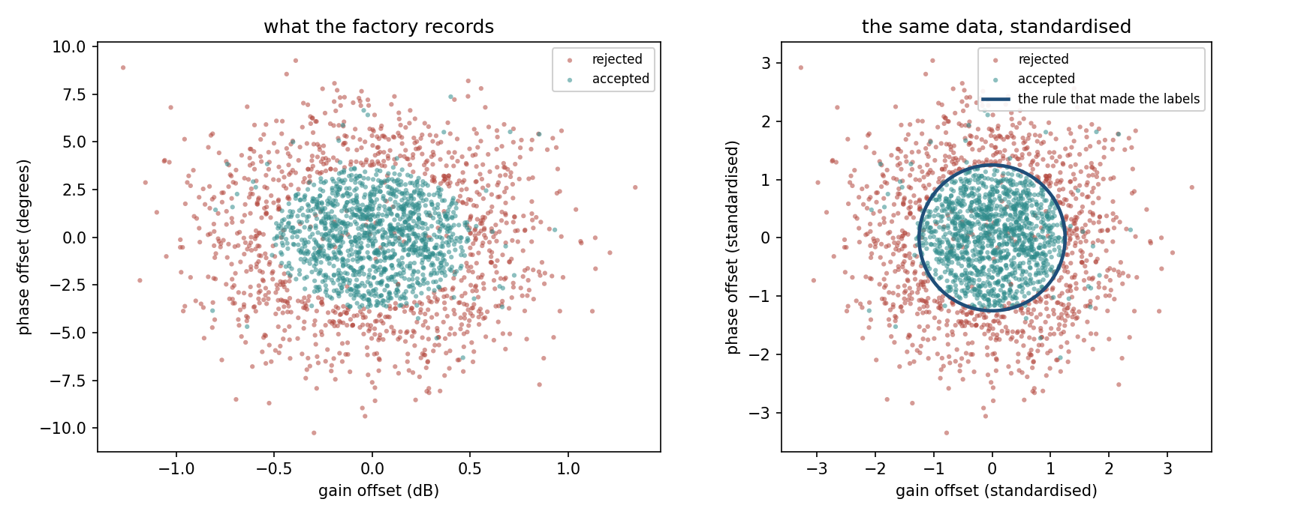
2,250 sensors, raw and standardised
Notes:
Left panel: the raw measurements in decibels and degrees, which is all Meridian’s engineers ever see. Right panel: the same points after each axis is divided by its own production spread, with the rule that generated the labels drawn on top.
Point directly at the wrong-coloured points scattered along the circle. Those are not model errors - nothing has been fitted yet. They are the 3% of verdicts the test rig recorded incorrectly, and they are the reason no score today can exceed 0.97.
Let the room look at the right panel and ask the obvious question out loud: where would you put a straight line? Handout section 2.2.

Slide 10
A circle of radius 1.25
Gain tolerance 0.50, production spread (standard deviation) 0.40
Phase tolerance 3.75, production spread 3.00
Both are exactly 1.25 spreads, so standardised, the accept region is a circle of radius 1.25
Two units, two tolerances, one shared shape
0.5497 of the 3,000 generated units fall inside it
Notes:
This is the payoff for the “try this” in the handout: the circle is not an arbitrary teaching choice, it falls out of the two tolerances being the same multiple of their own axis’s spread. Standardising is what makes that visible - in decibels and degrees the region is an ellipse and the coincidence is invisible.
The measured 0.5497 is worth stating before the theoretical number on the next slide, so that the comparison runs from data to formula rather than the other way round.
Handout section 2.2.

Slide 11
What fraction of units the circle holds
Notes:
The middle step is gone from the slide to keep the type readable: 1.25 squared over two is 0.78125, and that is the exponent. Do it out loud.
For a standard two-dimensional normal the probability of landing inside a circle of radius s is one minus e to the minus s squared over two - a fact worth a moment, since it is the same integral that reappears in section 11 when the lesson computes how well a polygon of a given number of sides could fence this region.
0.5422 predicted, 0.5497 measured on 3,000 units. The gap is sampling noise on three thousand draws and nothing else.
Docs/worked_examples.py recomputes this from the raw tolerances rather than from the standardised radius. Handout section 2.2.

Slide 12
What one line is worth
 | test accuracy
always predict “accepted” | 0.5480
fitted logistic regression | 0.5507
the best straight line for this population | 0.6491
the rig’s ceiling | 0.9700
Notes:
Read the table from the top. A model that ignores its inputs entirely scores 0.5480. Logistic regression, fitted properly on 2,250 examples, scores 0.5507 - 27 ten-thousandths better than knowing nothing.
Then read the gap at the bottom, which is the real content: even the best line that exists for this population reaches 0.6491, against a reachable 0.97. Three points of the first gap are the fit; thirty-two points of the second are the shape of the model family.
Ask the room whether they would suspect a bug if they saw 0.5507 come out of their own experiment. Most would, and they would be wrong. Handout section 2.2.

Slide 13
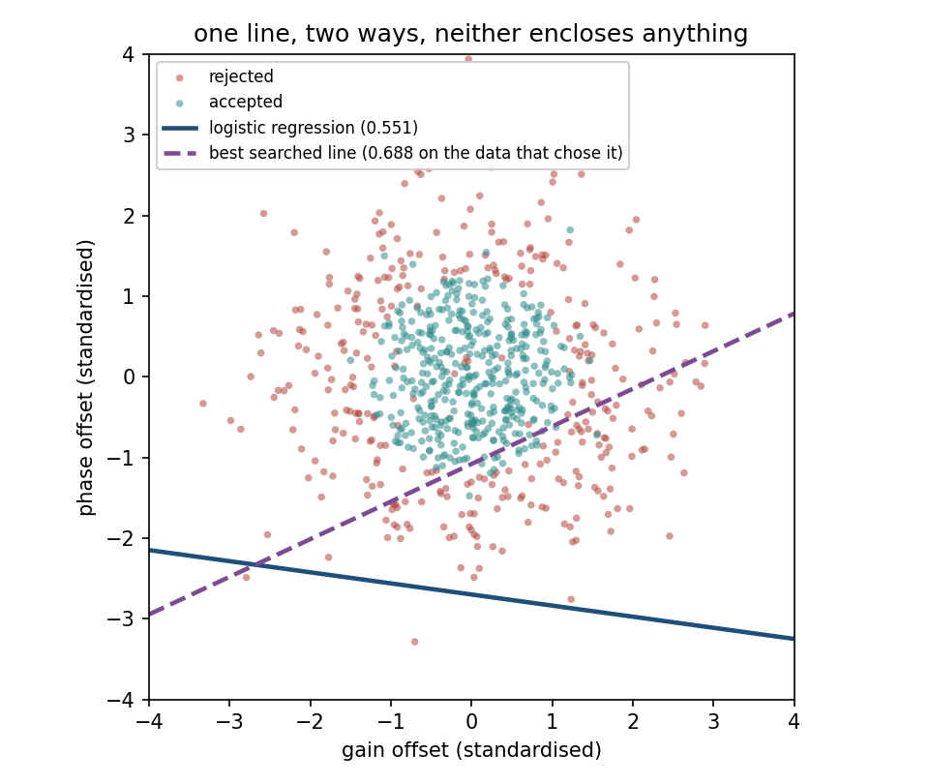
No line encloses it
Notes:
Solid line: the fitted logistic boundary. Dashed: the best line found by brute-force search over 72,762 candidates.
The thing to point at is what the best line does, because it is not what students expect. It does not attempt to enclose the accept region - it cannot - so it slices off one far tail of the distribution where almost every unit is a reject, and banks that. That is the honest ceiling for the family.
Handout section 2.2.

Slide 14
The fit did not fail
Coefficients (0.0096, 0.0701), intercept 0.1892
Almost exactly the constant model: no line does much better than that
Not an optimiser that gave up. The reason is symmetry
The accept region is a disc on the origin; every accepted unit has a partner opposite
Any tilt gaining accuracy on one side gives it back on the other
Notes:
This slide exists to head off the single most likely wrong diagnosis. A student who sees 0.5507 will reach for the optimiser: more iterations, a different solver, a smaller learning rate, scaling. None of it will help, and the reasoning behind reaching for it is perfectly sound - a score at chance usually does mean something failed to converge.
Walk the symmetry argument out loud, because it is a proof and it takes ten seconds: rotate the picture by 180 degrees and the labels are statistically unchanged, while any line becomes a different line. A quantity that must be invariant under a symmetry the model cannot represent has nowhere to go.
Handout section 2.2.

Slide 15
72,762 candidate lines, and 4 points of self-deception
The search tries 72,762 boundaries and scores the winner on the data that chose it: 0.6880
The honest figure, computed exactly from the geometry: 0.6491
Almost 4 points of pure selection bias
Nothing was fitted. No parameter estimated. Only a choice made
Lesson 5’s argument, inside a lesson-9 experiment
Notes:
This slide is a deliberate trap, and it is worth pausing on. The brute-force search has none of the features students associate with overfitting: no parameters, no training, no capacity. It picks the best of a list. And picking the best of a long list, then reporting that best, is enough on its own to inflate a score by four points.
Ask the room how many candidates they would have to try before the effect becomes serious, and whether they have ever reported the best of several configurations. Almost everyone has.
The 0.6491 is computed analytically in handout section 11.1, from the geometry rather than from any sample, which is precisely why it is trustworthy here. Handout section 2.2.

Slide 16
The smallest problem that needs a hidden layer
One correction removes the drift only when both channels drift the same way (same sign)
That is the exclusive-or (XOR) function
Four clouds of 200 units; a line scores exactly 0.5000
Coding the channels as ±1, the rule is about |a + b|
“Large in absolute value” is the outside of a strip: two boundaries, not one
Notes:
XOR is the traditional example and it is usually presented as an abstract logic puzzle. It is worth insisting that this version is a physical situation: common-mode drift is removable, differential drift is not, and the rule follows from the electronics rather than from a truth table.
The last two bullets are the whole diagnosis. The problem is genuinely one-dimensional - everything depends on a single number, the sum of the two drifts - and it is still not linearly separable, because the question asked of that number needs two thresholds rather than one. Say that plainly: it is not about dimension, it is about how many boundaries the answer needs.
Handout section 3.1.

Slide 17
Two units, written down rather than trained
Two rectified linear units (ReLU), each max(0, ·) of the same sum
One fires when a + b > 1, the other when a + b < -1
Between them they compute |a + b|, clipped
Output weights 10 and 10, bias -1: the rule is |a + b| > 1.1
Nothing trained, and over all 800 units it scores 0.9938
Notes:
This is the moment the lesson turns. Write the four hidden weights on the board if there is time - the first weight matrix is a column of ones beside a column of minus ones, both biases minus one, and the output weights are ten and ten. The handout works all four cloud centres through the network by hand in a table; do one row live, the plus-one plus-one corner, and let them check the rest afterwards.
The rectified linear unit is introduced here as a piece of machinery rather than as a topic: max of zero and the input, nothing more. Its properties get their own segment after the break.
The sentence to leave in the room: whatever training does, this is the kind of thing it is searching for. Handout section 3.2.

Slide 18
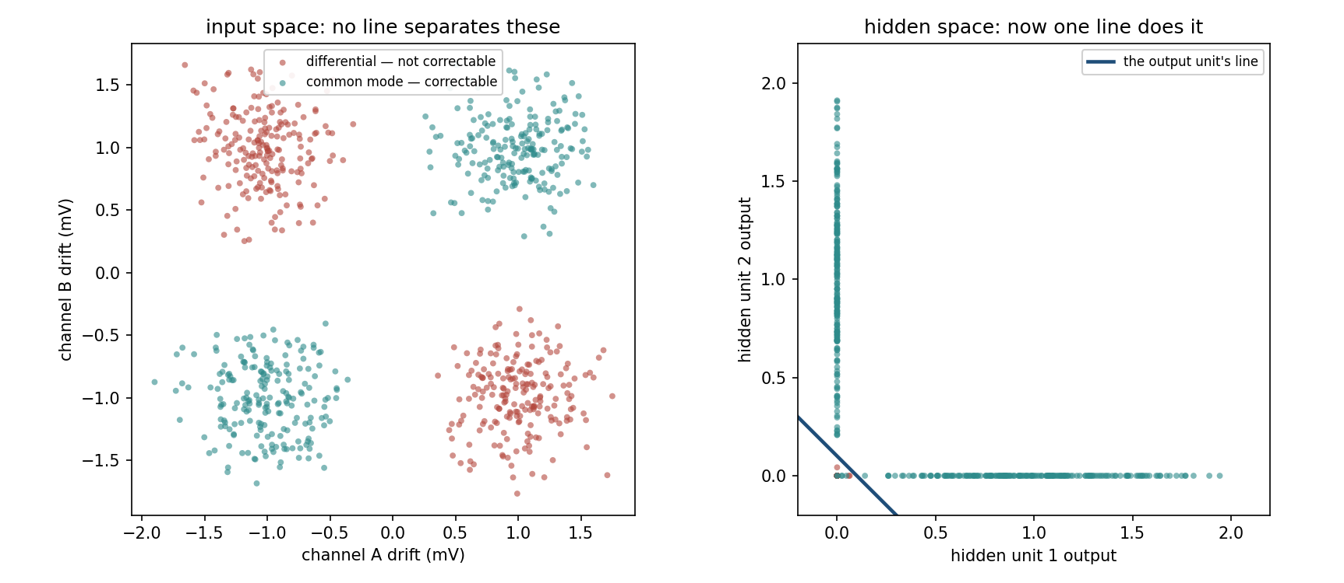
What the hidden layer actually did
Notes:
Left: the four clouds in the input space, where no line separates the colours. Right: the same 800 units plotted by what the two hidden units output.
Trace one cloud across the two panels with a finger. The two correctable clouds, which sat in opposite corners of the input space, have been moved to (1, 0) and (0, 1); both uncorrectable clouds have been stacked on top of each other at the origin. In the right-hand panel a single line separates them trivially.
Ask the room what the hidden layer classified. The answer is nothing - and that is the next slide. Handout section 3.3.

Slide 19
The hidden layer classified nothing
It moved the data until the output line was enough
Correctable clouds to (1,0) and (0,1); the rest to the origin
The name for this is representation learning
What is learned: coordinates in which the boundary is simple
Lesson 10’s convolutional networks: the same trick, with most weights fixed at zero
Notes:
This is the idea to carry out of the first half of the lesson, and it is worth more than the algebra that follows. Students tend to picture a deep network as a stack of classifiers, each refining the last. It is not. Every layer but the final one is changing coordinates; only the last one classifies.
That reading is also what makes the rest of the field intelligible: a convolutional layer, a recurrent layer, an embedding are all answers to the question “what coordinates would make this problem easy”, constrained in different ways.
Forward-reference lesson 10 explicitly here, so next week opens on a question already asked. Handout section 3.3.

Slide 20
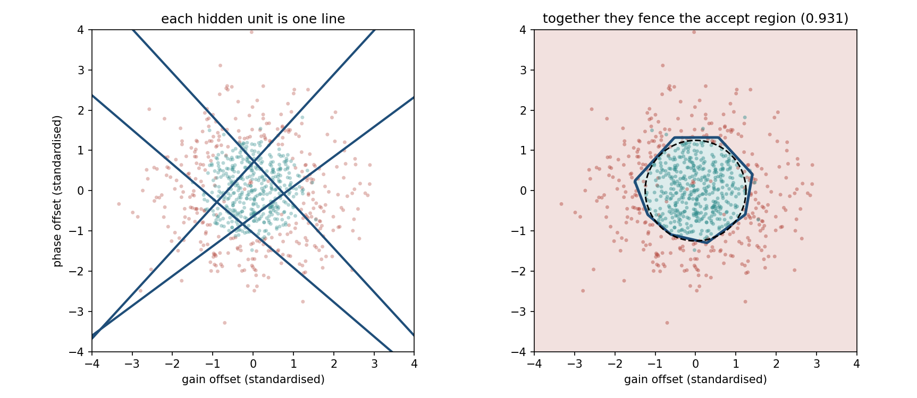
Four lines enclose a region; one never does
Notes:
Back to the acceptance data, with a trained four-unit hidden layer. Left: the four lines those units draw, plotted straight from the columns of the first weight matrix - not inferred from predictions, read off the parameters. Right: the decision region the four produce together, with the true circle dashed.
This is the picture that makes “a hidden layer of H units is H lines” concrete. Ask the room how many lines they think are needed before the score stops improving; the answer, from the sweep in handout section 11.2, is about three, which surprises most people.
Handout sections 4.1 and 11.2.

Slide 21
Capacity is not the same as findability
hidden units | median accuracy | best of 20 | runs above 0.95
2 | 0.7500 | 0.9975 | 4 of 20
3 | 1.0000 | 1.0000 | 15 of 20
4 | 1.0000 | 1.0000 | 19 of 20
8 | 1.0000 | 1.0000 | 20 of 20
Notes:
Twenty independent restarts at each width, on the drift problem. Two units are provably enough - the lesson wrote a two-unit solution down by hand three slides ago and it scored 0.9938 - and plain gradient descent finds something that good in four runs out of twenty.
The median tells you what goes wrong. 0.7500 is exactly three of the four clouds: the solution you get by spending both lines carving off a single quadrant. It is a local minimum, and from most starting points it is downhill.
The consequence is the honest reason production networks are wider than their task requires. The extra units are not extra capacity - they are extra starting points, so that some unit begins near a useful line.
Handout section 3.4.

Slide 22
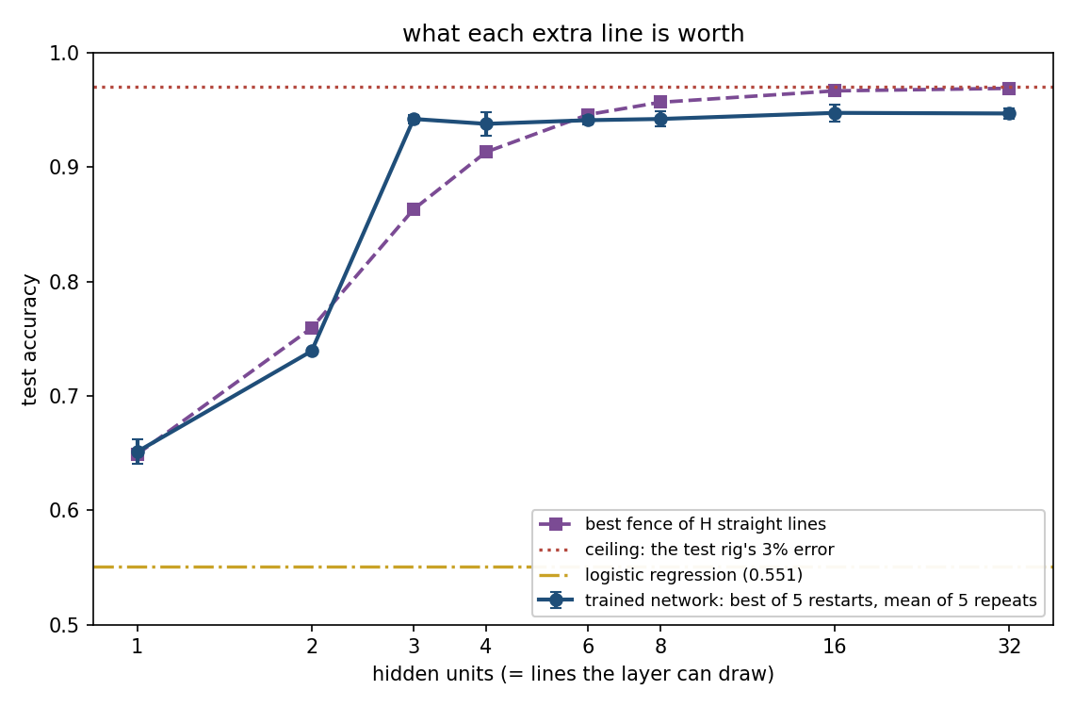
What each extra line is actually worth
Notes:
This is the capacity argument in one picture, and it is worth two minutes even though the segment is tight. The purple line is the best fence you could build from that many straight lines - a regular polygon, computed exactly rather than searched for. The blue line is what training actually reaches.
Three things to point at. Almost the whole gain arrives by three units: two to three is worth 20 points, three to thirty-two is worth half a point. At three and four units the trained network is above the polygon, because H lines cut the plane into far more than one polygon and the output unit votes over the pieces. And past six units the trained curve flattens while the polygon curve keeps climbing towards the ceiling - the lines are available and gradient descent does not use them.
Ask the room which of the two curves is a statement about the architecture and which is a statement about the optimiser. The gap between them, after six units, is the whole of section 9’s subject.
Handout section 11.2.

Slide 23
Universal approximation, and what it does not promise
Cybenko (1989), Hornik (1991): one hidden layer, enough units, any continuous function
Read the quantifiers. It says such a network exists
Nothing about how many units “enough” is
Nothing about whether training will find it
Nothing about behaviour outside the region
Two units sufficed on the drift data: descent missed it 16 times in 20
Notes:
This theorem is cited far more often than it is read, and the citation almost always carries an implication the theorem does not license - that a network is guaranteed to work if you make it big enough.
Put the question to the room directly: does the theorem say anything at all about training? It does not mention training. It is a statement about the existence of a set of weights, proved without reference to how anybody would obtain them.
Its real content is a licence to stop worrying about whether a network can express the answer, and start worrying about optimisation and data, which is exactly what the remaining two hours do. Handout section 3.5.

Slide 24
Forward propagation: examples in rows
One hidden layer of H units, one output unit, m examples, n inputs
Two matrix multiplies, each followed by an elementwise function
Examples in rows, as scikit-learn and Keras; in columns every transpose flips
In code: keras.Sequential of a keras.Input and layers.Dense layers
Notes:
The convention warning is not pedantry. It is the single most common source of wasted hours when a student implements backpropagation from a textbook while debugging against scikit-learn shapes, and it is worth thirty seconds now to save an evening later.
State the architecture once so the two equation slides that follow can be read without narration: inputs, one hidden layer, one output unit, binary classification. Multiclass comes after the break.
Handout section 4.1.

Slide 25
Layer 1: a line per unit, then a non-linearity
Notes:
Read the bracketed superscript as the layer index, not a power - say it once and it will not confuse anybody again. Z is the pre-activation, the raw weighted sum; A is what comes out after the activation function g.
The bias is added by broadcasting across rows: one bias per hidden unit, the same value for every example. Handout section 4.1.

Slide 26
Layer 2: one more line, then a probability
Notes:
The second layer is exactly the single neuron from the start of the lesson, with one change: its inputs are no longer the measurements, they are the hidden layer’s outputs. That is the whole architecture.
Say the consequence out loud, because it ties back to the drift example: the output unit is still just a line. It has not become cleverer. It is being handed better coordinates. Handout section 4.1.

Slide 27
The shapes
symbol | shape | what it is
X | m × n | the design matrix, one example per row
W, layer 1 | n × H | one column per hidden unit
b, layer 1 | H | broadcast across rows
Z and A, layer 1 | m × H | pre-activations and activations
W, layer 2 | H × 1 | the output unit’s weights
ŷ | m × 1 | one prediction per example
Notes:
Shapes are the cheapest debugging tool in the whole subject, and the habit worth installing is checking them before running anything. A backward pass that produces a gradient of the wrong shape has a bug you can see; one of the right shape may still have a bug, which is why section 5.5 exists.
Ask the room what shape the gradient of the cost with respect to the first weight matrix must have. The answer - the same shape as the matrix itself - is the check that catches most transpose errors before they cost anything.
Handout section 4.1.

Slide 28
Two facts the shapes hand you
Examples never mix: the row index passes through untouched
Nothing lets example 3 influence example 7, which is what makes mini-batching valid
Each column of the first weight matrix is one unit
Its weight vector, and the line that unit draws
So H hidden units are H lines, and the output unit votes
Notes:
Both facts look like bookkeeping and both are structural. The first is what allows every later decision to process examples in batches, or to split them across machines; if examples could influence one another, computing a gradient on 32 of them would not approximate the gradient on all of them.
The second is what makes a hidden layer interpretable at all in two dimensions, and it is the bridge to the fence picture and to the polygon yardstick in handout section 11. Put the question to the room: if a layer of H units is H lines, how many lines does it take to fence a circle well? Answer after the break, in the notebook.
Handout section 4.1.

Slide 29
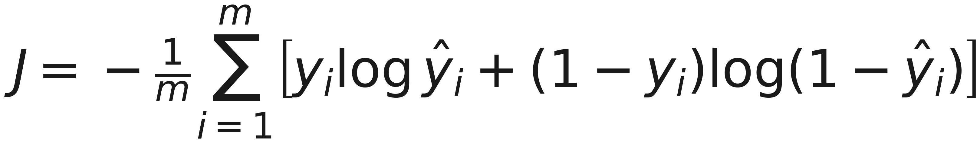
An untrained network costs 0.6721; guessing costs 0.6931
Notes:
Cross-entropy, unchanged from lesson 4 - say that explicitly, because students expect a new cost to come with a new model and it does not.
The two numbers in the title are the sanity check to run before training anything. A network at random initialisation should cost about log 2, roughly 0.693, on a balanced binary problem: it knows essentially nothing, and the cost says so. 0.6721 is that, slightly better than pure ignorance because the classes are not exactly balanced.
A network whose initial cost is far from this has a bug, usually in initialisation scale or in the labels, and it is worth ten seconds to check before spending an hour on the training curve. Handout section 4.1.

Slide 30
Break
Twelve minutes
Notes:
Twelve minutes. What comes back after the break is the derivation that makes all of this trainable - and the four-line check that tells you whether you got it right. Worth saying so before they leave the room.

Slide 31
Two bad ways to get every gradient
We need the derivative of the cost for every weight and bias
Perturb and re-run: one forward pass per parameter; for notebook 3’s network of 301,066 parameters, 301,066 passes for one step
Differentiate symbolically: the same sub-expressions, thousands of times
Both correct. Both unusable
Notes:
Set the problem up as a cost question rather than a calculus question, because that is what it is. The chain rule was never in doubt; what was in doubt for two decades was whether the gradient could be obtained cheaply enough to take millions of steps with it.
Say the 301,066 figure slowly - it is a real network from later in this lesson, two hidden layers of 512 units on eight-by-eight digit images - and let the absurdity land: three hundred thousand forward passes to take one step, and you would need thousands of steps.
Handout section 5.1.

Slide 32
Compute each repeated piece once, right to left
Carry the cost’s derivative for each layer’s pre-activations
From it: that layer’s weight gradients and the layer below’s, so one backward sweep gives every gradient
A weight’s gradient is how wrong the layer above was, times what this weight contributed
Keras automates it with tf.GradientTape
Notes:
The fourth bullet is the sentence students should be able to repeat to a friend without writing anything down, and it is worth asking someone to do exactly that before moving on. Both halves matter: how wrong the layer above was, and how much this particular weight contributed. A weight attached to a feature that was zero for every example gets no gradient no matter how wrong the output was - which is precisely the dead-unit failure later in the lesson.
Say why the right-to-left order is forced rather than chosen: the error is only known at the output, so information has to travel from there back towards the inputs, and the repeated sub-expressions are exactly what accumulates along the way.
Handout section 5.1.

Slide 33
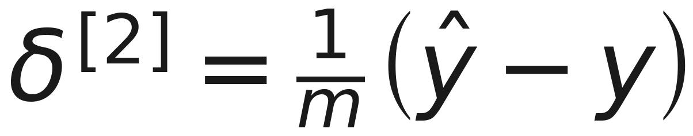
The output layer collapses to prediction minus truth
Notes:
Say what this is before saying why it is remarkable: it is the derivative of the cost with respect to the output layer’s pre-activation, one number per example, and it is the seed of the entire backward pass.
Then say why it is remarkable. Two messy derivatives went into it - the derivative of cross-entropy, which has a fraction with the prediction in the denominator, and the derivative of the sigmoid, which is a product - and what came out is a subtraction. Prediction minus truth, scaled by the number of examples. That is not luck, and the next slide says why.
The full derivation, both factors written out, is handout section 5.2.

Slide 34
Why sigmoid and cross-entropy belong together
The loss derivative carries a factor 1 over ŷ(1 − ŷ)
The sigmoid’s derivative is ŷ(1 − ŷ)
They cancel exactly, leaving ŷ − y
Squared error keeps that factor, and it is near zero exactly when the network is confidently wrong
Notes:
This is the slide that turns a pairing students have seen presented as a convention into a piece of engineering. Ask the room what happens, under squared error, to an example the network predicts at 0.999 when the true label is 0. The prediction is as wrong as it can be; the sigmoid derivative there is about 0.001; so the gradient is about a thousand times smaller than it should be, and the network barely learns from its worst mistake.
Cross-entropy removes the factor, and the confidently wrong example gets a gradient proportional to how wrong it is. Same idea, one dimension up, is what makes softmax work after the break.
Handout section 5.2.

Slide 35
One step down, through the activation
Weight gradient = incoming activations, transposed, times the signal above
To step down: multiply by the weight matrix above, then by the activation’s derivative
For the ReLU that derivative is an indicator: 1 where the pre-activation was positive
A unit that contributed nothing forward passes nothing backward
Notes:
The two multiplications on this slide are the entire algorithm, repeated once per layer. Emphasise that only one of them involves the data at all - the other is the same weight matrix used in the forward pass, transposed. That symmetry is why the backward pass costs about what the forward pass costs.
The ReLU indicator is worth a beat because it comes back twice: it is why the rectified linear unit does not shrink gradients the way a sigmoid does, and it is why a unit can die permanently. Both are in the segment after notebook 02.
Handout section 5.3.

Slide 36
Backward through one layer
Notes:
Read the two operations in order. First the matrix product with the transposed weights above, which redistributes the error at the layer above across the units that fed it. Then the circled dot - the elementwise product - with the activation’s derivative, which asks each unit how much it was actually responding when the example came through.
This one line is the recursion. Written for a general layer index it is identical, which is why adding layers changes nothing in the formula and a great deal in the numbers it produces. That is the subject of the vanishing-gradient segment.
Handout section 5.3.

Slide 37
What backpropagation costs
The backward pass does about the same arithmetic as the forward pass
A gradient costs roughly what a prediction costs: this is what makes training feasible at all
But every layer’s activations must be stored
Memory grows with depth times batch size, and memory, not arithmetic, is what usually limits batch size
Notes:
Both halves of this slide get quoted at students later in their careers and neither is obvious, so state them plainly.
The first is why the field exists: if a gradient cost a hundred times a prediction, nothing would have been trainable in 1986 and very little would be trainable now.
The second is why anybody has ever had to think about batch size at all. Ask the room what they would expect to run out of first when training a deep network, time or memory. Most say time. The answer in practice is memory, and the reason is on this slide - every activation from the forward pass has to be kept alive until the backward pass consumes it.
Handout section 5.4.

Slide 38
Check the gradient before you trust it
A wrong gradient raises no exception: it trains badly and looks like a modelling problem
Compare each partial with (J(θ + h) − J(θ − h)) ÷ 2h: error of order h²
Notebook 01: worst disagreement 1.97 × 10⁻⁸, median 7.83 × 10⁻¹¹
Relative error below 10⁻⁶: believe it. Above 10⁻⁴: there is a bug
Four lines of code, and not optional
Notes:
This is the highest-value slide in the lesson measured in hours saved, and it is worth saying why in the strongest terms available: a wrong gradient is the one bug in machine learning that produces no error message, no warning, and a plausible-looking training curve.
Ask the room how they would notice. The honest answer is that without this check they would not - they would conclude the architecture was wrong, or the learning rate, or the data, and they would be looking in the wrong place for as long as they had patience.
Run it once, on a small network with a handful of examples, whenever a backward pass is written by hand. Handout section 5.5.

Slide 39
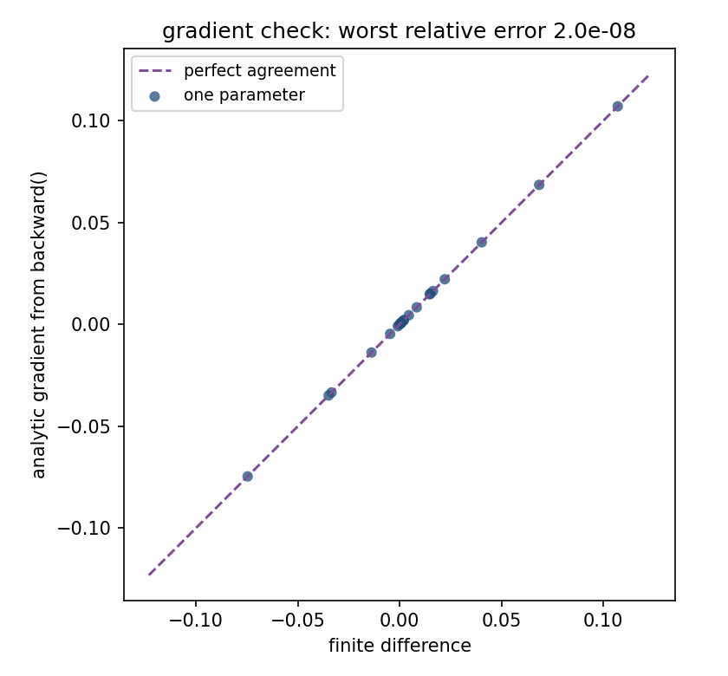
21 partial derivatives, on the diagonal
Notes:
Every one of the 21 partial derivatives of a small network: the analytic gradient on one axis, the finite-difference estimate on the other. The points lie on the diagonal to eight decimal places.
Say what a failure would look like on this plot, because that is what students will actually meet: a bug rarely displaces every point. It displaces one parameter block - all the biases, say, or one weight matrix - so the picture shows a tight diagonal with a handful of points visibly off it, and the ones off it name the layer with the mistake.
Handout section 5.5.

Slide 40
Notebook 1, live
section, and its slides | you call (→ the number to come back with)
split, then one straight line, 8-15 | train_test_split, StandardScaler, LogisticRegression → 0.5507
forward, backward, gradient check, 24-39 | NumPy only → untrained cost 0.6721, worst disagreement 1.97 × 10⁻⁸
the drift problem, 16-21 | the hand-built network, then 20 restarts per width → 4 of 20 above 0.95 at two units
the polygon yardstick, 22 | scipy.integrate → the best 4-sided fence scores 0.9396
zero initialisation, 52-53 | all weights 0 → final cost 0.6887
Notes:
Backpropagation from scratch, gradient-checked before it is trusted; the two-unit hand-built network, then the same problem trained from 20 random starts at each width; the polygon yardstick, how well H lines could fence a circle; and the one initialisation that cannot work.
Run Notebooks/01_backpropagation_from_scratch.ipynb. Twenty-two minutes.
If time runs short, keep the gradient check: watching the worst relative disagreement print as ten to the minus eight convinces far more than the previous slide does.
Second priority is the 20-restart sweep at width 2, because seeing sixteen of twenty runs stall at 0.75 is what makes “representable is not findable” a fact rather than a slogan.
Have them predict the sign of the disagreement before it prints, and have them run the sweep with their own seed rather than the notebook’s.

Slide 41
Ten classes need ten outputs
Softmax turns K scores into a probability distribution
For K = 2 it is the sigmoid: one construction, two sizes
Loss, categorical cross-entropy: −log(probability of the true class), sparse_categorical_crossentropy
The gradient at the output is again ŷ − y: the backward pass is unchanged
Notes:
The last bullet is the point of the slide, and it is worth deriving on the board if there is appetite - it is four lines, using only that the one-hot target sums to one. The full version is handout section 6.2.
Say why the coincidence is not a coincidence: sigmoid-with-cross-entropy and softmax-with-cross-entropy are the same construction for two classes and for K classes, and in both the loss was chosen as the one whose derivative cancels the output non-linearity’s. If you ever meet a third output non-linearity, the matching loss is the one that does the same job.
The max-subtraction trick is a one-line implementation detail that students will hit for real the first time they write softmax themselves.
Handout section 6.1.

Slide 42
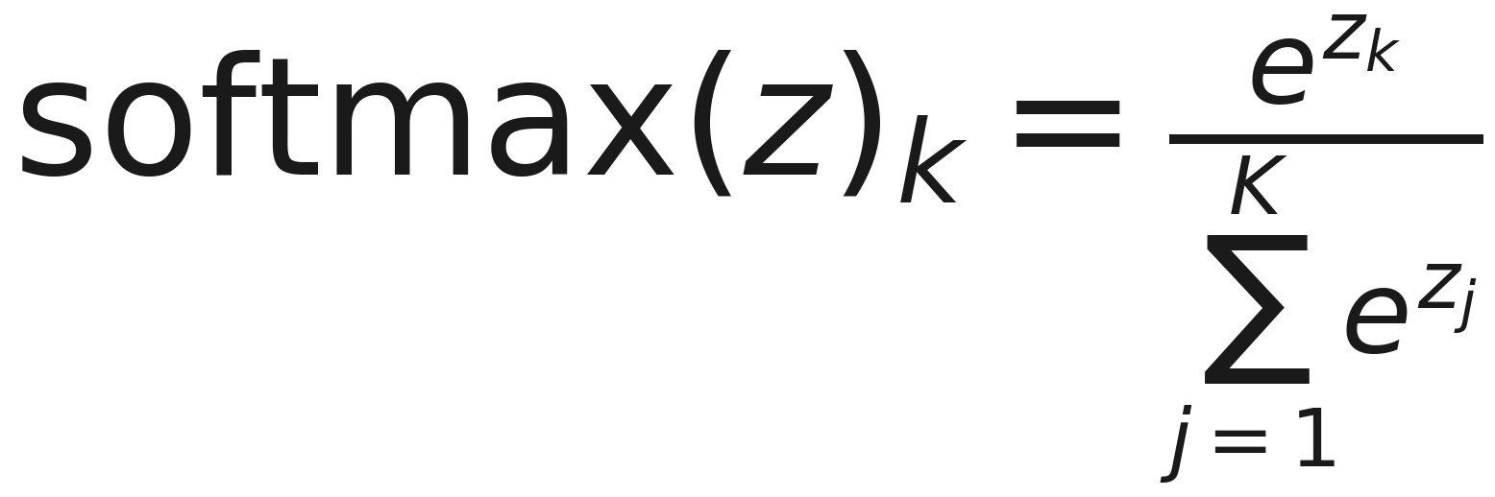
Softmax
Notes:
Read it in words: exponentiate every score, then divide by the total. The exponential makes everything positive; the division makes it sum to one. Monotone in each score, so the largest score still wins - softmax changes the confidences, never the ranking.
Handout section 6.1.

Slide 43
A hidden layer is not always the answer
architecture | parameters | validation accuracy | sd over 5 seeds
softmax alone, no hidden layer | 650 | 0.9324 | 0.0035
one hidden layer of 32 | 2,410 | 0.9602 | 0.0052
one hidden layer of 64 | 4,810 | 0.9611 | 0.0045
two hidden layers of 64 | 8,970 | 0.9676 | 0.0057
Notes:
Handwritten digits, eight by eight, ten classes, five seeds per row. The sd column is the seed-to-seed standard deviation, and it is on the slide because without it three of these four rows are indistinguishable.
Read the first row first: multiclass logistic regression, no hidden layer at all, 650 parameters, 0.9324. That is the baseline every architecture on this table has to beat, and most of them barely do.
Ask the room which row they would ship. The next slide is the reading.
Handout section 6.3.

Slide 44
Reading that table
No hidden layer at all is within 3.5 points of the best network here
The first hidden layer is worth 2.8 points; 32 units to 64, 0.09
On the acceptance data the same step was worth 39 points
Digits vote pixel by pixel: the acceptance rule needed two measurements at once
Notes:
This is the slide that keeps the lesson honest, and it should be delivered without apology. Two thirds of the way through a lesson about neural networks, the headline result on the real dataset is that a linear model was almost as good.
The last two bullets are the generalisable part and they belong in the summary table of handout section 12: reach for a hidden layer when the answer depends on inputs jointly, and try the linear model first when the inputs vote roughly independently.
Put it to the room as a diagnostic question they can ask before training anything: can I imagine a single weighted sum of these features answering this question? If yes, start there.
Handout section 6.3.

Slide 45
A sigmoid layer divides the gradient by about four
Any number of linear layers composes to one: the activation is the whole reason depth buys anything
The sigmoid’s derivative σ(z)(1 − σ(z)) peaks at ¼, at zero only
Backpropagation multiplies by it once per layer
At initialisation the weights multiply it by about 1, so the derivative decides: each sigmoid layer divides the gradient by about four
Notes:
This is the number the lesson exists to leave behind, so say it, write it, and come back to it at the close: a sigmoid layer divides the gradient by about four.
Take the first two bullets quickly but do not skip them - the collapse of stacked linear layers is a one-line calculation and it is the reason the whole activation question exists. It is also worth naming the consequence: a network whose units have all saturated or all died has effectively performed that collapse on itself.
Then the ¼. It is not an empirical observation, it is a maximum: the product of a number between zero and one with one minus itself cannot exceed a quarter. Ask the room where that maximum is attained, and why that is the worst possible place for it to be - the answer is at zero, which is exactly where a freshly initialised network’s pre-activations live.
Handout sections 7.1 and 7.2.

Slide 46
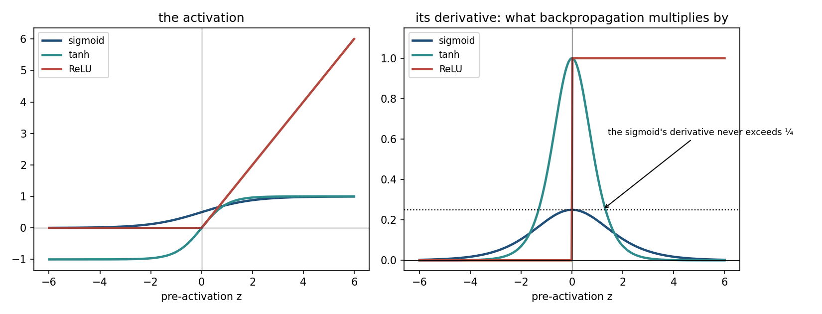
Three activations, and their derivatives
Notes:
Left panel: three activation functions. Right panel: their derivatives, which is the quantity backpropagation actually multiplies by once per layer - point at the right panel, not the left, because that is where the content is.
The horizontal line at a quarter is the subject of the previous slide. Note that tanh is every bit as much a squashing function as the sigmoid - same S shape, same saturation at both ends - and its derivative peaks at 1 rather than a quarter. That difference is the whole story, and it is why the slide after next reports tanh beating the rectified linear unit.
Handout section 7.2.

Slide 47
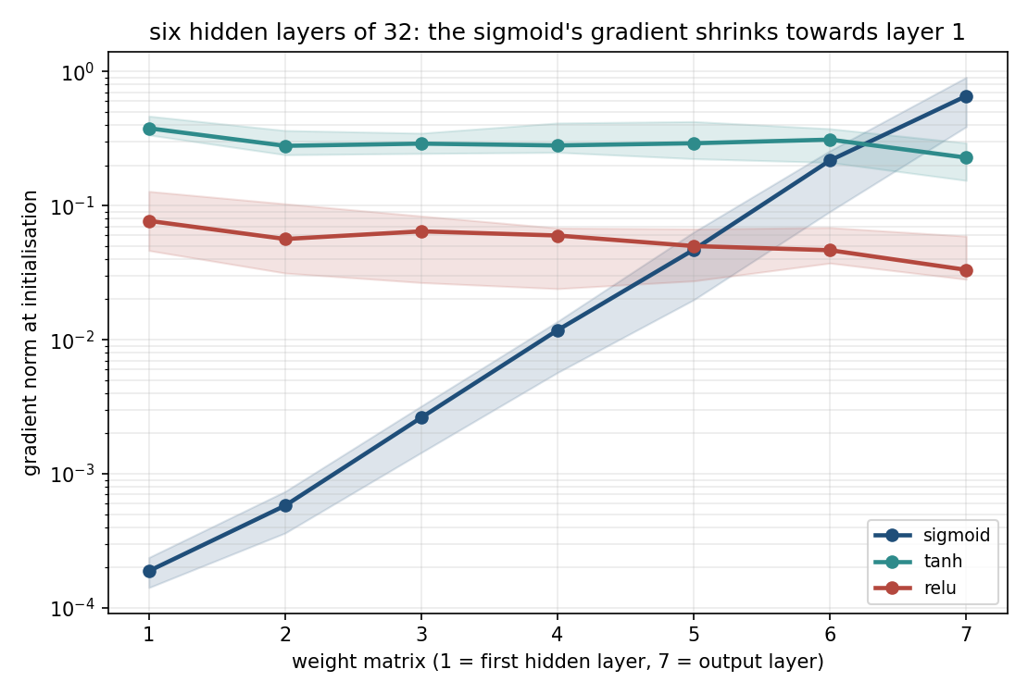
Six layers of it, measured
Notes:
Gradient norms at every weight matrix of an untrained six-hidden-layer network, on a logarithmic scale, with a band spanning eight random initialisations.
Read the slope, not the endpoints. The sigmoid line falls by three and a half orders of magnitude from output to input; tanh and the rectified linear unit are flat. The per-layer factors measured across those eight seeds are 3.90, 3.97, 4.14, 4.05, 3.92, 4.31, 4.06 and 3.86 - all eight between 3.9 and 4.3, scattered around 4 exactly as the bound predicts.
Say what this means for the first layer: it is receiving a gradient thousands of times smaller than the last layer’s, so in any fixed number of epochs it effectively does not move. The layers nearest the data, which is where representation learning has to happen, are the ones that learn least.
Handout section 7.3.

Slide 48
One draw is not a law
Gradient at the last weight matrix ÷ gradient at the first: median 3,547
Over the same eight seeds it ranges 2,734 to 4,607
Quoting the largest reports one draw as a law
The per-layer factor of about 4 is the property
By depth: 9.5, 170, 3,553, 46,250 at two, four, six and eight layers
Notes:
This slide is about method more than about the number, and the habit is worth more than the number. A single measurement of a compounding quantity is a draw from a distribution, and reporting its extreme as the headline is how plausible-looking folklore gets manufactured.
Ask the room which number they would put in a report, given the eight measurements. The defensible answers are the per-layer factor, because it is the thing that is actually stable, or the median with its range attached. “4,607-fold” is indefensible and is exactly the kind of number that ends up quoted in a slide deck five years later with no error bar.
The last bullet is the sanity check that the mechanism, not just the number, is right: the ratios track four-to-the-depth across four orders of magnitude, and sit slightly below it because the weight matrices give back a little of what the derivative takes.
Handout section 7.3.

Slide 49
Eighty epochs: only one of them never learns
Same six layers, same data, differing only in the activation
Sigmoid: 0.1000, exact chance on ten classes
tanh: 0.9750, past 0.85 within 3 epochs
Rectified linear unit: 0.9611, 9 epochs to get going
What kills the sigmoid is not squashing: it is where its derivative is bounded
Notes:
The last two bullets are why this slide is not a slogan. tanh saturates just as hard as the sigmoid does; it is fine because its derivative peaks at 1 rather than a quarter. If the explanation were “squashing functions are bad”, tanh would have failed too, and it did not.
“Use the rectified linear unit” remains reasonable default advice - it is cheaper to compute and does not saturate for large positive input - but on six layers of 32 units those advantages do not show up, and pretending they did would be teaching a slogan instead of a mechanism. Say that out loud; students will meet the slogan everywhere else.
Ask the room what they would have concluded from a single run comparing only the sigmoid and the rectified linear unit. The answer is the right conclusion for the wrong reason, which is the least useful kind.
Handout section 7.3.

Slide 50
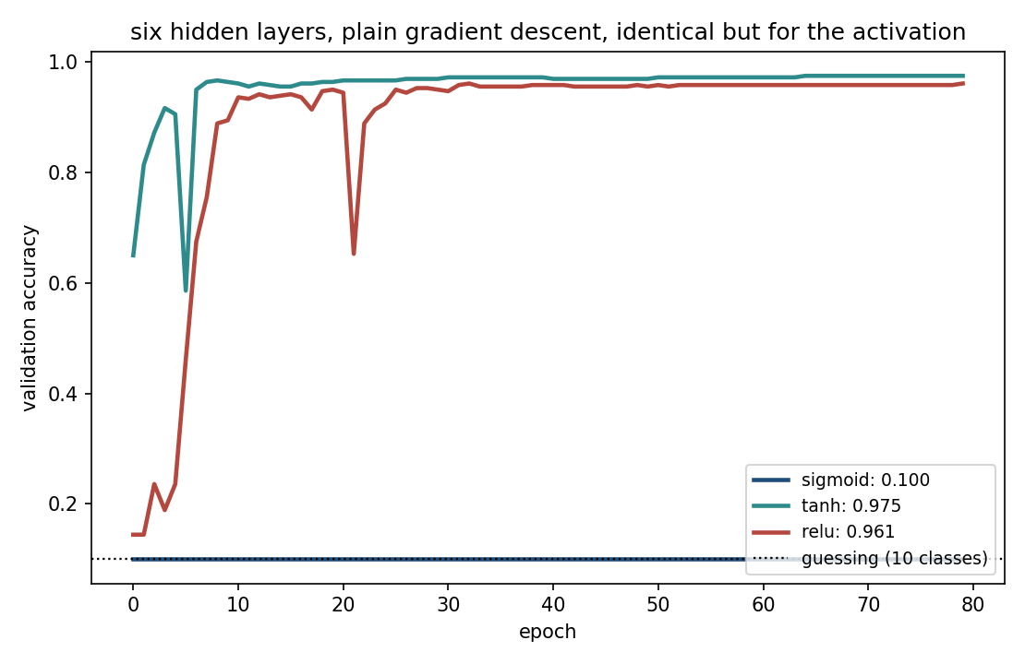
The sigmoid never leaves chance
Notes:
Put the previous slide’s numbers on the picture. The flat line at 0.1 is the six-layer sigmoid network: ten classes, exact chance, eighty epochs, and a gradient reaching its first layer some three thousand times weaker than its last. It is not learning slowly. It is not learning.
The question for the room: both of the other two curves belong to squashing functions or to a function with a hard corner - so what exactly is the sigmoid guilty of? The answer is the quarter. tanh squashes just as hard and its derivative peaks at one, which is why it is up there with the rectified linear unit rather than down with the sigmoid.
Handout section 7.3.

Slide 51
Notebook 2, live
section, and its slides | you call (→ the number to come back with)
the same network in Keras, 24-29 | keras.Sequential, keras.Input, layers.Dense, SGD; then compile, fit, evaluate → 0.9333
ten classes, 41-44 | Dense(10, activation="softmax"), Adam, Dropout, confusion_matrix → 0.9676 with two layers of 64
the shrinkage, measured, 45-48 | tf.GradientTape, sparse_categorical_crossentropy → about 4 per sigmoid layer
training six layers, 49-50 | SGD on three activations → sigmoid 0.1000, tanh 0.9750
how big the weights should be, 54 | RandomNormal at two scales, against Glorot → 73% saturated at N(0, 1)
Notes:
The same network again in six lines of Keras, with the same answer; softmax on ten classes and the depth comparison behind the table; the per-layer gradient shrinkage, measured across eight seeds at five depths; and how big the random weights should be.
Run Notebooks/02_keras_softmax_and_depth.ipynb. Twenty minutes.
Open by rebuilding notebook 01’s network in Keras and checking it lands in the same place - the point being that the library is a convenience, not a different algorithm, and that they now know what every one of those six lines does.
If time is short, keep the shrinkage measurement. Printing the eight per-layer factors themselves, and watching every one of them land between 3.9 and 4.3, is what makes the quarter-bound a measurement rather than an assertion.
Have them change the depth and predict the ratio before running it.

Slide 52
Zero cannot work
Lesson 3 started from zero, and was right to: those costs are convex
All-zero weights freeze a network: every gradient is exactly zero
Only the output bias ever moves
The bias converges to the base rate, and the cost to the cost of always predicting it, the label entropy: 0.6887 predicted, 0.6887 measured
Distinct hidden columns: 1 of 32
Notes:
The usual explanation for random initialisation is symmetry - identical units receive identical gradients and stay identical for ever - and that argument is correct and applies to any initialisation that repeats a weight vector.
For all-zero weights something stronger happens, and it is worth deriving in two lines because it is exact: the backpropagated signal into the hidden layer is the output weights transposed, which are zero, so it vanishes; and the output weight gradient is the hidden activations transposed, which are also zero. Nothing moves but one bias.
The prediction is not approximate. The cost converges to the entropy of the label distribution, 0.6887 at a base rate of 0.5471, and the notebook measures 0.6887. Ask the room why that agreement is exact rather than close - because the mechanism is exact, not statistical.
Handout section 8.1.
IF THE CLOCK IS AGAINST YOU, THESE ARE THE THREE TO DROP. This slide, the figure after it, and “How large? Propagate the variance” are the segment’s initialisation block, and it is the only block notebook 3 does not use - that notebook opens on the learning rate and never mentions initialisation. The 0.6887 they would have seen here was measured in notebook 01, two hours ago, so it is not new to them either. The handout carries both halves in full: section 8.1 derives the freeze exactly, 8.2 the variance argument.
Dropping the three removes about a fifth of this segment’s spoken content, which is the difference between the material it holds and the time it has. Say out loud that you are skipping them and why - “the handout does this properly and the notebook does not need it” - because a silent skip reads as running out of time, and this one is a decision.

Slide 53
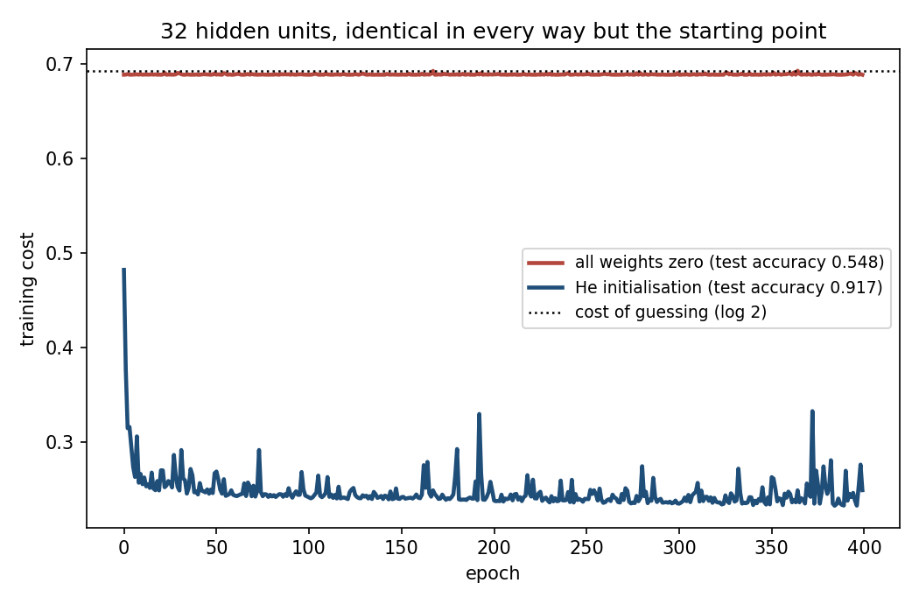
Only the starting point differs
Notes:
Thirty-two hidden units, identical in data, architecture and learning rate, differing only in where the weights started. The zero-initialised network flattens immediately at the entropy of the label distribution; the randomly initialised one trains.
The framing to leave them with: random initialisation is not a heuristic that happens to help. It is what makes the units different problems to solve. Without it there is one unit in the layer, repeated thirty-two times.
Handout section 8.1.
Second of the three slides the note on “Zero cannot work” marks as droppable if the clock is against you.

Slide 54
How large? Propagate the variance
A unit sums n inputs, so variance is multiplied by n × Var(w) each layer
Set Var(w) = 1/n: Glorot. ReLU halves it, so it wants 2/n: He
Too small collapses: indistinguishable from zero by layer 4
Too large saturates rather than exploding: 73% of the last layer’s tanh units past |a| > 0.99
Glorot loses half its spread over eight layers
Notes:
Give the variance argument in words before any of the numbers: a unit adds up n things, so its output variance is n times the variance of one term, and if that factor is not about 1 then repeating it once per layer gives you a geometric sequence in the depth. That is the entire derivation; the constants 1/n and 2/n follow immediately.
The two failure directions are worth contrasting explicitly because students expect “too large” to mean “explodes”. With tanh it cannot explode - the output is bounded by 1 - so it saturates instead, and a saturated layer passes signal forward and nothing backward. That is the vanishing gradient arriving from the other direction, which is a nice thing to notice out loud.
Handout section 8.2.
Third of the three slides the note on “Zero cannot work” marks as droppable if the clock is against you. If you keep only one of the three, keep this one - He initialisation is the line they will actually type.

Slide 55
The learning rate, swept
α | final training loss | validation accuracy | sd over 5 seeds
0.001 | 1.9550 | 0.5574 | 0.0794
0.01 | 0.1965 | 0.9398 | 0.0035
0.1 | 0.0115 | 0.9556 | 0.0039
0.5 | 0.0007 | 0.9685 | 0.0026
2.0 | 2.3222 | 0.1009 | 0.0013
Notes:
The same network and the same data at five learning rates, three orders of magnitude apart, five seeds each. The learning rate is the first thing to sweep and the last thing to guess.
Read the two ends against each other. At 0.001 the loss is still at 1.9550 when the epochs run out, and the seed-to-seed spread of 0.0794 is twenty times any other row’s - a network that has not settled anywhere. At 2.0 the accuracy is 0.1009, which is exact chance on ten classes: the steps overshoot every minimum they approach.
Between “still falling” and “never falls at all” there is about one and a half orders of magnitude of useful range. Handout section 9.1.

Slide 56
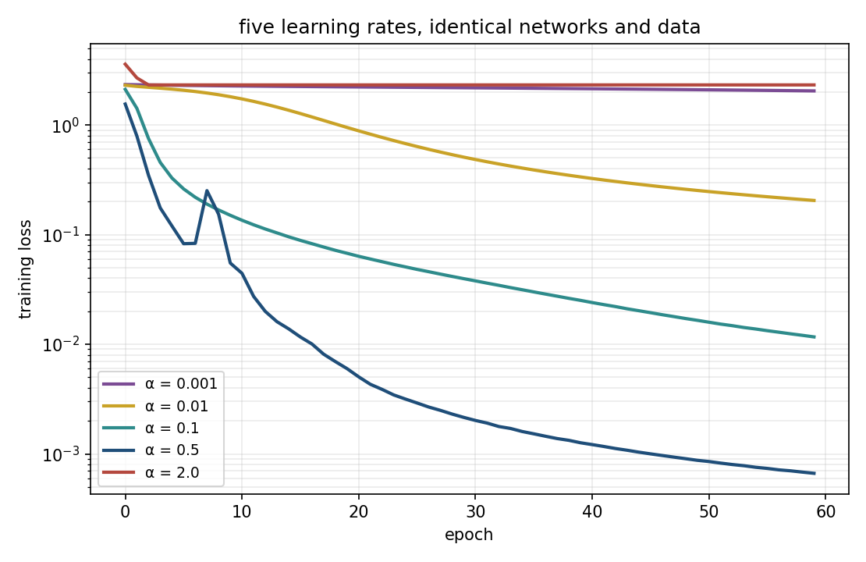
Three regimes, and a narrow band between them
Notes:
Logarithmic vertical axis, so each gridline is a factor of ten. Walk the three regimes: the top curve is still falling when the epochs run out, the middle band works, and the flat curve at the top is the rate that overshoots every minimum it approaches and never descends at all.
The useful range here spans about one and a half orders of magnitude, and it is found by sweeping, not by reasoning. Ask the room what the top curve would look like to someone who did not run this sweep - the answer is “a network that is too small”, which is the next slide.
Handout section 9.1.

Slide 57
The predictable mistake
Too small, and the loss is still falling when the epochs run out
It looks exactly like a network that is too small: both accuracies low
The instinct that follows is sound: low training accuracy really is the signature of underfitting
Vary α over orders of magnitude before touching the architecture
Notes:
This is the named predictable mistake of the segment, and the second bullet is the whole of it. The two situations produce the same symptoms, and the instinct to reach for capacity is not stupid - it is the textbook response to the textbook signature of underfitting. It is simply that the cause is in the optimiser rather than in the architecture, and adding capacity moves you further from the fix.
A second instance of the same family is in handout section 9.1: in notebook 01, five runs in eight finished above their own minimum, because a rate that is safe on a flat part of the cost surface is not safe on a sharper part reached later. Ask the room how they would detect that from a training curve - the answer is that the curve turning upward late is the signature, and it is invisible if you only look at the final number.
Handout section 9.1.

Slide 58
The rectified linear unit has its own failure
Its derivative is exactly 1 on the active side: so, no vanishing gradient
But a unit negative for every example gets zero gradient, for ever
Dead: the gradient that would revive it is the one it cannot receive
At α = 1.0, 33 of 64 are dead: accuracy 0.9583 against a best of 0.9667
Notes:
The second predictable mistake of the lesson, and it follows directly from the first segment doing its job too well. Having watched the sigmoid fail, the natural conclusion is that the rectified linear unit is safe, and the argument for that conclusion is correct as far as it goes.
Put the weight on the last bullet, not on the word “dead”. With half the layer dead the survivors absorb the work and accuracy drops by less than one point - nothing in the training curve announces the failure. That is what makes it dangerous: if that layer were your bottleneck, you would be tuning everything except the thing that is actually wrong.
Handout section 7.4 carries this measurement, and notebook 03 reproduces the sweep. The picture of it is the next slide, so do not point at anything yet. Ask the room how they would check. Counting units whose activation is zero on every training example takes one line.

Slide 59
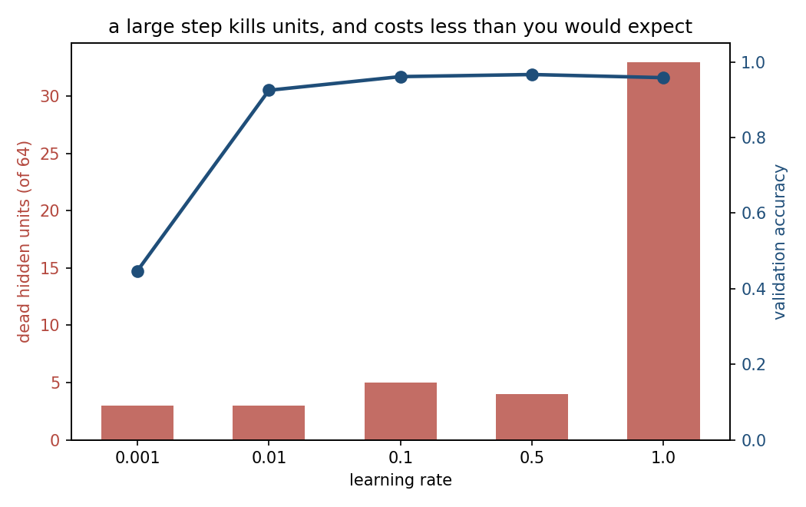
Half the layer dead, and almost no visible cost
Notes:
Two axes, and the point is the disagreement between them. The bars are dead units and they explode at the largest learning rate; the line is validation accuracy and it barely moves.
That is what makes this failure worth naming. Nothing in the training curve announces it - accuracy is fine, the loss is fine, and a third of the layer has been doing nothing for the whole run. Ask the room how they would ever detect it. The answer is the one measurement on this slide: push the training data through and count the units whose maximum activation over the entire set is exactly zero.
Handout section 7.4.

Slide 60
Mini-batches, momentum, and Adam
Mini-batch stochastic gradient descent (SGD), SGD: a small batch’s gradient, noisy but right on average
Momentum: step along a running average of past gradients
Adam (adaptive moment estimation), Adam: each parameter’s step scaled by its own recent gradients, so a badly chosen α matters less
Notes:
Three ideas at speed, because the measured comparison on the next slide is where the content is.
The one to spend a sentence on is why batch size and learning rate cannot be tuned independently: a larger batch gives a less noisy gradient, which tolerates a larger step. Students who tune them one at a time will find each sweep contradicting the other.
For Adam, the phrase worth remembering is per-parameter step size. A single global learning rate has to serve every coordinate, and coordinates differ enormously in scale - which is exactly the condition-number picture from lesson 3, now with one step size per direction.
Handout sections 9.2 and 9.3.

Slide 61
Adam, measured: read the spread before the mean
optimiser | test accuracy | sd over 5 seeds | worst of 5 | vs the true rule
plain gradient descent | 0.9389 | 0.0184 | 0.9027 | 0.9685
with momentum 0.9 | 0.9349 | 0.0094 | 0.9173 | 0.9645
Adam | 0.9485 | 0.0072 | 0.9360 | 0.9792
Notes:
All three on the acceptance problem, at the width where notebook 01’s plain gradient descent had stalled, five seeds each.
Read the worst of 5 column before the mean. Adam’s mean is about a point above plain descent, which is unremarkable; its worst run is more than three points above, and its spread is less than half. What Adam bought is the disappearance of the bad case - which is exactly what notebook 01 spent five restarts buying by hand. Adam in one run matches what plain descent needed five to reach.
Now the row nobody would put in an advertisement: momentum did nothing at all here, a fraction of a point below plain descent and well inside either method’s spread. Say it rather than dropping it. Momentum is a good default, not a guarantee, and a comparison in which every row improves on the last is usually a comparison that has been curated.
The last column is the same networks scored against the true acceptance rule instead of the rig’s recorded verdict - about three points higher throughout, which is the measuring instrument, not the model. Handout sections 9.3 and 11.3.

Slide 62
Three regularisers, and what they bought
method | test accuracy | sd over 5 seeds | train − test gap | epochs run
early stopping only (EarlyStopping: keep the best epoch) | 0.9411 | 0.0069 | 0.0589 | 38.8
+ dropout 0.4 (Dropout: drop 40% of units per batch) | 0.9483 | 0.0038 | 0.0503 | 48.8
+ L2 10⁻³ (l2: a penalty on squared weights, as Ridge) | 0.9478 | 0.0011 | 0.0522 | 198.4
+ dropout and L2 | 0.9511 | 0.0045 | 0.0489 | 161.6
Notes:
Trained with early stopping on validation, best weights restored, scored on a test set that nothing was chosen against, five seeds each. Name the three methods first: early stopping keeps the weights from the best epoch and is the cheapest regulariser there is; L2 adds a penalty on the squared weights, identical in form to Ridge in lesson 3; dropout deletes each unit independently on every training batch and rescales the survivors, so no unit can rely on any other being present.
Now read the table the way lesson 5 asks. All three land between 0.7 and 1.0 points above early stopping alone, against a seed-to-seed spread of 0.1 to 0.7 points - one to two standard deviations. Enough to say they helped, nowhere near enough to rank them. On a single run with one seed you could comfortably have measured the three in any order.
The epochs run column says something the accuracy column cannot: L2 kept validation loss improving for roughly four times as long before early stopping fired. A real qualitative difference, in a comparison whose headline numbers are not separable.
Handout section 10.3.

Slide 63
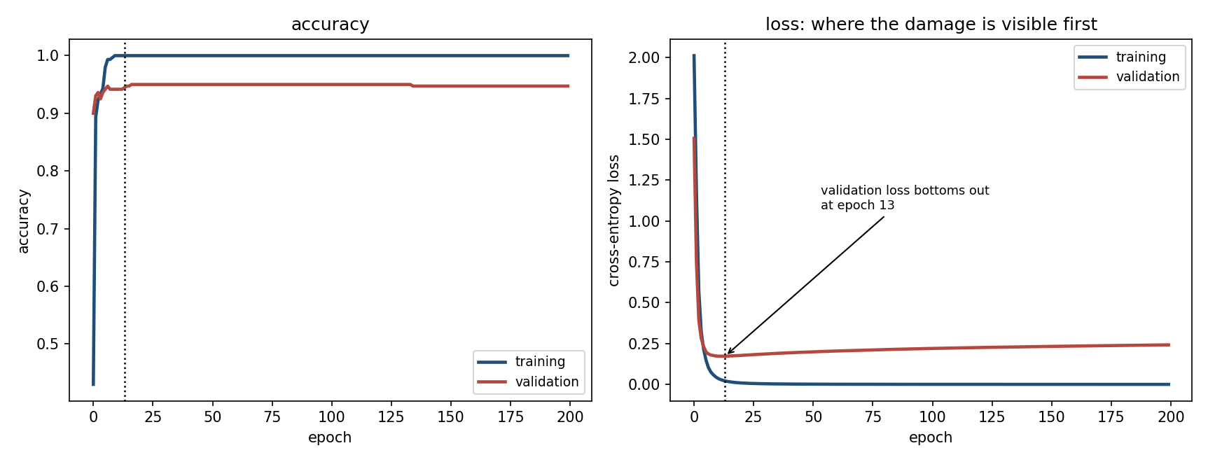
It memorises the training set, and generalises anyway
Notes:
301,066 parameters on 300 training examples - a thousand parameters per example. On the left, training accuracy reaches 1.000 and stays there: the network has enough freedom to store the answers outright, and it does. Validation accuracy sits near 0.95 and stays there too, which classical bias-variance reasoning from lesson 5 does not lead you to expect.
The right panel is the one to dwell on. Validation loss bottoms out at epoch 13 - the dotted line - and then climbs for the rest of training, while validation accuracy holds flat and in fact peaks later, at epoch 17. The network is not getting more answers wrong - it is getting steadily more confident about the ones it already has wrong. Accuracy cannot see that; cross-entropy can. Ask the room which of the two they would early-stop on, and why.
Handout section 10.1.

Slide 64
Notebook 3, live
section, and its slides | you call (→ the number to come back with)
the learning rate, 55-57 | SGD(learning_rate=α) at five rates → best 0.9685 at α = 0.5
dead units, 58-59 | keras.Model to read the hidden layer → 33 of 64 dead at α = 1.0
optimisers, 60-61 | SGD, SGD(momentum=0.9), Adam → Adam’s worst run 0.9360
memorising, 63 | two layers of 512 on 300 digits, count_params → 301,066 parameters
regularisers, 62 | EarlyStopping, Dropout(0.4), l2(1e-3) → 0.9411 to 0.9511
more data | train_test_split at six sizes → +3.2 points from 300 to 1,077 examples
Notes:
The learning-rate sweep and the dead-unit count; plain descent, momentum and Adam from an identical start; 301,066 parameters on 300 examples, which memorises and generalises anyway; validation loss climbing while accuracy stays flat; and more data beating more tuning, three to one.
Run Notebooks/03_training_in_practice.ipynb. Eighteen minutes.
Two cells to keep if time runs short. First, the overfitting run: a thousand parameters per training example, training accuracy at exactly 1.0000, and validation accuracy holding near 0.95 anyway. Classical bias–variance reasoning from lesson 5 does not lead you to expect that, and taking it seriously is an open research question - but taking it as licence to stop validating would be a serious mistake.
Second, the loss-versus-accuracy divergence, because it is the practical consequence: the network is not getting more answers wrong, it is getting steadily more confident about the ones it already has wrong. Accuracy cannot see that; cross-entropy can.
The last bullet is the one to say slowly. More data beat the best regulariser by a factor of three, and unlike every method in the previous segment it is not something you can tune your way to. Handout sections 10.1, 10.3 and 10.4.

Slide 65
What to take away
A neuron is a line: three enclose a region, one never does
A hidden layer moves the data; it does not classify
Backpropagation is the chain rule - so gradient-check it
A sigmoid layer divides the gradient by about four
Report a difference with its spread
Notes:
The number to carry out of the room is the fourth bullet, and it is worth asking them to write it down: a sigmoid layer divides the gradient by about four, because its derivative cannot exceed a quarter. Not 4,607-fold - that was one draw of a compounding quantity, and the honest version is the per-layer factor.
It joins the numbers the earlier lessons left behind - 77% accuracy on coin-flip labels in lesson 1, a coefficient of 365 where an unpenalised fit wanted billions in lesson 3, 37 of 40 disguised accounts caught by reconstruction error in lesson 8 - as this lesson’s: a factor of four per sigmoid layer.
If one habit survives today, make it the last bullet. This lesson’s methods produce impressive-looking numbers faster than anything else in the course, and every table today carries a spread beside its mean for that reason.
Lesson 10 changes exactly one assumption: everything here treats the 64 pixels of a digit as 64 unrelated numbers, and permuting them consistently would change nothing. That is obviously wrong for an image.
Handout section 12 and the summary.

Slide 66
Homework
Exercise 9, discussed at the start of Friday 4 December
Exercises/09_neural_networks.md
Notes:
Set it explicitly and say out loud when it comes back: the first ten minutes of lesson 10, Friday 4 December.
Two standing requirements, both of which today’s material makes easy to forget. Every reported difference needs the spread it was measured against - one seed is one draw, and this lesson has three separate tables where the seed-to-seed spread is comparable to the effect being reported. And any backward pass written by hand must be gradient-checked before any conclusion is drawn from what it trained; a wrong gradient trains, and it will not tell you.
Next week is convolutional networks, which is this lesson’s architecture with one assumption changed. Tell them so, and tell them which assumption: that the inputs have no spatial structure worth exploiting.

