Slide 1
Lesson 10: Convolutional Networks and Course Synthesis
Technologies for Artificial Intelligence Fabio Antonini, Università degli Studi dell’Aquila

Slide 2
Agenda
A convolution, and the two assumptions inside it
Equivariance and pooling: how position stops mattering
One defect, moved half an image
Transfer learning, and its narrow window
What ten lessons add up to
Notes:
Frame the three hours before any content. Last week’s networks treated the 64 pixels of a digit as 64 unrelated numbers. Today exactly one assumption changes - that the inputs have an arrangement worth keeping - and the whole lesson is the consequence of that single change, measured rather than asserted.
Say out loud that this is the last lesson, so it has two jobs rather than one: teach the convolution properly, and add the ten weeks up. The final segment is not a victory lap. It runs every family the course has met on one problem, and the result is not the one the table was built to show.
Nothing today needs a graphics card, a downloaded model, or a network call. The largest network in this lesson has 1,537 parameters. Handout section 1.

Slide 3
Exercise 9, before we start
What counts is the spread reported beside each number, not the number
The gap to watch for: a hand-written backward pass, never gradient-checked
Conclusions drawn from a single seed, presented as differences
Today the same obligation lands on an architecture claim
Notes:
Nothing to collect and nothing to hand back - discuss it. Two things to listen for: gradients written by hand and trusted without the four-line check, and single-seed runs whose differences were smaller than the seed-to-seed spread would have been.
Link it forward deliberately, because today is the easiest lesson in the course in which to fool yourself. Every claim this afternoon is of the form “architecture A beats architecture B”, and that is precisely the claim a lucky seed manufactures for free. Every table today therefore carries either a spread or a ceiling beside it, and one of them carries both.
Ask them to keep one question live all afternoon: against what was this difference measured?

Slide 4
The sentence lesson 9 ended on
“Permute the pixels consistently and nothing here notices”
True of every model in that lesson, and an admission
A 24×24 image is not 576 unrelated numbers
Neighbouring pixels are the whole point of a photograph
Today: what you get by refusing to throw the arrangement away
Notes:
Put last week’s closing sentence back on the screen, because this lesson exists to cash it. A dense layer sees a flat vector of 576 numbers. Shuffle those 576 positions with one fixed permutation, apply it to every image in the dataset, and a dense network trains to exactly the same accuracy. It never knew which pixel was next to which.
That is a strange property for a model of a photograph. Adjacency is not incidental in an image; it is what makes it an image rather than a bag of brightness values.
Ask the room the obvious follow-up before moving on: if the convolution is the architecture that does use the arrangement, what should happen to it under that same permutation? Hold their answer. We measure it at 2:43, and most people in the room will be wrong. Handout section 1.

Slide 5
One assumption changes
Same loss, same optimiser, same backpropagation as last week
One new layer type, and inside it two assumptions
Everything else today is consequence, or measurement
No new mathematics after the first twenty-five minutes
Notes:
Reassure them about scope. Nothing derived last week is superseded: the chain rule right to left, the ŷ − y gradient at the output, the initialisation and optimiser advice all apply unchanged. A convolutional layer is a layer, and it trains the way every other layer trains.
What is new is the shape of the layer, and the two assumptions that shape encodes. Name them now and keep the pair visible all afternoon, because the final segment takes them apart: weight sharing says a pattern means the same thing wherever it appears; locality says nearby pixels belong together. The usual one-line justification for convolution bundles the two, and one of today’s measurements shows they are not the same assumption at all.
Handout sections 1 and 9.

Slide 6
Not “convolution wins on images”
A random forest on raw pixels will come within 0.002 today
Lesson 9’s dense network will lose to plain logistic regression
Four hand-written numbers put every classical family at the ceiling
What wins is the representation, not the model family
Notes:
Say this at the start rather than at the end, so that today’s headline numbers are read honestly when they arrive. It would be easy to spend three hours building a case that convolutional networks are simply better at images, and the final segment of this lesson does not support it.
On the same wafer photographs, a random forest given raw pixels and no notion whatsoever of which pixel adjoins which reaches 0.9780 against the convolutional network’s 0.9800. Lesson 9’s dense network reaches 0.7430, behind logistic regression’s 0.8905. The spread across families is enormous, and it does not line up with how modern each family is.
The thing that changes everything is what the model is given to look at. That is the sentence the course closes on, and section 12 is where it is measured.

Slide 7
Three results that contradict a slogan
Permuting the pixels costs the convolution nothing on detection
Transfer learning helps in a window, and is negative outside it
Freezing a pre-trained base hurt even the good source
All three are measured this afternoon, in front of you
Notes:
Advertise the three uncomfortable findings now, because each contradicts something students will have read online, and knowing they are coming makes them land rather than slide past.
The received versions are: convolutions work because images have spatial structure; transfer learning helps most when data is scarcest; and freezing the base of a pre-trained network is the safe default. Each is defensible as a slogan. Each is wrong or incomplete on this data, and today’s numbers say in which direction.
Tell them explicitly that these were not planned findings. The permutation experiment was written expecting the convolution to collapse on both tasks; the freezing comparison was included as a control. Both surprised the person who wrote them, which is the only reason they are in the lesson.
Handout sections 9 and 10.

Slide 8
Five numbers so far; today the sixth
77% accuracy on coin-flip labels, from leakage alone
94 of 128 imputed rows borrowed from the test set
365: the largest coefficient a 0.01 penalty leaves
37 of 40 disguised accounts caught by reconstruction error
A sigmoid layer divides the gradient by about four
Notes:
This course has produced one number per lesson worth carrying out of the room, and this is the last time the list gets extended. Read the five out - they are lessons 1, 2, 3, 8 and 9 - and say that the sixth arrives at about half past one this afternoon.
The point of the list is not nostalgia. Each of these numbers was a surprise to somebody who had the correct general principle already: leakage is bad, imputation must sit inside the fold, regularisation controls coefficients, anomalies are relational, sigmoids attenuate gradients. Knowing the principle did not protect anyone. Seeing the number did.
Ask them to leave a line free in their notes for today’s, and to write down now what they think it will be about.

Slide 9
Meridian’s wafers
Lesson 9’s optical sensors are cut from silicon wafers
Every die is photographed at 24×24 pixels and graded
Rejected if it carries a defect: a scratch of about seven pixels, or a bright particle
Film thickness varies smoothly across each die
Notes:
Introduce the problem physically before any picture. Meridian Instruments is the fictional sensor maker from last week; this week we are one step upstream, on the wafer line where the sensors are cut. A die is a small square of silicon, photographed under a microscope at 24 by 24 pixels - 576 numbers - and graded pass or fail by an automatic station.
The last bullet is the one that decides the mathematics. The optical film laid over the wafer varies in thickness across the die, so the overall brightness of a photograph tells you about the coating, not about defects. A scratch is dark relative to its immediate surroundings; it is not dark in absolute terms, and on a thin-film region a scratch may be brighter than clean silicon elsewhere on the same die.
Ask them what that rules out before showing the figure: any rule of the form “reject if pixel brightness falls below a threshold”. Handout section 1.1.

Slide 10
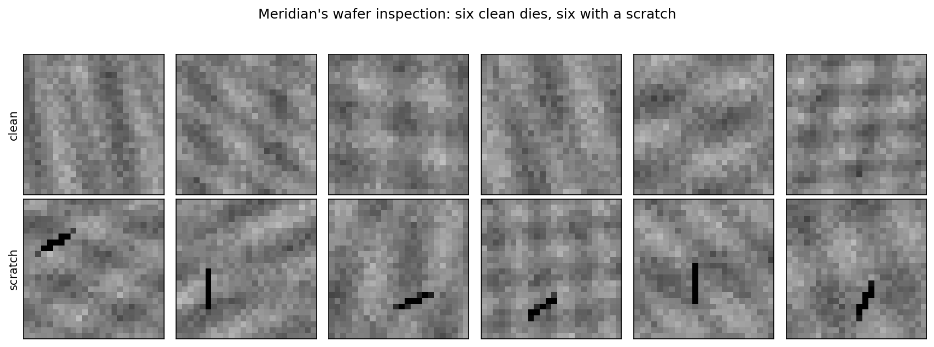
Six clean dies, six scratched
Notes:
Give them a moment to find the defects themselves before pointing at any. Most people find the scratches within a few seconds, which is worth naming: the human visual system solves this problem instantly and is doing something a dense layer cannot do.
Point at two panels with visibly different background brightness and the same defect. That is the film thickness varying, and it is why absolute brightness is useless here. Then point at how few pixels the defect actually occupies - about seven of 576, roughly one percent of the image.
Ask the room: how many of these twelve images would you need to see before you could grade a thirteenth? People answer two or three. Lesson 9’s dense network is still 0.235 short of the ceiling with eight thousand, and the reason why is the whole first half of this lesson. Handout section 1.1.

Slide 11
Two properties decide everything
Local: a handful of the 576 pixels matter, the rest is irrelevant
Position-independent: top left and bottom right are the same event
Both were visible in the twelve photographs
Every design choice this afternoon follows from these two lines
Notes:
These two sentences are the whole inductive bias of a convolutional network, stated in the language of the problem rather than the language of the architecture. Get them agreed in the room before any layer is defined, because the rest of the lesson is a construction that assumes them.
Locality: the evidence for a defect concerns a few adjacent pixels. Nothing about a scratch in the top left depends on what the bottom right looks like.
Position-independence: a scratch is graded as a scratch wherever it lands. The station does not have a special rule for row 5. That is a fact about the physical process, and it is the fact a dense layer cannot use.
Ask them which of the two properties they think is doing more of the work. Hold the answers - section 9 measures it, and the answer is not an even split.

Slide 12
The grading station is wrong 2% of the time
Published error rate 2%; notebook 01’s batch drew 2.55%
A high draw at 2.5 standard deviations, not a bug
Every score today is read against the ceiling of the set it was measured on
For the 2,000-image test set that ceiling is 0.9800
Notes:
Lesson 9 had a test rig wrong 3% of the time and a ceiling of 0.97. Same discipline, new number: this station mislabels 2% of dies, so no classifier can be scored above 0.98 no matter how good it is.
The 2.55% is worth a sentence of its own because a student who checks will find it and assume something is broken. It is not: with a few thousand dies, a 2% process draws 2.55% about as often as you would expect, and 2.5 standard deviations above the mean is an ordinary event when you look at several batches. The response is to quote the ceiling realised on the set actually used, not the design figure.
Put the question to the room: if the station is wrong 2% of the time and a model is right about every die, what accuracy will you measure? The answer is on the screen in half an hour, and it is exactly 0.98. Handout section 1.1.

Slide 13
One neuron per pixel is the wrong shape
A dense unit on this image has 576 weights, one per pixel
A unit that has learned to spot a scratch here…
…knows nothing about the same scratch three pixels to the left
Those are different weights, trained by different examples
Nothing in the architecture connects them
Notes:
This is the core complaint against a dense layer on an image, and it is not about size. Take a unit that has successfully learned to fire on a scratch at rows 4 to 6, columns 10 to 12. Its evidence lives in nine of its 576 weights. Now move the scratch three columns left. Those nine weights see clean silicon; nine entirely different weights see the scratch, and nothing has ever taught them anything.
Say plainly that the dense layer is not unable to solve this. Given enough examples of scratches at every position it will learn a detector at every position, independently, at full price each time. The complaint is about the bill, and section 8 prints it.
Ask the room how many independent detectors a 24×24 image would need if each covers a 3×3 patch. About 576 of them - trained separately. Handout section 2.

Slide 14
80 weights against 147,712
layer | parameters
dense, 256 units | 147,712
dense, 1024 units | 590,848
convolutional, 8 kernels of 3×3 | 80
convolutional, 32 kernels of 5×5 | 832
Notes:
The eight kernels of 3×3 come to 80 parameters: eight kernels of nine weights, plus one bias each. The dense layer of 256 units on a 576-pixel image comes to 147,712. The ratio is 1,846.
Let the number land, then immediately warn them against the obvious reading. Almost every textbook presents this table as a story about efficiency, and efficiency is the least interesting thing in it. If parameter count were the point, we could get the same saving by using 256 dense units on a downsampled image, and that helps nothing at all.
The next two slides say what the saving actually is. Ask them first: where did those 147,632 missing parameters go? They were not deleted. They were tied together. Handout section 2.

Slide 15
Compression is the least interesting reading
The convolutional layer produces more numbers, not fewer
Eight feature maps of 24×24 is 4,608 outputs, against 256
It is not a smaller layer: it is a differently tied one
The 1,846-fold parameter ratio is a side effect
Notes:
This slide exists because the parameter table misleads almost everybody the first time. Eighty parameters sounds like a tiny layer. It is not a tiny layer: it emits 4,608 numbers, eighteen times as many as the 256-unit dense layer it was compared against.
Make the distinction explicit, because it is the one that generalises. The convolutional layer has not removed capacity; it has constrained which functions the capacity can express, by forcing the same nine weights to be reused at every one of the 576 positions. Weights are shared, not discarded.
This is the first appearance of an idea the rest of the lesson depends on: a restriction that costs expressiveness can buy something worth more. Ask them what it might buy, and take answers before the next slide. Handout section 2.

Slide 16
What weight sharing buys is evidence
The same nine weights are applied at every position
So one scratch, anywhere, teaches the detector everywhere
The dense layer must be taught position by position
Not a memory saving: a data saving
We price it, in images, at 1:35
Notes:
This is the sentence to make them write down. Weight sharing converts one labelled example into evidence about every position in the image, because the gradient from a defect at row 4 updates exactly the same nine numbers that handle row 20.
Contrast it with the dense layer once more, in terms of data rather than memory. To learn a scratch detector at 576 positions, a dense network needs scratches at 576 positions. The convolutional network needs scratches.
The phrase “inductive bias” belongs here, and it is worth defining carefully: an assumption built into the model’s structure rather than learned from data. Weight sharing is one. It is not free - it is only correct because of the second property two slides ago - but when it is correct, it is worth more than any amount of tuning. Handout section 2.

Slide 17
Before the mathematics: what would you compute?
Look at the twelve dies again
What number would you compute from an image to grade it?
If your answer involves a small window and the word “anywhere”…
…you have already derived the next forty minutes
Notes:
Run this properly rather than rhetorically: take three answers from the room before showing anything, and write them on the board. It takes two minutes and it changes how the next segment is received, because most rooms produce the right answer without the vocabulary.
Typical answers, and what to do with each. “The darkest pixel” - good instinct, but defeated by the film thickness, so ask what it should be compared against. “The difference between a pixel and its neighbours” - that is the contrast kernel, and they have just invented section 3.3. “The variance of the image” - close, but a smooth brightness gradient has variance too.
The answer we are heading for is: slide a small window over the image, compute one contrast number at every position, and take the largest. That is a convolution followed by a global maximum, which is the whole architecture. Handout section 1.1.

Slide 18
The convolution, in words
Take a small array of weights: the kernel
Slide it over the image, one position at a time
At each position, write down the weighted sum of the pixels it covers
The result is a feature map: one number per position
The kernel is small; the image is not
Notes:
Say it in words first and let them picture the sliding window before the notation arrives. A kernel is a stencil of nine numbers. Lay it over the top-left 3×3 corner of the image, multiply the nine weights by the nine pixels underneath, add them up, and write that single number down. Slide one column right and repeat.
Two consequences worth naming immediately. The output is an image, not a number - smaller, and often much deeper, but still laid out in space. And the same nine weights produced every entry of it, which is the weight sharing from the previous segment made concrete.
Ask the room what the output of the sliding window means at each position. It is the answer to one fixed question - “how much does the pattern I encode look like what is here?” - asked everywhere at once. Handout section 3.1.

Slide 19
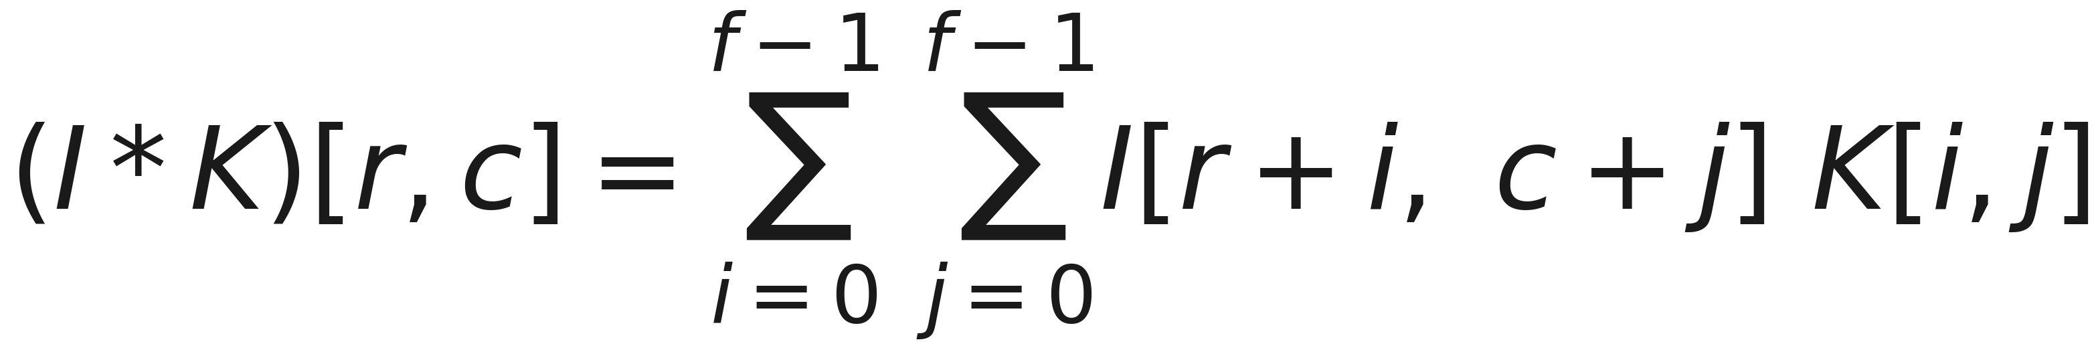
One weighted sum, at every position
Notes:
Read it out in words rather than in symbols, since the words were the previous slide: the entry of the output at row r, column c is the sum over the kernel’s own rows and columns of image pixel times kernel weight, with the kernel’s top-left corner placed at r, c.
Two details to point at. The image index is r + i, so the window moves with r - that is the sliding. And the kernel index is i alone, with no r in it: the same weight is used at every output position, which is weight sharing written down in one subscript.
This expression is eleven lines of Python in notebook 01, and the notebook checks it against scipy’s implementation rather than against itself. Handout section 3.1.

Slide 20
Strictly, this is cross-correlation
A true convolution flips the kernel before multiplying
Every deep learning library computes the formula above and calls it convolution
The kernel is learned, so the flip changes nothing that matters
Notebook 01 agrees with scipy to 8.9 × 10⁻¹⁶: rounding, not error
Notes:
Mention the naming discrepancy once, so that when a student meets it in a signal-processing course or a textbook they are not derailed by it. In signal processing, convolution flips the kernel and cross-correlation does not. Every deep learning library implements the unflipped version and calls it convolution. This course follows the library.
Say why it genuinely does not matter here: the kernel is learned. Whichever orientation the operation uses, gradient descent will find the weights that suit it, and the two conventions reach mirror-image kernels with identical outputs. It matters only when you write a kernel down by hand, which we do in ten minutes - and the four kernels we write are all symmetric.
The scipy check is worth a sentence: eleven lines of your own code agreeing with somebody else’s implementation to fifteen decimal places is what “verified” means. Handout section 3.1.

Slide 21
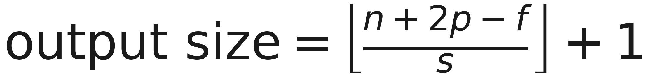
How big is the output?
Notes:
Four symbols: n is the input size along one dimension, f the kernel size, p the padding added on each side, s the stride, and the formula gives the output size along that same dimension. Square images make both dimensions the same, which is why this is quoted as one formula rather than two.
The floor is doing real work rather than tidying up. When the stride does not divide the available positions evenly, the last window would hang off the edge of the image, and it is simply not taken - those pixels are never looked at by that layer. Students who have only ever used padding="same" meet this the first time they set a stride and lose a row.
Get them to predict the next slide’s five answers before it appears. Handout section 3.2.

Slide 22
Worked on this lesson’s 24×24 images
kernel | padding | stride | output
3 | 0 | 1 | 22
3 | 1 | 1 | 24
5 | 2 | 1 | 24
3 | 1 | 2 | 12
Notes:
Walk two of these out loud. Row one: 24 plus nothing, minus 3, over 1, plus 1 is 22 - the two lost rows are the positions where a 3×3 window would hang over the edge. Row two: 24 plus 2, minus 3, plus 1 is 24, and the padding has bought those two rows back.
Every one of these was measured in notebook 01 by building the layer and printing the shape, not by trusting the formula. That is a habit worth copying: the formula is easy to misremember by one, and the shape is free to print.
Ask the room for row four before revealing it. The common wrong answer is 11, from forgetting the plus one; the second most common is 13, from adding one before the floor. Handout section 3.2.

Slide 23
Two cases cover almost everything
3×3 with padding 1 leaves the size unchanged: Keras calls this padding="same"
In general, padding = (kernel − 1) / 2 for odd kernels
Stride 2 halves it: the cheap alternative to pooling
Almost every architecture you will read is built from these two
Notes:
These two rules are what you actually need at the keyboard. Same-padding convolutions to compute, stride or pooling to shrink. If you internalise nothing else from the formula, internalise that a 3×3 with padding 1 is size-preserving, so you can stack as many as you like without arithmetic.
Say why odd kernels dominate in practice: the padding formula only gives a whole number for odd f, and an odd kernel has a well-defined centre pixel, so the output is aligned with the input rather than offset by half a pixel. That is why you see 3×3, 5×5 and 7×7 everywhere and almost never 4×4.
Today’s network uses same-padding 3×3 convolutions and 2×2 pooling, so the shapes go 24, 24, 12, 12, 6. Handout section 3.2.

Slide 24
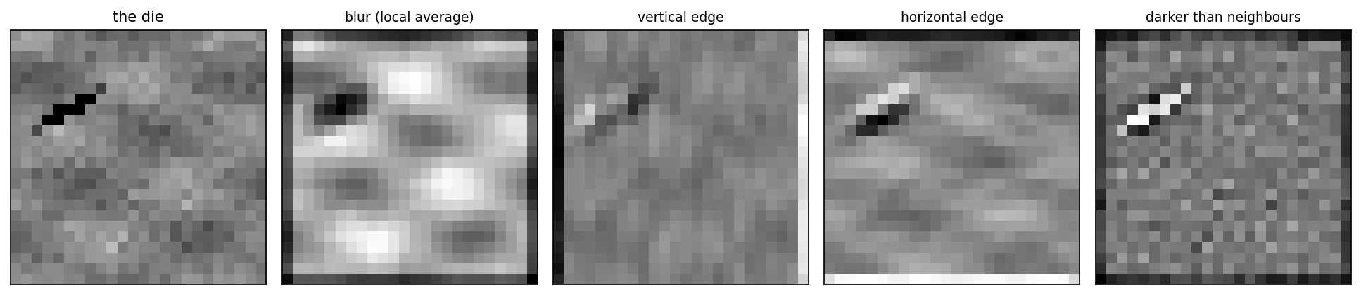
Four kernels written down, not learned
Notes:
Nothing here is trained. Four sets of nine numbers, chosen by hand, applied to the same defective die. Left to right: a local average, which blurs and hides the defect entirely; two edge detectors, which respond to the background gradient as strongly as to the scratch; and a centre-surround contrast detector, which isolates it.
Dwell on the failures rather than the success, because the failures are the argument. The averaging kernel destroys exactly the information we need. The edge detectors respond wherever brightness changes, and the film thickness changes brightness everywhere, so they light up across the whole die.
Only the fourth panel has a clean bright spot on the defect and near-zero elsewhere. Ask the room what is different about those nine numbers before the next slide answers it. The answer is a property of their sum. Handout section 3.3.

Slide 25
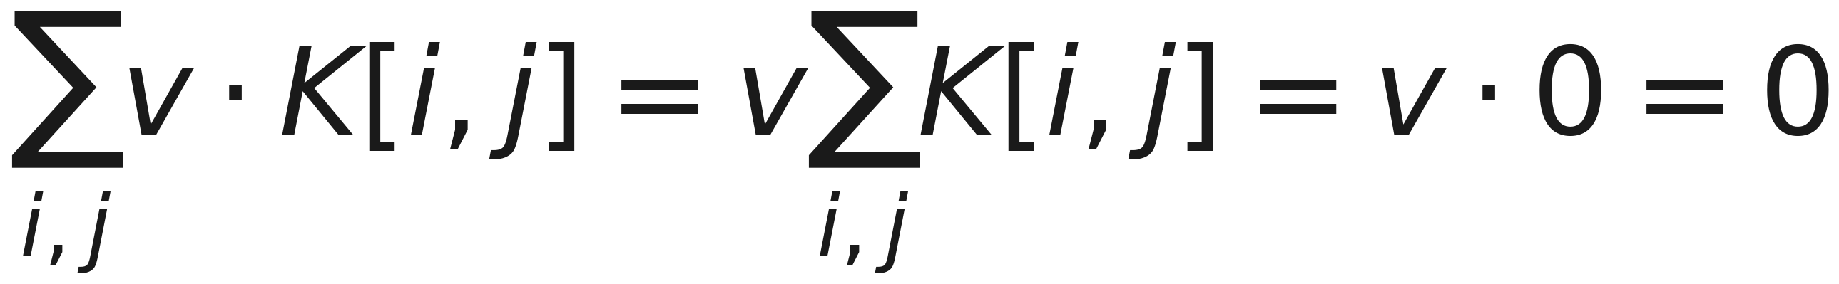
A constant patch gives exactly zero
Notes:
The fourth kernel is +8 in the centre and −1 in each of the eight surrounding positions, so its nine weights sum to zero. Feed it any patch in which all nine pixels have the same value v, and the response is v times zero, whatever v is.
This is the algebra behind the fourth panel. A zero-sum kernel is blind to absolute brightness - it cannot see the film thickness, because a smoothly varying background is locally almost constant. It responds only to how much a pixel differs from its own neighbourhood, which is precisely the definition of a defect on this line.
Nine numbers, chosen in advance, and the hardest part of the problem - the varying background that defeats every brightness threshold - is simply gone. Handout section 3.3.

Slide 26
Nine numbers, no training: 3.129 against 1.118
Centre +8, each of the eight neighbours −1, sum exactly zero
Blind to brightness, sensitive only to local contrast
Strongest response on a defective die: 3.129
Strongest response on a clean die: 1.118
Nothing has been trained yet
Notes:
Say the last bullet twice. No gradient descent, no labels, no training set - nine numbers written down from an argument about what the problem requires, and the two classes are already separated by a factor of nearly three.
This is the honest baseline that the rest of the lesson has to beat, and it is also a preview of the course’s closing argument: whoever computes the right feature has done most of the work. In section 12 we will hand four numbers derived from this kernel to logistic regression, k-nearest neighbours and a support vector machine, and all three will hit the ceiling.
One forward pointer to hold them: when notebook 02 trains a network and we look at the eight kernels its first layer learned, seven of the eight will sum to nearly zero. Nobody told it to. Handout sections 3.3 and 12.

Slide 27
Notebook 1, live
The convolution in eleven lines, checked against scipy
Output sizes measured, then compared with the formula
Four kernels by hand, and the zero-sum one that works
Equivariance checked at four offsets, then pooling
Notes:
Run Notebooks/01_what_a_convolution_is.ipynb. Twenty minutes.
The cell to protect if time runs short is the hand-written kernel comparison, because watching the contrast kernel isolate a defect that the edge detectors smear across the whole die is what makes the zero-sum argument concrete rather than algebraic.
Second priority is the equivariance check, which prints a difference of exactly zero rather than something small. Have them predict what it will print first - most expect a tiny floating-point residual, and the fact that it is bit-exact away from the borders says something stronger than “approximately equal”.
Have them change the kernel: ask what happens to the response if they scale all nine weights by ten, and whether that changes which dies are flagged.

Slide 28
Break
Twelve minutes
Notes:
Twelve minutes. What comes back after the break is the property the whole idea rests on, and then the experiment this lesson exists for - the one that produces today’s number. Worth saying so before they leave the room.

Slide 29
Shift the input, and the response shifts with it
Equivariance: the response does not change, it moves
It follows in one line from the definition
Notebook 01 checks it at four offsets: largest difference exactly 0
A dense layer has nothing of the kind
Shift by one pixel and all 576 weights meet different pixels
Notes:
Define equivariance carefully, because it is routinely confused with invariance, and today’s architecture uses both - one in the convolution and one in the pooling. Equivariant means the output changes in a predictable, corresponding way: shift the input by four pixels and the feature map shifts by four pixels, unchanged in value.
The proof is one line from the definition: the sum at the shifted position runs over exactly the pixels the unshifted sum ran over. But notebook 01 checks it rather than believing it, and the answer is not “small” - away from the borders it is bit-for-bit identical.
Then say what a dense unit does under the same shift. Its output is not shifted. It is unrelated: a different set of pixels now multiplies each weight, and there is no relationship between the two answers at all. Handout section 4.1.

Slide 30
Shift, then convolve, is convolve, then shift
Notes:
Read both sides in words. On the left: move the die, then run the detector. On the right: run the detector, then move the answer. They are the same thing, and that identity is the entire reason a convolutional network does not have to be taught about positions.
Point out what the equation does not say. It does not say the answer is unchanged by a shift - the feature map moves. Turning “it moved” into “it does not matter where it was” is a separate operation, and it is the next segment: pooling.
Worth one sentence on the borders, since the notebook shows it: at the edge of the image the shift has nowhere to come from, so the identity holds in the interior and not on the boundary. Every practical implementation makes some choice there, and padding is that choice. Handout section 4.1.

Slide 31
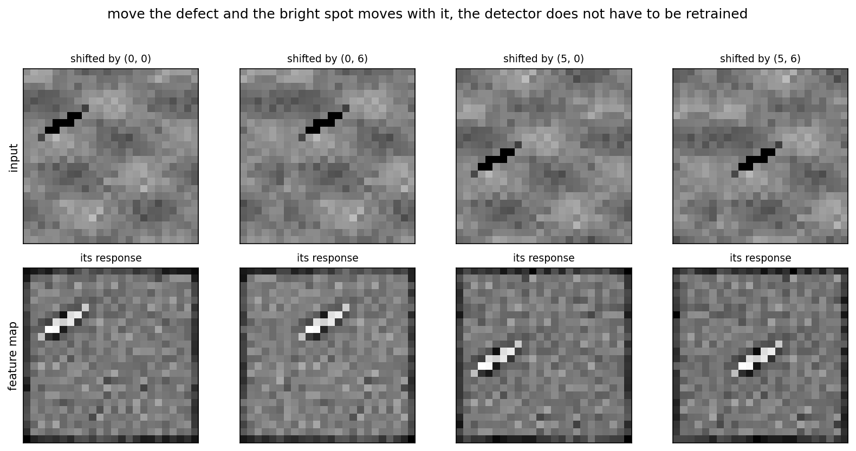
The bright spot tracks the defect
Notes:
Top row: the same die, shifted by four different amounts. Bottom row: each one’s response to the contrast kernel written down before the break. The bright spot in the response is directly under the defect in every panel.
The sentence to say slowly: no retraining occurs between these panels, because there is nothing to retrain. The nine weights are identical across all four columns. The detector was never told where to look, so it cannot be surprised by where the defect is.
Ask the room to imagine the same figure for a dense unit. Panel one fires; panels two, three and four are whatever those unrelated weights happen to produce, which is noise. Then tell them we are about to measure exactly that, and it is worse than noise - it is below chance. Handout section 4.1.

Slide 32
Pooling: from where to whether
Equivariance says the response moves with the defect
To grade a die we do not want it to move
We want one number: did a strong response occur anywhere?
Max pooling takes the maximum over a window, discarding the position
24×24 down to 3×3, and the maximum is still 3.129
Notes:
Frame pooling as answering a different question rather than as downsampling, because “shrinking the image to save compute” is the common and much weaker reading of it.
The grading task asks whether a defect is present, not where. Equivariance gives us a feature map in which the answer has moved; taking a maximum over that map throws the position away and keeps the strength. The question changes from where to whether, and that is exactly the question the station asks.
The 3.129 is the same number from the hand-written kernel: pool that feature map three times, from 24×24 to 12×12 to 6×6 to 3×3, and the maximum is 3.129 at every stage. Of course it is - that is what taking a maximum does. Say it anyway, because seeing it survive four sizes is what makes pooling feel safe. Handout section 4.2.

Slide 33
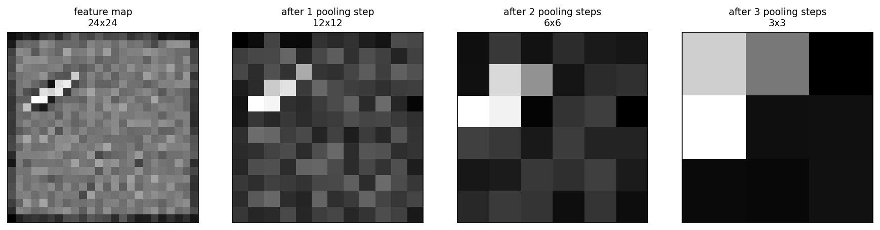
Pooled three times; the maximum never moves
Notes:
One feature map, pooled repeatedly. Read the maximum printed on each panel: it is 3.129 in all four. The map shrinks by a factor of two each time and loses its detail, and the one number we care about is untouched.
Point at what is lost as well as what is kept, because the loss is real. By the 3×3 panel you can no longer say where on the die the defect was, only that something scored 3.129 somewhere in a quadrant. For a pass or fail grade that is free. For a system that must tell a technician which corner to inspect, it is a serious cost.
Ask the room which tasks in their own experience would be damaged by that. Segmentation, object detection and keypoint location all need where, and all of them use architectures that undo this pooling later. Handout section 4.2.

Slide 34
Three things pooling does
Turns equivariance into invariance: one pixel of shift often changes nothing
Enlarges the receptive field: 3×3 after pooling covers 6×6 of the image
Discards spatial precision, which is a cost when where is the answer
Global max pooling: one number per kernel, over the whole map
Notes:
Separate the three, because they are usually presented as one benefit and only the first is the reason we are using it today.
Invariance is the goal here: after pooling, moving the defect by a pixel often produces a literally identical output. Receptive field growth is the reason depth works at all - stack pooling and small kernels and a 3×3 window at layer four sees most of the die, for nine weights. Precision loss is the bill.
The last bullet is the design choice that makes today’s headline result possible. Global max pooling reduces each of the 16 feature maps to a single number: did this kernel ever fire strongly, anywhere on this die? There is no position left in the representation for the dense head to depend on, which is why the network at 1:35 does not care where the defect is.
Handout section 4.2.

Slide 35
1,537 parameters, in full
layer | output shape | parameters
conv, 8 kernels of 3×3, same | 24 × 24 × 8 | 80
max pool 2×2 | 12 × 12 × 8 | 0
conv, 16 kernels of 3×3, same | 12 × 12 × 16 | 1,168
max pool 2×2 | 6 × 6 × 16 | 0
global max pool | 16 | 0
dense 16, then dense 1 | 1 | 289
total |  | 1,537
Notes:
Read the shape column down the middle: 24, 12, 6, then 16 numbers, then one. The image is progressively traded for depth, and then the global maximum collapses the spatial dimensions entirely.
Against this, lesson 9’s dense network on the same images has 213,761 parameters - a factor of 139. Both are trained with the same optimiser, the same loss and the same epoch budget throughout this lesson, which is what makes every comparison today about architecture rather than about tuning.
The two dense layers at the end are only 289 parameters because they sit after the global maximum, on 16 numbers rather than on an image. That ordering is the whole architecture: convolutions ask local questions, the maximum discards position, and only then does anything dense happen. Handout section 5.

Slide 36
The count students get wrong: 1,168
Each of the 16 kernels is 3×3 across all eight input channels
So each one holds 9 × 8 = 72 weights, not 9
16 × 72 + 16 = 1,168
A kernel’s depth always matches the input’s channel count
Only its two spatial dimensions are yours to choose
Notes:
This is the arithmetic worth stopping on, because nearly everybody computes 16 × 9 + 16 = 160 the first time and then cannot reconcile the framework’s summary with their own count.
The rule is the fourth bullet, and it is worth stating as a rule rather than as an example: a convolutional kernel is always as deep as its input. On a colour photograph the first layer’s 3×3 kernels are 3×3×3. Here the second layer’s input has eight channels because the first layer had eight kernels, so its kernels are 3×3×8. You choose the two spatial dimensions and the number of kernels; the depth is chosen for you.
Ask the room what the third convolutional layer would cost if we added one with 32 kernels of 3×3. It is 32 × (9 × 16) + 32 = 4,640. Handout section 5.

Slide 37
Head to head, and where the missing 2% lives
Dense network, lesson 9: 0.6928, standard deviation 0.0342
Convolutional: 0.9800, standard deviation 0.0000
Against the true grade the convolutional network scores 1.0000
Its visible 0.98 is the grading station’s error and nothing else
There is no gap left for a better architecture to close
Notes:
Same images, same optimiser, same epoch budget, 3,000 training and 2,000 test. Twenty-nine points apart, with the smaller model on top by a factor of 139 in parameters.
But the third bullet is the one that matters, and it is only available because the data is synthetic and publishes its own truth. Scored against what the die actually was, rather than against what the station recorded, the convolutional network is right about every single die in the test set. Its 0.98 is not a modelling shortfall of any kind.
Say the consequence out loud, because it is a professional habit rather than a fact about this dataset: any effort spent pushing this model from 0.98 to 0.99 would be effort spent learning to reproduce the station’s mistakes. Knowing where your ceiling comes from is what tells you when to stop. Handout section 5.1.

Slide 38
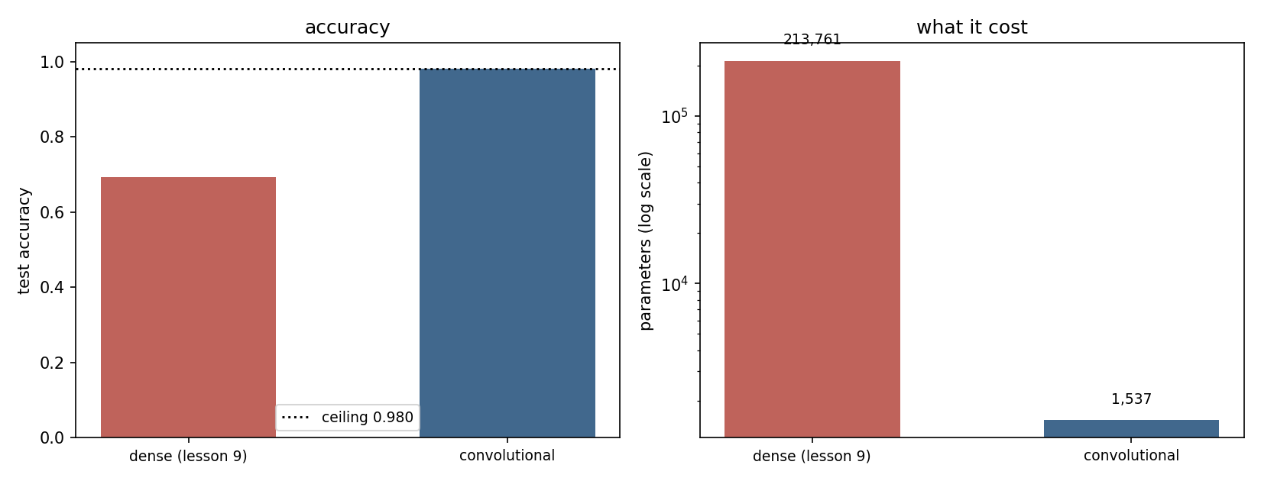
1,537 parameters against 213,761
Notes:
Left panel: test accuracy, 0.6928 against 0.9800. Right panel: parameter count, on a logarithmic scale because otherwise the convolutional bar is invisible.
The pairing is the point. Every other lesson in this course has traded capacity for performance in the expected direction - more trees, more units, more flexibility. Here the smaller model wins by twenty-nine points, and it wins because of what it cannot do rather than what it can.
Note the standard deviation of 0.0000 on the convolutional side across seeds. That is not a rounding artefact and it is not luck: every seed reaches the ceiling, because there is nothing difficult left in the problem once position stops mattering. Compare it with the dense network’s 0.0342, which is three and a half points of seed-to-seed variation. Handout section 5.1.

Slide 39
A defect where none has been seen
Training defects live only in the top band of rows
One test set keeps them there; the other moves them to the bottom
Same generator, same defect, same contrast, same number of images
Only the row changed
Predict the two numbers before you see them
Notes:
Set the experiment up properly and take predictions before revealing anything, because the room’s prediction is itself part of the lesson and section 6.1 of the handout is about why the reasonable prediction is wrong.
Everything is held fixed except the band of rows the defect occupies. Same code generates both test sets; the defect is identical in size, contrast and shape. This is a controlled experiment about position and nothing else.
Take a show of hands on the dense network’s score on the moved band. Most rooms predict a drop of ten or twenty points - the reasoning being that it has learned something about scratches in general and will retain part of it. That reasoning is sound for almost every kind of distribution shift you will meet, and it is wrong here. Handout section 6.

Slide 40
The number to carry out of the room
network | trained band | moved to the other half | cost
dense (lesson 9) | 0.8567 | 0.4617 | −0.3950
convolutional | 0.9800 | 0.9847 | +0.0047
Notes:
Say it slowly and then say it again. A dense network scoring 0.8567 on defects in the half of the die it was trained on scores 0.4617 - below chance - on the identical defect moved to the other half. The convolutional network goes from 0.9800 to 0.9847, which is noise around the ceiling.
Below chance deserves its own sentence. The dense network is not confused by the moved defect; it is confidently wrong about it, because the pixels that used to carry evidence of “clean” are now the ones carrying the defect. Nothing degraded gracefully. Thirty-nine and a half points, from moving a scratch.
This is the sixth carry-home number of the course and the last one it will produce. Ask them to write it down now: 0.8567 to 0.4617, against 0.9800 to 0.9847. Everything else today is commentary on that line. Handout section 6.

Slide 41
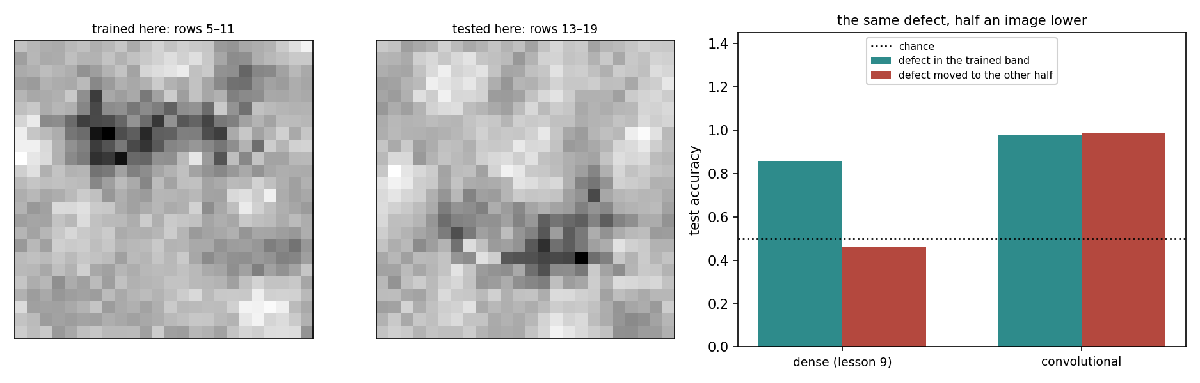
Where the defects were, and what it cost
Notes:
Left and centre panels: forty defective dies from each band, averaged, so the bright smear shows exactly where the defects lived. Top band for training, bottom band for the moved test set. There is no overlap at all, which is what makes this a clean test rather than a partial one.
Right panel: the result from the previous slide, drawn. The dense network’s bar falls through the chance line; the convolutional network’s does not move.
Point at the averaged panels once more and note what they say about the dense network’s task. During training, every defect it ever saw was in the top third of the image. It had no reason whatsoever to build a detector anywhere else, and no mechanism that would have shared one if it had. Handout section 6.

Slide 42
Below chance, and why nothing degraded
Most students predict a drop that stops well above chance
The reasoning is sound: shifts usually degrade, they do not vanish
But this is not a change of degree in the inputs
It is a change of which inputs carry the signal
Knowledge stored per position, at positions never trained
Notes:
This is the predictable mistake of the lesson, and the students who made it should hear why their instinct was reasonable rather than merely be corrected.
Almost every distribution shift you will meet is a change of degree: sensors drift, populations age, prices inflate. A model trained on the old regime degrades on the new one and usually retains something, because the features still mean roughly what they meant.
Here the features do not mean anything different - they are simply not the features carrying the signal any more. Pixel 100 was the evidence; pixel 400 is now the evidence; and pixel 400’s weights were trained exclusively on clean silicon. There is no partial credit available.
Ask them where else this failure shape occurs. A time-series model given reordered columns, a tabular model after a schema change: same category of break. Handout section 6.1.

Slide 43
A convolutional layer is a restricted dense layer
Every function it computes, a dense layer can compute too
Tie the shared entries, zero the rest: it is strictly less expressive
The functions it gives up all treat row 5 differently from row 15
Nobody wanted any of those
A model that cannot express a wrong answer need not learn to avoid it
Notes:
This is the intellectual core of the lesson and the argument runs opposite to the intuitive direction, so give it time.
The convolution is not a more powerful layer. It is a dense layer with most of its weights set to zero and the rest tied together in a particular pattern. Strictly fewer functions. On any expressiveness measure it loses.
And it wins by thirty-nine points, because the functions it surrendered were precisely the position-dependent ones, and every one of those was wrong on this problem. The dense network had to learn not to depend on position, from data that never showed it a defect low on the die, and it failed.
Put the general question to the room, because it is the question the whole course has been circling: what assumption does your model encode, and is it true? Handout section 6.

Slide 44
Augmentation buys 8 points and leaves it 44 short
Show the dense network shifted copies: a moved scratch is still a scratch
Dense: 0.4617 → 0.5423, a real gain of +0.0807
Convolutional: 0.9847 → 0.9847, unchanged, with nothing to gain
Augmentation teaches an invariance: approximate, and forgettable
Architecture asserts it: exact, free, permanent
Notes:
The obvious repair for the previous result is to manufacture the missing examples: take the training images and shift them, so the network sees defects lower down. It works, and it is worth eight points, and it is still forty-four points behind what the architecture provides for nothing.
Two details of the experiment are worth copying, because both are easy to get wrong in a way that flatters your conclusion. Both arms got the same number of epochs - an augmented set is five times larger, so equal wall-clock would have quietly given it five times fewer passes per image; an earlier version of this experiment did that and reported 1.6 points instead of 8.1. And the shift is drawn per image, not per batch: one offset applied to a whole copy just adds four more fixed positions.
Then give the rule: augment for invariances no layer can express - brightness, contrast, small rotations - where it is indispensable. Handout section 7.

Slide 45
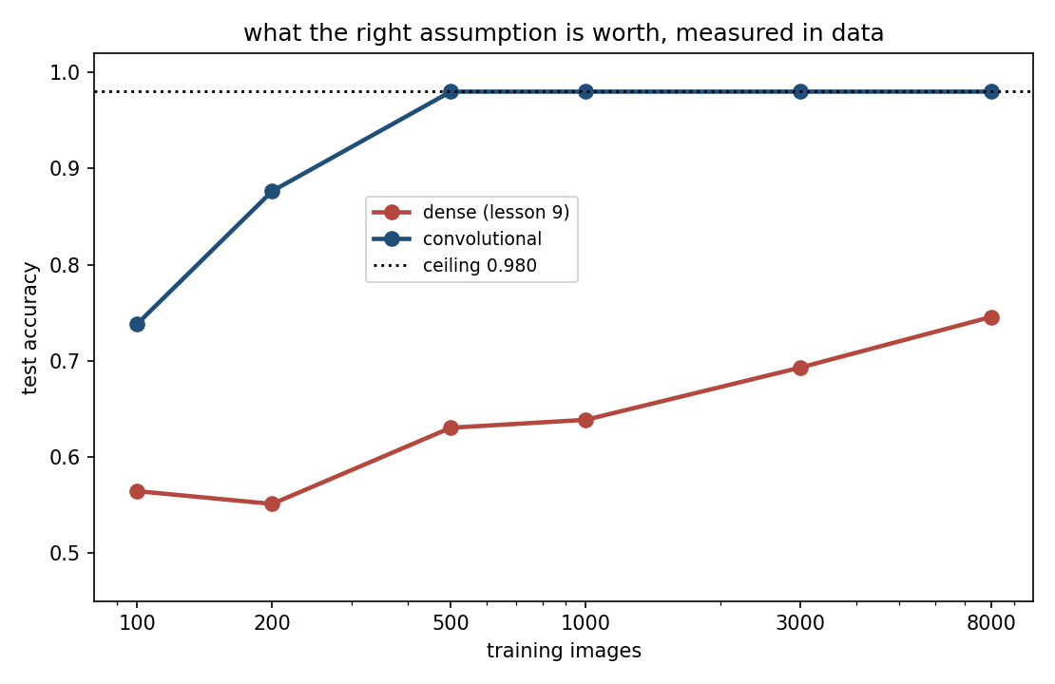
At the ceiling by 500 images; 0.235 short at 8,000
Notes:
Test accuracy against training-set size, logarithmic horizontal axis. The convolutional network reaches the ceiling at 500 images and stays flat. The dense network at 8,000 - sixteen times more data - is still 0.235 below it.
Warn them about the flat line before someone asks, because it looks like a plotting bug. It is not: the convolutional network is already right about every die at 500 images, and the only thing between it and 1.0 is the station’s 2%. There is nowhere left for the curve to go.
This is the price of the weight-sharing assumption, paid in the only currency that matters. The dense network is not incapable of this problem; it is required to learn separately, at every position, what the convolution learned once. Ask the room what they would rather have on a new project: a better optimiser, or a correct assumption. Handout section 8.

Slide 46
Notebook 2, live
Both architectures trained head to head, with seed spreads
The translation experiment, run in front of you
Augmentation with the epoch budget equalised
The learning curve from 100 images to 8,000
The permutation test: hold your prediction
Notes:
Run Notebooks/02_convnets_on_wafers.ipynb. Twenty-two minutes.
The cell to protect is the translation experiment, since it produces today’s number. Have them run it with their own seed and confirm that the dense network lands below 0.5 rather than near it.
Second priority is the augmentation comparison, specifically the epoch argument. Show them the two lines of code that equalise the passes per image and ask what the result would have been without them - it is in the notebook, and it is 1.6 points instead of 8.1. That is a lesson about experimental hygiene rather than about augmentation, and it is the lesson 5 habit applied to deep learning.
The permutation cells come last. Ask for predictions before running them: the room will be wrong, and that is the point of the final segment.

Slide 47
A new defect appears on a Monday
A contamination cluster: several faint specks together
By Friday, a few dozen labelled photographs
Section 8 says the network needs several hundred
Waiting six months is no answer: the line ships now
Can we borrow from a network trained on something else?
Notes:
Set up transfer learning as the response to a scheduling problem rather than as a technique in its own right, because that is what it is. The physics of the line changed on Monday; the label budget has not caught up; the sample efficiency curve you saw twenty minutes ago says the model needs data nobody has yet.
The new defect is genuinely different from the old ones: faint, bright rather than dark, and spread over several disconnected specks rather than a single line. Say that now, because it is what makes the negative-transfer result at the end of the segment work.
Ask the room what they would try first. Most say “fine-tune a pre-trained model”, which is right, and then the interesting questions are the two this segment measures: pre-trained on what, and with which layers frozen. Handout section 10.

Slide 48
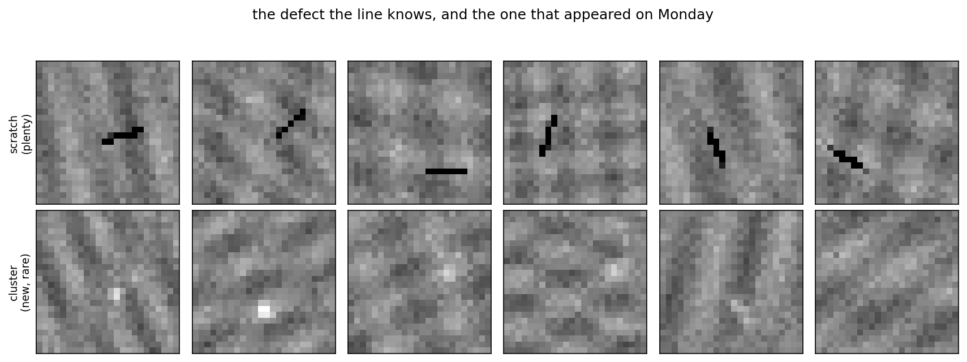
The defect the line knows, and Monday’s
Notes:
Left: the scratch, dark, linear, seven pixels, the thing every model in this lesson has been trained on. Right: the cluster, a handful of faint bright specks with no particular shape.
Point at the polarity difference explicitly and make sure it registers, because it is the mechanism behind the last result of this segment. The known defect is darker than its surroundings. The new one is brighter. Any detector that has committed to reporting local darkness is not merely uninformed about the new defect - it is pointed the wrong way.
Ask the room whether a network trained to grade scratches should transfer well here. The honest answer is “it depends entirely on what the source task forced it to learn”, and that sentence is the whole content of the next slide. Handout section 10.

Slide 49
Start from someone else’s weights
Transfer learning: initialise from a network trained on a related task
The argument: early layers detect local contrast, which is not scratch-specific
Two knobs: which source task, and which layers stay frozen
Both knobs matter more than the received wisdom suggests
Notes:
Define it plainly: instead of starting from random numbers, start from the weights of a network that already learned something on a related problem, then continue training on your small dataset.
The justification is architectural rather than mystical. The first layer of any image network learns local contrast operators - we saw eight of them rediscovering the zero-sum trick - and there is nothing about local contrast that is specific to scratches. If that is true, those layers are worth borrowing.
Flag the two knobs now, because the next three slides are one measurement each of them. Which source task, and how much of the borrowed network you allow to change. The received wisdom on both - “any related task”, “freeze the base” - is what this segment tests. Handout section 10.

Slide 50
The source task is the whole game
Pre-train on a task nobody at Meridian wants solved
Naming which of three types a die carries: clean, scratch, particle
Grading pass/fail teaches one detector; typing forces description
0.9993 on the source task: a receipt, not a result
Transfer carries what the source forced it to learn
Notes:
This is the design decision that makes the rest of the segment work, and it is counter-intuitive enough to state twice: we deliberately pre-train on a task that has no business value, because it demands richer features than the task we actually care about.
Pass/fail grading on scratches can be solved with a single dark-line detector. Naming which of three types is present forces the early layers to describe dark lines and bright blobs, and to tell them apart. Those are the features worth carrying to a new bright defect.
The 0.9993 is not a boast. It is a receipt: it confirms the source task was actually learned, which is the precondition for its features being worth anything at all. A pre-trained network that never solved its own task has nothing to lend. Handout section 10.1.

Slide 51
A window, not a slope
labelled images | from scratch | warm-started | gain
25 | 0.5100 | 0.5100 | 0.0000
100 | 0.7220 | 0.8640 | +0.1420
200 | 0.7270 | 0.8940 | +0.1670
400 | 0.8447 | 0.7877 | −0.0570
Notes:
The received wisdom is that transfer helps most when data is scarcest. These numbers do not say that, and the shape they do describe is more useful.
At 25 images nothing works - both arms sit at chance. There is too little data to fit even a small head onto good features, so the borrowed weights have nothing to attach to. Between 50 and 200 the warm start is worth 9 to 17 points and the gain grows across that range. By 400 it is negative: the from-scratch network has now seen enough of the new defect to learn its own features, and the borrowed ones are a constraint rather than a head start.
So transfer occupies a window. Too little data and it has nothing to attach to, too much and it has nothing to add. Ask the room how they would find that window on a real problem where they cannot see this table. The answer is the lesson 5 answer: measure it. Handout section 10.2.

Slide 52
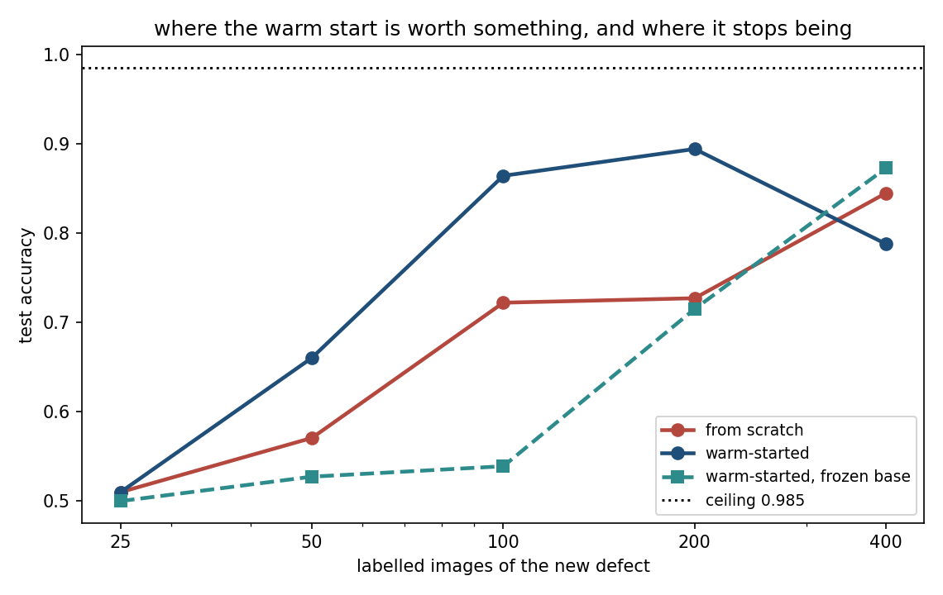
The window, drawn
Notes:
The same table as a picture. Two things to point at.
First, the gap between the warm-started curve and the from-scratch curve opens and then closes. That is the window. If you had run this experiment at a single dataset size - which is what most people do - you could have concluded anything you liked, including that transfer is useless, depending on which size you picked.
Second, the frozen-base curve, which is below the from-scratch curve at 50 and 100 images. That is the surprise of the next slide, and it is worth letting them see it here first and ask about it themselves.
The methodological point is one lesson 5 made: a single operating point is not a finding. The shape of the curve was the finding, and it needed five sizes to appear. Handout section 10.2.

Slide 53
When transfer makes things worse
labelled images | from scratch | frozen, typing source | frozen, scratches only
50 | 0.5707 | 0.5273 | 0.5150
100 | 0.7220 | 0.5390 | 0.5047
200 | 0.7270 | 0.7150 | 0.5350
Notes:
Read the right-hand column first. A base pre-trained only on scratches, then frozen and pointed at the bright cluster defect, never leaves chance at any dataset size. This is negative transfer, and it is real rather than theoretical: those kernels are committed to reporting local darkness where the new defect is bright, and a frozen layer cannot change its mind.
Now read the middle column, which was included as a control and turned out to be the more interesting result. The good source, the typing task, is also behind starting from noise at 50 and 100 images when frozen, and only pulls level at 200. Yet the same source, unfrozen, was fourteen points ahead at exactly 100 images.
So the features were useful. Freezing them was the mistake. Ask the room which of the two columns they would have predicted, and how many of them would have frozen the base by default. Handout section 10.3.

Slide 54
Two rules, and neither is “always pre-train”
Transfer carries what the source task forced the network to learn
Ask what the source required before trusting its features
Freezing is a bet that the borrowed features are already right
In doubt: warm start, and leave everything trainable
Notes:
Land the segment on two rules that are usable at the keyboard next week.
The first is about choosing a source. “Related task” is too weak a criterion. The right question is what the source task made impossible to ignore. Our typing task made it impossible to ignore bright blobs, which is why it transferred to a bright defect; the scratch task did not, and did not.
The second is about freezing. Freezing asserts that the borrowed features need no adjustment. When that is true it is cheap and it regularises. When it is false there is no recovery, because gradients never reach the frozen layers. An unfrozen warm start can recover from a mediocre source; a frozen base cannot.
The asymmetry is the argument: one option has a bad worst case and the other does not. Handout section 10.3.

Slide 55
Notebook 3, live
Pre-training on the task nobody wants solved, up to 0.9993
The transfer window, measured at five dataset sizes
Negative transfer, from a source chosen badly on purpose
Every family the course has met, on one problem
Notes:
Run Notebooks/03_transfer_and_synthesis.ipynb. Eighteen minutes.
Two cells to protect. The five-size transfer sweep, because the window only exists as a shape and any single row of it supports the wrong conclusion - and because they can see for themselves how tempting it would have been to run one size and publish.
The second is the final table, which is the course synthesis and the last cell of the last notebook. Let it run and let them read it before you comment. The random forest row is the one that changes the conversation, and it lands harder if they find it themselves rather than being told.
If time is short, cut the negative transfer cell and keep the synthesis: the numbers are already on the slide, and the synthesis is what the final segment needs on screen.

Slide 56
What is the convolution actually using?
“Images have spatial structure” is two claims, not one
Permute every image’s pixels identically, then train
Detection: 0.9798 → 0.9800, no cost at all
Typing: 0.9970 → 0.9523, 4.5 points
The dense network notices neither
Notes:
This is the experiment lesson 9 set up in its closing sentence, and the result is the one that surprised the person who wrote it.
Apply one fixed permutation to the 576 pixel positions, apply it to every image in the dataset, and retrain from scratch. Adjacency is destroyed - neighbouring pixels are now scattered across the image - while every pixel value is preserved.
On grading a die, the convolution does not notice. Read that again: the architecture defined entirely by adjacency loses nothing when adjacency is destroyed. It looks wrong until you ask what the task requires - “is there a patch of unusual local contrast somewhere” - and notice that a scattered permutation leaves those pixels somewhere, still extreme. On naming the defect type, which is a question about shape, the permutation costs 4.5 points, because shape is exactly what it destroys. Handout section 9.

Slide 57
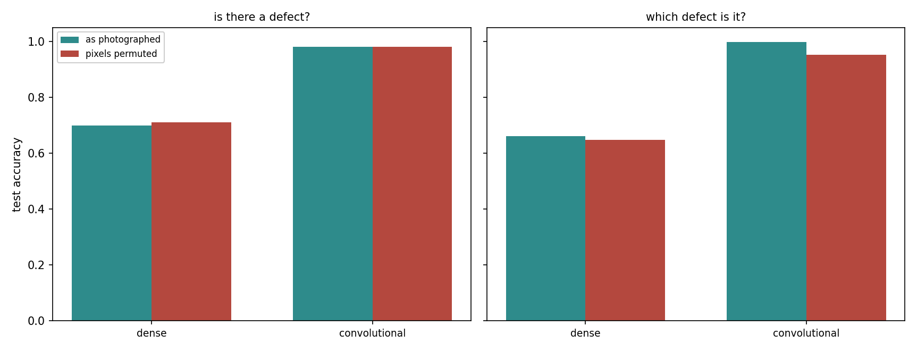
Nothing on detection, 4.5 points on typing
Notes:
Four pairs of bars: two tasks, two architectures, as photographed against permuted. Only one pair moves appreciably, and it is the convolutional network on the typing task.
Walk through the reading once more with the picture in front of them, because this is the most counter-intuitive result of the lesson. The dense pairs are flat because a permutation is, for a dense layer, nothing but a relabelling of input units. The convolutional detection pair is flat because the task never needed adjacency. The convolutional typing pair drops because telling a line from a blob is a question about arrangement, and the arrangement is gone.
Ask the room what this implies about a convolutional network’s advantage on a task they cannot inspect. It implies that “it uses spatial structure” is not an explanation until you say which part of the structure, and for what. Handout section 9.

Slide 58
Two assumptions, and only one is about arrangement
assumption | what it says | needed by
weight sharing | a pattern means the same thing wherever it appears | both tasks
locality | nearby pixels belong together | only the typing task
Notes:
This is the table to photograph. The usual one-line justification for convolution bundles two assumptions, and this data separates them: on detection the entire advantage came from weight sharing, and locality contributed nothing measurable.
Say why that matters beyond this lesson. Weight sharing is not unique to convolution - other architectures supply it in other forms, for sequences and for sets. If your task needs only weight sharing, convolution is one option among several, and the choice should be made on other grounds. If it needs locality too, you are asking for something more specific.
Put the question to the room in its practical form: the next time you reach for a convolution, which of these two are you buying? Anyone who cannot answer has chosen a default rather than a model. Handout section 9.

Slide 59
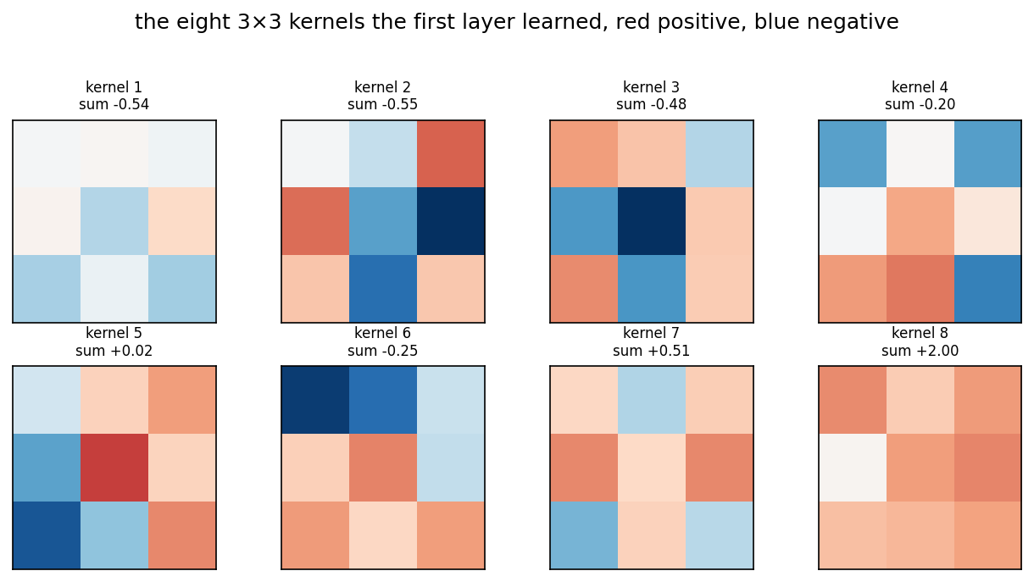
What the first layer learned, unprompted
Notes:
The eight 3×3 kernels the first layer learned, red positive and blue negative. Seven of the eight sum to less than 0.6 in absolute value, against a scale of 2.16 if all nine weights had pointed the same way.
Say what that means and let it close the loop with the first hour. Before the break we wrote a zero-sum kernel by hand, from an argument about film thickness and local contrast. Nothing in the loss function, the initialisation or the architecture mentions that argument. Gradient descent rediscovered it, because the data rewarded it.
This is the most honest thing that can be said in favour of learned representations, and it cuts both ways. It found a good feature without being told. It would equally have found a bad one had the data rewarded that - which is every leakage story from lesson 1, in a new architecture. Handout sections 3.3 and 9.

Slide 60
What this lesson did not need
Today ran on a laptop processor, no graphics card
Deeper networks revive lesson 9’s gradient problem
Batch normalisation rescales each layer’s activations
Residual connections let the gradient skip a layer
Neither is needed at 24×24
Notes:
Name what was skipped rather than pretending the field ends at two convolutional layers, and name why it was skipped: a technique introduced without a problem it solves is a technique nobody remembers.
Deep stacks attenuate gradients exactly as lesson 9’s sigmoid layers did, and the two standard repairs are on the slide. Batch normalisation keeps each layer’s activations at a sane scale so the signal neither dies nor explodes. Residual connections add a layer’s input to its output, so there is always a path along which the gradient reaches earlier layers undiminished.
Both are direct descendants of what was derived last week, which is the point worth making. Our images are 576 pixels with one defect, and 1,537 parameters solve them perfectly, so neither repair would have anything to do here. Resources/ carries the pointers. Handout section 11.

Slide 61
Ten lessons on one problem
family | raw pixels | 4 hand-made features
logistic regression (3, 4) | 0.8905 | 0.9800
k-nearest neighbours (6) | 0.4970 | 0.9800
support vector machine (6) | 0.9660 | 0.9800
random forest (7) | 0.9780 | 0.9795
dense network (9) | 0.7430 | -
convolutional network (10) | 0.9800 | -
Notes:
This table was built expecting to show that classical methods cannot handle images. It shows no such thing, and the honest reading is far more useful.
A random forest on raw pixels reaches 0.9780, within two thousandths of the convolutional network, knowing nothing about which pixel adjoins which. It does not need to: a defect drives some pixel to an unusual value, and 300 trees splitting on individual pixels cover enough of them. That is the forest’s own inductive bias - the answer depends on a few features crossing thresholds - and it happens to fit.
Two failures are instructive. k-nearest neighbours collapses to 0.4970 because Euclidean distance over 576 pixels is dominated by the smooth background - the curse of dimensionality from lesson 6, exactly. And lesson 9’s dense network, at 0.7430, sits behind plain logistic regression. Handout section 12.

Slide 62
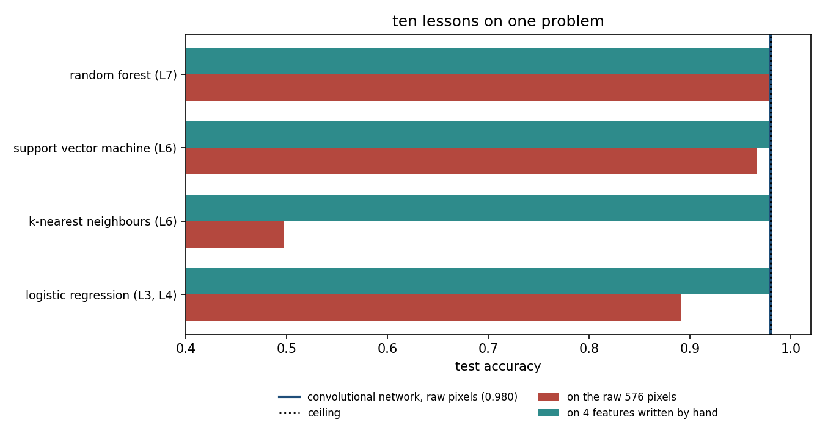
Four hand-written numbers reach the ceiling
Notes:
The same table, drawn, with the ceiling of 0.9800 marked. The right-hand cluster is what to look at: four hand-made features computed with the contrast kernel from the first hour, and every classical family lands at the ceiling.
Say what that costs and what it buys. It cost nine numbers and an argument about film thickness - twenty minutes of thinking by someone who understood the physics. It bought the entire problem, for every model family, including the one that scored 0.4970 on raw pixels.
The convolutional network, given only raw pixels, found an equivalent feature by itself, and paid for it in data and compute. Both routes end at the same ceiling. Ask the room which one they would take on a problem where they understood the physics, and which on a problem where they did not. That is the real choice, and it is the last one this course asks them to make. Handout section 12.

Slide 63
The representation matters more than the model
A model turns a representation into a decision
Classical methods make you build it; networks learn it, paid for in data
Lesson 9: a hidden layer worth 39 points on one problem, 0.09 on another
Today: a random forest within 0.002 of the convolutional network
Neither route is a default
Notes:
This is the sentence the ten weeks add up to, and it deserves to be said slowly and then written on the board.
Every lesson in this course has been an instance of it. Lesson 2’s imputation and scaling decisions changed more than any model choice that followed. Lesson 3’s polynomial features turned a straight line into a curve without changing the estimator at all. Lesson 6’s kernel is a representation chosen in advance; lesson 7’s trees build one by splitting; lesson 8’s components and embeddings are representations with no labels at all.
The handout’s closing table gives seven if-then rules for choosing - read it. The one that matters most is the last: if you cannot say what assumption your model encodes, you have not chosen a model, you have chosen a default.
Handout section 12 and 12.1.

Slide 64
Homework: the last one
Exercise 10, no lesson left to discuss it: work it for the exam
Exercises/10_convolutional_networks.md
It falls in the week of the project peer review: plan for both
Two reviews to write as well as two to receive
Notes:
Set it explicitly and say what is different about it: no lesson follows to discuss it, so this one is worked for the exam alone. It is the last exercise of the course.
Say the scheduling problem plainly rather than letting them discover it. That same week is the project peer review week - each of them reads two other projects and is read by two - and the reviews they write are assessed alongside the project they submit. Two pieces of work in one week. Anyone who starts the exercise on Thursday will do both badly.
Two standing requirements that today’s material makes easy to forget. Any claim that one architecture beats another needs the spread it was measured against. And any accuracy needs the ceiling it was measured against - on this data that is 0.98, and a model reported at 0.98 may be perfect rather than merely good.

Slide 65
What ten weeks add up to
0.8567 to 0.4617 for a dense network, on a defect moved half a die
The convolutional one went 0.9800 to 0.9847, because it cannot ask where
An assumption that is true beats flexibility that is not
The representation is doing most of the work; the only question is who builds it
Thank you, and good luck with the project
Notes:
Close on the number. A dense network scoring 0.8567 on defects in the half of the die it was trained on scores 0.4617, below chance, on the identical defect moved to the other half, while the convolutional network goes 0.9800 to 0.9847. That is the sixth and last carry-home number of this course, and it is the whole argument in one line: the convolutional network won by being less expressive.
Then step back over the ten weeks. They arrived able to fit models. What this course tried to add is the habit of asking what a number is measured against - a ceiling, a spread, a baseline, a fold that was kept honest - and the habit of naming the assumption a model encodes before trusting what it produces. Those two habits are what separate a result from a plausible-looking result, and nothing in this field has ever made them less necessary.
One forward-looking sentence, and only one: every system built on top of these fundamentals - including the ones this degree programme covers elsewhere - is still an argument about which inductive bias to encode and what to measure it against, so the questions you have practised for ten weeks are the ones that transfer.
Thank them, remind them of the project deadline and the office hours, and stop.

