Slide 1
Lesson 7: Trees and Ensembles
Technologies for Artificial Intelligence
Fabio Antonini, Università degli Studi dell’Aquila

Slide 2
Agenda
A fourth family, built on a threshold
Decision trees, and why one alone is mediocre
Depth as the bias-variance dial, again
Bagging and random forests
Feature importance, and its limits
Gradient boosting
Choosing among trees, forests and boosting
Notes:
Say what changes and what doesn’t. Lessons 3 and 4 fit a line. Lesson 6 offered three ways of bending a boundary a line cannot draw. Today adds a fourth primitive - a threshold, not a distance or an inner product - and then spends most of the three hours on a different question: not “does a tree work”, but “what happens when you build more than one”.
Tell them the punchline early, without the number yet: a single tree is one of the few models in this course a person with no mathematics background can read end to end, and it is also, on its own, a mediocre model. Ensembles of trees are what most tabular-data competitions are still won with, and the reason is the subject of today.
Handout section 1 sets this framing out in full.

Slide 3
Exercise 6, before we start
What counts is the defence of which family, not the winning score
The gap to watch for: a strong accuracy number with no check of why the assumption behind it held
Today’s models come with the same obligation
Notes:
Nothing to collect and nothing to hand back - this is a discussion. Ask who picked which family and why, and listen for the common gap: a cross-validated score quoted without any check of whether the model’s assumption, such as within-class independence, actually held on that data.
Link forward explicitly: today introduces a family with its own convenient assumption - that the columns you feed a random forest are all worth listening to - and by the end of the lesson you will have measured exactly how badly that assumption can fail.

Slide 4
1,200 loan applicants, two figures each
Income in thousands of euros a year, debt-to-income ratio
Underwriting is a checklist, not a formula: an income floor, a debt ceiling, and two “stressed” combinations in between
7% of labels are deliberately flipped; 38.7% of applicants defaulted, so the majority baseline is 0.613
Notes:
Describe the physical logic before the picture. A bank’s rule here is closer to a checklist than a smooth function: almost nobody is approved below an income floor or above a debt ceiling, and there are two further regions where income and debt are each unremarkable on their own but risky in combination.
Ask the room what shape that logic implies before you show the scatter. The useful answer is: not one connected region, so no single straight line can separate the classes - a different failure from lesson 6’s disc-in-a-ring, but a failure of the same kind.
Handout section 1.1.

Slide 5
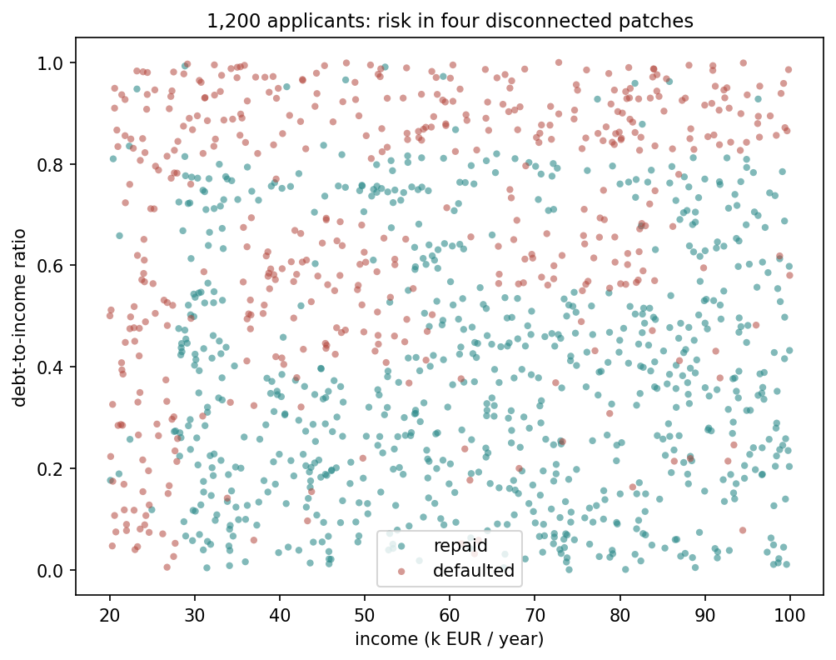
Four disconnected risky regions
Notes:
Let it sit for a moment before pointing anything out. Then trace the shape out loud: a strip of low income on one edge, a strip of high debt on another, and two disconnected rectangles in the interior where neither reading alone is remarkable.
Ask for a straight line that separates repaid from defaulted, exactly as you did with the pumps in lesson 6. This time there is a difference worth naming: unlike the pumps, the class you would have to isolate is not even one connected region, so “no line separates them” is true for a different reason than a ring around a disc.
Handout section 1.1.

Slide 6
No straight line separates them
Model | Cross-validated accuracy
Always predict the majority class | 0.613
Logistic regression | 0.748 ± 0.030
Notes:
Unlike lesson 6’s pumps, logistic regression clears the baseline by a wide margin here - it has learned something. Three of the four risky regions are monotonic in at least one feature, and a linear boundary handles monotonic effects reasonably well.
What it cannot do is wall off the two interior islands without cutting into healthy territory everywhere else. Ask the room what kind of boundary could close that gap, and let a few guesses land before moving on - a threshold rule, applied more than once, is exactly the answer the rest of the lesson builds.
Handout section 1.1.

Slide 7
The whole algorithm, in one sentence
Find the single (feature, threshold) split that makes the two resulting groups as pure as possible
Apply it. Repeat on each group, independently
Stop when a stopping rule is met
Nothing is estimated, no coefficient, no gradient with respect to a parameter vector
Greedy: whichever split helps most right now, with no lookahead
Notes:
Read the algorithm as one sentence and let it sit - it really is that short. Contrast it explicitly with lessons 3 and 4: no cost function is minimised over a continuous parameter, there is no gradient step. A tree is a sequence of yes/no questions, chosen one at a time.
The word to stress is “greedy”. At every step the tree takes whichever split helps most immediately, with no mechanism for looking two levels ahead. Tell them to hold onto that word - it is what explains, later this hour, why a shallow tree can miss the interior islands entirely even though the information to find them is right there in the data.
Handout section 2.1.

Slide 8
How pure is a group of examples?
A leaf that is all one class needs no more questions
A leaf split evenly between classes is the worst case: a coin flip
Impurity is a number that captures this, so “as pure as possible” has a target to maximise against
Notes:
Before any symbol appears, ask the room what “pure” should mean for a group of examples. Most will land close to the right answer on their own: a group where everyone shares a label needs nothing further, and a fifty-fifty split is as bad as it gets.
Say plainly that the standard choice for classification is called the Gini impurity, and that it is not a probability of misclassification - it is the probability that two examples drawn at random with replacement from the group, and labelled according to the group’s own class frequencies, would disagree.
Handout section 2.2.

Slide 9
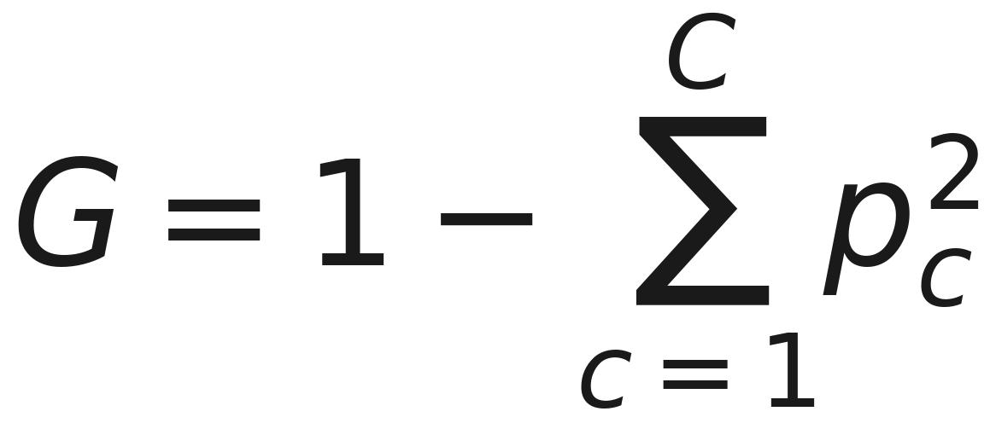
Gini impurity
Notes:
Each p in the sum is the fraction of the group belonging to one class, across C classes. Do not derive anything here - state what it does: subtract, from one, the chance two examples share a class if drawn independently from the group’s own frequencies. A pure group scores zero; a maximally mixed one scores as high as the formula allows.
Give them a moment to notice the formula asks nothing about which class is common, only about how mixed the group is - that symmetry matters later, when a split is chosen purely by how much it reduces this number.
Handout section 2.2 has the full definition.

Slide 10
For two classes, one number
G = 2p(1-p), where p is the fraction of one class
0 when the group is pure (p = 0 or p = 1)
0.5, the maximum, at p = 0.5
On the full 1,200 applicants, p = 0.387 gives G = 0.474
Notes:
Two classes is the case that matters for this dataset, and the formula collapses to something with an obvious shape: zero at the extremes, a single peak at fifty-fifty. Ask the room to sanity-check the peak location before you confirm it - it is the point where a random guess is least useful.
Give them the concrete number: on the full loan dataset, 38.7% defaulted, so p = 0.387 and G(parent) = 2 × 0.387 × 0.613 = 0.474. That is the impurity every candidate root split is measured against.
Handout section 2.2.

Slide 11
The gain a split buys
A candidate split divides a group into a left and a right child
It is worth taking if the children are, on average, purer than the parent was
“On average” is weighted by how many examples land in each child: a split that purifies nine points and dumps one troublemaker into its own leaf is not free
Notes:
Set up the idea in words before the formula: a split is only useful if the two resulting groups are, taken together, purer than the one group was. The weighting matters because a split that isolates one awkward point while leaving the rest exactly as mixed as before should not score as well as one that improves the picture broadly.
Ask what could go wrong if you didn’t weight by group size - the answer is that a tree would happily carve off tiny, perfectly pure single-point groups at every step, which is exactly the overfitting behaviour section 3 measures in a few minutes.
Handout section 2.2.

Slide 12
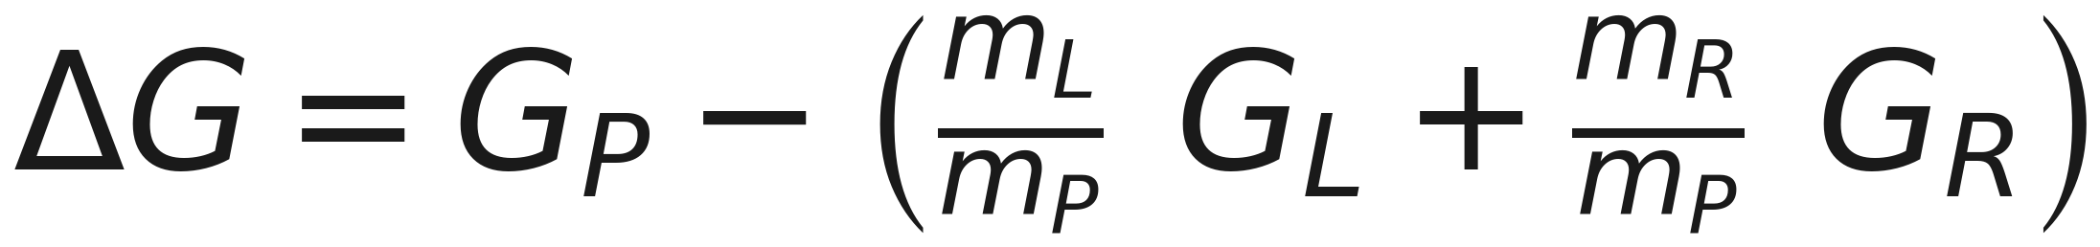
The reduction in impurity
Notes:
Say what the subscripts are before reading the formula: P, L and R are the parent group and its two children, the same three the handout names in words, and the m terms are how many examples are in each. The two m terms are the sizes of the left and right children, and they add to the parent’s. Read it as: what the parent’s impurity was, minus what is left after the split, weighted by how the group was divided. The tree keeps whichever candidate split makes ΔG largest.
No derivation needed here - the formula is exactly the weighted comparison the previous slide described in words. Handout section 2.2 has it worked through on the loan data’s actual root split.

Slide 13
Scanning for the best split
For a continuous feature, scan every midpoint between adjacent sorted values as a candidate threshold
Do this for every feature; keep the best pair
Repeat the search inside each child
Greedy: ΔG is judged one split at a time, never jointly
Notes:
This is the exhaustive-search part of the algorithm, and it is worth being concrete about the cost: every feature, every possible threshold, at every node, all the way down. It is brute force, and on a dataset this size it is cheap.
The last bullet is the one to slow down on. A feature that only helps in combination with a second split further down the tree can be - and in this dataset’s two interior islands, is - invisible to a shallow search, because ΔG is never evaluated for two splits together.
Handout section 2.2.

Slide 14
Worked example: the root split
p = 0.387 defaulted, so the parent group’s impurity is 0.474
Exhaustive search finds debt_ratio <= 0.82 as the best root split
Recognisably the debt ceiling the data was built with
971 applicants left (0.256 defaulted), 229 right (0.939): gain 0.144
Notes:
Walk the numbers once: parent impurity 0.474, and the winning split is the debt ceiling, found by brute-force search with no hint about how the data was generated. That agreement with the known generating rule is the first piece of evidence that the algorithm is doing something sensible.
Ask the room why finding the debt ceiling by blind search, with no knowledge of how the data was built, is a stronger check than it might first appear - the answer is that it rules out the split being an artefact of how the search was coded, since nothing in the algorithm knows the generating rule.
Handout section 2.2.

Slide 15
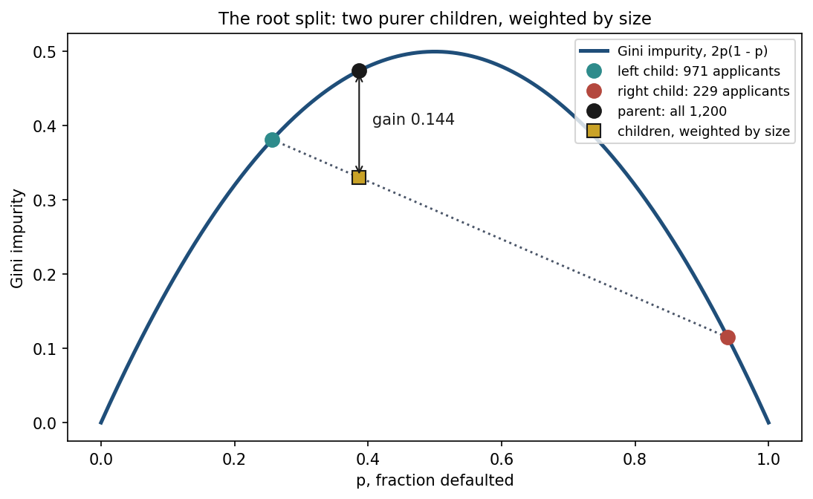
The root split, on the Gini curve
Notes:
The previous slide’s arithmetic, drawn. The curve is 2p(1-p): zero for a pure group, 0.5 for a fifty-fifty one. The black dot is all 1,200 applicants at p = 0.387, impurity 0.474. The split sends 971 left, at p = 0.256, and 229 right, at p = 0.939 - teal and rust.
The gold square is the two children averaged by size, 0.3305, and it sits on the dotted straight line between them. Point at the bulge: the curve lies above every such line, so any split that separates the classes at all lowers the weighted impurity. The gap, 0.144, is the gain, and the tree takes whichever split makes it largest. Handout section 2.2.

Slide 16
Checked against scikit-learn
The from-scratch implementation agrees with scikit-learn’s DecisionTreeClassifier to the fourth decimal place of resulting accuracy, at every depth tested
Not a coincidence: both search the same space by the same greedy rule
From here on, the notebooks use scikit-learn’s implementation: the same algorithm, compiled, not a different one
Notes:
This is the check notebook 1 runs live, and it matters for trust rather than for novelty: once the from-scratch version is shown to agree with scikit-learn exactly, every later result in the lesson - obtained with scikit-learn - inherits that confidence.
Point out the “Try this” box in the handout: computing Gini impurity for the income-floor subgroup alone and comparing it against the full dataset’s 0.474 is a two-line exercise that makes the impurity number concrete rather than abstract.
Handout section 2.2, and the “Try this” box that follows it.

Slide 17
What greedy misses
The search never asks “which pair of splits helps most together”: only “which single split helps most right now”
A feature that only pays off in combination with a later split can be invisible to a shallow tree
Exactly what happens to this dataset’s two interior “stressed” islands, covered next
Notes:
Close the Gini segment with the limitation, because it sets up everything that follows. Ask the room: if the debt ceiling and the income floor are the two easiest wins, what happens to the two interior islands, which need two conditions at once to identify?
The honest answer is that a shallow tree simply cannot see them - not because the information isn’t there, but because greedy search only ever commits to the best split available at each individual step. Depth is what buys the tree enough steps to eventually stumble onto them, which is exactly where the next segment goes.
Handout sections 2.2 and 3.

Slide 18
Depth is the bias-variance dial
max_depth: how many questions a tree may ask before a leaf must stop and vote by majority
Shallow tree: few questions, only the coarsest structure. High bias, low variance
Deep tree: enough questions to isolate almost any subset, down to single points. At full depth, training accuracy is exactly 1.000 on any dataset, including one with no structure at all
Notes:
Name the dial explicitly and connect it to lesson 6: k in k-nearest neighbours traded bias against variance directly, and depth is a tree’s version of the same knob.
The training-accuracy-1.000 claim is the one to make them justify. Ask why an unconstrained tree gets every training point right, always, on any data - the answer is that splitting never has to stop until every leaf holds one example, which it then “predicts” perfectly by definition. That number demonstrates the model class can memorise, not that anything has been learned - the same reading lesson 6 gave k = 1’s training accuracy.
Handout section 3.

Slide 19
Measured, at seven depths
max_depth | Training accuracy | Cross-validated accuracy
2 | 0.840 | 0.836 ± 0.024
4 | 0.843 | 0.827 ± 0.025
6 | 0.898 | 0.866 ± 0.016
8 | 0.951 | 0.882 ± 0.010
12 | 0.986 | 0.862 ± 0.018
16 | 0.993 | 0.852 ± 0.021
unconstrained | 1.000 | 0.852 ± 0.021
Notes:
Read the two columns against each other, never in isolation, exactly as lesson 5 taught. Training accuracy climbs monotonically towards 1.000. Cross-validated accuracy rises, peaks at depth 8, and then falls back - even though the model keeps getting strictly more flexible.
Ask which column they would have picked a tree by, if they had only seen the training column. The far right, the unconstrained tree, looks unbeatable on that evidence and is in fact the worst honest model on this table.
The unconstrained tree loses 3 points of cross-validated accuracy relative to the depth-8 peak, for a training score nobody should have trusted in the first place. Handout section 3.

Slide 20
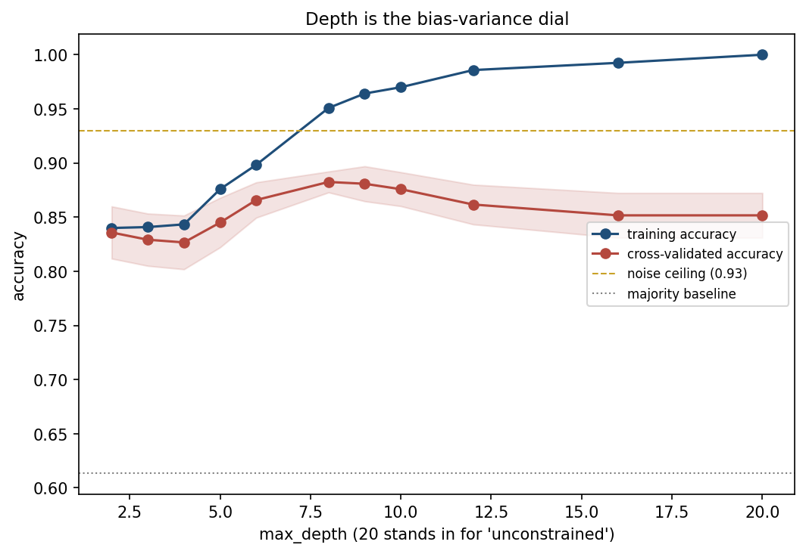
The curve bends downward
Notes:
Point at the two curves in order: training climbing steadily towards the top, cross-validated rising and then turning over. The peak is where the tree is deep enough to isolate both stressed islands and shallow enough to leave the flipped labels as errors rather than as leaves of their own.
Say plainly what past the peak is buying: every extra split is spent fitting some of the 7% of labels this dataset deliberately flips, and a flipped label has no pattern to learn. A tree that classifies it “correctly” on training data has memorised it, not generalised.
This is the second time this course has shown a curve bend this way - lesson 3’s Lasso penalty was the first. Handout section 3.

Slide 21
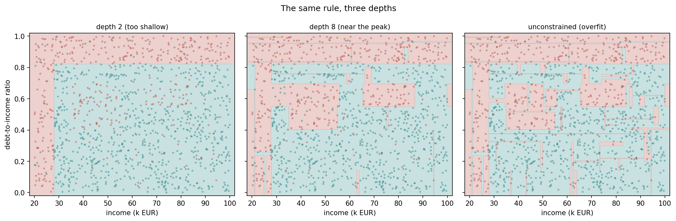
The same rule, three depths
Notes:
Left to right: at depth 2 the tree affords only the income floor and the debt ceiling - the two biggest, easiest-to-find regions - and neither interior island is visible at all. At depth 8 both islands appear as clean rectangles, close to the rule that generated the data. At full depth the boundary has grown a fringe of tiny rectangles chasing individual flipped labels.
Make the point explicit: the full-depth boundary is not a smoother version of the depth-8 boundary. It is a noisier one, built out of the same mechanism that gave the unconstrained tree its perfect training score.
Ask the room which of the three they would trust on a loan applicant they had never seen. Handout section 3.

Slide 22
Reading a tree, and the knob that keeps it small
max_depth grows the tree breadth-first: every leaf at level d splits before any leaf reaches d+1, useful or not
max_leaf_nodes grows it best-first: always expanding whichever leaf offers the largest ΔG
With max_leaf_nodes = 9: 90.8% training accuracy, every threshold recognisable: 28 the income floor, 0.82 the debt ceiling
Notes:
This is the readability half of the story. For a tree meant to be read rather than merely scored, best-first growth is the better knob: a small budget of splits goes to the ones that matter most, instead of being spent uniformly across every branch regardless of whether it’s worth it.
The nine-leaf tree is worth reading aloud as a sequence of if/else statements - that is the entire model, and it is the thing k-nearest neighbours and support vector machines cannot offer at all. For a decision that has to be justified to the person it affects, that can matter as much as accuracy.
Handout section 4.

Slide 23
A tree that doesn’t stay still
Two trees at max_depth = 6, fit to independent 65% resamples of the same 1,200 applicants
The debt ceiling, the strongest split, agrees to within 0.001
The trees grow 31 and 33 leaves, and disagree on 11.7% of predictions on the full dataset
The strongest split is stable; the many weaker ones are not, and they decide most of a tree’s shape
Notes:
This is the instability that ensembles turn into raw material. The strongest split barely moves under resampling, because the evidence behind it - 1,200 points supporting the debt ceiling - is overwhelming. Everything weaker than that is supported by far fewer points, and those splits are what actually determine a tree’s shape.
Ask the room what 11.7% disagreement between two trees fit to almost the same data implies about trusting any single tree’s exact boundary. The answer is the whole of the next segment: a single tree’s instability looks like a flaw, and it is about to become a strength.
Handout section 4.

Slide 24
Notebook 1, live
Decision trees from scratch, checked against scikit-learn
Depth swept, the two boundaries drawn, and the instability measured
Notes:
Run Notebooks/01_decision_trees_from_scratch.ipynb. Twenty minutes.
Have them watch the from-scratch implementation confirm the debt-ceiling root split before scikit-learn’s version ever runs - the point is that the agreement is not assumed, it is checked, at every depth.
The cell worth protecting if time is short is the two-tree resampling comparison at the end: printing the 11.7% disagreement figure themselves lands harder than reading it off a slide.

Slide 25
Break
Twelve minutes
Notes:
Twelve minutes. The next segment is where the lesson’s real content starts - one tree’s instability, turned into an ensemble’s strength - so they need to come back with that framing fresh.

Slide 26
Bagging: averaging away the instability
A tree’s mistakes differ across resamples, as just measured, so many trees, averaged should partly cancel out
Draw a bootstrap sample: m rows chosen with replacement from the m training rows
Fit a tree to it. Repeat n_estimators times; predict by majority vote
The tree algorithm itself is unchanged, only what surrounds it is new
Notes:
State the logic before the name. Section 4 just measured that two trees on overlapping resamples disagree on more than a tenth of predictions. If those disagreements are close to random, averaging many such trees should cancel some of them out - that is the entire idea behind bagging, bootstrap aggregating.
Be precise about “with replacement”: some rows appear more than once in a given sample, some not at all. That leftover fraction is not wasted - it becomes free validation data, on the next slide.
Handout section 5.

Slide 27
How much data one bootstrap sample sees
Each bootstrap sample is drawn from the same m rows, with replacement
About 63.2% of the distinct rows are drawn at least once
The remaining 36.8% are left out entirely: called out-of-bag (OOB)
At m = 1,200: a single simulated draw left out 36.6% of rows, close to the limit
Notes:
State the result, do not derive it - the limit that gives 63.2%/36.8% is a standard exponential limit, worked out in full in the handout, and it does not belong on a slide. What matters here is the consequence: every bootstrap tree automatically leaves out over a third of the data it never saw, for free.
Ask the room what that leftover third is good for. The answer is the next slide: it is validation data for exactly the one tree that never saw it.
Handout section 5.1.

Slide 28
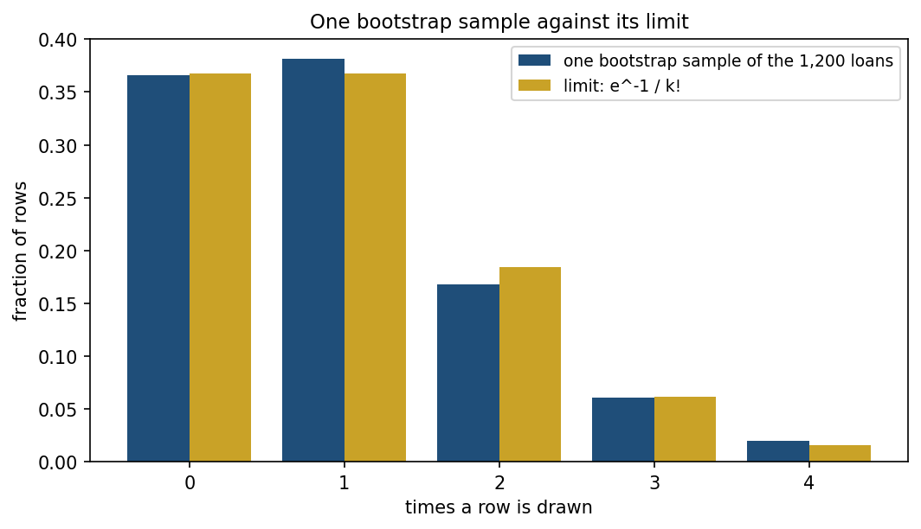
One bootstrap sample, counted
Notes:
How often each of the 1,200 loans turns up in one bootstrap sample, blue, against the limit e^-1 / k!, gold. The first bar is the out-of-bag share: 0.366 here, 0.368 in the limit. The rest are rows drawn once, twice, three times.
The point to make: about one row in four appears two or more times. Every tree sees a different mix of repeats and absences, and that is where their disagreement - the raw material of bagging - comes from. Handout section 5.1.

Slide 29
Out-of-bag: free validation
Every out-of-bag row is validation data for the tree that missed it
Averaging them gives the OOB score, at no extra split
A 300-tree forest: OOB 0.9117, 5-fold cross-validated 0.9117 ± 0.021
That match to four decimals is this seed’s luck: over twelve seeds the gap is 0.003: agreement to within their own noise, not to every decimal
Notes:
The agreement is the point, but be careful how you sell it. On this seed the two numbers match to four decimal places, and that is luck: over twelve seeds the typical gap is 0.0026 and the worst is 0.0075. What is not luck is that they track each other well inside cross-validation’s own ±0.021 spread, because OOB score is cross-validation with different bookkeeping - each tree supplying its own held-out fold, the rows it never bootstrapped, instead of the dataset being split up front.
Worth pausing on, because it is a habit rather than a fact: a single coincidence is not evidence of a law. If you catch yourself saying “exactly”, run it again with another seed. They will need that reflex in their own exercises, and it is cheaper to learn it here.
Then make the practical consequence explicit: with a bagged ensemble you get a trustworthy estimate of generalisation for free, without setting aside a separate validation set at all - just not one to read to the fourth decimal.
Handout section 5.1.

Slide 30
Why averaging reduces variance
Model each tree’s prediction as noisy, with variance σ², and let ρ be the correlation between any two trees
Averaging B trees drives variance toward a floor of ρσ², not zero: adding trees past that point buys almost nothing
Averaging cannot fix bias: unbiased-but-noisy trees average to unbiased; trees sharing a systematic error keep that error exactly
Notes:
State the headline, not the algebra - the covariance expansion behind this is in the handout, and it does not belong on a slide. The two consequences are what matter: there is a floor variance cannot fall below, set by how correlated the trees are with each other, and averaging is a variance tool only, powerless against a systematic mistake shared by every tree.
That second point is worth a beat: bagging does nothing for a tree that is too shallow to represent the rule in the first place. It cleans up noise, it does not add capability.
Handout section 5.2.

Slide 31
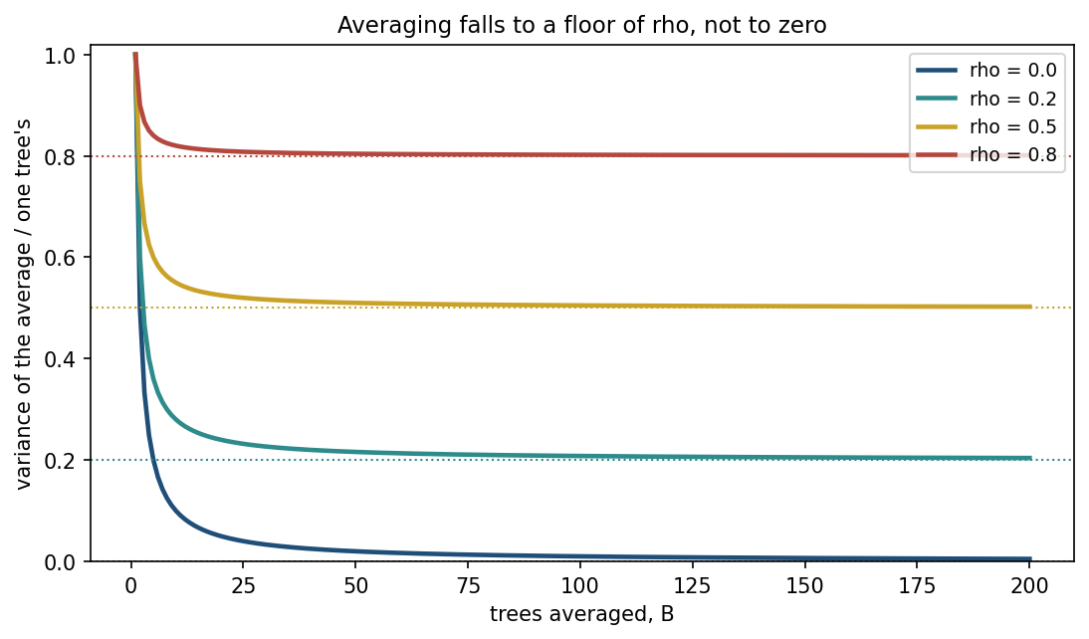
Averaging stops at a floor
Notes:
The previous slide’s formula as curves: the variance of an average of B trees, as a share of one tree’s, for rho = 0, 0.2, 0.5 and 0.8.
Only the rho = 0 curve goes to zero. Every other one flattens onto its dotted floor: at rho = 0.5, ten trees keep 0.550 of one tree’s variance and a hundred keep 0.505. Ask the room what the curves say about adding trees past fifty - almost nothing - and what the only remaining lever is: lower rho. That is the random forest, two slides on. Handout section 5.2.

Slide 32
Bagging, measured
Model | Mean test accuracy | Standard deviation
Single unconstrained tree | 0.856 | 0.0185
Bagging, 100 trees | 0.902 | 0.0153
Notes:
Across 30 independent 70/30 splits of the loan data, both numbers moved in the predicted direction. The mean rose, because bagging also averages out some of a deep tree’s overfitting; the spread fell, which is exactly what the previous slide’s formula says averaging correlated estimators should do.
Ask the room to name which of the two changes matters more for trusting a single deployed model - the tighter spread, because it means the number you report is less likely to be a lucky split.
Handout section 5.2.

Slide 33
Random forests: decorrelating the trees
The variance floor is ρσ²: lowering it further means making the trees agree less
Bagged trees still see every feature at every split, so a strong feature pulls most of them towards splitting on it first
A random forest restricts each split to a random subset of max_features (default √n, rounded down): different trees see different features at the same point, lowering ρ
Notes:
Connect this directly to the previous slide’s algebra: if the floor is ρσ², the only way to push it lower is to push ρ down, and bootstrap resampling alone only does that partially, because every bagged tree still gets to see the full feature list.
The random forest’s one change is a restriction, not an addition: at each split, only a random handful of candidate features is even offered. That forces disagreement between trees at the same point in the tree, purely by denying them the same menu.
Handout section 6.

Slide 34
Random forests, measured
Model | Mean test accuracy | Standard deviation
Single unconstrained tree | 0.856 | 0.0185
Bagging, 100 trees | 0.902 | 0.0153
Random forest, 100 trees | 0.908 | 0.0137
Notes:
Same 30 splits as the bagging comparison. The random forest beats plain bagging on both counts - a better mean and a tighter spread - consistent with ρ having fallen further, exactly as the restriction on the previous slide predicts.
Say plainly what has and hasn’t changed: nothing about the splitting rule is different from section 2. The only change across all three rows of this table is what surrounds the tree - resampling, then also restricting the feature menu.
Handout section 6.

Slide 35
Feature importance: what the forest claims to tell you
A random forest reports feature importance: the impurity reduction each feature is responsible for, summed over every tree and split
Tempting to read as “the forest tells you which features matter” - and with only the two real features here, it does exactly that
The question: what happens once most of the columns carry nothing?
Notes:
State the definition plainly, then set up the experiment. With just income and debt ratio in the dataset, feature importance is a clean, correct answer - both real features get essentially all the credit, because there is nothing else to compete with them.
Ask the room to predict what happens as you add columns of pure noise - np.random.normal, wired to nothing. Most will predict the noise columns get close to zero importance, because averaging over hundreds of trees should wash out anything with no signal. Do not confirm or deny yet - the next slide is the answer.
Handout section 7.

Slide 36
More columns, more noise
Noise columns added | Total columns | Cross-validated accuracy | Importance on noise
0 | 2 | 0.912 | 0.0%
5 | 7 | 0.874 | 33.9%
20 | 22 | 0.837 | 54.5%
Notes:
Read down the last column, slowly, and let the bottom row sit before explaining anything. With 20 pure-noise columns against 2 real features, more than half of the forest’s own importance scores land on columns that are np.random.normal noise by construction.
Name the instinct this breaks, and defend it before moving on: expecting an average over hundreds of trees to wash out noise is entirely reasonable - the variance-reduction result from section 5.2 is real and measured, and it does point the same way. It reduces the variance of the prediction. It does not guarantee small importance for irrelevant columns, because the very restriction that decorrelates the trees - a random, incomplete menu at each split - is what occasionally hands a split to noise with nothing better on offer.
The mechanism is exact and is in handout section 7. The practical consequence to leave them with: treat a random forest’s importances as suggestive, not definitive, when real features are few against many candidate columns.

Slide 37
Notebook 2, live
Bagging and random forests, from scratch and against scikit-learn
The out-of-bag score checked against cross-validation
The noise-column experiment, run live
Notes:
Run Notebooks/02_bagging_and_random_forests.ipynb. Eighteen minutes.
The cell to protect is the noise-column sweep. Let them add the columns themselves and watch the importance share climb - reading the number off a slide does not land the same way as watching it happen.
If time allows, have them try max_features=None instead of the default "sqrt" and predict what happens to the noise share before running it - it should fall, at the cost of the decorrelation that made the forest work in the first place.

Slide 38
Gradient boosting: correcting mistakes in sequence
Bagging and random forests build trees independently and average at the end
Boosting builds trees in sequence: each new tree is fit specifically to correct what the trees so far got wrong
Each addition is a shallow tree: depth 2 or 3, a weak learner
The learning rate α sets how much of each new tree’s correction is actually applied
Notes:
Contrast the two strategies directly, because the difference is the whole segment. Bagging and random forests are parallel: every tree is grown once, independently, and combined only at prediction time. Boosting is sequential: tree t exists specifically because of what trees 1 through t-1 still got wrong.
Name α carefully and tie it to the course’s shared notation - this is the same symbol as lesson 3’s gradient descent learning rate, doing an analogous job: how large a step each correction takes.
Handout section 8.

Slide 39
Building the ensemble, one tree at a time
Notes:
F₀ is the flat starting guess, the mean of the target. Each subsequent Fₜ is the previous ensemble plus a scaled correction from the newest tree, hₜ. Read it left to right: start flat, then keep adding small, scaled corrections.
Do not derive anything further here - the next slide states what hₜ is actually fit to. Handout section 8.

Slide 40
What each tree is fit to
For squared-error regression, “what remains unexplained” has an exact name: the residual, y - Fₜ₋₁(x)
This is a special case of a more general idea: functional gradient descent: hₜ approximates the negative gradient of the loss with respect to Fₜ₋₁
For squared error, “fit the residual” and “fit the negative gradient” coincide exactly
Notes:
State the result without the calculus. For plain squared-error regression, what a new tree corrects is literally the residual - the gap between the truth and the ensemble’s current prediction. That is intuitive on its own and does not need a derivative to justify.
The second bullet is the generalisation that pays off in the very next segment: the same recipe - fit a tree to the negative gradient of whatever loss you’re using - covers classification too, once the loss changes from squared error to something else. Handout section 8 has the one line of algebra connecting the two.

Slide 41
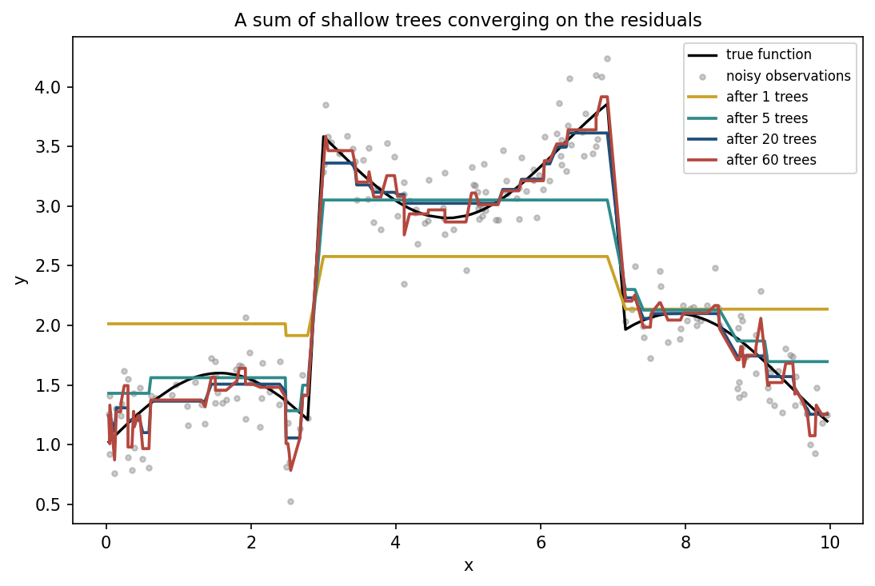
A sum of shallow trees converging on the residuals
Notes:
Sixty depth-2 trees, learning rate 0.3, fit to a step function plus a gentle sine wave, observed with noise. Walk through the panels in order.
Say the numbers as you point: one tree barely moves the flat starting guess. Five trees sketch the coarse shape. Twenty trace the step function closely - the ensemble’s best point, on the next slide. By sixty, the ensemble is tracking individual noisy observations as well as the underlying shape.
Handout section 8.

Slide 42
Reading the picture
1 tree: mean squared error (MSE) against the true function 0.395, barely moves the flat guess
5 trees: MSE 0.068, the coarse shape appears
20 trees: MSE 0.012, the ensemble’s best point
60 trees: MSE rises back to 0.018, tracking noise, not signal
Notes:
Put a number on each panel of the previous slide. Twenty trees is the sweet spot; by sixty the error against the true, noise-free function has risen again, even though the ensemble is still adding trees that reduce error on the training residuals.
Name what this is: the same overfitting story as the unconstrained single tree from section 3, reached by a completely different route - not one tree grown too deep, but too many shallow trees each chasing whatever residual noise is left.
Handout section 8.

Slide 43
Classification: the same idea, a different gradient
The label y is 0 or 1; the ensemble’s output becomes a probability, p = σ(F)
The loss is log-loss: lesson 4’s loss for logistic regression
The negative gradient, the pseudo-residual each tree fits, is y - p
True label minus predicted probability: lesson 4’s error term exactly
Notes:
State the result, not the chain rule behind it - the handout carries the full derivative. What matters for this course is the connection: boosting for classification fits a sequence of small trees to y - p, one correction at a time, rather than adjusting a fixed set of linear coefficients against the same quantity in one continuous descent.
Ask the room to name what’s genuinely different between this and lesson 4’s logistic regression, given they’re descending against the same quantity. The answer: lesson 4 moves a fixed number of coefficients; boosting adds entirely new trees, so the model’s structure itself grows with training rather than staying fixed.
Give them the first step in numbers, because it makes y - p concrete. The ensemble starts at the base rate’s log-odds, F0 = log(0.387 / 0.613) = -0.461, which predicts 0.387 for everyone. The first tree is fit to y - p: +0.613 for every applicant who defaulted, -0.387 for every one who repaid.
Handout section 9.

Slide 44
On the loan data
GradientBoostingClassifier, defaults: 100 trees, learning rate α = 0.1
Reaches 0.902 ± 0.020 cross-validated accuracy
Already ahead of any single tree from earlier in the lesson
Notes:
Give the number and let it sit against everything shown so far this lesson: 0.902, from a method run at scikit-learn’s defaults, no tuning at all. Ask the room to recall the single tuned tree’s number from section 3 - 0.882 at depth 8 - and note that boosting has already passed it without being told anything about depth.
The rest of this segment is what happens when boosting is not left at sensible defaults.
Handout section 9.

Slide 45
Boosting never stops fitting on its own
n_estimators (α = 0.3) | Training accuracy | Cross-validated accuracy
5 | 0.840 | 0.846 ± 0.025
10 | 0.888 | 0.870 ± 0.024
20 | 0.930 | 0.895 ± 0.027
30 | 0.948 | 0.897 ± 0.020
80 | 0.978 | 0.893 ± 0.012
200 | 1.000 | 0.895 ± 0.017
800 | 1.000 | 0.890 ± 0.019
Notes:
Unlike bagging, boosting keeps reducing training error for as long as it runs, because every new tree is built specifically to reduce what remains - including the 7% of labels that are noise by construction. There is nothing in the algorithm itself that says “stop”.
Point at the peak, 30 trees, and then at 800: training accuracy has been at 1.000 since well before 200, and cross-validated accuracy has drifted down by about a point since the peak. Contrast the size of that drop with section 3’s unconstrained tree, which lost three points past its own peak - boosting’s overfitting is real but gentler.
Handout section 10.

Slide 46
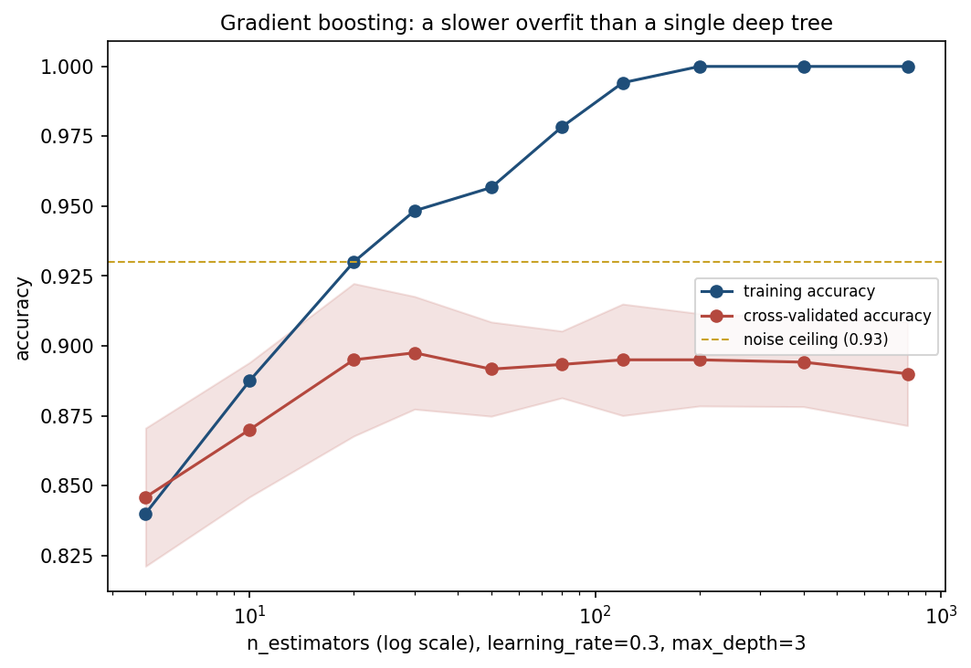
Training climbs to 1.000 and stays; the honest curve turns over first
Notes:
Two curves again, the same shape of story as the depth curve earlier this lesson but reached by adding trees instead of depth. Training reaches 1.000 by around 200 trees and sits there. Cross-validated accuracy climbs quickly, peaks near 30 trees, and drifts down over the following 770.
The point worth making explicit: the damage per added tree here is small and easy to miss on a single run - which is exactly why early stopping matters for boosting rather than being optional, even though the overfit is gentler than a single unconstrained tree’s.
Handout section 10.

Slide 47
Fixing 120 trees, varying only the learning rate
Learning rate α | Training accuracy | Cross-validated accuracy
0.02 | 0.888 | 0.872 ± 0.025
0.05 | 0.914 | 0.897 ± 0.022
0.10 | 0.939 | 0.902 ± 0.022
0.30 | 0.994 | 0.895 ± 0.020
1.00 | 1.000 | 0.878 ± 0.020
Notes:
Learning rate and tree count are not independent - both control how much total correction the ensemble applies, so they trade off against each other. At α = 0.02, 120 trees haven’t finished fitting the signal: training accuracy is still under 0.89. At α = 1.00, the ensemble has memorised the training set completely and given back several points of cross-validated accuracy for it.
The best setting sits in between - large enough to make real progress within the tree budget, small enough that any one correction is easy to outvote if it turns out to be wrong. Ask the room which direction they’d guess is “more regularised” before revealing that it’s the small α side, the same kind of inverted-direction trap lesson 6’s C was.
Handout section 10.

Slide 48
Notebook 3, live
Boosting from scratch on residuals, and against scikit-learn
The classification pseudo-residual, and the learning-rate sweep
Notes:
Run Notebooks/03_gradient_boosting.ipynb. Eighteen minutes.
The cell to protect is the residual sweep at 1, 5, 20 and 60 trees - seeing the ensemble’s fit against the true function rise and then fall again, in real time, is the most direct experience of boosting’s overfitting available in this course.
If time is short, skip the learning-rate sweep live and set it as reading - the table is in handout section 10.

Slide 49
Every method, on the same five folds
Model | Cross-validated accuracy
Majority baseline | 0.613
Logistic regression | 0.748
Single tree, unconstrained | 0.852
Single tree, max_depth = 8 | 0.882
Gradient boosting, 30 trees | 0.897
Bagging, 100 trees | 0.904
Random forest, 100 trees | 0.911
noise ceiling | ≈ 0.93
Notes:
Everything from this lesson, cross-validated the same way. Read down the column and let the pattern speak before naming it: every ensemble method - bagging, the random forest, gradient boosting - lands within about a point and a half of the others, and all three sit closer to the ceiling than either single tree.
The ceiling itself: 1 minus the 7% of labels deliberately flipped. No method reaches it, and none should - a model that classified the flipped labels “correctly” would be modelling the noise, not the rule.
Handout section 11.

Slide 50
Three findings
Every ensemble lands within a point and a half of the others: which strategy matters far less than whether you ensemble at all
The tuned single tree is close behind, 0.882 against 0.911, and the only model here a person can read
The unconstrained tree is the worst model on the list, despite being the most flexible one
Notes:
Read the three findings as a set - together they are this lesson’s real content, more than any single accuracy number.
The third finding is the one to land hardest, because it repeats a pattern they’ve now seen four times with four different methods: flexibility without a stopping rule is not an advantage. Ask the room to name the earlier three occurrences before you do - k = 1 in lesson 6, an unregularised fit in lesson 3, and today’s own unconstrained tree from section 3.
Handout section 11.

Slide 51
How to choose, in practice
Situation | Reach for
The decision must be explained to the person it affects | A single tree, depth-tuned, or nothing on this list
Tabular data, accuracy matters most, no explanation required | A random forest, as a strong and low-effort default
Training time matters, or the signal needs sequential refinement | Gradient boosting, tuned on a validation set
Very high-dimensional, few informative columns | Any tree method, cautiously
Rows only, and OOB score suffices for validation | A random forest, no explicit train/test split needed
Notes:
A table to photograph, exactly as lesson 6 closed with one. Work down it and attach today’s evidence to each row rather than leaving it as generic advice.
The fourth row is worth a sentence of its own, tying back to the noise experiment: with few real features against many candidate columns, trust importances less as the column count grows past what the data can support.
Handout section 11.

Slide 52
54% of the importance landed on noise
20 noise columns, 2 real features: not a small effect, and not a bug
The same restriction that decorrelates the trees occasionally hands a split to noise instead
Averaging reduces variance of the prediction; it does not guarantee small importance for irrelevant columns
The fix: cross-check against permutation importance on held-out data
Notes:
This is the number to carry out of the room. Say it once more, slowly: with twenty pure-noise columns against two real features, more than half of a random forest’s importance mass sat on columns wired to nothing.
Ask them to write it down - derivations fade, this kind of number tends not to. It is the fourth lesson this course has produced one of these: coin flip labels, borrowed test-set values, a coefficient of 365 where an unpenalised fit wanted billions, and now this.
Handout section 7 has the full mechanism.

Slide 53
What to take away
A tree splits greedily on Gini impurity, matching scikit-learn
Depth is the bias-variance dial: accuracy peaked at depth 8
Bootstrap resampling leaves 36.8% of rows out-of-bag: free validation
54% of a random forest’s importance landed on 20 noise columns, today’s number
Notes:
Close on the same shape as lesson 6’s summary: a handful of numbers that carry the lesson’s argument without needing the mathematics behind them re-derived.
If they remember one habit from today, make it this: before trusting a random forest’s importance ranking, ask how many candidate columns compete for attention at each split, because that number - not the accuracy score - is what decides how much noise gets credit it didn’t earn.
Next lesson turns from labelled data to unlabelled data - a fourth question this course asks of a dataset, after “what’s the relationship”, “which class”, and “how do you know you’re not fooling yourself”: what structure is there when nobody has told you the answer at all.
Handout summary and notation table.

Slide 54
Homework
Exercise 7, discussed at the start of Friday 20 November
Exercises/07_trees_and_ensembles.md
Notes:
Set it explicitly and say out loud when it comes back: the first ten minutes of lesson 8, Friday 20 November.
Remind them of the standing rule from lesson 5: every reported number needs a cross-validated spread, and any feature-importance claim needs the check this lesson just demonstrated - a random forest’s importance ranking is a claim to be verified, not a fact to be quoted.
Next week: unsupervised learning, the first lesson this course asks of data with no labels at all.

