Slide 1
Lesson 1: Introduction and the ML Workflow
Technologies for Artificial Intelligence
Fabio Antonini, Università degli Studi dell’Aquila

Slide 2
Welcome
10 lessons, 3 hours each, every Friday until 4 December
A first course in machine learning, for people who can already program
Foundations, not products
Course team on Microsoft Teams: code v0t2gvu
Notes:
Introduce yourself briefly, then establish the two facts that shape everything: this is a fundamentals course, and it assumes programming ability but no ML background.
Ask for a show of hands: who has trained a model before? Usually a handful. Tell that group they have an advantage of about two lessons, and a disadvantage that lasts longer, because they will have habits to unlearn around evaluation - most self-taught practice picks up the modelling and skips the validation.
Practical notes to give now: the repository is public to them via git, everything runs offline in Docker, and there is no cost attached to any part of this course. Nobody needs an application programming interface (API) key, a cloud account or a graphics processing unit (GPU).
Ask them to join the course team on Microsoft Teams now, with the code on the slide - v0t2gvu, zero not the letter o - so that announcements reach everyone from the first week.

Slide 3
What we will cover
1–2 | Workflow, data preparation
3–4 | Regression, classification
5 | Experimental methodology
6–7 | k-NN, support vector machines, trees, ensembles
8 | Unsupervised learning
9–10 | Neural networks, CNNs
Notes:
Point at lesson 5 and say it is deliberately in the middle, not at the end. It is the lesson about whether results mean anything, and everything after it depends on it. Most courses put this material last, where it arrives too late to change how students work.
Say explicitly that there are no LLMs in this course - they belong to another module in the programme. Some will be disappointed. Tell them the material here is what those systems are built on: the transformer is a neural network, trained by gradient descent on a loss function, and evaluated - badly, often - with the same statistical tools we will spend ten weeks on.
If asked “will we do deep learning?”: yes, lessons 9 and 10, but on a laptop CPU and with the emphasis on understanding rather than scale.

Slide 4
What this course is not
Not a tour of current AI products
Not a library tutorial
Not a course where you call .fit() and report the number
Notes:
Be direct here. They can learn the scikit-learn API from documentation in an afternoon, and they will. What takes a semester is knowing which number to trust.
The concrete promise to make: if they leave this course able to look at someone else’s reported result - a paper, a colleague’s notebook, a vendor’s benchmark - and identify what is wrong with the evaluation, the course succeeded. That skill outlasts every library we touch.

Slide 5
Your advantage, and your gap
Advantage: you can program. You will implement methods, not only call them.
Gap: you can produce results faster than you can judge them.
Notes:
This is the framing for the whole course, so spend a real minute on it. Handout section 1 develops it.
Within three weeks they will write thirty lines that give 95% accuracy on something. The hard question is whether it means anything. Say plainly: the most common failure in this field is not a bug - the code runs exactly as written - it is a number that was never valid in the first place.
Contrast with the audience this material used to serve: PhD engineers who had the mathematics and lacked the coding. This group is the mirror image, so the emphasis moves from “make it run” to “make it true”.

Slide 6
How you will be assessed
Weekly exercises: set each Friday, discussed the next. Never collected
Exam: one of the ten is drawn, and you talk through your own notebook
No written paper, no project. Keep all ten
Notes:
Set expectations now, and be explicit, because the arrangement is unusual and they will assume the ordinary one. Nothing is handed in, nothing comes back with a mark on it, and there is no written paper to revise for. Each lesson opens by discussing the exercise set the week before; at the exam one of the ten is drawn and they talk through their own notebook for it.
Say the consequence plainly, because it is the whole design: an exercise they skipped is one they may have to sit in front of with nothing to say, and an exercise someone else wrote for them is worse, because the questions are all “why did you do this”.
Expect the question “so what do we have to study?”. The answer is that the handouts are not optional: nothing is asked in the abstract, but “why that metric” and “what would have told you it was wrong” cannot be answered without them. The theory is examined through their own work rather than on paper.
Emphasise the principle: methodology outweighs accuracy. Two students with different scores can both do well. A spectacular score obtained by leaking the test set will not - methodological correctness is 40% of the criteria, and today’s third notebook shows exactly why.
Point them at Assessment/ in the repository.

Slide 7
The three things you get each lesson
Handout: the reference text, with the mathematics
Slides: what we do in the room
Notebooks: runnable implementations
Plus a quiz, and the exercise.
Notes:
Explain the division of labour, because it is unusual and it matters.
Derivations are NOT on the slides. They are in the handout, to be read afterwards. In the room we do results, intuition and code. This is what lets the lecture move at a sensible pace while the course stays rigorous - and it is why the exam can ask them to reproduce a derivation.
Slides and notebooks arrive on the Friday; the handout follows by the Monday, since it is study material rather than lecture support.
The quizzes are self-check and ungraded, but three or four questions in each require reasoning about a derivation rather than recall. Those are the closest thing to the exam there is: at the exam one of their own exercise notebooks is drawn and the questions are of exactly that kind, “why did you do this” rather than “state the definition”.

Slide 8
Getting the material
U=https://github.com/fabioantonini
R=technologies-for-artificial-intelligence
git clone $U/$R.git tai
cd tai
docker compose pull
docker compose up
Then open 127.0.0.1:8888, token aicourse
Notes:
The address is on the slide so it can be copied from the projector: it is split into two variables because the whole URL on one line wraps mid-word in this font and becomes untypeable. Read it out as github.com/fabioantonini, then technologies-for-artificial-intelligence. Course/Setup/Docker_Quickstart.md has it written out for anyone who mistypes it.
The folder name, tai, is theirs to choose: Docker Compose does not care what it is called, and a short one saves them typing all term.
Do this live and take ten minutes over it. Making sure everyone has JupyterLab running today is far cheaper than fixing it during lesson 3, when they also have an exercise due.
Explain the two-part design: the Docker image carries the environment, the repository carries the content. New lessons arrive with git pull - a few megabytes, seconds - not a new image. The image only changes if the libraries change, and they will be told when that happens.
Then the second thing to say, because it saves the room ten minutes today and a lecture in November. The image comes in two sizes. docker compose up gives them core, a 750 MB download carrying everything lessons 1 to 8 need. Before lesson 9 they change one line in .env to TAI_TAG=full, which adds TensorFlow - and because full is built on top of core, that switch downloads the TensorFlow layer alone rather than the whole environment again. Point them at Course/Setup/Docker_Quickstart.md for both steps.
Ask who has already pulled it. Anyone who has not should run docker compose pull at home tonight, not now: thirty simultaneous downloads on the lecture-theatre network is not a plan, and it is why the image was cut down in the first place.
Common problems: port 8888 already in use (edit docker-compose.yml to 8889), and the first pull taking several minutes on the room’s wifi. Warn them the first start is slow and every later one is not.

Slide 9
Today
What learning from data means
A short history, and what it teaches
The three kinds of learning
The end-to-end workflow
Four ways a model misleads you
Notes:
Agenda slide. Flag the last item as the one that matters most today: everything before it is orientation, and that section is where the real subject of the course appears.
Timing: roughly 50 minutes to the break, then the three kinds of learning, then the workflow worked live, then the failure modes. Homework is set in the last five minutes - do not let it slip, it is due next Friday.

Slide 10
A problem you cannot specify
Write a program that decides whether an email is spam.
Filter certain words? Spam adapts.
Filter certain senders? They change.
The exceptions grow until nobody can maintain it
Notes:
Work this conversationally. Ask the room for rules and write two or three on the board, then break each one: “buy now” - what about a legitimate shop newsletter? Sender blacklists - what about a compromised account belonging to a colleague?
Get them to feel the frustration before offering the alternative. The point to land, and it is handout section 2: the program is not hard to write, the RULE is impossible to state. You recognise spam instantly and cannot articulate how.
If someone proposes machine learning immediately, slow them down - the interesting part is understanding precisely which difficulty it addresses.
Take each row in turn and let someone in the room supply the exception before you reveal it. The pattern to draw out: every rule is defensible and every rule breaks, and the list has no end.

Slide 11
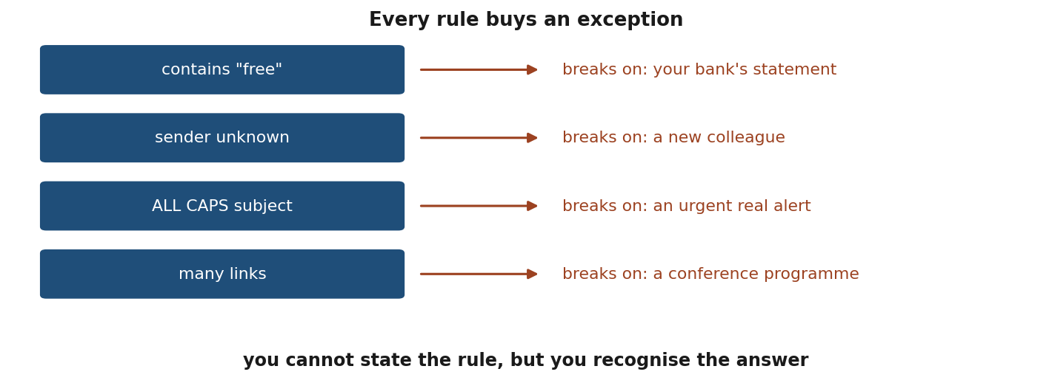
Every rule buys an exception
Notes:
Read the four rows down the left, and the exception each one buys on the right. Take them one at a time - the effect depends on the accumulation.
The point is not that these are bad rules. Each is a reasonable idea, and each fails on a case that is obviously not spam to any human reader. Ask the room for a fifth rule and then for what breaks it; somebody will supply both within a few seconds, which is the demonstration.
The line at the bottom is the one to leave them with: you cannot state the rule, but you recognise the answer. That gap is the whole reason this course exists, and every method in it is a way of closing it from examples instead of from specification.

Slide 12
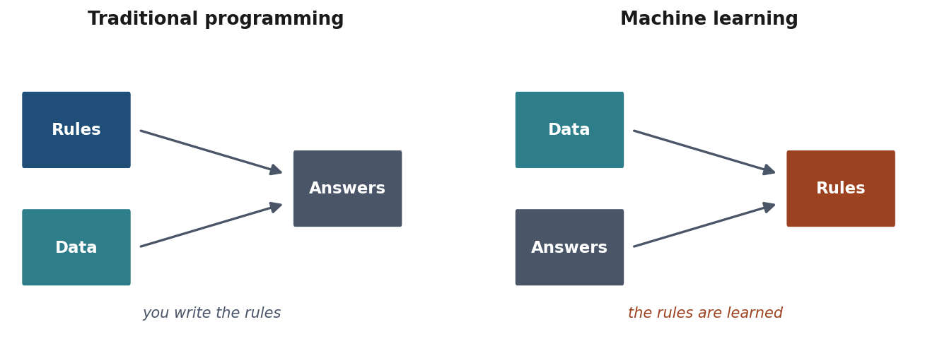
The inversion
You cannot state the rule. But you can recognise the answer.
Notes:
This is the conceptual move that defines the field, so say it slowly while the figure is up.
Traditional programming: you supply rules and data, the machine produces answers. Machine learning: you supply data and answers, and the machine produces the rules. The arrows literally reverse.
Everything else in this course is machinery for doing that search well - and for telling whether the rules it found are real or an artefact of the sample you happened to collect.
Worth adding: this framing is due to Arthur Samuel in the 1950s, and it is still the cleanest one-sentence description of what changed.

Slide 13
What the data actually is
One tumour = 30 numbers: radius 17.99, texture 10.38, perimeter 122.80, …
That row is one input x; its label y is malignant, coded 0
All 569 rows stacked is the design matrix X, 569 x 30
m = 569 examples (rows), n = 30 features (columns), all course long
Notes:
Do this before any symbol appears, because “pairs (x, y) drawn from a distribution” is unreadable to someone who has never seen what is inside an x.
Point at the numbers first. One tumour, thirty measurements taken from a digitised image of a tissue sample - radius, texture, perimeter, area and 26 more. THAT list is x. The thing we want to predict, malignant or benign, is y. Notebook 02 prints exactly this table in its second cell, and it is the dataset we use for the whole workflow later today.
Then the two letters, and say they never move: m counts examples, n counts features, rows are examples, columns are features. Every lesson of the course uses them this way, and lesson 3 will write the normal equation with them.
Last sentence, and it sets up lesson 2: the thirty columns are not the tumour. They are what somebody decided to measure of it. Ask the room what else they would have measured - age, family history, time since the last scan - and let them notice that none of it is in the file. Handout section 2.1.

Slide 14
Making it precise
Inputs from a space X, outputs from a space Y
Pairs (x, y) drawn from an unknown distribution D
A loss L(ŷ, y): the cost of answering ŷ when the truth is y
Goal: find f: X → Y that predicts well
Notes:
Keep this brisk - handout section 2.1 has the full treatment and they will read it.
Two things to stress about D. It is UNKNOWN, which is why we need data at all. And it is assumed FIXED - the same distribution generates the training data and the data we will meet later. That assumption is quiet and it fails constantly in practice: the hospital changes its equipment, the users change, the season turns. When it fails, models degrade without any warning from their metrics. Promise them we return to it.
The loss function is where the domain enters the mathematics. Choosing it is a decision about which mistakes matter, and we make that choice explicitly in twenty minutes.

Slide 15
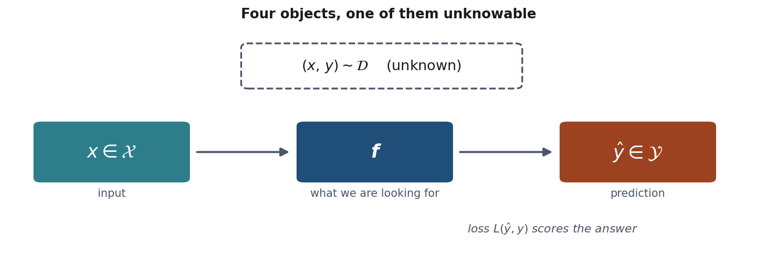
The setup, in one picture
Notes:
Everything on the previous slide, drawn once so it can be pointed at for the rest of the course.
Trace the path with a finger: a pair is drawn from D, x goes into f, f produces y-hat, the loss compares y-hat against the y that came with it.
Then point at the dashed box. Three of these objects we handle directly - the inputs, the function we search for, the predictions. The fourth, the distribution the data comes from, we never see. Everything difficult in this course comes from that one box being out of reach.
Worth naming now, because it returns in lesson 5: we see a sample from D, never D itself, and every claim we make about a model is an inference from the sample to the distribution. Most of the methodology later in the course is about not fooling yourself in that step.

Slide 16
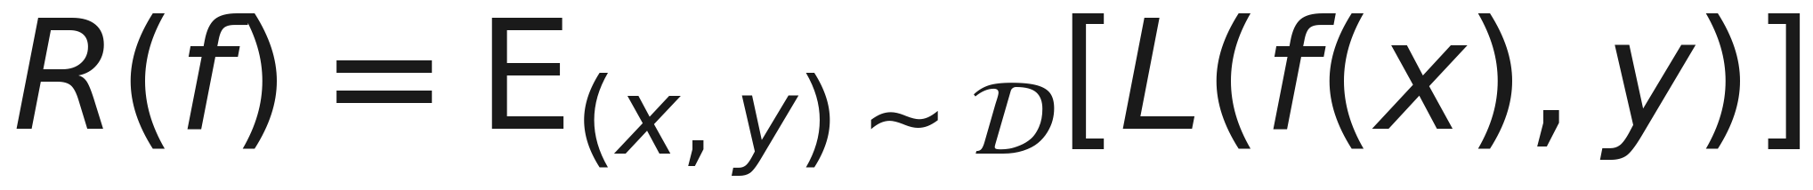
What we actually want
The average loss over all data the world might produce, including data that does not exist yet:
Notes:
Name it: expected risk, sometimes called true risk or generalisation error.
Then deliver the punchline and pause on it - we cannot compute this. D is unknown, the expectation is over data that has not been collected, and no amount of cleverness gets around it.
This is the central obstacle of the field, and everything else in the course follows from it. If a student takes one idea away today, this is a good candidate.

Slide 17
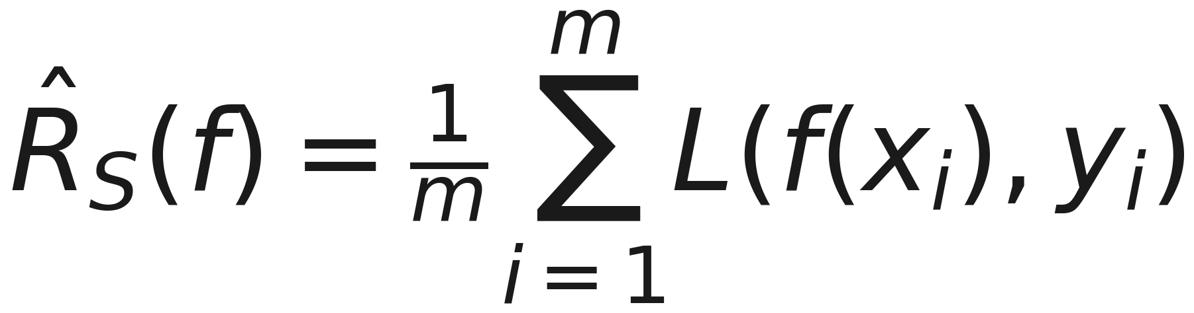
What we can actually compute
Average loss over the finite sample we happen to hold:
Notes:
Empirical risk. Minimising it is empirical risk minimisation, and essentially every method in this course is an instance of it - linear regression, logistic regression, trees, neural networks. Different function classes, same principle.
Say what L is, or it stays a placeholder all lesson - the next slide does it with the simplest choice, and that choice turns this formula into accuracy.
And say that choosing L is a modelling decision, not a technicality: it is where you state what counts as a bad mistake, before any model exists. Zero-one says every error costs the same, which is almost never true. Lesson 3 uses squared error, lesson 4 uses cross-entropy and then prices the two kinds of mistake separately. Handout 2.1.

Slide 18
Accuracy: the share of right answers
With the zero-one loss - 1 for a wrong answer, 0 for a right one - the empirical risk is the error rate
Accuracy = right answers ÷ all answers = 1 − error rate
141 right out of 143: accuracy 0.986, error rate 0.014
Every mistake counts the same, which is what we will see it hide
Notes:
The word has been used since the first slide and never pinned down, so pin it now, and pin it to the formula on the previous slide. Take the simplest loss there is: 0 when the answer is right, 1 when it is wrong. Then the average loss over the sample is just the fraction of wrong answers - the error rate - and accuracy is one minus it. Every accuracy in today’s notebooks is an empirical risk under a friendlier name.
The number they will see in notebook 02: the model gets 141 of the 143 test tumours right, 141 / 143 = 0.986, so the error rate is 2 / 143 = 0.014.
Flag the last bullet now and come back to it: the zero-one loss charges a malignant tumour sent home exactly what it charges a benign one sent to biopsy. That is the confusion-matrix slide later today, and lesson 4’s subject. Handout 2.1.

Slide 19
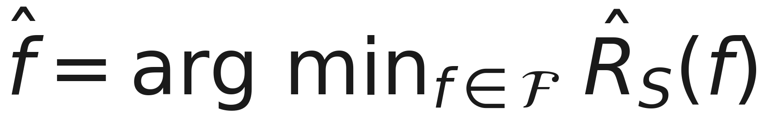
Learning, in one line
Notes:
The whole of “learning” in one formula, and it reads left to right as a sentence. F is the family: every model we are willing to consider - all the threshold rules on the next slide, all the weighted sums of the 30 features in notebook 02. R-hat is the empirical risk from two slides back, the training error. And arg min means “the member of the family where that error is smallest” - not the smallest error itself, the model that achieves it. f-hat, with the hat, is that model: an estimate, picked from data, of the f we really want.
So two decisions are made before any data arrives - which family F, which loss inside R-hat - and the data makes the third: which member of F wins. The next slide shows the arg min being taken, one candidate at a time. Handout 2.1.

Slide 20
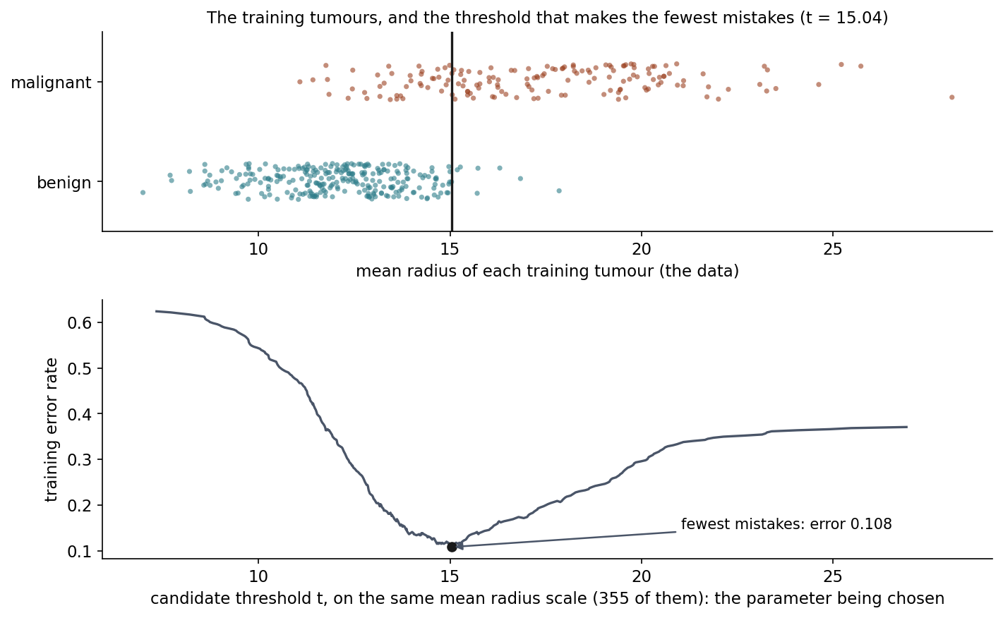
Learning is a search
Notes:
Before reading the curve, say what the two axes are, because they share one scale and are not the same thing. Top: each training tumour’s radius - the data. Bottom: the candidate threshold t - the parameter being chosen. They can share an axis only because this parameter is itself a radius value. Written as a linear model the rule is “malignant if w1 * radius + b > 0” with w1 fixed at 1, so the number being searched for is the intercept, b = -t = -15.04. Any positive w1 gives the same rule (w1 = 2, b = -30.08 is still “radius above 15.04”), so with one feature only the threshold matters. In lesson 2 the parameters are two coefficients, and this curve becomes a surface.
What “fit” actually does, on the smallest model there is. One feature - the mean radius of the tumour - and one family of rules: call a tumour malignant if its radius is above a threshold t. Every value of t is a different candidate model.
Top: the 426 training tumours along the radius axis, malignant above, benign below. Bottom: the training error rate of every one of the 355 candidate thresholds - a threshold halfway between each pair of neighbouring values. Learning, here, is literally this: try them all, keep the one with the fewest mistakes. It is t = 15.04, with training error 0.108, so training accuracy 0.892. On the 143 test tumours it never saw it scores 0.888.
Then generalise in one sentence each. The real model in notebook 02 does the same thing - choose a family, score every member on the training data, keep the best - with all 30 features, a far richer family (weighted sums of the features), and a smarter search than trying every candidate one by one; lesson 3 shows that search. It gets to 0.986.
Ask the room: what could go wrong with minimising the training error instead of the error we actually care about, on new tumours? Give them a moment. Here the two numbers are close, 0.892 and 0.888, because a one-threshold family is too small to memorise anything. Someone usually says “with a richer family it might not generalise”, which is exactly right and is the next slide. Notebook 02, section 5; handout 2.1.

Slide 21
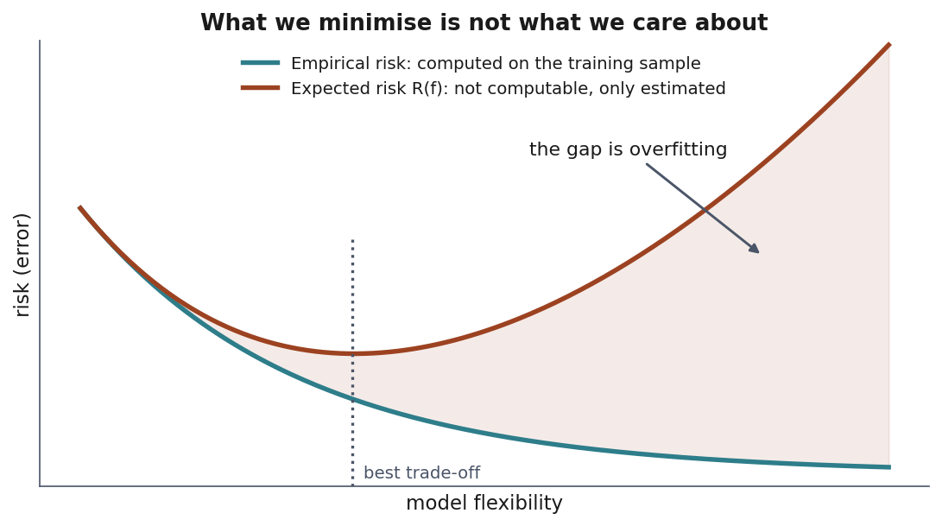
The gap that explains everything
We minimise the empirical risk
We care about the expected risk
Notes:
The central slide of the lesson. Walk the figure carefully.
Empirical risk falls monotonically as the model gets more flexible - more parameters always fit the sample better, and with enough of them you reach zero by storing every example and reciting its answer.
Expected risk turns back up. The shaded region between the curves is overfitting: the model has learnt the sample rather than the pattern.
Expect this question, because it is the right one to ask: if R(f) cannot be computed, what is the red curve? Answer in three steps. First, the two curves are not the same quantity measured on two datasets - empirical risk is an average over a sample you hold, expected risk is an average over the whole distribution, so there is no second R(f) “on the training data”. Second, empirical risk can be computed on ANY sample, and on rows the fitting never touched it is an unbiased estimate of R(f) - that is what a test set buys, and section 2.3 is the argument. Third, the red curve is drawn, not measured: in a simulation where we choose the true function ourselves R(f) really is computable, and lesson 5’s notebook 02 measures exactly this shape over 300 generated datasets.
The consequence for practice: performance on data you fitted to is ALWAYS optimistic and sometimes meaningless. Handout section 2.2 makes the argument in full.
Note the dotted line - the best trade-off - and say we spend lesson 5 learning to find it honestly, and lessons 3 and 7 meeting the two standard tools for controlling it, regularisation and ensembling.

Slide 22
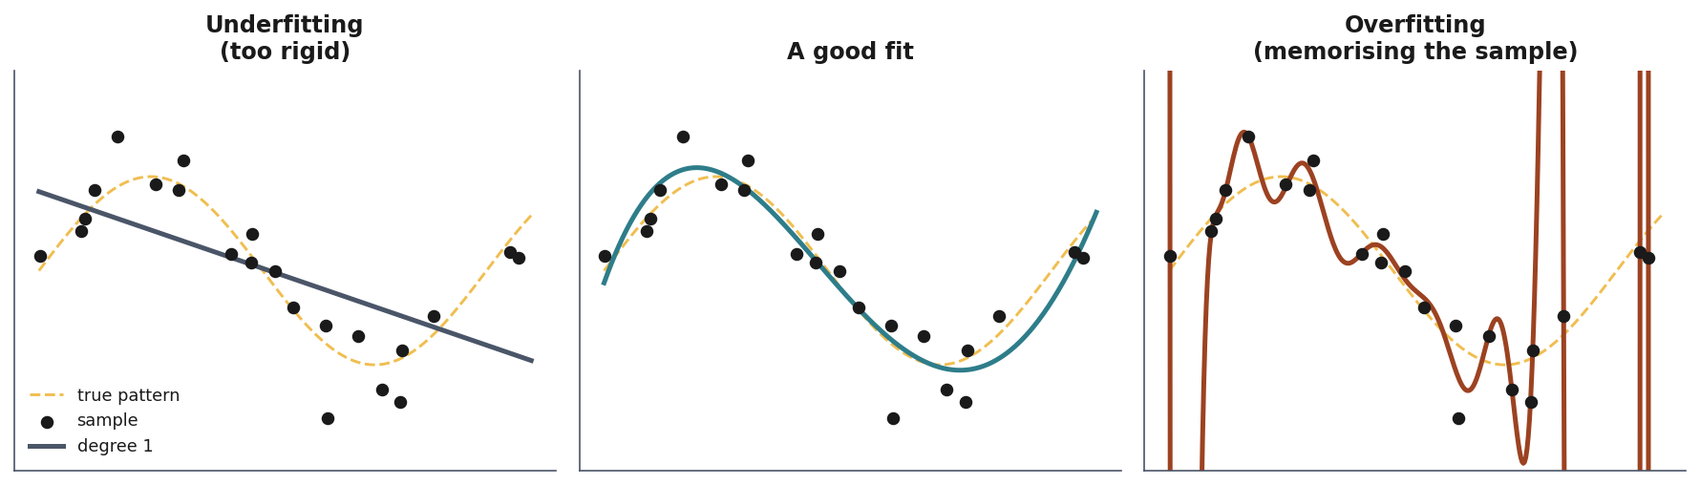
The lowest training error is the worst model
Notes:
Three fits to identical points. Left: a straight line cannot follow the curve, so it is wrong everywhere in the same way - high bias, poor on training AND test data. Right: degree-18 passes through nearly every point and oscillates wildly between them - it will be badly wrong on anything new.
Ask which one they would choose without seeing the dashed line. That is the real situation: the true pattern is never visible, only the sample.
Point out the trap in the right-hand panel - it has the LOWEST training error of the three. If you selected a model by training error you would pick it every time. That is precisely why we hold data out.

Slide 23
Which gives us the one rule for today
Hold out part of the data. Never let the fitting procedure touch it. Measure there.
Notes:
Say clearly: this is not bureaucratic caution, and give the reason rather than the instruction. Handout sections 2.3 to 2.5 carry the full argument.
The difficulty is not that a sample is small. It is that if the same data both CHOOSES the model and JUDGES it, the judgement stops being an unbiased estimate. The analogy that works: a revision session that happens to rehearse exactly the exam questions. Nobody cheated - the same questions both shaped the preparation and judged it.
Why a held-out set repairs it: if the test set played no part in choosing f, it stays independent of f, and the error measured on it is an unbiased estimate of the expected risk - the quantity we just said was not computable. Worth putting on the board.
Be precise about “unbiased”, because it is easy to over-read and somebody will. The average is taken over ALL the test sets of that size we might have drawn, not over the one we did draw. Our particular test set is still too high or too low by some amount; what the argument buys is that it is not too high SYSTEMATICALLY. One test set gives one draw from a distribution centred on the right answer - which is exactly why the next question is how wide that distribution is.
Stress what that argument depends on: the INDEPENDENCE of the test set, not its size or its proportion. The moment those rows influence any decision - a mean for scaling, a ranking for feature selection, a comparison between models - the independence breaks and the estimate is optimistic by an unknown amount. That is why the rule is “nothing is learned before the split” rather than “keep some data aside”.
Warn them we will break exactly that independence later today and watch 77% accuracy appear out of coin-flip labels.
If someone asks “how much do we hold out?” - typically 20-30%, and the trade-off is real in both directions. A bigger test set gives a more stable estimate; a bigger training set gives a better model. Say what “more stable” means before using it: the standard error is how far the measured accuracy would typically move if you drew a different test set of the same size, and it shrinks as one over the square root of m, the number of TEST examples - so quadrupling the test set halves the error bar, and that is the only way to buy precision. Give them the concrete number from notebook 02: 143 test examples at 0.986 accuracy carries a standard error of about one percentage point, so the third decimal place is noise. If anyone presses on the interval, concede it: 0.986 of 143 is two errors, the normal approximation is not admissible there - it returns an upper limit of 100.5% - and the honest lower bound is 95.0%, not the approximation’s 96.7%. Handout section 2.4 works it through. With a few hundred examples both sides hurt at once, which is what cross-validation exists for - lesson 5.
If someone asks “what if I try ten models and report the best?” - they have just selected using the test set, and the number is optimistic again. That is the bridge to the validation set, and to lesson 5. Today we need only train and test because we make no choices: one model, no tuning.

Slide 24
When not to use machine learning
The rule is known: write it
The data is not representative of deployment
Errors are certain, unrecoverable and unreviewed
The data encodes an injustice you would automate
A simple baseline already suffices: always give the most common answer
Notes:
Unfashionable and immediately useful - handout section 3.
First point: nobody should train a classifier to detect whether a number is even. It sounds obvious and is violated constantly, usually because ML is the interesting option and a rule is boring.
Second: a model learns the distribution it was trained on. Sample from one hospital, deploy in another, and the measured accuracy says very little.
Third, and expect this one to be challenged, because it sounds like something you could only know after deploying. Make the point that all three judgements are available before any code is written.
The model WILL be wrong - not might be. Section 2.2 settled that, and today’s best model gets 2 of 143 wrong. You cannot know which 2 in advance; if you could, you would fix them. Whether a wrong answer can be undone is a fact about the application - a misfiled ticket is reopened, a wrong dose is not. Whether a person sees the output before it acts is a fact about the deployment, not about the weights.
Certain, unrecoverable and unseen: no accuracy figure rescues that design, and you knew all three before you started.
Worth adding if someone raises it: “unexplainable” is partly a choice. A short tree in lesson 7 states its reasoning; a linear model in lesson 3 attributes the answer feature by feature. If somebody must justify the decision to the person it affects, that belongs in the framing step, where it rules families in or out.
Fourth: a model is not neutral because it is mathematical. It is a compressed summary of the decisions in its training data. We return to this at the end of the lesson.
Fifth: often a threshold on one variable solves 90% of the problem, is understandable by everyone, and needs no maintenance. Establishing baselines - step 4 of the workflow - is partly how you discover this before building something complicated.

Slide 25
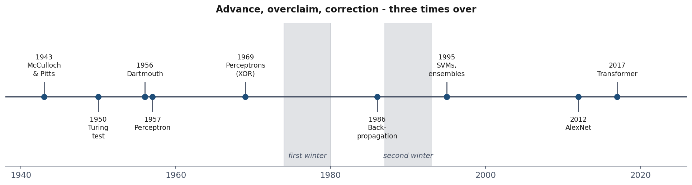
Seventy years in one picture
Notes:
Open the history section with the whole arc visible, then walk the individual moments. Resources/history_of_ai.md has the full version with primary sources - tell them it is worth an hour and is not examinable in itself.
The two grey bands are the AI winters. Point at them now and say the question for the next ten minutes is what caused them, because the answer is not “the technology did not work”.

Slide 26
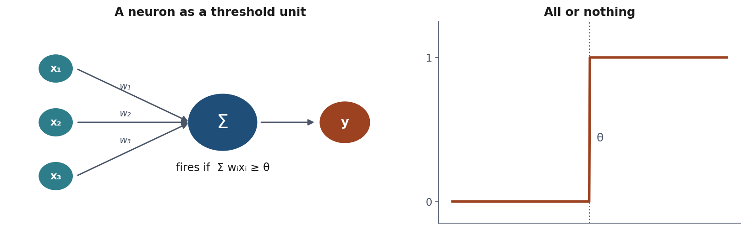
1943: the first artificial neuron
A neuron as a threshold unit: it fires when the weighted sum passes θ.
Notes:
A neurophysiologist and a logician. Their claim was philosophical as much as technical: thought might be computation. They showed networks of such units can compute any logical proposition.
Weights were set by hand - nothing learned yet. That comes in 1957.
Tell them the unit in lesson 9 is this unit with a smoother threshold. The history is not decoration; it is the same objects under different names.
Walk the diagram: inputs, a weight on each, a sum, and a hard threshold. Then point at the right-hand panel - the step function is what makes it all-or-nothing, and it is exactly what gets replaced by a smooth sigmoid in lesson 4 and by ReLU in lesson 9. Same object, softened, so that it becomes differentiable and therefore trainable.

Slide 27
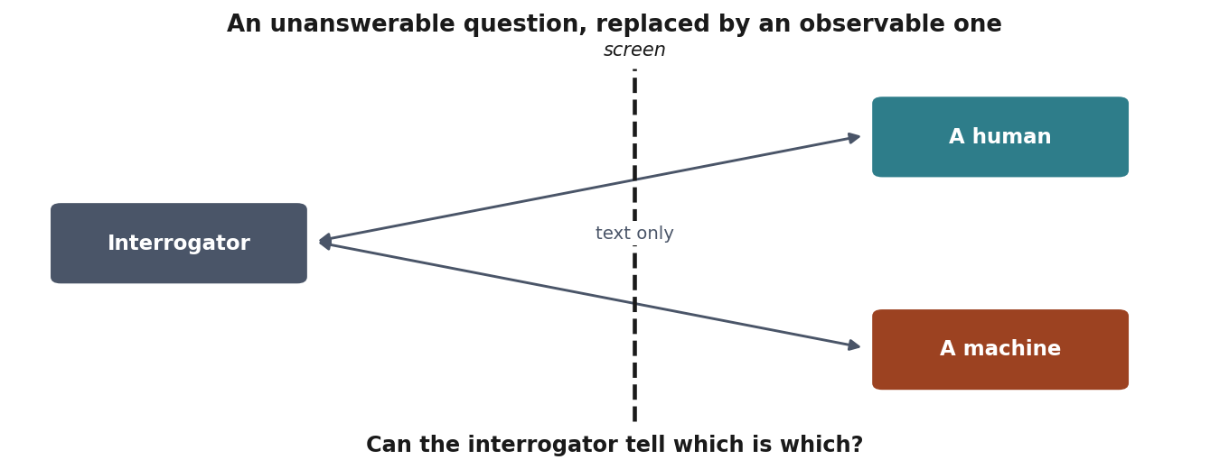
1950: Turing’s imitation game
“Can machines think?” becomes a question you can settle by observation.
Notes:
Highlight the MOVE rather than the test. Turing opens by declaring the original question too meaningless to deserve discussion, and substitutes an operational one.
That is exactly what they do every time they choose a metric: replace something that cannot be measured - “is this model good?” - with something that can. It carries the same obligation, to stay aware of the gap between the proxy and the thing itself. The whole of lesson 4 is about that gap for classification.
Recommend the paper. It is readable, funny, and answers nine objections including “a machine can only do what it is told” - his reply, that this assumes we can foresee the consequences of what we tell it, has aged extremely well.
The screen is the whole design: it removes appearance, voice and everything except the behaviour being tested. Ask the room what this test does NOT measure - understanding, consciousness, correctness - and note that Turing knew, and argued the substitution was worth making anyway.

Slide 28
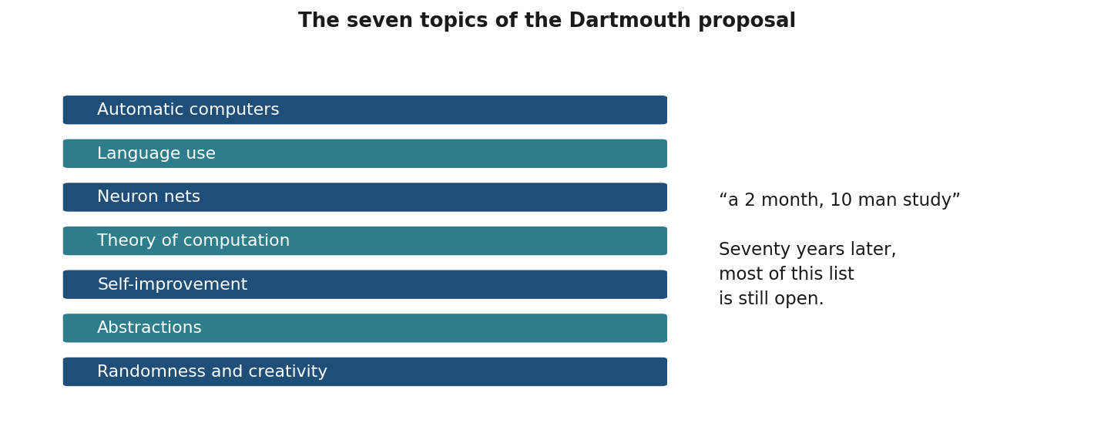
1956: Dartmouth
The term artificial intelligence is coined.
Notes:
Let the room react to “two months”. Seventy years later the problem is open.
McCarthy, Minsky, Shannon and Rochester convened it. The optimism is not incidental - it is present at the field’s naming and it recurs on a cycle, which is the argument of this whole section.
These are the seven topics from the actual proposal. Read two or three aloud - ‘self-improvement’, ‘randomness and creativity’ - and let the room judge how much of the list is settled. Then note that the proposal’s authors expected substantial progress on all of it in one summer.

Slide 29
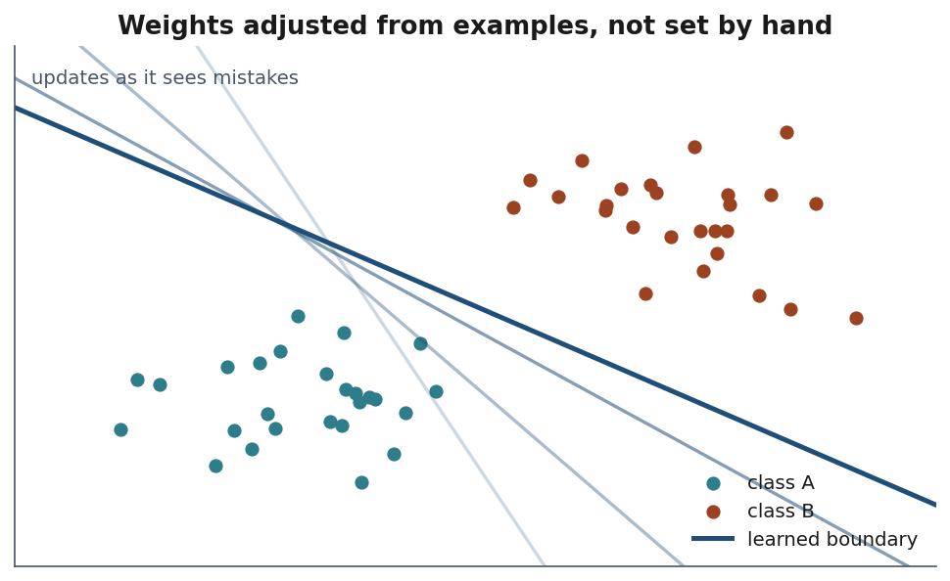
1957: the perceptron learns
Rosenblatt: weights adjusted from examples, not set by hand.
Notes:
The first machine that learns. Physical hardware - photocells, potentiometers, motors.
Stress the CONDITION on the theorem: “if linearly separable”. The theorem is true and that clause is carrying enormous weight, as 1969 will show.
Then the contrast: the New York Times reported the Navy expected a machine that would walk, talk, see, write and reproduce itself. Same year, same machine. Ask them which of those two statements a careful reader could have checked.
The faded lines are earlier states of the boundary. Every time the machine misclassified an example it nudged the weights, and the line moved. That is the whole idea: the model is corrected by its own mistakes, which is still what gradient descent does in lesson 3 - just with a smoother update rule.

Slide 30
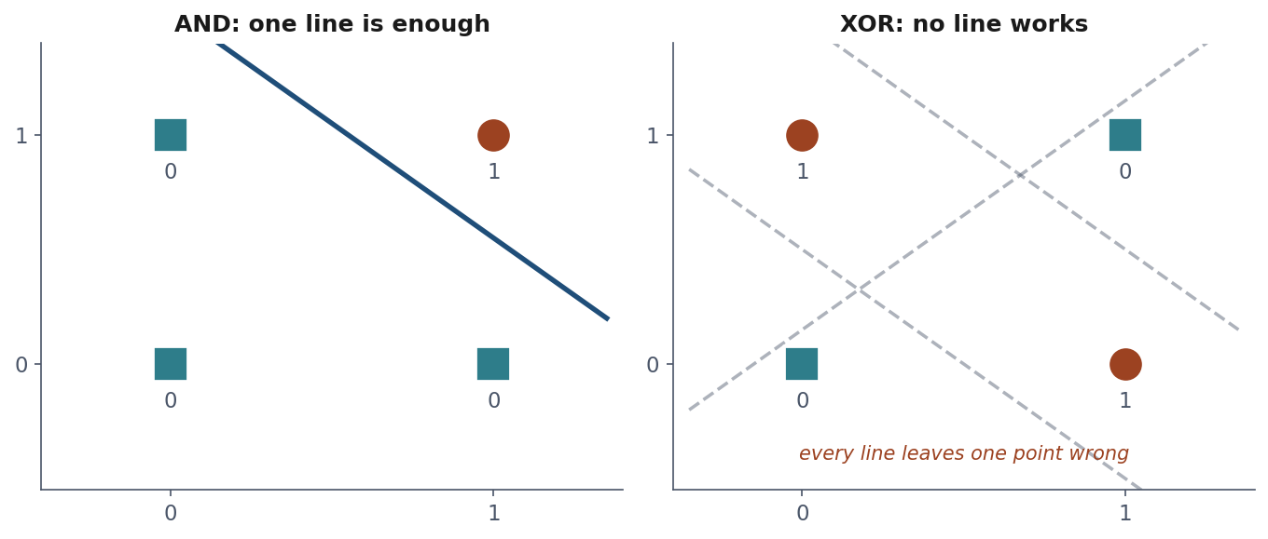
1969: the first winter
A single-layer perceptron cannot represent XOR.
Notes:
Draw XOR on the board - four points, alternating labels - and let them see that no single straight line separates them. Takes thirty seconds and lands permanently.
Then the key point: the result applies to ONE LAYER. Multi-layer networks were already known to be more expressive; what was missing was a way to train them. That distinction was lost in the retelling, funding collapsed, and neural network research became close to unpublishable for a decade.
In lesson 9 a hidden layer disposes of XOR in four lines of Keras. Fifteen years of lost time for a limitation that a correct reading would have scoped much more narrowly.
The transferable lesson: a correct result about a restricted case was received as a verdict on the whole approach. That failure mode is alive and well in how ML results get reported today.
Use the figure instead of the board. AND on the left: one line, done. XOR on the right: the dashed lines are attempts, and each leaves a point on the wrong side. Ask them to try to find one that works before you move on - the impossibility is more convincing when they have looked for it themselves.

Slide 31
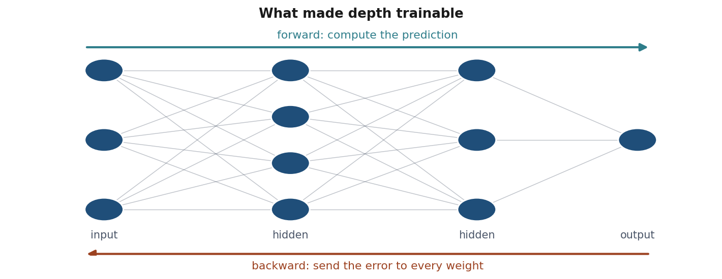
1986: backpropagation
An efficient way to train multi-layer networks.
Notes:
Rumelhart, Hinton and Williams. Note the technique had been derived before - Linnainmaa 1970, Werbos 1974 - without taking hold. Ideas need context as much as correctness, which is a useful thing for a researcher to know.
The second winter arrived in the early 1990s: networks were hard to train, needed more data than existed, and took too long on the hardware. Expert system companies collapsed as their products proved unmaintainable.
Lesson 9 derives this algorithm.
Two passes: forward to compute a prediction, backward to distribute the error across every weight, including the hidden ones. That second arrow is what was missing in 1969 - not expressiveness, but a way to assign blame to a unit that never sees the target directly. Lesson 9 derives it.

Slide 32
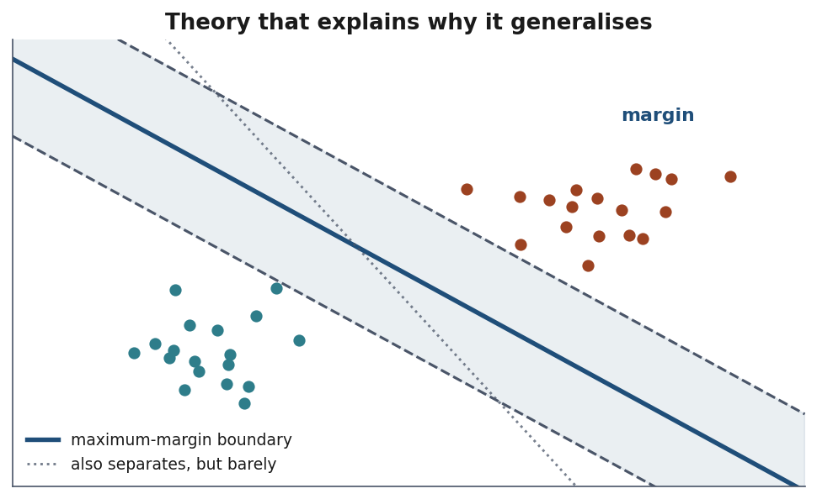
1995-2010: statistics takes over
From “simulating intelligence” to “estimating functions from data”.
Notes:
Say that most of this course lives here, and it is where the reliable tools come from. SVMs arrived with theory explaining WHY they generalise. Random forests and boosting won competitions for a decade. The bias-variance decomposition and cross-validation became standard practice.
It is unglamorous and it is what actually gets deployed. Lessons 5, 6 and 7 are this period, and lesson 5 in particular is its central contribution.
The dotted line also separates the classes perfectly, and would score identically on this training data. The SVM picks the solid one - the boundary furthest from both classes. Ask which they would trust on a new point near the middle. That intuition is what the theory of the period made precise, and it is lesson 6.

Slide 33
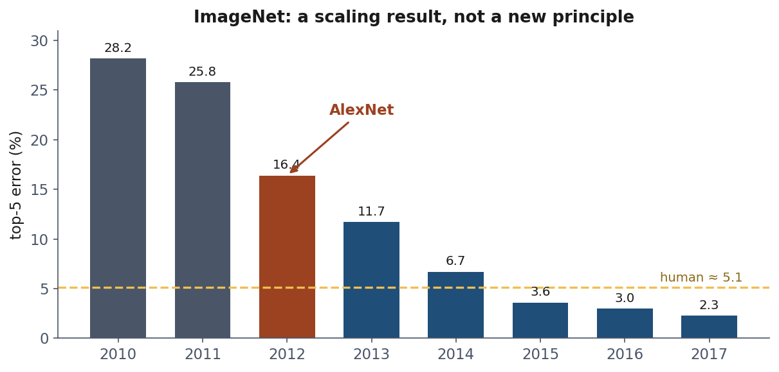
2012: AlexNet
The architecture was recognisably LeNet, from 1989.
Notes:
The most important slide in the history section.
What changed was DATA - ImageNet, 1.2 million labelled images, assembled over years - and COMPUTE, two consumer GPUs. Plus details that mattered: ReLU activations, dropout, augmentation.
A conceptual advance would have been visible in 1989, when LeCun was already reading postal codes with convolutional networks. This was a scaling result.
Saying so is not a criticism. It is the single most important fact about the last decade, and it licenses very different predictions than a conceptual breakthrough would.
Read the bars left to right. Two ordinary years, then the drop, then everyone adopts the approach and the error keeps falling past human performance by 2015. Point out that the years after 2012 fell further than 2012 itself did - the story is not one heroic result, it is a field switching methods.

Slide 34
The pattern
Advance | Overclaim | Correction
Perceptron learns | Machines that walk and talk | XOR, first winter
Backprop trains depth | Networks solve everything | No data, second winter
Scale delivers | ? | ?
Notes:
Leave the question marks and ask the room what belongs there. It usually produces a good discussion, and there is no answer you need to supply.
Three things to draw out. First, distinguishing a demonstrated result from an extrapolated promise: Rosenblatt’s theorem was true, “it will reproduce itself” was not, and both appeared in the same press cycle. Second, asking what changed - idea or resources. Third, and this is the one they will use professionally: the winters were caused by the gap between claims and evidence, not by the technology being worthless. The perceptron was genuinely useful; it was oversold.
Then make the connection explicit: the habit that prevents this is the same one we use to evaluate a model - state precisely what was measured, on what data, and what that does not establish.

Slide 35
Three kinds of learning
The taxonomy divides by where the target comes from, not by algorithm.
Notes:
Correct the common misconception immediately, before it takes hold. It is not about which algorithm you use: the same estimator can serve more than one setting, and they will see exactly that in notebook 01 where the supervised regression and the self-supervised task run identical code.
Handout section 5 has the full taxonomy.

Slide 36
Supervised
The answer is recorded by somebody, outside the measurements.
Category → classification
Continuous → regression
The cultivar is not a measurement: it is an answer written down
In code: a classifier such as LogisticRegression, a regressor such as LinearRegression
Notes:
Lessons 3, 4, 6 and 7 are all supervised, so this is most of the course.
Ask what the expensive part is. Someone will say the labels, and that is right: in practice labels - not algorithms, not compute - are what limits most real projects. Somebody has to produce them, correctly, in quantity, and for many problems that is expensive or simply impossible.
Give the concrete example: ImageNet took years of human annotation, and it is the reason 2012 happened when it did rather than in 1995.

Slide 37
Unsupervised
No targets at all. Find structure.
Groups → clustering
Fewer dimensions → dimensionality reduction
Odd points → anomaly detection
In code: KMeans for groups, PCA for fewer dimensions
Notes:
Lesson 8.
Plant the difficulty now, but plant the right one. It is NOT that there is nothing to minimise - k-means minimises the within-cluster sum of squares, which is an empirical risk in the sense of the slide before the break, with the loss measured against the model’s own summary instead of a label. Lesson 8 derives it and proves the algorithm decreases it every step.
What is missing is ground truth to check the answer against. The algorithm ALWAYS returns clusters, whether or not the data contains any groups. Whether they mean something is a judgement about the domain and cannot be delegated to a metric. It is a validation problem, not an optimisation one - and the distinction matters, because they will meet that cost function in lesson 8 and remember what was said here.
Worth thirty seconds: the overfitting gap survives the loss of the labels. One cluster per point drives the cost to exactly zero. Same memorisation, different clothes.
This is genuinely harder than supervised learning to do well, which is the opposite of how it is usually taught - it looks easier because there is no labelling effort.

Slide 38
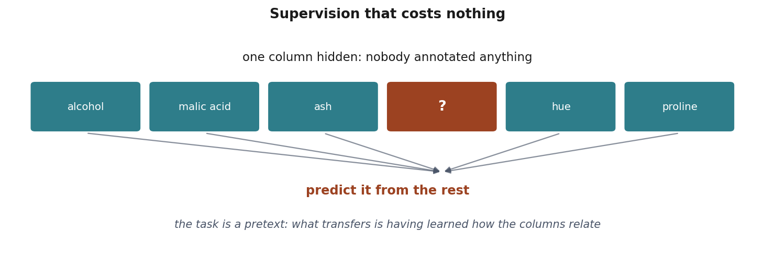
Self-supervised
Hide part of the input. Predict it from the rest.
Nobody annotates anything, and the supervision is real.
Notes:
An intuition, not a method: they meet the technique properly in a later course, and today only needs them to recognise the idea.
Say it in one breath. Nobody labels anything; you take part of the input and treat it as the answer. The value is real - flavanoids is a genuine measurement in the table - but nobody asked for it to be predicted. You use it because it is already there, which is why the supervision is free.
Then the contrast with the previous slide, because it is the whole distinction: in supervised learning the answer lives OUTSIDE the measurements and somebody recorded it - the cultivar. Here the answer is ONE OF the measurements.
The reconstruction is a pretext: nobody wants a flavanoid predictor. The reason anyone does it is that the model has to learn how the measurements relate, and that can be reused on a task you care about. Say plainly that the notebook stops before that step - a linear regression has nothing worth reusing.
Scale the idea up - hide a word in a sentence, hide a patch of an image - and it is how modern large models are trained. This is the honest one-paragraph answer to “how does ChatGPT learn?”, and it is worth giving them, since they will be asked it at every family dinner.

Slide 39
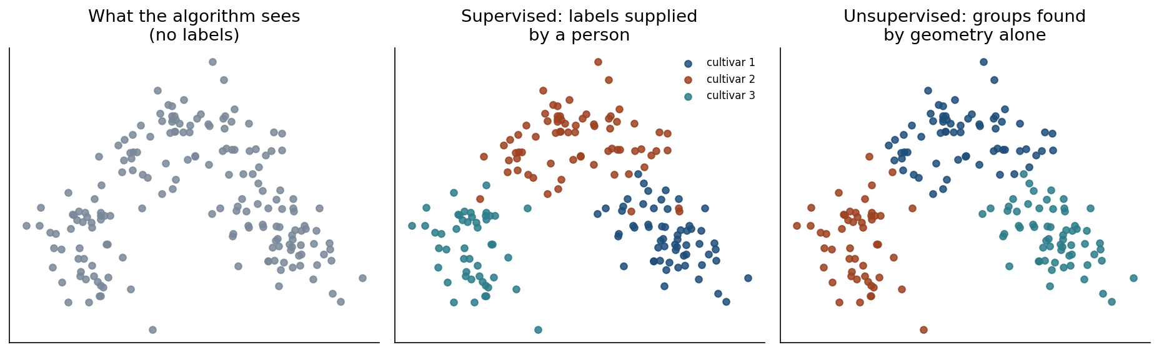
One dataset, three questions
Notes:
Work notebook 01 here, live. The same 178 wines appear in all three panels.
Left: what the algorithm sees when there are no labels - just points in space. Middle: labels supplied by a person. Right: groups found by geometry alone.
Point out that the cluster colours do not match the label colours. k-means numbers its groups arbitrarily, and without labels there is nothing to align to. That arbitrariness IS the point of the unsupervised setting.
Warn them the strong agreement here - adjusted Rand index 0.897 - is a happy accident of this dataset, where the chemical groups really are geometrically separated. Do not expect it. In most real data, clustering finds structure that corresponds to nothing you care about.

Slide 40
Where the target comes from
 | Where the answer comes from | Cost | Measurable?
Supervised | Recorded by somebody | Expensive | Yes
Unsupervised | Nowhere | Free | Not directly
Self-supervised | Part of the input | Free | Only the pretext
Notes:
Read the cost column aloud: it explains why self-supervision dominates wherever data is abundant and annotation is not, and why supervised learning still wins whenever someone has already paid for good labels.
Then read the right-hand column and flag the trap: in two cases out of three you cannot straightforwardly measure success at the thing you actually want. That is a much bigger practical problem than the choice of algorithm, and it is why unsupervised results are so often oversold.

Slide 41
Notebook 1, live
question | you call, and what it scores
the data: 178 wines, 13 measurements | load_wine
supervised: predict the cultivar | make_pipeline(StandardScaler(), LogisticRegression()) → accuracy_score 0.981
unsupervised: labels thrown away | KMeans(n_clusters=3), drawn with PCA → adjusted_rand_score 0.897
self-supervised: hide flavanoids, predict it | LinearRegression → r2_score 0.816 (1 perfect, 0 = guessing the mean)
before either model with a target | train_test_split
Notes:
The table is the map for the notebook: each row is one of the three questions, the call that answers it, and the number it reaches. Point at the middle column before they start - every name in it is a cell they are about to run.
Open notebook 01 and run it. Twenty minutes, and it is the only place today where all three kinds appear on identical data, which is the whole argument of this segment made operational.
The point to keep repeating as you scroll: nothing about the table changes between the three results. Same 178 wines, same 13 chemical measurements. What changes is where the answer comes from - recorded by somebody, nowhere at all, or one of the measurements themselves.
Two moments worth stopping on.
The unsupervised score, 0.897, is suspiciously good, and the notebook says so: it is a happy accident of this dataset, where the chemical groups really are geometrically separated. Say plainly that this is not what clustering usually looks like, or they will leave expecting it.
The self-supervised cell against the supervised one: ask the room what is different about the two targets. The cultivar is an answer somebody wrote down, not a measurement; flavanoids is one of the measurements, used as an answer because it was there. That is the distinction the segment has been building to.
If time is short, drop the R² aside and the n_init experiment; keep all three results, because the comparison is the content. Handout section 5.

Slide 42
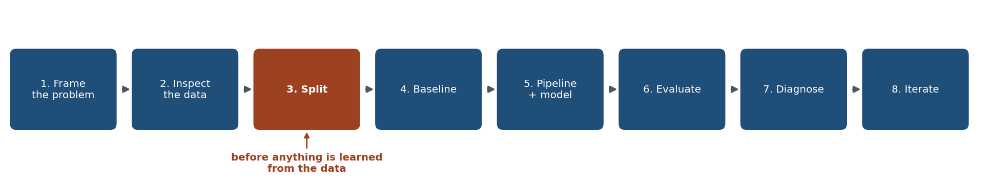
The workflow
Notes:
Say the order is not a convention: several steps are only valid in this order, and step 3 is the one that cannot move - hence the colour.
This is the map for notebook 02, which the next slide starts. Tell them to open it and follow along rather than watch.
Handout section 6 has each step in full. The two they will be tempted to skip are 1 and 4 - framing and baseline - and those are the two that make the difference between a result and a number.

Slide 43
Notebook 2, live
step, and its slide | you call
look, 46 | load_breast_cancer
split, 47 | train_test_split(X, y, test_size=0.25, stratify=y)
baseline, 48 | DummyClassifier, always the majority class
model, 49 | make_pipeline(StandardScaler(), LogisticRegression()), then .fit()
result, 51 | .score(X_test, y_test)
errors, 52-55 | ConfusionMatrixDisplay, classification_report, predict_proba
Notes:
A question, a dataset, a split, a baseline, a model, and a number you can defend. The table is that sentence with the code attached: each step, the call that performs it, and the slide where the idea was introduced. Students who get lost in a cell can find their way back to the slide from here.
45 minutes, and it runs alongside the next twelve slides rather than instead of them: each step of the workflow is a slide and then the cell that performs it.
Three moments to stop on together. The split, because it happens before anything is learned and that is the whole rule of the day. The baseline at 0.629, because it is what makes 0.986 mean something. And the threshold sweep at the end, where the same model - unchanged, same weights - goes from missing no malignancy with eleven false alarms to missing seven with none.
Tell them to run it themselves rather than watch: everything after this in the course assumes they have a working environment, and this is the session where a broken one shows up.

Slide 44
Step 1: frame it
What is predicted, from what?
Who would use it, for what decision?
Which error is worse?
Notes:
The step everyone skips, and the one the exercise marks hardest.
Our example: predicting whether a breast tumour is malignant from measurements of cell nuclei. A model here would be a screening aid, never a diagnosis - say that clearly, it matters.
The two errors are not comparable. A false alarm costs anxiety and a follow-up test; a missed malignancy can cost a life. Ask the room which they would rather make, and let them answer before showing any metric.
That answer determines the metric, and it must be fixed BEFORE seeing results. A metric chosen afterwards is a metric chosen to flatter - with enough candidates, one always looks good.

Slide 45
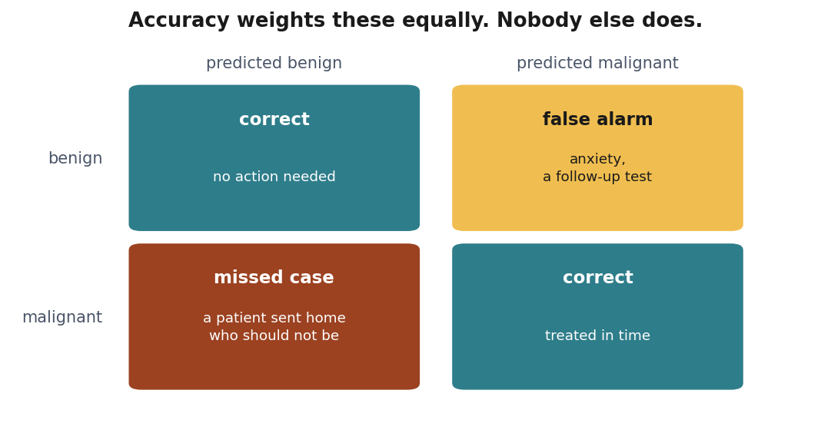
Which error is worse?
Notes:
One problem, four outcomes, and the two failures are not the same size. Two of these cells are fine and two are not, and accuracy adds all four up as though they weighed the same.
Ask the room which of the two failures they would rather make, and let them answer before any metric appears. A missed case sends home a patient who should not go; a false alarm costs anxiety and a follow-up test. Nobody needs statistics to rank those.
Then the part that makes it a lesson rather than an anecdote: answering requires knowing who bears the cost, which is not a question about data. Change the application and the answer changes with it - on a spam filter the expensive cell is the legitimate mail that got blocked, not the spam that got through. The ranking comes from the application, and it has to arrive before any modelling decision is made.
Lesson 4 turns this into a threshold that can be computed. Today it is enough that they see the question is not a modelling question, and that answering it with accuracy answers it by accident.

Slide 46
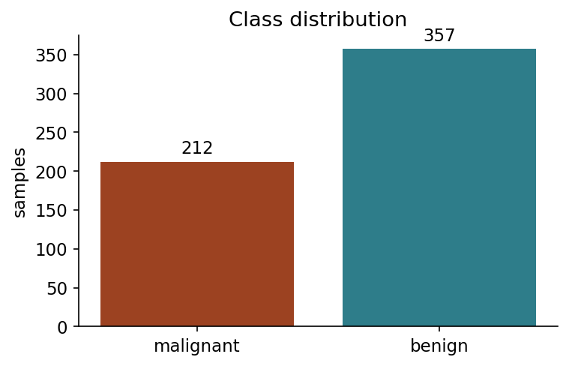
Step 2: look first
Notes:
569 samples, 30 features, 357 benign against 212 malignant.
Get them to compute the consequence out loud: always answering “benign” is right 62.7% of the time. That number is the bar any real model has to clear, and it is why step 4 exists.
Mild imbalance here. Later today we will see what happens at 99 to 1, where the same reasoning destroys accuracy as a metric entirely.

Slide 47
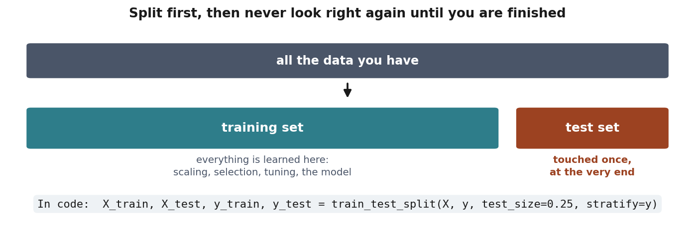
Step 3: split, before anything else
Before scaling. Before selecting features. Before looking at correlations with the target.
Notes:
Return to the risk_gap figure verbally - this slide is that argument made operational.
The moment anything from the test rows influences a decision, even something as innocent as computing a mean for scaling, the test set stops being unseen and the number it gives you is optimistic.
Mention stratify=y: it keeps the class proportions identical in both parts, so the test set is a fair miniature of the whole. Without it, on a small or imbalanced dataset, you can get a test set whose composition differs from the training set by chance.
They will violate this deliberately in the third notebook and see what it costs.
The caption under the test set is the whole discipline: touched once, at the very end. Say that every additional look spends some of its independence - if you test twenty variants and report the best, you have selected on the test set and the number is no longer honest.

Slide 48
Step 4: baseline first
Predict the majority class. Nothing else.
62.9% on the test set
Everything from here is measured against that.
In code: DummyClassifier(strategy="most_frequent")
Notes:
If someone remembers 62.7% from the class-balance step: that is the share of benign tumours in all 569. The baseline is scored like the model, on the 143 test tumours, where 90 are benign - 62.9%, the 0.629 the result slide quotes. The stratified split keeps the two close; they differ only because 143 is a small sample.
Without this, “96% accuracy” has no scale at all. With it, they can see whether the model is worth anything.
DummyClassifier does this in two lines, and the exercise requires it.
Foreshadow: on the imbalanced example later, the baseline will be unbeatable on accuracy and completely useless in practice. That is the lesson, not a curiosity - it is how you discover that accuracy is the wrong metric for your problem.

Slide 49
Step 5: pipeline, not two steps
model = make_pipeline(
StandardScaler(),
LogisticRegression(max_iter=5000),
)
model.fit(X_train, y_train)
Notes:
LogisticRegression is the model, and today it can stay a black box with one property worth saying: it belongs to the family of slide 20, weighted sums of the features, searched for the weights with the fewest training mistakes. Lesson 4 opens the box.
Explain WHY, not just what.
StandardScaler LEARNS something - a mean and a standard deviation per feature. That makes it part of the model, not preparation of the data. Inside a pipeline it learns them from the training fold every time the pipeline is fitted, including inside each cross-validation fold in lesson 5.
Write the two steps separately and one day you will scale using statistics computed over the whole dataset. Nothing warns you: no error, no exception, just a better number than you deserve.
This is structure beating discipline, and it is the single most useful habit in the scikit-learn API.

Slide 50
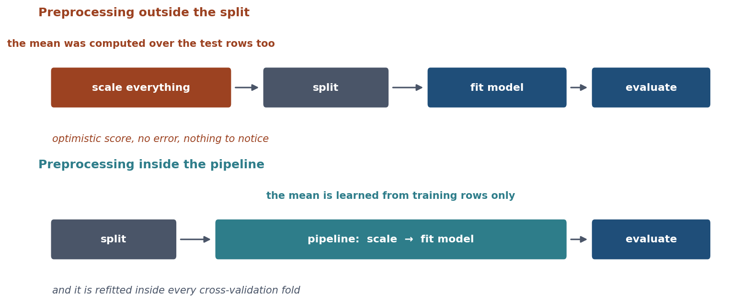
What the pipeline prevents
Notes:
The same two steps, done in the two orders, with what each one shows the test set.
Point at the top row and at where ‘split’ sits on it: after the scaling. That is the whole mistake, and it is one line out of order.
On the manual side the scaler is fitted on everything, so the mean and the standard deviation it subtracts already contain the test rows. The model is then evaluated on data it has, in a small way, already seen. The score comes out slightly too high, and nothing anywhere raises an error.
Emphasise that last part. This is not a mistake that announces itself: it produces a working notebook and a plausible number. Lesson 2 measures what it costs on a real dataset, and lesson 5 gives it its name.

Slide 51
Step 6: the result
Baseline: 0.629
Model: 0.986
In code: baseline.score(X_test, y_test), then model.score(X_test, y_test)
Done?
Notes:
Let “done?” hang for a few seconds. Someone will say no.
If nobody does, ask what 0.986 does not tell them. Then move to the confusion matrix - this is the pivot of the entire lesson.

Slide 52
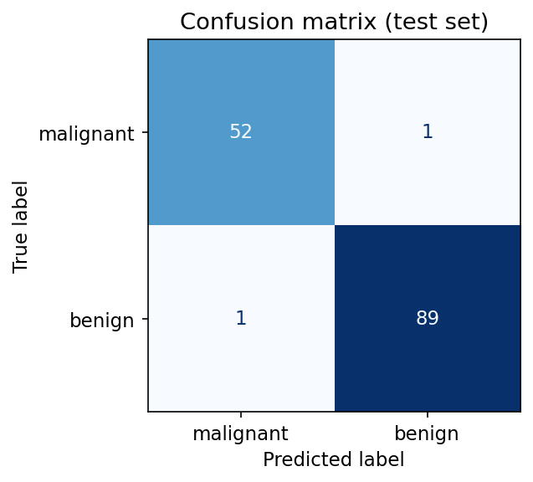
What accuracy hides
Notes:
One malignant tumour classified as benign.
As a fraction it is 1 in 143 and vanishes into the accuracy figure. As a consequence it is a person sent home who should not have been.
Say that sentence deliberately and let it sit. It is the gap between a metric and what the metric stands for, and it is the most important idea in today’s lesson.
Then the practical form: accuracy collapses every kind of mistake into one number, and our two mistakes are not comparable. The confusion matrix is the minimum tool for seeing them separately.

Slide 53
Precision and recall
Recall (malignant): how many malignant tumours we caught
Precision (malignant): how often an alert is correct
They trade off against each other
In code: classification_report(y_test, y_pred) prints both
Notes:
Define both against the confusion matrix still in their heads from the last slide, and keep them the right way round: recall divides by the row of things that really were malignant, precision by the column of things we flagged. The next slide makes the trade physical.
Push recall towards 1.0 by flagging anything suspicious, and precision collapses - the clinic drowns in unnecessary biopsies. Demand high precision and you start missing cases.
No single number resolves this, because the resolution is not mathematical. It is a question about consequences and it belongs to the people who bear them - here, patients and clinicians, not the person who trained the model.
Lesson 4 builds the tools properly: receiver operating characteristic (ROC) curves, precision-recall curves, choosing an operating point. Today they need to see that the trade-off exists and that it is not the model’s decision to make.

Slide 54
Precision and recall, counted
 | what it counts | our model
true positives (TP) | malignant, flagged | 52
false negatives (FN) | malignant, missed | 1
false positives (FP) | benign, flagged | 1
recall = TP / (TP + FN) | malignant tumours we caught | 52 / 53 = 0.981
precision = TP / (TP + FP) | alerts that were right | 52 / 53 = 0.981
Notes:
The previous slide in words, this one in counts. Name the three counts against the confusion matrix two slides back - the class we care about, malignant, is the “positive” one - then read the two formulas as sentences: recall divides by everything that really was malignant, the row; precision divides by everything we flagged, the column. Same numerator, different denominator. That is the whole difference, and the one students mix up.
Someone will notice the two values are identical and ask why. It is a coincidence: one malignancy missed and one false alarm, so both denominators are 53. The next slide shows where those labels come from - and that they can be moved, at which point the two numbers part company.
Notebook 02, cell after the confusion matrix, prints the same numbers in its classification report. Handout section 7.

Slide 55
Behind every label, a probability
The model does not output a label: it outputs the probability that the tumour is malignant, predict_proba()
predict() turns it into a label by comparing it with 0.5
The missed malignancy got 0.11: called benign
The false alarm, a benign tumour, got 0.62: called malignant
0.5 is a default. Nobody chose it
Notes:
This is the step the confusion matrix hid. Until now the model has been treated as something that answers “malignant” or “benign”; it does not. It answers with a number between 0 and 1 - in scikit-learn, predict_proba - and predict is that number compared with 0.5. Where the probability comes from is lesson 4’s subject (logistic regression ends in a sigmoid); today it is enough that it exists.
Ground it in the two errors they have just counted. The one malignancy we missed was not missed by a confused model: the model gave it 0.11, so the comparison with 0.5 called it benign. The one false alarm was a benign tumour the model gave 0.62. Those are the 1 and the 1 of the matrix.
Then the question that sets up the next slide: if the label is a comparison with 0.5, what happens when we compare with something else? At 0.10 the missed malignancy is caught - recall 53 / 53 = 1.000 - but eleven benign tumours join the alerts and precision falls to 53 / 64 = 0.828. Nothing about the model changed; only the line moved. Handout section 7.

Slide 56
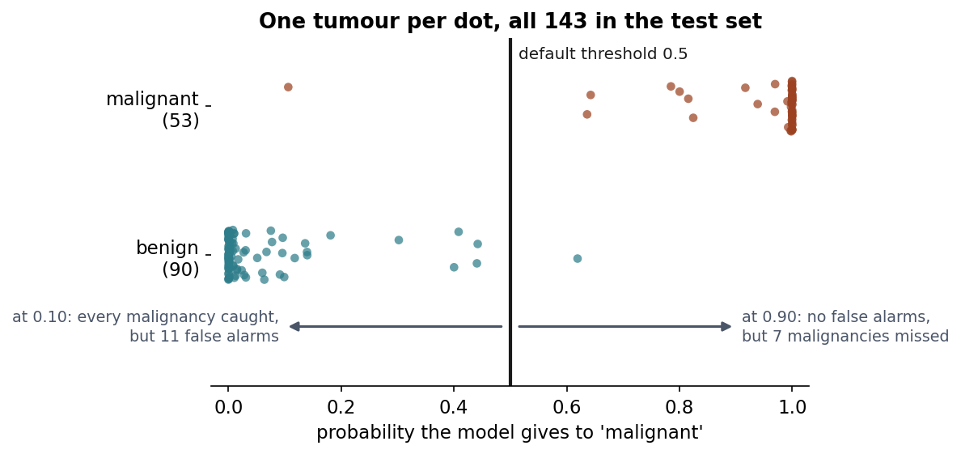
The trade-off, drawn
Notes:
Say what the axis is before anything else, because nothing else makes sense without it: every dot is one of the 143 tumours in the test set, and its position is the probability our model gave to “malignant”. Not a distance, not a score - a probability, 0 to 1.
The black line is 0.5, and it is worth saying out loud that nothing chose it. It is the default. Everything to the right of it we flag; everything to the left we send home.
Now the point of the slide. Most of the picture is the model being certain: 105 of the 143 sit within 0.02 of one end, which is where 0.986 comes from. Tell them to ignore those and look at the middle. The band from 0.11 to 0.62 holds the 12 it was unsure about - 1 malignant, 11 benign - and at 0.5 only two of the twelve are on the wrong side: the malignancy at 0.11 that we missed, and the benign at 0.62 that we flagged.
Then slide the line, and make them watch the band rather than the numbers. Down to 0.10 and it passes below the whole band: the missed malignancy is caught, and all 11 uncertain benign tumours turn into false alarms. Point at them - the eleven are countable on the slide, which is the whole reason this figure is here rather than a table. Up to 0.90 instead and no false alarm survives, at the price of 7 women sent home who should not have been.
Nothing about the model changed between those two sentences. So the question of whether it is good has no answer until somebody says which error is worse - which is the earlier slide arriving again, now with a number attached. Lesson 4 spends an hour here.

Slide 57
What we did not do
No tuning
No comparison of model families
No check of stability across splits
And: we never looked at the test set to make a decision.
Notes:
Name where each omission gets addressed: tuning and stability in lesson 5, model families in 6 and 7.
Then land the last line, which is the point of the slide: that discipline is the reason the 0.986 is worth anything at all. Every one of the four failures we are about to see comes from breaking it in some form.

Slide 58
Four ways a model misleads you
Leakage
Imbalance
Shortcut features
Single-split noise
All produce numbers that pass a casual review.
Notes:
The frame, and the next slide opens the notebook: none of these is a coding error. All four run exactly as written and return a number that a reviewer, a supervisor or a customer would accept.
This is the section they should still remember in five years. Handout section 7 summarises it, and every one of the four has been found in published work and in shipped products.

Slide 59
Notebook 3, live
failure, and its slides | you call
the model, every time, 49 | make_pipeline(StandardScaler(), LogisticRegression())
leakage, 60-62 | SelectKBest(f_classif, k=20), outside the pipeline and then inside it
imbalance, 63-64 | make_classification; accuracy_score against recall_score, confusion_matrix
shortcut, 65-66 | load_breast_cancer; SimpleImputer when the column is missing
single-split noise, 67 | train_test_split(random_state=seed) against cross_val_score
Notes:
Four failures, four plausible numbers, and not one bug among them. The table pairs each failure with the calls that produce it and the slide that explains it; note that the leakage row uses the same SelectKBest twice, once in the wrong place and once in the right one.
25 minutes, again alongside the slides that follow rather than instead of them.
Say what to watch for before they start, because the notebook is deliberately undramatic: every cell runs, nothing raises, and every number it prints would pass a review. The work is reading them.
The two cells to make sure nobody skips: the leaked selection reaching 77% on labels generated by a coin flip, and the four deployment scenarios for the shortcut column, where the two that raise an exception turn out to be the lucky ones.

Slide 60
200 samples. 5000 random features. Coin-flip labels.
There is nothing to learn.
Anything above 50% is an artefact.
Notes:
Set this up carefully before revealing anything. Make sure they understand the data is pure noise BY CONSTRUCTION - the labels come from a random number generator and no feature carries any information about them.
Ask what accuracy they expect. The honest answer is 50%, chance.

Slide 61
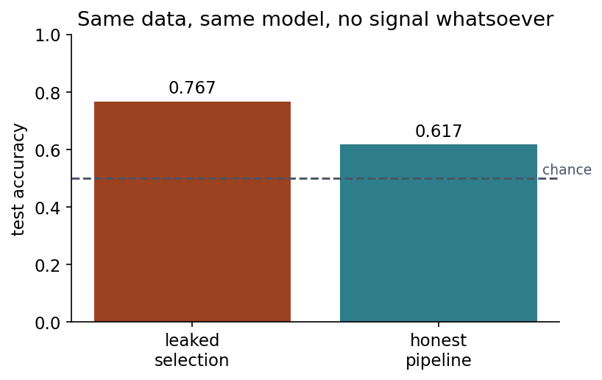
Select features first, split second
Notes:
77% on pure noise, against 50% for the honest pipeline.
Explain the mechanism: with 5000 random features, some correlate with the labels by chance. Selecting the best 20 using the whole dataset picks exactly those - including the ones that correlate with the labels of rows that later become the test set. The selection encoded information about the test labels, and the model inherited it.
Nobody wrote a bug. Selection feels harmless because it fits no model - but it LEARNS from data, so it belongs inside the training fold.
Then ask what happens with 20000 features instead of 5000. The illusion gets STRONGER, because there are more opportunities for a spurious correlation. That is the “try this” at the end of the notebook.

Slide 62
The rule
Every step that learns anything must be fitted on the training data only.
Scaling. Imputation. Encoding. Selection. Tuning.
In code: StandardScaler, SimpleImputer, SelectKBest… all inside make_pipeline
Notes:
The practical takeaway from the whole leakage section, and the thing to put on the board if anything goes on the board today.
Two of the five words are not today’s: imputation (filling missing values) and encoding (turning categories into numbers) are next week’s subject, and tuning is lesson 5’s. Name them now so the rule is already in place when they arrive - each one learns something from the data, which is the only property the rule cares about.
Pipelines enforce it structurally, which is why we used one from the first notebook.
Tell them the exercise checks this: scaling the full dataset before splitting caps the methodology marks regardless of the result obtained.

Slide 63
99% accuracy, detecting nothing
1% positives. Answer “negative” every time.
Accuracy: 0.986
Recall on positives: 0.000
In code: recall_score beside accuracy_score, every time
Notes:
The trained model in the notebook reaches 0.987 accuracy - barely above the trivial one - while missing 20 of the 21 positives in the test set.
On a problem where the positives are the entire reason the system exists.
Accuracy is dominated by the class nobody is looking for. Ask them what metric they would report to someone deploying this, and steer towards recall on the positive class - then note that recall alone is also gameable, by flagging everything, which is why lesson 4 needs a whole session.

Slide 64
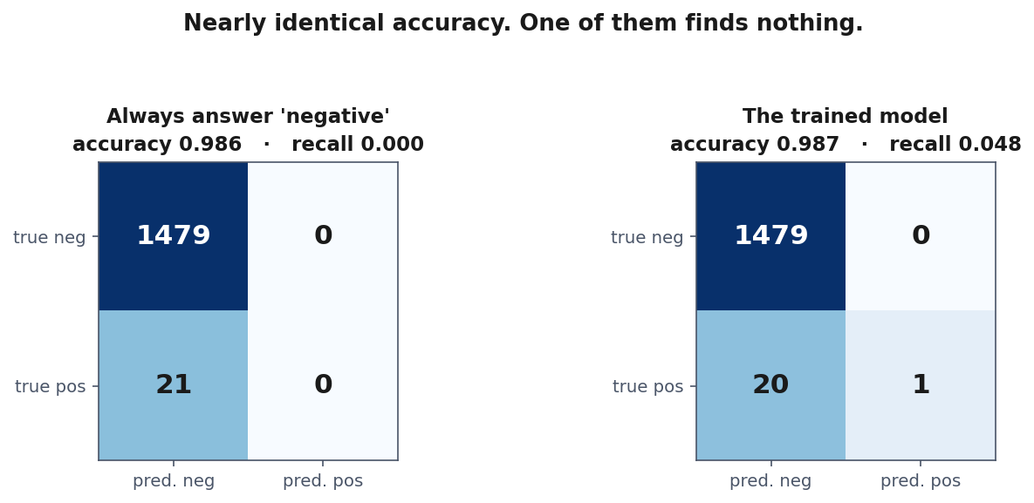
Two models, one accuracy
Notes:
Two confusion matrices side by side. Give them a moment to spot that the accuracies agree to three decimal places.
Left is the model that answers negative every time and has learned nothing whatever. Right is a trained model. 0.986 against 0.987 - and the one on the right finds a single positive out of twenty-one, which is barely better than nothing but is not nothing.
Ask what a report containing only the accuracy would say about these two, and let the silence do the work. Then point at the bottom-left cell of each: 21 missed, then 20 missed. That is the number the application cares about, and it is the one accuracy averages away.

Slide 65
Shortcut features
A column that is a consequence of the label, not a predictor of it.
biopsy_scheduled → accuracy rises → model is worthless
Notes:
Explain why it is worthless: biopsies are scheduled once malignancy is already suspected, so the field is populated AFTER the diagnosis it is supposed to predict. At prediction time for a new patient it is empty.
Then the point that makes this different from the others: no metric detects it, including cross-validated ones, because the information genuinely IS in the training data. The model is not cheating; the data is.
Only knowing how the data was recorded catches it. Ask them to imagine a hospital extract with 200 columns and no documentation - which is the normal case - and to think about how they would find this.
The question to carry: at the moment a prediction is needed, does this value exist yet?

Slide 66
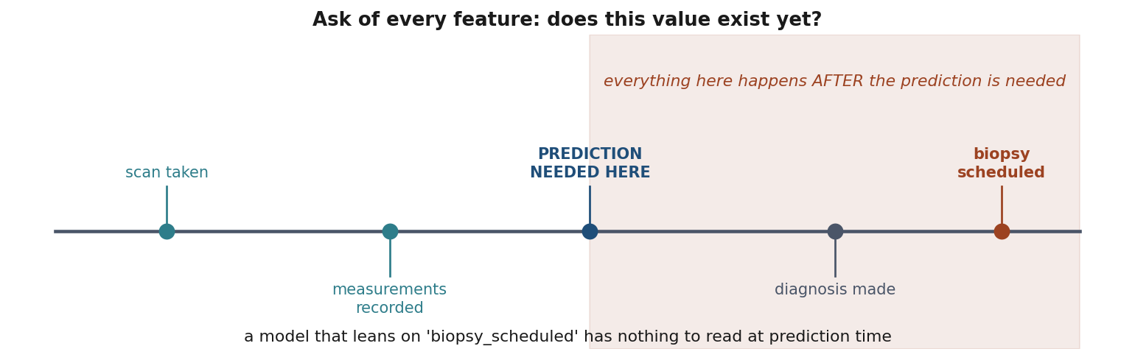
Does this value exist yet?
Notes:
A timeline, with the moment of prediction marked, and everything that happens after it shaded.
Walk left to right: the scan is taken, measurements are recorded - both before the prediction is needed, both usable. Then the shaded region: the diagnosis is made, the biopsy is scheduled. A model leaning on biopsy_scheduled scores beautifully in the notebook and has nothing to read at the moment it would actually be used.
The shaded region is the trap: everything to the right of the marked moment happens after a prediction is needed, so none of it can be an input.
The question in the title is the one to make a habit of, and it is worth saying that it cannot be answered by looking at the data. It is answered by asking somebody who knows how the data is produced. Put it to them as the thing to ask of every column in every dataset they are handed.

Slide 67
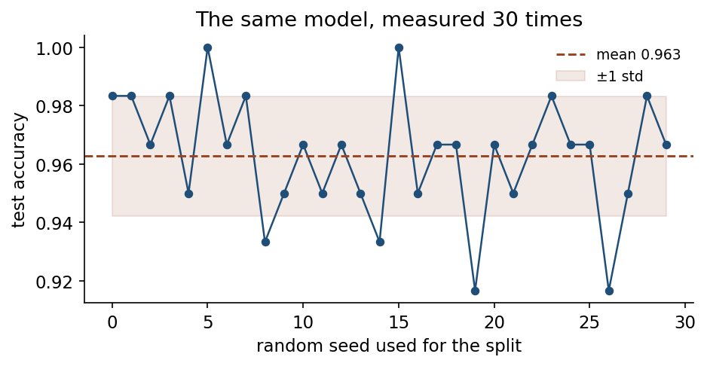
One split is one measurement
Notes:
Same model, same data, 30 different random seeds. Accuracy ranges from 0.917 to 1.000 - a spread of 0.083.
That is larger than most claimed improvements between competing methods in published work. Let that land.
Pick your favourite seed and you can report anything in that range, and a reader seeing one number cannot tell which you got. This is not fraud; it is the default behaviour of anyone who runs the code once.
Cross-validation replaces the single draw with an average and - more usefully - reports the spread. On this data, 5-fold gives 0.960 ± 0.030.
A result quoted with no indication of variability is incomplete. Lesson 5 makes this the centre of the course.

Slide 68
What the four have in common
None is a coding error.
All four run exactly as written and return a plausible number.
Notes:
They are caught by asking questions about the data and the process, not by reading the metric.
Give them the three questions to carry out of this room: where did this number come from, what does it leave out, and would it still hold on data I have never touched?
Then the professional version, connecting back to the history section: the habit of distinguishing what was demonstrated from what was extrapolated is the same habit, applied to your own work instead of someone else’s.

Slide 69
A model is not objective
It is a compressed summary of its training data, including its injustices
These methods find correlation, not cause
Accuracy is not the only property that matters
Notes:
Close the loop with the “when not to use ML” slide. Handout section 8.
If past decisions discriminated, a model fitted to them discriminates too - and it does so with an appearance of objectivity that makes it HARDER to contest than a human decision would be. “The algorithm decided” is a much harder claim to argue with than “the manager decided”.
Second point: nothing in empirical risk minimisation distinguishes a cause from a coincidence that predicts well in this sample. A model can be highly accurate and completely wrong about why - which is exactly why it fails abruptly when conditions change.
Third: whether a decision can be explained to the person affected, whether errors are recoverable, and who bears the cost of being wrong are engineering requirements. They belong in step 1, where they can still change what you build, not in a paragraph at the end of a report.
Keep this short and serious. Do not moralise - state it and move on.

Slide 70
Homework: we discuss it on Friday 9 October
Exercises/01_first_workflow.md
Wine quality: run the workflow yourself, and justify every decision.
No marks for accuracy
Marks for methodology, and for saying what your number does not mean
Notes:
Set it explicitly - do not let anyone leave without knowing it exists and when it is due.
Walk the tasks briefly. Task 1 is framing, and there is no single right answer: quality is an integer from 3 to 9, so they must decide how to treat it and defend the choice. Task 7 - repeat the split with ten seeds - connects directly to the figure they just saw.
Remind them: scaling the full dataset before splitting loses the methodology marks regardless of the score. And there are no marks for accuracy anywhere in this course.
Also point them at the quiz - 20 questions, ungraded, and the ones marked “reasoning” are the closest thing there is to the exam, because they ask why rather than what.

Slide 71
Before next week
Get the environment running
Work the three notebooks in order
Read the handout
Take the quiz
Do the exercise
Next week: data exploration, preparation, and leakage in earnest.
Notes:
Close on time and offer to stay for setup problems - it is worth twenty minutes now to avoid three people stuck for a fortnight.
Tell them lesson 2 goes deeper into data preparation, and that the leakage they saw today was the simple, visible version. The next one is subtler.
If anyone asks what to read beyond the handout: Resources/history_of_ai.md for context, and the scikit-learn “common pitfalls” page, which is the library’s own account of everything in notebook 03.

