Slide 1
Lesson 4: Classification and Evaluation Metrics
Technologies for Artificial Intelligence Fabio Antonini, Università degli Studi dell’Aquila

Slide 2
Before we start
Exercise 3, which we discuss now
Ridge, Lasso, and the choice of the penalty strength
Notes:
Nothing to collect. Ask who chose which penalty and why, and name the recurring mistake rather than praising the good answers - it is worth more to the room.
The one to watch for: choosing the penalty by looking at the test error. It is the natural thing to do because the test error is the number they were told to care about, and it is exactly the sin lesson 1 named. Today’s lesson ends up in the same place from a different direction, when we choose a decision threshold. Lesson 5 gives them the machinery to do both honestly.

Slide 3
Today: from a number to a decision
Logistic regression: the model and why the cost had to change
The confusion matrix, and why accuracy lies
Precision, recall, F1, and the threshold nobody chose
Receiver operating characteristic (ROC) curves, and where they mislead
Choosing a threshold from money
Notes:
Agenda. Flag the proportion out loud, because it is the point of the lesson: about a third of today is the model, two thirds is how to tell whether it works.
That is not padding. Fitting a classifier is one line of scikit-learn. Deciding whether the thing you fitted is any good, and reporting that honestly, is where the difficulty actually lives - and it is where working data scientists most often get it wrong in public.
If anyone asks why this comes before k-nearest neighbours and support vector machines: because every one of those needs the same evaluation apparatus, and it is better learned once, here, on the simplest possible model.

Slide 4
The question has changed
Lesson 3: given a house, how many euros?
Lesson 4: given a disk drive, will it fail?
Notes:
Draw the distinction sharply. Regression predicts a quantity; classification predicts a category. The change sounds cosmetic and forces two separate changes of machinery.
First, the model has to change, because a straight line is unbounded and a probability is not. Second, the evaluation has to change, because “how far off were we on average” means nothing when the answer is yes or no.
Ask the room for other examples of the second kind before moving on. You want them to notice that the interesting class is nearly always the rare one: fraud, disease, intrusion, equipment failure. That observation is the whole second half of today.

Slide 5
The fleet
8,000 disk drives in a data centre
Six SMART counters each: Self-Monitoring, Analysis and Reporting Technology
Label: did it fail within thirty days?
Notes:
SMART is the diagnostic data a drive keeps about itself: reallocated sectors, spin retries, read error rate, temperature, hours in service. Expand the acronym on the slide and out loud - it is the kind of thing that gets skipped and then quietly blocks a student for the rest of the hour.
The data is synthetic, and say why: the coefficients that generated the labels are written down in disk_data.py. Same argument as lesson 3 - a real dataset lets you admire an estimate, a synthetic one lets you check it.
One column, seek_error_rate, was generated with a coefficient of exactly zero. Do not reveal that yet. It comes back in the last section of notebook 1.

Slide 6
306
306 of the 8,000 drives failed. 3.8% of the fleet
Which means 96.2% did not
Notes:
Put this number on the board and leave it there. It is the number the whole lesson turns on, and they will meet it again as an accuracy score in an hour.
Ask, without answering: if a model has to guess for each drive, and it wants to be right as often as possible, what should it say?
Somebody will say “healthy, every time”. Agree, and move on. Do not explain the consequence yet - it lands far harder in section 5 when they see 96.2% printed as a model’s accuracy score.

Slide 7
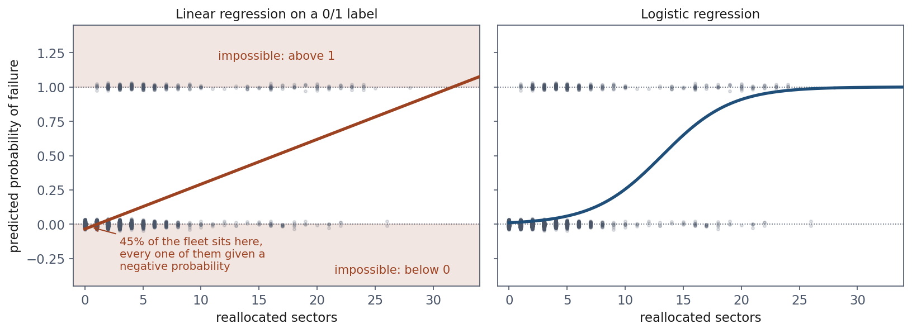
What goes wrong if we just fit a line
Notes:
This is notebook 1, section 1. Ordinary least squares on a 0/1 label, one feature. Nothing prevents it and the code runs.
The left panel: the fitted line gives a NEGATIVE probability to 3,606 of the 8,000 drives - 45% of the fleet. Not a small negative number. A negative probability. And extend it slightly past the data, to 32 reallocated sectors, and it predicts more than 1.
Say clearly that this is not a defect better fitting would remove. A straight line is unbounded, a probability is not; no slope and intercept reconcile them. The shape of the function has to change, not its parameters.
The right panel is where we are going. Same data, a curve that cannot leave the interval.

Slide 8
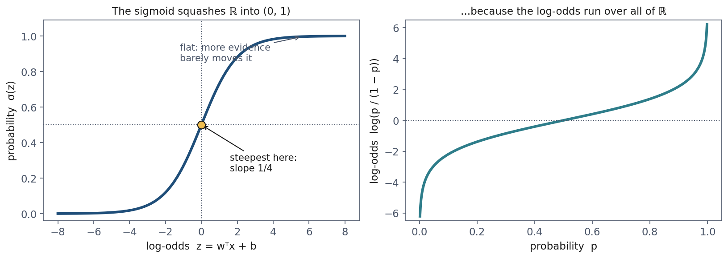
The sigmoid
Notes:
Left: the curve. Steep in the middle, flat at both ends. Make the case that the flatness is the right behaviour, not a compromise - going from 0 to 4 reallocated sectors should change your mind a lot; going from 40 to 44 should barely register, because you had already concluded the drive was finished. Evidence has diminishing returns.
Right: the same relationship inverted. This is the slide that explains WHY this particular curve and not some other S-shape. A probability is trapped in [0,1]. The odds - p over 1 minus p - remove the ceiling. The log of the odds removes the floor too, leaving something that runs over all of the real line.
And that is exactly what a linear model can safely predict. So the sigmoid is not a squashing trick bolted onto linear regression: it is what you get when you model the log-odds linearly and then ask for the probability back.

Slide 9
The model, in one line
Notes:
Read it aloud as a sentence: take the linear model of lesson 3, and instead of calling its output a prediction, call it the log-odds and convert.
Name the three properties we will use, without deriving them here - the handout section 2.2 does that: sigma of 0 is a half; sigma of minus z is 1 minus sigma of z; and the derivative is sigma times one minus sigma.
That last one is the one to flag. It is largest in the middle, one quarter, and it decays to zero at both ends. In fifteen minutes that fact will be simultaneously the reason the sigmoid works and the reason squared error does not.

Slide 10
What the coefficients mean
The model is linear in the log-odds, so exp(coefficient) multiplies the odds
Features standardised, so one unit = one standard deviation
A coefficient of 1.80 means six times the odds of failing
Notes:
This is the interpretability that keeps logistic regression in production in medicine and credit scoring. A coefficient of 1.80 means: a drive one standard deviation worse on that counter has exp(1.80), about six times, the odds of failing.
Now the mistake they will make, and it is a reasonable one. They will read “six times the odds” as “six times as likely”. For rare events those are nearly the same number, so here it is almost right - which is exactly why the habit survives until it does damage.
Give them the counterexample out loud: odds of 9, a probability of 0.90, multiplied by 5 gives odds of 45 - a probability of 0.978. The odds went up fivefold; the probability moved eight points. Odds ratios multiply odds.

Slide 11
The truth, and what we recovered
Feature | True | Fitted | Odds ×
reallocated_sectors | 1.80 | 1.66 | 5.28
spin_retry_count | 1.15 | 1.17 | 3.22
read_error_rate | 0.85 | 0.87 | 2.39
temperature_c | 0.45 | 0.47 | 1.59
power_on_hours | 0.35 | 0.38 | 1.46
seek_error_rate | 0.00 | 0.02 | 1.03
Notes:
Notebook 1, last section. This is the payoff of using synthetic data: we are not admiring the estimates, we are marking them.
Go down the column. Everything is close. Nothing is exact, and say why - 6,000 training drives carrying 230 failures is a modest amount of evidence, and 230 is the number that matters, not 6,000.
Then the last row, which is the one to pause on. seek_error_rate was generated with a coefficient of exactly zero: a real-looking counter with no connection to failure. The model estimates 0.02, an odds multiplier of 1.03. It did not fall for it.
Then ask the room the harder question: would you have noticed, if I had not told you? Leave it hanging. It is lesson 5.

Slide 12
The intercept is the base rate
Fitted intercept: −6.09
σ(-6.09) = 0.0023: a 0.2% chance for an average drive
Notes:
This is the slide that quietly explains everything in the second half of the lesson, so do not rush it.
An average drive has a 0.2% chance of failing in thirty days. For the model to reach an even bet - probability one half, log-odds zero - the evidence has to move the log-odds by more than six. Only badly degraded drives manage that.
So the model will assign small probabilities to almost everything, and a threshold of 0.5 will flag almost nothing. That is not the model being timid. It is the model being correct about a rare event. Everything that looks like a failure of the classifier in the next hour traces back to this number.

Slide 13
Fitting means minimising something, but what?
Squared error worked for lesson 3
Why not just apply it to the sigmoid’s output?
Notes:
Put the question to the room and take answers before showing the next slide. This is a good place for them to be wrong out loud, because the honest answer is not obvious and the usual first guesses (“it’s not differentiable”, “it doesn’t work for categories”) are wrong.
Squared error on the sigmoid IS differentiable, and it does produce a working model on easy problems. The reason to reject it is subtler and more interesting, which is what makes it worth ten minutes.

Slide 14
Maximum likelihood, in one sentence
The model has a knob; each setting assigns a probability to what happened
Turn the knob so that what actually happened is least surprising
Notes:
Say this before any algebra. It is the whole idea, and once they have it the derivation is bookkeeping.
Each drive contributes one factor: the probability the model gave to what actually occurred. Multiply across the fleet and you have the probability of the whole dataset under that setting of the parameters. Choose the setting that makes it largest.
Two practical notes worth saying aloud. We take the logarithm because it turns the product into a sum, which differentiates one term at a time - and because with 8,000 factors below 1 the product is about 10 to the minus 1000, which a 64-bit float stores as exactly zero. Every real implementation works in log space, and not for elegance.
Then negate, so we minimise as in lesson 3.

Slide 15
Cross-entropy, also called log loss
Notes:
This is the loss on ONE example, L, not the cost over the training set. Say the missing half rather than showing it: the cost J is the average of this over the m examples, one over m times the sum. Written out in full the formula reached the slide edge and came out at 26pt, smaller than the bullets on the slide before it.
Do not derive it here - the handout, section 3, does it in full. Show it and read it.
The reading that makes it stick: the cost of an outcome is the SURPRISE of seeing it. Something you called certain costs nothing. Something you gave a probability of one in a thousand costs log 1000, about 6.9. Something you declared impossible costs infinity.
Only one of the two terms is ever active, because y is 0 or 1. The bracket is a way of writing an if-statement in algebra, nothing more.
And the headline: nobody designed this function. It fell out of asking for the parameters that make the data least surprising.

Slide 16
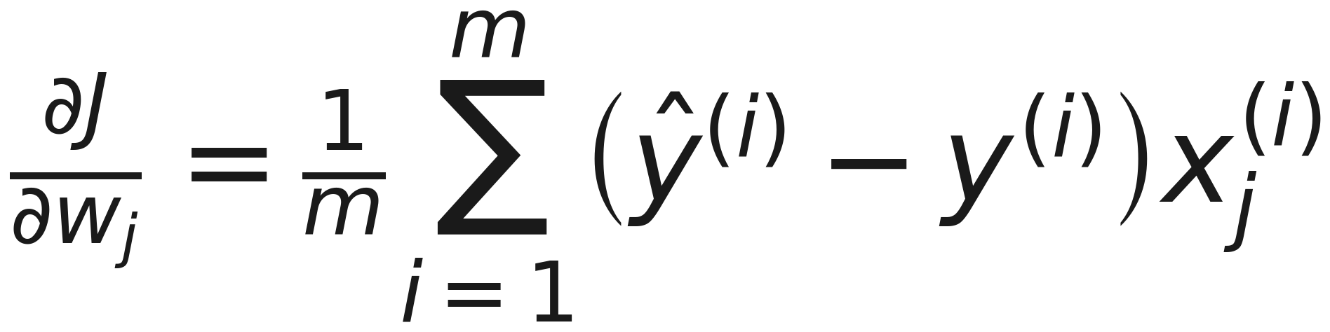
The gradient is the one you already know
Notes:
Prediction error times feature, averaged. Character for character the gradient of lesson 3, with a different model and a different cost function.
The cancellation is worth showing on the board if there is appetite: the sigma times one-minus-sigma from the chain rule cancels against the one-over-sigma from the logarithm. Handout section 3.4 has it.
If someone asks whether that is a coincidence: no. Both are generalised linear models fitted by maximum likelihood - Gaussian noise for regression, Bernoulli outcomes for classification - and the whole exponential family gives this form. They do not need that theory to use either method, but it is why the same gradient descent code, unchanged, trains both.

Slide 17
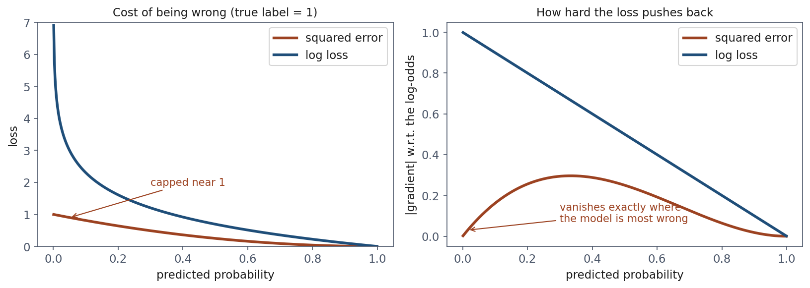
So why not squared error?
Notes:
Left panel, the costs. A drive failed and the model said 0.0001. Squared error charges 0.9998. An honest “don’t know” - 0.5 - costs 0.25. So the worst possible answer is four times worse than a shrug. Log loss charges 9.2 against 0.69, and the ratio grows without bound.
Right panel is the real argument, so spend the time here. The gradient is what the optimiser actually uses. Squared error’s gradient through the sigmoid carries a factor p times one-minus-p - which is exactly the sigmoid derivative from ten minutes ago - and that factor goes to zero as p goes to zero.
Say it as a sentence: the wronger the model gets, the less squared error asks it to change. At p = 0.001 the gradient is a five-hundredth of log loss’s. Log loss goes the other way, approaching its maximum push exactly where the error is worst.
That is the failure. Not that squared error scores badly - that it stops teaching.

Slide 18
And it is convex, which squared error is not
Log loss is convex in the weights, so any local minimum is global
Squared error through a sigmoid is not
Notes:
State it, do not prove it; the handout section 4.3 has the argument.
The consequence is practical: gradient descent on log loss cannot get trapped. Squared error through a sigmoid has no such guarantee and is in general non-convex.
Now the caution that catches people, and it is worth ten seconds because they will hit it in the notebook. Convex does NOT mean there is a closed-form solution. Setting the gradient to zero gives X-transpose times sigma of Xw minus y equals zero, which is not linear in w - the sigmoid is in the way.
There is no normal equation for logistic regression. It has to be solved iteratively, which is why LogisticRegression has a max_iter argument and LinearRegression does not. If a student ever sees a convergence warning, that is what it is about.

Slide 19
Notebook 1, live
Fifteen lines of NumPy, then one line of scikit-learn
Same answer
Notes:
Run notebooks/01. Twenty minutes. The parts worth stopping on:
The linear-fit failure - let them see 3,606 negative probabilities printed rather than being told.
The gradient/loss figure, which is the argument you just made, in code they can change. Invite them to change it: what happens to the squared-error gradient at p = 0.5?
The coefficient recovery table, including the decoy.
If time is short, skip the descent curve - it is the least surprising cell and they saw the same picture in lesson 3.

Slide 20
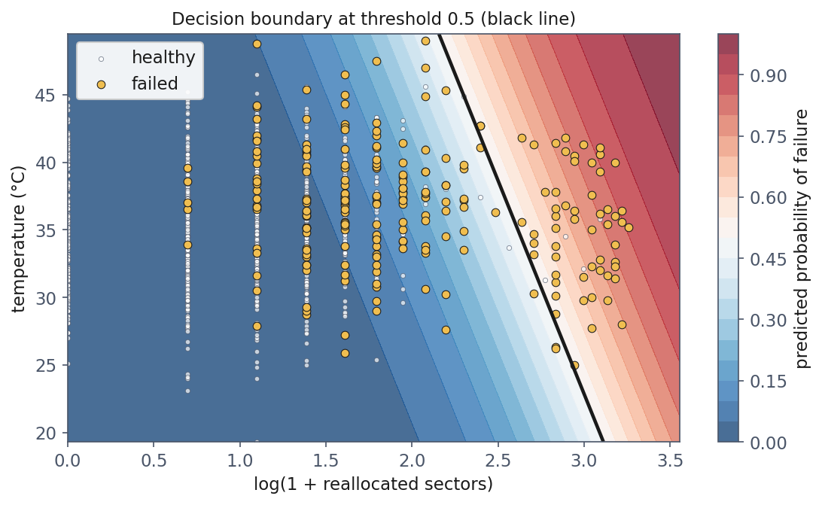
The decision boundary
Notes:
Two features, so the model can be drawn. The black line is where the predicted probability is exactly 0.5 - equivalently, where the log-odds are zero.
First observation: it is STRAIGHT. Logistic regression is a linear classifier. The curve is in the probabilities, not in the boundary. That surprises people who expected the sigmoid to bend it.
Second observation, and this is the bridge to the rest of the lesson: almost every gold point - every drive that actually failed - is on the blue side of the line. At a threshold of 0.5 this model calls nearly the whole fleet healthy, including most of the drives that failed.
Ask: is that a bad model? Take answers. Then say: the probabilities are fine. The threshold is a habit. Telling those two apart is the next two hours.

Slide 21
Break
Ten minutes
Notes:
Ten minutes. When they come back, the first slide is the trap, and it works best if they have not been thinking about it.

Slide 22
Two models
Model | Accuracy | Failures caught
Predict “healthy” for everything | 96.20% | 0 of 76
Logistic regression, threshold 0.5 | 97.70% | 43 of 76
Notes:
This is the number to remember from lesson 4. Put it up and say nothing for a moment.
A model that could be written return 0 - no learning, no data, no features - scores 96.20%. The model they just built, which finds more than half the failing drives, scores 97.70%. One and a half percentage points separate a real model from a worthless one.
The arithmetic is not subtle: 1,924 of the 2,000 test drives are healthy, so answering “healthy” collects them all for free. Only 3.8% of the test set is left to compete over.
This is the 306 from the first ten minutes, coming back as an accuracy score.

Slide 23
Why everyone makes this mistake once
Accuracy is the fraction of predictions that were right
On a balanced problem that is exactly what you want
The interesting class is almost always the rare one
Notes:
Be careful to defend the instinct rather than mock it. Accuracy is not a naive metric, and students who reached for it were not being lazy - on a balanced problem it is the correct summary and everything else is a complication.
It stops being informative precisely when one class is rare. And then list the problems: fraud, disease screening, intrusion detection, equipment failure, spam. In every one of them the class you care about is the small one.
The general statement, worth putting on the board: with a positive rate pi, the trivial always-negative classifier scores 1 minus pi. Here 96.2%. In some fraud problems, where the rate is one in a thousand, 99.9%.
Accuracy is not wrong. It is answering a question nobody asked.

Slide 24
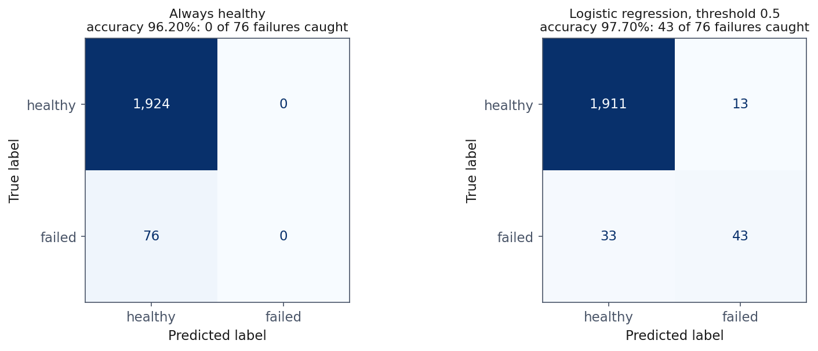
Four numbers instead of one
Notes:
The fix is to stop collapsing four outcomes into one number.
Side by side, the two models are obviously not comparable - and the number that separates them, 0 caught against 43, is nowhere in the accuracy figure.
Teach them to read the bottom-left cell first when misses are expensive: 33 drives failed and were called healthy. That is the cell that costs money, and it is the one a single-number metric hides.
Worth naming the convention while it is on screen, because half the world uses the transpose: scikit-learn puts truth in rows and predictions in columns. Any time they read a confusion matrix from a paper, check which way round it is before drawing conclusions.

Slide 25
The four outcomes, and what they cost
False positive: we replace a healthy drive. A technician’s hour, €140
False negative: a drive dies in service. Callout, rebuild, risk, €2,600
Notes:
The names are jargon until they are attached to consequences, so attach them here and keep the numbers visible - they come back at the end of the lesson when we choose a threshold.
The essential point: these two errors are NOT the same size, and no single-number metric knows that. Accuracy treats them as identical. F1 treats them as identical. Only a cost, supplied from outside the data, distinguishes them.
Ask for a domain where the ratio goes the other way - where a false positive is the expensive one. Medical screening that triggers an invasive biopsy is the usual answer; content moderation that removes a legitimate post is another.

Slide 26
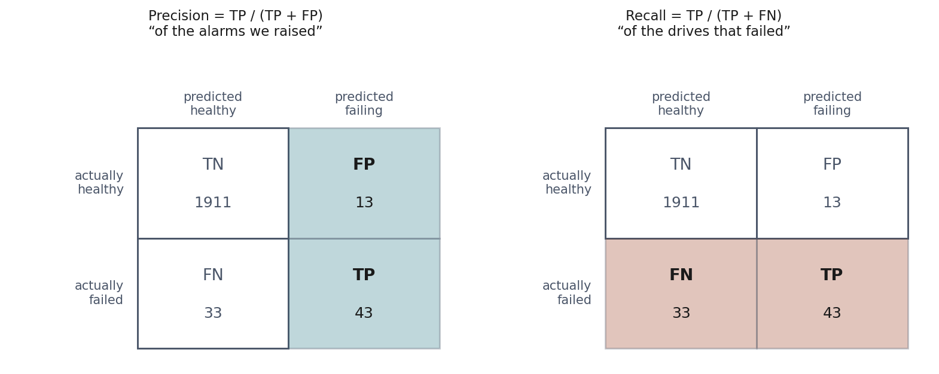
Precision and recall: look at the denominator
Notes:
This picture is the antidote to the most reliable confusion in the lesson. Both metrics divide the true positives. The difference is entirely in what goes underneath, and the shading shows it.
Precision divides by the COLUMN - everything we flagged. When this model raises an alarm, how often is it right? That is the technician’s question: how much of my time are you wasting?
Recall divides by the ROW - everything that actually failed. Of the drives that were going to fail, how many did we find? That is the operations manager’s question: how exposed am I still?
Give them the hook and make them repeat it: precision is about the alarms, recall is about the failures. When in doubt, find the denominator and ask which population it is.

Slide 27
Our model, in those terms
Precision 0.768: of 56 drives flagged, 43 really failed
Recall 0.566: of 76 drives that failed, we found 43
Specificity 0.993: of 1,924 healthy drives, we left 1,911 alone
Notes:
Read each line as an English sentence with the counts in it, not as a ratio. That is the habit worth building: a metric that cannot be said as a sentence about actual objects has not been understood.
Specificity is recall for the negative class, and one minus it is the false positive rate, which comes back in the ROC section. Mention it now so the term is not new later.
If someone asks which of the three to report: the answer is that it depends on who is asking, which is the honest answer and also the lesson.

Slide 28
F1: why the harmonic mean
Model | Precision | Recall | Arithmetic | Harmonic
Flag every drive | 0.038 | 1.000 | 0.519 | 0.073
Notes:
Take the stupidest possible model - flag every single drive - and score it. Recall is a perfect 1.0. Precision is 0.038.
The ordinary average gives that model 0.519, which looks respectable. Anyone scanning a results table would not blink at 0.52.
The harmonic mean gives it 0.073, which is the truth.
The reason: the harmonic mean is dominated by the smaller of the two numbers. A model is only as good as its weaker side, and F1 refuses to let a perfect score on one axis buy a pass on the other.
Mention F-beta in one sentence: beta above 1 weights recall more, which is what you want here where misses cost nineteen times more. F2 is the usual choice.

Slide 29
Read the minority class, not the average
weighted avg F1: 0.975 (dominated by the healthy class)
macro avg F1: 0.820 (both classes get an equal say)
Notes:
classification_report prints three summary rows and students quote whichever is biggest. Give them the rule.
The weighted average weights each class by how common it is, so on this problem it is essentially the healthy class talking, and it reads close to accuracy - inheriting exactly the blindness we spent twenty minutes on.
The macro average gives the two classes equal weight, so the rare class actually registers. 0.820 against 0.975 for the same model.
The rule: on an imbalanced problem, quote the macro average or the minority class directly. Reporting the weighted average is not incorrect - it is the number that makes a mediocre model look finished, and choosing it without saying so is how a result gets oversold.

Slide 30
Notebook 2, live
The confusion matrix by hand, then from scikit-learn
Then the threshold sweep
Notes:
Run notebooks/02. Twenty minutes.
Have them build the four counts by hand before calling confusion_matrix. It is four comparisons and it takes two minutes, and it is what makes the jargon stop being jargon.
The cell to linger on is the threshold sweep table. Do not explain it first - let them read the columns and say what they see. Somebody will notice that accuracy barely moves. That is the moment to make the next slide.

Slide 31
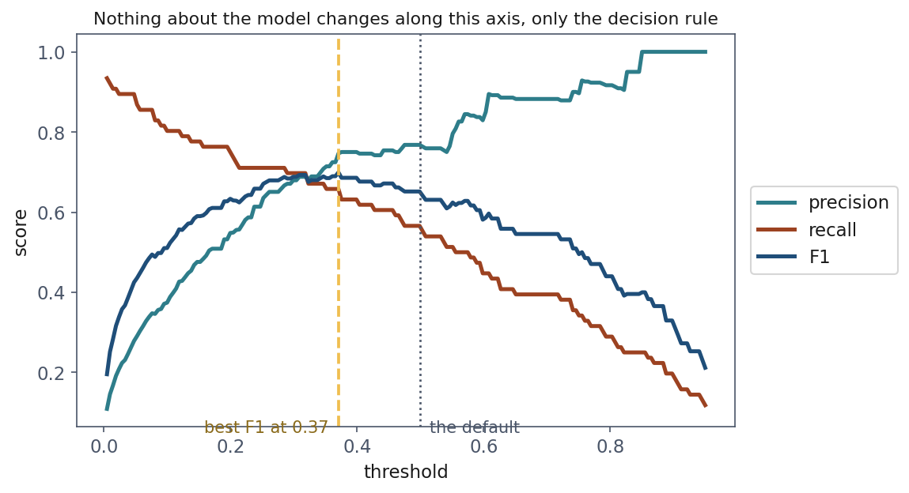
The threshold is a choice nobody made
Notes:
The title of that figure is the point: nothing about the model changes along the x-axis. Same coefficients, same probabilities, same drives. All that moves is where we draw the line between “leave it” and “replace it”.
That 0.5 is predict()’s default and nothing more. It is the right choice when the two errors cost the same AND the classes are balanced. Neither is true here, and neither is true in most real problems.
So when a paper or a colleague reports 77% precision, the useful follow-up is: at what threshold, and why that one? Most of the time there is no answer, because nobody chose it.

Slide 32
What the sweep actually costs
Threshold | TP | FP | FN | Precision | Recall | Accuracy
0.02 | 69 | 284 | 7 | 0.195 | 0.908 | 0.855
0.10 | 61 | 102 | 15 | 0.374 | 0.803 | 0.942
0.30 | 53 | 25 | 23 | 0.679 | 0.697 | 0.976
0.50 | 43 | 13 | 33 | 0.768 | 0.566 | 0.977
0.90 | 14 | 0 | 62 | 1.000 | 0.184 | 0.969
Notes:
Read it column by column with the room.
Lower the threshold: recall rises, precision falls. At 0.02 we catch 69 of 76 failures and replace 284 healthy drives to do it. At 0.90 every alarm is justified and we catch fewer than a quarter.
Now the accuracy column, which is the slide’s real argument. From 0.10 upwards it moves by three percentage points while recall falls from 0.80 to 0.18. And its maximum is at 0.5 - the threshold that misses 33 of the 76 failures.
Say the consequence plainly: tune on accuracy and it will quietly recommend catching fewer failures, because every alarm it drops was a possible false positive.

Slide 33
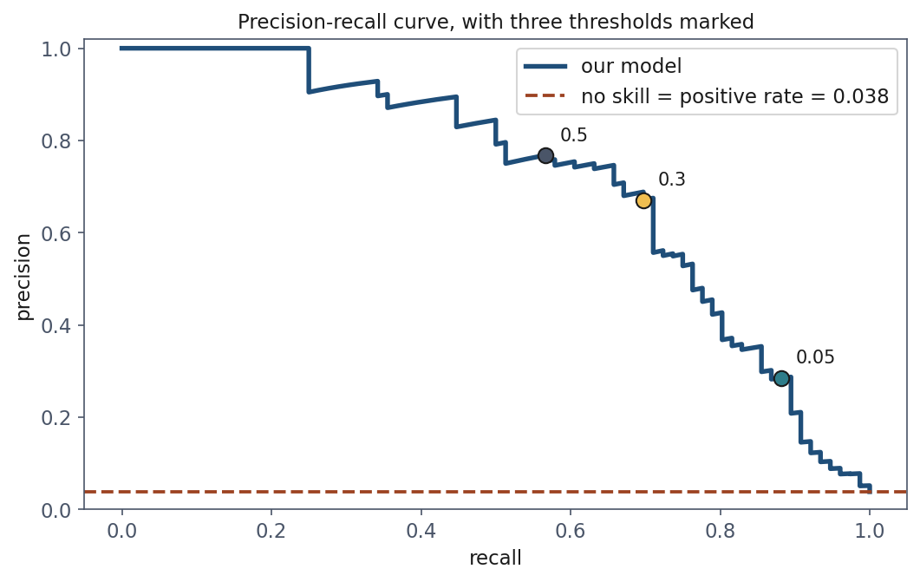
The precision-recall curve
Notes:
The sweep traced a path through precision-recall space; this is that path drawn directly. Every threshold at once.
The part to teach is the baseline. A model with random scores has precision equal to the positive rate - 0.038 here - at every recall. That flat red line, not 0.5, is what “no skill” looks like on an imbalanced problem.
That is why this curve is so much more informative than accuracy when positives are rare: the floor is where the difficulty actually is. Our model’s area under it, the average precision, is 0.717 against a floor of 0.038.
The three marked dots are the same three thresholds from the last two slides, so they can see the correspondence.

Slide 34
Comparing models without choosing a threshold
We keep evaluating at one threshold, but which?
What if we score the whole ranking instead?
Notes:
Set up the next section as a question rather than announcing a tool.
Everything so far has needed a threshold. That is fine when you know the costs, and we will come back to it. But often you want to compare two models before committing - is model A better than model B, at any operating point?
The move is to stop asking “how many did it get right” and start asking “did it put the failures at the top of the list”. That is a question about ranking, and ranking has no threshold in it.

Slide 35
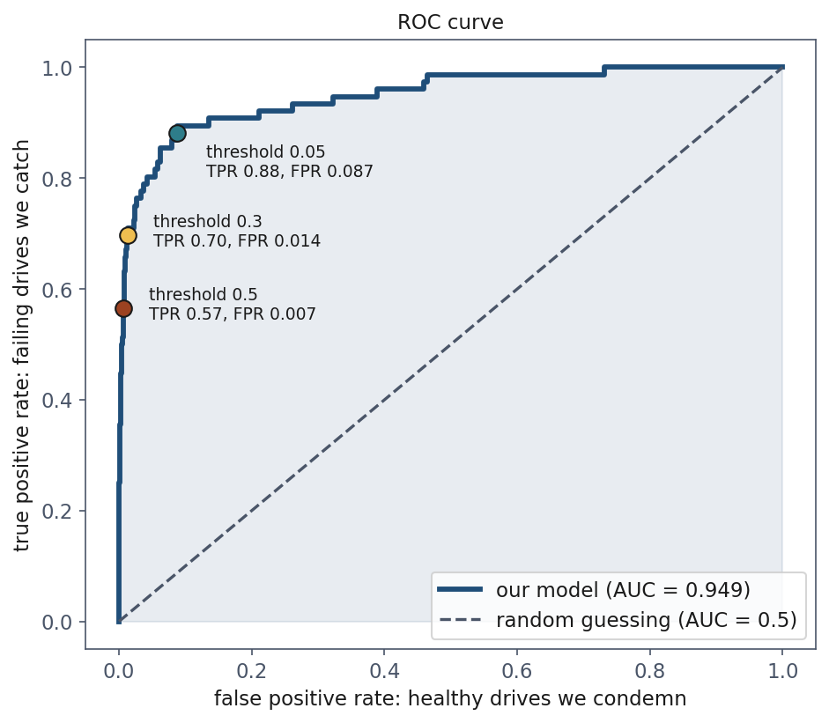
The ROC curve
Notes:
Receiver operating characteristic - expand it, and say where the name comes from, because it makes the idea concrete. Wartime radar: operators tuning receivers to spot aircraft without chasing flocks of birds. Same problem shape, literally the same trade-off.
The two axes: true positive rate, which is recall under another name - the failures we catch. False positive rate - the healthy drives we condemn.
The intuition worth saying slowly: at threshold 1 both are zero, flag nothing. At threshold 0 both are one. The entire content of the curve is the ORDER in which they get there. A good model raises TPR fast while FPR is still low, because its highest scores really are the failures. A useless model raises them together and traces the diagonal.
So the curve asks: as we grow more willing to raise alarms, do we catch failures faster than we annoy technicians?

Slide 36
What the area means
AUC = the probability that a random failing drive scores above a random healthy one
Ours: 0.949
Notes:
This is the definition to remember, and it is much more useful than “area under the curve”, which is a geometric fact rather than a meaning.
Say it concretely: pick one drive that failed and one that did not, at random. 95 times out of 100 the model gave the failing one a higher score.
That makes AUC a measure of RANKING quality. It is threshold-free because ranking is threshold-free.
The identity with the Mann-Whitney U statistic is in the handout, section 8.2, for anyone who wants the proof. But notebook 3 does something better than a proof for this audience: it draws 200,000 random pairs and counts. 0.9488 against roc_auc_score’s 0.9493.

Slide 37
What AUC does not tell you
Divide every predicted probability by 10
AUC is unchanged; every decision changes
Notes:
Short slide, important consequence. AUC depends only on the ordering, so it is invariant under any monotone transformation of the scores.
Divide all the probabilities by ten and the ranking is identical, so the AUC is identical - while the model is now badly calibrated and every threshold-based decision it makes is different.
The consequence: AUC says nothing about whether “0.7” means anything. If you need the probabilities to be believable - because you are computing expected costs, as we will in ten minutes - AUC is not the check you want.
Good place to mention calibration exists as a topic, without going into it.

Slide 38
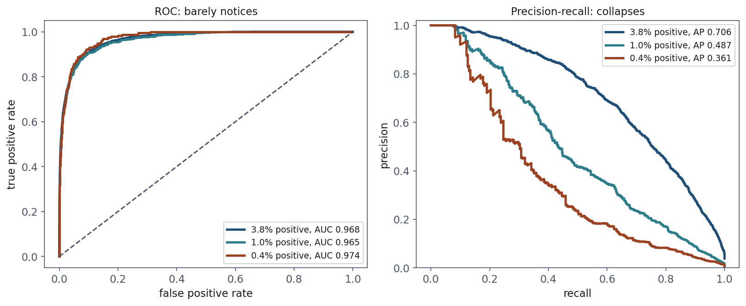
Where ROC misleads
Notes:
Same model. Not retrained. We keep every healthy drive in a fleet of 60,000 and thin the FAILURES until they are 0.4% instead of 3.8% - the direction reality moves in fraud, disease, hardware failure.
Left: the three ROC curves sit on top of each other. AUC 0.968, 0.965, 0.974. It reports an excellent model throughout, and at the rarest setting a marginally better one, which is sampling noise on 231 positives.
Right: the precision-recall curves are in three different worlds. Average precision falls from 0.706 to 0.361, and precision at the same threshold falls from 0.79 to 0.26 - two alarms in three now false.
Three curves on the left, one model, no problem. Three curves on the right, same model, a disaster. Let that sit for a second before explaining.

Slide 39
Why the two disagree
FPR divides by all healthy drives: an enormous, growing denominator
Precision divides by the alarms raised, where the false ones dominate
Notes:
The explanation is entirely in the denominators, and it is worth writing on the board.
A thousand false alarms among a hundred thousand healthy drives is a false positive rate of 0.01 - invisible on the ROC axis, a rounding error. The same thousand false alarms, set against the alarms actually raised, may be most of them.
So ROC is measuring the false alarms against a population nobody experiences. The technician does not see the 99,000 drives left alone; they see the alarm queue.
This is the second predictable mistake of the lesson, and again defend the instinct: AUC is threshold-free, comparable across models and datasets, bounded in a familiar range. Those are real virtues. It simply answers a question about ranking when the question was about the alarm queue.

Slide 40
The rule
On an imbalanced problem, report the precision-recall curve alongside AUC
Never instead of it, and never AUC alone
Notes:
Short and quotable, and this is the thing to have on the board when they write their exercise reports.
If someone asks which single number to use when a single number is demanded: average precision, because its baseline moves with the problem. But push back on the premise - the reason to demand a single number is usually to avoid thinking, and this lesson is about the thinking.

Slide 41
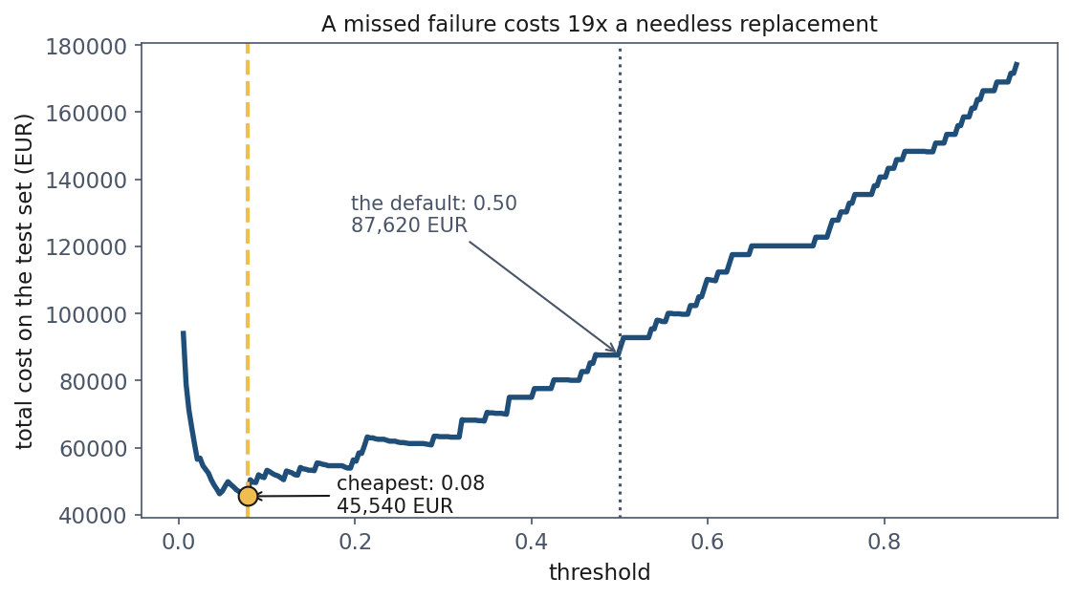
Choosing the threshold from money
Notes:
Finally, the honest way to pick a threshold. It needs one ingredient no metric can supply: what the errors cost. We wrote those down an hour ago - €140 for a needless replacement, €2,600 for a drive that dies in service.
The curve is the total cost on the test set as the threshold moves. The default 0.5 costs €87,620. The cheapest, at 0.08, costs €45,540.
Choosing the threshold on purpose HALVED the cost of the same model. No retraining, no new features, no better algorithm. One number, taken from the economics instead of from the library default.
Note the flatness around the minimum, and say why it is good news: the exact threshold does not have to be right. Which is fortunate, because cost estimates never are.

Slide 42
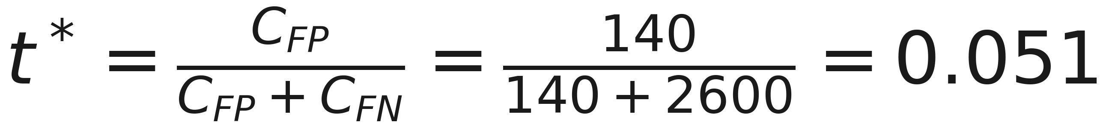
And it has a closed form
Notes:
Derive it in one line on the board, because it is two steps and it lands: flag the drive if the expected cost of flagging is lower than the expected cost of not. Flagging costs C-FP if the drive was healthy, which happens with probability 1 minus p. Leaving it costs C-FN if it fails, probability p. Set one below the other and solve.
Then read the formula rather than the number, which is the part worth remembering: the optimal threshold does not depend on the model, the dataset, or the class balance. Only on the RATIO of the two costs.
If the errors cost the same, t-star is 0.5 and the default was right all along. As misses grow more expensive, it falls towards zero.
Empirically we found 0.08 against a theoretical 0.051, and the curve is flat between them.

Slide 43
The caveat you must state
We chose the threshold by looking at the test set
That is precisely what lesson 1 forbade
Notes:
Say this out loud rather than leaving it in the handout, because it is the same mistake you may have just named to them, this morning, on exercise 3.
The threshold is a parameter. Choosing it by looking at the test set means the test set has influenced the model, and the number it then reports is optimistic.
Done properly: choose the threshold on a validation set, then measure once on test. Lesson 5 builds exactly that machinery, and this is the concrete reason it is needed - not a hygiene rule, a thing that changes the number you report.
Until then, treat the 0.08 as a demonstration of a method, not a result anyone could publish.

Slide 44
Class weights: the same lever, pulled earlier
Model | Recall | Precision | AUC | Cost
Plain, threshold 0.50 | 0.566 | 0.768 | 0.949 | 87,620
Plain, threshold 0.08 | 0.855 | 0.349 | 0.949 | 45,540
Balanced weights, 0.50 | 0.895 | 0.249 | 0.950 | 49,500
Notes:
class_weight=“balanced” makes each rare example count as many, here about 25. It changes the training rather than the decision.
Point at the AUC column: 0.949 against 0.950. Reweighting taught the model essentially nothing new about disk failure. What it did was move where the model puts its 0.5 line - the same lever as the threshold, pulled at a different moment.
That matters because class weighting is usually presented as a REMEDY for imbalance. It is not a remedy; it is a reparameterisation of the same decision. The remedy, where one exists, is more positive examples.
Where it earns its place: when a downstream tool insists on predict() and gives you no threshold to move. Then this is how you shift the operating point.
Same caution for resampling and SMOTE - and it must happen inside the cross-validation fold, for the reasons lesson 2 gave about imputation.

Slide 45
Notebook 3, live
ROC by hand, the 200,000-pair experiment, the cost curve
Then the multiclass matrix
Notes:
Run notebooks/03. Twenty minutes if the clock allows, otherwise show the pairs experiment and the imbalance comparison and leave the rest for them.
The pairs experiment is the cell worth protecting if time is short: it turns a definition they would otherwise memorise into something they watched happen.

Slide 46
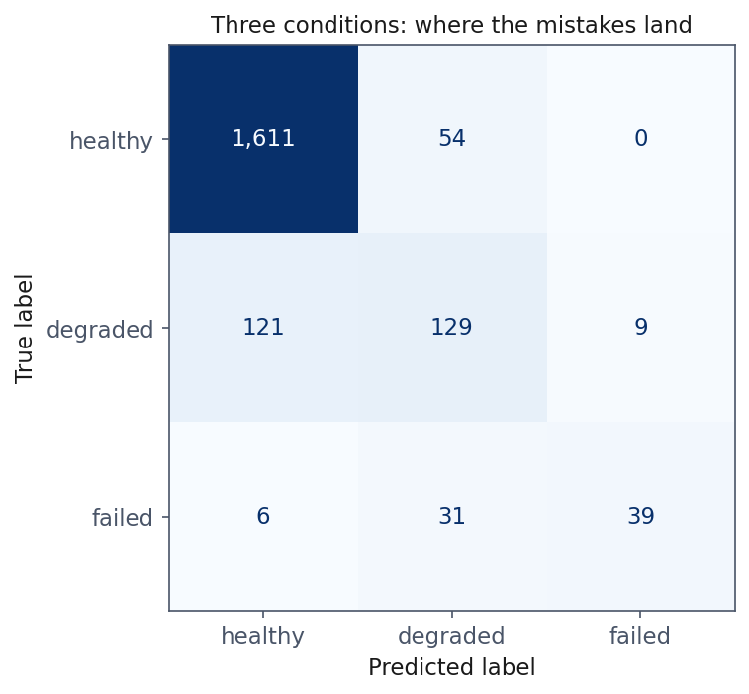
More than two classes
Notes:
Real fleets are not healthy-or-dead. A drive can be degraded: readable, but reporting errors, and worth replacing at the next maintenance window rather than at three in the morning.
For K classes the model produces one score per class and normalises them - the softmax, which for two classes reduces exactly to the sigmoid. The cost generalises to categorical cross-entropy, and it is the same idea: the negative log of the probability assigned to what actually happened. Handout section 10.
Read the off-diagonal cells rather than the accuracy. Degraded is the hard class, and understandably - it sits between two neighbours that both look like it from a distance.
Precision and recall are computed one class at a time: each class in turn is the positive one, the rest are negative.

Slide 47
Macro against weighted, one last time
macro avg F1: 0.707
weighted avg F1: 0.883
Notes:
The same choice as before, now with a much starker gap on three classes.
Macro treats the three conditions as equally important. Weighted lets the healthy class - five drives in six - do most of the talking.
Which to quote is a question about the application, not about statistics. If missing a failure matters as much as missing a healthy drive, macro is the honest one. Say which you used, always.

Slide 48
What to take away
96.20% accuracy, nothing caught. Accuracy measures the majority class
Precision is about the alarms, recall is about the failures
The threshold is a decision, and it has a formula
AUC measures ranking and hides imbalance
Notes:
Close on the number they started with. 306 failures out of 8,000; 96.2% accuracy for a model that does nothing.
If they remember one thing from today, it should be the reflex to ask “what’s the base rate?” before believing any accuracy figure. That reflex is worth more than any of the formulas.
The second thing: every metric on the slide depended on a threshold, and the threshold has an answer - C-FP over C-FP plus C-FN - that comes from the business, not from the data.

Slide 49
Homework
Exercise 4, discussed at the start of Friday 23 October
Build a classifier, choose a threshold from a stated cost ratio, defend it
Notes:
Set it explicitly and say out loud when it comes back: the first ten minutes of next Friday, 23 October.
Emphasise which part carries the marks. The classifier is a few lines and everyone will get it. The paragraph defending the threshold choice is where the learning is, and it is where the marks are.
Warn them about the trap deliberately planted: the dataset has a decoy column, as this one did, and the exercise asks them to report AUC and average precision together. Anyone reporting AUC alone will be reporting a number that looks better than the model is.
Next week: experimental methodology. Cross-validation, bias-variance, and the honest way to make every choice we made by hand today.

