Slide 1
Lesson 2: Data Exploration and Preparation
Technologies for Artificial Intelligence
Fabio Antonini, Università degli Studi dell’Aquila

Slide 2
Before we start
Exercise 1 was set last week. We discuss it now.
The wine-quality workflow, end to end
What counts is methodology, not accuracy
A show of hands on how you framed it
Notes:
The fifteen minutes on what lesson 1 clarified come before this slide; the exercise discussion follows them, and the seed part of it lands better for having just seen that a test score is one measurement.
Open with the exercise, briefly - two or three minutes, not a review session. Nothing is collected, so this is the whole of the feedback: ask for a show of hands, who treated quality as binary and who kept it as an integer regression problem. Both are defensible if justified; that was the whole point of Task 1.
Say once, here and only here, why it is worth having done: at the exam one of the ten exercises is drawn and they talk through their own notebook for it. Then move to today’s material.

Slide 3
What today builds on
Lesson 1’s rule: nothing is learned before the split
Lesson 1’s tool: Pipeline, so the rule is structural, not just discipline
Today: apply both to data that is actually messy
Notes:
Recap in one sentence each, then land the framing for the whole lesson: Pipeline stops being “the scaling trick” and becomes the central tool of the lesson, because everything from here on - imputing, encoding, engineering - is another thing that learns from data and must sit inside it.
Handout Section 1 makes this explicit.

Slide 4
Today
Exploratory analysis
Missing values
Outliers
Scaling and encoding
Feature engineering and pipelines
Leakage, in a form nothing warns you about
Notes:
Agenda slide. Flag the last item now as the one to remember in five years - everything before it is the machinery that makes the leakage discussion precise rather than hand-wavy.
Timing: roughly 25 minutes to the first notebook, then a break, then scaling and encoding, then the leakage section closes the lesson before homework.

Slide 5
One dataset, all lesson long
2000 synthetic telecom customers. Will they churn?
Numeric: tenure, monthly charges, age, support calls
Categorical: contract type, region, zip code (493 levels)
Missing values, outliers, and one column built to carry no signal
Notes:
Explain why synthetic: every real messy teaching dataset sits behind a network call or a licence, and this lesson needs exact control over the missingness mechanism and the leakage story to make both demonstrable rather than merely plausible.
Say explicitly: because we generated it, we know the ground truth. zip_code does not affect churn at all, by construction. Keep that fact in mind - it is what makes notebook 3 a clean experiment rather than an anecdote.
Framing, as Lesson 1 asked: predicting churn to decide who a retention team calls. A missed churner costs a lost customer; an unnecessary call costs a few minutes. Keep the asymmetry in mind for Lesson 4.

Slide 6
Look before you touch anything
.info(), .describe(), class balance, first: always.
2000 rows, 8 columns, mixed types
Churn rate: 19.4% → baseline accuracy 80.6%
tenure_months max: 999. Not a typo in the slide.
Notes:
Read the three numbers off the slide and stop. The plot on the next slide is what makes the 999 mean something, and it needs the whole slide to be legible from the back of the room.
Ask, before turning over: what will a histogram of tenure look like, if one customer in the file has 999 months?

Slide 7
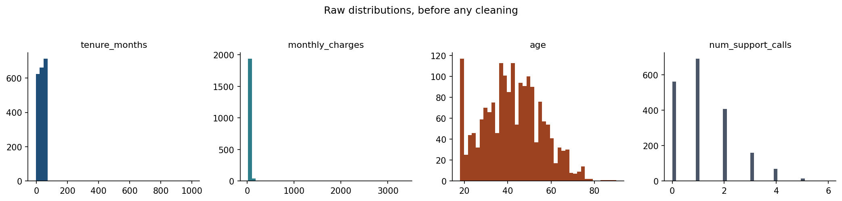
Two of these four have no shape left to read
Notes:
Do not describe shapes the room cannot see. On the first two panels there is no shape to read: tenure and monthly_charges are each a single spike at the left, with the axis running out to 1000 and 3500 and nothing drawn out there.
That absence IS the slide. Ask them what stretched the axis, and let someone say it: a few values so extreme that every other customer has been squashed into one bar. This is the figure that makes the next forty minutes necessary.
Then point at age and num_support_calls, which are on their own honest ranges and do show a distribution - age skewed with a spike at the youngest bound, support calls a Poisson-looking count. That contrast is the argument for cleaning before looking any further, and it is why the same plot reappears after Section 4.

Slide 8
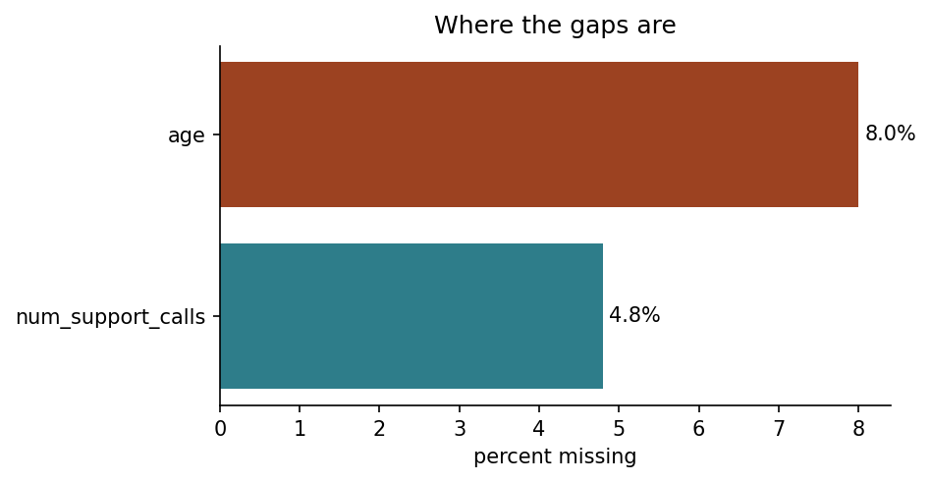
Where the gaps are
Notes:
Two columns have gaps: age at 8.0% and num_support_calls at 4.8%. The count is the easy half of the question; the next three slides are the hard half - why are they missing?
Make the point that this figure took one line to produce and is the first thing to run on any new dataset, before any modelling thought at all. A column that is 90% empty is a column you drop; a column that is 5% empty is a decision.
Warn them about what the picture cannot show: whether the gaps are related to each other, or to the target. That is what the next slides are for, and it cannot be read off a bar chart.

Slide 9
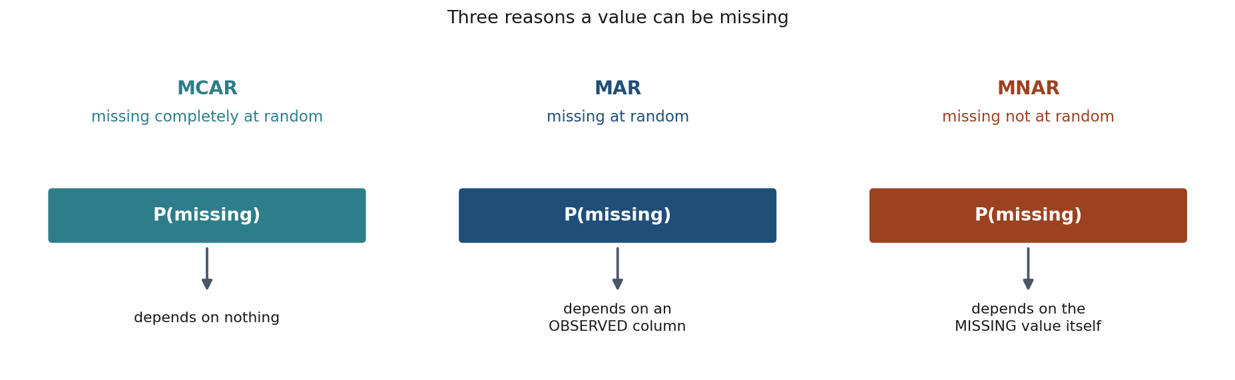
Three reasons a value is missing
Notes:
Handout Section 3.1. Define each precisely, because the distinction is not academic - it determines which fix is valid.
MCAR, missing completely at random: probability of missing depends on nothing. A blank field for no systematic reason.
MAR, missing at random: depends on something you DO observe. Our num_support_calls is MAR against tenure - long-standing customers’ early call history predates the customer relationship management (CRM) system. Conditional on tenure, the gap carries no further information.
MNAR, missing not at random: depends on the value itself, even unobserved. A customer who leaves because of a shockingly high bill and never finishes a survey. No column in the table can detect this - only knowing how the data was collected can. Say plainly: this is the dangerous one, and it does not appear in today’s dataset, which is itself worth noting - most real ones have some.

Slide 10
age: missing completely at random
MCAR, for short: some customers just left it blank. Nothing systematic.
Safe to impute with a fixed statistic
The bias question is not “is this fair”: it is “what does filling it cost”
Notes:
Bridge to the derivation. Ask: if the missingness is completely random, is mean imputation “free”? Let them guess before the next slide - most will say yes, and the reasoning is sound as far as it goes: the mean is unbiased, so filling with the mean introduces no bias in that column.
The answer is no, and the reason is that a column is never used alone. Handout Section 3.2 derives it: filling p of the entries with a constant shrinks the variance to (1-p) times the original, and attenuates every correlation the column has with anything else by the square root of (1-p).
Have the numbers ready. For age at p = 0.08 the factor is 0.96 - small enough to ignore. At p = 0.4 it is 0.77, which erases nearly a quarter of a genuine relationship. Tell them the practical rule that follows: mean imputation is fine when the gaps are few, and quietly destructive when they are many.

Slide 11
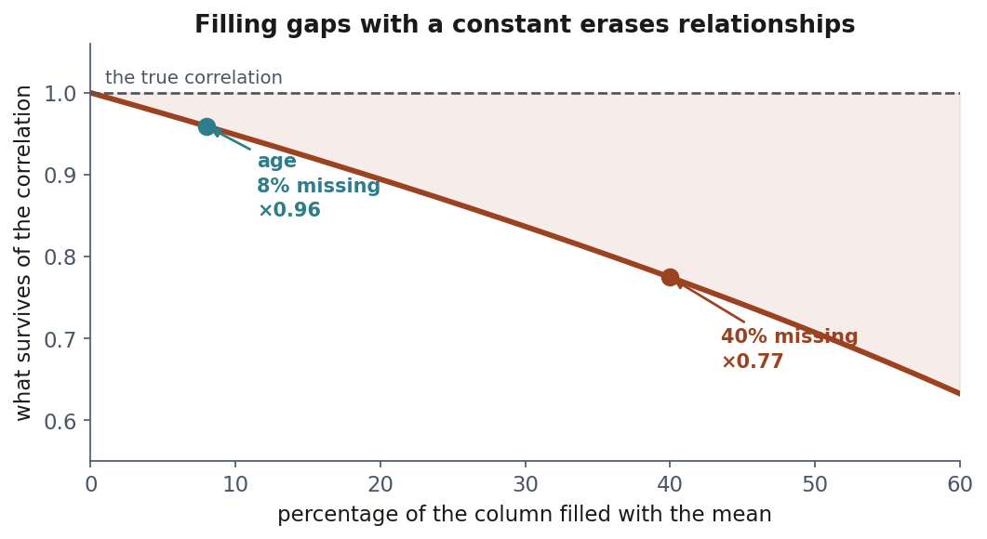
What mean imputation actually costs
Every correlation involving the imputed column shrinks, even under MCAR.
Notes:
Read the curve rather than the formula. Filling gaps with a constant costs correlation, and the cost grows with the fraction filled.
Point at the two markers. For age at 8% the factor is 0.96 - negligible, and this is why nobody notices. At 40% it is 0.77, which erases nearly a quarter of a real relationship.
The practical rule to state: mean imputation is fine when gaps are few, and quietly destructive when they are many. Nothing warns you at which point it crossed over.
The algebra is Handout Section 3.2: the correlation is multiplied by the square root of one minus the missing fraction. Write it on the board if the room wants it - the figure is what they will remember.

Slide 12
Support calls: missing at random
MAR, for short: long-tenure customers leave it blank more often.
Dropping those rows would remove mostly long-tenure customers
A missingness indicator (1 if missing, 0 if not) adds nothing here: tenure_months already tells the model which rows tend to have a gap
Notes:
The predictable answer is “add an indicator, it keeps the MAR signal”, and the reasoning is sound as far as it goes: the gap rows are the long-tenure ones, and they churn at 12.5% against 19.7%, so the fact of the gap is informative.
But under MAR the gap is explained by a column we already hold - that is the definition - so the model already has what the indicator would tell it. Notebook and handout agree: adding it moves the area under the curve from 0.751 to 0.741, no gain, well inside split-to-split noise. The indicator is worth adding only if being missing tells the model something the other columns cannot - typically when the value is missing not at random (MNAR), because whether it is missing depends on the missing value itself. Handout Section 3.3.

Slide 13
What to do about a gap
Drop rows: only if few, and only if MCAR
Drop the column: if it is missing too often to help
Impute: mean/median or most-frequent with SimpleImputer, neighbours with KNNImputer
Add a missingness indicator: only if being missing tells the model something the other columns cannot - typically when missing not at random (MNAR)
Notes:
Four options, and the choice is a question about WHY the data is missing rather than about how much is missing.
The one worth dwelling on is the fourth, because its usual justification is half right. An indicator keeps the fact of the gap in the table after the gap is filled; that fact only helps if no other column already carries it. Under MCAR it carries nothing; under MAR the column that explains the gap is already there; under MNAR the blank may be the only trace left, and that is where the indicator earns its place.
Then the line at the bottom: every option except dropping the column learns a statistic, so all of them are fitted on the training data only. That is the thread the whole lesson pulls on.

Slide 14
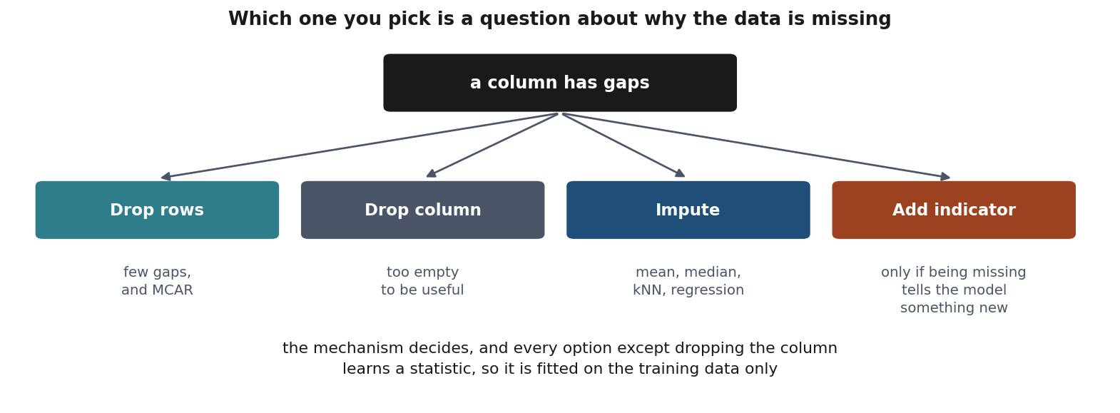
Choosing among the four
Notes:
A decision path rather than a rule: how much is missing, does the missingness look related to anything, and what does the column cost if it goes.
Point out that three of the four branches end somewhere defensible, and that the indicator branch is the one people reach for by reflex. It is cheap, but it adds information only when the gap tells the model something no other column does: on this dataset it does not, and the area under the curve goes 0.751 to 0.741 with it.
The branch worth warning about is dropping rows. It is the easiest to do and the only one that can quietly change what the sample represents.

Slide 15
An outlier is far from the rest - not necessarily wrong
tenure_months runs -3 to 999; ordinary customers sit at 0 to 72
Three reasons: a recording error, a rare but genuine value, a different population
The arithmetic cannot tell which: 3,344.7 may be a typo or a corporate account
Two rules follow - standard deviations, then quartiles - and both only flag
Notes:
Pay off the 999 from slide 6: they have already seen it, and now it gets a name.
Put the three reasons to the room before reading them out - ask what could make a customer’s monthly charge 3,344.7 when everyone else is under 128. Someone will say typo; ask whether they are sure, and let the silence do the work. That is the point of the third bullet.
The last bullet is the promise the next six slides keep: rule 1 in standard deviations, rule 2 in quartiles, then the slide where they disagree and the slide where the robust one is the one that got it wrong. Nothing here deletes a row - what to do once something is flagged is Section 4.2, and it has no automatic answer.
Handout Section 4 opening.

Slide 16
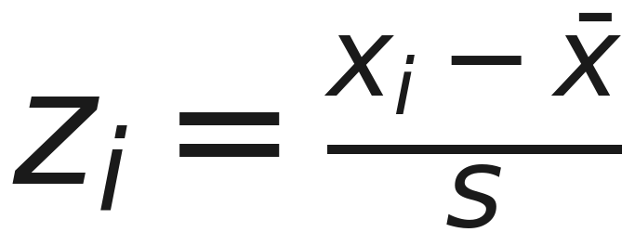
Rule 1: distance in standard deviations, flag beyond k = 3
Notes:
The z-score rule. Standardise the column, then flag anything more than k standard deviations from the mean - we use k = 3 throughout.
Say what it assumes, because everything in the next three slides follows from it: measuring in standard deviations only means “surprising” if the column is a bell curve. It also computes its own ruler from the data being measured, which is the crack the section prises open.

Slide 17
Rule 2: distance measured in quartiles
Notes:
Tukey’s fence, built on the interquartile range (IQR) - the spread between the first and third quartiles, so the middle half of the data. Flag anything more than 1.5 interquartile ranges past the quartiles.
It assumes no shape at all, and its ruler barely moves when a few points are extreme. That sounds strictly better than rule 1. Two slides from now it will be the rule making the mistakes.
Now give the probabilistic reading of each, because it is what makes them more than recipes. Under normality |z| > 3 flags 0.27% of a column, both tails together. And the 1.5 is not arbitrary: for a normal column the IQR is 1.349 sigma, so the fence lands at 2.698 sigma - just inside 3. Handout Section 4.1 derives it.
Then put the two side by side, counting both tails each time, because this is where people quietly mislead themselves: 0.27% against 0.70%. The fences are 10% apart in position and a factor of 2.6 apart in what they flag.
Then make that concrete, because a percentage does not land: take 2,000 values off a perfect bell curve, nothing wrong with any of them. The z-score rule still nominates about 5 and Tukey about 14 - false alarms both, the tail being flagged for being the tail. Say what that means for the twenty real billing errors in this dataset: neither rule can tell the two kinds apart, which is why a flag is a candidate and never a verdict.
The moral to state out loud: the two rules were built to sit in the same neighbourhood, not to agree, and even on perfect data Tukey’s is the readier of the two to call something an outlier. The next slide draws it.

Slide 18
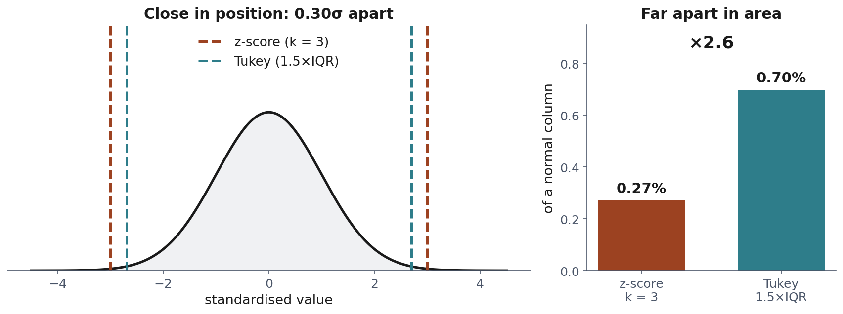
Same neighbourhood, not the same answer
Notes:
Handout Section 4.1 derives the 1.5 constant from the standard normal quantile function.
Work the two panels in order, because the slide is an argument and not an illustration. Left: the two fences are 0.30 sigma apart. Ask the room whether that looks like a difference worth caring about - it does not. Right: the same two rules flag 0.27% and 0.70% of a normal column, a factor of 2.6.
The reason is the steepness of the tail. Move a fence in by a third of a standard deviation and you nearly triple the area beyond it. So resist saying “the two rules agree here”: they sit in the same neighbourhood, and out in the tail a neighbourhood is a factor of 2.6.
Say this is a design choice with an assumption baked in, and the next slide is what happens when the assumption fails.

Slide 19
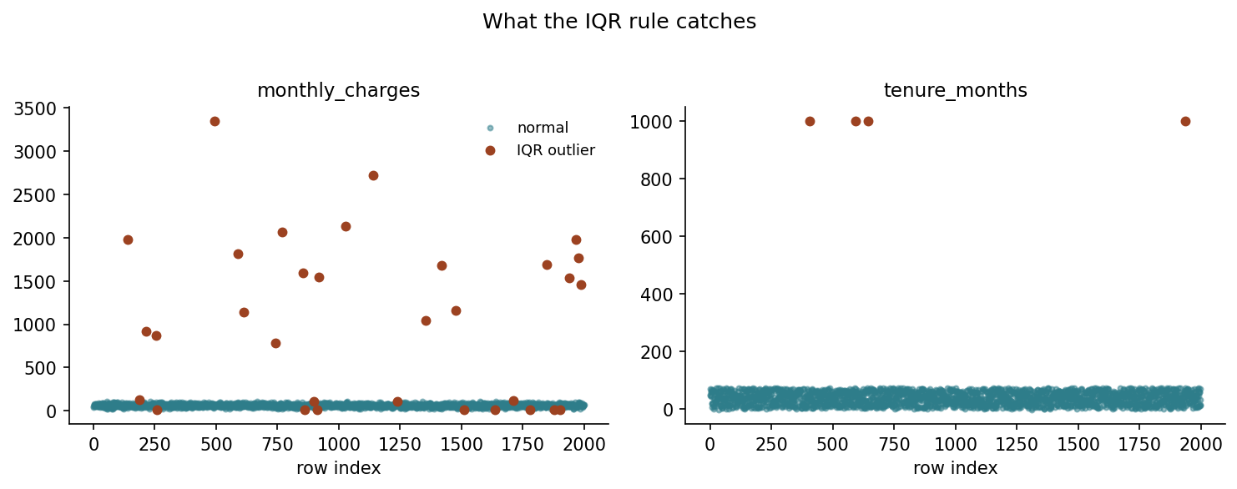
The robust rule is the one that got it wrong
Notes:
Put the counts up before the picture is read: 20 genuine billing errors in monthly_charges. The z-score rule flags 20 - all of them, nothing else. Tukey flags 32 - the same 20, plus 12 ordinary customers.
Ask the room to predict which rule was damaged by the contamination, then give them the number: the billing errors inflate s from 17.23 to 171.25, dragging the z-score fence from 115.0 out to 593.0. The rule was genuinely crippled. It got every error anyway, because the smallest of them is 780 - still past the ruined fence.
Meanwhile the twelve Tukey extras are real people on real tariffs: eight paying 15.0 to 16.7, four paying 111.6 to 128.4, outside fences of 17.3 and 110.0.
The line to land, and it is the whole point of the slide: a detector’s output does not report the detector’s health. The z-score rule was right by luck. Push those errors down towards 200 and its fence sails straight past them, exactly as the theory says. So the lesson is not “prefer IQR” - it is “recompute s without the candidates and see what moved”. Handout Section 4.2.
Point at the left panel’s bottom band: those scattered red dots down in the ordinary customers are the twelve.
tenure_months, right panel: only 4 flagged, all at 999, and here the two rules agree exactly. Ask the room: where did the negative values go? Nobody will know yet - next slide.

Slide 20
What neither rule can tell you
tenure_months of -3 is impossible. Neither rule flags it.
-3 is not extreme relative to a column spanning 0–72
It is not unusual. It is invalid: a different question entirely
Notes:
This is the slide worth remembering over the two formulas. Statistical rules find points that are unusual relative to the rest of a column; they know nothing about domain validity. A negative tenure sits comfortably inside the IQR fence because the column’s own spread is wide enough to hide it.
The fix is a domain rule: 0 <= tenure_months <= some sane maximum. Say plainly: a thorough pass runs both kinds of check, because they catch different mistakes, and neither substitutes for the other. Handout Section 4.2.

Slide 21
Once something is flagged
Detection finds candidates. What to do next is a domain decision.
Cap it at the fence: 3,344.7 becomes 110.0 (Winsorising)
Remove the row
Correct it, if the true value is recoverable
Leave it: unusual is not the same as wrong
Notes:
A long-tenure, high-paying customer is not an error; a tenure of 999 months is. Say plainly that a statistical rule cannot make this call - it only nominates candidates, and the decision is a domain decision.
Walk the four options and note that each is a different claim about the world. Capping - Winsorising, after Charles Winsor - replaces the value with the fence itself: the billing error of 3,344.7 becomes 110.0, the row keeps every other column it has, and the sample keeps its size. It says “the value is real but the scale is misleading”. Removing says “this row is not from the population I am modelling”. Correcting says “I know what it should have been”. Leaving it says “the model should handle this”.
The one that gets chosen by default, without anyone deciding, is removal - and it is the one that silently reweights the sample. Handout Section 4.2 closes on exactly this. If a rule flags 3% of your rows and you drop them all, you have changed the population your model is trained on.

Slide 22
Notebook 1, live
section, and its slides | you call (pandas, no model yet)
first look, 6 | df.info(), df.describe()
distributions, 7 | df.hist()
missingness, 8-12 | df.isna().mean(), and the mean before and after filling
outliers from scratch, 15-19 | .mean() and .std() for rule 1, .quantile([0.25, 0.75]) for rule 2
correlations, categories | df.corr(), .value_counts()
Notes:
Exploration, missingness mechanisms, both outlier rules: from scratch. The table is the notebook’s map - no scikit-learn yet, only the pandas calls that do the looking, each next to the slides where the idea was introduced.
Work through notebook 1 now, 20 minutes. Let them drive; walk the room rather than presenting.
The domain-rule cell is worth pausing on collectively: a two-line check for negative tenure catches something no statistical rule would flag, because a negative tenure is not extreme, it is impossible. That distinction - impossible versus unusual - is the lesson of the whole section, and it lands better from their own screen than from the projector.
Two cells now open with “Your prediction”: the correlation left after filling 40% with the mean, and how many points each outlier rule flags. Give them a minute to write a number in the cell before running it. The point is to commit to an answer, not to be right; the most useful wrong answer in the room is “the IQR rule, because it flagged more”.
Watch for the group that finishes early. Point them at the “try this” in the notebook: change the missing fraction and watch the correlation attenuate as the derivation predicts.

Slide 23
Break
Notes:
10 minutes. Back for scaling, encoding and the pipeline.
Use the break to check who is stuck in the notebook - the second half assumes everyone has a working ColumnTransformer, and it is much cheaper to fix now than during the leakage section.

Slide 24
Why scale?
tenure_months: 0–72. monthly_charges: 15–128
Training = choosing the model’s numbers to make Lesson 1’s average loss small
Gradient descent does it by repeated small steps downhill on that loss
One step size - the learning rate - along every axis, every iteration. Can it suit both columns?
Notes:
Reconnect to Lesson 1 before anything else, because the vocabulary is already theirs: the empirical risk was the average loss over the rows we hold, and choosing the f that makes it small was the whole definition of learning. What was left open there is HOW you make it small. This is the how.
Say what a model’s “numbers” are, once: one coefficient per feature, plus the intercept. Training is a search over those numbers, and every candidate set of them has a loss.
Then say what a single step is, because the slide leans on it: gradient descent starts from some numbers, works out for each one whether nudging it up or down lowers the loss, and moves them all at once - each by the same step size, times how steeply the loss falls in that direction. One step size for the whole model, not one per feature. That is the sentence the next slide draws.
Ask, before turning over: if two features live on very different scales, can a single step size be right for both directions at once? Let the room reason about it first.
Be honest about this dataset, because a sharp student will check: once the outliers of Section 4 are removed, these two columns have comparable spreads - the ratio of their standard deviations is about 0.8. They are not a dramatic case, which is exactly why notebook 2 builds a toy pair with a 110:1 variance ratio to make the effect unambiguous. The point is not that churn data is pathological; it is that you cannot count on it not being.
The punchline, which handout Section 5.2 states: the safe step size is set by the feature with the largest spread, so progress along the smallest-spread direction is throttled by their ratio. Scaling is not cosmetic - it changes how long training takes, and sometimes whether it converges at all. The derivation is deliberately NOT here: it belongs with gradient descent itself, Lesson 3.

Slide 25
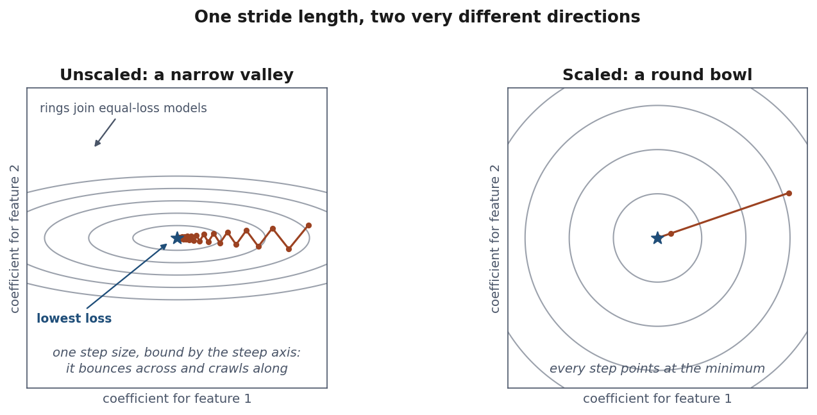
A ravine, not a bowl
Notes:
Do this one entirely on the picture; there is no algebra on this slide by choice.
Read the axes first, and do not skip this - a contour plot of a loss surface is new to most of them and it is not a plot of the data. Neither axis is a column. The horizontal axis is the coefficient the model gives feature 1, the vertical axis is the coefficient it gives feature 2, so every point in the square is one candidate model. The grey rings join the models that fit equally badly, the way contour lines on a map join points of equal altitude. The blue star is the model with the lowest loss - what training is looking for. The rust dots are successive steps, and the line joining them is the search.
Left: the two features have different spreads, so the loss surface is a narrow ravine - steep across, almost flat along. One step size has to serve both. Long enough to advance along the flat direction and it overshoots the steep one and bounces from wall to wall; short enough to be safe on the steep one and it crawls along the flat one. Count the dots out loud: twenty-six steps and it is still not at the star.
Right: after scaling, the ravine is a bowl and every step points at the minimum.
Give them the handle without the derivation: how stretched the ravine is - the ratio of the largest feature variance to the smallest - is called the condition number, and the number of steps you need grows with it.
If someone asks WHY the surface has that shape, that is the right question and the honest answer is “Lesson 3, where we derive gradient descent” - its Section 4.4 puts the number on it: standardising the housing design matrix takes the condition number from 285 to 3.4.

Slide 26
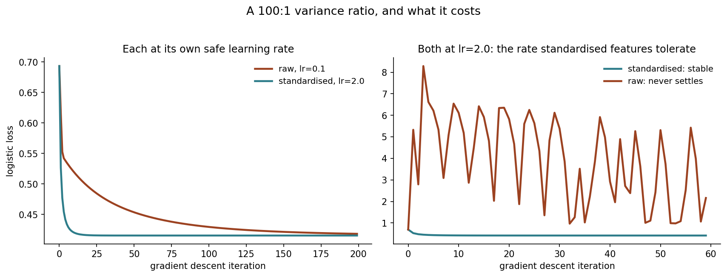
A 100:1 variance ratio, and what it costs
Notes:
Say which number is which before anyone asks: the title’s 100:1 is how the two features were built, spreads of 1 and 10; the sample of 1,000 points measures 110:1, which is the figure notebook 2 prints and the toolbox slide quotes.
Left panel: each feature set at its OWN safe rate - standardised still gets there faster, because it tolerates a larger rate. Right panel is the sharper point: give the RAW features the rate the standardised ones handle comfortably and it does not converge slowly, it never converges at all.
Be precise about the failure if anyone asks, because “diverges” is the word people reach for and it is not what this is. The loss does not climb away to infinity - it swings between 0.69 and 8.29 and stays there, bouncing off one wall of the ravine into the other. Run it for 2000 steps and it is still in the same band. Worse than slow, not better: a slow run finishes.
This is a controlled toy (notebook 2), built to a 100:1 variance ratio and landing at 110 once drawn, so the effect is unambiguous. On the real churn columns, once cleaned, the two spreads are within about 20% of each other - so this toy is not exaggerating a big effect in the data, it is manufacturing a clear one to show a mechanism.

Slide 27
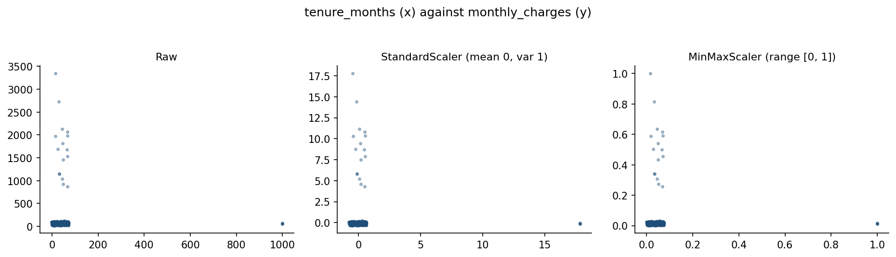
StandardScaler vs MinMaxScaler
(x − μ)/σ and (x − min)/(max − min), both fitted on training data only.
Notes:
MinMaxScaler is the more outlier-sensitive of the two: one extreme billing error stretches the whole 0-1 range, compressing every ordinary customer into a sliver of it. StandardScaler is pulled too, through the mean and standard deviation, but far less dramatically.
Both must be fitted on training data only - say this every time a fitted transform appears, because it is the thread the whole lesson hangs from.

Slide 28
Every encoding makes a claim about the categories
A model does arithmetic, and "month-to-month" offers none.
contract_type | rows | churn rate
month-to-month | 1,092 | 0.266
one-year | 488 | 0.137
two-year | 420 | 0.071
Notes:
Open by saying what the problem is, because nothing so far has needed it: a model does arithmetic, and a column holding the words “month-to-month” offers nothing to do arithmetic with. It has to become numbers, and there is more than one way to do that.
Give them the word: the distinct values a categorical column can take are its levels. contract_type has three, with 2,000 rows spread across them.
Then the sentence the whole section hangs on, and it is worth saying slowly: every way of turning a category into numbers makes a claim about the categories. The claim is the part to get right - the code is three lines either way.
Point at the churn column before moving on. It does double duty: it is what target encoding will use as the number, and it is the evidence that will convict ordinal encoding two slides from now.
Handout Section 6.

Slide 29
One customer, three encodings
Encoding | A one-year customer becomes | What that asserts
One-hot | [0, 1, 0] | simply different: no order, no distances
Ordinal | 1 | ordered, and equally spaced
Target | 0.137 | the level’s own average outcome stands in for it
Notes:
One customer, one contract, three numbers. Read the table a row at a time and let the right-hand column do the work - it is what each encoding is asserting about the world, not about the data type.
The middle row is where damage usually happens, and this column shows why the mistake is reasonable: the order is genuine. A one-year contract really does sit between the other two, so ordinal looks safe here in a way it would not for region or zip code.
Ask the room which of the three claims is true for THIS column before turning over. It is a domain question, not a technical one, and no cross-validation score will answer it.
Handout Section 6.

Slide 30
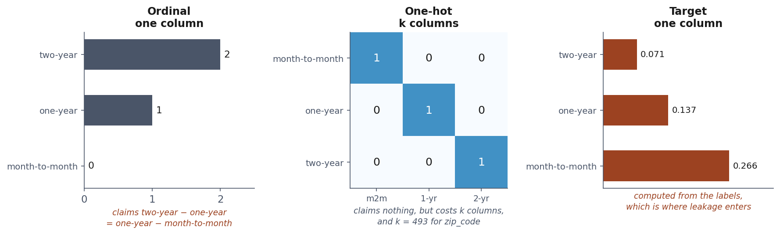
Equal steps, unequal meaning
Notes:
Left panel against right panel - that is the whole slide, and it is the answer to the question left hanging.
Ordinal spaces the levels 0, 1, 2: equal steps by construction. The churn rates those levels stand in for fall 0.266, 0.137, 0.071, so the first step is 0.129 and the second is 0.066 - the first is nearly twice the second. The encoding asserts a regularity the column does not have, and a linear model has exactly one coefficient with which to believe it.
Then the middle panel, which claims nothing at all and pays for that neutrality in columns - the caption says k = 493 for zip_code, and that is the thread into the next three slides.
The right panel is computed from the labels. Say that out loud and leave it there: it is the first appearance of the leak the last third of the lesson is about.
Handout Section 6.2.

Slide 31
One-hot claims nothing, and pays in columns
A column with k levels becomes k binary columns, one 1 per row: OneHotEncoder
It asserts no order and no distance - which is why it is the default
The price is width: zip_code would add 493 columns to 2,000 rows
Target encoding compresses any cardinality into one column - computed from the labels, which is where leakage gets in
Notes:
A warning on the letter: k here counts the levels of a category. Slide 16 used k for the z-score cut-off, 3. Same letter, two jobs, both declared in the handout’s notation table - say so out loud once.
This is the encoding to spend time on, because it is what scikit-learn’s OneHotEncoder does and what the pipeline later in the notebook uses.
The mechanics first: k levels, k binary columns, exactly one 1 in every row. No category is closer to any other, which is precisely the neutrality that makes it the safe default.
Then the cost, which is the honest trade: k columns. Three is nothing; 493 on 2,000 rows is the curse of dimensionality, two slides from here.
The last bullet is the hook, not a conclusion. Target encoding is the obvious escape from the width problem and it is the more dangerous of the two encodings in this entire lesson. Do not resolve it - the leakage section does.
One more thing this slide sets up: k columns plus an intercept is one column too many, which the next slide proves.
Handout Section 6.1 and 6.2.

Slide 32
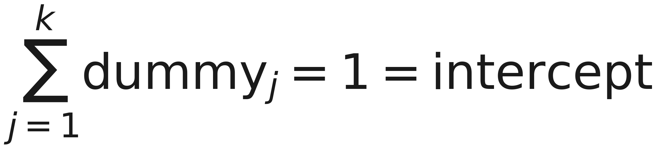
All k dummies plus an intercept cannot both be free
Most models carry a column of ones - the intercept - so they can fit a baseline level.
Notes:
Define the word before using it, because this is the first time in the course they meet it: a model that fits an intercept is carrying one extra column made entirely of ones, so that it has a baseline to work from. That is all they need today - Lesson 3 is where it becomes a coefficient in an equation.
Now the redundancy, which needs no model at all. Ask them the survey question from the handout: you record whether someone travels by car, by bus or by bicycle, three yes/no columns, and everyone answered exactly once. How many of those columns do you actually have to read? Two. The third is whatever is left, which means the three columns carry two columns’ worth of information.
The slide is that sentence in symbols, plus one step: the k dummies sum to 1 in every row, and a column of ones is exactly what the intercept is. So k dummies and an intercept are k+1 columns carrying k columns’ worth of information, and one of them is spare.
Stop there. What exactly breaks - the design matrix losing rank, the normal equation no longer having a unique solution, infinitely many coefficient vectors fitting equally well - is Lesson 3’s machinery, and it is the right place for it. Today’s consequence is practical: pass drop=“first”.
Handout Section 6.1 carries the proof for whoever wants it now. The next slide shows the redundancy as a number.

Slide 33
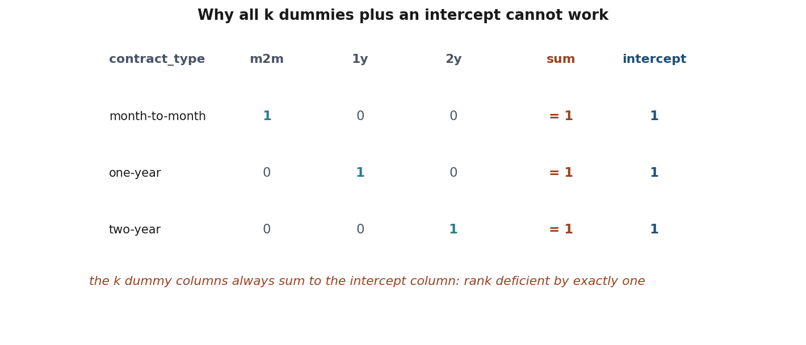
Rank deficient by exactly one
Notes:
This is the redundancy counted by numpy rather than argued, which is the version they will believe: matrix_rank on the k+1 columns comes back one short.
Point at the number: short by exactly one, not by an arbitrary amount. That is the signature of a single dependence - the dummies summing to the intercept - and not of general collinearity.
The fix is OneHotEncoder(drop=“first”). The dropped category becomes the reference level, absorbed into the intercept: no information is lost, because that category is still recoverable as “all the other dummies are 0”.
What a rank-deficient matrix does to a fit - infinitely many coefficient vectors that predict identically, and a solver returning whichever one the arithmetic happens to land on - is Lesson 3, once the normal equation exists to say it with. Flag it as coming and move on.
Two caveats worth saying now. Tree-based models (Lesson 7) do not need the drop at all. And regularised models tolerate the rank deficiency, because the penalty picks one solution out of the many - which is a good early sketch of what regularisation does, and Lesson 3 returns to it.

Slide 34
The curse of dimensionality, briefly
One-hot zip_code: 493 new columns, mostly zero.
Distance-based methods (Lesson 6): everything looks equidistant
More parameters to estimate, same sample size → more variance
Notes:
Handout Section 6.3. Deliberately quick - the point is to motivate why target encoding looks attractive for high-cardinality columns, before the next section shows why it needs care.
The number to dwell on: one-hot encoding zip_code produces 493 columns, almost all zero, on 2000 rows. More columns than a quarter of the sample size, for one field.
Two consequences to name. Distance-based methods (Lesson 6) degrade, because in high dimensions everything becomes roughly equidistant from everything else. And every column is a parameter to estimate from the same fixed amount of data, which is the bias-variance trade-off from Lesson 1 arriving from a new direction.

Slide 35
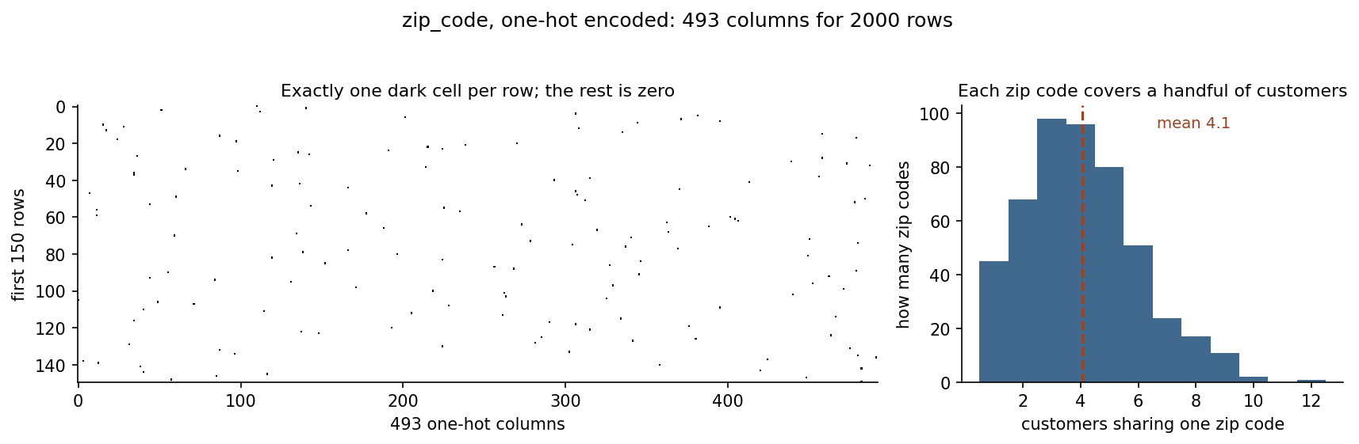
zip_code: 493 codes, 2,000 customers
Notes:
Read the right panel out loud before making any argument with it, because it is a histogram of the 493 codes and nobody reads that off a projector unaided: the horizontal axis is how many customers share one zip code, the vertical axis is how many zip codes that happens to. The tallest bar stands at 3 and 4 - about a hundred codes each - and the whole thing stops at 12.
Then point at the zip_code row/column - or its absence, since it is not even numeric yet - and say: notebook 1’s correlation check already suggests this column carries nothing. One-hot encoding it would add 493 mostly-empty columns. The natural alternative - replace each code with the average churn rate of its customers - is exactly the technique the leakage section is about. Do not resolve the tension yet; let it hang until after the break-free run into notebook 2’s pipeline section.

Slide 36
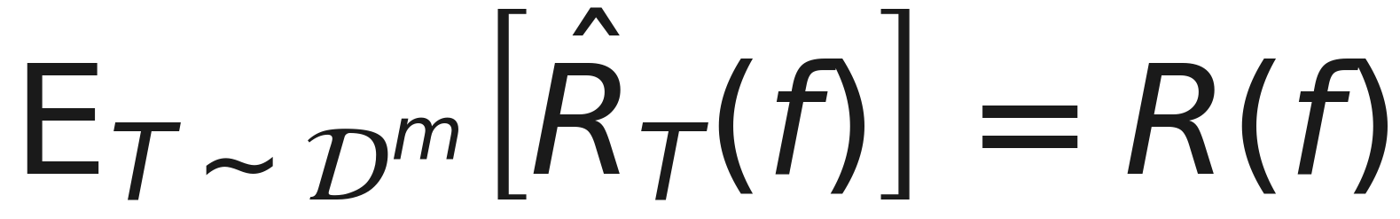
Restating Lesson 1’s argument
f includes every learned parameter, not just “the model part”.
Notes:
Say the condition out loud, because it is no longer written on the slide and it is the whole content: this equality holds ONLY IF f is independent of T. It was on the slide and made the formula too small to read from the back; it belongs in your mouth, not in the image.
Handout Section 8.1. Lesson 1’s unbiasedness argument never mentioned “the model” specifically - it is about f, whatever function maps raw inputs to predictions. In deployment, a fitted scaler or imputer travels WITH the model, so f includes their learned parameters too.
The moment any of those parameters - a mean, a set of neighbours, a per-category average - is estimated using rows that later appear in T, f is no longer independent of T, and the equality breaks. This is the one-sentence version of everything Section 9 is about to demonstrate concretely.

Slide 37
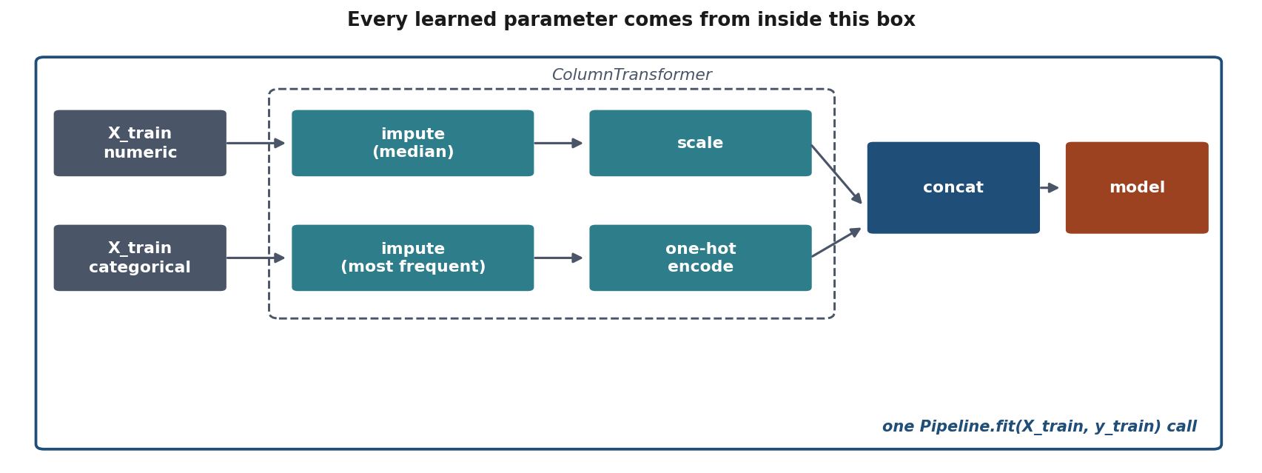
ColumnTransformer + Pipeline
Notes:
The structural version of the argument just stated. Different columns need different treatment; ColumnTransformer routes each group through its own sub-pipeline and concatenates the result; the outer Pipeline adds the classifier.
One fit() call, on X_train, fits every imputer, the scaler, the encoder AND the classifier - in that order, on training data only, by construction. Say explicitly: this is not tidiness. It is what makes “nothing learned before the split” true even when nobody is watching, which today’s leakage section is entirely about.

Slide 38
The code
prep = ColumnTransformer([
("num", num_pipe, num_cols),
("cat", cat_pipe, cat_cols),
])
model = Pipeline([
("prep", prep),
("clf", clf),
])
model.fit(X_train, y_train)
Notes:
Say out loud what the five short names stand for, or someone spends the next minute working it out instead of listening: num_pipe and cat_pipe are the impute-then-transform pairs from the diagram two slides back, num_cols and cat_cols are plain lists of column names, and clf is the classifier. They are abbreviated here only to fit the slide - handout Section 8.2 prints the same block with full names, every import, and both column lists, and it runs as printed.
Point out there is exactly ONE call to fit, at the very bottom, on X_train alone - everything above it declares structure, not computation.
This is the code notebook 2 runs, nearly verbatim. Say that reading it should now feel unremarkable - that is the goal, structure that makes the right thing the easy thing.

Slide 39
The model, on churn
Accuracy: baseline 0.806, model 0.820 (numeric + low-cardinality categoricals, no zip)
Area under the receiver operating characteristic curve (AUC): 0.751, the chance a random churner scores above a random non-churner; 0.5 is a coin flip
In code: LogisticRegression against DummyClassifier, roc_auc_score
Modest accuracy gain. Why?
Notes:
Let the room answer why the accuracy gain is modest. The dataset is 80/20 imbalanced, so accuracy is dominated by the majority class - exactly as Lesson 1 warned, and the first time they meet it on data they prepared themselves.
The matrix shows where the errors sit: read the bottom-left cell, the churners the model missed. The area under the receiver operating characteristic curve - AUC, which Lesson 4 builds properly - at 0.751 is unaffected by the imbalance and says there is real signal that accuracy is hiding.
Had we reported only accuracy, this model would look barely better than the baseline and someone would reasonably conclude the features were useless.

Slide 40
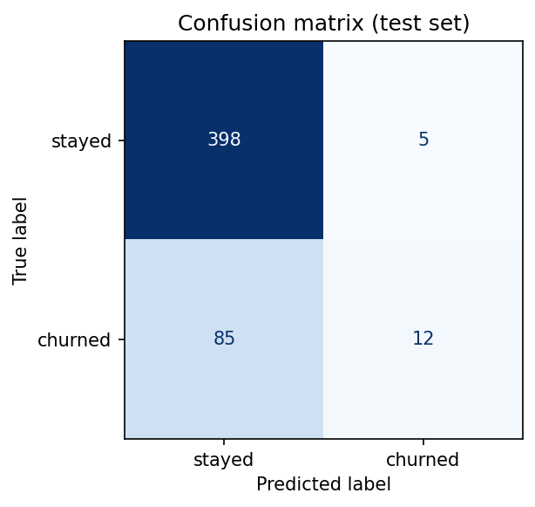
Where the errors fall
Notes:
Say what the picture is before reading anything off it: a confusion matrix is a table counting predictions against truth, one cell per combination - predicted stay and did stay, predicted stay and churned, and so on. Lesson 4 gives it its proper treatment; today it is a way of seeing where an accuracy number comes from.
The accuracy gain was fourteen thousandths. This is where those errors actually sit, and it explains why the gain is small.
Read the bottom row: almost every customer who churned was predicted to stay. The model has learned to predict the majority class slightly more cleverly than the baseline does, and on the class the business would pay to identify it is close to useless.
Then connect it back to lesson 1 and its imbalance slide. Same shape, different dataset, and it took a confusion matrix to see it in both cases. Accuracy on its own would have reported this as progress.

Slide 41
Feature engineering
Ratios, interactions, binning: a linear model cannot invent these itself.
total_paid = charge × months stayed. AUC: 0.7514 → 0.7548, under four thousandths. Clean tenure_months first and the same feature scores 0.7439 - the gain was living in the 999s.
In code: FunctionTransformer(add_total_paid), a step inside the pipeline
Notes:
The formula was on this slide as a rendered equation and came out at 23pt, the smallest in the course: the column names are long enough that no amount of trimming saves it. It is one sentence to say - total_paid is the monthly charge times the months stayed, with tenure clipped at zero first - and the three AUCs are what does the work in the room.
Do not let anyone in the room call three thousandths a win, and do not call it one yourself. Quote the four decimals, 0.7514 against 0.7548: at three, 0.751 against 0.755 sounds like a difference of 0.004, and the difference is 0.0034. It is a legitimate result, not a failed experiment - the hypothesis that what a customer has been worth so far predicts whether they leave was reasonable, it was tested, and the data declined it. Feature engineering is a hypothesis about the domain, not a guarantee. Handout Section 7.
Then the second number, which is the one to spend time on. Rebuild the same column after Section 4’s domain rule - tenure clipped to 0-120, not just at zero - and +0.0034 becomes -0.0075. The gain was never about what the customer paid: 999 months times a billing error of 3,344.7 is a total_paid no real customer could have, and those rows line up with the target well enough to move the score. Multiplying two contaminated columns concentrates the contamination. Say the moral out loud: the order of the steps is part of the method.
Then plant the flag for Lesson 5: a difference this small is inside the range a different train/test split would produce on its own, so a single split cannot settle it either way. Reporting it as an improvement is the first step onto exactly the path Lesson 5 exists to close off.
Explain the max rather than skating over it, because someone will ask. tenure_months still holds the -3 of Section 4 at this point, and multiplying by it unclipped hands the model a customer who has paid minus two hundred euros. That is Section 4 turning up in Section 7, and it is what feature engineering on real data actually looks like - one line of algebra, three lines of defending it against the column you have.
If someone objects to the obvious alternative, monthly_charges divided by tenure_months, they are right to: monthly_charges is already a rate, so dividing it by months again gives euros per month per month. Check the units before trusting a construction.
The point to land: any engineered feature that involves a statistic LEARNED from data - bin edges from quantiles, a scaled interaction - is subject to the same rule as scaling. A pure arithmetic combination (this product) needs no fold-awareness; a learned one does.

Slide 42
Notebook 2, live
section, and its slides | you call → the number to come back with
why scale, 24-27 | gradient descent by hand → ratio 110:1 (built as 100:1); rate 2.0 scaled, 0.1 raw; raw at 2.0 swings 0.69 to 8.29
encoding, 28-33 | pd.get_dummies, np.linalg.matrix_rank → 4 columns, rank 3
the pipeline, 36-38 | train_test_split, then ColumnTransformer + Pipeline: SimpleImputer, StandardScaler, OneHotEncoder, LogisticRegression
the result, 39-40 | DummyClassifier, accuracy_score, roc_auc_score, ConfusionMatrixDisplay
feature engineering, 41 | FunctionTransformer → 0.7514 → 0.7548 → 0.7439
Notes:
The right-hand column carries the four numbers to come back with, each next to the calls that produce it. The rest of the table is the map: every scikit-learn name the notebook uses, beside the slides that introduced the idea.
20 minutes. Let them work; circulate.
Say what the eight sections are for before they start, because the notebook is long and the middle of it looks like plumbing: sections 3 and 4 are why we scale, 5 and 6 are why we encode and what zip_code costs, 7 is the pipeline that makes the rule true by construction, and 8 is the feature that does not work.
The gradient descent toy in section 3 is worth running interactively - change the variance ratio live and watch the iteration count move, per the handout’s “try this”. It makes the condition number argument concrete in a way the derivation alone does not. The number to make them say out loud is the second one on the slide: the raw features do not diverge to infinity, they oscillate between 0.69 and 8.29 and never settle. That is a worse failure than slowness, because nothing errors.
Section 5 is the one that lands without discussion: matrix_rank returns 3 for four columns, and short by exactly one is the signature of a single dependence. They believe numpy where they might not believe the algebra.
If the room is moving fast, section 7 is where to slow down: ColumnTransformer is the piece they will reuse in every exercise, and getting the column selectors right is fiddlier than it looks.
And leave time for section 8, which is the one they will get wrong on their own data: the engineered feature gains 0.0034, then loses 0.0075 once tenure is cleaned first. Ask them why before telling them.
Two prediction cells to give a minute each: what learning rate 2.0 does on the raw features (most expect “slower”; it oscillates for ever), and what accuracy the full pipeline reaches against the 0.806 baseline (0.820, which is the cue for why accuracy is the wrong scale here).

Slide 43
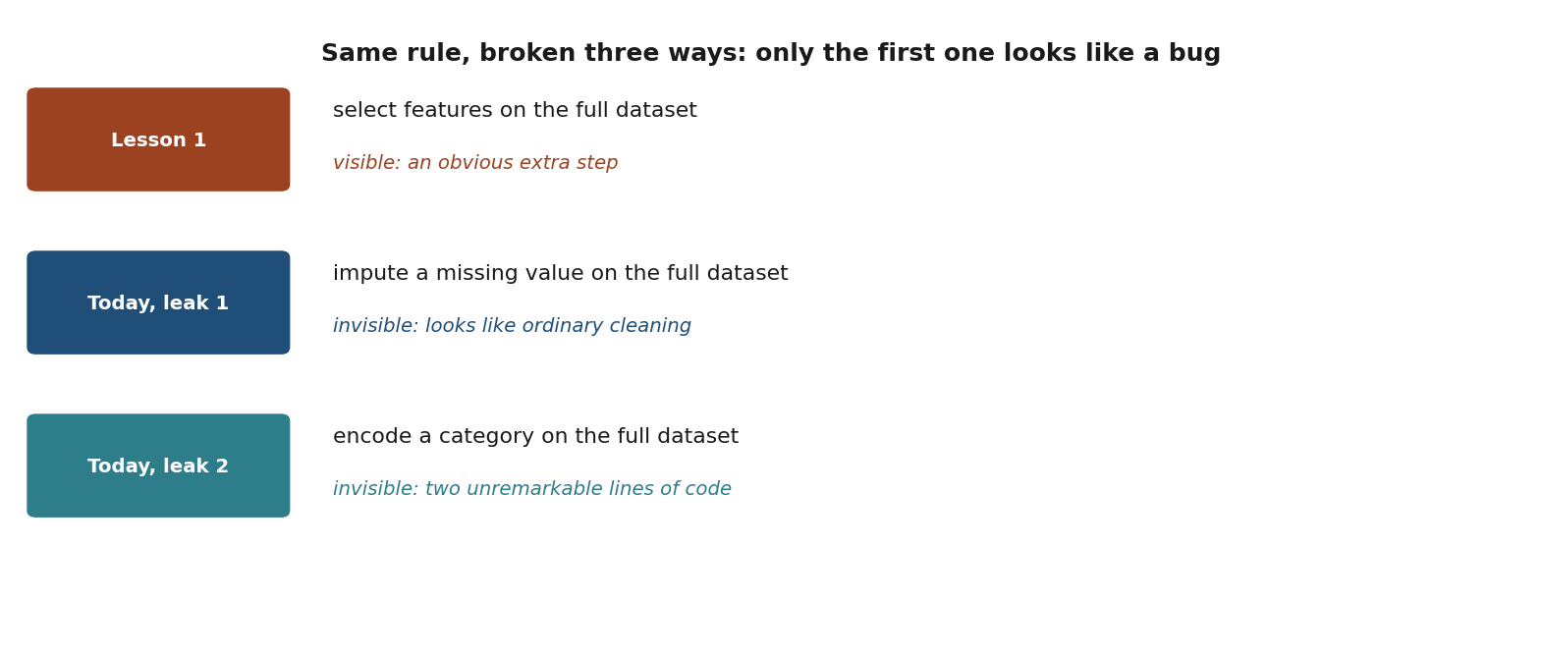
Same rule, broken three ways
Notes:
Set up the closing section. Lesson 1’s leak - selecting features on the full dataset - is visible once you know to look for it: an obviously extra step. Today’s two are not. Imputing a missing value and encoding a category both read as ordinary data cleaning, not as “training a model.” They ARE training a model, in the sense Section 8.1 makes precise: any fitted parameter is part of f, and f must be independent of the test set.

Slide 44
Leak 1: impute before splitting
KNNImputer fills a gap with the average of the five most similar rows: its donors.
Fit it on train + test, and some of those rows are in the test set.
Notes:
Walk the mechanism before the number. KNNImputer fills a gap using other rows’ values: it finds the nearest neighbours in feature space and averages them. “Nearest in the whole dataset” includes test rows, if it was fitted before the split existed.
So a TRAINING row’s missing age can be filled with a value read off a TEST row - the test set writing into the training data, one gap at a time. Note the imputer never touches a label; it copies feature values. That is enough: those values are what the model then fits on. The imputer did nothing wrong; it was simply shown data it should not have seen.
Notebook 3 measures the gap. Connect it back to Lesson 1: this is the same independence argument, applied to a step nobody thinks of as learning. The imputer learns; therefore it is fitted on the training data only.

Slide 45
The smoking gun
94 of 128 training rows with missing age had a test-set row among the five donors used to fill it.
In code: nan_euclidean_distances, the imputer’s own metric, names the donors.
Nothing raised an error.
Notes:
94 of 128. Not an edge case - nearly three quarters of the imputed training rows borrowed a value from at least one row the model would later be scored on.
Stress that nothing in the code looks wrong. KNNImputer did exactly what it says: found the nearest neighbours in the data it was given. The error was in what it was given, and it happened one line earlier.
This is the number to put on the board if only one number from today survives.

Slide 46
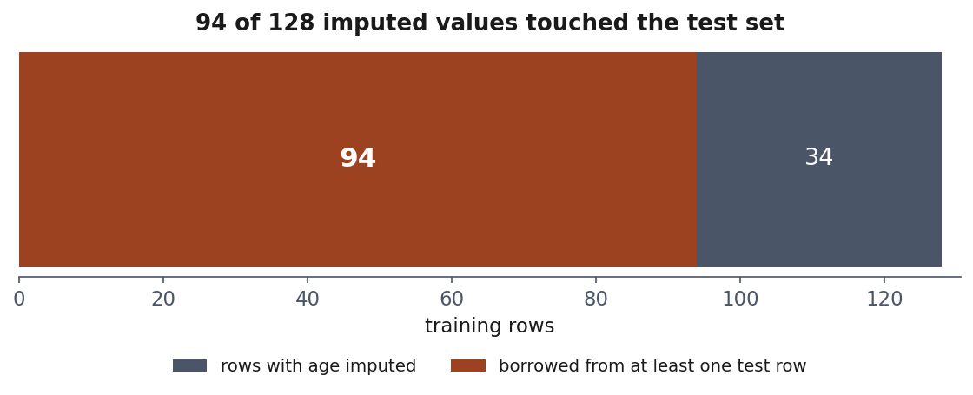
Leakage, counted
Notes:
Ninety-four of a hundred and twenty-eight, drawn so the proportion lands.
Say what was actually done: the imputer was fitted before the split, so when it filled a missing age it was allowed to look at test rows to decide what to fill it with. Nearly three quarters of the affected training rows had a test row among the five donors it consulted.
The sentence to leave hanging is the one from the slide before: nothing raised an error. The notebook ran, the score improved, and the improvement was the test set leaking into the training data one imputed value at a time. This is the argument for the pipeline, made in numbers.

Slide 47
Leak 2: encode before splitting
Replace zip_code with the average churn rate of its own customers, computed before anybody has split anything.
Notes:
zip_code has no real relationship with churn - the data was generated that way deliberately, so any apparent signal is an artefact we can measure exactly.
Target encoding replaces each zip code with the average churn rate of its own customers. Computed before the split, that average includes the test rows’ labels. The feature now contains the answer, in diluted form.
This is the most dangerous leak of the three, because the resulting column looks entirely reasonable in a dataframe: a number between 0 and 1, sensibly distributed, with no trace of where it came from. Nothing about it says “this was computed from the labels”.

Slide 48
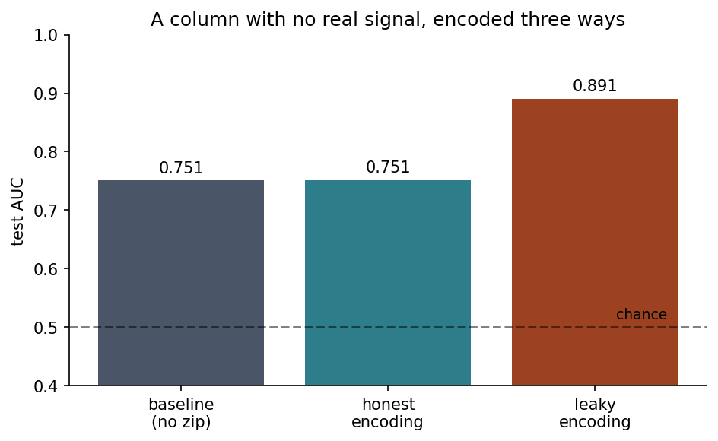
A column with no real signal, encoded three ways
Notes:
Baseline without zip: AUC 0.751. Honest encoding (sklearn’s TargetEncoder, cross-fitted inside the pipeline): 0.751 - indistinguishable, correctly, since zip carries nothing. Leaky encoding, computed before the split: 0.891.
Let that number sit. It looks like a genuinely better model. It is not one - the improvement is manufactured entirely by the mechanism on the next slide. This is Lesson 1’s 77%-on-coin-flip-labels story again, produced by two unremarkable lines of preprocessing instead of an obviously wrong one.

Slide 49
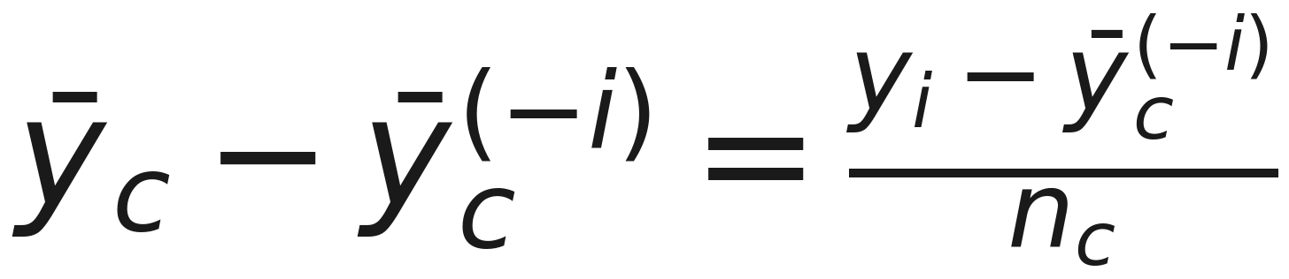
Your own disagreement, divided by your group size
Notes:
Name the symbols first, pointing at each: ȳ_c is the churn rate of zip code c over all its customers, row i included; ȳ_c with (−i) is the same rate with row i left out; y_i is row i’s own label; n_c is how many customers zip code c has - not n, the number of features.
Read the equation out as a sentence: the “leave-in” encoding differs from the honest leave-one-out encoding by the row’s own disagreement with its group, divided by how many people are in it.
Handout Section 9.2 has the algebra. The intuition: for a zip code with a single customer, the target encoding IS that customer’s label, straight through. With two customers it is the average of two labels. Only as the group grows does the encoding become a genuine statistic rather than a copy of the answer.
So the leak is worst exactly where the data is thinnest - which is also where high-cardinality columns spend most of their mass. Most zip codes here have a handful of customers.
Give them the diagnostic to remember: if a feature’s usefulness comes mostly from its rarest levels, be suspicious. That is the shape of a leak, not of a signal.

Slide 50
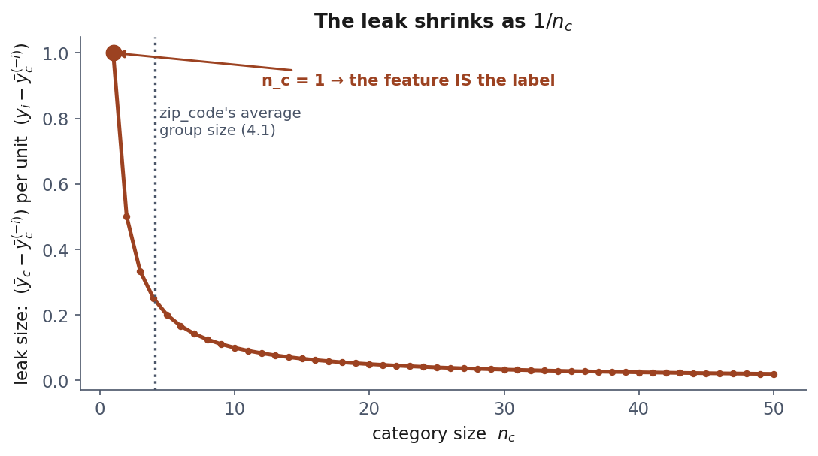
The leak shrinks as 1/n_c
Notes:
Notebook 3 shows the n_c=1 case literally: zip code Z472, one customer, churn label 0, encoded value 0.000. Not correlated with the label. IS the label, relabelled as an input.
Connect to Section 6.3: high cardinality means small groups means a bigger leak by exactly this formula - the curse of dimensionality and the leakage risk are the same underlying fact.

Slide 51
The fix
sklearn.preprocessing.TargetEncoder, inside the pipeline.
It splits the training rows into five parts and encodes each row from the other four: never from its own label.
Notes:
Smoothing pulls each group’s mean towards the global mean, weighted by group size, so a one-customer zip code barely moves from the overall rate. It reduces the leak but does not remove it.
Say clearly what actually removes it: fitting the encoder inside the training fold, exactly as with every other learned step. Smoothing is a refinement on top of that, not a substitute for it.
This is the third time today the same rule has appeared - imputation, scaling, encoding - and that repetition is the point of the lesson. Lesson 1 stated the rule for one case; today it turns out to be the same rule every time.

Slide 52
The rule, restated
Everything that learns from data is fitted on the training rows only, inside the pipeline.
A mean. A median. A set of neighbours. A per-category average. A set of bin edges.
Notes:
One test, not a growing list of special cases: does fitting this step compute anything from the rows it is given? If yes, it goes inside the pipeline. Handout Section 9.3.
Say explicitly: Lesson 5 returns to leakage a third time, for hyperparameter tuning, where the same test applies once more.

Slide 53
Notebook 3, live
leak, and its slides | you call → what it shows
imputation, 44-46 | KNNImputer fitted on every row; nan_euclidean_distances, its own metric, names the donors → 94 of 128
encoding, 47-50 | churn rate per zip_code, before train_test_split → AUC 0.891 from a column with no signal
the fix, 51 | TargetEncoder inside the ColumnTransformer → the honest 0.751
your own split | clone both models, refit on a split of your own
scored with | roc_auc_score throughout
Notes:
Trace the imputation leak. Watch the encoding leak manufacture 0.89 from noise. The table puts each leak beside the calls that commit it and the slides that explain it; the fix row is the one to leave on screen.
22 minutes. This notebook is the payoff of the lesson: the two leaks of today, each measured against an honest pipeline on the same data. The third way of breaking the rule, on the earlier diagram, was Lesson 1’s.
The numbers matter less than the pattern - neither leak raises an error, and both are things a competent person does by accident. They differ in what they do to the score: the imputation leak contaminates 94 of 128 rows and barely moves the AUC (+0.0007, negative in 14 of 20 splits), so it cannot be caught by its effect; the encoding leak adds 0.14 out of a column with no signal. Three cells ask for a prediction first - how many rows borrow from the test set, how much that leak is worth, what AUC an empty column reaches - give each a minute.
Close with section 6, five minutes: everyone sets MY_SEED to their birthday as DDMM, runs the cell and calls out the three numbers; tally them on the board. Expect leak 1 at roughly 70-80% of the rows every time, the leaky encoding always about 0.11-0.15 above the honest one, and the honest AUC itself moving between about 0.74 and 0.80 from one birthday to the next - lesson 5’s lottery, seen a week early.
If time is short, the target encoding case is the one to keep: it is the subtlest and the one most likely to appear in their own exercises.

Slide 54
What we did today
Explored before transforming: types, gaps, shape, correlations
Diagnosed why values are missing, not just how many
Two outlier rules, and what neither can tell you
Scaling, encoding, engineering: all inside Pipeline
Two leaks that look nothing like leaking
Notes:
Draw the thread together explicitly. Lesson 1 said nothing is learned before the split, using feature selection as the example. Today every preprocessing step turned out to be a learning step: an imputer learns a mean or a set of neighbours, a scaler learns a mean and a standard deviation, an encoder learns a mapping from categories to numbers.
So the rule did not get more complicated - it got more general. And the pipeline is not tidiness, it is the mechanism that enforces the rule structurally, which is why we now build one for everything.
Preview Lesson 3 in one sentence: with the data prepared honestly, we can finally fit something and look at what the fitting actually does.

Slide 55
Homework: we discuss it on Friday 16 October
Exercises/02_data_exploration_and_preparation.md
Build the full preparation pipeline yourself, and find a leak on purpose before fixing it.
Notes:
Set it explicitly. The exercise reuses churn_data.py with a different seed, so results will not match today’s numbers exactly - that is intentional, it stops copy-pasted answers from working.
Remind them: as in Exercise 1, there are no marks for accuracy. Marks are for methodological correctness, and specifically here for correctly identifying which preprocessing steps needed to be inside the pipeline and demonstrating, with a number, what leaving one out would have cost.
Also point them at the quiz - the reasoning-tagged questions are the closest thing to the exam there is, since the exam draws one of their own notebooks and asks why each decision was made.

Slide 56
Before next week
Work the three notebooks in order
Read the handout: the derivations are examinable
Take the quiz
Do the exercise
Next: regression, the first model we derive completely.
Notes:
Set the exercise explicitly and say when it is discussed - the first ten minutes of Lesson 3, Friday 16 October.
Point out that it uses the same churn dataset, so the exploration they did today carries over, and that the marks are again on methodology: a pipeline that is correct but modest beats a better score obtained by preparing the full dataset before splitting.
Remind them that nothing is handed in: every exercise is kept, because one of the ten is drawn at the exam and discussed from their own notebook.

