Slide 1
Lesson 3: Regression
Technologies for Artificial Intelligence Fabio Antonini, Università degli Studi dell’Aquila

Slide 2
Before we start
Exercise 2, which we discuss now
The pipeline you built is the one we fit models into from now on
Notes:
Nothing to collect - ask two or three people what they built, and name the recurring mistake if it came up. The recurring mistake to name, if it appeared: fitting the scaler or the imputer before splitting. It is the exact thing lesson 2 warned about, and seeing it in their own work is more instructive than any slide.
Then the connection forward: everything from today onwards goes inside that ColumnTransformer. We are no longer preparing data, we are fitting models to prepared data.

Slide 3
Today: the first real model
The model and what it claims
The exact solution, and why it sometimes fails
Gradient descent
Curves, and the price of flexibility
Ridge and Lasso
Notes:
Agenda. Flag that this is the first lesson where we fit something, and that regression is a deliberate first choice for three reasons: it has an exact solution, so we can see what fitting means with no machinery in the way; it has an iterative one too, which is the same algorithm that trains neural networks in lesson 9; and its coefficients are readable in the units of the problem.
That third property is why linear models are still in production in medicine and credit scoring, decades after more accurate methods existed. Worth saying - the room usually assumes “simple” means “obsolete”.

Slide 4
One dataset, all lesson
600 houses. Six measurements. A price.
And we know the coefficients that generated it.
Notes:
Synthetic, deliberately. Every estimate today can be checked against the truth, which no real dataset allows.
Give the numbers: 2,400 euros per square metre, 9,000 per bedroom, 14,000 per bathroom, minus 1,800 per year of age, minus 6,500 per kilometre from the centre, 12,000 for a garage. Noise of 18,000 euros on each price.
Say why this matters: without the truth, “the coefficient is 7,503” is a number. With it, “the coefficient is 7,503 and the truth is 9,000” is a lesson about when estimates can be trusted - which is section 7 of the handout and the most useful thing in today’s lesson.

Slide 5
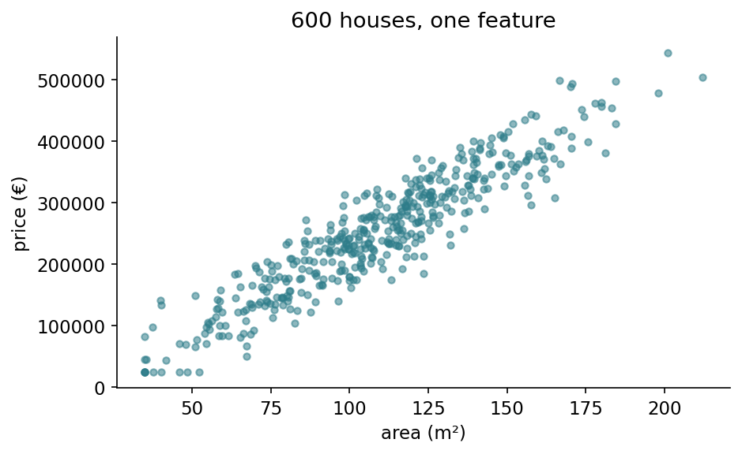
What we are trying to predict
Notes:
From notebook 1. Before any model, look at the data - the habit lesson 2 spent three hours arguing for.
Two things to point at. The cloud clearly slopes, so a line is a reasonable first guess; and the spread around that slope is wide, which is the 18,000 euros of noise we put in. That spread is the floor: no model, however clever, can predict these prices better than the noise allows.
Ask the room to eyeball the slope in euros per square metre before you show any fit. Someone usually lands near 2,400, and having guessed it makes the fitted number mean something when it arrives.

Slide 6
What a linear model claims
Each feature contributes a fixed amount per unit, and the contributions add up.
Every square metre: the same 2,400 €
Every kilometre out: the same −6,500 €
Notes:
Read it as a sentence, then attack it. Is the hundred-and-first square metre really worth what the fiftieth was? Is a garage worth the same in the centre as in the suburbs, where there is street parking anyway?
Almost certainly not. The right response is not to abandon linear models but to know what you have assumed - section 5 shows how to check the assumption and how to relax it when it fails.
Ask the room for a feature where the constant-per-unit claim would obviously break. Bedrooms is a good answer: the tenth bedroom is not worth what the second was.

Slide 7
Fitting means minimising something
We need one number saying how badly a candidate model is doing.
Adding up the errors fails: +50,000 and −50,000 cancel to zero.
Notes:
This is the intuition before the formula, and it takes ten seconds. A model that is 50,000 too high on one house and 50,000 too low on another is not perfect, but the sum of its errors is zero.
So every error must count as a positive amount. That is the requirement; squaring is one way to meet it, absolute value is another. The next slide says why we choose squaring.

Slide 8
Why squared, not absolute
Differentiable everywhere: no corner at zero
Punishes one large error more than several small ones
Under Gaussian noise, it is maximum likelihood
Notes:
Give the three in increasing order of depth. The first is convenience. The second is a design decision: being wrong by 40,000 on one house costs the same as 20,000 on four, which matches most intuitions about what a bad prediction is.
The third is the real reason and worth saying even though we do not prove it: if you believe the noise is Gaussian, least squares is not a convention, it is the maximum likelihood estimator. That connects to the residual histogram in notebook 1.
Then the consequence, which is not optional: squared error is sensitive to outliers, because one absurd value contributes its error squared. Lesson 2’s outlier work is a prerequisite for this lesson, not a preliminary.

Slide 9
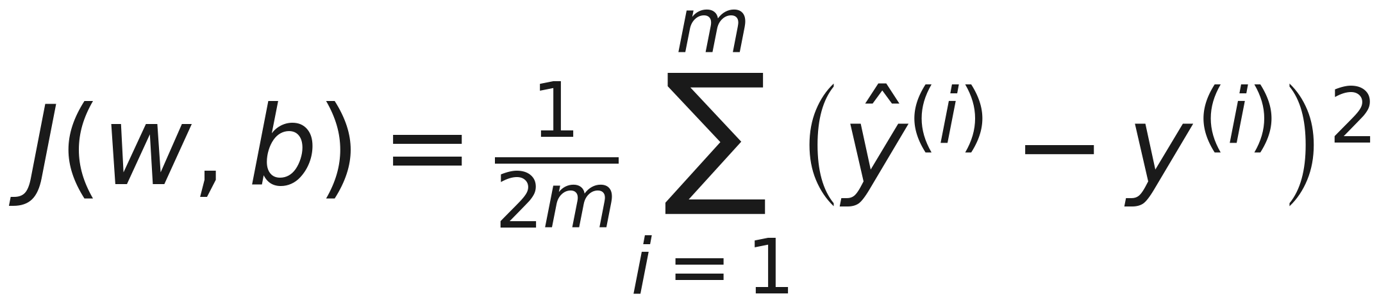
The cost function: mean squared error
Notes:
Name the parts: m examples, the half for convenience when we differentiate, the square doing the work discussed. This is the mean squared error, MSE from here on, and the name is worth saying aloud because every later slide uses the abbreviation.
Ask where the half comes from if nobody has. Answer: differentiating a square brings down a 2, and the half cancels it. It cannot move the minimum, because scaling a function by a constant does not move its minimiser.
Handout section 2.2. The worked table there computes the cost for three houses and shows how the two large errors contribute nearly everything - squared error spends its attention on the worst predictions, which is a choice you are making whether or not you notice.

Slide 10
Trying ŷ = 2,400 · area + 45,000
Area (m²) | True (€) | Predicted (€) | Error ŷ − y | Error²
80 | 240,000 | 237,000 | −3,000 | 9.0 × 10⁶
120 | 320,000 | 333,000 | +13,000 | 1.69 × 10⁸
200 | 540,000 | 525,000 | −15,000 | 2.25 × 10⁸
Notes:
Walk the first row across out loud: 80 square metres, the model says 237,000, the truth is 240,000, so it is 3,000 euros light. Then the last column squares it.
Dividing the sum by 2m gives a cost of about 6.7 × 10⁷. Nobody should be impressed by that number on its own - a cost is only meaningful compared with another cost, which is exactly what fitting does.
Handout section 2.3 has this table. The next slide is what it is really for.

Slide 11
Squared error spends its attention on the worst house
The 3,000 € error contributes about 2% of the total
The two large errors contribute the other 98%
Halving the 15,000 € error cuts the cost by 42%
Notes:
This is the point of the worked example, and it is a design decision rather than a fact of nature.
Put the third bullet against its opposite, because the contrast is the whole lesson: halving the worst error cuts the cost by 42%, while halving the best one cuts it by 1.7%. Same effort, twenty-five times the reward - so that is where the fit will go.
Squaring means the fit will bend itself towards its worst predictions and largely ignore the ones it already gets nearly right. Most of the time that is what you want - a model wrong by 40,000 on one house is worse than one wrong by 10,000 on four.
But say the flip side plainly, because it is lesson 2 arriving from a new direction: one absurd outlier contributes its error squared, so it can drag the entire fit towards itself. If you did not clean the data, least squares will faithfully optimise for the mistake.
Ask what would change if we minimised absolute error instead. Answer: the fit would follow the bulk of the data and shrug at the outlier - which is what robust regression does, and why it exists.

Slide 12
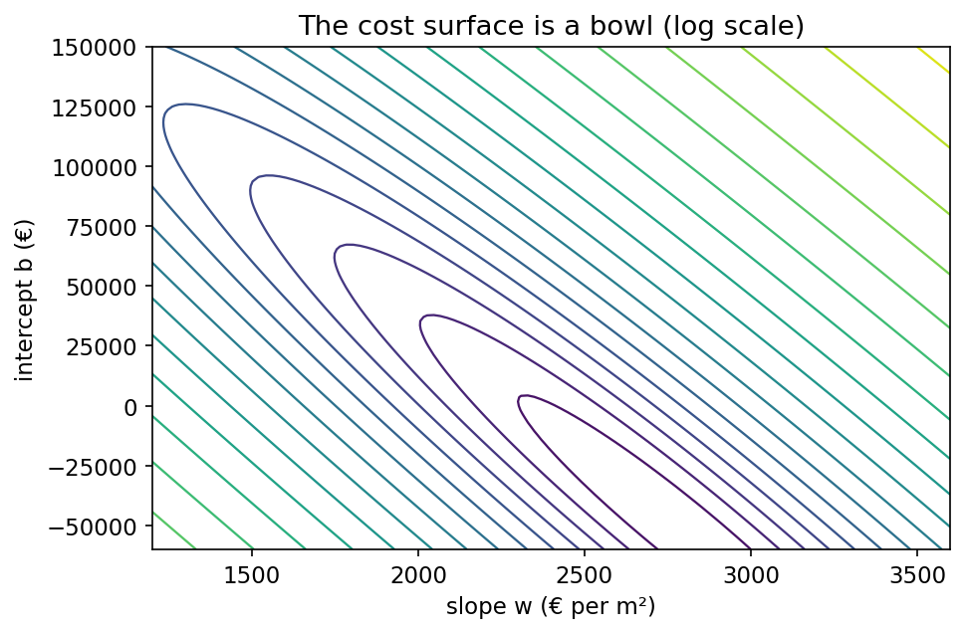
The cost is a bowl
Notes:
From notebook 1. Two parameters, so the cost is a surface over the plane of (slope, intercept), and fitting means finding its lowest point.
The important structural fact: this bowl is convex. There is one minimum and no local traps. Say that explicitly, because it is a property most methods later in the course do NOT have - lesson 9’s networks have cost surfaces full of local minima, and a great deal of the difficulty of training them comes from exactly that.

Slide 13
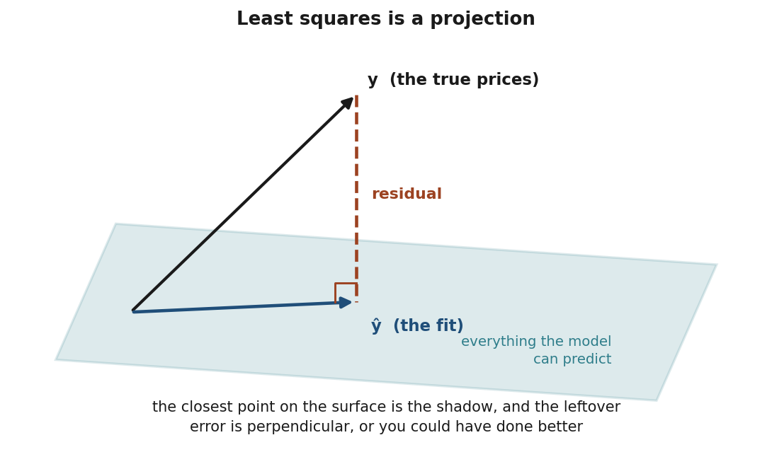
The picture behind the exact solution
Notes:
Spend a full minute here. This is the intuition; the algebra follows.
Each feature is a direction the model can move in. Everything the model can predict lies on the flat surface those directions span. The true prices are a point that almost certainly does NOT lie on it - no combination of area and age reproduces them exactly.
So the best you can do is the closest point on the surface: the shadow, the perpendicular projection.
Then the punchline, which is the whole method: why perpendicular? Because if the leftover error had any component lying ALONG the surface, you could have moved that way and done better. At the optimum the error must be at right angles to every feature. That is what the normal equations say, and it is where the name comes from.

Slide 14
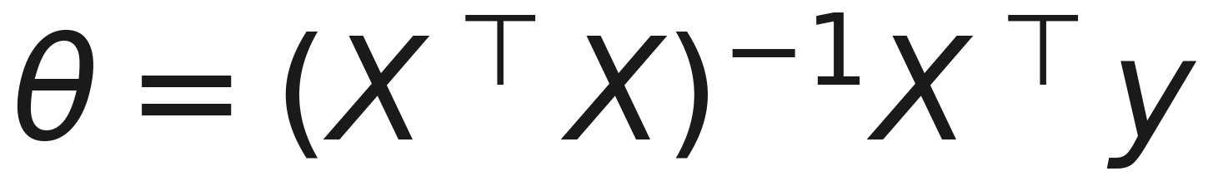
The normal equation
Notes:
Four lines of NumPy, and notebook 1 shows it agreeing with scikit-learn to 1.8e-12 euros per square metre.
Handout section 3.1 derives it properly and section 3.2 does it by hand on three houses: X transpose X, determinant 22,400, the inverse, and out comes 2,536 euros per square metre against a true 2,400. Three data points, two parameters, 6% error. Worth doing on the board if the room is engaged.
Also mention the second derivative is X transpose X, which is positive semi-definite, so the cost is convex and any stationary point is global. That is the formal version of “the bowl has one bottom”.

Slide 15
The same equation, by hand
Quantity | Value
the three houses | 80, 120, 200 m² → 240k, 320k, 540k
XᵀX | rows (3, 400) and (400, 60,800)
Xᵀy | (1,100, 165,600)
determinant | 22,400
slope w | 2,536 €/m² (truth 2,400)
intercept b | 28,600 €
Notes:
Worth doing on the board if the room is awake - it takes four minutes and it turns the formula into something they have touched.
The whole method on three data points: build the two-by-two matrix, take its determinant, invert it, multiply. Out comes a slope within 6% of the value that generated the data, from three houses and two parameters.
If you do put it on the board, show the dot product that gives the second entry of X transpose y - 80 times 240, plus 120 times 320, plus 200 times 540. It is the step where an arithmetic slip hides, and watching it done is what makes the formula stop being a black box.
Then the honest caveat, and it is sharper than it looks: three points is nothing, and the 6% is luck. Run the SAME one-feature fit on 450 houses and you get 2,785 - sixteen percent high, further from the truth, with 150 times the data. More rows cannot fix it, because nothing is broken: asked what a square metre is worth when area is all you are told, the honest answer includes the bedrooms and bathrooms that come with it. All six features give 2,421.
So the point is not the accuracy. It is that the formula is arithmetic you could do by hand - and that what a coefficient means depends on what else is in the model, which is section 7.
Handout section 3.2 carries every intermediate step.

Slide 16
And it really is the minimum
The second derivative is XᵀX, never negative in any direction
So the cost is convex: one bottom, no local traps
Any stationary point is the answer, not an answer
Notes:
Short slide, big consequence. Setting a gradient to zero finds a flat spot; it does not by itself tell you the flat spot is the lowest point rather than a ridge or a local dip.
Here it does, because the cost is convex. Give the one-line reason without the algebra: XᵀX can never be negative in any direction, since asking for its value in direction v gives the squared length of Xv, and a squared length is never negative.
Now flag it forward, because this is the slide they should remember in lesson 9: this property is a luxury. Neural network cost surfaces are full of local minima, and a large part of the difficulty of training them is that nobody can promise the point you reached is the point you wanted. Today we can.
Handout section 3.1, the paragraph headed “Is this really a minimum?”.

Slide 17
So why learn anything else?
(XᵀX)⁻¹ costs about n³ operations
Two columns carrying one fact → no inverse exists
Nearly-redundant columns → an inverse that is useless
Notes:
Three failure modes, and the third is the dangerous one because nothing visibly breaks.
At a thousand features the cube is a billion operations; at a hundred thousand it is out of reach. Every large model in this course is trained iteratively.
For the second: notebook 3 constructs exactly this, an area column in metres and the same in feet.
For the third, give the number from notebook 3: a coefficient that moves from 9,261 to 45,307 across four random splits of the same dataset. The matrix was invertible every time. The answer was garbage every time.

Slide 18
How stretched is the valley?
The condition number compares the steepest direction with the shallowest.
Housing features as recorded: 285
The same features, standardised: 3.4
Add area_sqft beside area_sqm: 2,286
Notes:
This is the number behind “nearly redundant”, and it is the most transferable idea in the first half of the lesson.
The picture: a round bowl is easy to walk down because every direction behaves the same. Two nearly-identical columns produce a ravine instead - steep across, almost flat along. The flat direction is the one where moving one coefficient up and the other down changes the predictions barely at all, which is precisely why the fit cannot decide between them.
Then the payoff, which lands twice. For the exact solution, a stretched valley is what makes the inverse enormous and the answer unstable. For gradient descent - next section - one step size has to serve every direction at once, so the steep direction sets the limit and the shallow one crawls. The condition number is, near enough, what sets the iteration count.
Lesson 2 introduced this for scaling; unscaled features stretch the valley for exactly the same reason. Handout section 4.4.

Slide 19
The picture behind gradient descent
You are on a hillside in fog.
You cannot see the valley, but you can feel which way the ground slopes.
Notes:
The intuition before any notation. Take a step downhill, feel again, repeat. That is the entire algorithm.
The gradient is the direction of steepest ascent, so we walk against it. The learning rate is the length of the stride.
And the danger is equally intuitive, which is the point of using this picture: stride too far and you cross the valley and end up higher on the far slope. Everyone has done that walking down a steep hill.

Slide 20
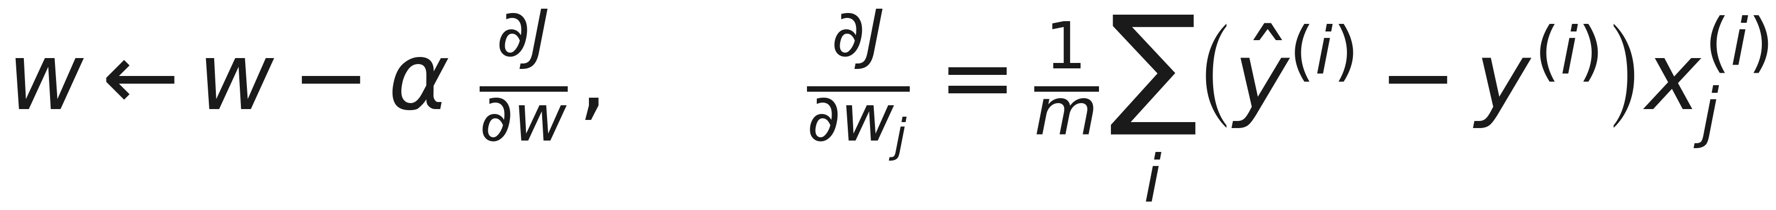
The update rule
Notes:
Read the gradient aloud as a sentence, because its shape carries a lesson: each example pulls the coefficient in proportion to two things - how wrong the prediction was, AND how large that feature was for that example.
So a 200 square metre house that is badly mispriced moves the area coefficient much more than a 40 square metre one with the same error. The gradient is a weighted vote and the weights are the feature values.
That is precisely why unscaled features cause trouble, and it is lesson 2’s argument arriving from a different direction. The intercept gradient has no x in it - every example gets an equal vote there.
Handout 4.2 works one step by hand: after a single update the slope has moved 163 times further than the intercept.

Slide 21
One step, from w = 0 and b = 0
α = 10⁻⁵ | Gradient | After one step
slope w | −63,600 | 0.636
intercept b | −390 | 0.0039
Notes:
Both gradients are negative - the model predicts zero for everything, so every prediction is far too low - and both parameters therefore increase. So far, so unremarkable.
Now the thing to notice, and give the room a moment to spot it: after one identical step the slope has moved 163 times further than the intercept.
Nothing clever caused that. Areas are around 140, and the intercept’s “feature” is always 1, so the slope’s gradient is roughly 140 times larger before anything else happens. With one shared learning rate, the intercept crawls towards its value long after the slope has arrived - which is exactly what notebook 1 shows after 4,000 iterations.
That is the concrete cost of unscaled features, and the cure is lesson 2’s. Handout section 4.2.

Slide 22
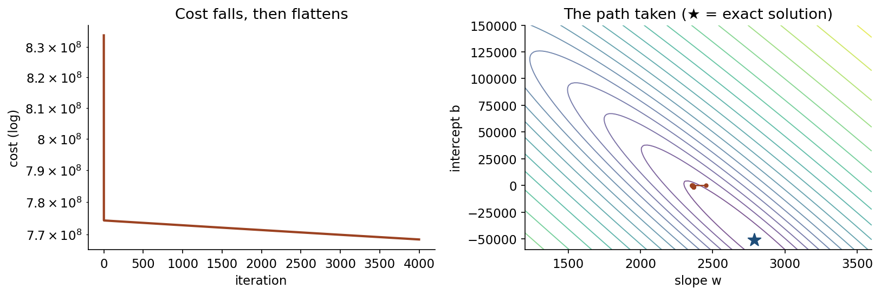
The path it takes
Notes:
Both panels are from notebook 1, and they are the same run seen two ways.
Left: the cost against iteration. It drops off a cliff in the first few dozen steps and then flattens into a long tail that is still creeping at 4,000. Point at the flat part and say what it means - the model was essentially fitted very early, and almost all the iterations bought almost nothing.
Right: the same run drawn on the contours, with the star marking the exact solution from the normal equation. The path arrives quickly in the steep direction and then crawls along the floor of the valley towards the star. That crawl is the previous slide’s 163-to-1 asymmetry, and it is the condition number made visible.
The two panels are one point: progress stalls because one stride length has to serve a direction that is steep and a direction that is nearly flat.
Ask what would happen with a much larger stride. Answer on the next slide.

Slide 23
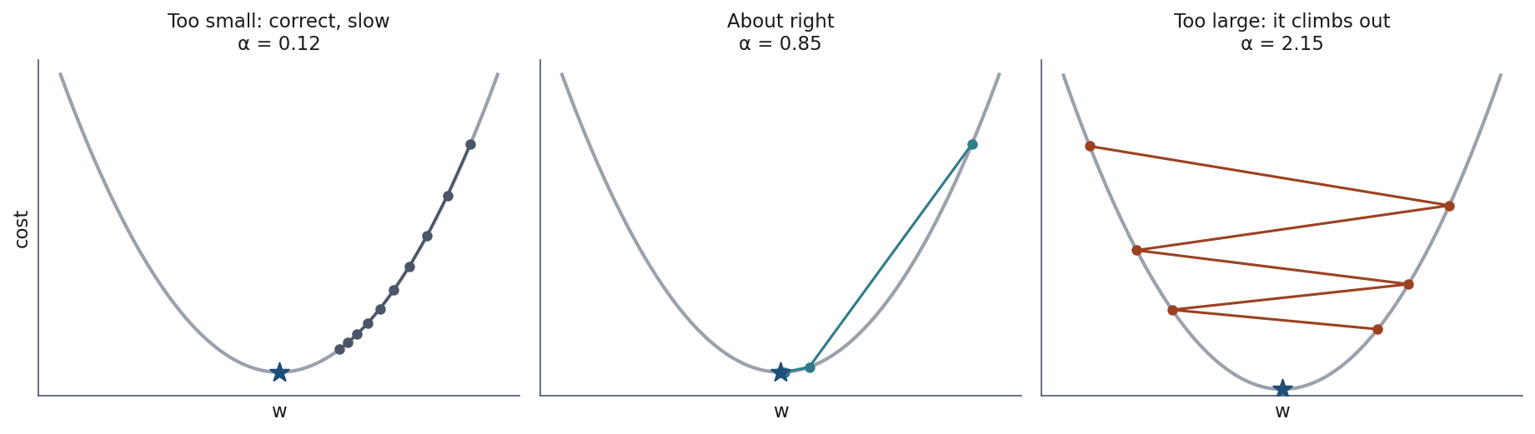
Three learning rates
Notes:
Left: too small, correct but slow - the cost falls every iteration and simply takes too many of them. Middle: about right. Right: too large, and it climbs out of the valley.
The threshold is not folklore. Lesson 2 derived it: for a bowl of curvature c, convergence requires alpha below 2/c, and with several features the binding constraint is the largest curvature - the largest feature variance.
So the safe learning rate is set by your worst-scaled feature, which is another argument for scaling everything.
Practical recipe to give them: start at 0.01 on scaled features, watch the cost, divide by three if it rises. Lesson 5 replaces the recipe with a search.

Slide 24
Notebook 1, live
The model, the cost, the exact solution, the iterative one: from scratch.
Notes:
30 minutes. Let them drive.
The two moments worth pausing on together. First, the agreement between their four-line normal equation and scikit-learn to twelve decimal places - it lands better than any assurance from the front. Second, the coefficient table at the end, which is the setup for the last section of the lesson.
Watch for anyone whose gradient descent diverges. That is the “try this” at the end of the notebook and it is a good thing to have happen.

Slide 25
Break
Notes:
15 minutes. Back for curves, overfitting and regularisation.
Check who is stuck in notebook 1 - the second half assumes everyone got the coefficient table out, and it is much cheaper to fix now.

Slide 26
What if the relationship bends?
Energy consumption against temperature: heating in the cold, cooling in the heat.
No straight line follows that.
Notes:
Set the problem before the solution. Draw the U shape in the air: consumption high at both ends, minimum somewhere around 18 degrees.
Ask what a straight line would do here. Someone will say it averages through the middle - right, and it will be too high in the centre and too low at both ends, wrong in a structural way rather than slightly imprecise.
Notebook 2 has this dataset: 30 days of measurements, which is deliberately few.

Slide 27
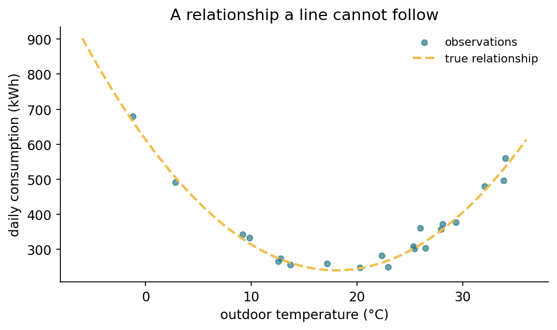
A relationship a line cannot follow
Notes:
From notebook 2. Daily energy consumption against outdoor temperature: heating at the cold end, cooling at the warm end, a minimum somewhere around 18 degrees.
Let them look at it before saying anything. The U is obvious to a human eye in under a second, which is worth remarking on - the hard part was never seeing the shape, it is getting a model to represent it.
Note the sample size out loud: 21 training points. Deliberately few, because the overfitting we are about to produce needs the model to have nearly as many coefficients as there are observations, and that situation is far more common in real work than people expect.

Slide 28
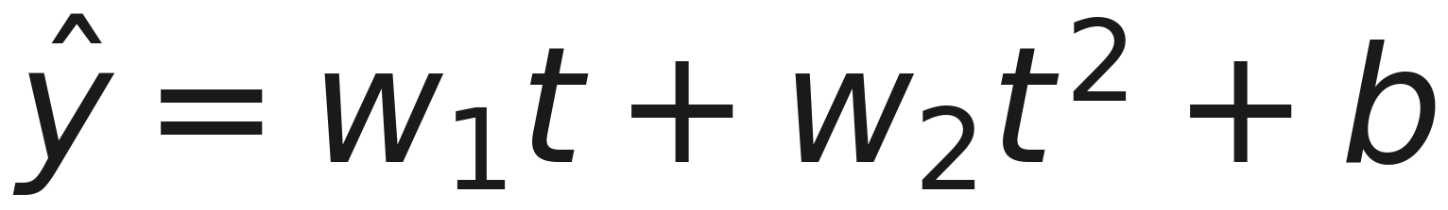
“Linear” means linear in the coefficients
Notes:
The trick, and it surprises people. Nothing in the derivation required the inputs to be straight - only that the model is linear in w, which it still is.
So this is the same least squares, the same normal equation, the same code, on a design matrix with one extra column. PolynomialFeatures builds those columns.
The same trick covers interactions like x1 times x2, logarithms, anything you can compute. It is why linear models remain useful on relationships that are not lines.

Slide 29
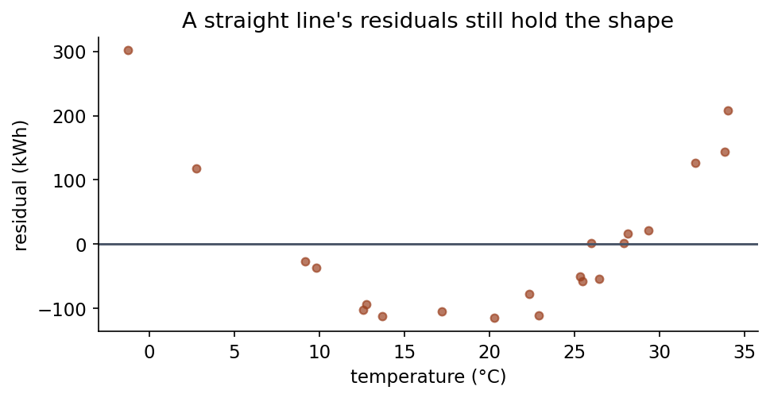
The straight line’s residuals keep the shape
Notes:
This is the diagnostic to teach. The U in the residuals says: there is structure here the model did not take.
Contrast with notebook 1, where the residuals were a formless cloud with a spread matching the known noise. That is what “the model got everything” looks like.
Give them the habit: after fitting anything, plot the residuals against each feature. A pattern is a message.

Slide 30
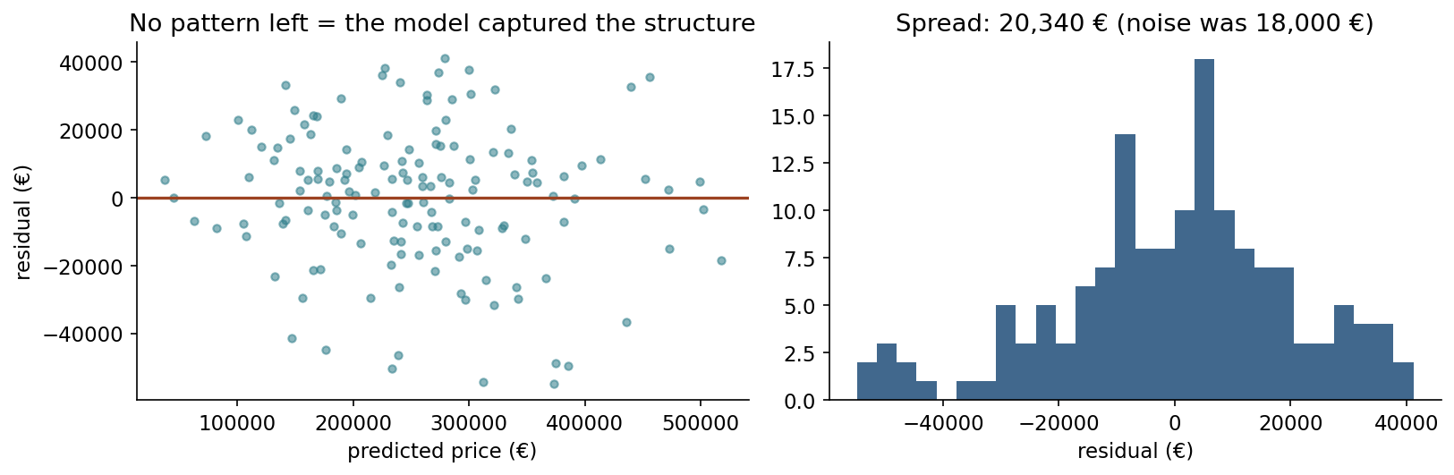
What “nothing left” looks like
Notes:
The contrast to the previous slide, and from notebook 1 - the housing fit, where the model did capture the structure.
A formless cloud, centred on zero, with no pattern as you sweep left to right. The spread matches the 18,000 euros of noise we know we put in, which is the best possible outcome: the model has taken everything that was there to take, and what remains is the part nobody could have predicted.
Put the two pictures side by side in words: a U means structure you missed, a cloud means you are done. That is the whole diagnostic, and it costs one line of code after every fit.
Give them the habit explicitly - plot residuals against each feature, every time. A pattern is a message.

Slide 31
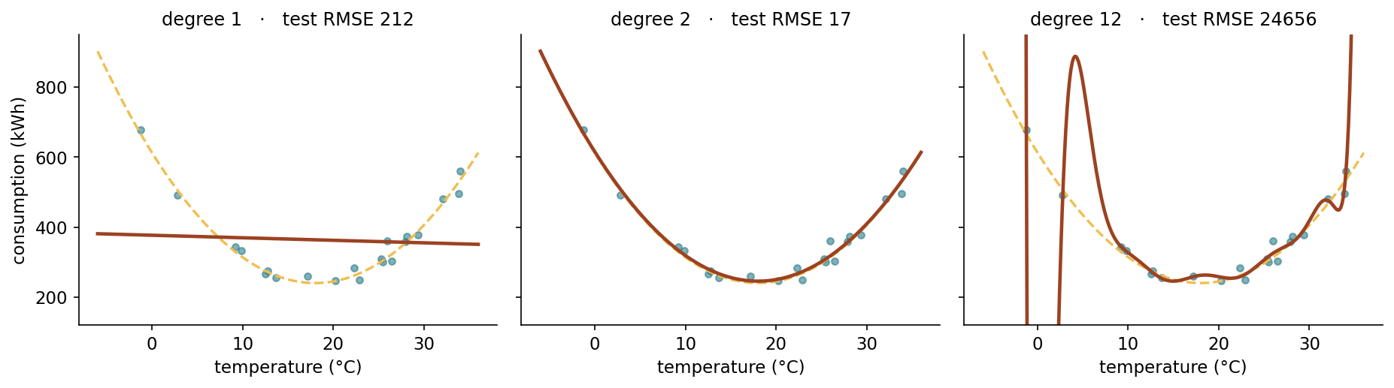
So use more flexibility?
Notes:
Degree 1 too rigid, degree 2 right, degree 12 wild.
Ask them which they would pick if the dashed true curve were not drawn - because that is the real situation. The only thing you ever see is the points.
Then note the trap in the right-hand panel: it passes closest to the training points of the three. If you selected by training error you would pick it every time.

Slide 32
Root mean squared error (RMSE), by degree
Degree | Train RMSE | Test RMSE
1 | 113.3 | 212.1
3 | 17.5 | 16.9
9 | 16.2 | 590.1
12 | 13.6 | 24,655.7
Notes:
Say the name in full before anything else, because every later slide uses the abbreviation: root mean squared error, RMSE, the square root of the mean squared error. Taking the root puts the number back into the units of the target - kilowatt-hours here - so it can be compared with the thing being predicted. An MSE of 285 means nothing to anyone; an RMSE of 16.9 kWh does.
This is the table the whole lesson turns on. Read the columns against each other, slowly.
Training error falls at every single step, 113 down to 14, monotonically, never once suggesting anything is wrong. Test error bottoms out at degree 3 and then climbs: 590 at degree 9, and 24,656 at degree 12.
So the model that fits the training data best is more than a thousand times worse on data it has not seen - and the training error congratulated us the whole way.
This is lesson 1’s empirical-versus-expected risk with numbers in it. And note how little it took: 21 training points, and by degree 9 the model has nearly as many coefficients as data.

Slide 33
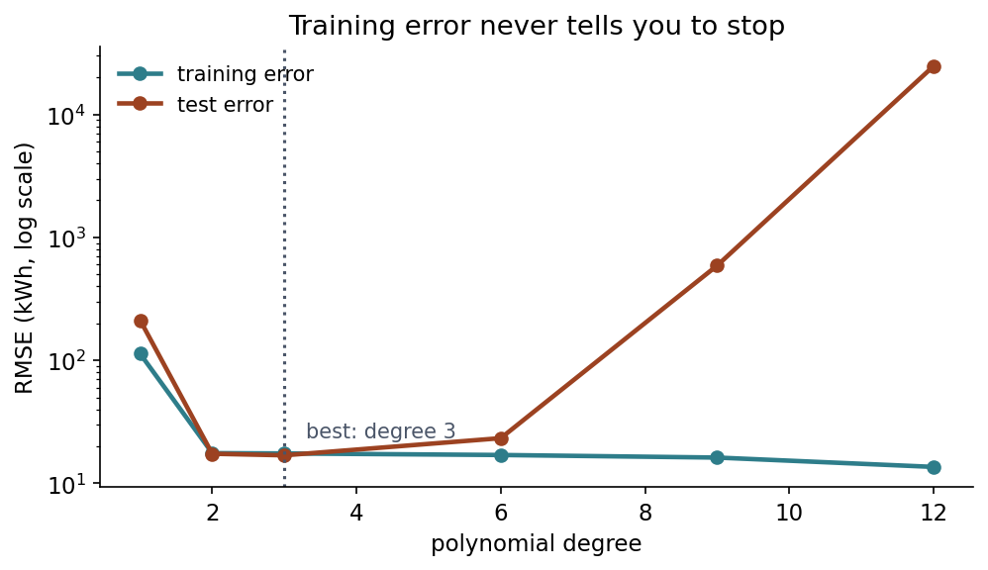
The gap is the overfitting
Notes:
The previous table as a picture, and the shape is the one to carry out of the room.
Training error, the lower line, falls monotonically and never once turns up. If that were the only curve you could see - and on your own data it is - you would keep adding degrees forever and congratulate yourself the whole way.
Test error is the other line, and it turns. The gap between the two curves is the thing with a name: that gap is overfitting, and it widens without limit.
This is lesson 1’s empirical risk versus expected risk, now with numbers and a picture. Lesson 5 is about measuring the upper curve honestly when you do not have a test set to spend.

Slide 34
Notebook 2, live
Fit the curve, push the degree up, and watch the test error turn.
Notes:
20 minutes. This is the shortest of the three notebooks and the most visual.
Have them run the degree sweep first and stop at the table, then predict which degree wins before scrolling. Most rooms guess too high - the instinct that more flexibility is better is exactly what the lesson is dismantling.
The moment to make sure everyone reaches is the coefficient printout at the end, because the next slide is about that number and it lands far better if they have just seen it appear on their own screen.
The “try this” reduces the training set from 21 points to 15 and asks which degree wins then. The answer moves down, which is the first hint that the right amount of flexibility depends on how much data you have - a theme for lesson 5.

Slide 35
Why flexibility goes wrong
Largest coefficient, degree 2: 411
Largest coefficient, degree 12: 3,097,038,010
Notes:
Here is the mechanism, and it is the setup for everything after the break.
The huge coefficients work in OPPOSITION. With 21 points and 12 coefficients there are many ways to pass close to every point, and the one least squares finds has terms that nearly cancel - one pushing the curve up where the next pushes it down, the cancellation failing exactly where a training point sits. Between the points, nothing constrains the swing.
Then the question that leads the rest of the lesson: if enormous opposing coefficients are the symptom, what would happen if we charged for coefficient size?

Slide 36

Charge for size
Notes:
Two penalties, one difference: squares or absolute values. MSE here is the mean squared error from the first half of the lesson. Lambda sets the exchange rate between fitting the data and keeping coefficients small; at lambda = 0 both are ordinary least squares.
Say the naming trap out loud, because they will hit it in five minutes: we write the penalty strength as lambda, and reserve alpha for the learning rate. scikit-learn calls the penalty alpha. So Ridge(alpha=0.01) in code is lambda = 0.01 on this slide.
Two things that are not optional and that students get wrong. The intercept is never penalised - it is not a claim about any feature, and shrinking it would bias every prediction towards zero. And features MUST be scaled first: the penalty is a sum over coefficients, so the same feature in metres and in kilometres attracts penalties differing by a factor of a thousand.
Lesson 2 introduced scaling for optimisation speed. Here it is correctness.

Slide 37
Two rules that are not optional
The intercept is never penalised: it is not a claim about any feature
Features must be scaled first, or the penalty is arbitrary
Notes:
Both of these are things students get wrong, and both produce results that look fine, which is what makes them worth a slide of their own.
The intercept says where the surface sits, not what any feature is worth. Shrinking it would drag every prediction towards zero, which for house prices in euros is a meaningless place to be dragged. scikit-learn handles this for you in both Ridge and Lasso - but only because someone decided it should, not because the formula does it by itself.
Scaling is the sharper one. The penalty is a sum over coefficients, so the same feature measured in metres and in kilometres attracts penalties differing by a factor of a thousand. Whichever feature happens to be recorded in small units gets a large coefficient and is therefore punished hardest, entirely by accident of the unit someone chose.
Say the contrast with lesson 2 explicitly, because it is the point: there, scaling was about optimisation speed and you could skip it and still be right. Here it is correctness. Skip it and the model answers a different question.
Handout section 6.1.

Slide 38
What a penalty buys
Model | Train | Test | max |w|
none | 13.6 | 24,655.7 | 3,097,038,010
λ = 0.01 | 18.0 | 22.8 | 365
λ = 1 | 44.5 | 105.2 | 156
λ = 100 | 96.0 | 227.6 | 6
Notes:
Read the last column first: three billion down to 365, from a penalty of one hundredth. And the test error falls from 24,656 to 23, which is the noise floor - a thousandfold improvement bought with one number.
Now the training column, which is the honest part: it gets WORSE at every step. 13.6, 18, 45, 96. That is the trade being made deliberately - a worse fit on the data we have, in exchange for a better fit on data we do not.
And it stops paying. The test error rises from 22.8 at lambda 0.01, to 105 at lambda 1, to 228 at lambda 100 - a tenfold loss against the best penalty, because the model is now too rigid to follow the curve.
The useful range spans four orders of magnitude, which is why lambda cannot be guessed.

Slide 39
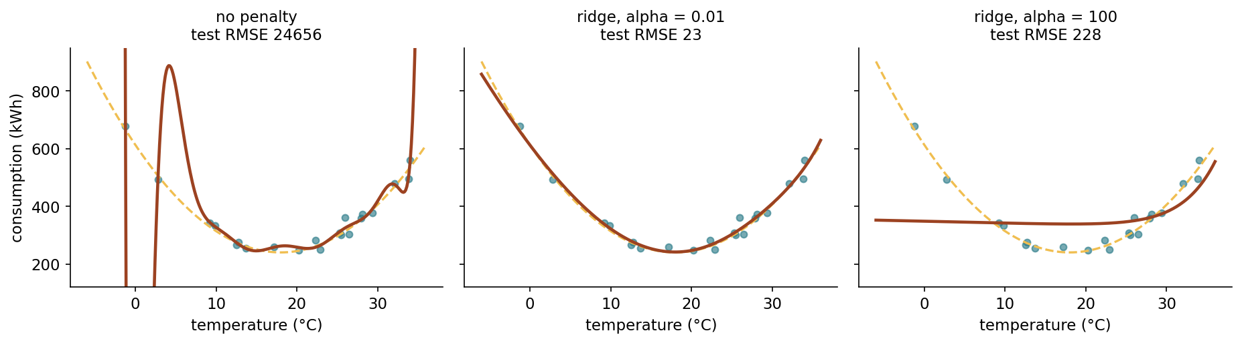
The unpenalised fit leaves the picture
Notes:
The last column of that table, drawn. Give the room a moment on the left panel before saying anything.
Point at the vertical scale. The unpenalised curve goes off the top and off the bottom between the training points, and it only comes back where a point is sitting there to pull it. That is what a coefficient of three billion looks like from the outside.
Middle panel, lambda one hundredth: on top of the true curve, the dashed line. You cannot separate them by eye.
Right panel, lambda one hundred: a nearly flat line. It misses the curve completely - but look at how it misses. It is wrong by a few hundred kilowatt hours, on a plot where the left panel is wrong by thousands.
That is the asymmetry to take away, and the table hides it: too much penalty is a mild failure, too little is a catastrophic one. If you have to err, err towards more penalty. Handout section 6.4.

Slide 40
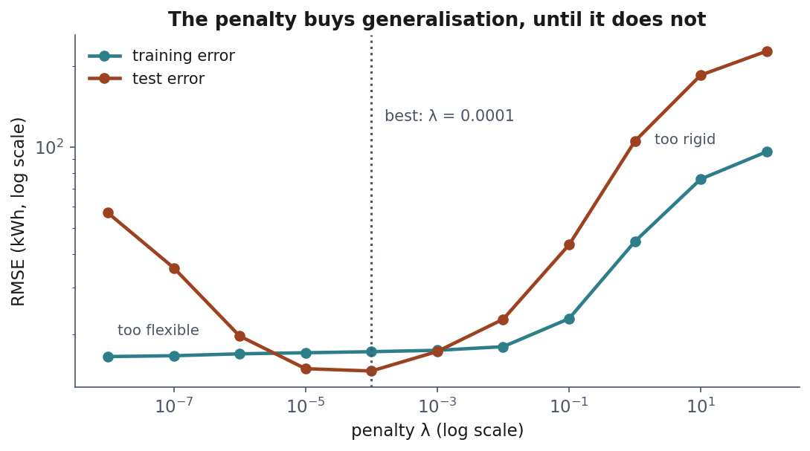
Too flexible, too rigid
Notes:
The same table as a picture. Both ends are failures, and they fail for opposite reasons.
This shape has a name - the bias-variance trade-off - and lesson 5 gives it the treatment it deserves along with the machinery to find the bottom of that curve honestly. Today the point is only that the bottom exists and is not where either extreme is.
If someone asks how to choose lambda: not by looking at this test curve, because that would be selecting on the test set. Cross-validation, lesson 5.

Slide 41
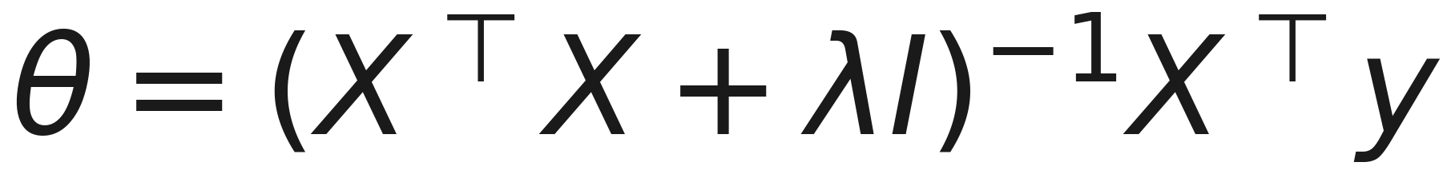
Ridge has an exact solution too
Notes:
Put this next to the normal equation from before the break and ask what changed. The answer is: one term. Add lambda down the diagonal of the matrix you invert, and that is the entire modification.
Everything else is identical - same derivation, same projection idea, same four lines of NumPy. Ridge is not a different method; it is least squares with the floor tilted.
Note that Lasso has no such formula. The absolute value has a corner, so it cannot be differentiated at zero, and the solution has to be found iteratively. That inconvenience is inseparable from the property that makes Lasso useful - the corner is exactly what produces the zeros.
Handout section 6.2 derives it in three lines.

Slide 42
Why that one change fixes it
Least squares fails when a direction costs nothing: the valley is flat
The penalty makes every direction cost something
Every eigenvalue shifts up by λ, so none of them can be zero
Notes:
Come back to the ravine picture from before the break. The reason two identical columns break least squares is that there is a direction in which moving the coefficients changes the predictions not at all - the valley is perfectly flat along it, so there is no unique lowest point. Infinitely many answers fit equally well.
Ridge tilts the floor. Once coefficient size costs something, moving along that flat direction is no longer free, the flatness acquires a slope, and a single lowest point appears.
The algebraic version is the third bullet and it is worth one sentence: adding lambda to the diagonal shifts every eigenvalue up by lambda, and a matrix is singular exactly when one of its eigenvalues is zero. So for any lambda above zero, it cannot be singular. Ridge always has a unique answer, even where least squares has none at all.
Worth saying plainly: Hoerl and Kennard invented ridge in 1970 for this problem, not for overfitting. The overfitting cure was the side effect.

Slide 43
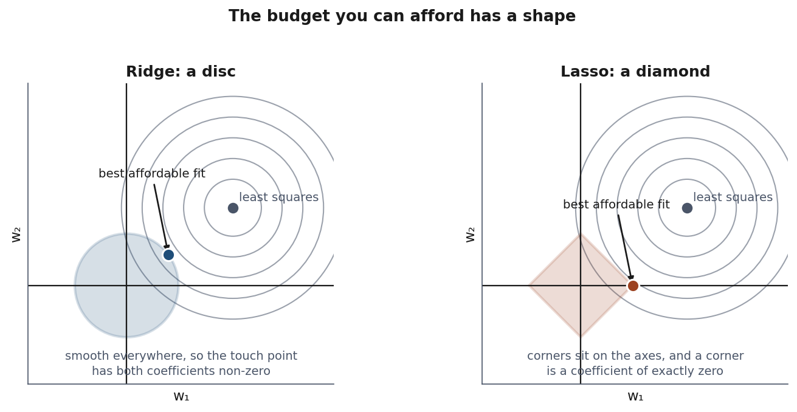
The picture behind Ridge vs Lasso
Notes:
Intuition before algebra again, and this one is worth the time.
Think of the penalty as a budget: you may spend a fixed total on coefficients and want the best fit that money buys. Draw what you can afford. Charging squares gives a disc; charging absolute values gives a diamond on its corners.
The best affordable fit is where the error contours first touch the region.
A disc is smooth, so contact happens at a generic point with both coefficients non-zero. A diamond has corners, its corners lie ON THE AXES, and a corner is a point where one coefficient is exactly zero. Corners stick out, so they get touched first.
That is the entire reason Lasso produces zeros and Ridge does not. Not a tolerance, not a numerical accident - the shape of the budget.

Slide 44
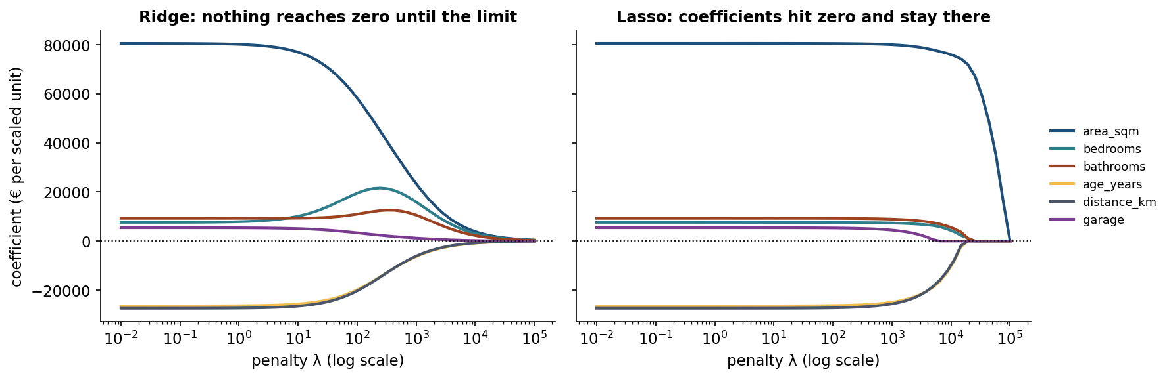
Ridge shrinks, Lasso selects
Notes:
From notebook 3. Left: ridge coefficients approach zero smoothly and never arrive. Right: lasso coefficients hit zero at a finite lambda and stay.
Give the order in which lasso drops features on the housing data, because it is not arbitrary: garage first at lambda 10,000 - the smallest effect once everything is on a common scale - then distance and age, and by 40,000 only area survives.
Nobody told it which features matter. It was told to keep the total size small, and this is the arrangement that buys the most accuracy per euro of coefficient spent.
The warning: the selection depends entirely on lambda, so “Lasso chose these features” is never a complete statement.

Slide 45
The order Lasso drops features
λ | Features kept
1,000 | all six
10,000 | five: garage dropped
20,000 | three: area, bedrooms, bathrooms
40,000 | one: area_sqm
Notes:
The previous picture, now as numbers. Read down the right column.
The order is not arbitrary and it is worth asking the room to explain it before you do. garage goes first because, once every feature is on a common scale, it buys the least accuracy per unit of coefficient spent. area_sqm survives longest because it buys the most.
Nobody told Lasso which features mattered. It was given a budget and told to spend it well, and this ranking fell out of that - which is genuinely remarkable and is why Lasso is used as a feature selector at all.
Now the warning, and it is the part that gets forgotten in practice: the selection depends entirely on lambda. “Lasso chose these four features” is not a complete statement - at a different lambda it chooses differently. Presenting lasso output as an objective ranking of importance is one of the commonest misuses of it.
Handout section 6.5.

Slide 46
The case Ridge was invented for
area_sqm and area_sqft: the same measurement, two units.
Correlation: 0.999999
Notes:
The situation from the failure-modes slide, made concrete: someone merged two systems and the same fact arrived twice.
Ask what least squares should do. The honest answer is that it has no basis for choosing between “all the effect on the metres column” and “all of it on the feet column” and everything in between - they all fit identically.
So it picks one arbitrarily, and the arbitrariness changes with the sample.

Slide 47
The coefficients are noise
Split | area_sqm | area_sqft
0 | 9,261 | −640
1 | 14,535 | −1,127
2 | 45,307 | −3,989
3 | 39,061 | −3,402
Notes:
Same dataset, four different random splits. The area coefficient varies by a factor of five, and its duplicate swings the opposite way to compensate.
Stress what is and is not broken: the PREDICTIONS are fine throughout - the combined effect is stable at about 2,420, close to the true 2,400. It is the EXPLANATION that is noise.
Anyone reading these coefficients to learn what drives house prices would draw nonsense, confidently. With ridge at lambda 10 the same four splits give 38,000 to 41,000 on both columns, split evenly, because two moderate coefficients cost less under a squared penalty than one huge positive and one huge negative.
So ridge is not only a cure for overfitting. It is what makes coefficients readable when features overlap - which in real data they always do.

Slide 48
What a coefficient actually says
The change in the prediction for a one-unit change in that feature, with every other feature held fixed.
Notes:
That last clause is doing enormous work and is almost always skipped over. Say it slowly, then make it concrete.
The coefficient on bedrooms is not “what a bedroom is worth”. It is what a bedroom is worth to a house whose floor area does not change - which is a strange object. A house that gains a bedroom without gaining any space has had its existing rooms subdivided, and that is a genuinely different proposition from an extra bedroom in an extra 15 square metres.
Ask the room what the coefficient on bedrooms ought to be for the subdivision version. Plausibly near zero, or negative. The estimate we get, 7,503, is a blend of that and something else - which is the setup for the next slide.
This is the reason two honest analysts fit the same data, report different coefficients, and are both right: they included different features, so their “held fixed” clauses differ. Handout section 7.1.

Slide 49
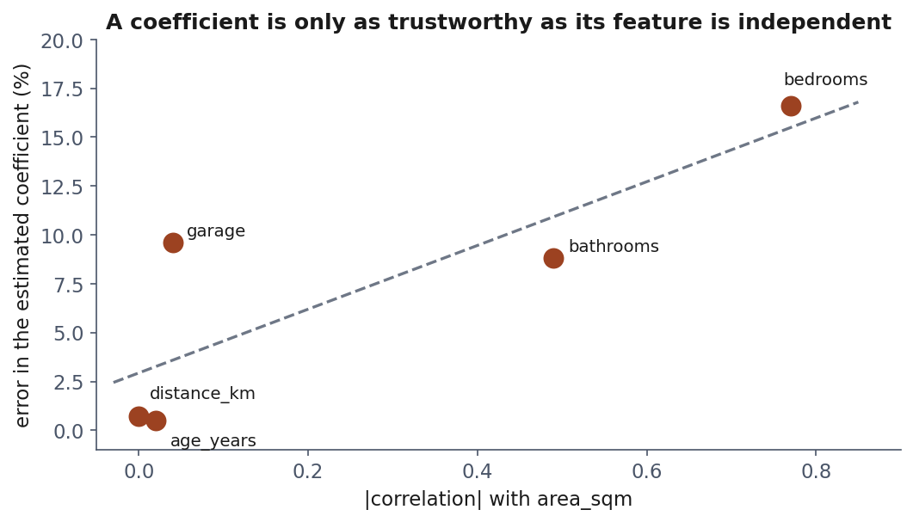
When can you trust a coefficient?
Notes:
From notebook 1, and this is the most transferable slide of the lesson.
The x axis is how correlated each feature is with area; the y axis is how far its estimated coefficient landed from the truth. The three features uncorrelated with area - distance, age, garage - are recovered to within 1%. Bathrooms, at 0.49, is out by 9%. Bedrooms, at 0.77, is out by 17%.
State the rule: a coefficient is only as trustworthy as its feature is independent. And on a real dataset the same wobble is there with nothing to reveal it - you would just have a number.
Then the harder point, briefly: a coefficient is an association, not a causal effect. If houses near the centre are older and dearer, age and distance divide the effect between them however the sample suggests. Neither number tells you what would happen if you moved a house.

Slide 50
Notebook 3, live
Ridge on the disaster, the regularisation paths, the collinear case.
Notes:
30 minutes. The collinear section is the one to make sure everyone reaches - it is the argument they will use in their own projects when a stakeholder asks what the model says drives the outcome.
The “try this” swaps Ridge for Lasso on the redundant columns. Ask them to predict which way lasso resolves it before running, then to explain why the two penalties disagree. It is a good check of whether the disc-and-diamond picture landed.

Slide 51
What we did today
A model that claims a fixed amount per unit
An exact solution (a projection), and when it fails
An iterative one: walk downhill, mind your stride
Flexibility helps until it does not
Charging for size buys generalisation, and readable coefficients
365 against billions: what a penalty of 0.01 costs, and buys
Notes:
Draw the thread. Lesson 2 prepared data honestly; today we fitted something to it and found that fitting well and explaining well are different goals.
The one sentence to leave them with: the model that fits your training data best is usually not the one you want.
And the number to leave them with, repeated from before the break: a penalty of one hundredth took the largest coefficient from billions to 365 and the test error from 24,656 to 22.8. One number, chosen well, bought all of that.
Preview lesson 4 in a sentence: same machinery, but the target becomes a category instead of a number - and that single change turns out to require a different cost function, for a reason that is one of the exam derivations.

Slide 52
Homework: we discuss it on Friday 16 October
Exercises/03_regression.md
Fit, regularise, and explain which coefficients you believe.
Notes:
Set it explicitly with the deadline. It uses a new dataset - bike sharing demand - so the exploration is theirs to do.
Flag the two tasks that carry the most marks. Task 4 asks them to justify a choice of lambda without looking at the test set, which is genuinely awkward before lesson 5 and is meant to be: the point is to feel the need for cross-validation before being handed it. Task 6 asks which coefficients they trust and why, which is section 7 of the handout applied.
As always: no marks for accuracy.
Also remind them the project topic must be confirmed by lesson 4 - next week.

