Slide 1
Lesson 6: k-NN, Naive Bayes and Support Vector Machines
Technologies for Artificial Intelligence
Fabio Antonini, Università degli Studi dell’Aquila

Slide 2
Before we start
Exercise 5, which we discuss now
The score that was too good, and what the honest number cost you
Notes:
Nothing to collect. What matters is the diagnosis, not the final figure, so ask the room what it found and listen for what it missed.
There was more than one problem planted. Ask out loud how many people found the second one, and how many stopped after the first - stopping after the first is the realistic failure, because once a score drops from excellent to plausible the pressure to keep looking disappears.
Then the sentence that links last week to today: everything from now on is evaluated with the apparatus you built in lesson 5. Today adds three model families, and each of them offers new ways to be wrong while looking right.

Slide 3
Today: the first lesson that offers a choice
k-nearest neighbours (k-NN): remember, and vote
The curse of dimensionality: the bill for that
Naive Bayes: one strong assumption, bought cheap
Support vector machines (SVM): margins, and kernels
Which family to reach for, and why that beats tuning
Notes:
Agenda, and one framing sentence that is worth saying deliberately.
Lessons 3 and 4 built linear models and spent most of their effort on fitting them honestly. Lesson 5 built the apparatus for telling whether a model works. None of that told them WHICH MODEL TO REACH FOR. This is the first lesson that offers a choice, and the choosing is the content.
Stress that these are not three ways of doing the same thing. They attack classification from three unrelated directions: one makes no assumptions and does no fitting at all, one makes an assumption that is usually false and wins anyway, one changes the criterion and then changes the space. The differences between them are the point, not the accuracy figures.
Handout section 1 sets this out in a paragraph each.

Slide 4
1,200 pumps, two readings each
Vibration in Hz, pressure in bar
A pump is faulty when its readings fall outside the design envelope, too low as readily as too high
61.3% faulty; 4% of the labels are deliberately flipped
Notes:
Describe the physical fact first, before showing the picture, and let them predict what it implies. A pump has a design operating envelope. It can fail by running too slow just as easily as by running too hot.
Ask the room what that does to the shape of the two classes before you advance. Somebody will get it: healthy in the middle, faulty all around.
The 4% flipped labels are lesson 5’s noise floor arriving in a classification problem. No model here can exceed roughly 0.96, and that is the number every score today should be compared against - not against 1.000, and not against each other in isolation.
Handout section 1.1.

Slide 5
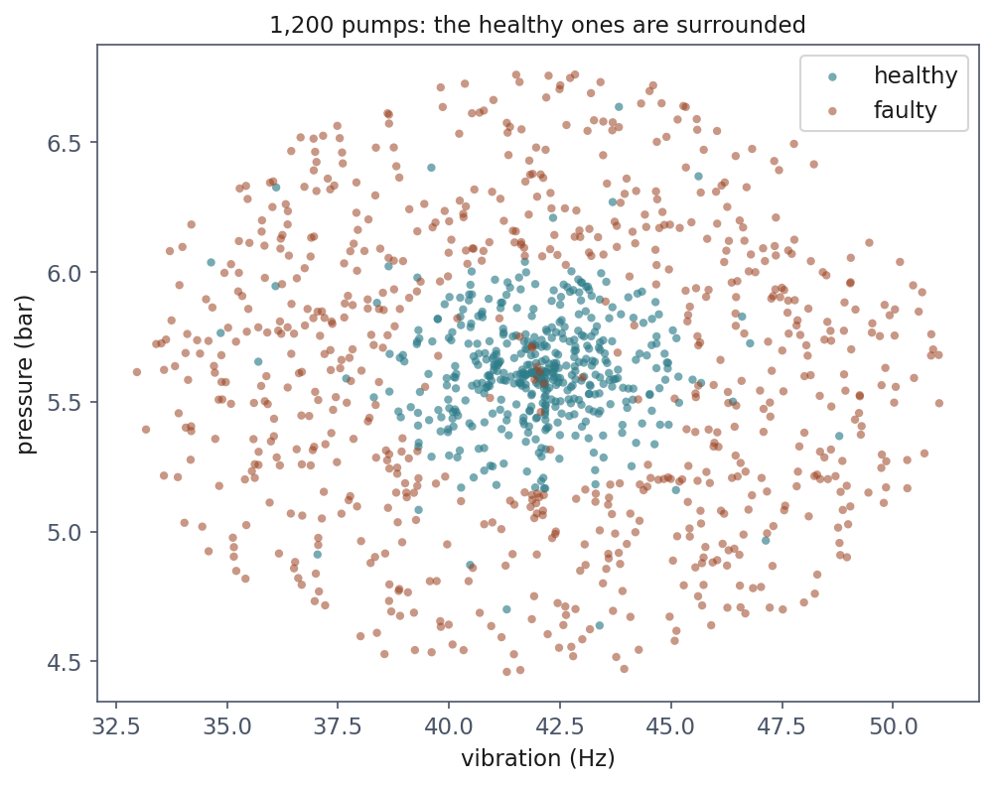
The shape of the problem
Notes:
Give them a moment before saying anything. Then ask for a straight line that separates these two classes, and let them try.
The healthy pumps form a disc around the design point; the faulty ones form the annulus around them. There is no line. Not a badly chosen line - no line at all, because the class you want to isolate is completely surrounded.
Worth naming what is unusual here, since most textbook pictures are blobs side by side: the geometry comes from the physics, not from an attempt to be awkward. Any “within tolerance versus out of tolerance” problem has this shape, and that covers a large fraction of industrial classification.
The scattered wrong-coloured points inside each region are the 4% flipped labels. Point at two of them now - they come back at k = 1.

Slide 6
What a straight boundary costs
Model | Cross-validated accuracy
Always predict the majority class | 0.613
Logistic regression (lesson 4) | 0.613 ± 0.000
Notes:
Read the two rows and let the equality sit there.
The thing to say clearly, because it is easy to under-read: logistic regression has not been narrowly beaten by the baseline. It has learned NOTHING AT ALL. It predicts “faulty” for every pump, because with a straight boundary that is genuinely the best answer available to it.
Then point at the standard deviation, which is the real tell: ± 0.000. A model that gives everything the same answer is perfectly consistent across folds. Give them that as a diagnostic to keep - a suspiciously stable cross-validation score often means a model that is not using its input.
Connect back to lesson 5’s habit: quote the baseline first, always. Without the 0.613 in the row above, 0.613 looks like a mediocre result rather than an absent one.

Slide 7
k-nearest neighbours: the whole algorithm
To classify a new point, find the k closest training points and take the majority vote
There is no training step: “fitting” means storing the data
Called a lazy learner: an unusually honest name for an algorithm
Notes:
The whole method is one sentence, and it is worth pausing on how strange that is after three weeks of optimisation. There is no cost function, no gradient, no parameters. Nothing is estimated.
Ask the room what could possibly go wrong with a method that makes no assumptions. The answer is the next fifteen minutes: making no assumptions means having no way to ignore anything, and that turns out to be expensive.
Two decisions hide inside that sentence - what “closest” means, and what k is - and both are consequential. Take them in that order.
Handout section 2.1.

Slide 8
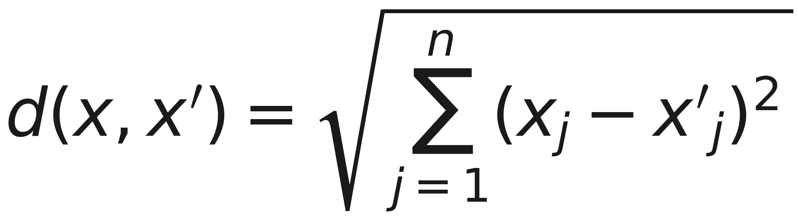
Distance is all it has
Notes:
Euclidean distance, almost always. Do not dwell on the formula; dwell on what it implies, which is the next slide.
The observation that matters: every feature contributes to that sum through its own units. There is nothing in the expression that knows Hz from bar. The method has no other channel through which the data reaches it - no coefficients, no weights, no notion that one column might matter more than another.
Say that plainly: for k-NN, the distance IS the model. Anything that distorts the distance distorts everything.
Handout section 2.1 has it with the scaling argument attached.

Slide 9
Scale first, or vibration decides everything
Vibration runs over tens of Hz; pressure over a couple of bar
Unscaled, a one-bar pressure difference is invisible beside a ten-Hz one
Lesson 2’s scaling argument, arriving with immediate consequences
Notes:
This is where lesson 2 stops being hygiene and starts being the difference between a working model and a broken one.
Work the arithmetic out loud. Two pumps differing by 10 Hz and 0 bar are 10 apart. Two differing by 0 Hz and 1 bar are 1 apart. So the algorithm considers the second pair ten times more similar - for no reason other than the units somebody chose when the sensors were installed.
The consequence: without standardisation, vibration picks every neighbour by itself and pressure is decorative. Change the pressure sensor to millibar and the model’s answers change. That should feel unacceptable, and it is.
Practical instruction: k-NN goes in a Pipeline with StandardScaler, always, and the scaler is fitted inside the fold - which is last week’s lesson, not a new one.

Slide 10
k is the bias-variance dial, made visible
Small k: the boundary follows every point, mislabelled ones included. Low bias, high variance
Large k: the vote is taken over a wide neighbourhood, and eventually stops following real structure. High bias, low variance
At k = 1 the training accuracy is exactly 1.000. Always, on any dataset
Notes:
Lesson 5 decomposed error into bias and variance and had to build 300 parallel universes to show it. Here you watch the same trade-off by turning one integer, and that is why this slide is worth more time than its size suggests.
The k = 1 claim is the one to make them prove to themselves. Ask why the training accuracy is exactly 1.000 at k = 1, and wait. The answer is that every training point is its own nearest neighbour, at distance zero. So it votes for itself and wins.
That is the purest illustration in the whole course of lesson 5’s point: a training score can be perfect and measure absolutely nothing. Not approximately nothing - nothing, by construction, independent of the data.
Handout section 2.2.

Slide 11
Measured on the pumps
k | Training | Cross-validated
1 | 1.000 | 0.912
5 | 0.953 | 0.944
15 | 0.948 | 0.938
51 | 0.940 | 0.933
401 | 0.828 | 0.708
Notes:
Read the first row, then the last, then the middle.
Row one: training 1.000, honest 0.912. The gap is the whole of lesson 5 in two numbers on one line.
The best value is k = 5, at 0.944 - wide enough to average out the flipped labels, narrow enough to still follow the boundary. Note that it is not dramatically better than 15 or 51: the choice of k is forgiving over a wide range, which is worth saying because they will otherwise grid-search it to death.
The last row is the interesting failure. At k = 401 the training score has collapsed too, which distinguishes it from overfitting: this model is bad everywhere, not just on data it has not seen. That is what bias looks like.
Compare 0.944 against the ceiling of 0.96, not against 1.000.

Slide 12
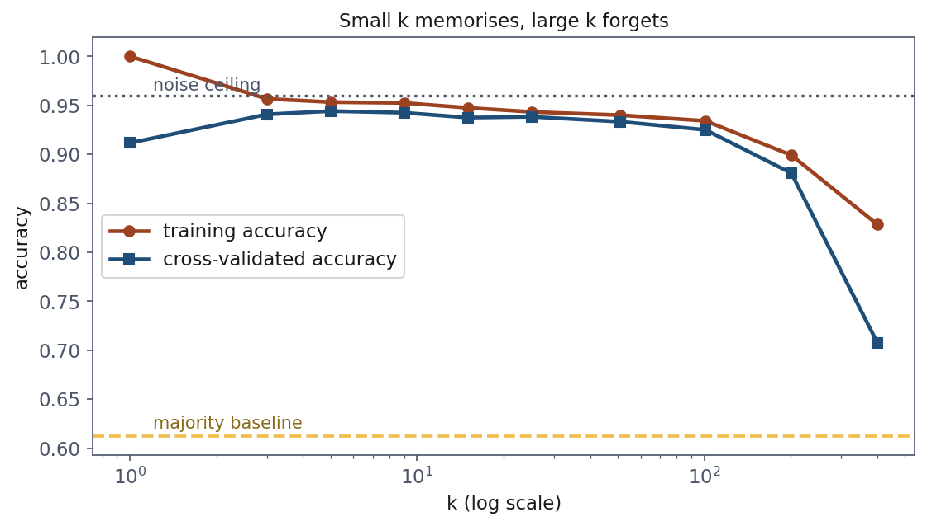
The two curves, and the two lines that bound them
Notes:
Point at the left edge first. The training curve starts at exactly 1.000 and falls; that is the k = 1 identity, drawn.
Then the two horizontal lines, which are the honest frame for reading any score in this lesson: the noise ceiling at 0.96, which nothing can exceed, and the majority baseline at 0.613, which everything should.
The gap between the two curves is variance, and watch it close as k grows. Where they meet and then both fall together, you have run out of variance and started buying bias. The minimum of the honest curve sits just before that.
Ask them which end of this plot they would have picked by looking at the training curve alone. The answer is the far left, which is the worst honest model on the plot bar one.

Slide 13
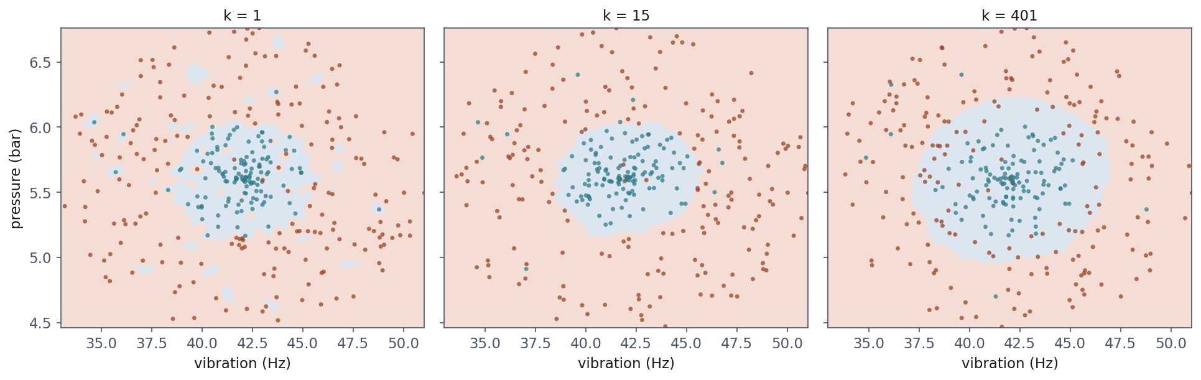
The same data at three values of k
Notes:
Three panels, and each says something different.
k = 1: the boundary is ragged, with islands around individual points. Those islands are the mislabelled 4% - the model has carved out a small territory for each one. That is variance made visible.
k = 15: a clean disc, close to the envelope that actually generated the data. This is roughly the truth.
k = 401 is the one worth the time, because it does not do what people expect. It has not collapsed to a single class. The boundary has INFLATED past the true envelope and now swallows faulty pumps. With 401 votes taken over a large neighbourhood, the majority class wins in regions where it should not. The model has stopped following the boundary and started averaging over it.
Handout section 2.2 carries the same three panels.

Slide 14
What k-NN costs
No training time at all: you pay at every prediction instead
A naive implementation compares the query against every training row: O(mn) for m rows and n features
The model is the dataset. You cannot ship one without the other
Notes:
The first cost is engineering. For 1,200 pumps it is nothing. For ten million rows answering a thousand queries a second it is the entire problem, and it is why approximate nearest-neighbour indexes are a small industry. Mention that the scikit-learn default uses a k-d tree or ball tree, which helps in low dimensions and stops helping in high ones - for reasons that are the next segment.
The second cost is easy to miss and matters more often. Every other model in this course compresses its training data into parameters and then throws the data away. k-NN cannot: to make a prediction it must hold the training set.
Spell out what that means when the training set is medical records or customer transactions. Shipping the model means shipping the data - to a phone, to a customer’s server, to a third party. That is a legal question before it is a technical one. This lesson’s Resources document and lesson 2’s cover it.

Slide 15
Now the price: add columns of nothing
Extra columns of pure noise, drawn from a normal distribution
The two real readings are untouched: the problem is exactly as solvable
Only the number of columns changes
Notes:
Set the experiment up carefully before showing the result, because the whole force of it depends on them believing that nothing was taken away.
Say it twice if necessary: the signal is still there. Both original columns are present, unmodified, and still sufficient to solve the problem perfectly. We are adding columns that contain nothing - no relationship to the label, no relationship to each other.
Ask for a prediction before you advance. Most of the room will say performance degrades gently, or not at all, because the useful information is intact. That instinct is exactly right for a linear model and exactly wrong here, and the next slide is why.
Handout section 3.1.

Slide 16
The signal never left
Total columns | Accuracy | Above baseline
2 | 0.938 | +0.325
12 | 0.762 | +0.149
27 | 0.662 | +0.049
52 | 0.602 | −0.011
102 | 0.578 | −0.035
Notes:
Read down the last column, slowly, and stop at the fourth row.
At 52 columns - that is 2 real and 50 empty - k-NN is BELOW the majority baseline. A model that ignored the data entirely and always answered “faulty” would now do better than a model that looked at it.
Let that be uncomfortable before explaining. Nothing was removed. Fifty columns of nothing were added, and they destroyed a method that a moment ago was near the noise ceiling.
Point out that the damage is already serious at 12 columns: 0.938 down to 0.762 for ten empty columns. Twelve features is not a large table. Nobody would look at a twelve-column dataset and think “high-dimensional”.
The mechanism is on the next three slides, and it is geometry, not statistics.

Slide 17
Why: distances stop varying
Scatter points in a cube, pick one, measure its nearest and its farthest neighbour
In two dimensions those are very different numbers, which is what makes “nearest” a meaningful word
Each new dimension adds its own squared difference, and the contributions average out
Notes:
Give the picture in words before showing it - the figure is on the next slide, and it lands better once they have pictured it themselves.
In two dimensions, the nearest point is genuinely near and the farthest is genuinely far. That difference is the entire basis on which k-NN operates: it assumes that “the five nearest” is a meaningfully different set from “five chosen at random”.
Now add dimensions. Every new coordinate contributes its own squared difference to every pairwise distance. Those contributions are independent draws from the same distribution, so by the law of large numbers their average concentrates, and every distance converges on the same value.
Say explicitly that this has nothing to do with k-NN, or with machine learning at all. It is a fact about high-dimensional Euclidean space. k-NN is simply the first method we have met that depends on it.
Handout section 3.2 does it properly.

Slide 18
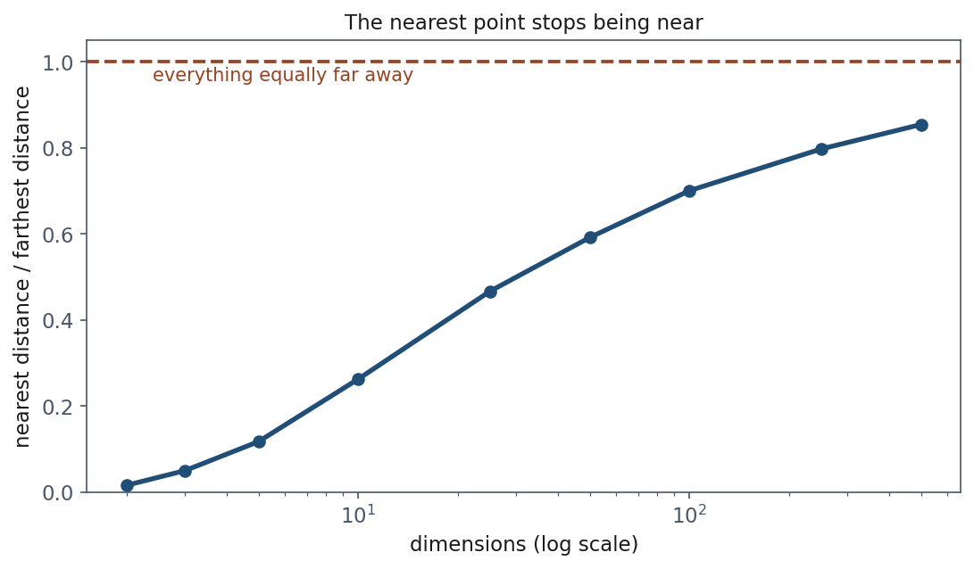
The nearest point stops being near
Notes:
The ratio of the nearest distance to the farthest, plotted against dimension. It climbs towards 1, and 1 is the point at which every point is the same distance from every other point.
The shape is the thing to notice: the damage is done early. Most of the rise happens in the first fifty dimensions, well below anything anyone would call high-dimensional. By the time you are worrying about a thousand features it is long over.
Connect it back to the previous table so nobody treats this as a separate curiosity. The reason 52 columns took k-NN below the baseline is drawn on this plot: at that width, “nearest” has already stopped meaning much.

Slide 19
Nearest divided by farthest
Dimensions | nearest ÷ farthest
2 | 0.016
10 | 0.263
50 | 0.592
100 | 0.701
500 | 0.855
Notes:
The same curve as numbers, because these are the ones worth carrying out of the room.
Start at the top. In two dimensions the nearest point is about 2% as far away as the farthest. “Nearest” is a strong claim there - it picks out something genuinely special.
Then walk down. By ten dimensions it is a quarter. By fifty it is more than half.
Give them the ten-dimension row as the practical warning, because it is the one that applies to their work: at a size that feels completely ordinary, the nearest neighbour is already a quarter of the way to being an arbitrary point.

Slide 20
In 100 dimensions the nearest point is 70% as far as the farthest
In two dimensions it is 2%: “nearest” picks out something special
In one hundred it is 70%: the nearest point is barely nearer than a random one
A vote among “the five nearest” becomes a vote among five taken at random
Notes:
This is the number to carry out of today, so slow down and say it twice.
Seventy per cent. The closest point in your entire dataset is seven tenths of the way to the furthest one. There is almost nothing left of the idea of a neighbourhood.
And then the sentence that makes it operational: if the nearest five points are barely nearer than five chosen at random, a majority vote among them is barely different from a majority vote among five random labels - which is the base rate, which is exactly what the 52-column row showed.
Ask them to write the number down. Derivations fade; this one tends not to. It comes back at the close.
Handout section 3.2.

Slide 21
What the curse is, and is not
Not that high-dimensional problems are unlearnable: lesson 9’s networks work in thousands of dimensions
That methods built on distance lose their footing, because the quantity they depend on stops varying
k-NN, k-means (lesson 8), and radial basis function (RBF) kernels, all of them
Notes:
Correct the overstatement before it forms, because “the curse of dimensionality” gets remembered as “high dimensions are bad” and that is not the claim.
Neural networks work happily in thousands of dimensions. So do linear models with regularisation. What breaks is specifically the family of methods whose mechanism is a distance, because a quantity that no longer varies can no longer discriminate. Name the three that appear in this course: k-NN today, k-means in lesson 8, and the RBF kernel later this afternoon - which is why the RBF SVM also degraded in that table, though more slowly.
Now the predictable mistake, and defend the instinct first. Adding features because they might help is good practice with a linear model: an irrelevant feature earns a coefficient near zero and costs you almost nothing. That reasoning is sound, and it is what they have been taught for three lessons. With k-NN the same feature costs you a dimension in the distance, and dimensions are what the method is made of. The habit is right; transferring it one lesson later does real damage. Say that the fix is to select features BEFORE the distance, inside the pipeline - which is last week’s rule again.

Slide 22
Notebook 1, live
k-NN on the pumps, choosing k, and the curse measured
Notes:
Run notebooks/01. Twenty-two minutes.
Have them run the unscaled version first, before the Pipeline appears, so they watch the score drop and can attribute it to the units rather than to the method.
The cell to protect if time runs short is the noise-column sweep. Let them add the columns themselves and watch the score cross the baseline - it changes behaviour in a way that reading the table does not.
If somebody finishes early, the interesting extension is to ask what happens with 50 noise columns and 12,000 rows instead of 1,200. The curse is partly a sample-size problem, and more data does push it back - just far more slowly than anyone expects.

Slide 23
Break
Twelve minutes
Notes:
Twelve minutes. The second half is two more model families, so they need to come back awake.

Slide 24
Naive Bayes: turn the question around
We want the probability of the class given the readings
The prior is a count; the denominator is identical across classes and cancels
Everything hard sits in one term: the probability of this exact combination of readings among examples of that class
Notes:
Say the strategy in words before the symbols appear. We want a quantity we cannot estimate directly. Bayes’ rule trades it for quantities we might be able to estimate. That is the whole move.
Walk the right-hand side once. The prior is the class frequency - a count, no difficulty. The denominator is the same number for every class, so it cannot change which class wins, and it can be dropped entirely.
That leaves one term, and it carries all the trouble: how likely is THIS combination of readings, among pumps of this class. With two features that is a two-dimensional density and we could estimate it from 1,200 rows. With twenty features it is a twenty-dimensional density, and no quantity of data populates a twenty-dimensional space.
Point out that this is the curse again, arriving from a completely different direction - density estimation rather than distance. Handout section 4.1.

Slide 25
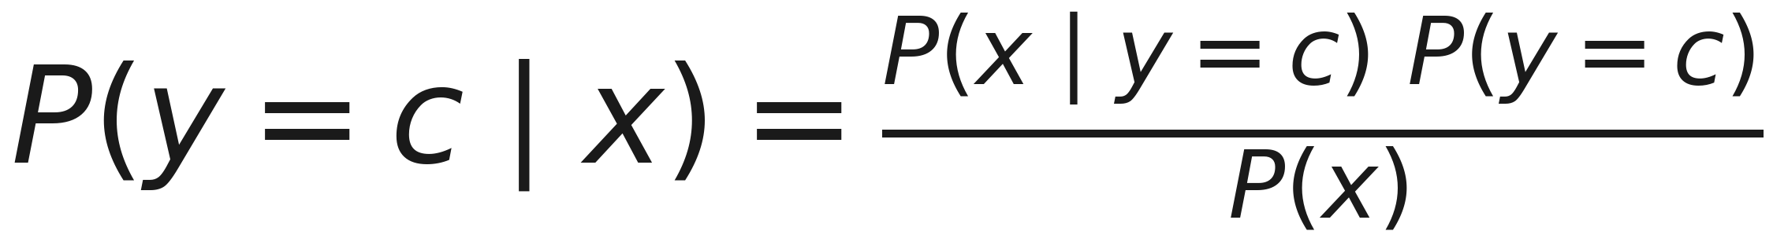
Bayes’ rule, applied to a class
Notes:
Left, what we want: the probability of the class given this pump’s readings. Right, what the data can supply: how often pumps of that class produce readings like these, times how common the class is.
Point at the denominator and say it out loud once: it does not depend on c, so it is the same number for healthy and for faulty. We are choosing the larger of two quantities, and dividing both by the same thing changes nothing. It can be dropped, and scikit-learn drops it.
What remains is the numerator, and only the first factor is hard. Handout section 3.1 works the same rule through with counts if anyone wants it in numbers rather than symbols.

Slide 26
The decision drops the denominator
Notes:
This is the classifier, before any assumption: score each class by the numerator and pick the largest. The denominator has gone because it is the same for every class.
Expect someone to object that the number is then no longer a probability. The instinct is sound - a term has been thrown away - and the answer is that it is recoverable. The denominator is the sum of the numerators over the classes, so dividing each score by the sum of the scores gives the probability back exactly. That is what predict_proba does, in logarithms. Dropping it costs nothing in calibration; where Naive Bayes does lose calibration is inside the numerator, and we will see that in a few slides.
Then point at the first factor: this is where all the difficulty now sits, and the next slide is the assumption that makes it estimable. Handout section 4.1 carries a worked example with the pumps’ priors.

Slide 27
The assumption: independent, given the class
Given the class, the features are independent of one another
The joint density then factorises into n one-dimensional densities
Each factor is estimated from the rows of that class alone
Notes:
One assumption, stated in one line, and everything follows from it.
Emphasise the words “given the class”. This is not a claim that the features are independent - it is a claim that whatever dependence they have is entirely explained by which class they belong to. Those are different claims and the distinction matters in about ten minutes, when we measure it.
What it buys: one n-dimensional estimation problem becomes n one-dimensional ones. A one-dimensional density needs very little data. Training becomes a single pass computing a mean and a variance per feature per class - there is no iteration, no optimisation, nothing to converge.
Mention that in practice this is computed as a sum of logarithms, for the same underflow reason as lesson 4’s log-likelihood: a product of several hundred small probabilities is exactly zero in floating point. Handout section 4.2 has the log form.

Slide 28
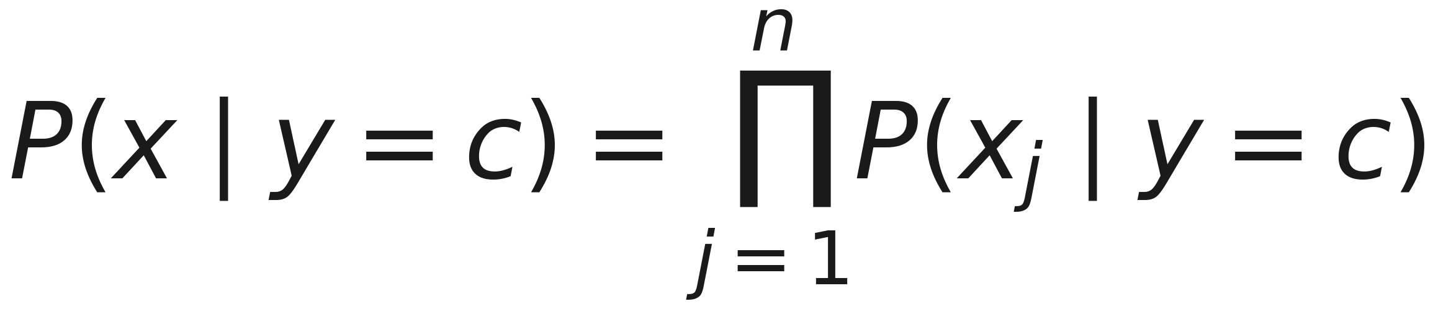
The factorisation the assumption buys
Notes:
This is the naive assumption, written down. One n-dimensional density on the left; n one-dimensional densities on the right.
Why that matters is a counting argument, and it is worth making concrete. To estimate the left-hand side directly you would need enough pumps to fill an n-dimensional space - the curse of dimensionality from an hour ago, arriving in a new disguise. To estimate the right-hand side you need enough pumps to fit n separate histograms, which is a completely different demand.
That is the whole bargain: an assumption that is usually false, traded for an estimation problem that is actually solvable. Notebook 02 measures what the assumption costs when it fails.

Slide 29
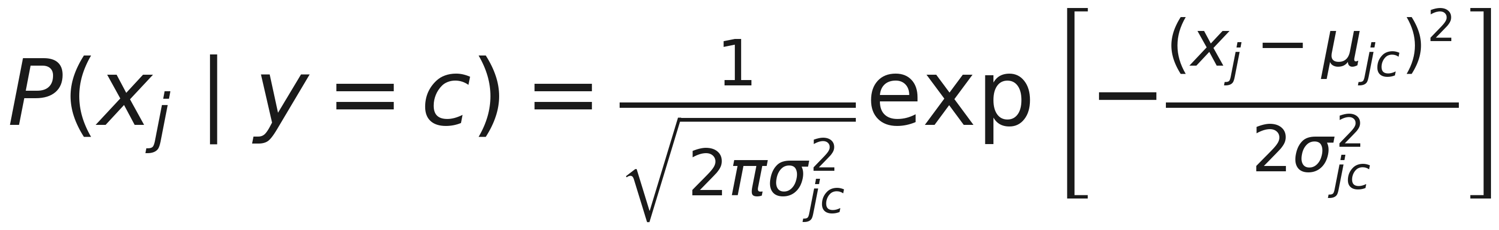
Gaussian: each factor is a bell curve
Notes:
The factorisation leaves one choice open: what shape each one-dimensional density has. “Gaussian” answers it. Every feature, in every class, gets its own bell curve with its own centre mu and its own width sigma.
So say plainly what training is, because students expect an optimisation and there is none. Training computes three kinds of average: the class priors, and a mean and a variance per feature per class. One pass over the data. No gradient descent, no learning rate, no iterations, nothing to converge.
Ask the room how many numbers that is for the pumps - two features, two classes. Let them count: two priors, four means, four variances. Ten. The next slide shows all ten. Handout section 4.2.

Slide 30
Ten numbers, and the widths decide
Class | Prior | Vibration mean | Vibration sd | Pressure mean | Pressure sd
Healthy | 0.3875 | 41.986 Hz | 1.695 | 5.617 bar | 0.219
Faulty | 0.6125 | 42.015 Hz | 4.636 | 5.616 bar | 0.576
Notes:
Let them read the means first and find the surprise themselves: the two classes have the same centre, to a few hundredths of a hertz. What differs is the width. Healthy pumps are a narrow bell around the design point, faulty ones a wide bell - the disc and the ring, one feature at a time.
This explains the result they are about to see. A linear model separates classes by putting a boundary between their means, and here there is nothing between the means to find, so logistic regression will sit at the baseline. Naive Bayes compares widths.
One pump makes it concrete. At 48 Hz and 5.6 bar, 6 Hz off the design point, that is three and a half healthy standard deviations but barely more than one faulty one. The vibration term decides it: P(faulty) = 0.981. At the design point itself, 42 Hz and 5.6 bar, P(healthy) = 0.820. The next slide draws it.
If someone spots in the handout that one log-density is positive, that is the moment to say a density is not a probability: a bell with a standard deviation of 0.219 bar peaks at about 1.82. Handout section 4.2 works the pump through term by term.

Slide 31
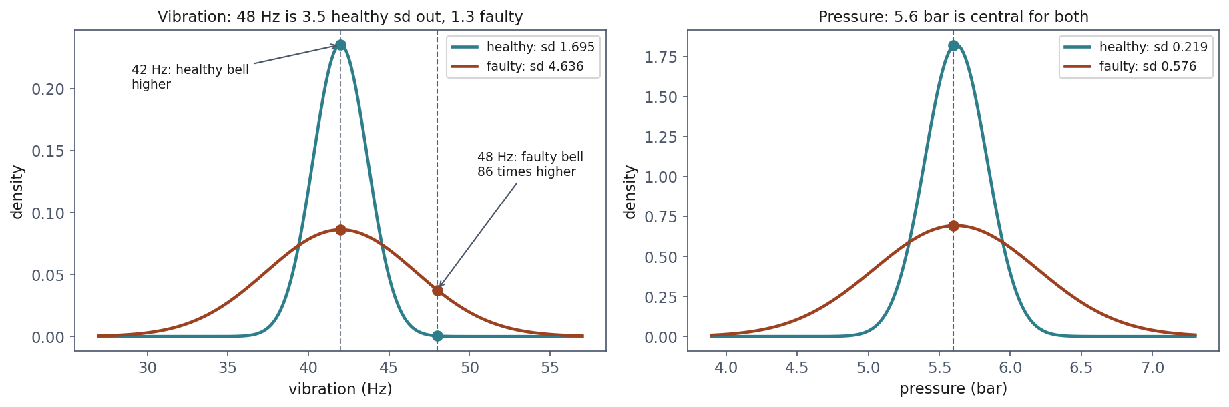
48 Hz: one bell is 86 times the other
Notes:
The previous slide’s numbers, drawn. Left, vibration: both bells are centred on 42 Hz, and the only difference is width. Follow the dashed line at 48 Hz up. The narrow healthy bell has fallen almost to nothing there - 6 Hz is three and a half of its standard deviations - while the wide faulty bell, for which 6 Hz is barely more than one, is still well up: 86 times higher.
Then the other dashed line, at 42 Hz, the design point: there the narrow bell is on top, and that pump comes out healthy, 0.820.
Right, pressure: 5.6 bar is central for both classes, so this reading barely discriminates - and the narrow healthy bell peaks at about 1.82, which is why its log-density comes out positive on the next slide. A density is not a probability.
The next slide puts these heights, as logarithms, in a table.

Slide 32
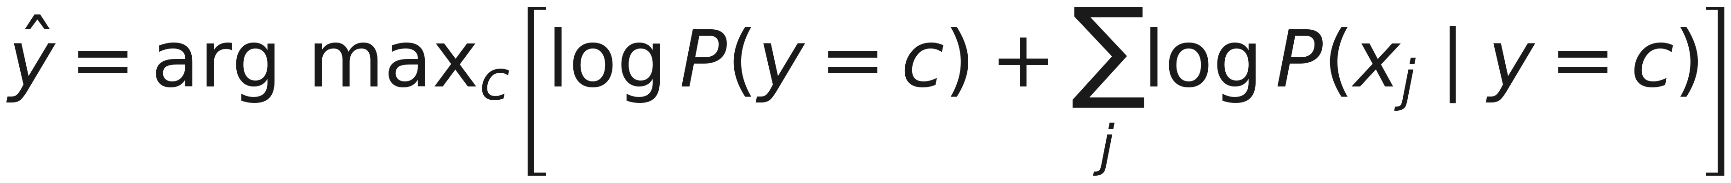
Add the logs, do not multiply
Notes:
Until now the classifier has been a product: prior times one density per reading. Say why nobody computes it that way. With hundreds of features the product is hundreds of small numbers multiplied together, and it underflows to exactly zero in floating point - 0.5 to the power 300 is already 5 times 10 to the minus 91, and real likelihoods are far smaller than 0.5. Every class then scores zero and nothing can be compared.
Two facts fix it. The logarithm is increasing, so whichever class has the larger product also has the larger log: the arg max does not change. And the log of a product is the sum of the logs. So: add one log per reading to the log prior, and compare the sums. This is lesson 4’s log-likelihood, for the same reason.
Show it on the 48 Hz pump before the table, so the table is not a surprise. Healthy: 0.3875 times 0.000433 times 1.818 = 0.000305; in logs, −0.948 − 7.745 + 0.598 = −8.095, and e^(−8.095) is the same 0.000305. Faulty: 0.6125 times 0.0374 times 0.692 = 0.01585; in logs, −4.144. The next slide is exactly those numbers. Handout section 4.2.

Slide 33
48 Hz, 5.6 bar: faulty, 0.981
Class | log prior | log P(vibration) | log P(pressure) | Total
Healthy | −0.948 | −7.745 | +0.598 | −8.095
Faulty | −0.490 | −3.286 | −0.368 | −4.144
Notes:
This is inference, and it is worth saying how little it is. For each class, take the log prior and add one number per reading: the log of that class’s bell, evaluated at the reading. Compare the totals. That is the prediction. No training row is consulted - only the ten stored numbers - which is the exact opposite of k-NN, where prediction is the whole cost.
Walk the pump across. Vibration decides it: 48 Hz is 6 Hz from the centre, three and a half standard deviations for the narrow healthy bell, so its log density is −7.745; for the wide faulty bell it is barely more than one, −3.286. Pressure is at the centre, so it favours the narrow bell slightly - and its healthy log density is positive, +0.598, because a density is not a probability and a narrow bell peaks above 1.
Faulty has the larger total, so faulty is the prediction. How the two totals become the 0.981 in the title is the next slide. Handout section 4.2 lists the four steps.

Slide 34
From the two totals to 0.981
Each total is a log score: log prior + log P(vibration) + log P(pressure)
The gap: −4.144 − (−8.095) = 3.951, in favour of faulty
P(faulty) = 1 / (1 + e^(−3.951)) = 1 / 1.0192 = 0.981
As odds: e^3.951 ≈ 52, so 52 to 1, and 52 / 53 = 0.981
Notes:
The step students do not see on their own. Each total is a logarithm: undo it and you get back the Bayes numerator, prior times likelihood - e^(−4.144) = 0.01585 for faulty, e^(−8.095) = 0.000305 for healthy. These are the two scores of slide 26, and the probability is one divided by their sum: the last bullet, 0.01585 over 0.01616, is 0.981.
Now divide the top and the bottom of that fraction by the faulty score - the fraction does not change. The ratio of the two scores is e^(healthy total) / e^(faulty total) = e^(healthy total − faulty total), so what is left is 1 / (1 + e^(−3.951)): only the GAP between the totals survives.
Then give them the reading that makes it obvious: that gap is the log-odds, and e^3.951 is about 52. Faulty is 52 times as likely as healthy - odds of 52 to 1 - and 52 to 1 is a probability of 52/53 = 0.981, the way anyone would compute it for a bet. 1 / (1 + e^(−Δ)) is just odds over odds plus one, rewritten. The same 0.981 also comes out of normalising directly, 0.01585 / (0.01585 + 0.000305).
Point out whose function this is: 1 / (1 + e^(−z)) is lesson 4’s sigmoid, fed the difference between two Naive Bayes scores instead of a linear combination of features. And say why the gap form is the one to compute: with hundreds of features the totals reach −800, e^(−800) is zero in floating point, and the direct fraction becomes 0/0, while the gap stays an ordinary number. Handout section 4.2, “From log scores to a probability”.

Slide 35
A wonderful bargain, and almost never true
Training is a single pass; adding features costs almost nothing
But vibration and pressure are both driven by the operating point
“New” is not independent of “York” given the topic. Symptoms co-occur
So the question is not whether it holds: it is when being wrong about it costs you nothing
Notes:
Both halves matter, and students tend to hear only one of them.
The bargain is real. Nothing else in this course trains in one pass, and nothing else tolerates ten thousand features on a few thousand rows.
The assumption is false almost everywhere, and give concrete cases rather than a general warning. Two sensors on the same machine are both driven by the operating point, so of course they move together. In text, “New” and “York” co-occur far more than independence would allow. In medicine, symptoms of the same disease arrive in clusters.
Then the framing that makes the rest of this segment worth doing, and put it as a question to the room: given that the assumption is essentially always false, why does anybody use this? The answer is that the assumption being false and the CLASSIFIER being wrong are different things. Argmax only needs the ordering right, not the probabilities. Handout section 4.2 closes on exactly this.

Slide 36
On the pumps, it scores 0.933
Model | Accuracy
Majority baseline | 0.613
Logistic regression | 0.613
Gaussian Naive Bayes | 0.933
k-NN, k = 5 | 0.944
Notes:
A point behind k-NN, and an enormous distance ahead of the linear model - from a method that assumes something false and trains in a single pass over the data.
Resist the temptation to stop here, because a score alone tells you nothing about when it will hold. Ask the room the useful question instead: WHY did that work? If the assumption is false, what happened?
Then be explicit that we are about to check, rather than speculate. This is the habit worth transferring: when a model does better than you expected, find out whether it worked because its assumption held or despite it failing. That tells you whether the result will survive on the next dataset.
Handout section 4.3.

Slide 37
Uncorrelated, but not independent
Within class | Readings | Squared distances
healthy pumps | −0.006 | +0.168
faulty pumps | −0.049 | −0.420
Notes:
Show the middle column first and let the room draw the conclusion everyone draws: within each class the readings are uncorrelated, so the assumption holds. It is the natural check, and for bell-shaped data it would settle it.
Then the trap. Correlation only sees straight-line dependence. Healthy pumps fill a disc and faulty ones a ring; on a ring, a pump far out in vibration must be central in pressure. That dependence is symmetric, so the straight-line summary averages it to zero. Square each reading’s distance from the design point and it appears: −0.420 among the faulty pumps. Or say it as a spread: the pressure of a faulty pump has a standard deviation of 0.784 when its vibration is extreme (the fifth furthest out, beyond 6.2 Hz from the centre) and 1.309 when it is not - 0.37 against 0.62 bar, same average, very different spread. Put the distinction on the board in two lines: uncorrelated, yes; independent, no. Naive Bayes assumes the second. The assumption is false.
So why 0.933? Because the densities are wrong but the boundary they imply is right. With both classes centred on the same point, comparing a narrow bell with a wide one gives an axis-aligned ellipse, and the true envelope is an axis-aligned ellipse. The fitted model’s edge sits at about 3.17 Hz by 0.41 bar against a true 3.5 by 0.45 - the same shape, a tenth small. A false assumption is cheap when it leaves the boundary the right shape. The next slide is the case where it does not. Handout section 4.3.

Slide 38
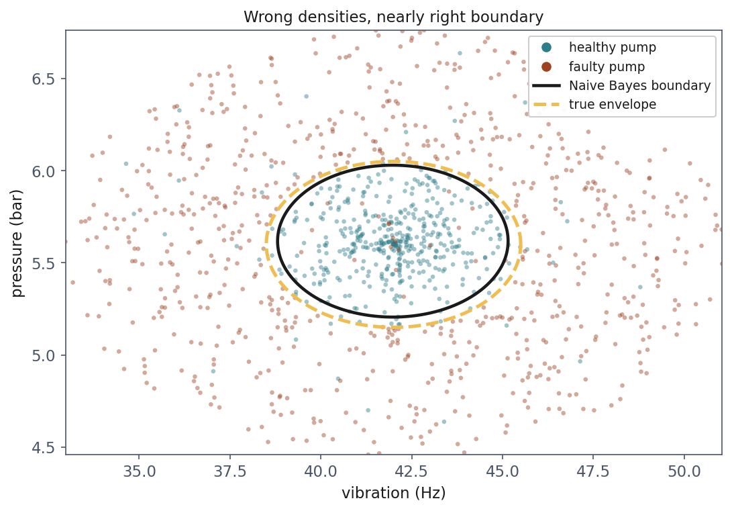
Wrong densities, right boundary
Notes:
The previous slide’s argument, drawn. Dots are the pumps; the solid black ellipse is where the fitted Naive Bayes model changes its mind; the dashed gold one is the envelope the data was generated from.
Let them compare the two shapes before saying anything: same orientation, same proportions, the model’s about a tenth smaller - 3.17 Hz by 0.41 bar against 3.5 by 0.45. The assumption is false, the densities it multiplies are wrong, and the boundary they imply is nearly right. That is why 0.933 sits so close to k-NN’s 0.944. Handout section 4.3.

Slide 39
One step away: when the signal is an interaction
A second pair of sensors on the same fleet
Faulty when exactly one of the two readings is high
Both high is the designed high-load mode; both low is idle; one without the other is a mismatch between demand and delivery
Notes:
Change one thing about the problem and watch the method fall apart. Describe the physics before the geometry, because the rule is completely reasonable engineering.
High demand and high delivery: fine, that is the machine working hard. Low and low: fine, that is idle. High demand with low delivery, or the reverse: something is wrong between them. Exactly one high means faulty.
Ask them, before the picture, what each sensor tells you ON ITS OWN under that rule. Give it a moment. The answer is: nothing at all. Every value of sensor A appears in both classes about equally often, because whether it means “faulty” depends entirely on sensor B.
That is what an interaction is, and it is precisely the structure the independence assumption is unable to represent. Handout section 4.4.

Slide 40
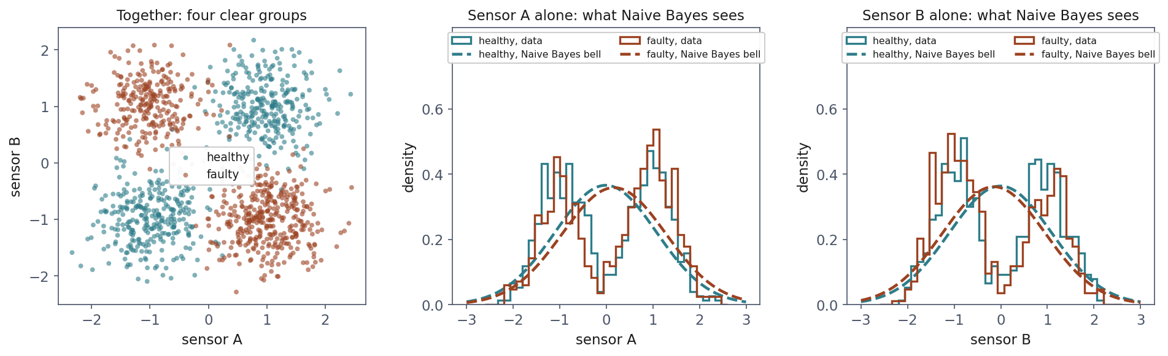
What Naive Bayes gets to see
Notes:
Left panel: the two sensors together. Four clean groups, and a perfectly learnable rule - any method that can draw a non-linear boundary will find it.
Colours first, because someone will ask: teal is healthy, rust is faulty, everywhere. In the left panel each class owns two opposite quadrants - healthy has both sensors high or both low, faulty one high and one low.
Middle and right: each sensor on its own, which is ALL Naive Bayes ever gets. Solid outlines are the data. Each sensor is either low or high, so each outline has two humps - and healthy and faulty have the SAME two humps, because each class is about half low and half high on each sensor alone.
The dashed curves are what the model fits: one bell per sensor per class. A single bell cannot follow two humps, so it sits in the valley between them, and the two classes’ bells almost coincide - centre near 0, sd about 1.1 for both. Contrast the pumps a few slides ago: bells with a shared centre but widths of 1.695 against 4.636 Hz, and the widths carried the class. Here nothing does.
That is the slide in one sentence: the information is real, it is entirely in the relationship between the columns, and factorising the density throws that relationship away before the model ever sees it.
Worth saying that no amount of data repairs this. It is not an estimation problem - with a million rows the marginals still overlap. The model cannot represent what is being asked of it.

Slide 41
0.404: below the baseline, and below chance
Model | Accuracy
Majority baseline | 0.523
Gaussian Naive Bayes | 0.404
Logistic regression | 0.393
SVM, linear kernel | 0.606
k-NN, k = 5 | 0.967
SVM, RBF kernel | 0.972
Notes:
Two things to draw out, and the second is the more interesting.
First: k-NN and the RBF SVM are at 0.967 and 0.972 on this data. The problem is not hard. It is only hard for a model that looks at one feature at a time.
Second, and take the time: 0.404 is BELOW CHANCE. Below the majority baseline of 0.523, and below what you would get by flipping a coin. Ask how that is even possible - a model with no information should surely sit at 50%.
The explanation is worth having in full. The class means on each sensor differ by about 0.17, against a spread near 1, purely as an artefact of a finite sample. That accident is the ONLY per-feature evidence available. Naive Bayes has nothing else to multiply, so it follows it - and in this sample it points the wrong way.
The sentence to land: a model with no signal does not sit politely at 50%. It follows whatever spurious structure it can find, with complete confidence.

Slide 42
Its probabilities are not probabilities
Mean confidence when correct: 0.567. When wrong: 0.555
It cannot tell the difference between the two situations
With features that repeat each other it fails the other way: 0.999 reported, with an accuracy nothing like that
The ranking may be useful while the probabilities are not
Notes:
Two numbers, four thousandths apart. The model is exactly as confident when it is wrong as when it is right, which means predict_proba carries no usable information about reliability here.
The more common complaint runs in the opposite direction, so give it too: when features carry the SAME evidence about the class - near-copies of one another - multiplying their probabilities counts it repeatedly. Be precise here, because they have just seen two kinds of dependence that are not this: the pumps’ ring and the XOR sensors. Ten correlated words in a document are treated as ten independent pieces of evidence, and the posterior saturates. Naive Bayes is famous for reporting 0.999 on problems it gets wrong a fifth of the time.
Then lesson 5’s distinction, which this is the textbook case of: ranking and calibration are different properties. A model can order examples usefully and still report numbers that mean nothing.
The practical consequence, and it is concrete: do not use Naive Bayes anywhere a calibrated probability enters a decision - including lesson 4’s cost calculation in section 7.2, where the threshold depends on the probability being real.

Slide 43
Notebook 2, live
Where breaking the assumption is cheap, and one step away where it is fatal
Notes:
Run notebooks/02. Sixteen minutes.
The cell to protect is the one that prints 0.404 next to the 0.523 baseline. Let them see a below-chance score appear from correct code on solvable data before any explanation arrives.
The notebook prints the within-class correlations on both datasets. Before that cell runs, ask them to predict the signs for the interacting sensors: it is the diagnostic they should carry - measure the assumption, do not assume it.
If time allows, the interesting exercise is to hand Naive Bayes the product of the two sensors as a third column and watch it recover. That is the whole story of feature engineering versus model choice in one cell.

Slide 44
The margin: a criterion that is not the error
On separable data there are infinitely many separating lines, and every one has zero training error
Minimising the error therefore cannot choose between them
The SVM picks the widest slab: push it out until it touches the nearest point of each class
A boundary passing close to a point is one small perturbation from getting it wrong
Notes:
Start with the problem rather than the solution. Draw two well-separated blobs on the board and ask for the boundary. Somebody will draw a line. Ask whether another line would have been equally good, and keep asking until the room sees that there are infinitely many, all with identical training error.
So the error cannot decide. Something else has to. Logistic regression breaks the tie with log loss - a perfectly respectable answer, and one answer among several. The SVM breaks it differently: take the boundary with the most room around it.
The intuition, and this is the sentence to say slowly: maximising the distance to the closest points chooses the boundary that tolerates the most movement in the data before it changes its mind. That is a statement about GENERALISATION, not about fit - which is unusual, because almost everything else in this course optimises fit and controls generalisation indirectly.
Handout section 5.1.

Slide 45
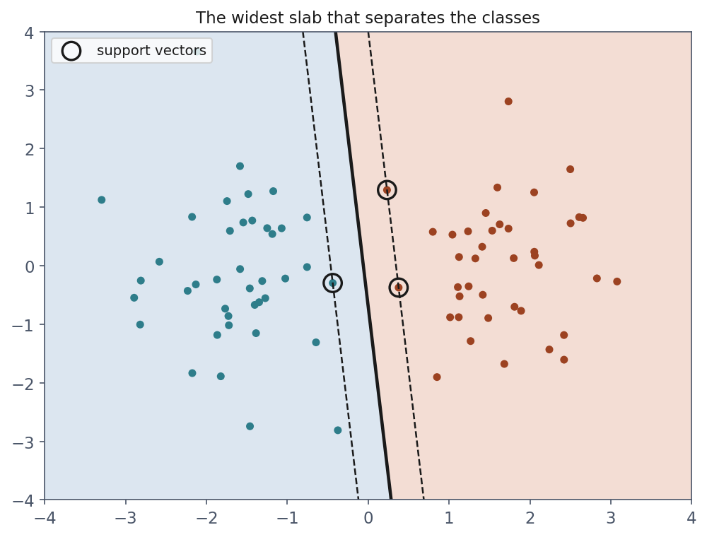
Three points decide everything
Notes:
The solid line is the boundary, the dashed lines are the edges of the slab, and the circled points are the support vectors touching it.
The number to say out loud: of eighty points, THREE determine the answer. Move any of the other seventy-seven - anywhere, as far as you like, as long as they stay outside the slab - and the boundary does not shift by a millimetre.
That is where the name comes from, and it is a genuinely different idea from anything so far. Every linear model in lessons 3 and 4 used every row: each one contributed to the gradient in proportion to its error. Here most of the data is irrelevant once the fit is done.
Two consequences worth naming. The model is small - you store the support vectors, not the dataset, which is the contrast with k-NN. And it is sensitive in a specific way: an outlier near the boundary matters enormously, while an outlier far from it matters not at all.

Slide 46
Not separable? Charge for the violations
Our labels are 4% flipped, so the strict problem has no solution at all
Let each point violate the margin by ξᵢ, and charge C for every unit of it
ξᵢ = 0 outside the slab, between 0 and 1 inside it, above 1 on the wrong side
That is the hinge loss: exactly zero for a point with room to spare
Notes:
The point worth stressing is why the soft margin is not a patch or a convenience. With even one mislabelled point inside the other class, the strict problem is INFEASIBLE - there is no solution, not a bad one. Real data always contains such points. So the soft margin is the only version anyone ever runs; the hard-margin problem is a teaching device.
Our own labels are flipped at 4%, deliberately, so this is not a hypothetical for this dataset: the hard-margin problem on these pumps has no answer.
Then read the three cases of the slack aloud, because they come back twice: in the weights the training produces, and in who gets a vote at prediction. Put it next to lesson 4’s log loss: that one shrinks for a well-classified point but never reaches zero, so every row keeps pulling. The hinge reaches zero, and a point with zero loss drops out of the answer entirely.
The next slide puts it in symbols. Handout section 5.2 has the derivation.

Slide 47
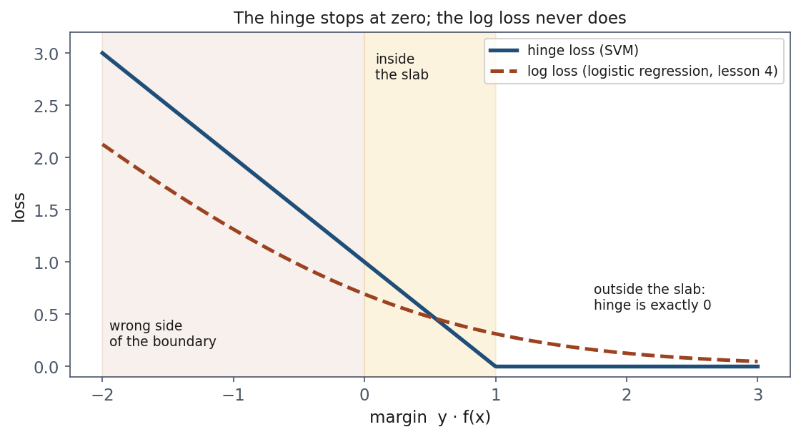
The hinge stops at zero
Notes:
What each point pays, against its margin y times f(x): large and positive when it is safely on its own side, negative on the wrong side.
Walk the three zones left to right. Wrong side: both losses are large. Inside the slab: the hinge still charges, falling in a straight line. Right of 1, outside the slab: the hinge is exactly zero, and the log loss from lesson 4 is still charging - 0.127 at a margin of 2, 0.049 at 3.
The sentence to land: a point with zero loss stops pulling on the answer. That is where support vectors come from - and why logistic regression never has any. Handout section 5.2.

Slide 48
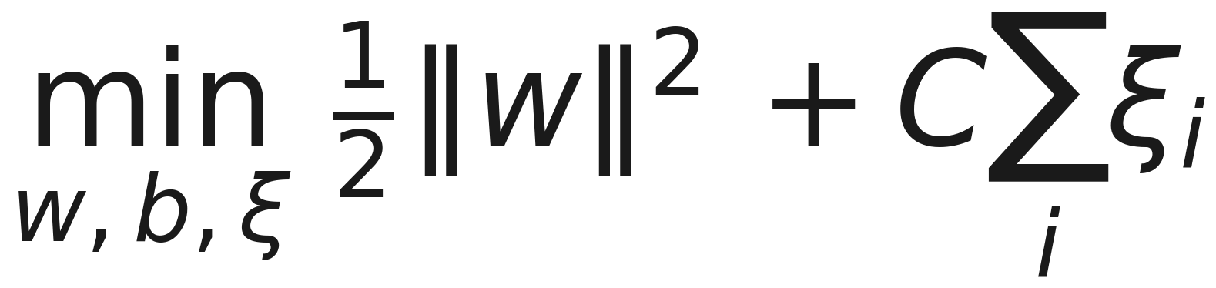
A wide slab, minus what the violations cost
Notes:
The constraint is not on the slide any more - it made the line wide enough to land at 28pt - so state it: subject to y_i(w’x_i + b) >= 1 - xi_i, every point on the right side of the slab by a margin, or paying xi_i for the shortfall. Handout section 5.2 writes it out.
Do not derive this. State what each piece is doing and move on - handout section 5.2 has the derivation, including why maximising the margin is the same as minimising the norm of w.
The first term wants a wide slab. The second term wants few violations. C sets the exchange rate between them, and that is the entire content of the expression. Read it out in those words rather than reading the symbols.
If someone asks about the half in front of the norm: it is there to make the derivative tidy, exactly as in lesson 3’s cost function.

Slide 49
C is the price of a training error
Large C: violations are expensive, so the model contorts to classify everything. Narrow margin, low bias, high variance
Small C: a wider, calmer boundary, at the cost of some errors
The same dial as k in k-NN and λ in lesson 3, in a third costume
Note the direction: large C means less regularisation
Notes:
Third appearance of the same idea, and say so - that repetition is the point. Lesson 3 had λ, this morning had k, now C. Every model has one knob that trades fitting this data against surviving the next, and recognising it in an unfamiliar model is worth more than memorising three names.
Then the direction, which catches people out constantly and is worth writing on the board. Large λ means MORE regularisation. Large C means LESS. They run opposite ways, and scikit-learn’s C parameter in LogisticRegression has the same inverted convention - it is the reciprocal of the penalty there too.
Ask them which way they would expect C to run before you tell them. Most guess wrong, and having guessed wrong once is what makes it stick.

Slide 50
The best straight line is still a straight line
Model | Accuracy | Support vectors
SVM, linear kernel | 0.613 ± 0.000 | 947 of 1,200 (79%)
SVM, RBF kernel | 0.947 ± 0.005 | 278 of 1,200 (23%)
Notes:
The linear kernel scores 0.613 - the base rate, exactly as logistic regression did this morning, with the same zero variance across folds.
Make the point explicitly, because it is the one students most often get backwards: the margin criterion is a better way of CHOOSING among straight lines. It does not give you anything other than a straight line. When no straight line works, choosing the best one optimally still gets you nothing. A better criterion cannot rescue an inadequate hypothesis class.
Then the RBF row, which is the same algorithm with one argument changed, at 0.947 - the best number in the whole lesson, and within a hair of the 0.96 ceiling.
The support-vector column says the same thing in a second language, and that is the next slide.

Slide 51
A high support-vector fraction is a free warning
The linear model needs 79% of the training set to define its boundary
The RBF model needs 23%
Almost every point sits on or inside the margin: there is no slab that separates anything
The count falls out of fit at no cost, and you should look at it
Notes:
Explain what 79% actually means geometrically. A support vector is a point on the margin or inside it. If 79% of your data is in that position, there is no region of empty space between the classes at all - the model has been forced to place a boundary through a crowd.
Contrast with 23%, where the model found genuine room and only the points near the edge matter.
Give them the diagnostic to keep, since it costs nothing: after fitting an SVM, look at len(model.support_) over the number of training rows. High means the model is struggling to find room, which usually means the kernel is wrong for the geometry. It is a warning available BEFORE you cross-validate anything.
Worth adding that it also predicts prediction cost - every support vector is one kernel evaluation per query, so a model needing 79% of the data has thrown away most of the speed advantage over k-NN.

Slide 52
The kernel trick: they needed different coordinates
Healthy pumps in a disc, faulty ones around it: no line works in the plane
Add a third coordinate: the distance from the design point
Healthy pumps rise a little, faulty ones a lot, and a flat plane separates them perfectly
The classes were always separable. They were measured in the wrong coordinates
Notes:
Build the picture in words first and let them see it before the figure appears. Take the scatter plot from the start of the lesson, lift each point off the page by its distance from the centre, and look from the side.
Then the sentence that reframes the whole afternoon: the classes were never inseparable. Separability is not a property of the data - it is a property of the data AND the coordinates you happen to have measured it in.
Ask what is unsatisfying about what we just did, and wait for it. We chose that lift by already knowing the answer. We knew the fault mode was radial. In any real problem you do not, and inventing the right coordinate is the hard part - which is exactly the difficulty the kernel trick removes.
Handout section 5.4.

Slide 53
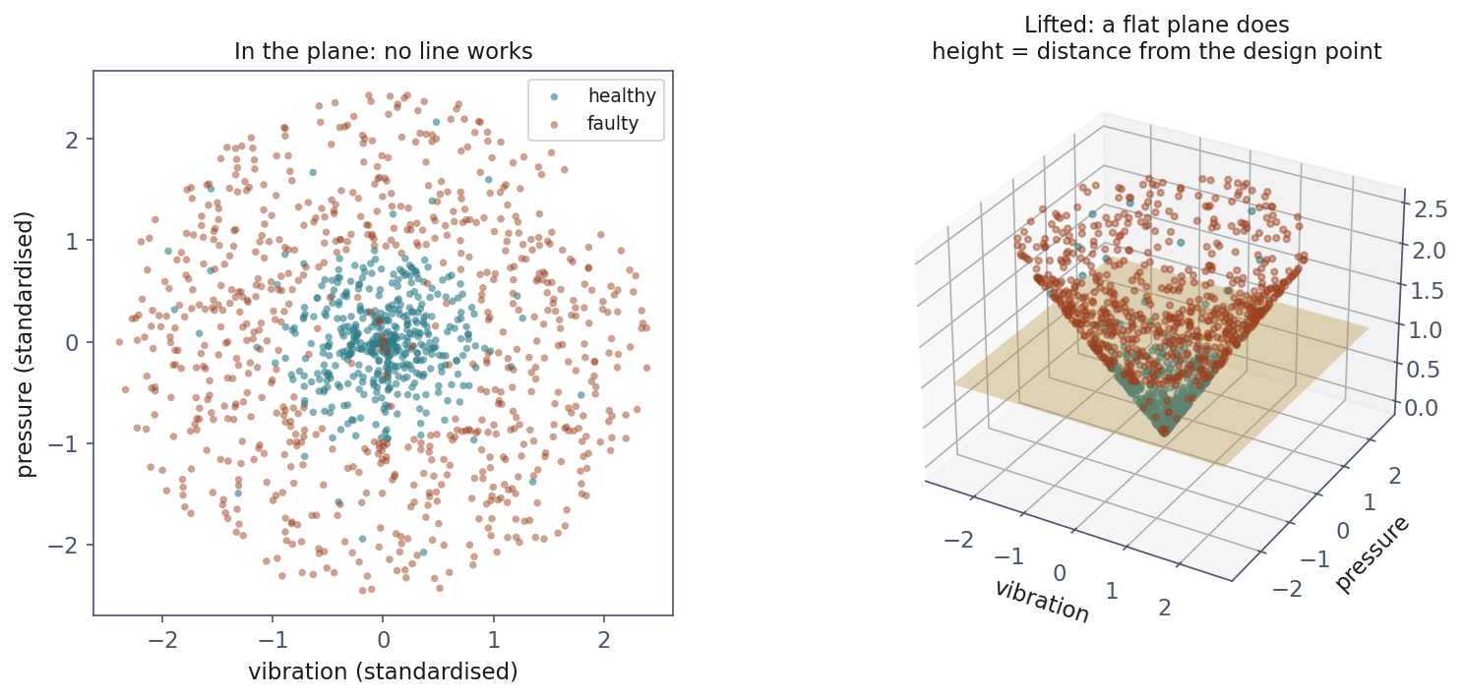
The same pumps, lifted
Notes:
The same 1,200 pumps twice: on the left in the plane where they were measured, on the right lifted by their distance from the design point. The gold plane does what no line could.
Have them look at the right panel and confirm for themselves that a flat horizontal cut separates the colours cleanly. Nothing was added - no new measurement, no extra sensor. The third coordinate is computed from the two they already had.
Then set up the objection that the next slide answers. This worked because the lift was three-dimensional and we could guess it. The spaces that work in general are enormous - the useful ones are sometimes infinite-dimensional - and computing the coordinates of every point in such a space is impossible.

Slide 54
And the map is never computed
The solution depends on the data only through inner products between pairs of points
So we need a function returning the inner product in the new space, while computing only with the original one
The radial basis function is scikit-learn’s default: one exponential per pair, for an infinite-dimensional space
Notes:
The trick in one sentence: the SVM never needs the coordinates, only the angles and lengths between points, and those can be obtained without ever going there.
Do not prove it - handout section 5.4 shows where the inner products come from in the dual formulation. The claim to state and let land is that a function of two ordinary two-dimensional vectors returns their inner product in a space of infinite dimension, at the cost of one exponential.
And close the loop from the previous slide: we chose the lift in the picture by knowing the answer. The RBF kernel does something equivalent without being told, which is exactly why it works on problems where nobody could guess the right coordinates.

Slide 55
The kernel trick by hand: 25 = 25
Route | Computation | Result
Lift, then multiply | (1, 2.83, 4) · (9, 4.24, 1) = 9 + 12 + 4 | 25
Never lift | ((1, 2) · (3, 1))² = 5² | 25
Notes:
Make the trick concrete before the famous formula. The lift here lists every product of two coordinates: phi(x) = (x1², √2·x1·x2, x2²). Two points, a = (1, 2) and b = (3, 1).
First row: lift both into three dimensions and take the ordinary inner product - 9 + 12 + 4 = 25. Second row: never lift, take the inner product in the plane, 5, and square it - 25. Same number. The second route never left two dimensions, so the function (a · b)² IS the inner product in the lifted space. That is all a kernel is.
Then connect it to the figure they just saw: the lifted space contains x1² and x2², and their sum is the squared distance from the centre - the coordinate we chose by hand. A flat plane there is a circle down here. The kernel found the lift we had to guess. Handout section 5.4.

Slide 56
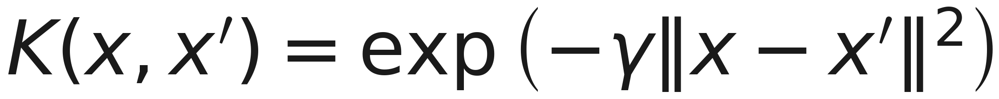
The radial basis function, written out
Notes:
One line, and it is the whole of what scikit-learn does when you leave kernel at its default.
Read it aloud as a similarity rather than as a formula: the closer two points are, the nearer the exponent is to zero and the nearer the kernel is to one; far apart, it falls away to nothing. That is all an RBF kernel says - how much does this point look like that one.
Now say what γ means, because the next two slides turn on it: it sets how far a single training point’s influence reaches. Small γ, wide reach, smooth boundary. Large γ, each point influences only its immediate neighbourhood - and a boundary that can afford an island around every mislabelled pump.
A number to anchor it: the similarity halves at a distance of sqrt(ln 2 / γ). For scikit-learn’s default on the standardised pumps, γ = 0.5, that is about 1.2 standard deviations.
Worth naming the cost, since this is an engineering course: one exponential per pair of points, so the kernel matrix is m × m. That is why support vector machines are a poor fit above a hundred thousand rows, and it is a property of the method rather than of the implementation.

Slide 57
Training: one weight per pump
Weights adjusted two at a time; no learning rate, same answer every run
922 pumps: weight 0, forgotten
268 at the ceiling C = 1, 10 on the edge: the 278 support vectors
The model: 278 points, their weights, and b = +1.105
Notes:
Say what “fit” does, because after lesson 3 they will expect gradient descent. It is not. The SVM solves the dual: one weight per training point, found by a solver that picks two weights at a time - two, because the weights times the labels must sum to zero, so one cannot move alone - sets them to their best values with the rest fixed, and repeats until nothing improves. Convex, so there is one answer and it is found every time.
Then the counts, which match the three cases of the slack from earlier. Weight zero: the 922 pumps safely on their own side, which the model now forgets. Weight at the ceiling C: the 268 inside the slab or on the wrong side - with C = 1 that weight is exactly 1, so each of them simply votes with its label. Between: the 10 sitting exactly on the edge.
The model you ship is 278 points and their weights. Handout section 5.5.

Slide 58
The SVM on 48 Hz, 5.6 bar: +1.883
Term | Value
votes from faulty support vectors | +37.455
votes from healthy support vectors | −36.677
intercept b | +1.105
total | +1.883
Notes:
Inference is a vote, in four steps. Standardise the pump with the training scaler. Compute its RBF similarity to each of the 278 support vectors. Add up weight times label times similarity - label +1 for faulty, -1 for healthy - and add b. Read the sign. Nothing else goes in: the total is exactly what decision_function returns.
The same pump Naive Bayes called faulty at 0.981, reached by a completely different route.
The point to make: the neighbourhood decides. The 56 support vectors within about 1.2 standard deviations contribute a net +1.141 towards faulty; the other 222 only -0.363. But not one neighbour - the five nearest disagree, because pumps just outside the envelope are faulty and some just inside carry flipped labels. So the SVM is k-NN again, with a smooth similarity instead of a hard k, only the support vectors voting, and learned weights. And the output is a score, not a probability. Handout section 5.5.

Slide 59
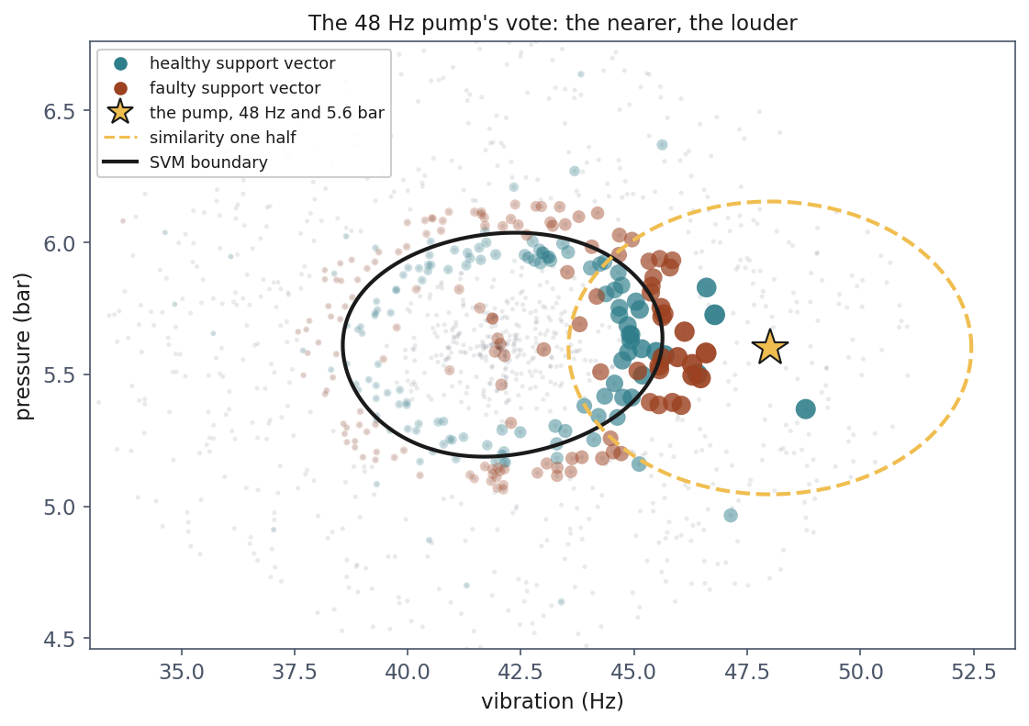
One pump’s vote, drawn
Notes:
The table on the previous slide, drawn. Every support vector is sized and shaded by its similarity to the pump, the gold star at 48 Hz and 5.6 bar; the dashed ellipse is where similarity falls to one half, about 1.2 standard deviations; the black line is the SVM’s boundary.
Point out where the weight is: the 56 support vectors inside the dashed ellipse carry most of it, the ones across the disc have faded out. Then point at the star’s immediate neighbours - teal and rust together, boundary pumps and flipped labels. That is why the five nearest nearly cancel, and why it is the neighbourhood’s balance, not one neighbour, that makes it faulty. Handout section 5.5.

Slide 60
The highest training score, the lowest honest one
Setting | Training | Cross-validated
γ = 0.1, C = 1 | 0.936 | 0.929
γ = 1, C = 1 | 0.950 | 0.944
γ = 50, C = 1000 | 0.995 | 0.902
Notes:
Read the two columns against each other, exactly as lesson 5 taught, and let the last row do the work.
The bottom row has the best training score on the slide - 0.995, nearly perfect - and the worst honest one. That is the signature of overfitting, and here it is not inferred from theory but measured on the same data by two different procedures.
Now the second predictable mistake, and defend the instinct. Choosing between these three on the training score selects the WORST model, with complete confidence and a very impressive number to report. And the instinct behind it is not stupid: a higher score on the data you have is, in every other part of engineering, evidence of a better system. Fitting the data well is what we spent lessons 3 and 4 doing. What breaks the analogy is that a flexible model can fit data it has already been shown without learning anything transferable.
The reason this table is on the slide rather than in the handout is that the next slide shows the same three settings as pictures - so the failure is visible as well as measurable, which is rare.

Slide 61
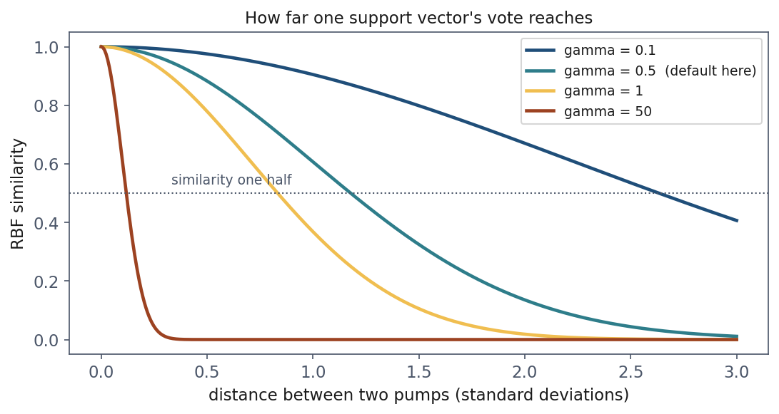
How far one vote reaches
Notes:
Gamma as a distance rather than a symbol. Each curve is the RBF similarity against the distance between two pumps; where it crosses the dotted line is the distance at which a support vector’s vote has halved: 2.63 standard deviations at gamma 0.1, 1.18 at the default 0.5, 0.83 at 1, and 0.12 at 50.
Ask them to predict the next slide from this one: at gamma 50 a point speaks only for a neighbourhood a tenth of a standard deviation wide. What will the boundary look like? Islands. Handout section 5.6.

Slide 62
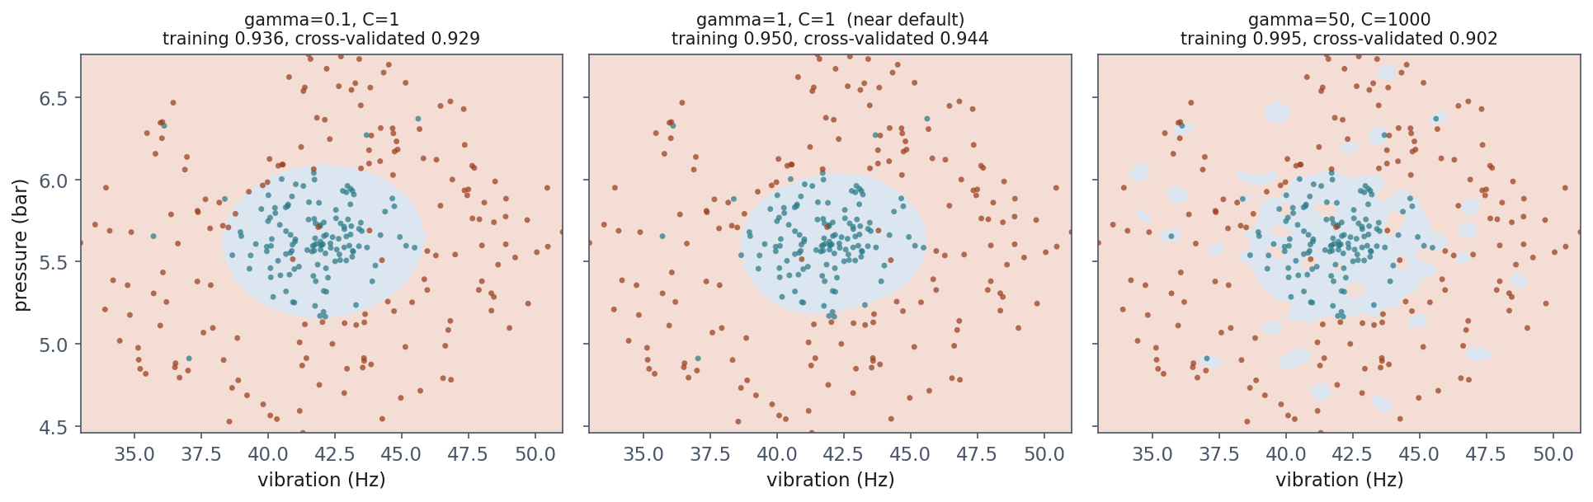
Overfitting you can see
Notes:
Three settings, with training and cross-validated scores in each title. Read them together.
Left, γ = 0.1: a smooth boundary, slightly too smooth, and the two scores agree. Middle, γ = 1: close to the true envelope, and the best honest score.
Right is the one to sit on. The boundary has broken into bubbles - small islands around individual points, including the mislabelled ones. That is what a 0.995 training score looks like from the outside: the model has drawn a private territory around each flipped label so that it can get it right.
Ask them what happens to a new pump landing in the gap between two bubbles. That is the 0.902.
The reason this slide matters more than the table: they have seen overfitting as a curve on a plot since lesson 5. Here it is a shape in the input space, and the shape is obviously wrong in a way no number is. When you can plot the boundary, plot it.

Slide 63
Notebook 3, live
Margins, support vectors, and what γ does to the boundary
Notes:
Run notebooks/03. Sixteen minutes.
The cell to protect is the γ sweep with the boundary drawn at each setting. Let them turn γ up themselves and watch the bubbles form - it is the most direct experience of overfitting available in this course.
Have them print the support-vector fraction for the linear and RBF kernels side by side. Two numbers, and it makes the diagnostic real rather than a claim on a slide.
If time runs short, skip the C sweep and set it as reading: the table is in handout section 5.6.

Slide 64
The three compared, on identical data
Model | Accuracy
Majority baseline | 0.613
Logistic regression (lesson 4) | 0.613
SVM, linear kernel | 0.613
Gaussian Naive Bayes | 0.933
k-NN, k = 5 | 0.944
SVM, RBF kernel | 0.947
noise ceiling | ≈ 0.96
Notes:
Everything in the lesson on the same 1,200 pumps, cross-validated the same way.
Read the top three rows together: all exactly 0.613, and all three are linear. Then the bottom three, all near the ceiling, reached by three completely unrelated routes - remembering the neighbourhood, assuming independence, bending the space. There is no single idea shared between them.
Then the number that is the lesson: the gap between best and worst is 0.334. Larger than any difference this course has shown between a good model and a carefully tuned one - lesson 5’s entire hyperparameter search moved things by a few hundredths.
Say the conclusion plainly, and it is the practical takeaway of the whole lesson: choosing the right family matters far more than tuning the wrong one. Nobody in the top three rows could have tuned their way out. And the way to tell which family you need is to look at the data first, which is what lesson 2 was for.

Slide 65
How to choose, in practice
Situation | Reach for
Few features, plenty of data, odd-shaped boundary | k-NN, or an RBF SVM
Very many features, little data | Naive Bayes
Need a calibrated probability | Not Naive Bayes
Model must be small, or fast at prediction | SVM, not k-NN
The signal is an interaction between features | k-NN or a kernel
Notes:
A table to photograph. Work down it and attach today’s evidence to each row, so it is remembered as a set of conclusions rather than as advice.
Row two deserves a sentence on its own, because it is the one that sounds wrong after the last hour. Text classification is the canonical case: tens of thousands of word-count features, an assumption that is transparently false, and a method that works anyway - because being roughly right in ten thousand dimensions beats being unable to estimate anything at all. Also mention Naive Bayes as a baseline: it trains in one pass, so if your tuned model does not beat it you have learned something quickly and cheaply.
One row that did not fit and should be said out loud: when you need to explain the decision to the person affected, none of today’s three will do it. A support vector machine in a lifted space has no explanation a customer would accept. Lesson 3’s Resources document covers why that is sometimes a legal requirement rather than a preference.

Slide 66
What to take away
No line separates the pumps: 0.613, the base rate
k is the bias-variance dial, made visible
In 100 dimensions the nearest point is 70% as far as the farthest
Naive Bayes: 0.933 where independence holds, 0.404 where it does not
Choosing the family beats tuning the wrong one: 0.613 to 0.947
Notes:
Close on the number they opened the second segment with, and say it one more time: seventy per cent. In a hundred dimensions the nearest point in the entire dataset is seven tenths of the way to the farthest, and every method built on distance is operating on a quantity that has stopped varying.
If they remember one habit from today, make it the diagnostic pair: before reaching for a model, look at the shape of the data; after fitting one, check whether the assumption it depends on is actually satisfied on your data - and check it properly. The −0.006 said yes; the squared distances said no; and the ellipse the model drew explained the 0.933.
And the correction to the instinct that this lesson exists to install: more features is not free. It is nearly free for a linear model and it is expensive for anything built on a distance.
Handout section 7 lists all of this with the section numbers.

Slide 67
Homework
Exercise 6, discussed at the start of Friday 13 November
A dataset, three families, and a defence of which one you chose
Notes:
Set it explicitly and say out loud when it comes back: the first ten minutes of next Friday, 13 November.
The marks are for the reasoning, not for the accuracy. A well-argued choice that scores slightly worse beats a lucky winner with no justification - and the argument has to reference the data, in the way that the squared distances and the fitted ellipse explained Naive Bayes on the pumps this afternoon.
Remind them that everything must be cross-validated and reported with a spread, in the format lesson 5 set. Scaling goes inside the pipeline; that will be checked.
Next week: decision trees and ensembles. A fourth family, with a different answer again to the same question - how do you draw a boundary that is not a line.

