Slide 1
Lesson 5: Experimental Methodology
Technologies for Artificial Intelligence Fabio Antonini, Università degli Studi dell’Aquila

Slide 2
Before we start
Exercise 4, which we discuss now
The threshold you chose, and how you chose it
Notes:
Nothing to collect. The defence of the threshold is the part that matters, so ask two people to give theirs out loud - that is the rehearsal for the exam, where one of the ten exercises is drawn and discussed.
The recurring mistake to name, if it appeared: choosing the threshold by sweeping it on the test set. The exercise sheet said that losing marks for it was avoidable by simply declaring it - and today is the lesson that shows why it matters rather than asserting that it does.

Slide 3
We broke a promise on purpose
Lesson 4 chose a threshold by looking at the test set
Lesson 1 forbade exactly that
Today we pay the debt
Notes:
Be explicit that this was deliberate. In lesson 4 there was no machinery available to do it properly, and inventing half of that machinery mid-lesson would have buried the actual subject.
Keep the debt visible through the whole lesson, because nearly every error today has the same shape: a choice was made by looking at data that was then used to report the result.
Section 8 of the handout pays it off, and slide 39 shows the number.

Slide 4
Today: how to tell whether it works
One split is a lottery, and how wide the lottery is
Cross-validation: what it estimates, and what it does not
Bias, variance, and the floor you cannot go below
Learning curves: which fix to buy
Leakage that survives cross-validation
Notes:
Agenda. Say why this lesson sits in the middle of the course, because it is a deliberate choice and the syllabus says so.
They can already build models - lessons 3 and 4 gave them two, scikit-learn gives a hundred more for one line each. Producing a model that appears to work is an afternoon’s work and it is not the job. Knowing whether it does work is considerably harder.
And everything after today makes it harder still: lessons 6 to 10 add more flexible methods, and every increase in flexibility adds ways for a result to be wrong while looking right.

Slide 5
A test score is a measurement
You would not report a poll of forty people to three decimals
Holding data out makes the estimate unbiased
It does nothing to make it precise
Notes:
This distinction is the whole first half of the lesson, and it is routinely missed - because “test set accuracy” sounds like a property of the model rather than a measurement with a standard error.
Lesson 1’s rule was about bias: never let the test set influence the model, and the number you get is centred on the truth. Correct, and it says nothing at all about how far from the truth any particular measurement lands.
Ask the room, before the next slide: how far apart do you think two honest splits of the same dataset can be? Take a guess out loud. They will underestimate it.

Slide 6
The fleet, cut down
Lesson 4’s drives, reduced to 800, of which 29 fail
Not to exaggerate: 800 rows with 29 positives is the ordinary case
Notes:
Justify the reduction explicitly, because a sharp student will otherwise suspect the demonstration is rigged.
With 8,000 drives a single split is fairly stable, and lesson 4’s numbers were trustworthy. Eight hundred records with 29 positives is a far more common situation than eight thousand - it is what a real pilot study looks like - and what follows is simply what the honest version of that situation looks like.
Same data, same model, same code as last week. Only the sample size changed.

Slide 7
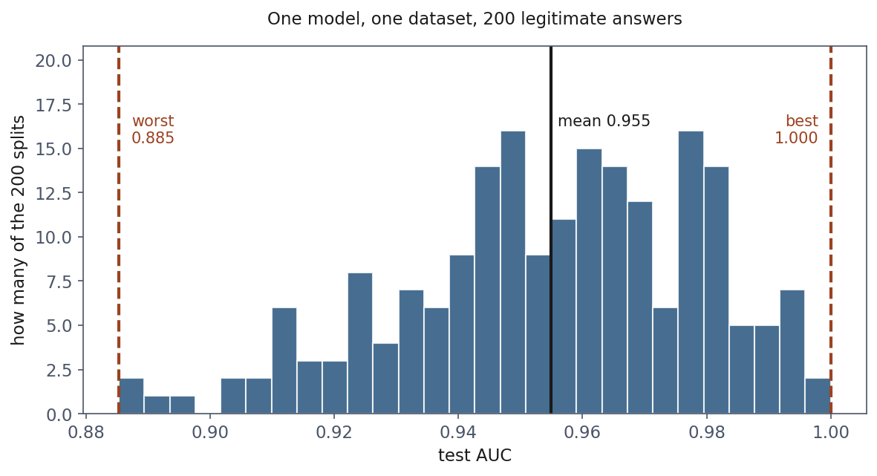
200 honest splits, one dataset
Notes:
Two hundred legitimate experiments. Every one done correctly: nothing fitted before the split, the test set never inspected, the metric computed properly.
Worst 0.885. Best 1.000. Mean 0.955.
Sit on the 1.000 for a moment. That split reports a PERFECT classifier - every failing drive ranked above every healthy one - for a model whose honest performance is about 0.95. Ten of the two hundred scored above 0.99.
Then the point that matters most, and say it slowly: the right-hand tail is the dangerous end, not the left. A disappointing score makes you frown and keep working. A delightful score makes you stop, write it down, and put it in the report. The splits that flatter you are the ones you are least likely to question.

Slide 8
Why so wide?
Each test set holds 7 failures
Every AUC (area under the receiver operating characteristic curve) rests on seven
Notes:
This is the arithmetic behind the previous slide, and it generalises into the single most useful diagnostic question in the course.
The precision of a classification metric is governed by the count of the RARER class, not by the size of the dataset. Eight thousand drives at 3.8% gives 306 positives and a stable estimate. Eight hundred gives 29, and it does not.
Give them the question to carry away: how many positive examples are in the test set? If the answer is under about fifty, treat every metric as provisional.
Worth connecting to lesson 4: this is the same reason precision collapsed there while AUC did not notice.

Slide 9
Now the expensive part: choosing
Model | Mean AUC | Times declared best
C = 0.01 | 0.9549 | 91
C = 1 | 0.9549 | 71
C = 100 | 0.9544 | 38
Notes:
Reporting a noisy number is bad. Choosing with one is worse, because noise does not average out when it is used to decide - it decides.
Read the first column, then the last. The three models are the SAME: their mean performance agrees to three decimal places, a difference an order of magnitude smaller than the spread of a single measurement.
And yet a winner is declared every single time. Those counts carry no information about the models. They record which model happened to suit which random quarter of the data.
Then the sentence to land: run this once, which is what real life allows, and you will report that one of these is best with a number to support it. That conclusion is noise wearing the clothes of a result.

Slide 10
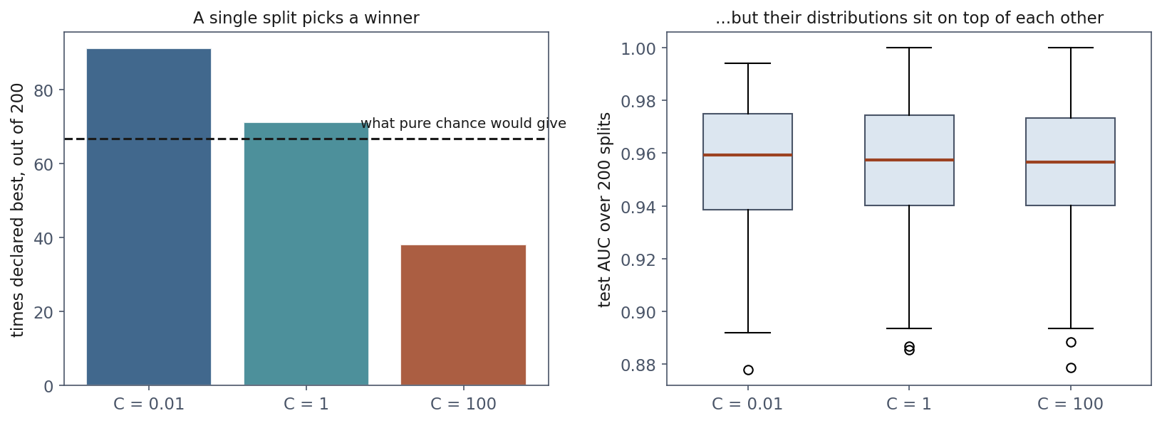
The same three models, drawn honestly
Notes:
Left: the win counts, against the dashed line showing what pure chance would give. Right: the actual distributions, sitting on top of each other.
The right panel is the truth about these three models. The left panel is what a single experiment reports.
If anyone asks why C=0.01 won more often than the others - it is not evidence of anything. Run the whole thing with different seeds and the ordering moves. That is exactly the point.

Slide 11
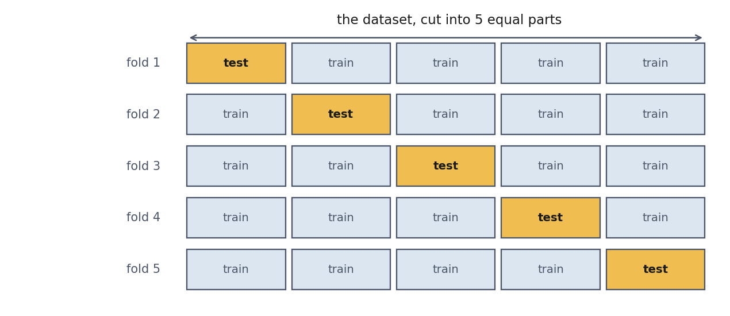
k-fold cross-validation
Notes:
The idea in a sentence: if one measurement is noisy, take several and average them. The difficulty is that you cannot afford several test sets - every row spent on testing is a row not spent on training.
Cross-validation resolves it by rotating the role of the test block. Cut the data into k parts, train on k-1, test on the one left out, repeat until every part has been the test set exactly once.
Then the clause that makes it legitimate rather than a trick, and say it explicitly because students suspect otherwise: every row is predicted exactly once, by a model that never saw it. This is not testing on training data with extra steps.

Slide 12
What it actually estimates
The performance of a procedure, not of one fitted model
Slightly pessimistic: each fold trains on 80% of the data
Notes:
Two consequences, both of which surprise people.
First: there are k different fitted models in the calculation, and the reported number belongs to none of them. It answers “if I apply this procedure to a dataset of about this size, what should I expect?” - which is the question you actually have.
Second: every fold trains on four fifths of the data, so it estimates the performance of a model trained on less data than the one you will eventually ship. The bias is in the safe direction, and it shrinks as k grows. That is the argument for leave-one-out, where k equals the number of rows.
Handout section 4.2 has both in symbols.

Slide 13
Report the spread, but not as a confidence interval
Any two training folds share three quarters of their rows
The scores are correlated, so the usual standard error is optimistic
Notes:
The temptation is to quote s over root k and call it a confidence interval. Do not, and give them the specific reason rather than a warning.
That formula assumes the k scores are independent. They are not: for k=5, any two training sets have three quarters of their rows in common. Positively correlated measurements carry less information than independent ones.
The handout gives the variance with the correlation term, and the result of Bengio and Grandvalet from 2004: no unbiased estimator of that variance exists in general.
Practical instruction: quote the mean and the spread, call the spread a spread, and treat small differences between models as unresolved.

Slide 14
Stratify when a class is rare
Fold | Plain KFold | StratifiedKFold
1 | 7 failures of 160 | 5 of 160
2 | 1 failure of 160 | 6 of 160
3 | 7 of 160 | 6 of 160
4 | 5 of 160 | 6 of 160
5 | 9 of 160 | 6 of 160
Notes:
Point at fold 2 of the left column. An AUC computed from a single positive example is not a measurement of anything - and nothing in the code warns you.
StratifiedKFold keeps each fold’s class balance equal to the whole dataset’s. It costs nothing and it is one word in the call.
The rule: stratify whenever a class is rare. Which, as lesson 4 established, is whenever the problem is interesting.

Slide 15
How much does it help?
 | Single split | 5-fold CV
worst | 0.9119 | 0.9439
best | 1.0000 | 0.9588
spread | 0.0881 | 0.0149
Notes:
Forty seeds, changing nothing but the seed.
The spread falls from 0.088 to 0.015 - about seven times more stable. And note that both centre in the same place: cross-validation is not more pessimistic, it is less arbitrary.
What it costs is k fits instead of one. For everything in this course that is seconds. For a large network it is a real decision, and the usual compromise is a single validation set with enough rows that its own error bar is tolerable.
What it does NOT fix is the whole last hour of today.

Slide 16
How many folds?
k = 5 or 10 in practice
Larger k: less pessimistic, more expensive, folds more correlated
k = m is leave-one-out
Notes:
The question always comes, so answer it before it does.
Larger k means each fold trains on more data, so the estimate is less pessimistic - the bias shrinks. It also means more fits, and the training sets overlap even more heavily, so the fold scores are more strongly correlated and the spread you observe understates the uncertainty by more.
Five and ten are the conventional choices and the difference between them rarely matters. Leave-one-out is the extreme: nearly unbiased, m fits, and notoriously high variance for the estimate itself.
If you have the compute, repeated k-fold - the whole procedure run with several different shuffles, averaged - buys more than moving from 5 to 10.

Slide 17
When the rows are not independent
Ten readings from the same drive, split at random
Nine in training, one in test
The model recognises the drive, not the failure
Notes:
Everything so far assumed rows are independent draws. That assumption is violated constantly and silently, and random k-fold gives no warning.
The concrete case, which they will meet: your table has ten telemetry readings per drive. A random split puts nine of a drive’s readings in training and one in test. The model does not need to learn anything about failure - it learns to recognise that drive, and the test row is nearly a duplicate of a training row.
The score is excellent and the model is worthless on a drive it has never seen, which is the only situation anyone cares about.
Other instances worth naming out loud: several images of the same patient, several sentences from the same document, repeated measurements of the same machine, any panel data.

Slide 18
Split by the thing you must generalise to
Same entity in two folds → GroupKFold
Predicting the future → TimeSeriesSplit
Notes:
The rule that covers both: split along the axis you need to generalise across. If the model must work on a drive it has never seen, no drive may appear in both training and test. GroupKFold takes a group label and guarantees that.
Time is the other case, and it is stricter. With a random split the model trains on Wednesday and tests on Tuesday, which is not the problem anyone has. Real deployment always predicts forward, so validation must too: TimeSeriesSplit trains on a prefix and tests on what comes next.
The tell that you needed one of these and did not use it is the same in both cases - a validation score that is excellent and a production score that is not. That gap is the most common cause of a model failing after deployment.

Slide 19
Notebook 1, live
The split lottery, the three identical models, k-fold by hand
Notes:
Run notebooks/01. Twenty minutes.
Have them run the five-seed cell first and watch seed 3 return 1.000 before you say anything about it.
The cell worth protecting if time runs short is the 200-split model selection - it is the one that changes behaviour rather than just adding knowledge.

Slide 20
Break
Ten minutes
Notes:
Ten minutes. The second half is bias-variance, which needs them awake.

Slide 21
Where does the error come from?
Bias: the average model is wrong
Variance: the individual models disagree
Noise: the target itself is uncertain
Notes:
Set up the decomposition in words before any algebra.
Imagine drawing many training sets from the same source and fitting the same model to each. You get many models, and they fail in two distinguishable ways.
They may agree with each other and all be wrong - a straight line fitted to a curve gives nearly the same line every time and every one misses the curvature. That is bias: consistently, confidently wrong.
Or they may disagree wildly - a twelfth-degree polynomial on twenty-five points gives a different wild curve every time. That is variance: unreliable, whatever the average looks like.
Underneath both sits noise in the measurements, which is not a property of the model at all.

Slide 22
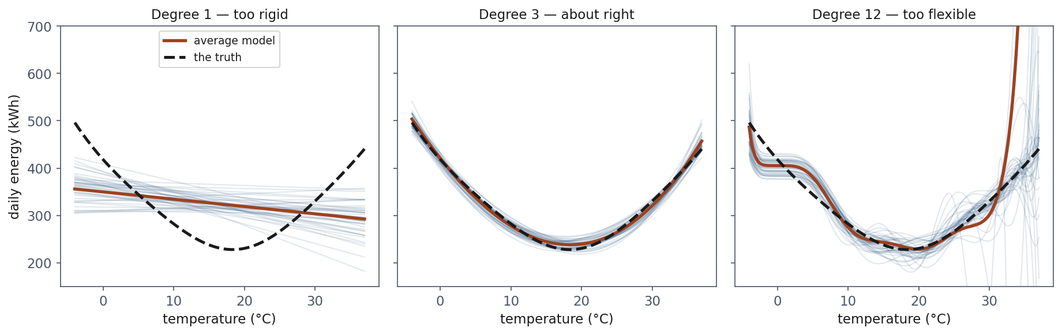
Three hundred parallel universes
Notes:
Each faint line is a model fitted to a DIFFERENT training sample from the same curve. In real life you drew exactly one of them and never knew about the rest.
Left, degree 1: the lines lie almost on top of each other - stable - and the red average is nowhere near the black truth. That gap is bias.
Middle, degree 3: average tracks the truth, spread is modest. Both small.
Right, degree 12: through the middle it follows the truth better than degree 1 ever could, and at the edges the lines fly off and drag the average off the top of the plot with them. That scatter is variance.
Two things to point at in the right panel. The scatter is worst WHERE THE DATA RUNS OUT - beyond about 30 degrees nothing constrains the fit. Extrapolation is where flexible models embarrass themselves.
And any one of those faint lines is a model somebody actually deployed.

Slide 23
The decomposition
Notes:
State it, do not derive it - handout section 5.2 does that in five lines, and it is worth reading because the derivation is short and the cross terms vanishing is the whole trick.
The important claim is that this is an IDENTITY, not an approximation or a useful metaphor. Notebook 2 checks it on 300 independently drawn training sets and the two sides agree to three times ten to the minus twelve - floating-point equality.
That matters pedagogically: they have seen this picture in every textbook drawn as a schematic. Here it is measured.

Slide 24
Measured, on 25 observations
Degree | bias² | Variance | Noise | Total
1 | 5,250.8 | 723.8 | 484.0 | 6,458.6
2 | 59.6 | 70.8 | 484.0 | 614.3
5 | 8.9 | 368.9 | 484.0 | 861.8
12 | 153,537.3 | 32,174,344.9 | 484.0 | 32,328,366.2
Notes:
Noise is 484 in every row - point at the column and say that it never moves, because it is a property of the data and not of the model.
Degree 1 is a bias problem: the largest bias² and the smallest variance. Stable and wrong.
Degree 12 is a variance problem, and the magnitude deserves a pause: 32 million, four orders of magnitude larger than anything else. On 25 points a degree-12 polynomial nearly interpolates, and an interpolating model is a machine for amplifying noise.
Someone will notice that degree 12 also has the worst bias², which contradicts “flexible models have low bias”. It does not: with variance this large the average of the fitted curves is not a meaningful curve, so the bias term inherits the instability. Read the two together.

Slide 25
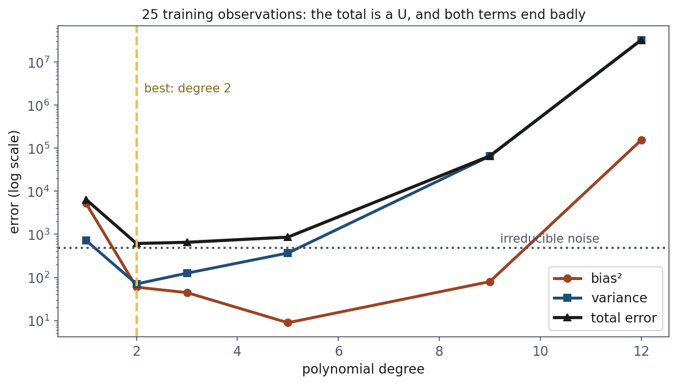
The picture everyone has seen, now measured
Notes:
Bias falls monotonically with complexity; variance rises; the total is a U whose minimum is the model you want.
The y-axis is logarithmic, and say why: otherwise degree 12 flattens everything else onto the baseline. That in itself tells them something about the scale of the failure.
The dotted line is the noise floor at 484.

Slide 26
The floor you cannot go below
Noise variance is 484 at every complexity
A reported error below the floor means contamination, not excellence
Notes:
The noise column never moves, because it is a property of the data rather than of the model. No model, no algorithm and no quantity of data brings the expected error below it.
The corollary is a practical diagnostic worth writing down: if you know your measurement precision and your model beats it, something has leaked. This is a real check used in engineering and in the physical sciences, and it catches errors nothing else catches.
Connects forward to the last hour, where we manufacture exactly that symptom deliberately.

Slide 27
The best model depends on how much data you have
Degree | m = 25 | m = 60 | m = 150
2 | 614.3 | 570.6 | 555.3
5 | 861.8 | 540.9 | 506.9
12 | 32,328,366.2 | 7,626.9 | 899.0
Notes:
The same experiment at three sample sizes. The best degree moves from 2 to 5 as the data grows, because there is now enough of it to pin down the extra coefficients and the variance has fallen accordingly.
Degree 12 improves by a factor of four thousand between 25 and 150 observations and is still the worst model in its column.
Then the sentence worth putting on the board: “which model is best” is not a question about models. It is a question about models AND the quantity of data you have.
This explains something they will meet constantly - a paper reports a large model beating a small one on a dataset far bigger than theirs, and it does not reproduce for them. Neither experiment was wrong.

Slide 28
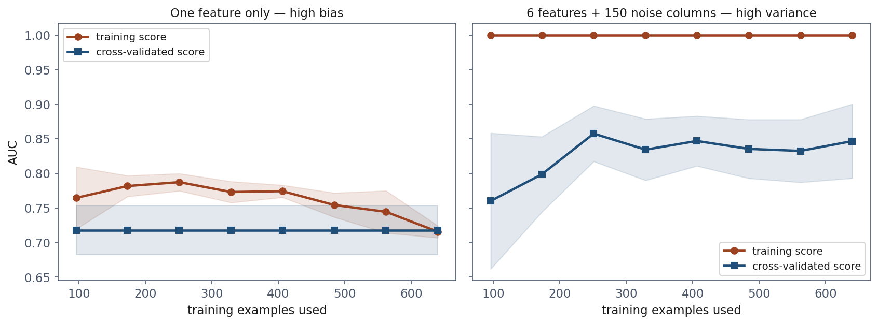
Learning curves: the same diagnosis, without knowing the truth
Notes:
Everything so far needed the true function. Learning curves need only data you have, which is why they are the practical tool.
Train on 15% of the data, then 25%, and so on, plotting training score and cross-validated score against the number of examples used.
Left, one feature only: the curves MEET, and they meet LOW - 0.715 against 0.718 - and the validation curve is flat from the first point to the last.
Right, six features plus 150 columns of pure noise: training exactly 1.000 against validation 0.847, a gap of 0.15, and the validation curve still climbing at the right edge.
Say that the right-hand setup is not contrived. It is what a wide feature table looks like when most columns carry nothing, which is most feature tables.

Slide 29
Which fix to buy
Curves meet low → bias. More data will not help
Wide gap, validation still rising → variance. More data will
Notes:
This slide is the practical payoff of the entire second hour, so do not rush it.
High bias: the model is equally mediocre on data it has seen and data it has not, because it extracted everything available and that was not enough. What helps is a more flexible model, better features, less regularisation. What does NOT help is more data - the curve is already flat, and more rows land on the same plateau.
Emphasise that this is the expensive mistake. Collecting data is the slowest and costliest item on the list, and the plot says in advance that it will buy nothing.
High variance: the rising curve is itself the evidence that more data will help.
Name the predictable mistake and defend the instinct: prescribing data for a bias problem is what almost everyone does, and the reasoning is sound - more data almost always helps and never makes a model worse. It just does not help THIS failure, and fifteen lines of code tell you which failure you have.

Slide 30
Notebook 2, live
Measuring bias and variance; the learning curves
Notes:
Run notebooks/02. Twenty minutes.
The cell to protect is the decomposition table where the sum equals the measured error to twelve decimal places. Let them see the identity hold rather than telling them it does.
If time is short, skip the three-sample-size comparison and assign it as reading - the table is in the handout.

Slide 31
Now: what cross-validation does not protect you from
2,000 columns of pure random noise
No relationship to the label whatsoever
The honest score of any model on it is 0.500
Notes:
Set this up carefully, because the demonstration only lands if they believe the data is genuinely empty.
Two thousand columns drawn from a standard normal, independent of the label and of each other. There is nothing to find. Any model’s honest AUC is one half.
Tell them what is coming so they can watch for it: we are going to write code that looks completely reasonable, and get 0.93.

Slide 32
The code almost everyone writes
sel = SelectKBest(f_classif, 10) sel.fit(noise, y) X = noise.loc[:, sel.get_support()] cross_val_score(model, X, y, cv=cv)
Notes:
Read it aloud as the sentence a practitioner would say: “two thousand features is too many, so let me keep the ten most predictive ones, then cross-validate a model on those.”
Every line is defensible in isolation. Feature selection is normal. Ten from two thousand is reasonable. Cross-validating afterwards is exactly what we spent the morning recommending.
Do not reveal the bug yet. Ask them to find it before the next slide.

Slide 33
0.931
Cross-validated AUC 0.931 on data with no signal
Four of five folds between 0.93 and 0.98
Notes:
The result. Tight fold agreement, which is exactly what a trustworthy result looks like.
Now the bug, which is on the first line: SelectKBest was shown EVERY row, including the rows that would later serve as test folds. It searched two thousand columns for the ones that best matched labels it had already seen, and handed the winners to cross-validation.
The framing worth using: cross-validation did not fail. It was lied to. It faithfully measured a procedure that had already peeked.
This is the single most common serious error in applied machine learning, and it is committed in published work regularly.

Slide 34
Fix it, and look what happens
Selection moved inside the pipeline, refitted per fold
20 different fold seeds: 0.658
The truth is still 0.500
Notes:
The fix is one Pipeline: selection becomes part of the model, so it is refitted on the training rows of each fold.
The leak is mostly gone - 0.93 down to 0.66. And it has NOT come back to 0.5. Twenty different fold seeds all agree that a signal-free dataset supports a model better than chance.
Let that be uncomfortable for a moment before explaining. Most treatments of this topic stop at “put it in a Pipeline” and imply the problem is solved.

Slide 35
Why it does not return to 0.5
With 2,000 columns and 800 rows, some columns match the label by accident
That accident belongs to the sample, not to the split
Every fold contains it
Notes:
This is the most useful idea in the lesson, so take the time.
With two thousand columns and eight hundred rows, some columns correlate with the label purely by chance across the whole dataset. That accident is a property of this particular sample. It is present in every subset of it - every training fold and every test fold alike.
So a selector fitted honestly on four fifths finds those columns, and they still work on the remaining fifth, because the spurious correlation was never fold-specific in the first place.
The statement to write on the board: cross-validation protects you from leaking between folds. It cannot protect you from having searched a large space of possibilities on a small sample. No rearrangement of the same 800 rows removes a pattern that is genuinely in those 800 rows and absent from the world.
What helps: a test set held out before any of this and used once; fewer candidates; or more rows. Nothing else.

Slide 36
Hyperparameter search is the same problem
 | AUC
best of 25 candidates | 0.7999
average candidate | 0.7265
nested cross-validation | 0.6699
the truth | 0.5000
Notes:
Choosing between configurations is choosing, and choosing on data costs the same honesty. Twenty-five combinations on the same signal-free table.
The number a practitioner reports is best_score_, and it is the MAXIMUM of 25 noisy estimates. The maximum of a set of noisy numbers is biased upward even when every one measures the same quantity - and here they nearly do, since the average candidate is 0.73 and the worst is 0.68.
So 0.7999 is not the performance of the chosen configuration. It is the performance of whichever configuration got luckiest.
The optimism is +0.13, which is larger than most differences anyone reports between competing methods.

Slide 37
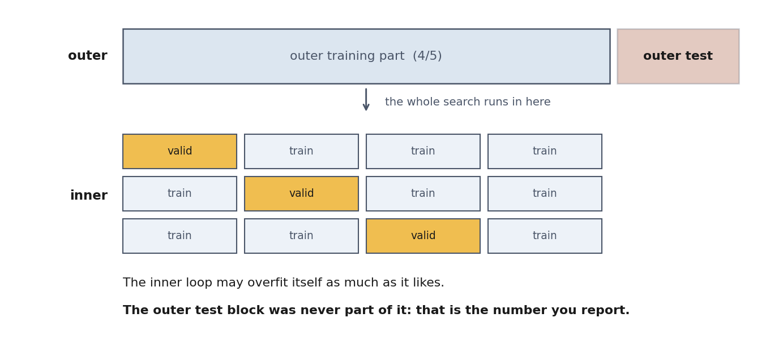
Nested cross-validation
Notes:
Measure the search, not the winner.
Outer loop holds out a fifth. The entire search runs inside the remaining four fifths. Score the search’s chosen model on the held-out fifth. Repeat five times.
The inner loop may overfit its own data as much as it likes; the outer block was never part of it.
One clarification that always comes up, so pre-empt it: nested cross-validation is NOT a way to choose hyperparameters - it produces k possibly different winners. It is a way to estimate what choosing costs. You choose on all the data afterwards, and you report the nested figure.

Slide 38
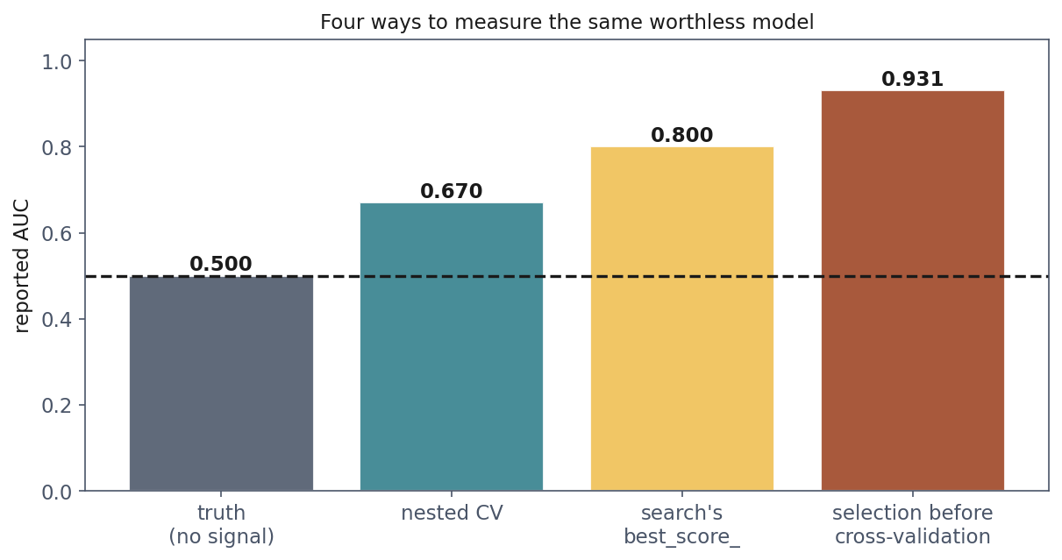
Four ways to measure the same worthless model
Notes:
The summary of the whole last hour, on one axis. Same data, containing nothing.
0.500 is the truth. 0.670 is nested cross-validation. 0.800 is what the search reports. 0.931 is selection before cross-validation.
Say clearly: nobody in this picture wrote dishonest code. The difference between 0.93 and 0.50 is entirely a matter of which choices were made while looking at which data.
Each step to the left is a piece of discipline, and each one costs a chunk of the score you would otherwise have reported. That is what discipline feels like from the inside, and it is why it is unpopular.

Slide 39
The debt, paid
Policy | Cost on the test set
threshold 0.50, the default | 10,540 EUR
threshold chosen on validation | 4,700 EUR
threshold chosen on test | 3,300 EUR
Notes:
Lesson 4’s threshold, done properly. Split three ways: train to fit, validation to choose, test to report once.
The honest threshold is WORSE on the test set than the cheating one. It is supposed to be - and this is the slide where that finally makes sense to them.
The cheating figure describes a threshold tuned to this particular test set, and there is no reason it survives contact with the next two hundred drives. The honest figure is an unbiased estimate of what happens next.
Note the cost: we now train on 56% of the data instead of 75%, because the validation set has to come from somewhere. On a small dataset that hurts - which is the argument for choosing by cross-validation on the training portion and keeping the test set whole.

Slide 40
Three sets, three jobs
Train: fit the parameters
Validation: make every choice: model, hyperparameters, threshold
Test: report. Touched once
Notes:
The organising principle of the whole lesson, on one slide. Put it on the board and leave it there.
Every choice belongs to the validation set. Which model, which penalty, which features, which threshold, when to stop training, whether to try a different approach entirely - all of it.
The test set has exactly one job and one use. The moment you look at it and change something in response, it has become a validation set, and you no longer have a test set at all.
The honest thing to say aloud, because they will do it anyway: everyone looks twice sometimes. The requirement is that you SAY SO in the report. A stated weakness costs a little credibility; an unstated one costs all of it when somebody else fails to reproduce your number.

Slide 41
A fixed seed buys repeatability, not stability
30 seeds, all perfectly reproducible: 0.913 to 1.000
AUC 1.000 (random_state=3) is reproducible and misleading
Notes:
Every one of those thirty runs is exactly reproducible by anyone with the same code. They disagree with each other by nearly nine points.
So reproducibility is necessary and nowhere near sufficient. Report the seed AND the spread.
Contrast the two ways of writing the same experiment up. “AUC 1.000, random_state=3” - fully reproducible, thoroughly misleading. “AUC 0.951 plus or minus 0.019 over 5-fold cross-validation, seed 0” - reproducible and honest.
The second one is also the format the final project will be marked in.

Slide 42
What to fix, and what to write down
Every random_state, and np.random.default_rng(seed)
Library versions: defaults change between releases
What you could not fix: threads, GPU non-determinism
Notes:
Practical checklist. The container exists for the second item: it pins the environment so that their result and the marker’s result are the same result.
Worth saying that a result nobody can reproduce in two years was not really reproducible - and that scikit-learn genuinely does change defaults between minor versions, which has invalidated published comparisons.
Commit the code that produced the number, not a tidied-up version of it.

Slide 43
Notebook 3, live
The 0.931, the fix, the nested search
Notes:
Run notebooks/03. Twenty minutes if the clock allows.
The cell to protect is the first one - let them watch 0.931 appear on empty data before any explanation. Nothing else in the lesson changes behaviour as reliably.

Slide 44
What to put in a report
The metric, the spread, and how it was estimated
How many positives the test set held
Every seed, and every library version
Which choices were made on which data
Notes:
A checklist they can apply to the final project and to anything they read.
The four items map to the four failures of today: a number without a spread hides the lottery; a metric without a positive count hides why the spread is wide; a missing seed makes it unreproducible; and an unstated selection procedure hides the optimism.
Turn it around as a reading habit too. When they meet a paper reporting a single figure with no spread, no fold count and no statement about how the hyperparameters were chosen, they now know exactly which questions are unanswered - and roughly how large the correction is likely to be.

Slide 45
What to take away
A test score is a measurement. 0.885 to a perfect 1.000, same model
Choosing on one split chooses noise
bias² + variance + noise is an identity, and the noise floor never moves
Curves that meet low mean bias: more data will not help
Cross-validation protects against fold leakage, nothing more
Notes:
Close on the number they opened with. Seed 3, AUC 1.000, on a model whose honest performance is 0.951.
If they remember one habit from today, make it this: before believing any reported score, ask what the base rate is, how many positives are in the test set, and which choices were made while looking at which data.
That third question is the one that separates a result from a story, and it is the question the final project will be marked on.

Slide 46
Homework
Exercise 5, discussed at the start of Friday 30 October
A result that is too good. Find out why, then produce the honest number
Notes:
Set it explicitly and say out loud when it comes back: the first ten minutes of next Friday, 30 October.
The shape of it: they are given a notebook that reports an excellent score, and the score is wrong. They have to find the reason, fix it, report the honest number, and say how much honesty cost.
Warn them that there is more than one problem planted, and that the marks are for the diagnosis rather than for the final figure - which will be much worse than the one they start with, and is supposed to be.
Next week: k-nearest neighbours, Naive Bayes and support vector machines. Three new model families, all of them evaluated with what we built today.

