Slide 1
Lesson 8: Unsupervised Learning
Technologies for Artificial Intelligence
Fabio Antonini, Università degli Studi dell’Aquila

Slide 2
Agenda
A fourth question this course asks of data: no target at all
k-means: the objective, Lloyd’s algorithm, choosing k
Hierarchical clustering and DBSCAN: shape versus density
Validating a clustering with no labels
Principal component analysis (PCA) and t-SNE
Notes:
Frame the whole lesson before the first slide of content. Every method met so far in this course - regression, logistic regression, trees, ensembles - learned from pairs: an input and a target. Today removes the target entirely. The task changes from “predict the label” to “describe the structure”: which points look alike, which few numbers summarise the many, which points do not belong.
Say the running example once, up front: a fictional retailer, Aurora, and three of its actual questions, one per notebook - segmenting customers, telling bots from humans, and catching disguised fraud. None of the three has a y supplied by anyone.
Handout section 1.

Slide 3
Exercise 7, before we start
What counts is the defence of the chosen family, not the winning score
The gap to watch for: a feature-importance ranking quoted without checking how many candidate columns competed for attention at each split
Today’s methods come with a version of the same obligation: a clustering or a projection is a claim, and it needs its own check
Notes:
Nothing to collect and nothing to hand back - discuss it. Ask what the importance ranking was taken to mean, and listen for the gap: reading it as settled fact rather than as something section 7 of that lesson showed could be dominated by noise columns.
Link forward: today has no labels at all, so there is no accuracy score to fall back on even provisionally. The obligation to check a result does not go away just because there is no y to check it against - it changes shape, and section 4 of today’s handout is entirely about that change.

Slide 4
No y at all
Every method so far learned from pairs: input x, target y
Unsupervised learning removes y: measurements, no answer key
The question: not “predict the label” but “describe the structure”
Most organisational data was never labelled: expensive, slow, often not well-defined
Often the first pass on a dataset
Notes:
Make the shift concrete rather than abstract. Ask the room: if you were handed 2,000 customers’ spending records with no group name attached to any of them, what would “a good answer” even mean, before any algorithm runs? There is no accuracy to check against - only whether the grouping looks and behaves like something real.
That is the conceptual pivot for the whole three hours: every diagnostic today either measures internal consistency (does this clustering agree with itself) or borrows an outside signal when one happens to exist (section 4). Neither is the clean “score against the test set” this course has used since lesson 1.
Handout section 1.

Slide 5
Aurora: three problems, no answer key
Segment 2,000 customers, from spend and visits (k-means, nb. 01)
Tell bots from humans in 1,500 sessions, same average behaviour (hierarchical clustering, DBSCAN, nb. 02)
Catch disguised fraud in an 8-column table, ordinary on every column (PCA, nb. 03)
Every dataset is synthetic: its truth is normally hidden
Notes:
Walk the three problems as three genuinely different shapes of “no labels” - not three demonstrations of the same idea. Segmenting customers is close to what students probably picture when they hear “clustering.” Bots-versus-humans is deliberately built to break that picture: same mean, different spread. The fraud problem breaks it again: individually unremarkable values, anomalous only in combination.
Say explicitly that one notebook is not “the more advanced version” of another - each is chosen because a different method is the right tool for it, and section 8 of the handout is the summary table of when to reach for which.
Handout section 1.1.

Slide 6
A ground truth Aurora will never have
Notebooks/retail_data.py publishes the true structure as TRUE_* constants
This lesson can check every method against a real answer: Aurora’s own analysts never could
Hold onto that asymmetry: it makes today teachable, and it is exactly what is missing the first time this runs on real data
Notes:
This is a methodological point, not a throwaway remark - flag it so it does not get lost under the numbers that follow. Every “matches the truth” claim this lesson makes (ARI scores, the scree plot recovering exactly 3 latent factors) is only checkable because the data was built for teaching. On a real, unlabelled dataset, none of those checks are available in the same form, which is precisely why section 4 exists: what is left to check when there genuinely is no answer key.
Handout section 1.1.

Slide 7
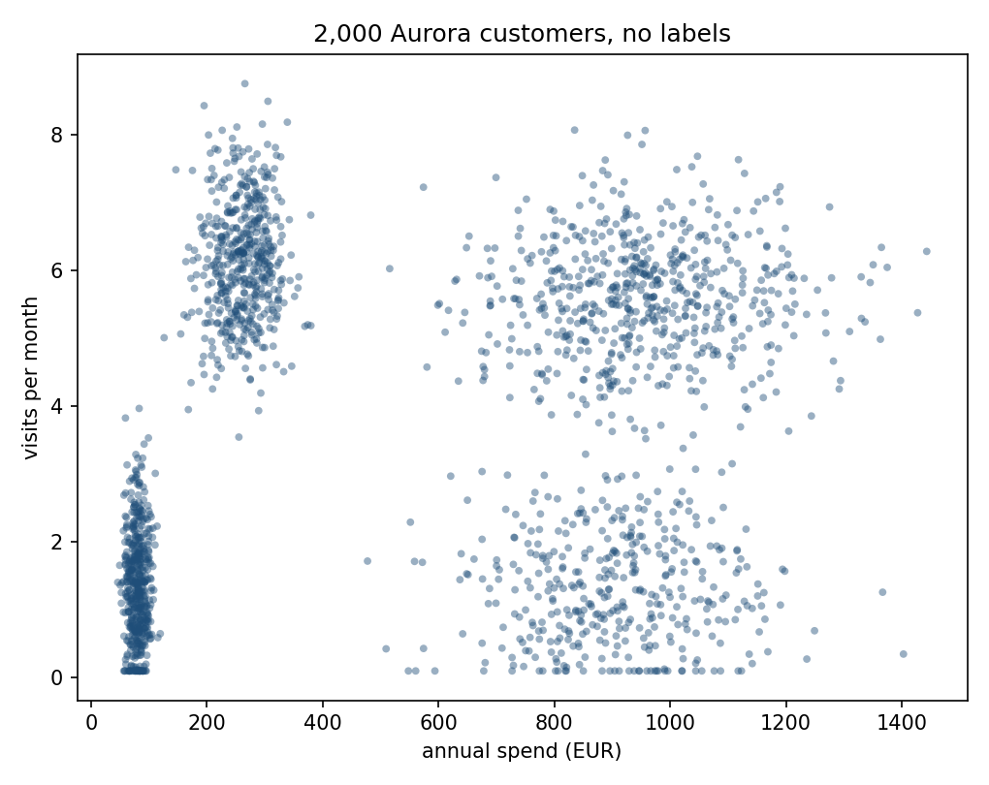
2,000 customers, no labels
Notes:
Let the picture sit for a moment before saying anything. Four clouds are visible to the eye before any algorithm runs - ask the room to count them before you say the number.
That is not an accident of this dataset: it is exactly the structure k-means is built to exploit, and it is why this figure opens the section rather than any equation. The “try this” in the handout asks students to predict, from the four segment means alone, where each cloud should sit - worth mentioning as a pre-read they can still do retroactively.
Handout section 2.

Slide 8
Turning “alike” into a number
A good grouping puts every point close to one representative “typical customer,” and far from every other group’s
k-means turns “close” into a number and minimises the total
Two things are searched for jointly: every point’s assignment, and the k cluster centres
Both at once is hard; the trick is minimising each separately, holding the other fixed
Notes:
Give the intuition with no symbols first, exactly as the handout does: picture each cluster as having one representative point, and ask what “good” means for such a picture. Then say that k-means turns “close” into a squared distance and adds it up.
Flag the two-kinds-of-variable structure before the objective appears - it is the reason the algorithm on the next few slides is two alternating, each individually easy, steps rather than one hard search.
Handout section 2.1.

Slide 9
The objective: within-cluster sum of squares
Minimise, jointly, over the cluster centres μⱼ and every assignment rᵢⱼ
rᵢⱼ = 1 if point i is assigned to cluster j, else 0: exactly one 1 per row
This quantity has a name: within-cluster sum of squares (WCSS), or inertia in scikit-learn
Notes:
Set the two unknowns up before showing the formula on the next slide: k-means is searching over the cluster centres and the assignment of every point at once, and rᵢⱼ is just bookkeeping for which point goes where - 1 if point i is in cluster j, 0 otherwise, exactly one 1 per row.
Handout section 2.1.

Slide 10
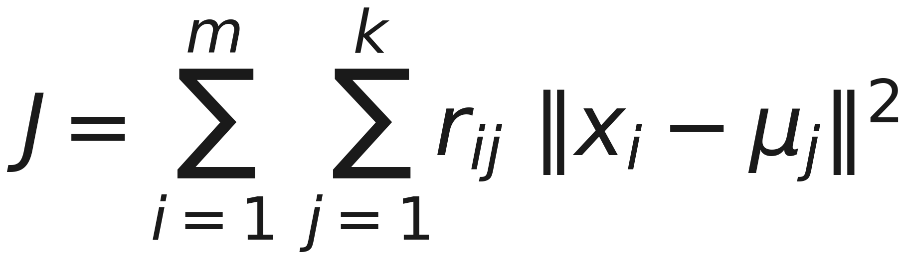
Minimise J
Notes:
Read the sum out loud in words: for every point, add the squared distance to the centre of the cluster it belongs to; add that up over all points.
This cannot be minimised in one shot: choosing the best assignment needs the centres, and choosing the best centres needs the assignment. Do not derive the two closed-form minimisations here - state that they exist and move to what they say on the next slide. The full derivation, including the gradient that gives the mean as the exact minimiser, is handout section 2.1, for after the lecture.
Handout section 2.1.

Slide 11
Lloyd’s algorithm: assign, then update, repeat
Assign step: centres fixed, send every point to its nearest centre: exact minimiser over assignments
Update step: assignment fixed, move every centre to the mean of its points, where the algorithm’s name comes from
Alternate the two until nothing changes
Each step is an exact minimisation, no approximation, no step size
Notes:
Both steps are genuinely exact, not heuristic approximations - worth stressing, since students have just spent two lessons on gradient descent, where every step is approximate. Here, each half of the alternation solves its half of the problem exactly: nearest-centre assignment is provably optimal given fixed centres, and the mean is provably optimal given a fixed assignment.
Ask the room: if each step is exactly optimal, what could possibly go wrong? The answer is the next slide.
Handout section 2.1.

Slide 12
Every step can only lower J
Assign and update each solve an exact minimisation, so neither step can ever increase J
J is bounded below by 0, with only finitely many ways to partition m points into k groups
Never increasing, cannot fall forever: the sequence must repeat, and that is convergence
It converges to a local minimum, not necessarily the global one
Notes:
This is the argument for why Lloyd’s algorithm terminates at all, and it is worth giving in full even though it is not a derivation of a formula - it is three short facts (non-increasing, bounded below, finitely many partitions) chained together, and it is the kind of argument students will meet again.
The sting is in the last bullet. Converged does not mean correct - it means stuck, possibly at a bad local minimum. That is exactly what the next few slides measure.
Handout section 2.1.

Slide 13
Worked example: six customers, badly-chosen starts
Iteration | Assignment | WCSS after assign | WCSS after update
0 | [0 1 1 1 0 1] | 15.965 | 7.281
1 | [0 0 1 1 0 1] | 5.491 | 4.674
2 | [0 0 1 1 0 1] | 4.674 | 4.674
Notes:
Six standardised customers, two deliberately bad initial centres - the first two points in the dataset. Walk the WCSS column: 15.965, 7.281, 5.491, 4.674 - falling at every single step, exactly as the previous slide argued it must.
By iteration 2 the assignment repeats and both steps leave J unchanged: converged. In this particular six-point case it happens to be the global optimum - say clearly that this is a property of this small example, not a guarantee, since section 2.2 is about exactly the case where it is not.
Docs/worked_examples.py reproduces this table directly from retail_data.py. Handout section 2.1.

Slide 14
A bad start is a real risk
30 independent naive random starts of Lloyd’s algorithm on the 2,000-customer data
Best final WCSS: 374.1. Worst: 1,390.4, 3.7 times worse, same data, same update rule
One start in 30 ended there; the other 29 all found 374.1
The naive fix (k points picked uniformly at random) gives no way to tell in advance which kind of run you got
Notes:
Land the number, then the framing. Nothing about the update rule changed between the best run and the worst - only where the search started. That is the entire content of “local, not global minimum” made concrete.
Ask the room: if you ran this once, on real data, with no truth to check against, how would you know which kind of run you got? You would not - the WCSS value alone does not distinguish a global optimum from a mediocre local one, because you have no reference point.
Handout section 2.2.

Slide 15
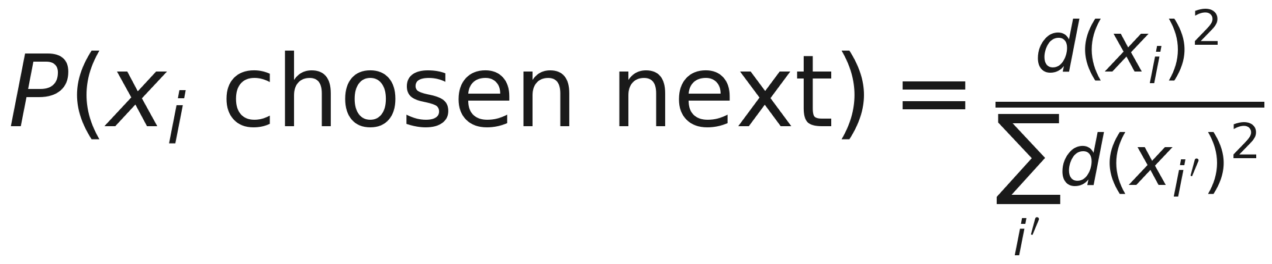
k-means++: favour centres far from what’s chosen
Notes:
Define d before reading the formula, since it is no longer beside it: d(x_i) is the distance from x_i to the NEAREST centre already chosen, not to all of them. The two formulas side by side came out at 25pt, which needs the front row.
Say the rule in words first: the first centre is a uniformly random point; every centre after that is picked with probability proportional to its squared distance from the nearest centre already chosen. A point already close to an existing centre is unlikely to be picked again; a point far from everything picked so far - plausibly the seed of an as-yet-unrepresented cluster - is favoured.
This is initialisation only - Lloyd’s algorithm afterward is completely unchanged. It addresses exactly the risk on the previous slide, by making a bad draw of starting centres much less likely.
Handout section 2.2.

Slide 16
k-means++, measured
Same 30 seeds, k-means++ instead of naive random
Range narrows to 374.1–1,088.3: the worst case gains ~300 units
Also 29 of 30 at the optimum: the bad case is less bad, not rarer
sklearn.cluster.KMeans uses k-means++ plus 10 restarts by default
Notebook 01 matches its WCSS to 10⁻⁴
Notes:
Read the range change against the previous slide’s 374.1–1,390.4: the worst case is about 300 units less bad. Be honest about what it did not do - k-means++ also reached the optimum in 29 of 30 runs, exactly as the naive starts did. On this data it made the bad case less bad, not rarer, which is why the library default is k-means++ AND ten restarts, keeping the best.
The 10⁻⁴ agreement is worth naming explicitly as a genuine check, not an assumption - the from-scratch and scikit-learn implementations are searching for the same optimum from starts drawn the same way, and the notebook confirms it rather than takes it on faith.
Handout section 2.2.

Slide 17
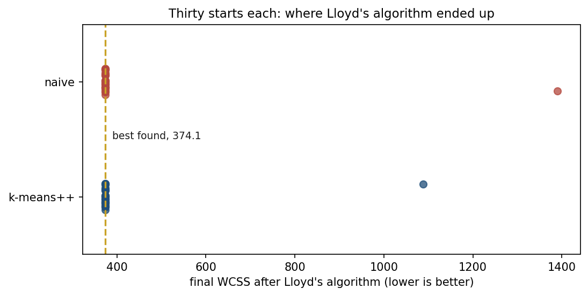
Sixty starts: where each one ended
Notes:
Every one of the 60 runs from the last two slides, as a dot: naive starts on top, k-means++ below, the dashed line at the best partition found, 374.1.
Let them see the pile-up first: 29 of each on the line. Then the two stragglers - 1,390.4 for the naive start, 1,088.3 for k-means++. That is the whole story of initialisation on this data: rare, and not rare enough to ignore, because a single run gives no sign of whether it was the straggler. Restarting and keeping the best is what makes it harmless. Handout section 2.2.

Slide 18
Choosing k
k is an input to k-means, not something the algorithm discovers
WCSS is monotonically non-increasing in k: at k=m, J=0 exactly
So the raw value of J at the “best” k is not the signal
The elbow: where the WCSS curve stops falling steeply, past the true count, an extra centre only subdivides an already-coherent group
Notes:
Make the trap explicit: a student who does not think about this will be tempted to pick the k with the lowest WCSS, and the lowest WCSS is always the largest k tried, which is a useless answer.
The elbow logic is a shape argument, not a threshold - ask the room how they would describe “where the curve stops falling steeply” precisely enough to automate it. The honest answer is that it is somewhat subjective, which motivates a second, more quantitative diagnostic on the next slide.
Handout section 2.3.

Slide 19
The silhouette score
For point i: aᵢ is its mean distance to every other point in its own cluster
bᵢ is its mean distance to the points of the nearest other cluster
Combine the two into a single number per point
Notes:
Set up the two ingredients before showing the formula on the next slide: aᵢ measures how well a point fits its own cluster, bᵢ measures the best alternative it could have had instead.
Handout section 2.3.

Slide 20
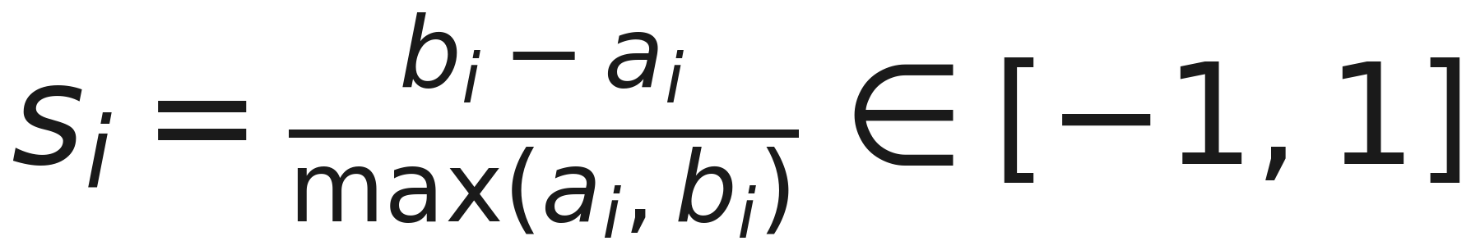
Between -1 and 1
Notes:
Walk the three regimes: sᵢ → 1 when a point sits deep inside its own cluster and far from every other; sᵢ ≈ 0 on a boundary between two clusters; sᵢ < 0 when a point is, on average, closer to a different cluster than its own - an assignment the silhouette treats as actively wrong.
Averaged over all points, this gives one number per k that is a genuine quantity to search over, not only a shape to eyeball - a sharper diagnostic than the elbow, and one that measures something related but not identical: whether every point sits closer to its own group than to any rival.
Handout section 2.3.

Slide 21
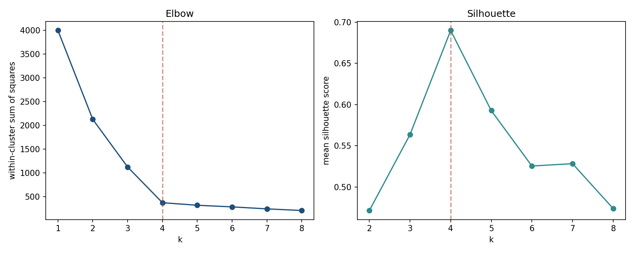
Elbow and silhouette, on the same data
Notes:
WCSS falls sharply through k=4 and flattens after; silhouette peaks at k=4 and then declines. Point out that the two curves are answering different questions - WCSS asks only “does adding a cluster help,” which is agnostic to what a cluster means; silhouette asks whether every point is closer to its own group than to any rival, a stronger, more geometric condition.
Say plainly that the two diagnostics agreeing here is a property of this dataset’s four well-separated, comparably sized blobs - not a guarantee. Section 4 of the handout returns to a dataset where a diagnostic can be confidently wrong.
Handout section 2.3.

Slide 22
Both point to k=4
WCSS at k=4: 374.1, the sharpest bend in the elbow curve
Silhouette at k=4: 0.690, the peak across k=1 to 8
Both match the number of segments the data was actually built with
Agreement here is worth noting precisely because it does not always happen, and is not required to
Notes:
State both numbers before the punchline. The agreement is genuinely nice for teaching, but resist letting the class walk away thinking the two diagnostics always agree - that is exactly the kind of overclaim the handout’s “predictable mistake” boxes exist to head off, and this lesson’s own section 4 will show a case where a diagnostic looks fine and is not.
Handout section 2.3.

Slide 23
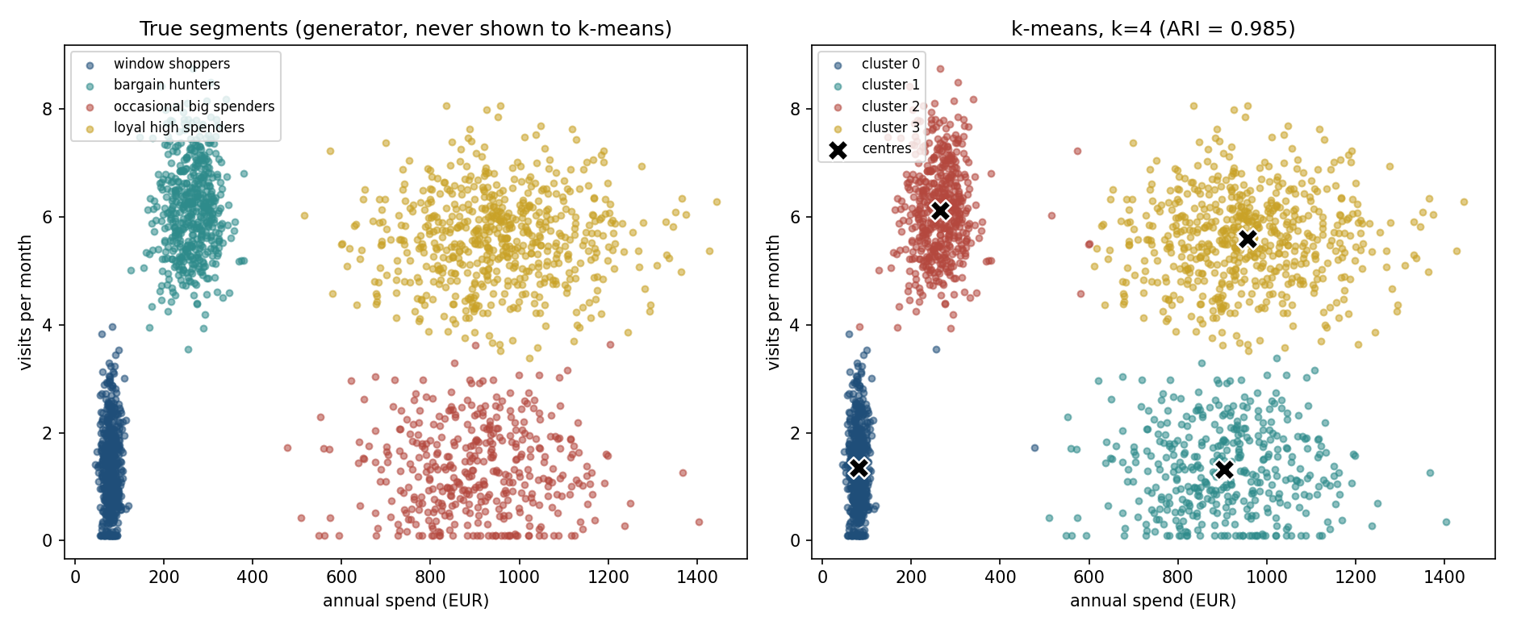
k-means against a ground truth Aurora doesn’t have
Notes:
Left: the true segments, generated by retail_data.py, never shown to k-means. Right: k-means’ own k=4 clustering, fitted centres marked. Visually near-identical - say the number on the next slide rather than here, since this slide is the figure alone.
Repeat the asymmetry from earlier: this comparison exists only because the data is synthetic. Aurora’s own analysts would have the right panel and nothing else.
Handout section 2.3.

Slide 24
The adjusted Rand index
Compares two labellings: a random assignment scores 0, identical labellings score 1
Cluster “0” need not mean the same thing on both sides: relabelling is handled
k-means vs. the true segments: 0.985, near-perfect
An external metric: needs a ground truth, which section 4 asks about when there isn’t one
Notes:
Give the definition before the number, since ARI will recur for the rest of the lesson as the standard way to score a clustering against a truth. 0.985 is about as good as this metric gets - worth contrasting later against the bot/human numbers in section 3, which come out negative.
Bridge forward explicitly: everything scored today with ARI is only checkable because this lesson knows the answer. Section 4 is about what happens when it does not.
Handout section 2.3.

Slide 25
Notebook 1, live
k-means from scratch, checked against scikit-learn’s k-means++ and 10-restart defaults
The 30-seed initialisation comparison, reproduced live
The elbow and silhouette curves, computed directly from the data
Notes:
Run Notebooks/01_kmeans_from_scratch.ipynb. Twenty minutes.
Have them watch the from-scratch assign/update loop converge on the six-point worked example before scikit-learn’s version ever runs - the agreement is checked, not assumed.
The cell worth protecting if time is short is the 30-seed initialisation sweep: printing the 374.1-versus-1,390.4 gap themselves lands harder than reading it off a slide.

Slide 26
A dataset built to defeat k-means
Security suspects some of 1,500 sessions were automated
Two features: duration in minutes, pages viewed
12% are, by construction, bots: scripted and consistent
Bots and humans share the same mean: a tight cloud inside a diffuse ring
No straight cut separates them: there are no two offset clouds
Notes:
Set this up as a deliberate provocation, not a natural dataset. Section 2 just showed k-means recovering four clusters almost perfectly - this section is built specifically to break the assumption that made that possible.
Ask the room to predict, before the figure: if the two groups share a mean, what happens when k-means tries to place two centres? The honest answer, which the next slide shows, is that there is no separating line for it to find at all.
Handout section 3.1.

Slide 27
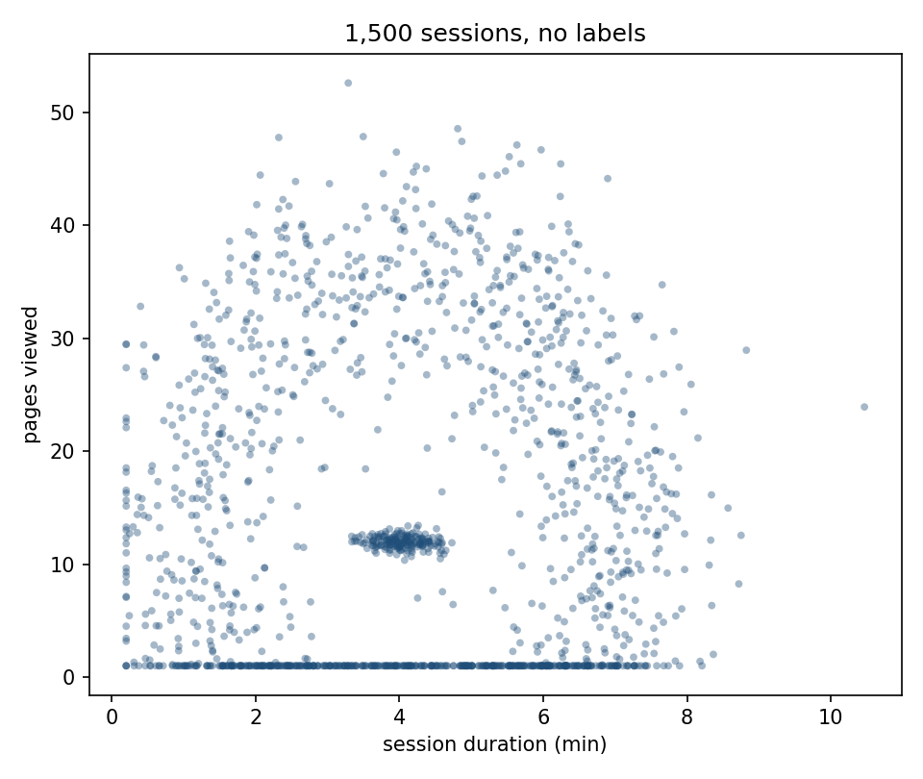
1,500 sessions, unlabelled
Notes:
A dense smudge sitting inside a much larger, looser cloud, both centred in roughly the same place. Let the room look for a gap a linear or round boundary could exploit - there isn’t one, and that is the point.
Contrast directly with the four visible clouds from section 2’s opening figure: same task (cluster with no labels), a completely different picture, and it should not be obvious yet which algorithm handles it.
Handout section 3.1.

Slide 28
k-means on this shape
Run k-means with k=2 on the session data
ARI: -0.046, indistinguishable from a random split
Not a tuning or initialisation failure, no starting point fixes it
WCSS wants round, compact clusters; the only cut through this cloud slices both the bot core and the human ring in half
Notes:
Stress “no starting point fixes it” - this is not the local-minimum problem from section 2.2, which k-means++ addresses. This is a mismatch between what k-means optimises (compactness) and what the data actually looks like (a core and a surrounding ring, same centre). Better initialisation cannot fix an objective that is the wrong shape for the data.
Ask the room: what would a “cluster” need to mean for this shape to be findable at all? The answer - density, not compactness - is where the next two sections go.
Handout section 3.1.

Slide 29
Merge the two closest
Start with every point as its own cluster
Repeatedly merge the two closest clusters, recording every merge as a branch in a tree: a dendrogram
Cutting the tree at a height is equivalent to choosing k: branches crossed = cluster count
“Closest” needs a rule for distance between clusters: the linkage criterion
Notes:
Introduce the dendrogram as an object before any linkage rule - the tree itself is the useful idea, and any linkage rule can build one. Say explicitly that choosing k after the fact, by cutting the tree at a height, is a genuinely different workflow from k-means, where k has to be fixed before the algorithm starts.
The linkage criterion is where the real content is, and it is the next slide.
Handout section 3.2.

Slide 30
Four notions of “closest”
Single: closest pair, which can chain a winding path, or bridge two groups at one touching point
Complete: farthest pair, which favours compact groups
Average: mean distance over every cross-pair, a compromise
Ward: least added variance, the same objective k-means minimises
Notes:
Four rules, four different biases - worth naming what each one is built to find, since the next slide is going to show all four failing on this particular dataset for two different reasons.
Ward is worth pausing on: it is not a fourth, unrelated idea, it is k-means’ own objective expressed as a merge rule, so predict out loud that it should fail on this data for the same reason k-means just did.
Handout section 3.2.

Slide 31
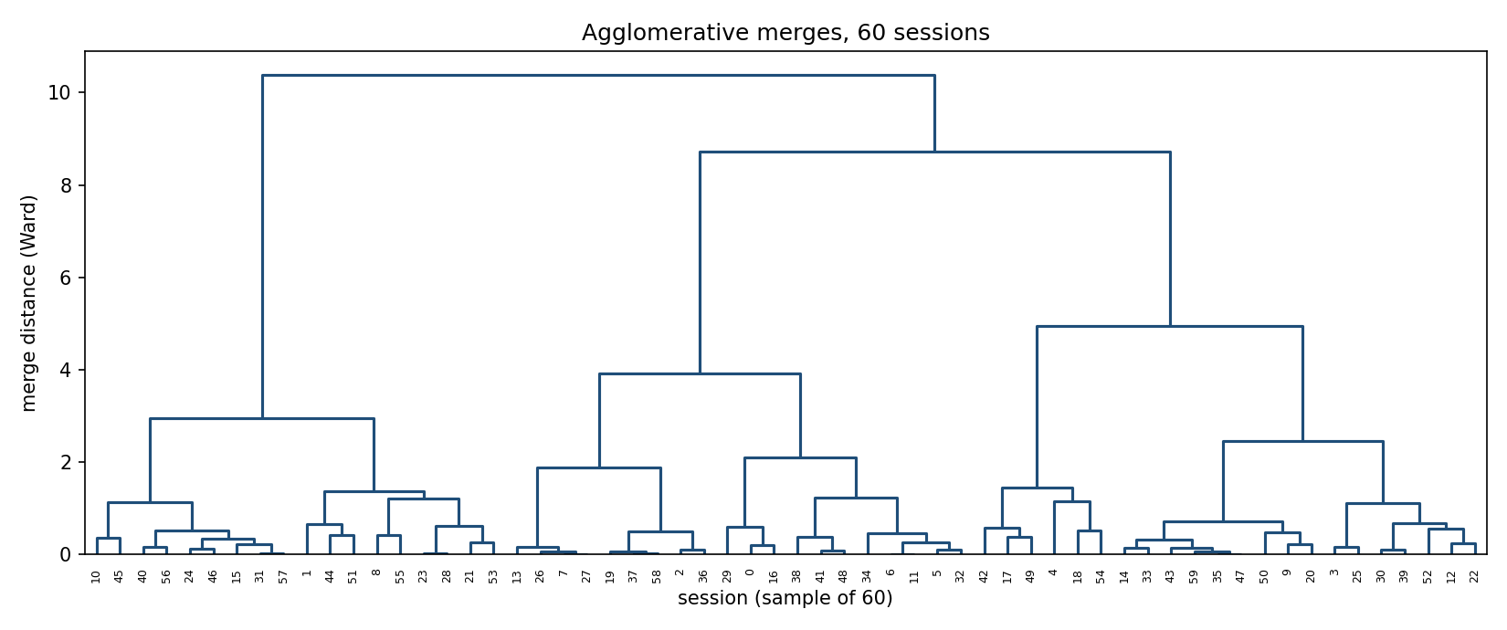
Ward-linkage merges on 60 sessions
Notes:
Ward joins compact, comparably sized groups at every level - look how balanced the branches are. That is its variance objective at work, the same one k-means has, and it is exactly why Ward cannot follow a dense core inside a diffuse ring: it keeps making round pieces.
Show how to read it: draw a horizontal line across the tree, and the number of branches it crosses is k. Then contrast with what the next slide shows for single and average linkage on all 1,500 sessions - chaining, one cluster of 1,499 and one of 1 - which this balanced Ward tree does not do.
Handout section 3.2.

Slide 32
All four linkage rules, scored
Linkage | ARI | Cluster sizes
Ward | -0.062 | 1,007 / 493
Complete | -0.101 | 1,253 / 247
Average | -0.001 | 1,499 / 1
Single | -0.001 | 1,499 / 1
Notes:
Read the two failure modes separately, they are not the same failure. Ward and complete fail for the same reason k-means did - both still search for compact, comparably sized pieces, which this shape does not have. Single and average instead produce one cluster of 1,499 points and a cluster of size 1 - not a discovery, but chaining: the algorithm absorbed almost the entire dataset along its densest path before running out of points to merge.
Land the summary line: all four linkage rules score at or below zero ARI. Hierarchical clustering, by itself, is not a fix for the shape problem - it needs a rule that looks for density rather than compactness or chained proximity.
Handout section 3.2.

Slide 33
Break
Twelve minutes
Notes:
Twelve minutes. What comes back after the break is the method that actually solves the bot/human problem - worth saying, so the room returns with the open question fresh: what would a cluster need to mean for that ring-around-a-core shape to be findable?

Slide 34
DBSCAN: density instead of shape
DBSCAN: density-based spatial clustering of applications with noise
Classifies points by neighbourhood crowding: radius eps, minimum count min_samples
Core point: at least min_samples others within eps
Border point: within eps of a core, but not core itself
Everything else: noise
Notes:
Say the name in full once, then use the acronym. Walk the three point types slowly - core, border, noise - since the next slide’s definition of a cluster depends on all three.
Nothing here mentions a centre or a mean - flag that explicitly as the structural difference from everything in sections 2 and 3.2.
Handout section 3.3.

Slide 35
What counts as a cluster
A maximal set of core points, chained by mutual eps-closeness, plus every attached border point
No centre, no mean, no shape assumption in the definition
A compact core and a diffuse ring both count, if dense enough at the scale eps measures
Points can belong to nothing: noise is first-class, not an error
Notes:
This is the slide that answers the question left open before the break: a cluster defined by density, rather than compactness, can be a ring around a core, because nothing in the definition forces round or convex shapes.
The “noise is first-class” point matters on its own - every method in sections 2 and 3.2 must assign every point to exactly one cluster. DBSCAN does not, and section 3.3’s numbers later show exactly what that buys.
Handout section 3.3.

Slide 36
Choosing eps: the parameter that matters most
Too small: even the dense bot core fractures into isolated noise points
Too large: the ring bridges back into the core, everything merges, as Ward linkage did
A k-distance plot: distance from every point to its min_samples-th nearest neighbour, sorted
Dense regions give a small distance, sparse ones a large one: the plot typically bends sharply between the two
Notes:
Two failure directions, both bad, and eps sits between them - motivate the k-distance plot as a principled way to find that middle point rather than guessing.
Ask the room what shape they expect the sorted-distance curve to have before showing it. The intuition: flat while you are still inside dense regions, then a sharp climb once points start being genuinely far from their neighbours.
Handout section 3.3.

Slide 37
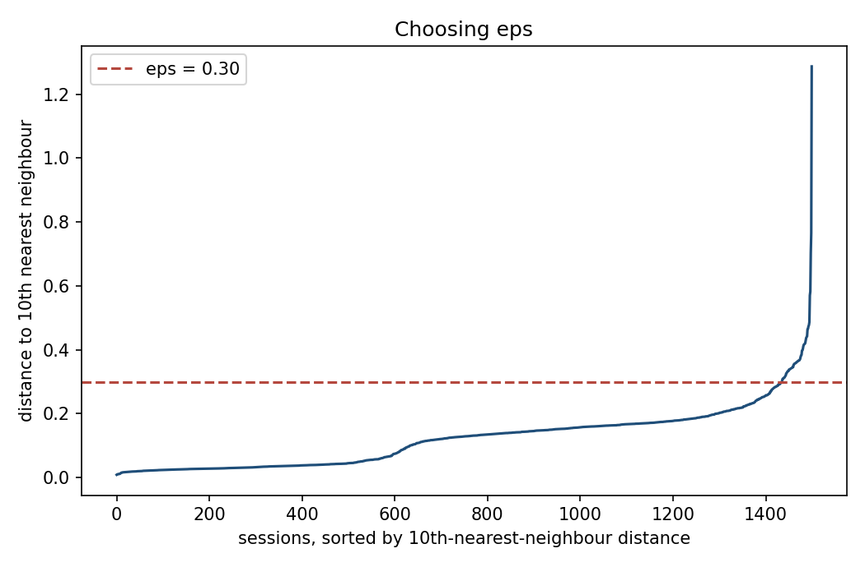
The bend in the curve
Notes:
10th-nearest-neighbour distance, sorted, for all 1,500 sessions. The curve stays low and flat through most of the range and bends sharply upward near the end.
eps = 0.30 sits where the climb begins, a little above the knee this week’s curve gives, 0.258 - point at exactly where on the curve that is, because section 3.4 comes back to that gap. This is the value used on the next slide’s results.
Handout section 3.3.

Slide 38
DBSCAN, measured
 | Result
ARI against true bot/human split | 0.941
Core points | 1,435 of 1,500
Noise points | 13
Notes:
0.941 against k-means’ -0.046 and Ward’s -0.062 on the identical dataset - same data, a method built for the actual shape.
Worth reading the noise points individually rather than as a rounding error: checking their true label shows all 13 are genuine human sessions, not misplaced bots - sessions whose one week of browsing happened, by chance, to look almost as mechanically regular as a script’s. DBSCAN’s answer for them - not confidently either group - is more honest than a forced binary label, and it is an answer no method in section 2 or 3.2 can even give.
Handout section 3.3.

Slide 39
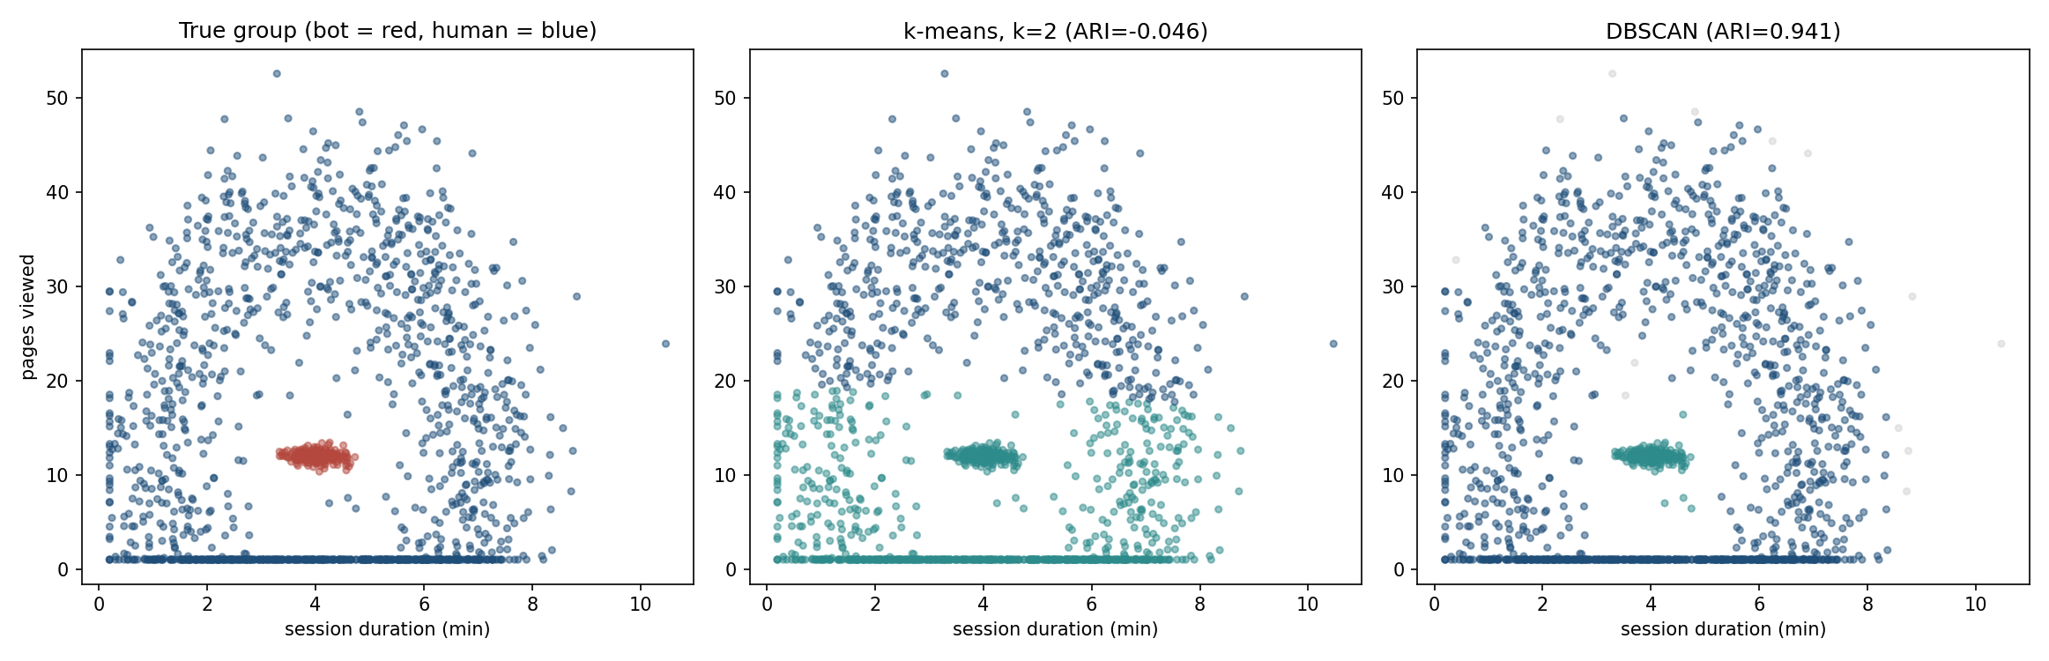
Three views, side by side
Notes:
True group, k-means, and DBSCAN on the same axes. DBSCAN’s cluster boundary follows the actual density gap; k-means’ straight cut does not exist in this data at all - point directly at the contrast rather than describing it.
This is the single figure to leave up longest in this segment - it makes the whole section’s argument visible in one look.
Handout section 3.3.

Slide 40
Does eps transfer?
Week | ARI at eps = 0.30 | Knee eps | ARI at knee
this one | 0.941 | 0.258 | 0.890
week 4 | −0.012, one cluster | 0.226 | 0.858
week 5 | −0.009, one cluster | 0.232 | 0.887
the other four | 0.93 – 0.96 | 0.21 – 0.23 | 0.79 – 0.85
Notes:
Seven weeks regenerated from the same generator - same site, same bot fraction, same shapes, different individual sessions. Read the two ARI columns against each other before saying anything.
The constant does not transfer. On two of the seven, DBSCAN returns a single cluster and an ARI of zero. Not a worse answer - no answer at all. The reason is in the knee column: 0.30 is larger than any of these weeks’ own curves suggest, and on those two draws it is large enough to bridge the density gap and swallow the ring into the core.
The recipe does transfer. Re-read eps off each week’s own k-distance curve and the split comes back every time, at 0.79 to 0.89.
Now the row to sit on, and it is the first one. On the week we studied, the hand-picked 0.30 beats the recipe - 0.941 against 0.890. Say the consequence out loud: the tuned constant is better where it works and absent where it does not.
That is not a fact about DBSCAN. It is what fitting a constant to one sample buys and costs, and lesson 5 said the same thing about trusting a single train/test split. Ask the room which of the two they would ship to Aurora’s security team, and why.
Handout section 3.4.

Slide 41
Choosing among the three
Situation | Reach for
Clusters plausibly round, similar size, k known or searchable | k-means
Want the hierarchy itself: nested groupings at every scale | Agglomerative clustering
Clusters irregular, nested, or of very different densities; outliers should be flagged | DBSCAN
Dataset is very large, every point must be assigned to something | k-means (DBSCAN’s noise needs a policy)
Notes:
This table is worth reading as a decision the data makes, not the analyst. The predictable mistake, from the handout: having watched k-means recover the customer segments almost perfectly in section 2, the reasonable conclusion is that clustering as a category works well. The instinct is not wrong about k-means specifically - it is wrong about clustering being one method with one assumption.
k-means and Ward both optimise “compact and round”; DBSCAN optimises “densely connected” - a nested structure like today’s bot core is exactly where the two notions give opposite answers, and which definition is right is a property of the data, not the algorithm.
Handout section 3.5.

Slide 42
Notebook 2, live
Agglomerative clustering, all four linkage rules, and the dendrogram
DBSCAN, the k-distance plot, and the eps sweep
Every result checked against the true bot/human labels
Notes:
Run Notebooks/02_hierarchical_and_dbscan.ipynb. Twenty minutes.
Protect the eps sweep if time is short - watching ARI rise and then fall again as eps moves past the bend makes the “too small fractures, too large merges” argument concrete rather than asserted.
Have them check the 13 noise points’ true labels themselves rather than reading the number off a slide.

Slide 43
No answer key this time
Every check so far, ARI in sections 2 and 3, used a ground truth this lesson happens to have because the data is synthetic
Aurora’s actual analysts, on real customer or session data, will never have that
Two families of metric fill the gap, and it matters which one is available in a given situation
Notes:
Return explicitly to the asymmetry flagged in section 1: everything scored with ARI today is checkable only because the truth is published. This section is about what is left when it is not.
Set up the two-way split before naming either family - internal (only the clustering and the data) versus external (an outside answer key) - the next two slides take one each.
Handout section 4.

Slide 44
Internal metrics: only the clustering and the data
Use no outside answer key: computed from the clustering and the points alone
Silhouette: are points closer to their own cluster than to any other? Answerable from the clustering alone
WCSS: usable, but weaker, only comparable across different k on the same algorithm, not across different methods
Always available, even when nothing else is
Notes:
Silhouette already appeared in section 2.3 as a way to choose k - here it is being recast as one member of a broader category, “internal metrics,” which is the useful generalisation.
The WCSS caveat is worth spelling out: it cannot be used to compare k-means against DBSCAN, because DBSCAN does not even define centres the way WCSS needs. That limitation is part of why a family of alternatives exists at all.
Handout section 4.

Slide 45
External metrics: an outside answer key
Compare a clustering against a separate labelling assumed correct, ARI and its relatives
Here: the data generator’s true_segment / true_group
In practice: a hand-labelled sample, a business rule, or a downstream outcome: did the “bot” cluster get blocked and never return?
When such a signal exists, even partial or noisy, use it
Notes:
The examples of a real-world external signal matter more than the definition here - a downstream outcome (blocked and never returned) is the kind of proxy label that is available far more often than a clean, hand-verified truth, and it is worth spending a moment on that it counts even when partial or noisy.
Set up the punchline explicitly: internal metrics can be confidently wrong, because they have no way to know the clustering’s underlying assumption is the wrong one for this data - only whether it is self-consistent. That is the next slide.
Handout section 4.

Slide 46
What silhouette can’t see
It endorses only what the metric can see: the shape
k-means on the sessions: silhouette 0.401, ARI −0.046
DBSCAN, correct: silhouette −0.106, ARI 0.941
Silhouette measures roundness, not correctness
Notes:
This is the handout’s named predictable mistake, and it deserves to be said slowly. Ask the room directly: if you only had the silhouette score and not the ARI, would you have any hint that k-means’ clustering on the session data is worthless? The honest answer is no - the internal metric alone gives no warning. Worse, it points the wrong way: k-means’ useless split scores 0.401, DBSCAN’s correct one -0.106, because two compact halves are rounder than a core inside a ring.
That is the whole reason external validation matters whenever any signal for it exists, even a rough one, and it is why this section sits between the clustering methods and PCA rather than being a footnote to section 2.
Handout section 4.

Slide 47
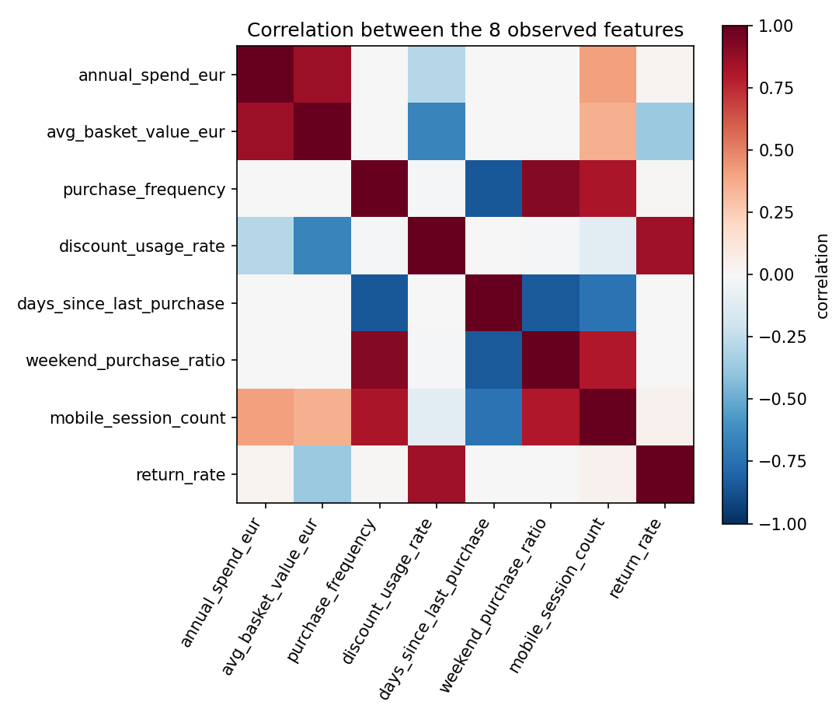
Eight columns, not eight independent numbers
Notes:
Aurora’s account table has 8 columns. The block of warm cells among spend-related columns, and the separate block among engagement-related columns, is the correlation structure PCA is about to compress - point at both blocks directly.
Say plainly what this figure is doing here: it is the motivation for everything that follows, not a result. Spend, basket value and mobile session count all move together because they partly reflect the same underlying tendency to spend - PCA is about to find that underlying tendency directly.
Handout section 5.1.

Slide 48
PCA: the direction that varies most
Finds the direction in feature space along which the data varies most: the first principal component
Then the next-most-varying direction, perpendicular to the first, and so on
“Varies the most” stands in for “carries the most information”: a direction where every point looks nearly identical tells points apart hardly at all
A direction like that is safe to discard
Notes:
Give the intuition before any algebra, exactly as the handout does: PCA is looking for the direction that best tells points apart, not a mysterious transform. “Safe to discard” is the key phrase - it is what makes dimensionality reduction a defensible operation rather than just throwing information away.
The next few slides give the two derivations the handout works through in full - state results here, point to the handout for the steps.
Handout section 5.1.

Slide 49
Maximise variance, subject to unit length
The variance of standardised data projected onto a direction v, with ‖v‖ = 1, is what PCA maximises
Σ is the sample covariance matrix: diagonal 1, off-diagonal entries the correlations the previous figure showed as colours
The unit-length constraint matters: without it, variance grows without bound simply by scaling v up
Notes:
“Maximise variance” is meaningless until direction is separated from length - that is what the unit-length constraint buys. The handout works the constrained optimisation through a Lagrange multiplier in full - worth saying that word exists, not deriving it here.
Handout section 5.2.

Slide 50
Variance along a direction
Notes:
Σ is the sample covariance matrix - for standardised columns, its diagonal is 1 and its off-diagonal entries are correlations, the same numbers the previous figure showed as colours.
Handout section 5.2.

Slide 51
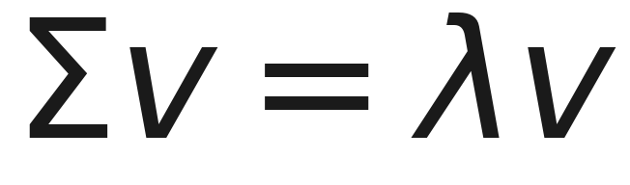
The stationary points are eigenvectors of Σ
Notes:
State the result, not the Lagrangian steps that get there - those are handout section 5.2, in full. Say what this equation means in words: directions that solve the constrained maximisation are exactly the eigenvectors of the covariance matrix, with λ the corresponding eigenvalue.
Substituting back gives vᵀΣv = λ - the variance a direction captures is its eigenvalue. That single fact is the bridge from “an eigenvector” to “a principal component,” and it is the fact worth the class actually remembering.
Handout section 5.2.

Slide 52
The eigenvalue is the variance that direction captures
Substituting Σv = λv back: vᵀΣv = λ
The direction of largest variance is the eigenvector with the largest eigenvalue; the second is next-largest, orthogonal to the first
Orthogonality is automatic: Σ is symmetric, by the spectral theorem
Order all n eigenvalues largest to smallest: every component, at once
Notes:
This slide turns the previous slide’s single equation into the actual recipe: sort eigenvalues, keep eigenvectors in that order, and that ordered list is PCA. Worth saying explicitly that this is the entire algorithm once the eigendecomposition is in hand - everything before this was justifying why eigenvectors are the right thing to compute at all.
The automatic-orthogonality point is worth a beat: it is not a separate constraint PCA has to enforce, it falls out of Σ being symmetric.
Handout section 5.2.

Slide 53
Worked example: spend and visits
 | Value
Correlation (off-diagonal of Σ) | 0.171
Eigenvalues, 1 ± r | 1.171 and 0.829
First component direction | (1,1)/√2
Notes:
Two standardised features from section 2 - spend and visit frequency. For this symmetric 2×2 form, the eigenvalues are exactly 1+r and 1-r for correlation r, checkable directly from Σv = λv with no numerical solver - with r = 0.171: 1.171 and 0.829. numpy.linalg.eigh gives 1.171 and 0.830; the last digit moves because np.cov divides by m - 1, so the diagonal is 1.0005 rather than 1.
The direction (1,1)/√2 is the “spend and visit often together” diagonal, not either axis alone - say why that makes sense: customers who spend more also tend to visit more, so the greatest joint variation runs along the diagonal between the two original features.
Handout section 5.2.

Slide 54
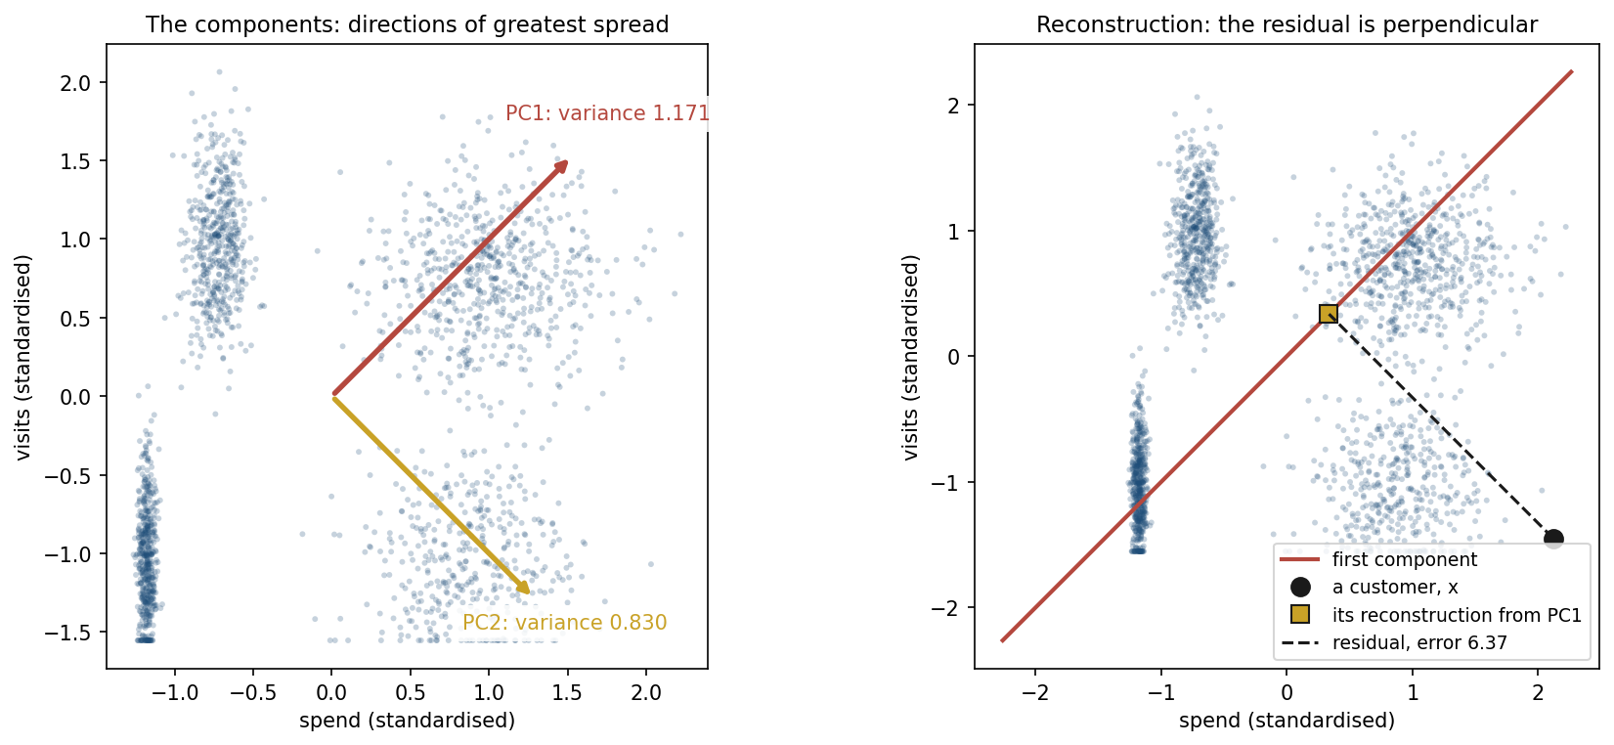
Two columns, drawn
Notes:
Left: the two components on spend and visits, each arrow two standard deviations long. PC1 runs along the diagonal with variance 1.171, PC2 across it with 0.830 - the previous slide’s numbers, as directions.
Right: previewing the anomaly section. The customer furthest off the diagonal, customer 13, and its reconstruction from PC1 alone - the closest point on the line. The residual meets the line at a right angle; that is what makes the reconstruction the closest point, and its squared length, 6.37, is the reconstruction error. In section 6 the same measurement, in eight dimensions with three components kept, catches 37 of 40 disguised accounts. Handout sections 5.2 and 6.1.

Slide 55
The same answer, more stably: the SVD
The singular value decomposition (SVD) of the centred data is the numerically preferred route to the same components
Squaring a matrix squares its condition number, never form XᵀX explicitly
Notes:
Callback to lesson 3 deliberately - condition number squaring is the same argument that motivated preferring gradient-based or QR-based solvers over the raw normal equation there, and it is worth naming that connection out loud so the pattern generalises for students.
The equation is on the next slide.
Handout section 5.3.

Slide 56
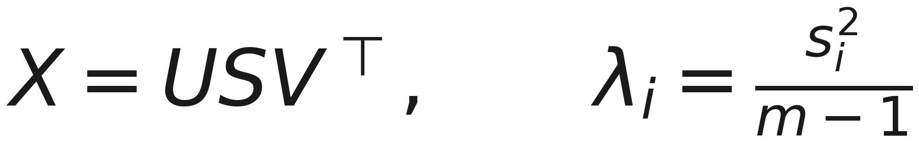
λᵢ from singular values
Notes:
Say what the equation means: U and V orthogonal, S diagonal with non-negative singular values s₁ ≥ s₂ ≥ …; the columns of V are exactly the eigenvectors of XᵀX, and λᵢ = sᵢ²/(m-1) recovers the eigenvalues without ever forming Σ.
Handout section 5.3.

Slide 57
Three routes, one answer
numpy.linalg.eigh on the covariance matrix
numpy.linalg.svd on the centred data, with λᵢ = sᵢ²/(m-1)
sklearn.decomposition.PCA
On the 8-feature account table, all three agree to within 5 × 10⁻¹⁵: floating-point rounding, and nothing more
Notes:
This is a genuine cross-check, in the same spirit as the k-means++ notebook agreeing with scikit-learn to 10⁻⁴ earlier - three independent computational routes to the same mathematical object, converging to sixteen significant figures.
Worth a sentence on why this matters pedagogically: it is one thing to prove eigendecomposition and SVD give the same eigenvalues on paper, and another to watch three separate library calls confirm it to floating-point precision on real data.
Handout section 5.3.

Slide 58
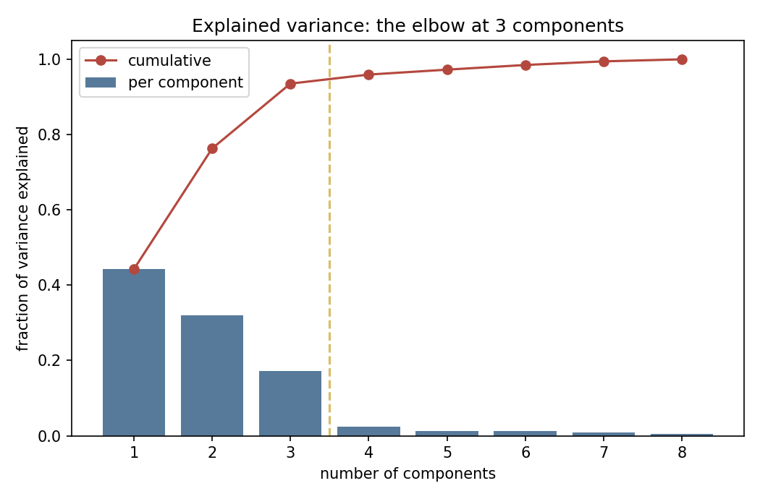
How many components: the scree plot
Notes:
Per-component and cumulative explained variance for the 8 account features. The first 3 components explain 93.5% of total variance; the 4th adds only 2.4% more - point at exactly where the sharp elbow sits.
Ask the room to predict the number before you say it - most will read the bend correctly from the shape alone, which is the whole point of a scree plot as a diagnostic.
Handout section 5.4.

Slide 59
The elbow lands on 3
Component | Eigenvalue | Variance | Cumulative
PC1 | 3.539 | 44.2% | 44.2%
PC2 | 2.568 | 32.1% | 76.3%
PC3 | 1.380 | 17.2% | 93.5%
PC4 | 0.192 | 2.4% | 96.0%
PC5–PC8 | 0.043–0.104 | 0.5–1.3% each | 100.0%
Notes:
3 is not an arbitrary read of the elbow - it is the exact number of latent factors (retail_data.py’s spending propensity, engagement, price sensitivity) that generated all 8 observed columns. The scree plot recovered, from the data alone, a number this lesson deliberately withheld from every method until now.
Say clearly that this clean an elbow will not appear on every dataset students meet later - it exists here because the generator built 8 columns as noisy linear combinations of exactly 3 signals. The next slide is what to do when it is not this clean.
Handout section 5.4.

Slide 60
What to do when the elbow is softer
This dataset’s elbow is unusually clean; most real data is not
Common alternative: keep enough components for a chosen fraction of the variance, typically 90–95%
Or treat the number of components as a hyperparameter, and let cross-validation decide
The scree plot starts the judgement; it does not automate it
Notes:
Close the PCA segment by generalising beyond this lesson’s convenient dataset - students will not always get a number this clean, and this slide is explicitly about what changes when they don’t.
Frame the cross-validation option as a callback to lesson 5: choosing the number of components is a model-selection decision like any other, and the same honest-validation discipline that lesson used for hyperparameters applies here too.
Handout section 5.4.

Slide 61
Notebook 3, live
PCA on the 8-feature account table, checked three ways, to 5×10⁻¹⁵
Reconstruction error flags disguised fraud: 37 of 40 planted anomalies caught at the 98th-percentile threshold
A 2-D PCA and t-SNE scatter of the same accounts, and why neither shows the anomalies as outliers
Notes:
Run Notebooks/03_pca_and_anomaly_detection.ipynb. Twenty minutes.
This is the lesson’s headline number and it is delivered live in the notebook rather than pre-built on a slide - reconstructing accounts from the top 3 components and watching genuine accounts snap back almost exactly, while planted anomalies do not, is more convincing run than described.
Protect the reconstruction-error histogram and the 2-D scatter comparison if time is short: the point that anomalies sit closer to the centre than genuine accounts, on average, in both the PCA and t-SNE projections, is the section’s real content, and it needs to be seen, not just quoted.
Handout sections 6.1, 6.2.

Slide 62
t-SNE: a tool built for looking, not for measuring
t-SNE (t-distributed stochastic neighbour embedding) arranges points so those close together stay close
Distances between points that started far apart are not preserved
Excellent at making separate clusters visually obvious, more so than PCA’s first two components
Distances between clusters mean nothing
Notes:
Position t-SNE precisely: a visualisation tool, not a measurement tool, and the two limitations on this slide are the reason. Two clusters drawn far apart in a t-SNE plot are not necessarily more different than two drawn close together - resist any temptation to read distance off the picture the way a PCA plot’s axes can be read.
Tie back directly to notebook 03: t-SNE inherited the exact same blind spot PCA’s 2-D projection had for the fraud anomalies - good for looking, not a substitute for reconstruction error. The full KL-divergence derivation is deliberately out of scope; point to the further reading.
Handout section 7.

Slide 63
What to take away
k-means converges only to a local minimum: 30 starts ranged WCSS 374.1 to 1,390.4
A core inside a ring defeats k-means and Ward; DBSCAN scored 0.941
Internal metrics measure self-consistency, external (ARI) a truth real problems rarely have
37 of 40 disguised accounts caught by reconstruction error, invisible to a 2-D scatter
Notes:
This is the number to carry out of the room: 37 of 40, using nothing but the relationship between eight individually ordinary-looking columns, on a detection problem neither of the standard 2-D visualisation tools could solve.
Ask them to write it down - the fourth lesson this course has produced one of these carry-home numbers: 77% accuracy on coin-flip labels, 94 of 128 imputed rows that borrowed from the test set, a coefficient of 365 where an unpenalised fit wanted billions, and now this.
If one habit should survive from today: before trusting an unlabelled result, ask what the metric or the picture in front of you is actually capable of seeing - a silhouette score cannot see a wrong shape assumption, and a 2-D scatter cannot see what the discarded dimensions would have shown.
Handout summary and notation table.

Slide 64
Homework
Exercise 8, discussed at the start of Friday 27 November
Exercises/08_unsupervised_learning.md
Notes:
Set it explicitly and say out loud when it comes back: the first ten minutes of lesson 9, Friday 27 November.
Remind them of the standing rule from lesson 5, still in force with no labels at all: every reported number needs a check against what the method could and could not see - an ARI needs a ground truth to be meaningful, a silhouette score needs to be read as roundness rather than correctness, and a reconstruction-error threshold needs its false-positive rate reported alongside its catch rate, not instead of it.
Next lesson moves to a different question this course has not yet asked. Close the loop on today: four lessons in a row have each produced one number worth remembering - encourage them to notice that pattern themselves before it is pointed out again.

