Slide 1
LNSM project 2019/2020
Prof. Nicoli Monica
Carminati Fabio, ###
Gallone Emanuele, 10549382
Notes:
Hello, we’re here today to show you our work regarding train cloud-edge performance analysis........

Slide 2

Task1a
By inverting this system we can find the locations of the APs

Slide 3
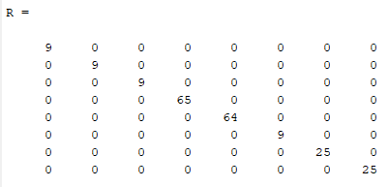
Task1b
Avendo 5000 TOA measurements, ed avendo h(u) per ogni measure possiamo trovare n e crearci una popolazione di n abbastanza grande da poter calcolare la varianza e capire quale sia l’accuracy di quel particular AP

Slide 4
Task2
By calculating the Mean and Variance of wx we found out that the best model to use is the Model 3: Random force model

Slide 5
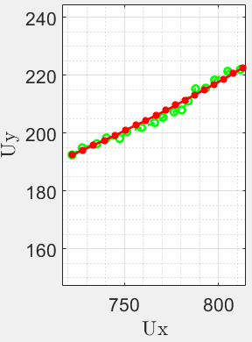
Task3

Slide 6
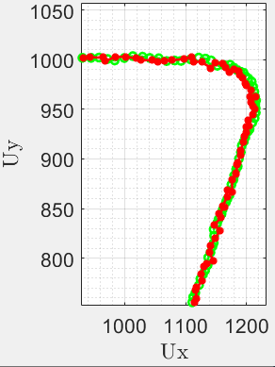
Task4
Ricorda di specificare che about the legend ‘Real Ue location’ is instead the one calculated using the NLS algorithm
Zoom sulla curva (forse inutile)

Slide 7
Task5
Ricorda di specificare che about the legend ‘Real Ue location’ is instead the one calculated using the NLS algorithm

Slide 8
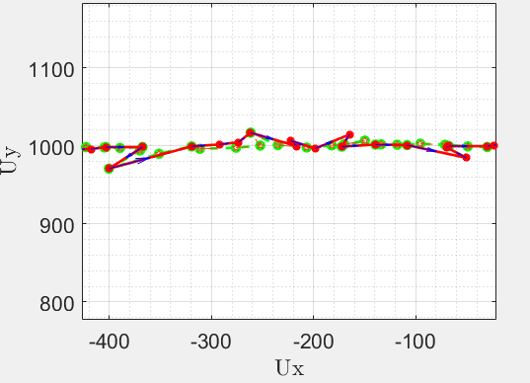
Task6
Ricorda di specificare che about the legend ‘Real Ue location’ is instead the one calculated using the NLS algorithm and feeded to the kalman

