Slide 1
MO850 – Tópicos Avançados em Ciência da Computação I
Dr. Fabio Carrella

Slide 2
What is this course about?
Natural language processing...with a twist.
Computer Science
Linguistics
Psychology
We are here
CSS
NLP
PL

Slide 3
Why this course matter?
According to the latest report by the World Economic Forum, misinformation stands out as the most significant short-term global risk, capable of disrupting elections and exacerbating societal polarization.
Computer Science
Linguistics
Psychology
We are here
CSS
NLP
PL

Slide 4
Course structure
Part 1: Foundations & Data
Data collection (problems) and exploration
Part 2: Representation Meaning
Lexicon- and vector-based approaches
Part 3: Applied Statistics for Text-Derived Measures
Wrangling text-derived measures
Part 4: Case Study – Synthetic Realities
LLMs, persuasion, social agents

Slide 5
Course structure
Assessment
Readings
Materials & Softwares

Slide 6
What is misinformation?
Misinformation = false,” “inaccurate,” or “incorrect”information
Misinformation = disinformation?
Disinformation = false information that is described as being intentionally shared
Disinformation = malinformation?
Malinformation = Information shared for malicious ends
Fake news = similar to disinformation, news that is intentional and verifiably false

Slide 7
What is misinformation?
High veracity
Misinformation
Disinformation
Fake News
Rumors
Conspiracies
News Parody
Low veracity
News Satire
Malicious Intent
Good Intent

Slide 8
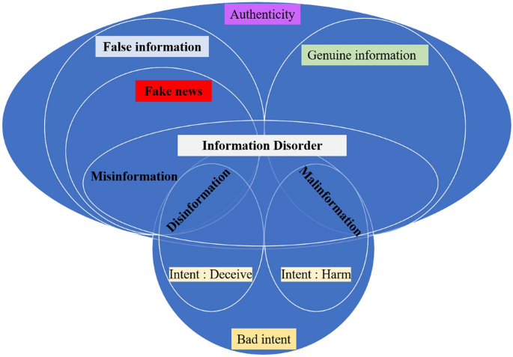
What is misinformation?
Aïmeur, E., Amri, S., & Brassard, G. (2023). Fake news, disinformation and misinformation in social media: a review. Social Network Analysis and Mining, 13(1), 30.

Slide 9
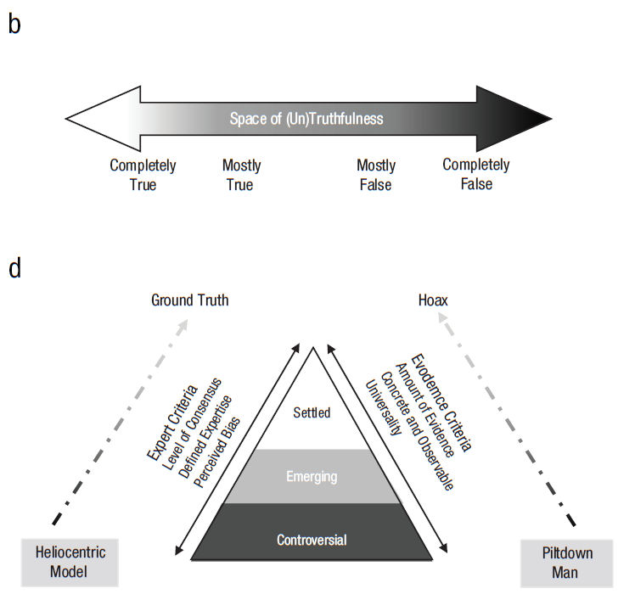
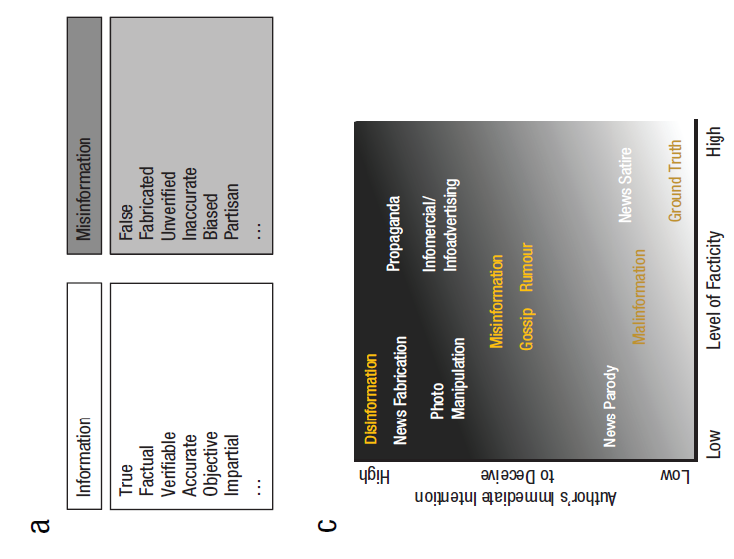
What is misinformation?
Adams, Z., Osman, M., Bechlivanidis, C., & Meder, B. (2023). (Why) is misinformation a problem?. Perspectives on Psychological Science, 18(6), 1436-1463.

Slide 10
Why do we fall for misinformation?
Cognitive miserliness^{[1]} / Dual process theory^{[2,3]}
Heuristics^{[4]}
Confirmation bias^{[5]} / Selective exposure ^{[6]}
Identity-Protective Cognition^{[7]}
Naive Realism^{[8] /} Pluralistic ignorance ^{[9]}
Illusory Truth Effect ^{[10]} / Bandwagon effect ^{[11]}
Algorithmic Amplification / Homophily ^{[12]}

Slide 11
From cognitive biases to linguistic signals
Exploiting Cognitive Miserliness
Linguistic cues:
Repetition
Simple syntax / short words
Urgency cues (“Act now”)
Emotional intensifiers (“Catastrophic”, “Unprecedented”)
Easy-to-process content feels true and shareable

Slide 12
From cognitive biases to linguistic signals
Exploiting Motivated Reasoning
Linguistic cues:
Moral language (“Corrupt”, “Betrayal”)
Us vs. Them pronouns
Dehumanization (“Illegal aliens”)
Absolutist terms (“Always”, “Never”)
Victimhood framing
Triggers identity-protective cognition

Slide 13
From cognitive biases to linguistic signals
Exploiting Social Heuristics
Linguistic cues:
Anecdotal reporting (“We saw firsthand…”)
Authority appeals (“Scientists confirm…”)
Consensus claims (“Everyone knows…”)
Pseudo-scientific tone
Reduces epistemic effort, reliying on others as cues

Slide 14
From cognitive biases to linguistic signals
Exploiting Uncertainty
Linguistic cues:
Vagueness (“Reports say…”)
Epistemic hedging
Rhetorical questions
Suspicion framing (“Why are they hiding this?”)
Encourages inference without verification

Slide 15
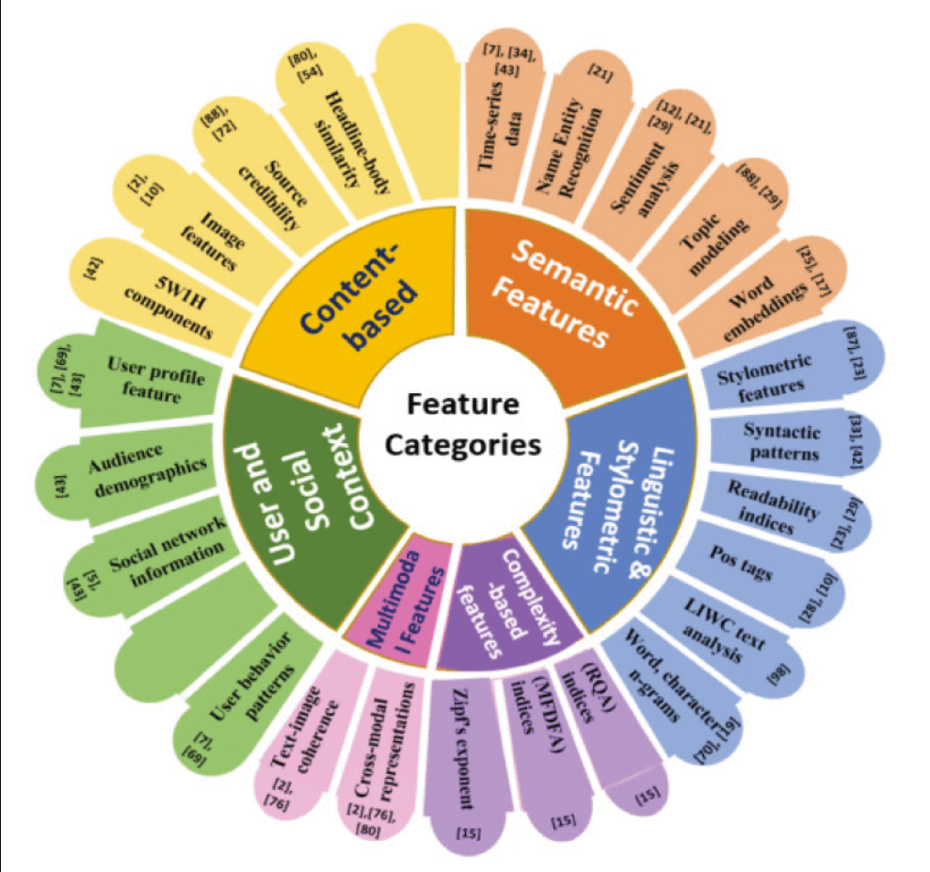
From bias to classifiers
If bias has linguistic signals, can we detect them?
Many classifiers use rhetorical & stylistic features
Deep learning models (e.g., XLNet, BERT) accuracy > 95% ^{[13,14]}

Slide 16
The limits of detection
Data-Related Challenges
Quality vs quantity
Balance issue
Computational and Architectural Challenges
Real-time applications
Interpretability and Explainability Challenges
Lack of transparency
Ethical Challenges
User data in training phase
Generalizability and Adaptability Challenges
Cross-language and domain adaptation
LLMs

Slide 17
Static vs. adaptive manipulation
Static manipulation
Cognitive biases exist
Certain linguistic framings exploit them
We try to detect or debunk those patterns
What if the message changes depending on the audience?
(LLM-based) Microtargeting ^{[16]}
Interventions can also be personalized ^{[17]}

Slide 18
The limits of debunking
Prebunking vs debunking ^{[15]}
Examples:
Inoculation, accuracy nudges, media literacy
Fact-checking corrections, platform labels
Classifiers are closer to debunking than prebunking
Debunking works too but:
Causal alternative > retraction
Correction from high-credibility sources
Language is important
Effects do not last/generalize to group-level

Slide 19
What is this course about?
Natural language processing...with a twist.
Why it matters?
We use NLP to measure “minds” through language
Computation
Linguistics
Psychology
We are here
CSS
NLP
PL

Slide 20
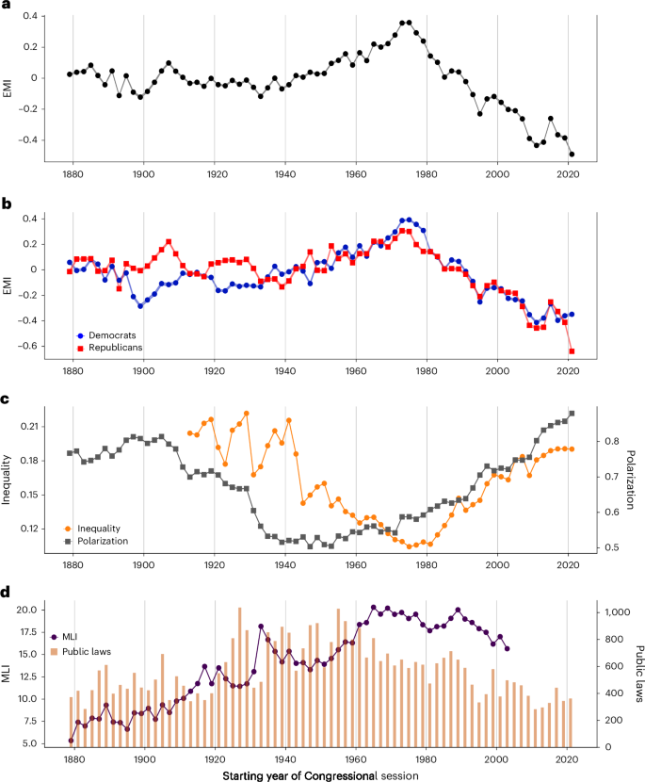
Why it matters?
Aroyehun, S.T., Simchon, A., Carrella, F. et al. Computational analysis of US congressional speeches reveals a shift from evidence to intuition. Nat Hum Behav 9, 1122–1133 (2025). https://doi.org/10.1038/s41562-025-02136-2

Slide 21
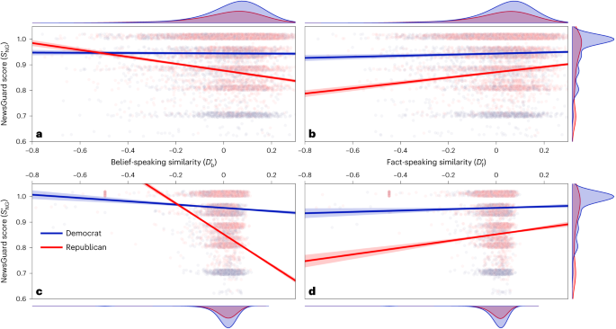
Why it matters?
Lasser, J., Aroyehun, S.T., Carrella, F. et al. From alternative conceptions of honesty to alternative facts in communications by US politicians. Nat Hum Behav 7, 2140–2151 (2023). https://doi.org/10.1038/s41562-023-01691-w

Slide 22
Toplak, M.E., West, R.F., & Stanovich, K.E. (2011). The Cognitive Reflection Test as a predictor of performance on heuristics-and-biases tasks. Memory & Cognition, 39, 1275-1289.
Evans, J. (2008). Dual-processing accounts of reasoning, judgment, and social cognition. Annual review of psychology, 59, 255-78 .
Pennycook, G. (2017). A perspective on the theoretical foundation of dual process models. In Dual process theory 2.0 (pp. 5-27). Routledge.
Metzger, M. J., & Flanagin, A. J. (2013). Credibility and trust of information in online environments: The use of cognitive heuristics. Journal of pragmatics, 59, 210-220.
Klayman, J. (1995). Varieties of confirmation bias. Psychology of learning and motivation, 32, 385-418.
Freedman, J. L., & Sears, D. O. (1965). Selective exposure. In Advances in experimental social psychology (Vol. 2, pp. 57-97). Academic Press.
Ross, L., & Ward, A. (2013). Naive realism in everyday life: Implications for social conflict and misunderstanding. In Values and knowledge (pp. 103-135). Psychology Press.
Prentice, D. A., & Miller, D. T. (1996). Pluralistic ignorance and the perpetuation of social norms by unwitting actors. In Advances in experimental social psychology (Vol. 28, pp. 161-209). Academic Press.
Kahan, D. M. (2017). Misconceptions, misinformation, and the logic of identity-protective cognition.
Fazio, L. K., Brashier, N. M., Payne, B. K., & Marsh, E. J. (2015). Knowledge does not protect against illusory truth. Journal of experimental psychology: general, 144(5), 993.
Schmitt‐Beck, R. (2015). Bandwagon effect. The international encyclopedia of political communication, 1-5.
McPherson, M., Smith-Lovin, L., & Cook, J. M. (2001). Birds of a feather: Homophily in social networks. Annual review of sociology, 27(1), 415-444.
Capuano, N., Fenza, G., Loia, V., & Nota, F. D. (2023). Content-based fake news detection with machine and deep learning: a systematic review. Neurocomputing, 530, 91-103.
Bashaddadh, O., Omar, N., Mohd, M., & Khalid, M. N. A. (2025). Machine learning and deep learning approaches for fake news detection: A systematic review of techniques, challenges, and advancements. IEEE Access.
Ecker, U.K., Lewandowsky, S., Cook, J., Schmid, P., Fazio, L.K., Brashier, N.M., Kendeou, P., Vraga, E.K., & Amazeen, M.A. (2022). The psychological drivers of misinformation belief and its resistance to correction. Nature Reviews Psychology, 1, 13 - 29.
Simchon, A., Edwards, M., & Lewandowsky, S. (2024). The persuasive effects of political microtargeting in the age of generative artificial intelligence. PNAS nexus, 3(2), pgae035.
Costello, T. H., Pennycook, G., & Rand, D. G. (2024). Durably reducing conspiracy beliefs through dialogues with AI. Science, 385(6714), eadq1814.
Notes:
https://yourmist.streamlit.app/

