Slide 1

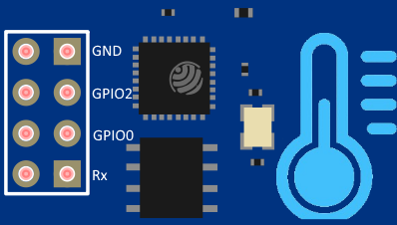

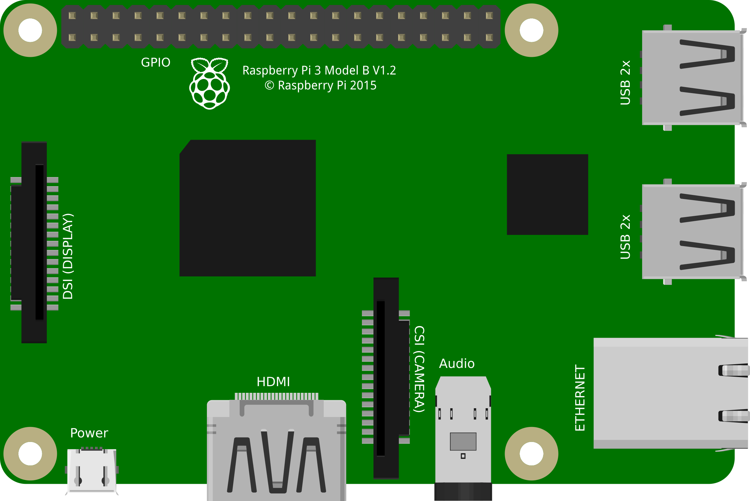
1
Remote Temperature Sensor
Powered by ESP8266
Netatmo cloud
TemperatureHub
2
Powered by ESP8266
Powered by Raspberry pi 3
Powered by ESP8266

