Slide 1
Riverside Office refurbishment
Project kickoff
Alder Row Facilities Ltd | October 2026

Slide 2
Scope
Level 2 open offices and two meeting rooms
  New LED lighting with presence detection
  Replacement of the ceiling cassettes
Kitchen refit and accessible WC
Works out of hours, office stays open
Budget approved: 186,000

Slide 3
Milestones
Milestone | Owner | Due
Design sign-off | R. Okafor | 14 Nov
Contractor appointed | D. Whitfield | 28 Nov
Phase 1: open office A | Site team | 16 Jan
Phase 2: meeting rooms | Site team | 13 Feb
Handover | D. Whitfield | 6 Mar

Slide 4
Planned spend per phase

Slide 5
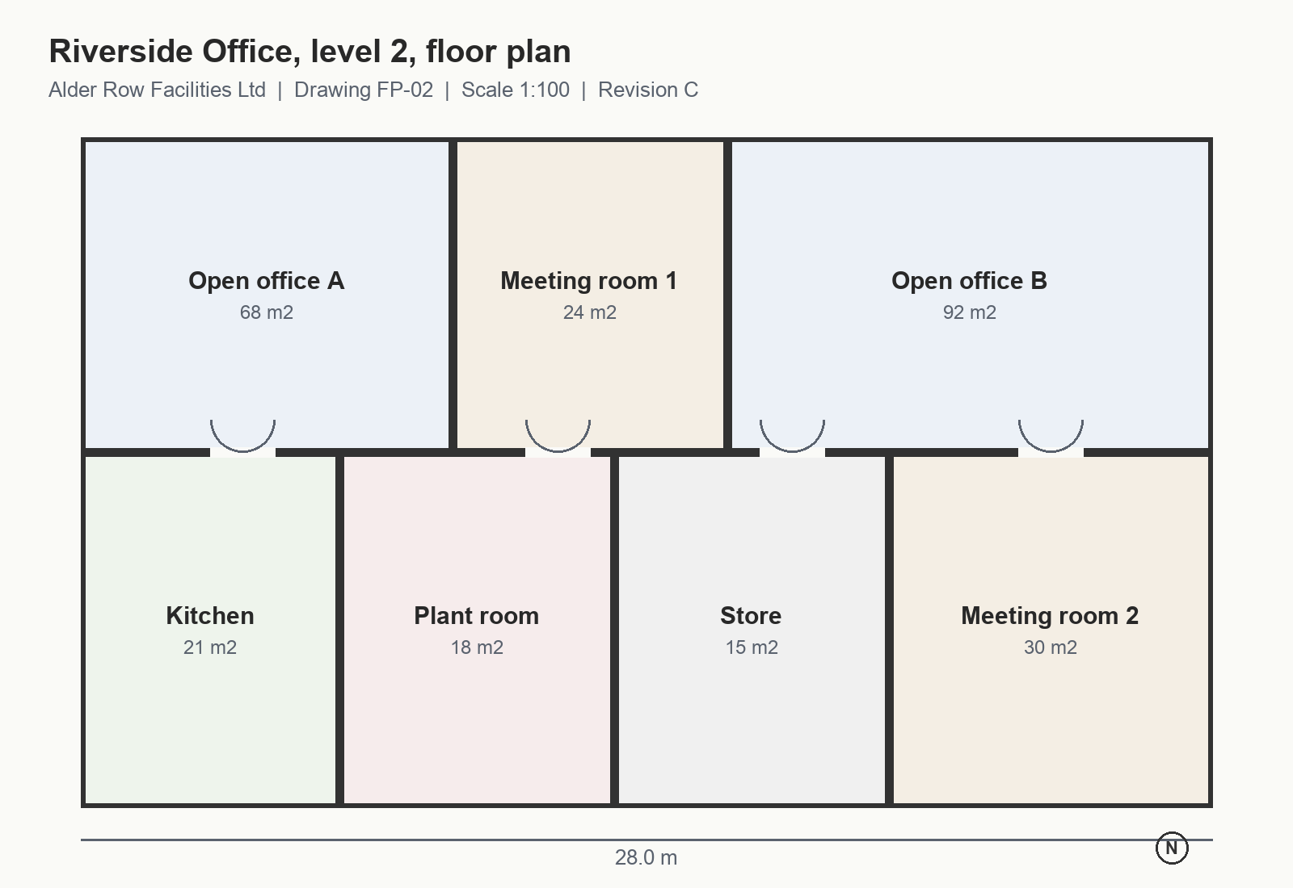
Level 2 layout

