Slide 1
Newspaper App https://ffs-newspaper.herokuapp.com/ https://github.com/fabiofilz/newspaper_app
A Newspaper website built with Django
Fabio de Simoni
14/12/2018

Slide 2
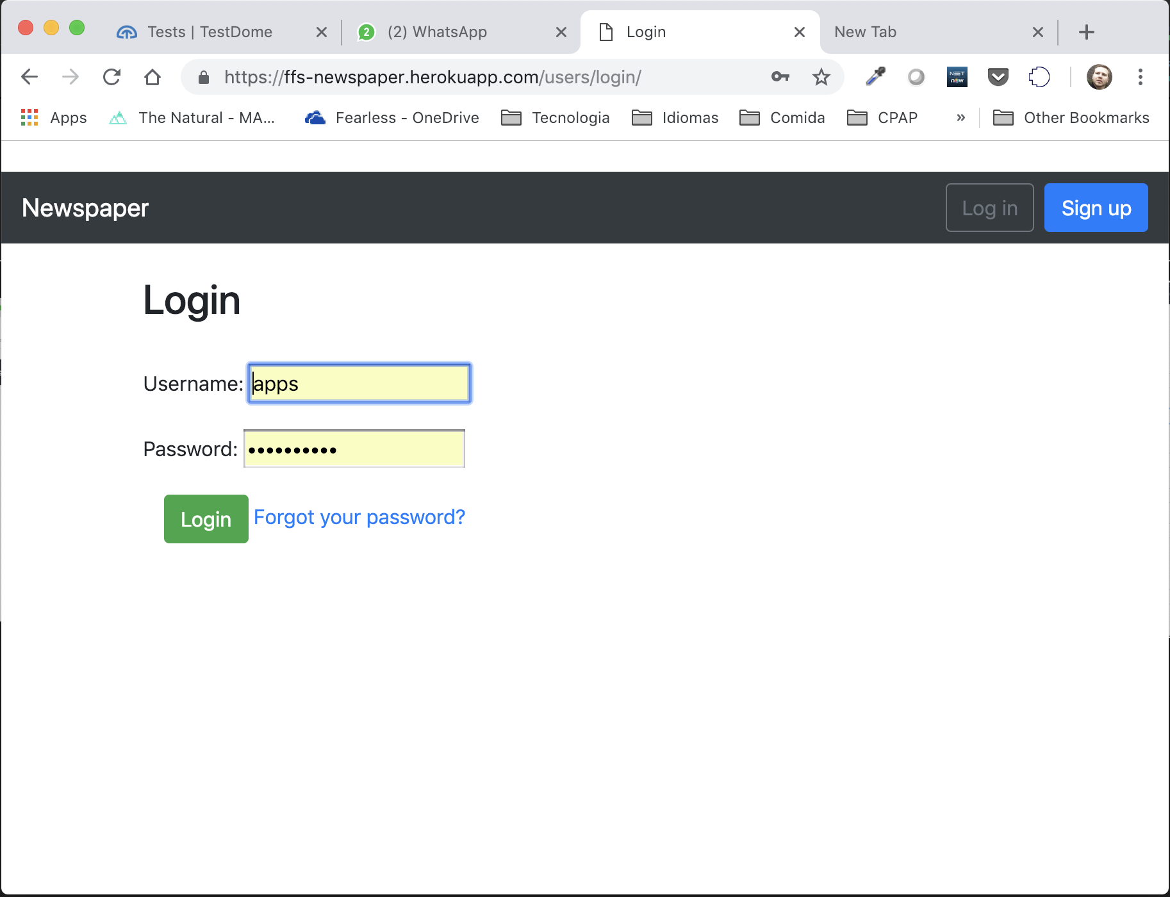
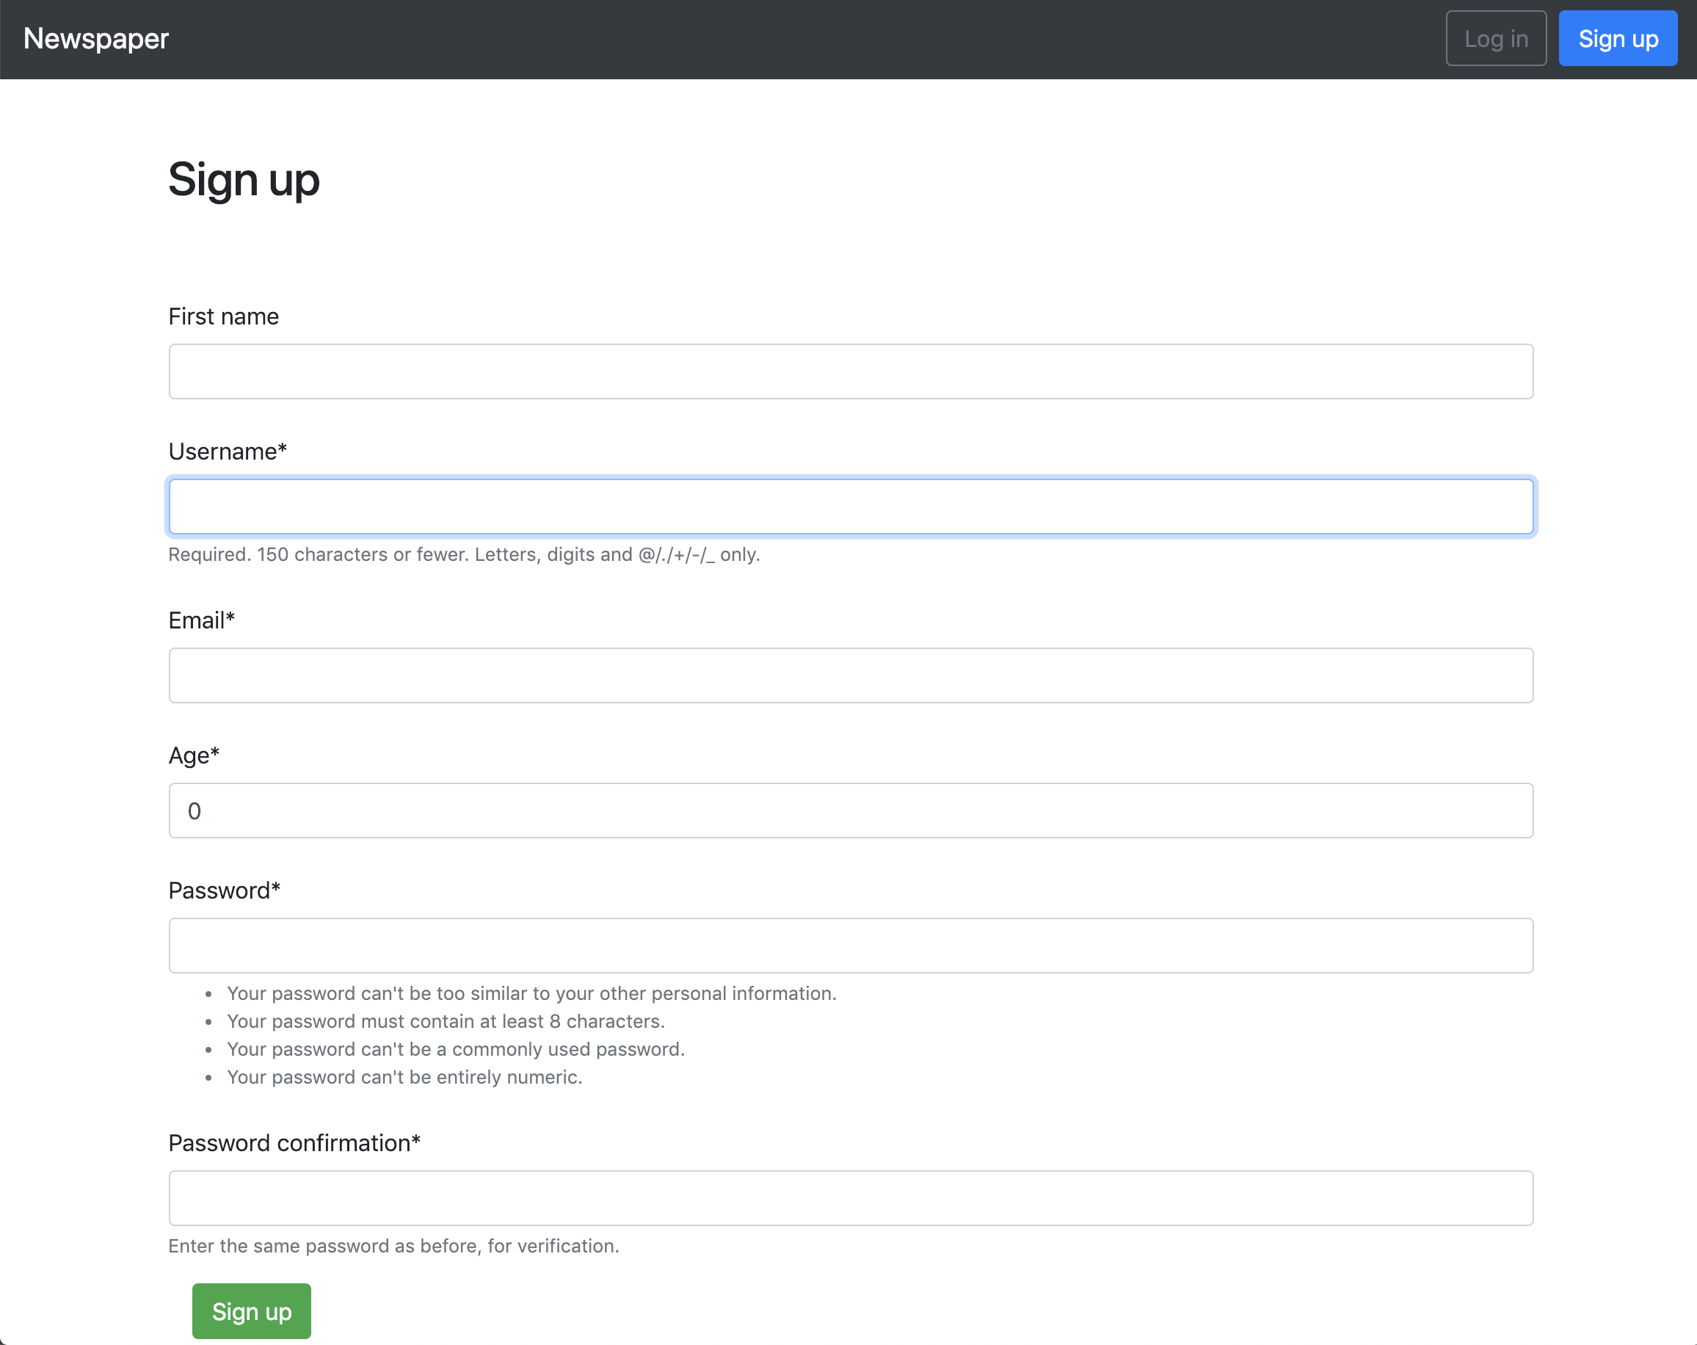
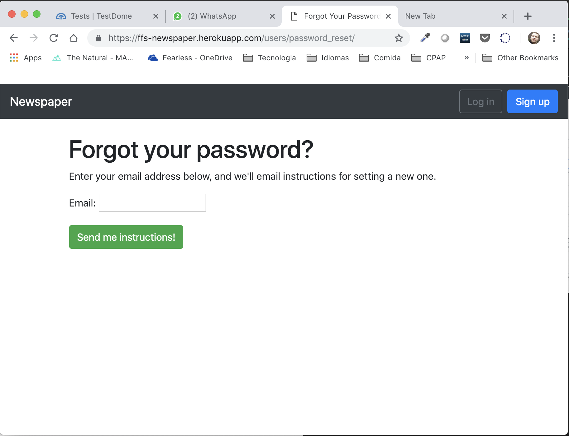
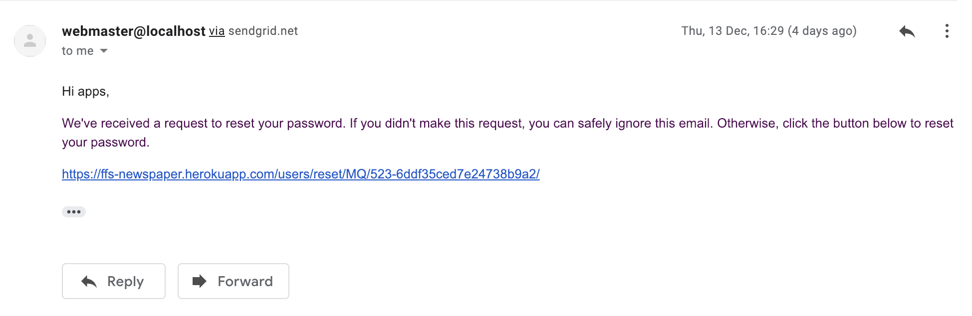

Slide 3
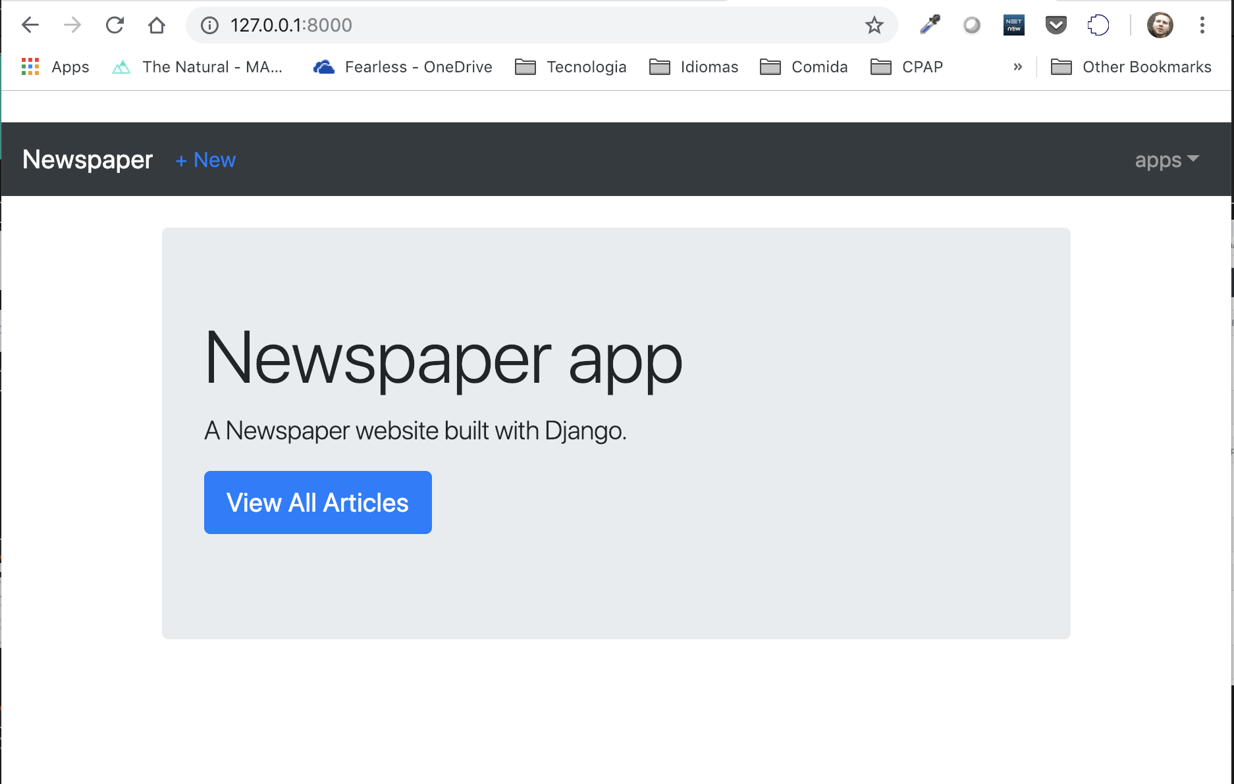
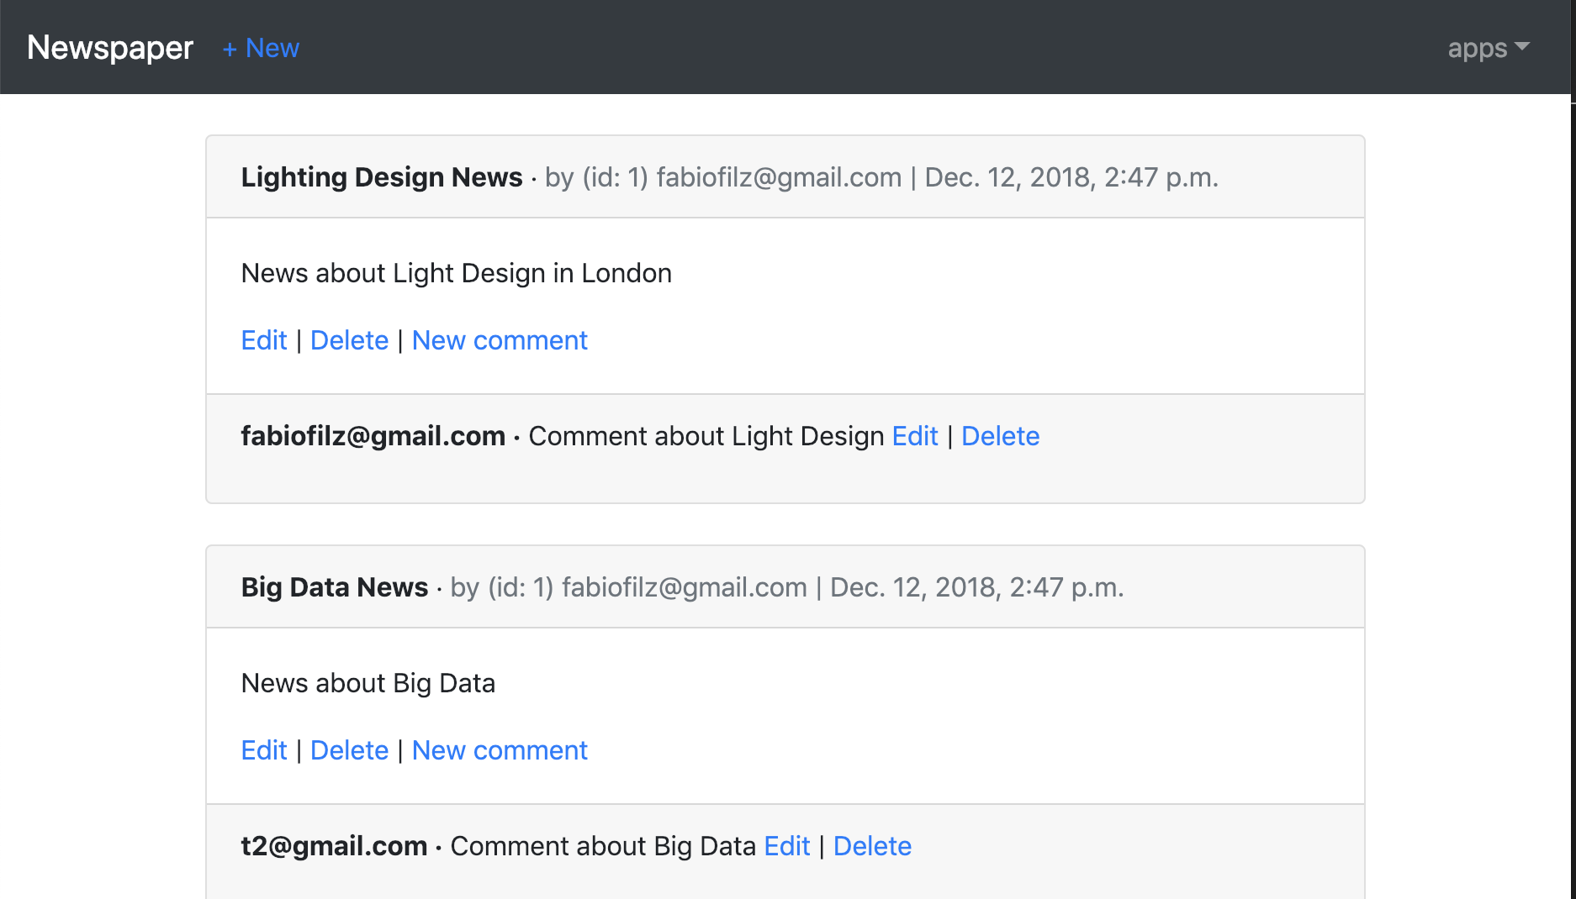
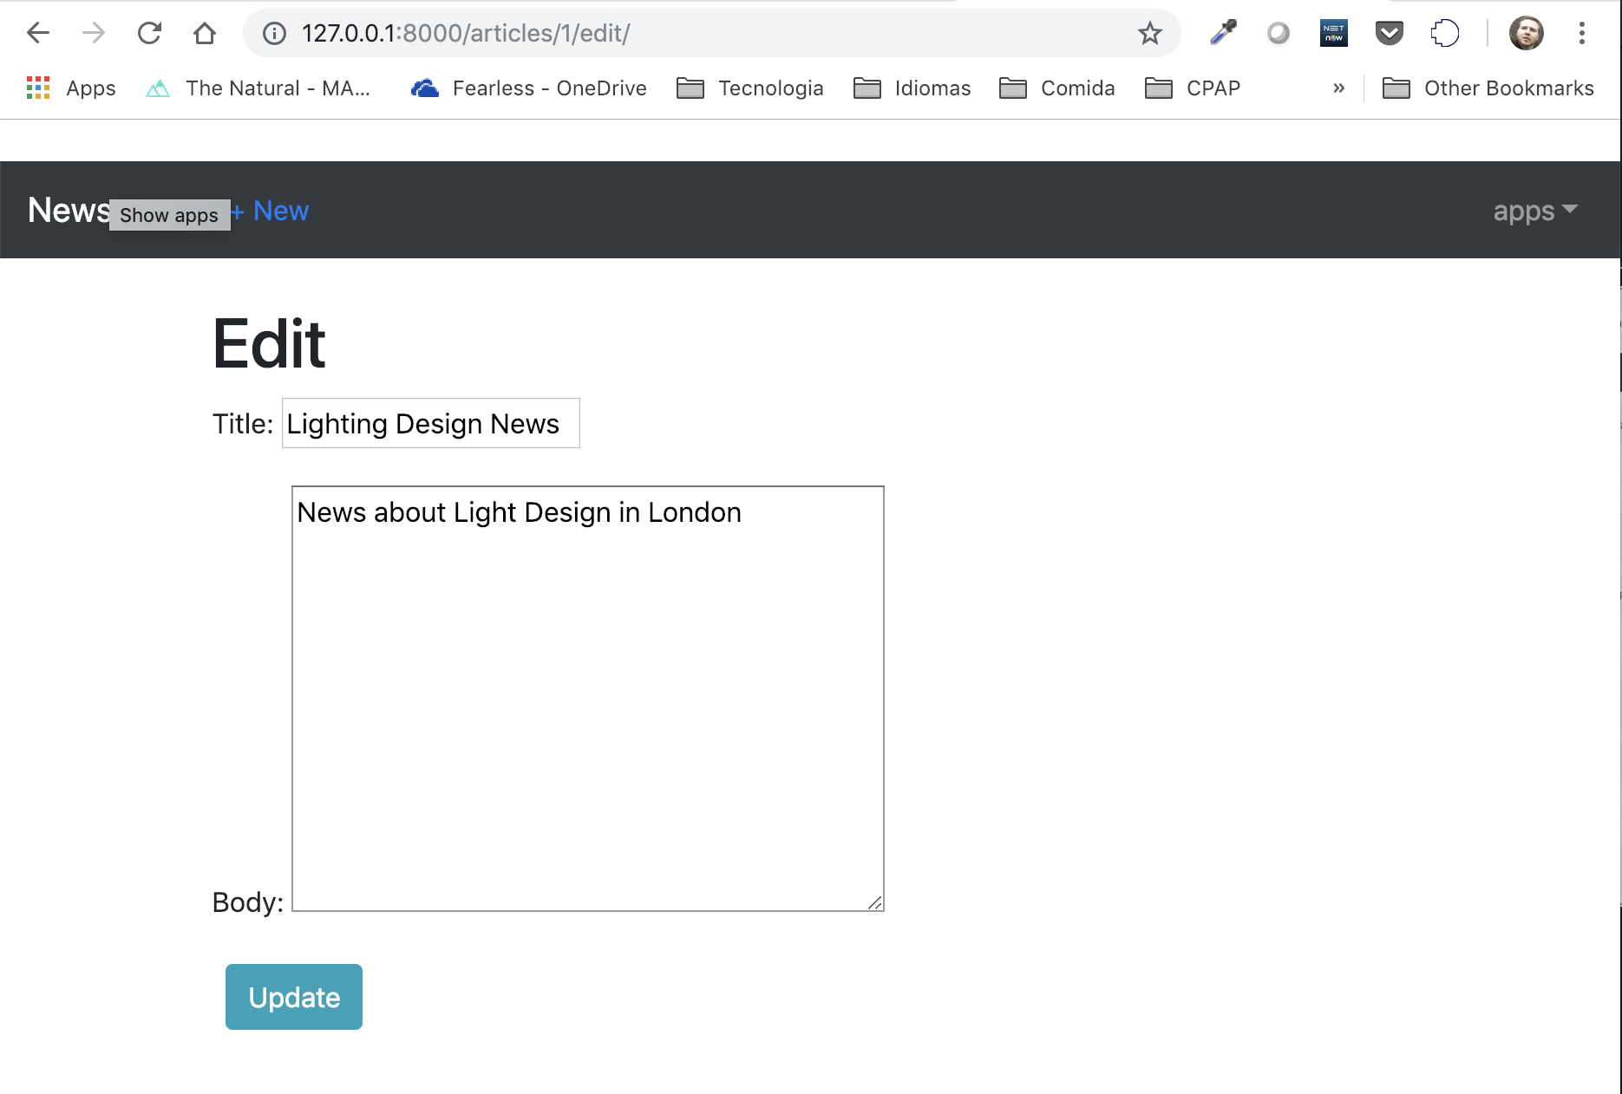
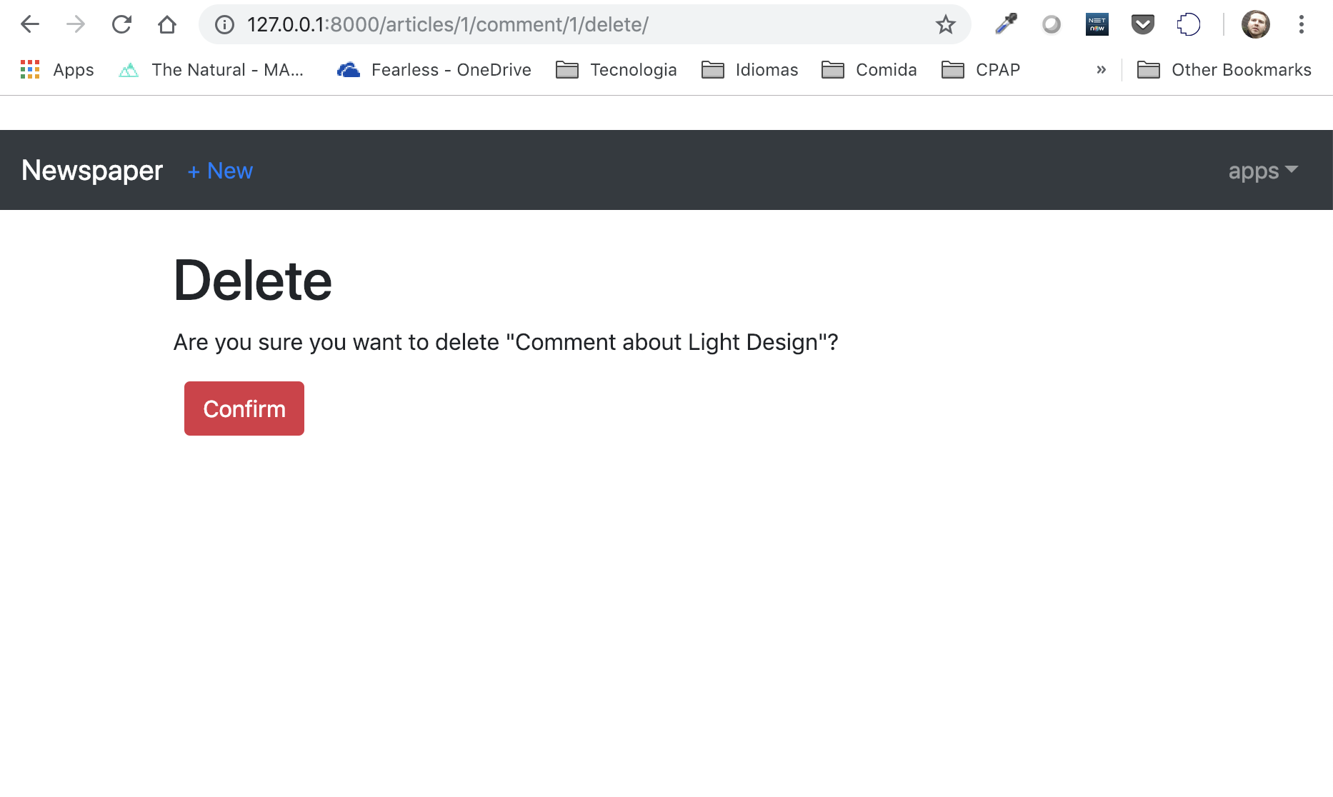

Slide 4
Technical details:
It is a web application built with the Django 2.1 and Python 3.7 and deployed into Heroku.
It is using the most modern user access control built-in with Django framework
It is responsive website powered by Bootstrap 4.0 allowing the user to access the application from mobile, compute and tables
It uses sendgrid service to send e-mail with smtp protocol
It uses SQLite database
It uses Django generic views to reduce the amount of code
The code is stored in bitbucket repository
Business details of the release 1.0:
Administrative control that allows the webmaster to see and edit any information
The newspaper app allows the user to sign in, log in, log out, change the password and recover the password by e-mail
It requires the user to be logged in order to read or edit any Article or comment
it allows the user to add new Articles, edit or delete
It allows the user to add, edit and delete comments about a specific article
Future features:
Allowing the user to edit/delete only articles and comments that he is the owner
Allow the user to update the user details
Associating automatically the Article when adding a new comment
Improvement of access control by rule (admin / reporters / customer)
Allow only reports and Admin to add new articles
Age classification per article allowing control if the user has the minimal age to read the article/comments

