Slide 1


Monitoring a hive

Slide 2
Content list
People involved
The project
Benefits
Equipment used
possibilities
Utilization of Lora WAN and MQTT
Use MQTT
Local solution
Graphics (Prototype)
Forward-Looking Statements

Slide 3




People involved
Professor Project Advisor
-Desenvolvedor student Software / Hardware
Student - Designer Advertising / Marketing
Software developer, Data base, Web-Page.

Slide 4
The project
Monitoring of the following variables
Temperature
Humidity
Weight
(Sound)
(Location)
(Theft)
Data collection
Date
Processing
view
data

Slide 5
Benefits
More efficiency in honey production
Cost savings associated with travel.
time spent in reducing constant checking hive
Analyze constant and "Real time" Beehive
Weight
Temperature
Humidity
Sound*
Count bees *
Scheduling tasks to perform in the hive *
maintenances
face check Beehive State
Exchange of queen bees e.g.
Know and / or predict the time more accurate the collection of raw materials *

Slide 6
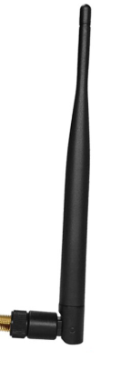
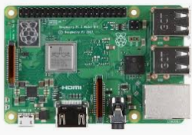
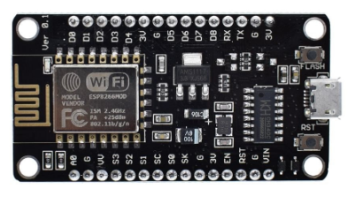
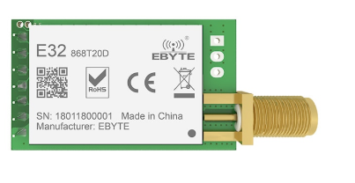
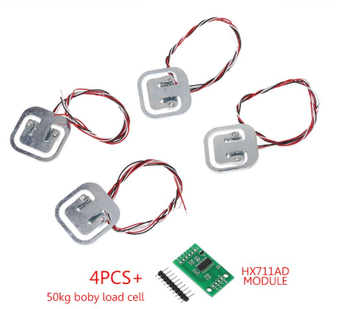
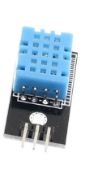
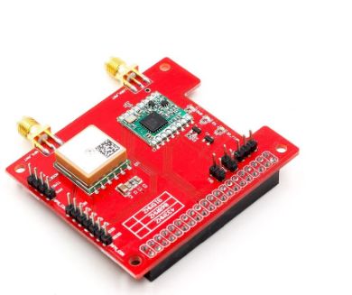
Equipment used
end Device
Lora SX1276
Node-mcu Board
ESP8266
raspberry
Temperature sensor
Relative humidity
DHT11
Shield Lora to
raspberry
Sensors weight
ADC converter

Slide 7
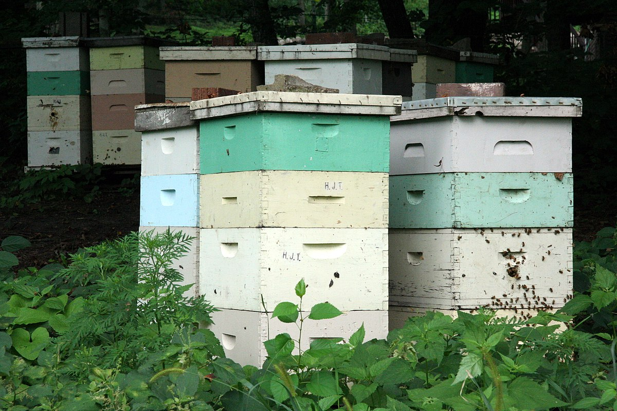


Operation - Possibility 1st
Interface Lora/
raspberry
hive 1
Lora 868MHz
MQTT Interface /
Lora
~ 2Kms
MQTT
Beehive 2
MQTT
Master
Internet
Ethernet Router
The image this Photography Author Unknown is licensed under CC BY-SA
The image this Photography Author Unknown is licensed under CC BY-SA

Slide 8
Operation - 2nd Chance
hive 1
3G / 4G Router
MQTT
MQTT
Wired
Connection
Beehive 2
MQTT
Master
The image this Photography Author Unknown is licensed under CC BY-SA
The image this Photography Author Unknown is licensed under CC BY-SA

Slide 9
Running - 3rd Place Possibility (No Internet connection)
hive 1
MQTT
MQTT
MQTT
Beehive 2
MQTT
Master
The image this Photography Author Unknown is licensed under CC BY-SA

Slide 10
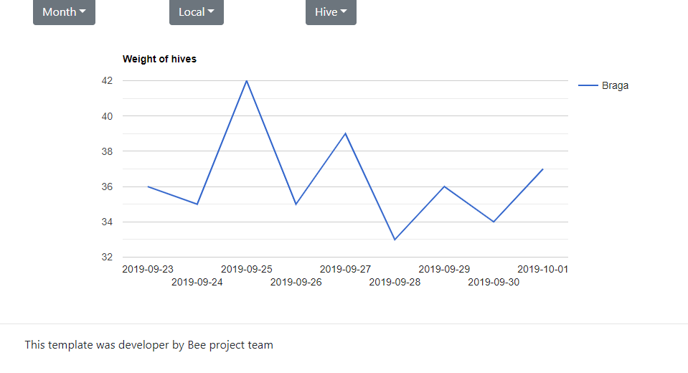
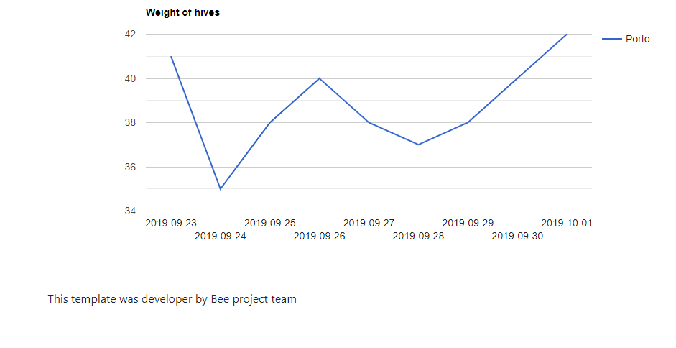
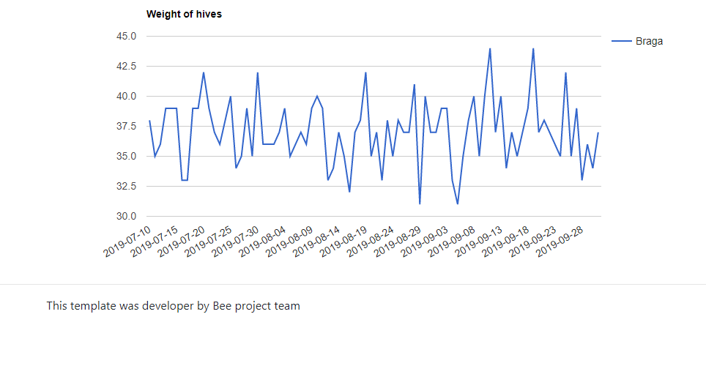
Graphics (Prototype)

Slide 11
Future forecasts
Development of a platform Multi-device
Android
Web page
IOS
Artificial Intelligence for analysis and data processing for suggestions and presentation of data to the beekeeper.
Forecasts of short-term beehive state.
Forecast attacks and / or invasions of other insects in the hive.
Development of other solutions cheaper and more energy efficient.
Presence in marketing and advertising activities for product dissemination and partnerships.

Slide 12

End

