Slide 1
Building Reactive Applications with Akka.io
Fabio Fumarola

Slide 2
Large-Scale Data-Intensive Application
High-Perfomance Computing Cluster and Grid Computing (Terracotta, Oracle Coherence, GigaSpace, GridChain)
MapReduce

Slide 3
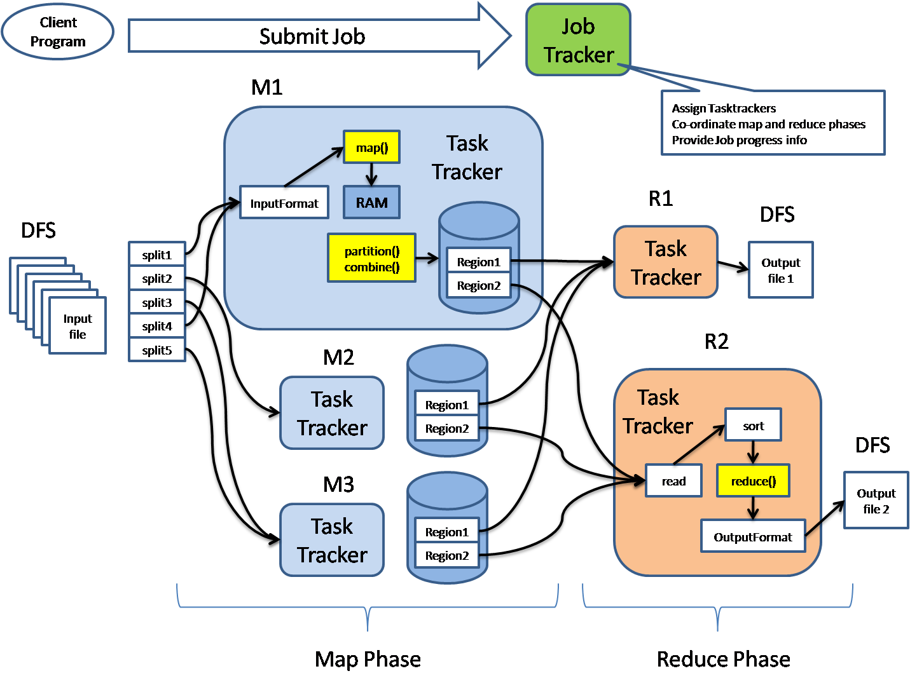
MapReduce

Slide 4
MapReduce & Spark
Successfully applied in implementing large-scale data intensive applications
Well suited for Batch Processing
Not for interactive analytics
Apache Spark
Run from 10x to 100x faster that MapReduce
Workflows are formalized through DAG

Slide 5
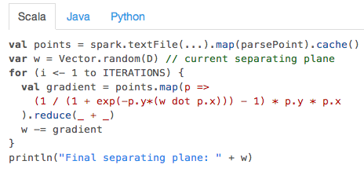
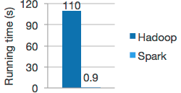
Apache Spark Logistic Regression
Running time per iteration of Spark w.r.t MapReduce implementation on 100GB of data on a 100-node cluster.

Slide 6
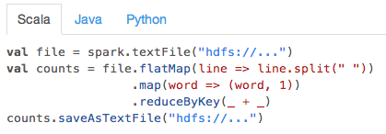
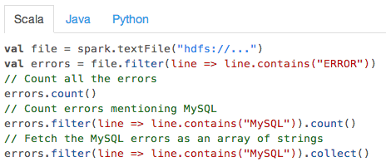
Apache Spark

Slide 7
Why Spark?
It is build using:
Scala
Akka
Sbt
Powered by Spark: Adatao Inc, Alibaba, Amazon, Baidu, DataBricks, Groupon, IBM, Knoldus, Nokia, Ooyala, Shopify, Techbase, TrendMicro, Twitter, AirBnb,…

Slide 8
Why Actors?
CPUs are not getting faster anymore
They are getting wider (multi-core)
We need:
Multi-tasking
Multi-Threading
without using lock, mutex, semaphore and synchronized blocks (Ebean)
Notes:
Ebean

Slide 9
Example Bank Account
class BankAccount {
private var balance = 0
def deposit(amount: Int): Unit = synchronized {
if (amount > 0) balance += amount
}
def withdraw(amount: Int): Unit = synchronized {
if (amount > 0 && balance > amount) {
balance -= amount
balance
} else throw new Error("insufficient funds")
}
}

Slide 10
Composition of Synchronized Objects
def transfer(from: BankAccount, to: BankAccount, amount: Int): Unit = {
from.synchronized {
to.synchronized {
from.withdraw(amount)
to.deposit(amount)
}
}
}
Introduces Dead-Lock
transfer(a,b,amount) in one thread
transfer(b,a,amount) in another thread
One lock taken by each, nobody can progress

Slide 11
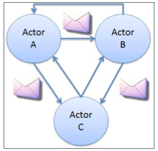
What is an Actor?
The Actor Model:
All the computational units are modeled as independent Actors
An Actor Is an object with
State
Behavior
Interacts only by message passing

Slide 12
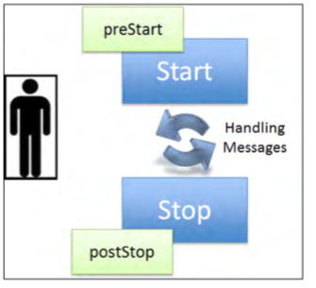
Actor’s Lifecycle
It is initialized and started
It receives and process messages
It stops itself when it receives a termination message

Slide 13
The Actor Trait
type Receive = PartialFunction[Any, Unit]
Trait Actor {
implicit val context: ActorContext
final def sender: ActorRef = context.sender
def receive: Receive
}

Slide 14
Partial Functions
trait PartialFunction[-A, +R] extends Function1[-A,+R] {
def apply(x: A): R
def isDefinedAt(x: A): Boolean
}

Slide 15
A Simple Actor
class Counter extends Actor {
var count = 0
def receive = {
case "incr" => count += 1
case "get" => sender.!(count)(self)
}
}

Slide 16
How messages are Sent
trait Actor {
implicit val self: ActorRef
def sender: ActorRef
...
}
abstract class ActorRef {
def !(msg: Any)(implicit sender: ActorRef = Actor.noSender): Unit
def tell(msg: Any, sender: ActorRef) = this.!(msg)(sender)
...
}

Slide 17
The Actor’s Context
trait ActorContext {
def become(behavior: Receive, discardOld: Boolean = true): Unit
def unbecome(): Unit
...
}
trait Actor {
implicit val context: ActorContext
...
}

Slide 18
A Simple Actor
class Counter extends Actor {
def counter(n: Int): Receive = {
case "incr" => context.become(counter(n+1))
case "get" => sender ! n
}
def receive = counter(0)
}

Slide 19
Creating and Stopping Actors
trait ActorContext {
def actorOf(p: Props, name: String ): ActorRef
def stop(a: ActorRef): Unit
...
}
Actors are created by Actors.
“stop” is often applied to “self”

Slide 20
An Actor Application
class Main extends Actor{
val counter = context.actorOf(Props[CounterWC], "counter”
counter ! "incr"
counter ! "incr”
counter ! "get"
def receive = {
case count: Int =>
println(s"count was $count")
context.stop(self)
}}

Slide 21
Actor Encapsulation
Creating an actor returns an address
Messages can only be sent to known addresses (ActorRef)
Actors are completely independent agent of computation
Messages are processed sequentially and atomically
Behavior changes before processing the next message

Slide 22
The Bank Account (revisited)
class BankAccount extends Actor {
import BankAccount._
var balance = BigInt(0)
def receive = LoggingReceive {
case Deposit(amount) =>
balance += amount
sender ! Done
case Withdraw(amount) if amount <= balance =>
balance -= amount
sender ! Done
case _ => sender ! Failed
}}
Eclipse example

Slide 23
Reliable Messaging
All messages can be persisted
Can include unique correlation IDs
Delivery can be retries until successful
Applied to Bank Transfer
Log WireTranfer to persistent storage
Add a unique id to each transfer
Add ID to Withdraw and Deposit
Store IDs of completed actions

Slide 24
Message Ordering
If an actor sends multiple messages to the same destination, they will not arrive out of order (this is Akka-specific)

Slide 25
Designing Actor Systems

Slide 26
Designing Actor Systems
visualize a room full of people (i.e. the Actors)
consider the goal to achieve
split the goal into subtasks that can be assigned to the various actors
who needs to talk to whom?
remember that you can easily create new Actors, even short-lived ones
watch out for any blocking part
prefer immutable data structures that can safely be shared
do not refer to actor state from code running asynchronously

Slide 27
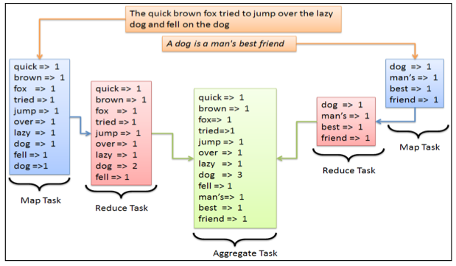
Example: Word Count

Slide 28
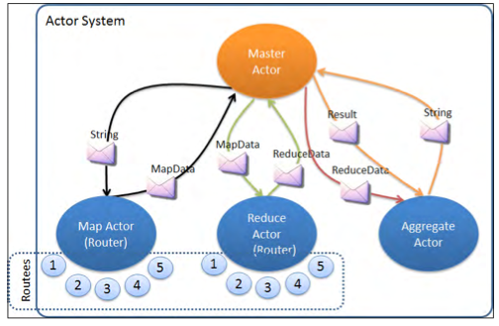
Application Design
Map Actor
Reduce Actor
Aggregate Actor

Slide 29
Link Checker Example
Write an actor system which given a URL will recursively download the content, extract links and follow them, bounded by a maximum depth; all links encountered shall be returned.
Write a Web Client which get the HTTP body from a url asynchronously
Write a Getter actor for processing the body
Write a Controller which spawns Getters for all links encountered.
Write a Receptionist managing one Controller per request.

Slide 30
Web Client
We will use the Spray.io
"io.spray" % "spray-client" % "1.3.1”
"io.spray" % "spray-can" % "1.3.1”
It offers three different levels of abstractions
Connection (full control HTTP connections opened/closed)
Host (let spray manage the connection-pool per host)
Request ( letting spray take over the all the connection management)

Slide 31

Spray.io
entirely built in Scala, no wrapping of Java libraries
fully async and non-blocking
only one type of active components in all layers: actors
core API style: message protocol
actor-friendly (e.g. "tell don't ask")
fast, lightweight, modular, testable
http://spray.io/webinar

Slide 32
Web Client Request Level
object SprayWebClientRequestLevel extends WebClient {
def get(url: String)(implicit system: ActorSystem): Future[String]={
import system.dispatcher
val pipeline: HttpRequest => Future[HttpResponse] = sendReceive
val r = pipeline(Get(url))
r.map(_.entity.asString)
}
}

Slide 33
Finding Links
val A_TAG = "(?i)<a ([^>]+)>.+?</a>".r
val HREF_ATTR = """\s*(?i)href\s*=\s*(?:"([^"]*)"|'([^']*)'|([^'">\s]+))\s*""".r
def findLinks(body: String): Iterator[String] = {
for {
anchor <- A_TAG.findAllMatchIn(body)
HREF_ATTR(dquot, quot, bare) <- anchor.subgroups
} yield if (dquot != null) dquot
else if (quot != null) quot
else bare
}

Slide 34
The Getter Actor
class Getter(url: String, depth: Int) extends Actor {
...
def receive = {
case Success(body) =>
for (link <- findLinks(body))
context.parent ! Controller.Check(link, depth)
stop()
case _: Failure => stop()
}
def stop(): Unit = {
context.parent ! Done
context.stop(self)
}
}

Slide 35
Actor-Based Logging
Logging includes IO which can block indefinitely
Akka’s logging passes that task to dedicated actors
supports ActorSystem-wide levels of debug, info, warning, error
Set level using application.conf
class A extends Actor with ActorLogging {
def receive = {
case msg => log.debug(“received message: {}”, msg) }
}

Slide 36
The Controller
class Controller extends Actor with ActorLogging {
var cache = Set.empty[String]
var children = Set.empty[ActorRef]
def receive = {
case Controller.Check(url, depth) =>
log.debug("{} checking {}", depth, url)
if (!cache(url) && depth > 0)
children += context.actorOf(Getter.props(url, depth - 1))
cache += url
case Getter.Done =>
children -= sender
if (children.isEmpty)
context.parent ! Result(cache)
}
}

Slide 37
Lesson leaned
A reactive application is non-blocking & event-driven top to bottom.
Actors are run by a dispatcher—potentially shared—which can also run Futures.
Prefer immutable data structures, since they can be shared.

Slide 38
Handling Timeouts
import scala.concurrent.duration._
class Controller extends Actor with ActorLogging {
context.setReceiveTimeout(10.seconds)
...
def receive = {
case Check(...) => ...
case Getter.Done => ...
case ReceiveTimeout =>
children foreach (_ ! Getter.Abort)
}
}
The receive timeout is reset by every received message

Slide 39
Handling Abort in Getter
class Getter(url: String, depth: Int) extends Actor {
...
def receive = {
case Success(body) if body.isInstanceOf[String] =>
findLinks(body.toString).foreach { l =>
context.parent ! Controller.Check(l,depth)
}
stop()
case Failure(ex) => stop()
case Abort => stop()
}
}

Slide 40
The Receptionist
class Receptionist extends Actor {
def receive = waiting
val waiting: Receive = {
// upon Get(url) start a traversal and become running
}
def running(queue: Vector[Job]): Receive = {
// upon Get(url) apppend that to queue and keep running
// upon Controller.Result(links) ship that to client
// and run next job from queue (if any)
}
}

Slide 41
The Receptionist
Has two states
Waiting
Running
Change the state using context.become
Create a Controller per Get
Return the result to the asker

Slide 42
Testing Actors
http://www.scalatest.org/
http://doc.akka.io/api/akka/2.3.2/index.html#akka.testkit.TestKit

Slide 43
Testing Actors
Test can verify externally observable effects
class Toggle extends Actor {
def happy: Receive = {
case “How are you?” =>
sender ! “happy”
context become sad
}
def sad: Receive = {
case “How are you?” =>
sender ! “sad”
context become happy
}
def receive = happy
}

Slide 44
Akka’s TestKit (1)
implicit val system = ActorSystem("TestSys")
val toggle = system.actorOf(Props[Toggle])
val p = TestProbe()
p.send(toggle, "How are you?") p.expectMsg("happy")
p.send(toggle, "How are you?")
p.expectMsg("sad")
p.send(toggle, "unknown")
p.expectNoMsg(1.second)
system.shutdown()

Slide 45
Akka’s TestKit (2)
class Test extends TestKit(ActorSystem()) {
try {
val toggle = system.actorOf(Props[Toggle]
within (1 second) {
toggle ! "How are you?"
expectMsg("happy")
toggle ! "How are you?"
expectMsg("sad")
toggle ! "unknown"
}
} finally {
system.shutdown()
}
}

Slide 46
Test LinkChecker
class GetterSpec extends TestKit(ActorSystem("GetterSpec"))
with WordSpecLike with BeforeAndAfterAll with ImplicitSender {}
class ReceptionistSpec extends TestKit(ActorSystem("ReceptionistSpec"))
with WordSpecLike with BeforeAndAfterAll with ImplicitSender {}
http://www.scalatest.org/user_guide/selecting_a_style
http://doc.akka.io/docs/akka/2.3.2/scala/testing.html

Slide 47
Failure Handling

Slide 48
Failure Handling
Where shall failures go?
reify as messages?
send to a known address?
Actors work together in teams (systems)
individual failure is handled by the team leader

Slide 49
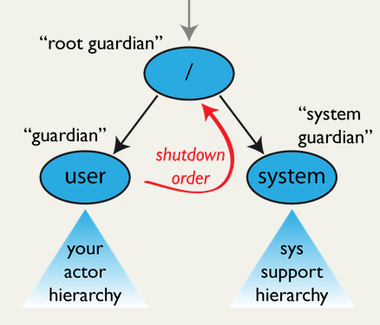
Supervision
failed Actor is terminated or restarted
decision must be taken by one other Actor
supervised Actors form a tree structure
the supervisor needs to create its subordinate

Slide 50
Supervisor Strategy
One For One Strategy
OneForOneStrategy(maxNrOfRetries: Int, withinTimeRange: Duration, decider: Decider)
AllForOneStrategy
AllForOneStrategy(maxNrOfRetries: Int, withinTimeRange: Duration, decider: Decider)

Slide 51
One For One Strategy
import akka.actor.OneForOneStrategy
import akka.actor.SupervisorStrategy._
import scala.concurrent.duration._
override val supervisorStrategy =
OneForOneStrategy(maxNrOfRetries = 10, withinTimeRange = 1 minute) {
case _: ArithmeticException => Resume
case _: NullPointerException => Restart
case _: IllegalArgumentException => Stop
case _: Exception => Escalate
}

Slide 52
Supervisor Strategy Guidelines
allow a finite number of restarts
allow a finite number of restarts in a time window
If restriction violated then Stop instead of Restart
OneForOneStrategy(maxNrOfRetries = 10, withinTimeRange = 1.minute) { case _: DBException => Restart // will turn into Stop
}
Actor Lifecycle
start
(restart)*
stop

Slide 53
Lifecycle Monitoring

Slide 54
Lifecycle Monitoring
Having an ActorRef implies:
Restarts are not visible
After stop there will be no more responses
Therefore Akka support Monitoring via DeathWatch
trait ActorContext {
def watch(target: ActorRef): ActorRef
def unwatch(target: ActorRef): ActorRef
...
}

Slide 55
Applying DeathWatch to Getter
class Getter(url: String, depth: Int) extends Actor {
...
def receive = {
case body: String =>
for (link <- findLinks(body))
context.parent ! Controller.Check(link, depth)
context.stop(self)
case _: Status.Failure => context.stop(self)
}
}
We simply terminate the actor and use the DeathWatch on the parent
case Terminated(_) =>
if (context.children.isEmpty)
context.parent ! Result(cache)

Slide 56
The Error Kernel

Slide 57
The Error Kernel
Keep important data near the root, delegate risk to the leaves
Restarts are recursive
Restart are more frequent near the leaves
Avoid restarting Actors with important state

Slide 58
Application to Receptionist
Always stop Controller if it has a problem.
React to Terminated to catch cases where no Result was sent.
Discard Terminated after Result was sent.
class Receptionist extends Actor {
override def supervisorStrategy = SupervisorStrategy.stoppingStrategy
...
val controller = context.actorOf(controllerProps, s”c$reqNo”)
context.watch(controller)
}

Slide 59
Subscribe EventStreams
Actors can direct messages only at known addresses.
The EventStream allows publication of messages to an unknown audience.
Every actor can optionally subscribe to (parts of) the EventStream.
trait EventStream {
def subscribe(subscriber: ActorRef, topic: Class[_]): Boolean
def unsubscribe(subscriber: ActorRef, topic: Class[_]): Boolean
def unsubscribe(subscriber: ActorRef): Unit
def publish(event: AnyRef): Unit
}

Slide 60
Where do Unhandled Messages Go?
Actor.Receive is a partial function, the behavior may not apply.
Unhandled messages are passed into the unhandled method:
trait Actor {
...
def unhandled(message: Any): Unit = message match {
case Terminated(target) => throw new DeathPactException(target)
case msg =>
context.system.eventStream.publish(
UnhandledMessage(msg, sender, self)) }
}

Slide 61
Persistence

Slide 62
Persistent Actor State
Actors representing a stateful resource
shall not lose important state due to (system) failure
must persist state as needed
must recover state at (re)start
Two possibilities for persisting state:
in-place updates
persist changes in append-only fashion
"com.typesafe.akka" %% "akka-persistence-experimental" % "2.3.2"

Slide 63
Architecture
Processor Actor:
Received messages are written to a journal before its receive message is called
View:
Receives journaled messages written by another processor
Channel:
Used by processors and views to comunitate with other actors
Journal: is a sequence of sent messages
Snapshot store: persists snapshots of a processor or a view internal state

Slide 64
Processor Actor
import akka.persistence.{ Persistent, PersistenceFailure, Processor }
class MyProcessor extends Processor {
def receive = {
case Persistent(payload, sequenceNr) =>
// message successfully written to journal
case PersistenceFailure(payload, sequenceNr, cause) =>
// message failed to be written to journal
case other =>
// message not written to journal
}
}

Slide 65
Processor Actor
By default, a processor is automatically recovered on start and on restart by replaying journaled messages.
New messages sent to a processor during recovery do not interfere with replayed messages.
New messages will only be received by a processor after recovery completes.

Slide 66
View
class MyView extends View {
def processorId: String = "some-processor-id"
def receive: Receive = {
case Persistent(payload, sequenceNr) => // ...
}
}
The processorId identifies the processor from which the view receives journaled messages.

Slide 67
Channel
class MyProcessor extends Processor {
val destination = context.actorOf(Props[MyDestination])
val channel = context.actorOf(Channel.props(), name = "myChannel”)
def receive = {
case p @ Persistent(payload, _) =>
channel ! Deliver(p.withPayload(s"processed ${payload}"), destination.path)
}
}
class MyDestination extends Actor {
def receive = {
case p @ ConfirmablePersistent(payload, sequenceNr, redeliveries) =>
// ...
p.confirm()
}
}

Slide 68
Snapshots
class MyProcessor extends Processor {
var state: Any = _
def receive = {
case "snap" => saveSnapshot(state)
case SaveSnapshotSuccess(metadata) => // ...
case SaveSnapshotFailure(metadata, reason) => // ...
}
}

Slide 69
Distribution

Slide 70
The inpact of the Network Comunication
Data sharing only by value
Lower bandwidth
Higher latency
Partial failure
Data corruption

Slide 71
Actors are Distributed
Actors are “Location Transparent”, hidden behind ActorRef
val system = ActorSystem("LinkChecker")
val mainActor = system.actorOf(MainActor.props)
println(mainActor.path)
//prints akka://LinkChecker/user/$a
Remote address example
akka.tcp://LinkChecker@0.0.0.0:2552/user/$a
context.actorSelection("../brother") ! msg
context.actorSelection("/user/serviceA") ! msg

Slide 72
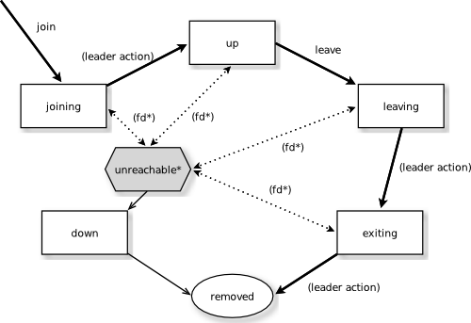
Cluster Protocol
It is based on Amazon’s Dynamo and in particular Riak distributed database
Cluster communication is based on heartbeat messages (e.g. Zookeeper)

Slide 73
Setup a Cluster 1
"com.typesafe.akka" %% "akka-cluster" % "2.3.2”
actor {
provider = "akka.cluster.ClusterActorRefProvider"
}
remote {
log-remote-lifecycle-events = off
netty.tcp {
hostname = "127.0.0.1"
port = 0
}
}
cluster {
seed-nodes = [
"akka.tcp://ClusterSystem@127.0.0.1:2551",
"akka.tcp://ClusterSystem@127.0.0.1:2552"]
auto-down-unreachable-after = 10s
}

Slide 74
Setup a Cluster 2
class ClusterMain extends Actor {
val cluster = Cluster(context.system)
cluster.subscribe(self, classOf[ClusterEvent.MemberUp])
cluster.join(cluster.selfAddress)
def receive = {
case ClusterEvent.MemberUp(member) =>
if (member.address != cluster.selfAddress) {
//someone joined
}
}
}
This will start a single-node cluster on port 2552

Slide 75
Setup a Cluster 3
class ClusterMain extends Actor {
val cluster = Cluster(context.system)
cluster.subscribe(self, classOf[ClusterEvent.MemberRemoved])
val main = cluster.selfAddress.copy(port = Some(2552)
def receive = {
case ClusterEvent.MemberRemoved(member) =>
if (member.address == main)
context.stop(self)
}
}
This needs configuration akka.remote.netty.tcp.port = 0

