Slide 1

Julio Arruda MVP / GitHub star julio.arruda@OUTLOOK.COM
Automatizando seu GitHub
#VSSUMMIT

Slide 2


Slide 3



Matrix builds
Streaming, searchable, linkable logs
Built-in secret store
Easy to write, easy to share
#VSSUMMIT
Notes:
To recap, key functionalities of GitHub Actions include:
Run an Action in a container, or in a virtual machine, with hosted runners for Linux, macOS and Windows.
Actions also supports matrix builds, so you can run parallel jobs across OS versions, runtime versions, or any variable you want to use to multiply your workflows
Actions gives you real-time feedback with streaming logs that are searchable and deep-linkable, so you can share a link to a specific line of a log with a friend to get help debugging a build.
To help integrate with third-party services or deployment targets, every repo on GitHub has a built-in secret store, and Actions will substitute secrets for your tokens.
And finally, because it’s GitHub, Actions are easy to write, and easy to share.
And this is core to how software development works today.…

Slide 4
Matrix builds
Streaming, searchable, linkable logs
Built-in secret store
Easy to write, easy to share
#VSSUMMIT
Notes:
To recap, key functionalities of GitHub Actions include:
Run an Action in a container, or in a virtual machine, with hosted runners for Linux, macOS and Windows.
Actions also supports matrix builds, so you can run parallel jobs across OS versions, runtime versions, or any variable you want to use to multiply your workflows
Actions gives you real-time feedback with streaming logs that are searchable and deep-linkable, so you can share a link to a specific line of a log with a friend to get help debugging a build.
To help integrate with third-party services or deployment targets, every repo on GitHub has a built-in secret store, and Actions will substitute secrets for your tokens.
And finally, because it’s GitHub, Actions are easy to write, and easy to share.
And this is core to how software development works today.…

Slide 5
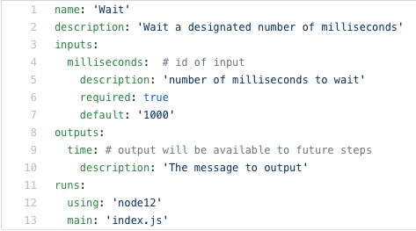
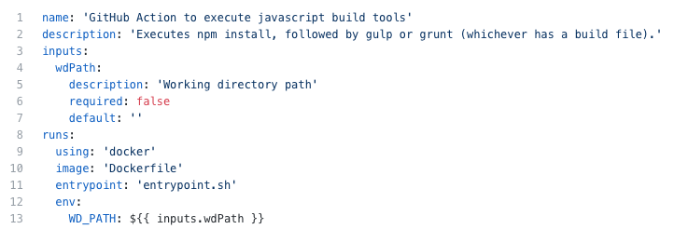
Actions are reusable components
Live in independent repositories
Public repositories for now
Official list: https://github/actions
Written in JavaScript (node12)
May use GitHub Actions Toolkit JS for command line argument parsing, passing parameters, interacting with the GitHub API
Or Docker
Similar to beta 1 actions, but with updated syntax & argument passing
Or point to existing actions published to Docker Hub
1
2
#VSSUMMIT

Slide 6
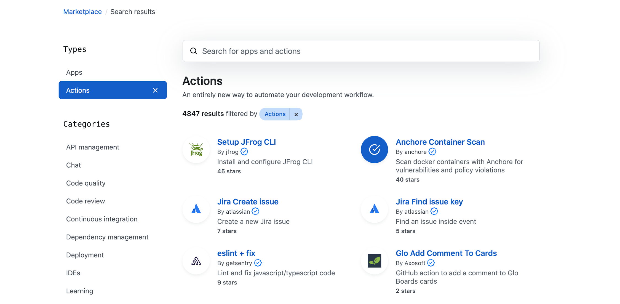
https://github.com/marketplace

Slide 7

Live Demo
CI/CD powered by Actions

Slide 8
Live Demo
CI/CD powered by Actions

Slide 9

Actions Pro-Tips

Slide 10
# Trigger workflows externally
on: workflow_dispatch: # Run Workflow Manually
{
"event_type": "custom-name",
"client_payload": {
"custom_message": “Hello world!”
}
}

Slide 11
# Scheduled workflows with CRON syntax
on:
schedule:
# * is a special character in YAML # so you have to quote this string
- cron: ’*/15 * * * *’

Slide 12
# Resolve dependencies across jobs
jobs:
Job1:
# ...
Job2:
needs: Job1
# ...
Job3:
needs: [Job1, Job2]
# ...
Notes:
In this example, job1 must complete successfully before job2 begins, and job3 waits for both job1 and job2 to complete.
The jobs in this example run sequentially:
job1
job2
job3

Slide 13
# Run a job based on previous step exit status
jobs:
MyJob:
Steps:
# ...
- name: Trigger alert
if: failure()
# if: success()
# if: canceled()
# if: always()
Notes:
Triggers if any of the previous step of a job fails.

Slide 14
# Use the built-in Secrets store
jobs:
MyJob:
steps:
# ...
- uses: azure/login@v1
with:
creds:
${{ secrets.AZURE_CREDENTIALS }}
Notes:
Triggers if any of the previous step of a job fails.

Slide 15
Julio Arruda MVP / GitHub star julio.arruda@OUTLOOK.COM
MUITO OBRIGADO!
#VSSUMMIT

