Slide 1
FM_Capstone_Project:Idea
The purpose of this project is to identify where to open an Italian restaurant in the city of Toronto.

Slide 2
FM_Capstone_Project:Consideration
There are some important information that will be taken into consideration:
It should not open in an area where other Italian restaurants are already present.
Possibly it shouldn't be too far from the center even if it means paying less.
Neighborhoods with Italian ethnicity will not be taken into consideration as they are not very significant in terms of earnings.

Slide 3
FM_Capstone_Project:Dataset
The datasets used are:
1) list of Toronto neighborhoods and postal codes taken from Wikipedia
2) Georeferencing information from Foursquare API.
3) List of Venues categories from Foursquare API.
4) List of Restaurants from Forsquare API.
5) List of Italian Restaurants from Foursquare API.

Slide 4
FM_Capstone_Project:Data Cleaning
Only information gathered from Wikipedia must have boroughs otherwise they will not be imported.
If Neighbourhood is not present on the Wikipedia table Borough will be used.
In the Dataframe of the Neighbourhoods we do not yet have the georeferencing information, in Join we add the location information from FourSquare.

Slide 5
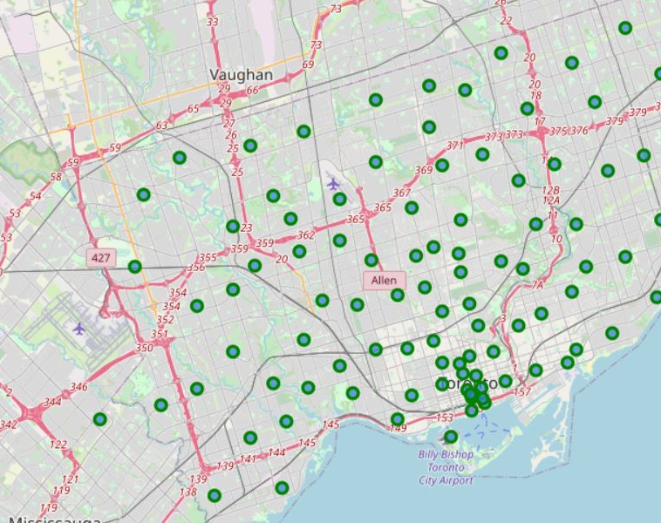
FM_Capstone_Project:Exploratory Analysis 1/4
Let’s visualize the map with the neighborhoods of Toronto to understand how they are distributed.

Slide 6
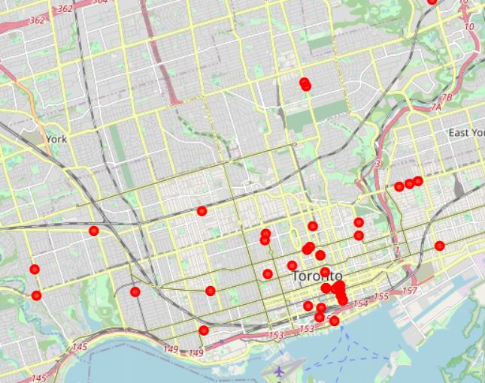
FM_Capstone_Project:Exploratory Analysis 2/4
Map of the Italian Restaurant.

Slide 7
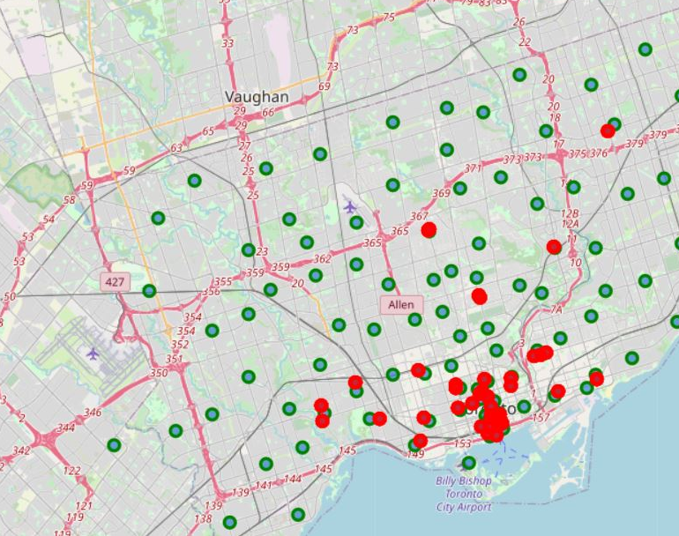
FM_Capstone_Project:Exploratory Analysis 3/4
Map of the neighborhoods (green) and Italian Restaurants (red).

Slide 8
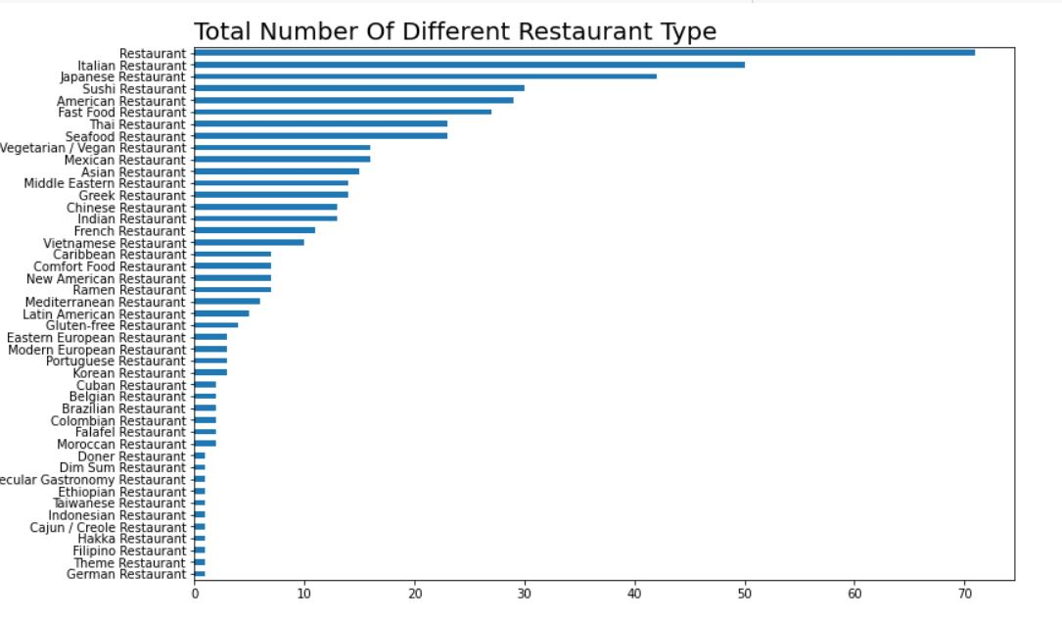
FM_Capstone_Project:Exploratory Analysis 4/4
A Plot of all the Restaurant category.

Slide 9
FM_Capstone_Project:Clustering
We apply with Algorithm KMeans suggests a split of Toronto city into 6 Clusters.

Slide 10
FM_Capstone_Project:Conclusions
Cluster with Number 4 is the best, essentially for the fact that not a few restaurants in its Cluster.
There are certainly many other considerations to make (not developed in this study): Does the proposed Cluster collect "important" neighborhoods? Does the proposed Cluster have rents that still allow especially at an early stage not to have too high costs? Does the proposed Cluster certainly gather heterogeneous population situations? Can a higher density of the Italian ethnic group in the vicinity give a greater impulse to the start of the restaurant?

